Slide 1
2019/07/10
progress update
presenter:Chung Chun Wu

Slide 2
outline
Introduction
reverse-parking
reward function design
results
Future plans
Notes:
W

Slide 3
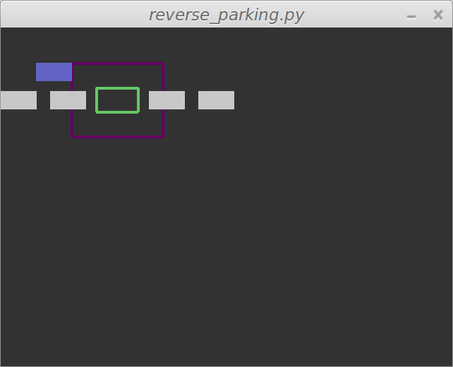
Environment

Slide 4
Reward function
Description | Reward
Arrive the Parking place. | 100
Close to parking location. | 10
Close to parking location and closer the angle is to 0 degrees | 10/(|x|+1)
Out of range and terminate game | -10
Don’t arrive the Parking place. | -1
Don’t arrive the Parking place at 1000 actions | -50

Slide 5
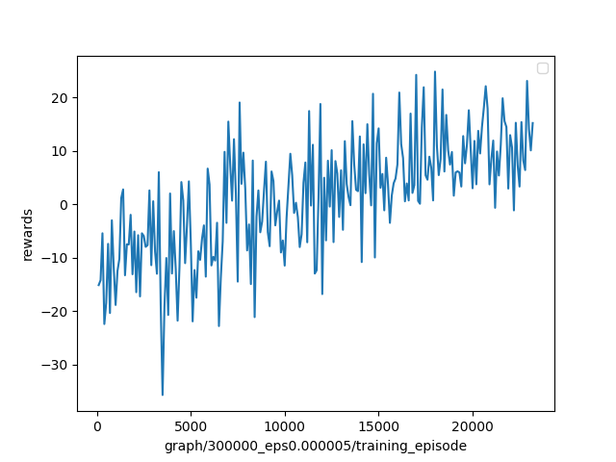
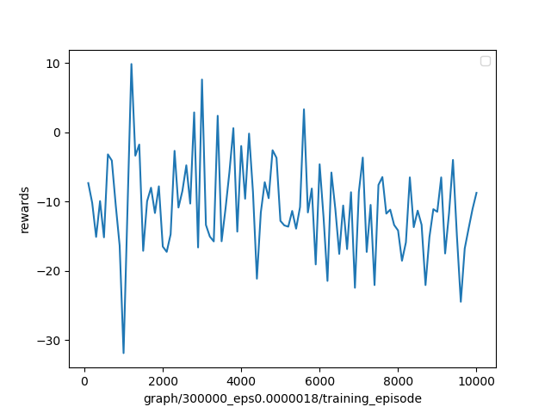
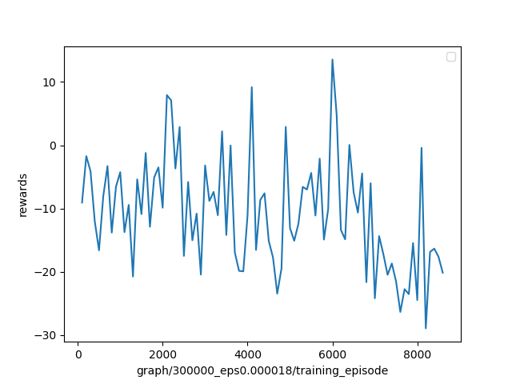
Memory capacity = 300000
Results

Slide 6
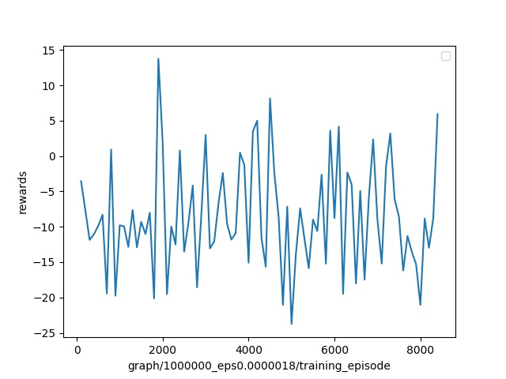
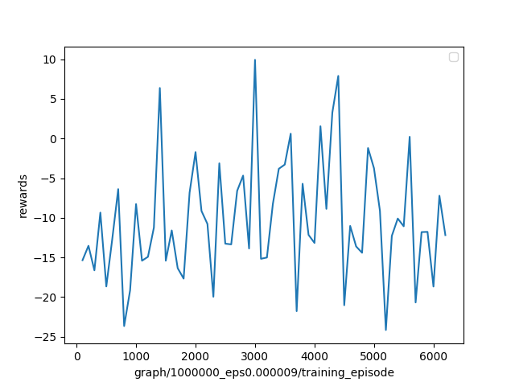
Memory capacity = 1000000
Results

Slide 7
Future plans
Adjust reward function
Calculate the area that overlaps with green
Adjust terminal reward
Algorithm:
DQN →Double DQN → Dualing DQN → Prioritized DQN →Hierarchical RL→ Inverse RL
Environment:
Normal → have Crush → Random generate parking place →having other moving cars →Increase environment size Continuous action space

