Slide 1
STRUCTURED SYSTEMS ANALYSIS AND DEVELOPMENT
Aphrodite Tsalgatidou
University of Athens,
Department of Informatics
e-mail: afrodite@di.uoa.gr

Slide 2
Contents
Organisational and Information Systems
Approaches to Information Systems Development
A Framework for Systems Analysis and Development
    Problem Analysis
    Process Analysis
    Conceptual Data Modelling
    System Design (Process, Data and U.I. Design)

Slide 3
Organisational Systems
System: A collection of interrelated parts which act as a whole towards a common goal
Externally, systems have boundaries and interact with their environment (regarded as open systems)
Internally, systems contain subsystems interacting to serve a common goal
Interaction is governed by a set of rules and stimuli from ext.envrironment

Slide 4
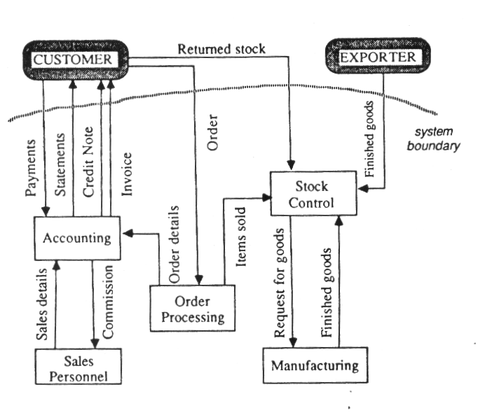
An Information Flow Diagram

Slide 5
Information Systems
Defined as the mechanism providing the means for storing, generating and distributing infromation for supporting operations and management functions of an organisation. Can be manual, semi- or fully-automated.
Information can be of two main kinds;
  operational information
  management information

Slide 6
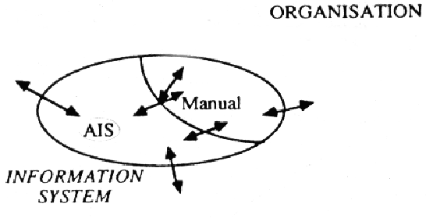
Information Systems in Organisations

Slide 7
Developing an Information System
What is the technology that makes information systems work ?
  Databases, data communications, development environments, programming languages, etc.
How are Information Systems developed ?
  What is the process of developing software which constitutes the automated information system of an organisation

Slide 8
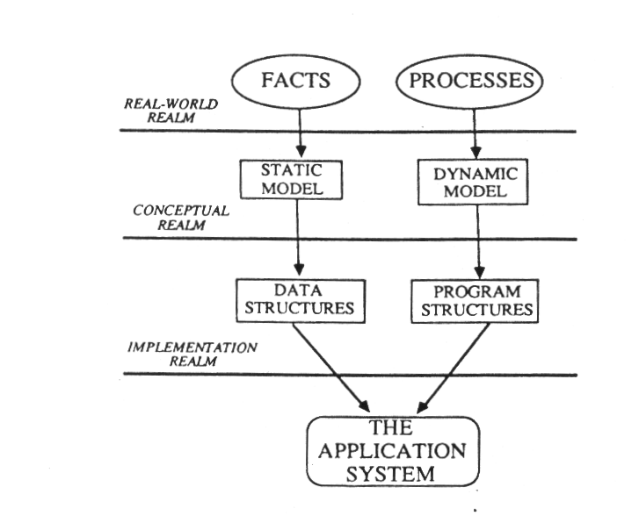
Static and Dynamic Aspects of an Information System

Slide 9
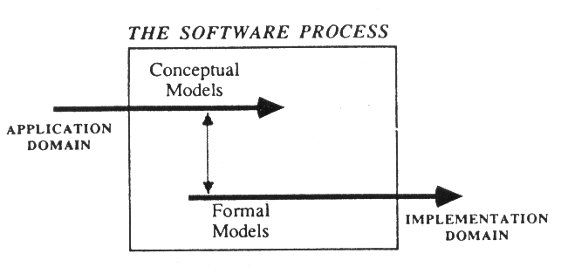
A Simple View of Software Development

Slide 10
Methodical Approach to I.S. Development
Life-Cycle Model (classical model)
  requirements analysis
  design
  implementation and testing
  operation and maintenance
Prototyping
Fourth generation techniques
Formal approaches

Slide 11
The Information Strategy Planning Phase
Objectives:
  identify system goals and scope of system development
  define a technical architecture which provides a statement of direction for h/w and s/w facilities
  outline proposed arrangements for management and control of the information systems activity within the organisation
  formalise a problem definition which will act as a control mechanism for the remaining phases of the development process

Slide 12
The Requirements Analysis Phase
Objectives:
  accurately model the part of the system in which the analyst is interested
  accurately model the user requirements
  encourage user involvement
  produce an analysis specification which can be transformed easily into a design specification
  fully document the existing system
  coordinate the work of many analysts working on a large complex system and consider many user views, thus resolving conflicts, interderminancies, redundacies, etc.
  view the system as a whole, I.e. a set of interrelated parts which all act together towards a common goal

Slide 13
The Design Phase
Objectives:
  transform the requirements specification into logical and physical models
  provide a specification for man-machine interface
  evaluate design
  fully document design model and enforce maintenance and documentation

Slide 14
The Implementation Phase
Objectives:
  to create a physical database as specified in the design model
  to transform the designed system into executable code
  to carry out the changeover procedures in order to start operating the new computer system

Slide 15
The Maintenance Phase
It is concerned with the development of a system after it has entered the production stage.
There three of Maintenance types:
  Corrective Maintenance
  Perfective Maintenance
  Adaptive Maintenance

Slide 16
Approaches to Information Systems Development
Traditional Approaches
  forms flowchart, clerical procedural flow chart, system flow chart, flow diagram
Pressures for Change
  Hardware is less important, new application requirements, shortage of computer personnel, poor requirements specs, poor designs, maintenance problems, user dissatisfaction
Information Systems Development Methods
  Objectives of a Method: logical system model, graphical notations, rules, tools
  Method-Related Development Tools & Environments: CASE Tools, PCTEs
Classification of Methods (philosophy, modeling orientation, approach, coverage, deliverables, assumptions)
A Framework for Analysis and Development
  Problem Analysis
  Functional Analysis
  Conceptual Data Modeling
  System Design

Slide 17
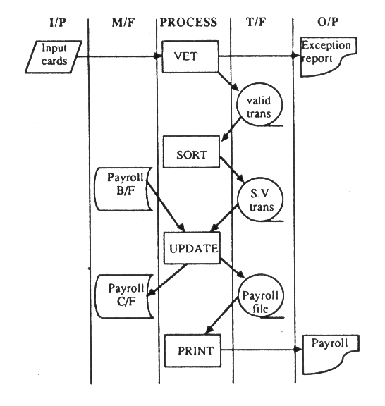
A System
Flowchart

Slide 18
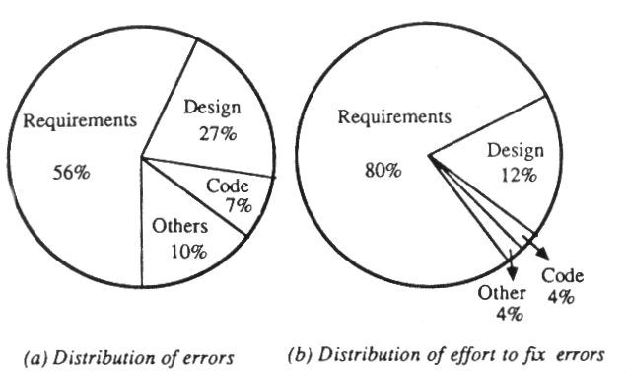
Errors in the
Development Lifecycle

Slide 19
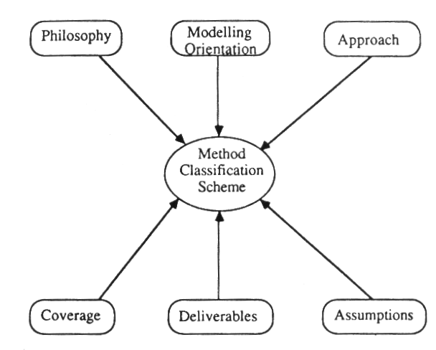
Approach to Method Classification

Slide 20
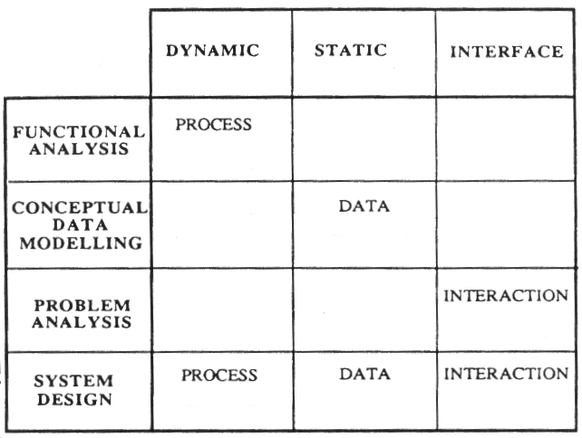
A Framework for Analysis and Development

Slide 21
Problem Analysis and Fact Collection
Objectives
  determine the organizational structure and its purpose, the problem areas, the environment around the organisation and identify the boundaries of the problem
  establish a detailed specification of the problem
  validate the gathered information
Techniques for Fact Collection
  documentation review, interviewing, questioning, observation, measuring
Preliminary Fact Documentation
  Matrices, Flowcharts, etc.

Slide 22
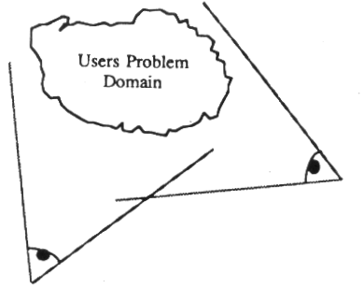
A User’s View and an
Analyst’s View

Slide 23
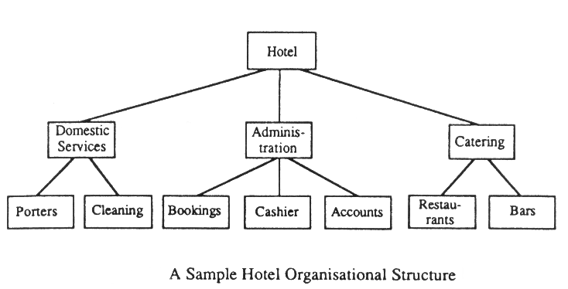
Determine the Organisatonal Structure

Slide 24
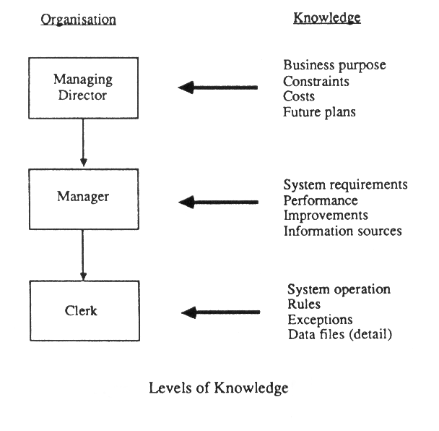

Slide 25
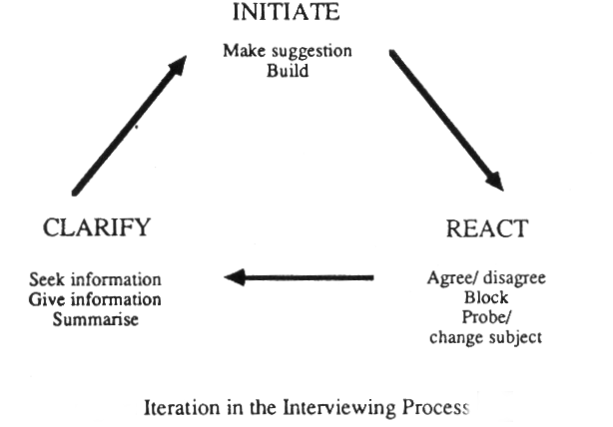
Fact Collection: Interview

Slide 26
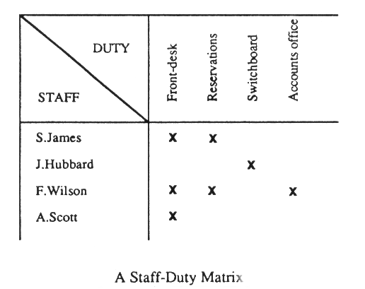
Preliminary Fact Documentation: Matrices

Slide 27
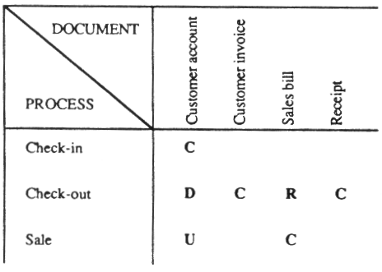
A Document Processing Matrix

Slide 28
Process Analysis
Introduction
Objective: to produce a specification that accurately embodies the requirements fo future users of the system under development
Characteristics of a desirable specification include:
  coherence of specification
  functionally decomposed
  graphical
  maintainable

Slide 29
Process Analysis
System Process Modeling
Three main analysis techniques to be reviewed here are:
  Data Flow Diagrams (DFDs)
  Data Dictionary Definitions
  Process Specifications

Slide 30
Introduction to Data Flow Diagrams
Basic Constructs:
  Processes
  Data flows
  Files
  External Entities: sources or sinks

Slide 31
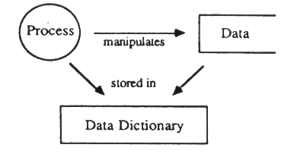
The Interrelation Between Specification Components

Slide 32
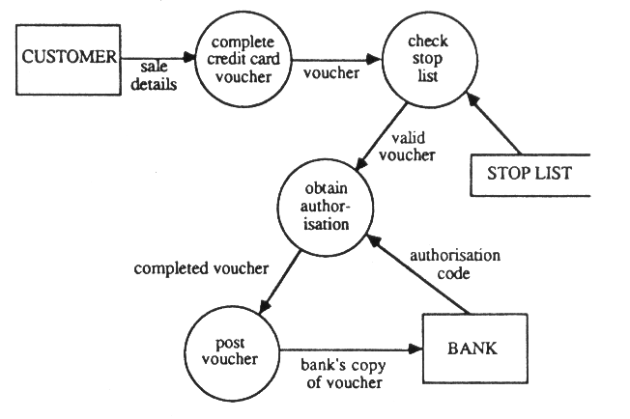
Example of a Data Flow Diagram(1)

Slide 33
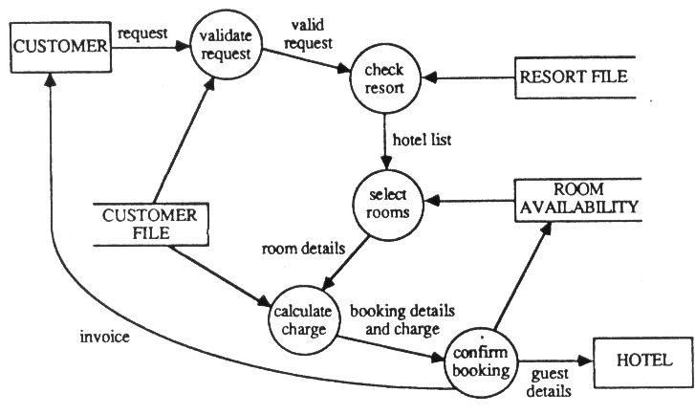
Example of a Data Flow Diagram(2)

Slide 34
Introduction to Data Flow Diagrams (cont.)
Constructing Data Flow Diagrams
  Identify the Static Components
  Identify the Main Processes
  Expand and Refine the Diagram
  Review the Diagram

Slide 35
Introduction to Data Flow Diagrams (cont.)
Levelling Data Flow Diagrams
  The Concept of Levelling
  Levelling Conventions
    Process Referencing
    Functional Primitives
    Balancing
Hints on Data Flow Diagramming
  Annotation of Diagrams
  Extent of Decomposition
  Extent of Partitioning
  Check for Usefuleness

Slide 36
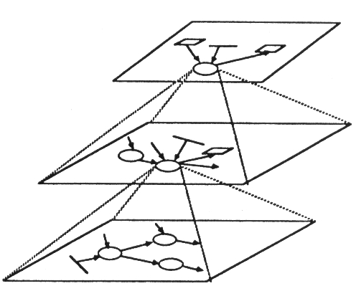
The Structure of a Set of
Levelled DFDs

Slide 37
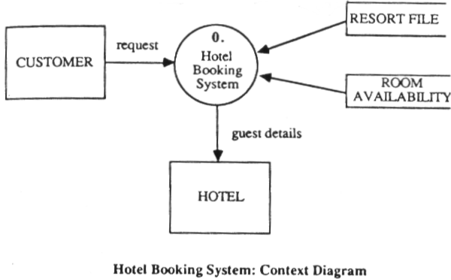
Context Diagram
Decomposition Level: 0

Slide 38
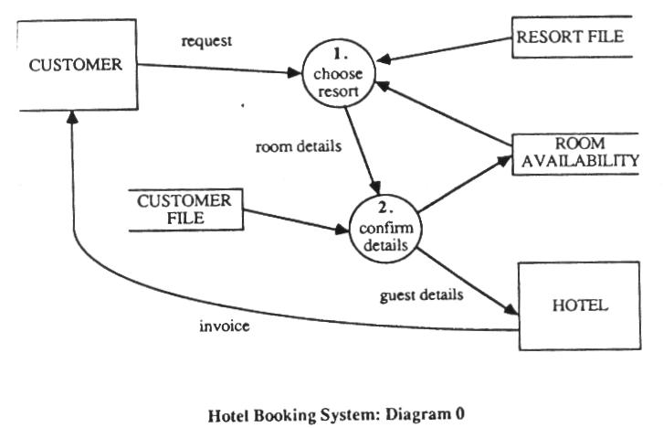
Diagram 0
Decomposition Level: 1

Slide 39
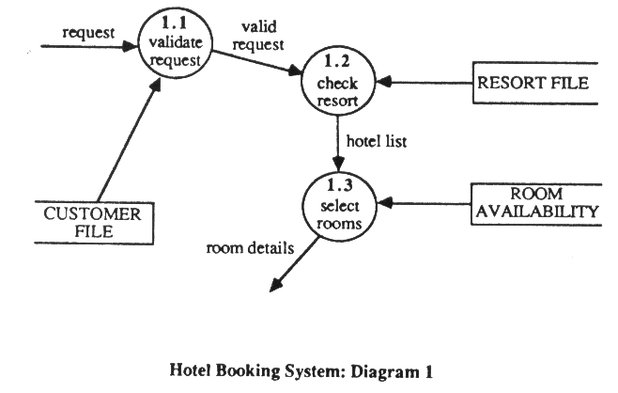
Diagram 1
Decomposition Level: 2

Slide 40
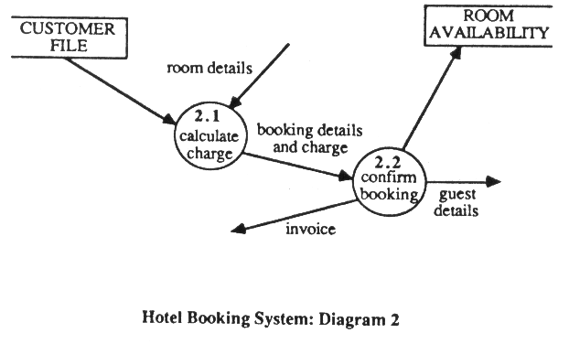
Diagram 2
Decomposition Level: 2

Slide 41
Data Dictionaries (DD)
Purpose:
  to keep data about:
    Data Flow and Data Item Specifications
    File Specifications
    Process Specifications
Data Specification Language:
    Notational Conventions: = , + , [ ] , { } , ( )
    e.g. amount due = [dollar amount, sterling amount]
Process Specifications

Slide 42
Process Specifications
Processing and control information omitted from a DFD belongs in a process specification
Each functional primitive has one process specification
Process Specifications can be represented in a variety of languages, the most popular are:
    Structured English
    Decision Tables and Decision Trees

Slide 43
Structured English
A rigid subset of the English language omitting adjectives, adverbs, compound and complex sentences, all verb modes except imperative and most punctuation
Result: A language containing a limited set of conditional and logic statements with nouns and strong verbs
Standards vary between organisations - objectives of: conciseness, preciseness and lack of ambiguity apply to all variants

Slide 44
Structured English (cont.)
Posesses the three standard control constructs of:
    sequence
    selection
    iteration
and
    primitive actions
These constructs permit the specification of any system

Slide 45
Structured English (cont.)
Primitive Actions
inform the reader of sth which must be done as opposed when it is to be done
expressed as imperative statements, e.g.
      READ-FILE STOCK-DETAILS
should be concise
    avoiding vague words (e.g. process / handle)
    containing a strong verb identifying the function
    stating explicitly the object of the statement, which is selected from the data dictionary

Slide 46
Structured English (cont.)
Control Constructs
Sequences: represent actions taking place in sequence without interruption. They are defined by the successive appearance of a set of primitive actions
Selections: describe a series of alternative policies from which only one is selected
  IF <condition> CASE
    <statement> WHEN <condition> <statements>
  ELSE WHEN <condition> <statements>
    <statement> … ……….. …...
Iterations: A policy or series of actions is repeated within some bounds. Represented by DO…WHILE construct or a REPEAT … UNTIL construct

Slide 47
Structured English (cont.)
Total_charge = 0
REPEAT
get_next_room
IF room_type = ‘EXECUTIVE’
total_charge=total_charge+60$
ELSE
total_charge=total_charge + 35$
UNTIL all_booked_rooms_processed
OR total_charge > credit_limit

Slide 48
Structured English (cont.)
Advantages:
consice and precise, allow easy reading without ambiguity & misunderstanding
language notation may be tailored to suit user
must exist a cross-referencing with any dfd & dd entries thus perimitting thourough verification
Disadvantages:
formality may be alien when first read or write
Avoid assuming that anything written in SE is correct

Slide 49
Decision Tables
A tabular of conditions and actions and an indication under which conditions, which actions must be performed
Consists of four quadrants
Condition Stub Rules
a list of all possible conditions contains selectors which identify
that can arise within the process different combinations of the possible conditions
Action Stub Action Entries
a list of all possible actions that indicators which select the actions to be performed
occur within the process

Slide 50
Decision Tables: 3 variants
Limited Entry Decision Table
Mixed Entry Decision Table
Extended Entry Decision Table

Slide 51
Limited Entry Decision Table
Contains only the binary selectors Y & N and the catch all selector - in the rules quadrant. In the action entries, it contains only the action selector symbol X.
1 2 3 4
Credit Satisfactory Y N N N
Prompt Payer - Y N N
Special Clearance - - Y N
Accept Order X X X
Return Order X

Slide 52
Mixed Entry Decision Table
Contains only the binary selectors Y & N and the catch all selector - in the rules quadrant. In the action entries quadrant, indicators other than X appear.
1 2 3
Salaried Employee N N Y
Hours Worked > 40 Y N -
Pay Overtime Regular Regular
rate rate rate

Slide 53
Extended Entry Decision Table
Selectors in the rules quadrant are no longer simply binary (y or N) bt may take on specific values or ranges of values.
1 2 3 4
Approved Credit N Y Y Y
Quantity Ordered - 0-24 25-55 56-99
Discount (%) 0 5 10
Release Order X X X
Reject Order

Slide 54
Validating Decision Tables
Limited and Mixed Decision Entry Tables can be checked for completeness, according to the following algorithm:
i = j
2 ^{number of conditions} =
Σ
2_{i} ^{c}
_{i}
i = 1

Slide 55
Advantages of Decision Tables
Easily understood
Alternatives are shown side by side
Cause & effect relationship is shown, thus permitting easier user validation
Possible to check that all combinations of conditions have been considered

Slide 56
Decision Trees
Alternative to Decision Tables
Employ tree structures which show conditions and actions within a problem
Advantage: Easy to understand, no need for special training
Root of tree -> name of process
Nodes -> conditions
Leaves -> actions to be performed

Slide 57
Summary of Process Modeling
A system is described using three modes of representation:
data flow diagrams
  show relationships between processes, data flows, data repositories and external infulences beyond the system boundary in a graphical and structured manner
process specifications
  structured english, decision trees or tables: they document in a precise and consice fashion the elementary processing operations performed by each functional primitive in a set of dfds
data dictionary entries
  describe the nature of data flows and hold the process specifications

Slide 58
Documentation In Structured Systems Analysis and Design
Data Flow Diagrams
Data Dictionary
Process Specifications
Structure Chart
To Implementation

Slide 59
Conceptual Data Modeling
It is the activity of
  understanding
  documenting
  analysing corporate data
It is also called Data Analysis
It is concerned with taking an amorphous mass of facts about the data used within a system and turning them intoa precise, unambigous and non-redundant data description.

Slide 60
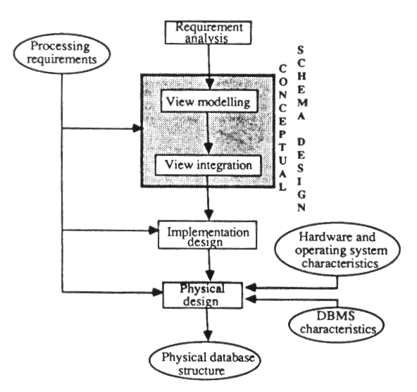
Conceptual Data
Modeling

Slide 61
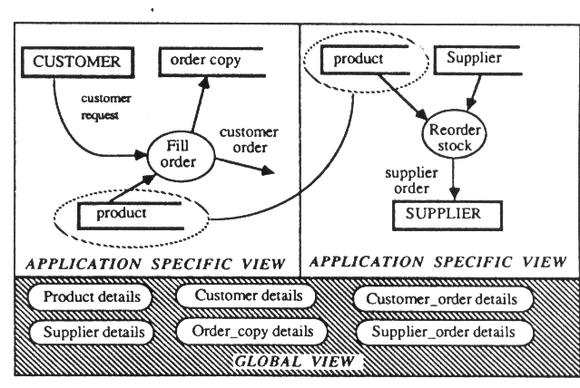
A Conceptual Schema is a Global View of Data

Slide 62
Properties of a
Conceptual Schema
Implementation Independence
Abstraction
Formality
Constructability
Ease of Analysis
Traceability
Executability

Slide 63
Two Key Questions
WHAT to model
  what aspects of the information system and the universe of discourse need to be captured
HOW to model
  what particular concepts must a developer use for reprenting a slice of reality and what method should be followed for constructing an appropriate conceptual schema

Slide 64
Conceptual Modeling Formalisms: The Entity-Relationship Model
The basic concepts are:
  Entity
  Attribute
  Relationship

Slide 65
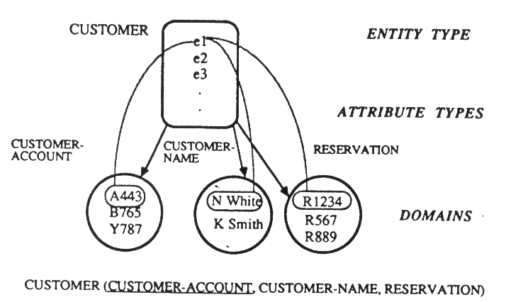
Entity Types, Attribute Types, Relationship Types

Slide 66
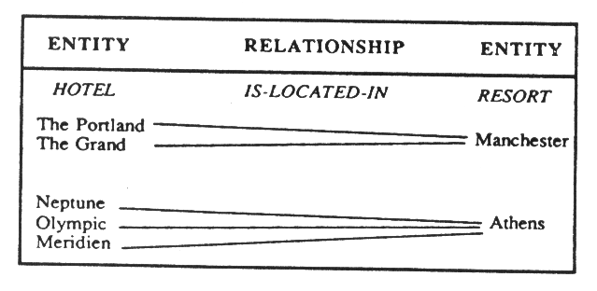
Entity and Relationship Occurences

Slide 67
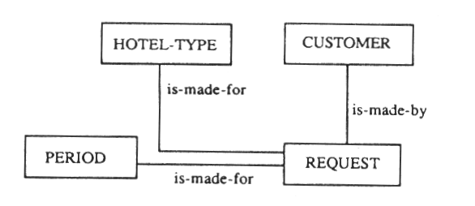
Relationships Between
Entity Types

Slide 68
Types of Associations and Mappings between A & B
Associations:
    Simple : Any value A uniquely identifies exactly one B
    Complex: Each A can be associated with any number of B
    Conditional: Any A is associated with either one or none of B
Mappings: 1:1, 1:M, M:N

Slide 69
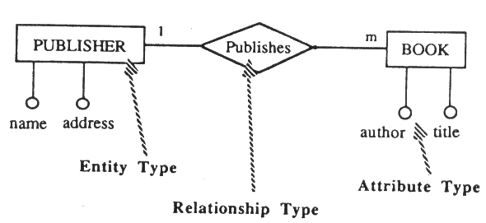
An E-R Diagram

Slide 70
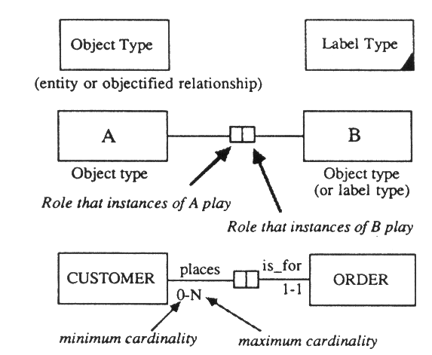
The Fact-Based Model
Major difference from ER is that no distinction is made between attributes and relationships

Slide 71
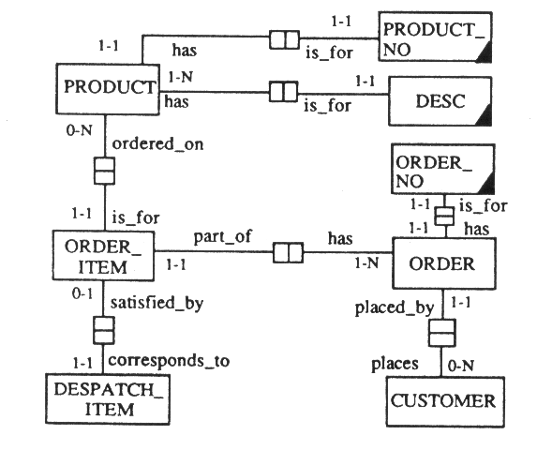
Example of an
Information Diagram

Slide 72
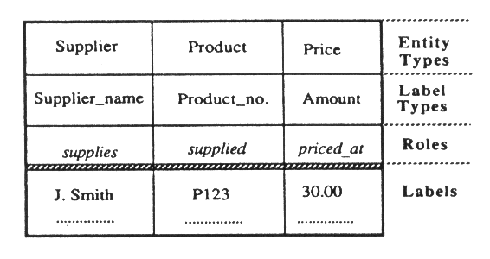
An Heterogeneous Ternary Fact Type

Slide 73
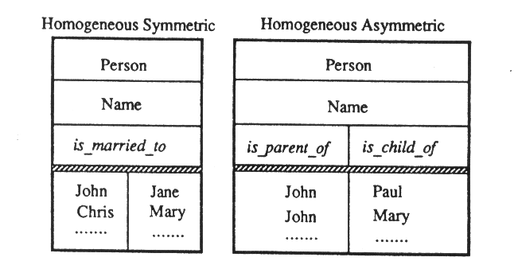
Homogeneous Fact Types

Slide 74
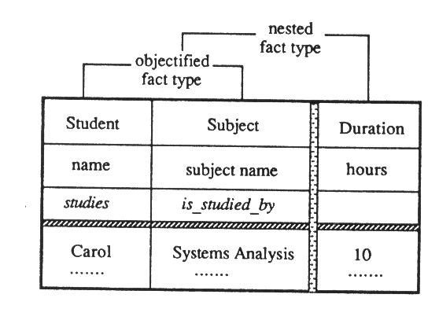
Objectified Fact Type

Slide 75
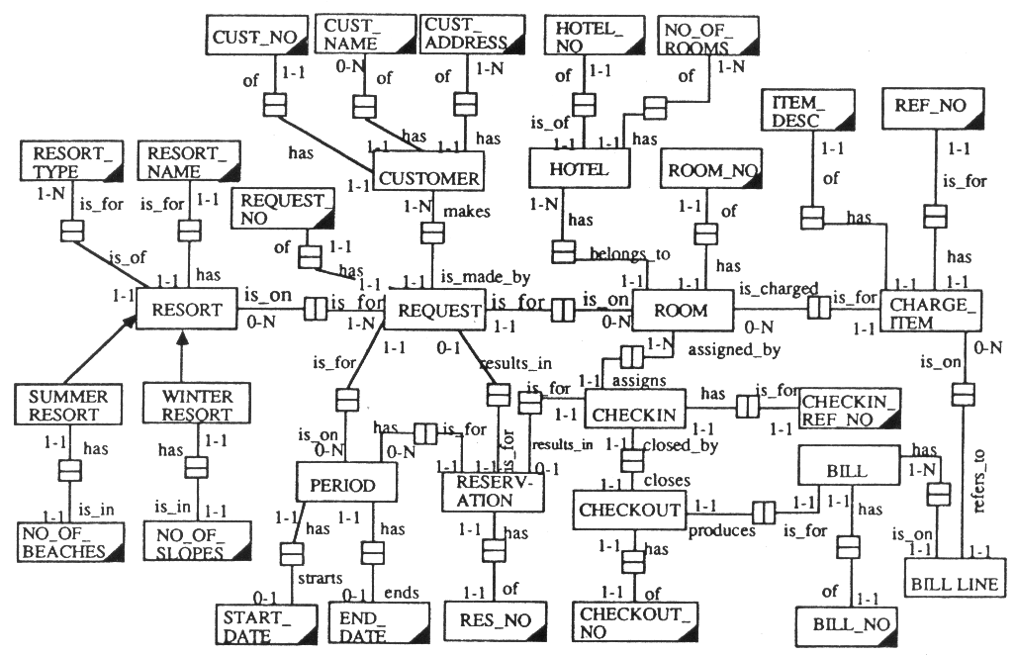

Slide 76
Summary of Conceptual Data Modelling
Goal: Analyse the static elements of the UoD and derive a precise, unambiguous and non-redundant schema
Activities: cross reference the data specification to process specification, develop a conceptual schema for each application and integrate all different user schemas (views) into a single global conceptual schema
Modelling formalism: Should provide structures independent of any implementation considerations, offer powerful abstraction mechanisms, encourage communication between users and developers, offer facilities for reasoning about a cs
Concepts and Techniques available to an I.S. developer for designing a conceptual schema to serve as the basis of defining all data types in a database and allowable operations were discussed

Slide 77
Process Design
Aim: to specify a number of program modules and their interrelationships. The basic technique for representing modules is the structure chart (modules and connections are the two basic building blocks)
Two Distinct Approaches:
  Process-Driven and
  Data-Driven

Slide 78
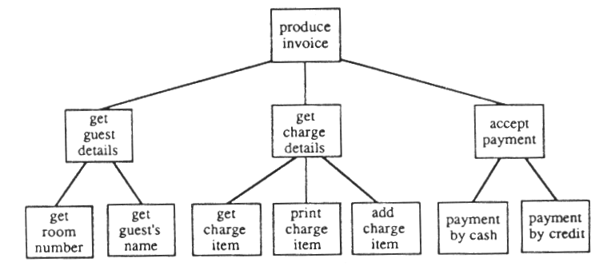
A Sample Structure Chart

Slide 79
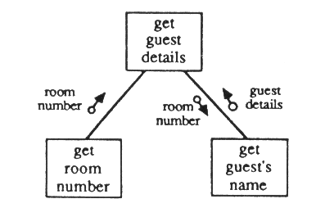
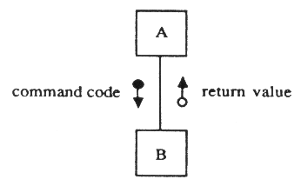
Paremeters in Structure Chart

Slide 80
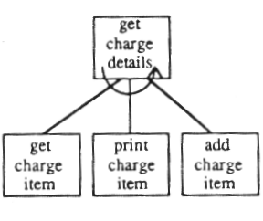
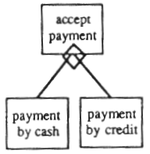
Repetitions and Selections

Slide 81
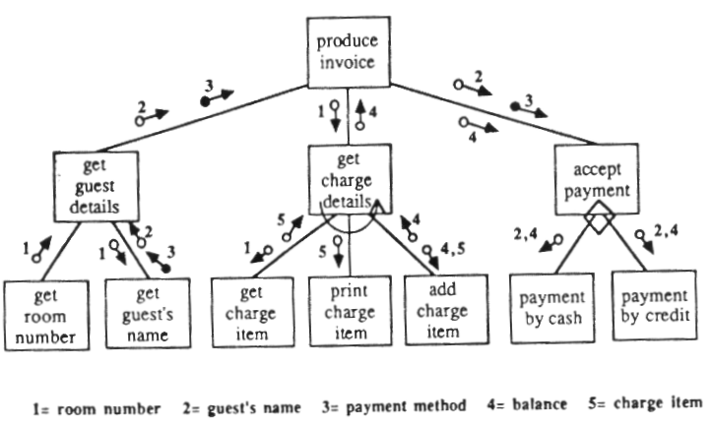
A Complete Structure Chart
(process driven notation)

Slide 82
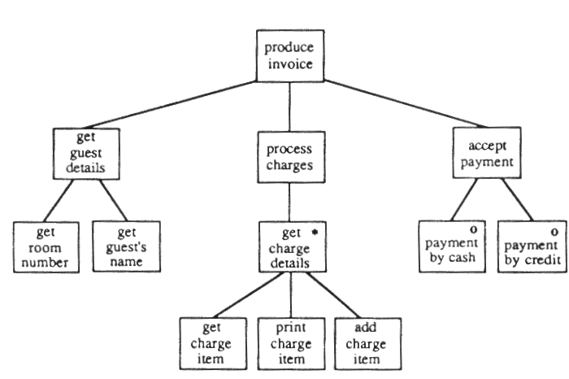
A Complete Structure Chart
(data driven notation)

Slide 83
Module Independence
It is formalised in the concepts of
coupling: it is concerned with the degree of independence between modules (the number of data links between modules);
cohesion: relates to the degree to which a module performs one and only one task

Slide 84
Factors influencing coupling
Complexity of the Interface: A simple parameter count can be misleading, e.g. in Pascal parameters can be grouped together into records and passed as a single physical parameter
Parameter Type: the type of data passed as a parameter between two modules can be: pure data or control data (which cause a model to take different action depending on the value of data)
Binding Time: refers to the time the data references between modules become fixed (e.g. if two modules can be independently compiled, there will be easier to maintain)

Slide 85
Degrees of Coupling
LOW
Data Coupling
Control Coupling
Common Environment Coupling
HIGH

Slide 86
Common Environment Coupling
Module A
Module B
Writes to..
Reads from..

Slide 87
Decoupling
Removal of Common Areas
Documenting of Remaining Common Areas
Change Parameters for the latest possible binding
removal of control parameters

Slide 88
Degrees of Cohesion
LOW
Coincidental
Logical
Temporal
Procedural
Communicational
Sequential
Functional
HIGH

Slide 89
Process Driven Design
Three steps:
Identification of the Characteristics of the DFD
Employing Techniques of Transform or Transaction Analysis to produce a Structure Chart depending on the characteristics identified in the DFD
Optimisation of the Structure Chart using design heuristics to produce higly cohesive, loosely coupled modules

Slide 90
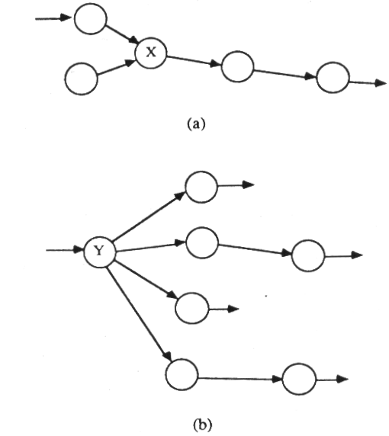
Identifying DFD Characteristics
a) central transform
b) transaction center

Slide 91
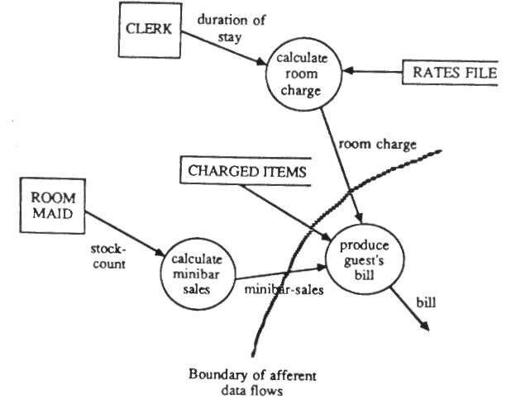
Producing a Structure Chart:
Transform Analysis
Afferent data flows

Slide 92
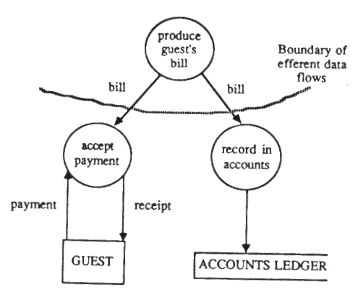
Producing a Structure Chart:
Transform Analysis
Efferent data flows

Slide 93
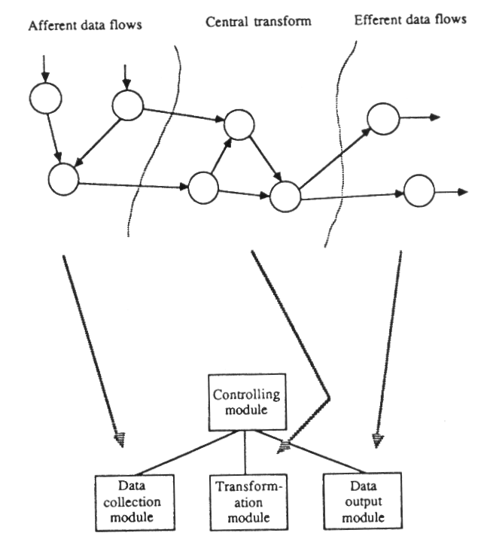
Transform
Analysis

Slide 94
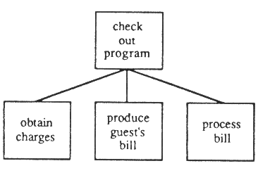
Outline Program Structure

Slide 95
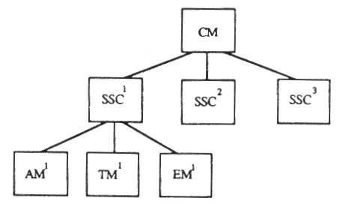
Transform Analysis with Subsystems

Slide 96
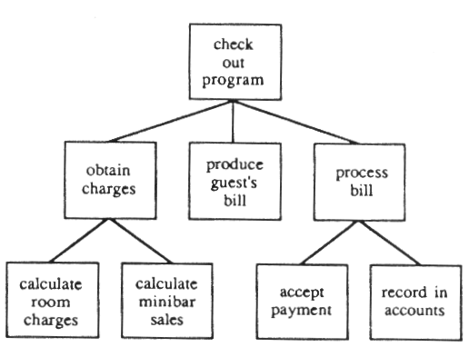
Second-Cut Program Structure

Slide 97
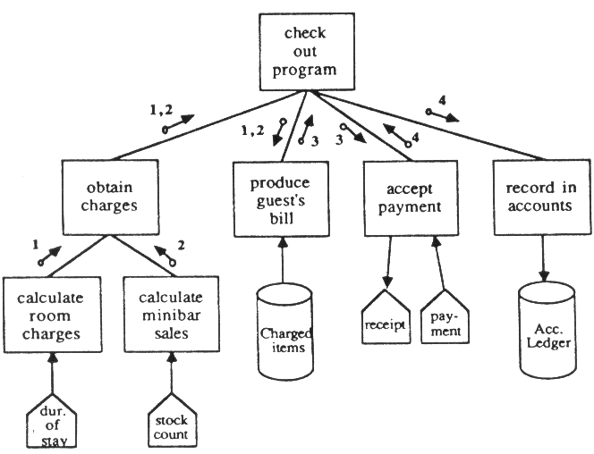
Hotel Check-Out Program:
Final Structure

Slide 98
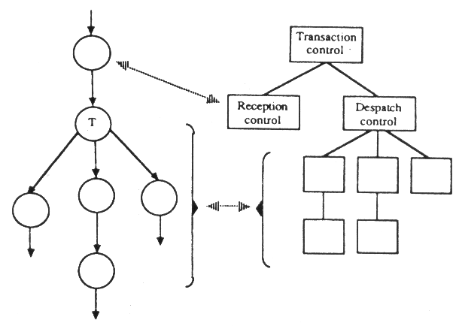
Transaction Analysis

Slide 99
Summary of Process Design
Define the basic structure of a system
Ensure independence of modules
Cohesion and Coupling are degrees of module independence
Structure Charts can be produced by the process driven techniques of transform and transaction analysis

