Slide 1
Jersey
Java Web Services
Charlie B.
D. Fisher E.
Drew F.

Slide 2
Agenda
The Big Picture
Servlets and Web Containers
HTTP and REST
JAX-RS
Jersey Basics
Using Jersey
In Summary

Slide 3
The Big Picture
Jersey:
Is an open source Java framework
Aids in the development of RESTful web services
Often runs inside a Web Container

Slide 4
Servlets
The Java counterpoint to server-side web content frameworks like PHP
Allow web-based access to the richness of Java back end architectures

Slide 5
Servlets
Require a Web Container to allow remote interaction with the servlet
Examples of Web Containers include:
Tomcat - http://tomcat.apache.org/
JBoss - http://www.jboss.org/
GlassFish - https://glassfish.java.net/
Jetty - http://eclipse.org/jetty/

Slide 6
Servlets
Take a request, and generate an appropriate response
In response generation, can access any Java processes that they are aware of

Slide 7
HTTP
Most common RESTful protocol
Each HTTP request header contains a method (GET, POST, PUT, DELETE)
Each server response header contains a status code (200 OK, etc)

Slide 8
REST
REpresentational State Transfer
RESTful APIs define resources via URIs, then use HTTP methods to access and/or manipulate them
Ex: To retrieve data from a users resource, an HTTP GET request might be sent to ‘/users’

Slide 9
JAX-RS
Stands for Java API XML Restful Services.
It’s an architectural pattern in Java for defining RESTful APIs
Consists of Java annotations

Slide 10
Jersey
An open source implementation of the JAX-RS standard.
Can act as a Server or Client
Supports many media types (not just XML)

Slide 11
Jersey Examples

Slide 12
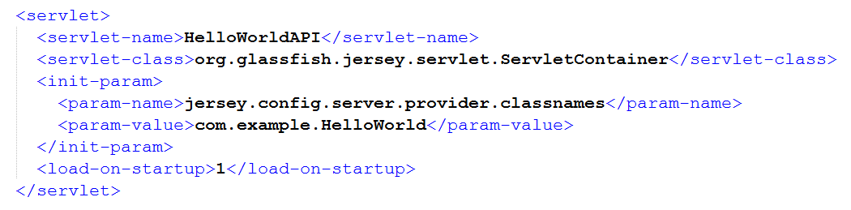
Web Container Config (Tomcat or similar)
In a Tomcat web.xml file, we can define the Jersey servlet and specify a “Provider”

Slide 13
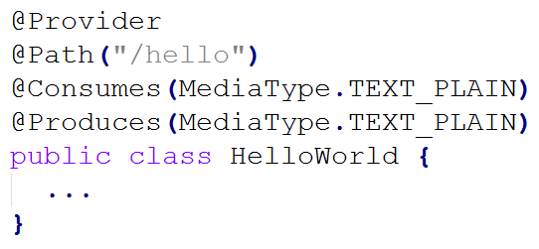
The Provider
Provider
Designates the class as a Web-Service Provider
Path
Specifies the URI Path this Provider serves
Consumes/Produces
Defines the media type this Provider can handle/dish-out

Slide 14
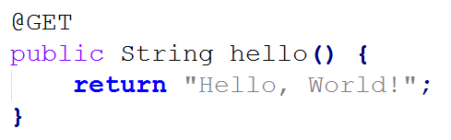

Simple Provider Method
The @GET annotation tells Jersey that this method only accepts GET HTTP requests
This very basic example returns a raw String as the HTTP response body

Slide 15
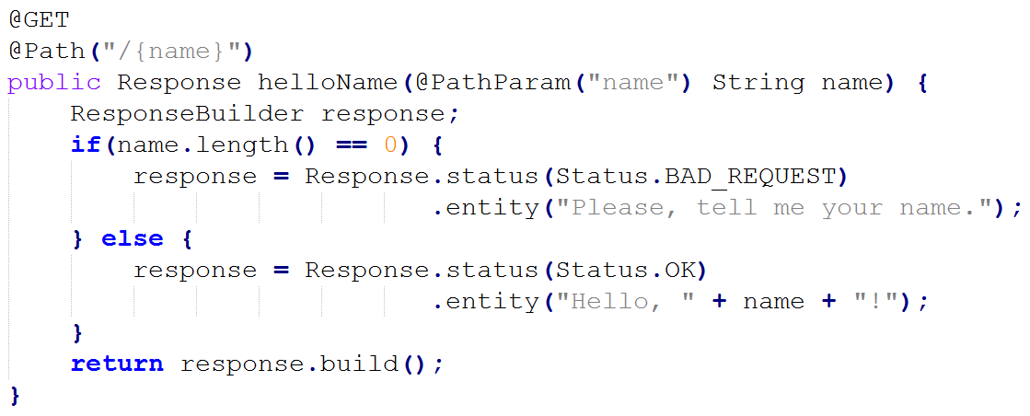


More Complex Example
Sub-Paths
Custom Responses
Path Parameter

Slide 16
Other Functionality
Jersey offers an enormous amount of additional functionality:
Request/Response Body Readers/Writers
Request and Response Filters
Security Integration
Java Bean Support
Many more features...

Slide 17
In Summary
Jersey is an implementation of JAX-RS
JAX-RS is an architectural pattern that helps define RESTful APIs in Java
Jersey runs as a Servlet within a Web Container (like Tomcat)
Offers the robustness and functionality of Java for back-end Web-Development

Slide 18
Questions?

Slide 19
Additional Resources
Java Servlets - http://docs.oracle.com/javaee/6/tutorial/doc/bnafd.html
HTTP - http://www.w3.org/Protocols/HTTP/1.0/spec.html
REST - http://www.ibm.com/developerworks/library/ws-restful/
JAX-RS - https://jax-rs-spec.java.net/
Jersey - https://jersey.java.net/

