Slide 1

Senior Projects 2014-2015
December Progress Report
Charlie Babcock
Drew Fead
Fisher Evans

Slide 2


Outline
The Proposal
Requirements
Design and Technologies
Where We’re At
Target Functionality
Q & A

Slide 3

What is ?
The Proposal

Slide 4

The Problem
Scheduling shifts that can vary from week to week is a time-consuming task. It’s often done with pen and paper or spreadsheets.

Slide 5



Existing Solutions
7Shifts, When I Work, and Infor Work Brain

Slide 6

What’s Missing
Support for mid-sized business
Department/managerial based scheduling
Automatic scheduling
Employee controls

Slide 7

Our Deliverables
Product Website
Web Based Application
3rd Party Accessible API
Tutorials & Documentation

Slide 8
What can you do with ?
The Requirements

Slide 9

Non Functional
Privacy: Employee Info (Wages, Schedules, etc.)
International: Multi-Lingual and Global Locations
Users: Working Age Facebook User
Documentation: Design, Manuals/Tutorials

Slide 10

Non Functional (cont.)
Reliability: 99% Service Uptime
Performance: Load Times < 5 Seconds
Scale: At least 5,000 Employees per Business
Web Platform: IE 10+, Supported Versions
of Chrome, Firefox, Opera and Safari

Slide 11

Groups and Roles
Organizational Aspect
Groups → Departments
Roles → Positions
Hierarchical System (Sub-Groups)

Slide 12

Employees
Configure Availability
Request Time Off
Ad-Hoc Shift Swapping
View Schedules
Message Other Employees

Slide 13

Managers
Schedule Employees
Group and Role Management
Labor Reporting
Application Configuration
Oversee Ad-Hoc Actions

Slide 14

Scheduling
Workforce Requirements
Guided via Availability
Templates
Auto Generation (AI)
Staging & Publishing

Slide 15

Notifications
Triggered by Application Events
Via Email, SMS and in-app Alerts
Configurable per User per Employee

Slide 16

Web Users
Manage User Profile
Link to (Multiple) Employees
Update Notification Settings

Slide 17

Messaging
Multi-User Threads
Customizable Notifications
Proxy for Personal Contact Info

Slide 18
What’s under the hood of ?
The System Design

Slide 19
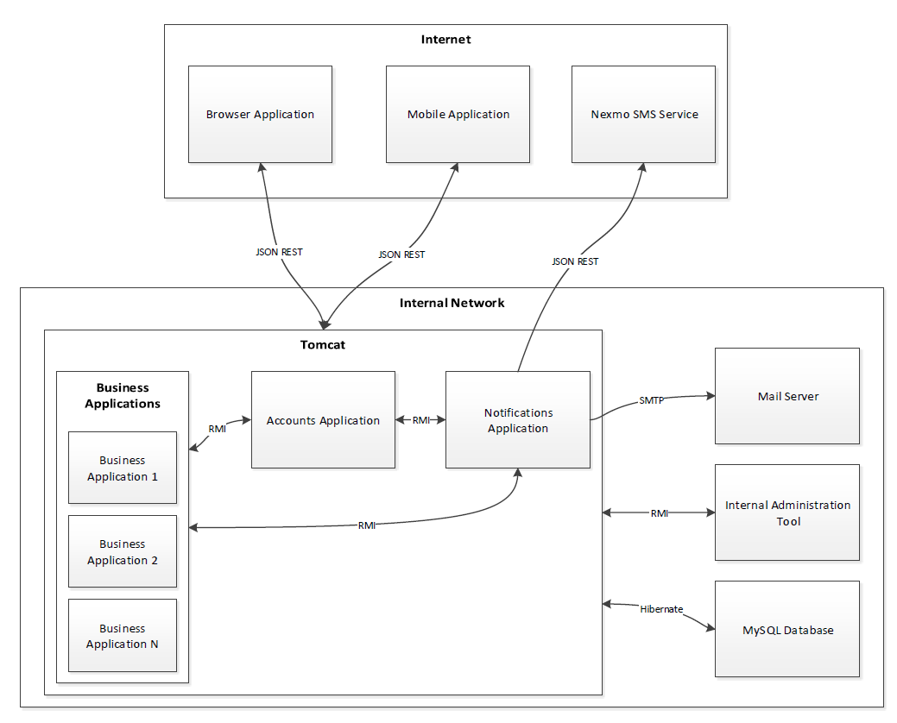
Components

Slide 20
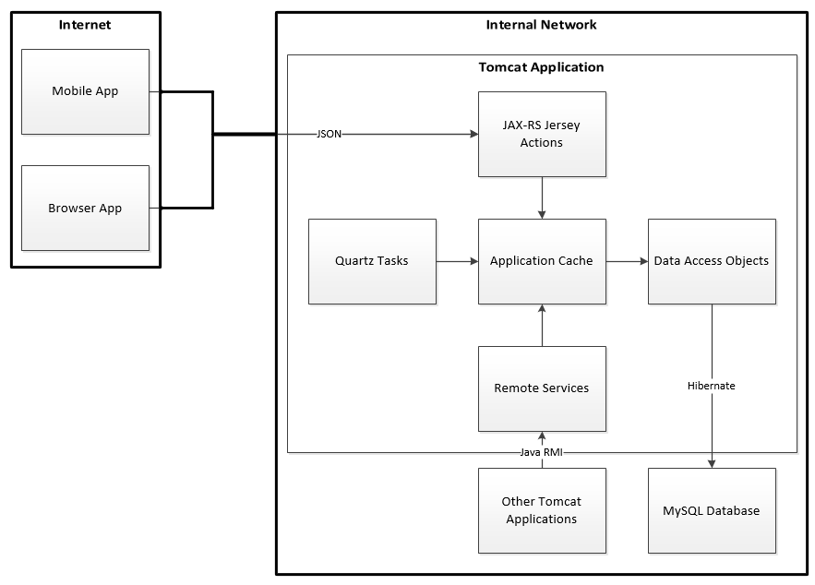
Top Level
Database
Tomcat App
AngularJS Web-App

Slide 21
Database
MySQL
Centralized User System
Multi-Tenant Business Schemas

Slide 22
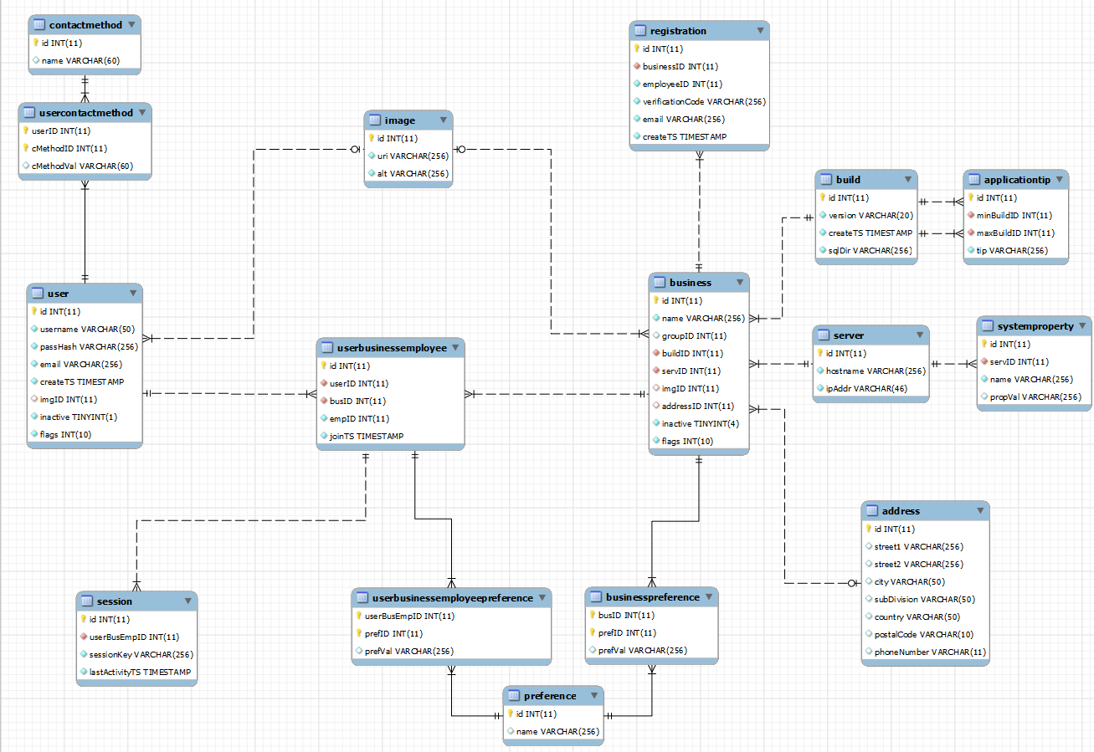
Accounts Database

Slide 23
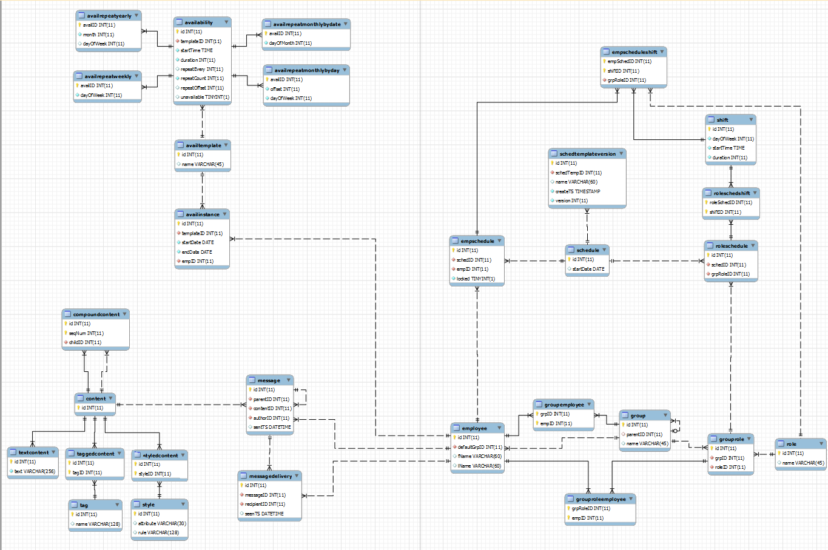
Business Database

Slide 24
Tomcat Applications
JAX-RS & Quartz
Hibernate
Cache
GSON Data Types

Slide 25
Accounts Application
Service Director
User Authentication
Registration and Settings

Slide 26
Business Application
Many Businesses Each
Employees & Managers
Schedules
Messaging

Slide 27
Notifications Application
Nexmo SMS Service
SMTP Mail Server
API for Application Alerts

Slide 28
Web-App
AngularJS
HTML/CSS
Responsive

Slide 29
What’s the current status of ?
Our Progress Thusfar

Slide 30
Database
Business
Accounts

Slide 31
Dev. Environment
Eclipse
Ant

Slide 32
Tomcat Structure
Business
Accounts

Slide 33
Accounts API
Sessions
User Management

Slide 34
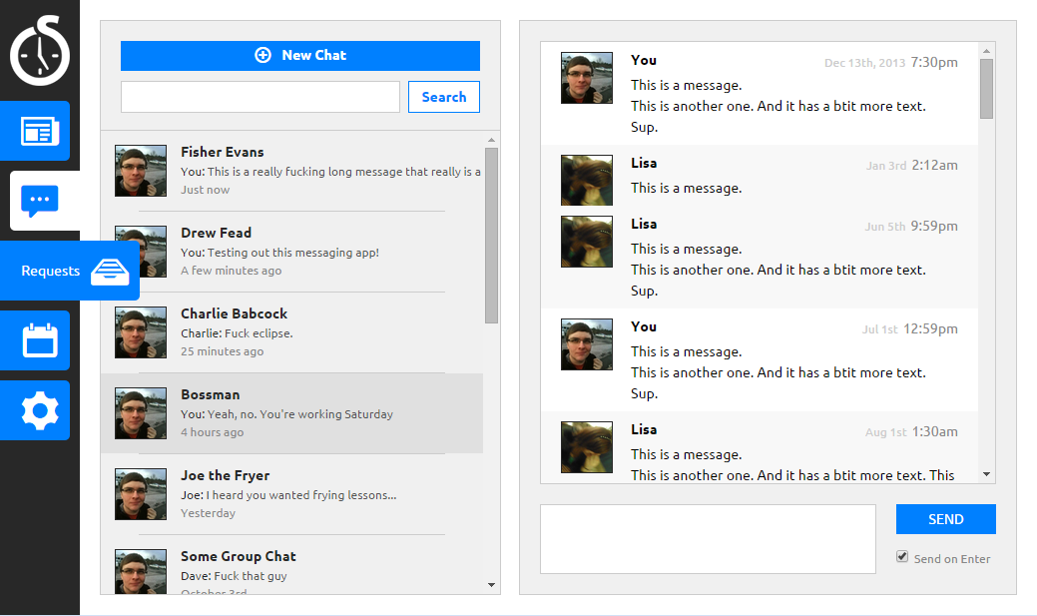
Web-App

Slide 35
What’s on the horizon for ?
Target Functionality

Slide 36
Have any questions about ?
Q & A

