Slide 1

2012-2016

Slide 2
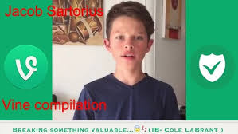
What is vine?
Short 6 second video sharing platform
Funny videos
Birth of social media influencers
Comedy Content

Slide 3
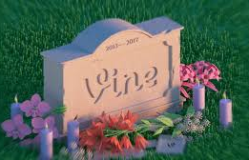


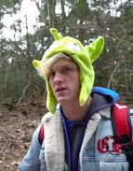
Decline of Vine
With over 200 million active users it died
Vine asked Twitter for support but the deal died and Twitter pulled the plug
Creators slowly left

