Slide 1
StrikerRank
Fisher Marks and Thomas Orozco

Slide 2
Project Overview
Expected Goals (xG): probability shot will go in based on various factors (%)
Real Goals (rG): actual goals (0 or 1)
rG minus xG: one useful way of measuring how good a striker is
Market Value: estimated transfer fee a team would have to pay a player’s team to acquire the player

Slide 3
Data Sources
FBRef: a good source for raw soccer stats
TransferMarkt: a good source for player market values
FBRef Scraper: https://github.com/fisherm123/soccerdata
TransferMarkt Scraper: https://github.com/fisherm123/transfermarkt-scraper

Slide 4
Tech Stack
Scrapers
Python
Database
PostgreSQL
pgAdmin4 (easy for importing large csv files)
Web App
Flask
Psycopg2 (connects to PostgreSQL servers)
HTML/CSS/JavaScript
GitHub: https://github.com/fisherm123/strikerrank

Slide 5
Database Design
Data Transformation
tfmkt_players
Entity Resolution
players
raw_players
fbref_players
appearances
Raw Imports
raw_appearances
matches
Cleaned Scraped Data
raw_matches
shots
raw_shots
leagues
teams

Slide 6
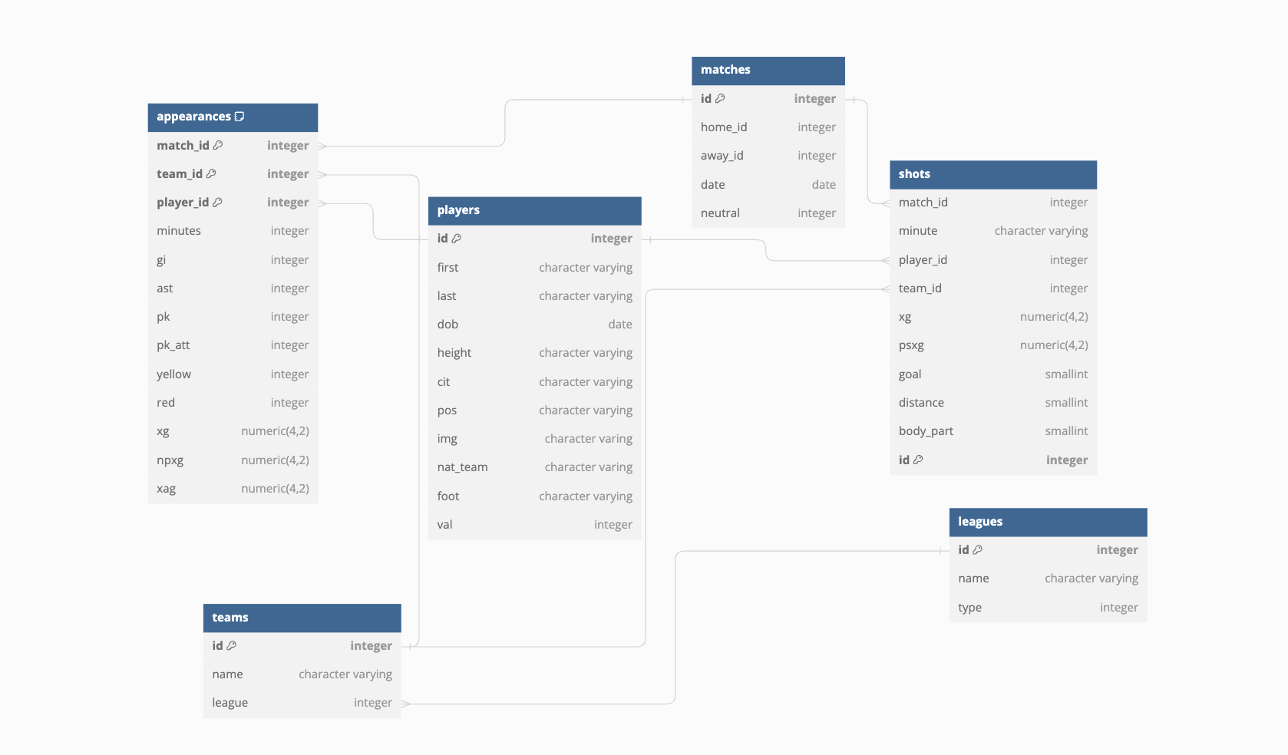
Schema
Key Design Choices:
No match score
Smaller files
Longer compute
Player-focused analysis
No team attribute for players
Transfers mid-season
Player image is saved as a link
Notes:
Highlight why we left score off matches (saves space, you can still calculate winner of game through appearance table) our analysis focuses on individual performances, so for our purposes this was a good trade
Explain what the tuples in the appearances mean (it shows how a player played in the game)

Slide 7
Main Features
Ranked list of players by our key metric alongside market value
Dynamic filter (options adjust automatically if more data is scraped)
Increase query size
Player-specific info menu

Slide 8
Good Decisions
Scraping our own data
After initial time investment can get whatever data we needed
Expansion of project as simple as rerunning scraper
Multi-tier database design

Slide 9
Bad Decisions
Scraping our own data
High initial time investment
Proper Data Cleaning
Frequently failed quality checks
Harder to find problem than solve it from beginning

