Slide 1
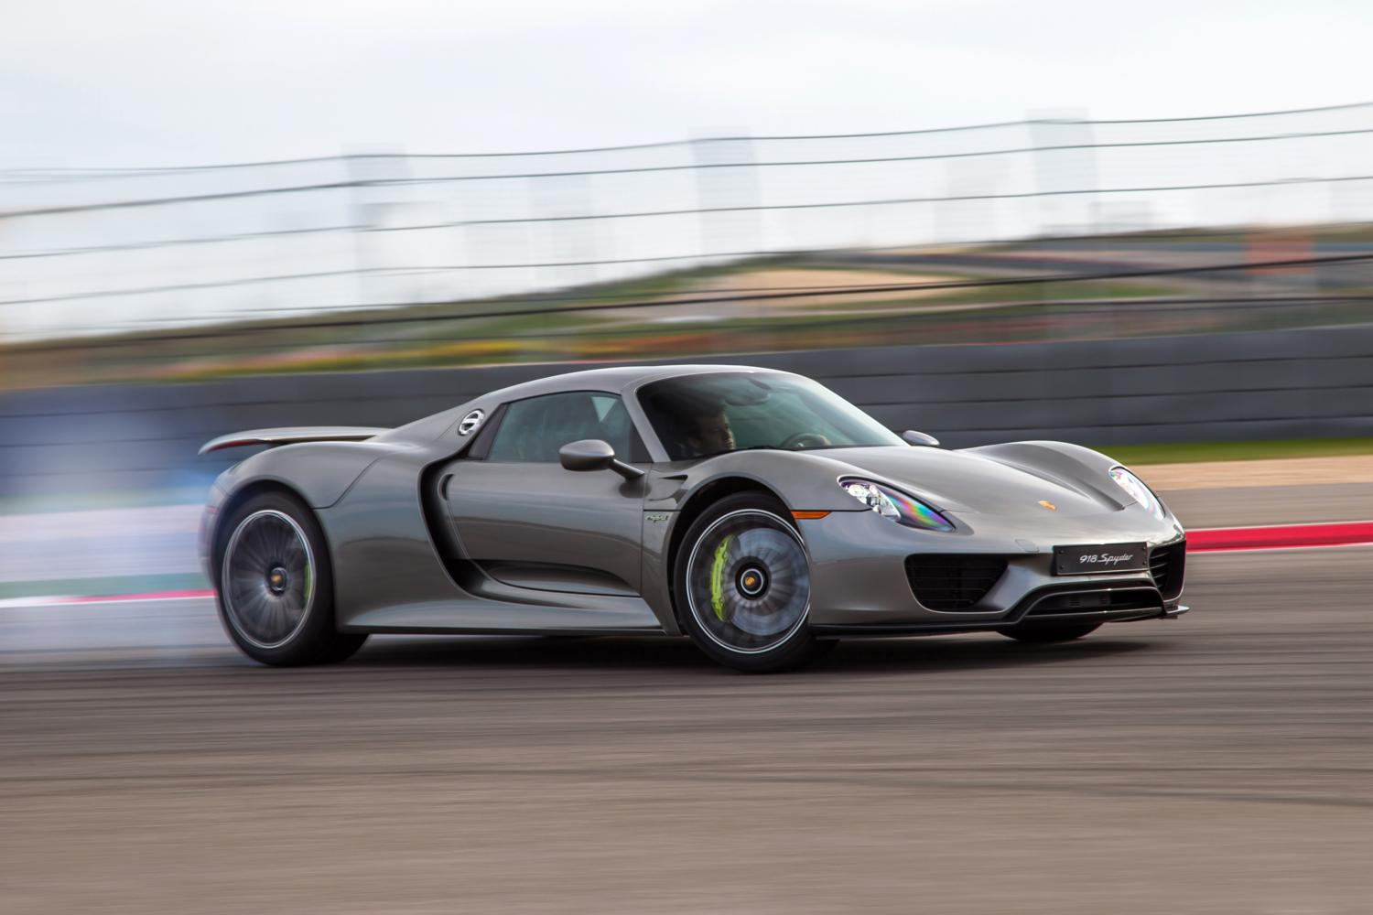
Growth accelerations bridge the mechanistic and ecosystem scales in microbiomes
Oliver Meacock
Physics of Life Fellow
University of Sheffield
Fisher’s fishes talk
24/07/2026

Slide 2
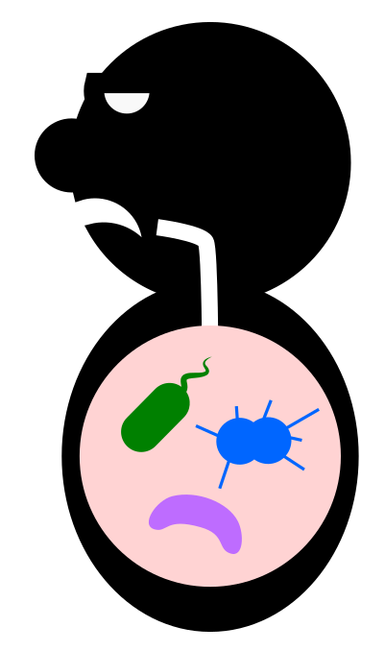
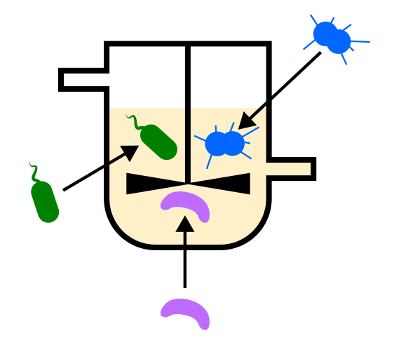
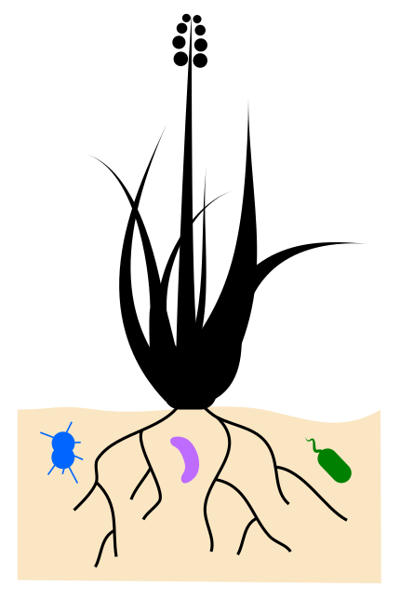
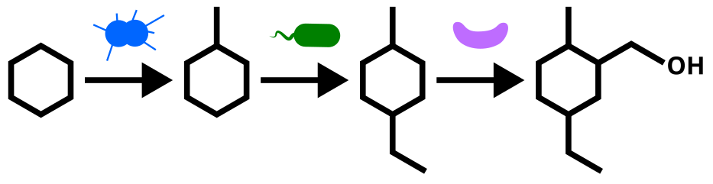
Microbial ecology – a practical discipline
Add useful species
Remove pathogens
Assemble microbial factories

Slide 3
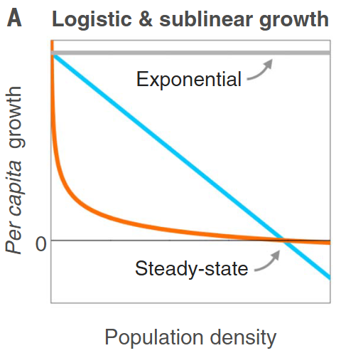
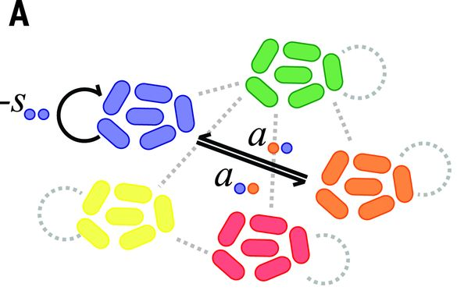
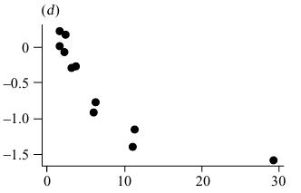


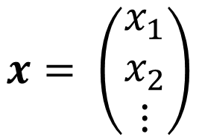
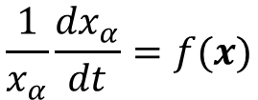
Two modelling traditions: Phenomenological models
Generalised Lotka-Volterra (gLV) model
General form
$$\frac{1}{x_{α}}\frac{{dx}_{α}}{dt}=f(x)$$
Per-captia growth rate (PCGR)
Coyte et al. (2015) Science
Hatton et al. (2024) Science
Density vector
$$x= \left(\begin{matrix}x_{1} \\ x_{2} \\ ⋮\end{matrix}\right)$$
Sibly and Hone (2002) Phil. Trans. R. Soc. B

Slide 4
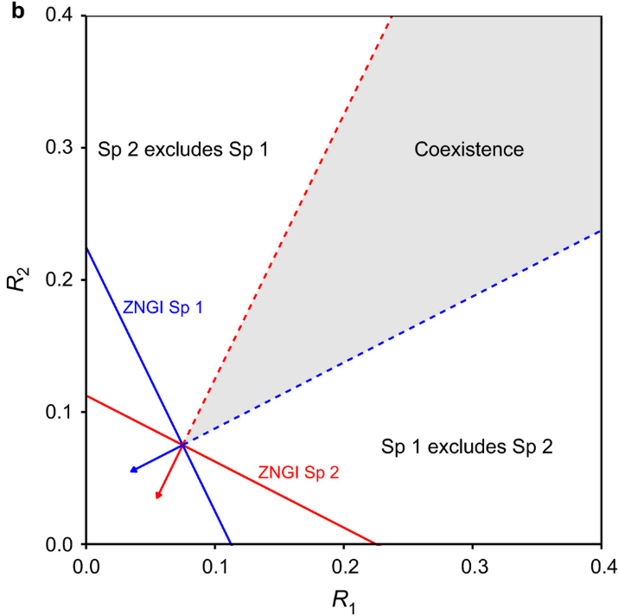
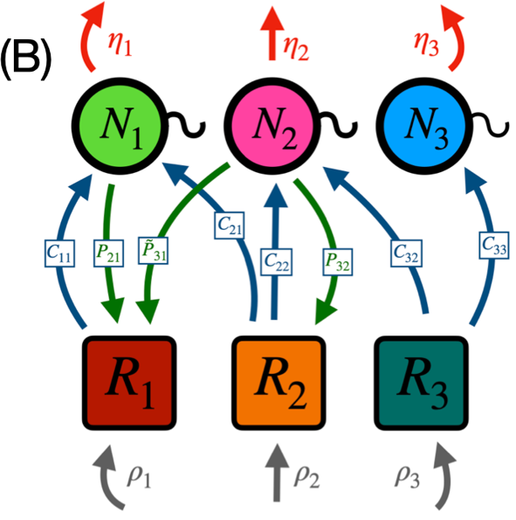
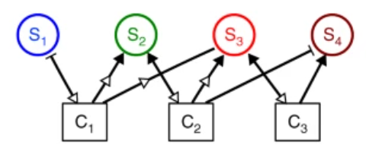
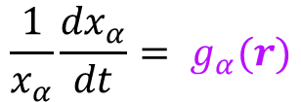

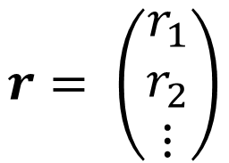
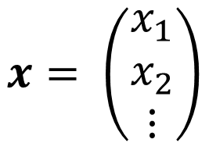
Two modelling traditions: Mechanistic models
General form
$$\frac{dr}{dt}=\sum_{β}{x_{β}f_{β}(r)+ σ(r)}$$
$$\frac{1}{x_{α}}\frac{{dx}_{α}}{dt}= g_{α}(r)$$
Environment vector
Letten et al. Eco. Monographs (2017)
Gibbs et al. PLoS Comp. Bio. (2022)
Density vector
$$x= \left(\begin{matrix}x_{1} \\ x_{2} \\ ⋮\end{matrix}\right)$$
$$r= \left(\begin{matrix}r_{1} \\ r_{2} \\ ⋮\end{matrix}\right)$$
Niehaus et al. Nat. Comms. (2019)

Slide 5
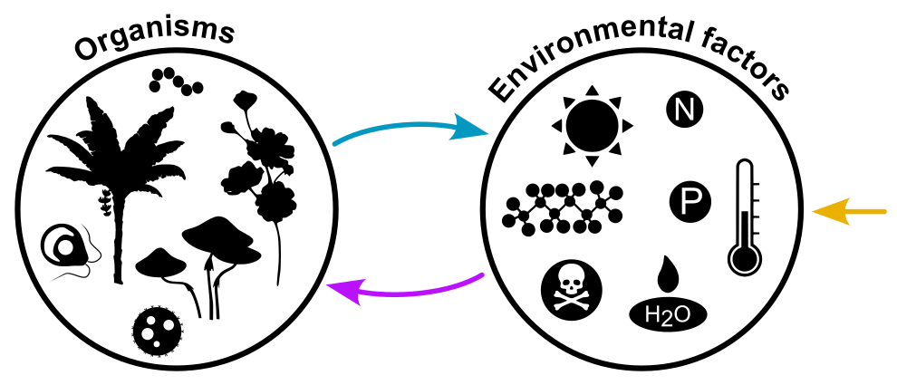
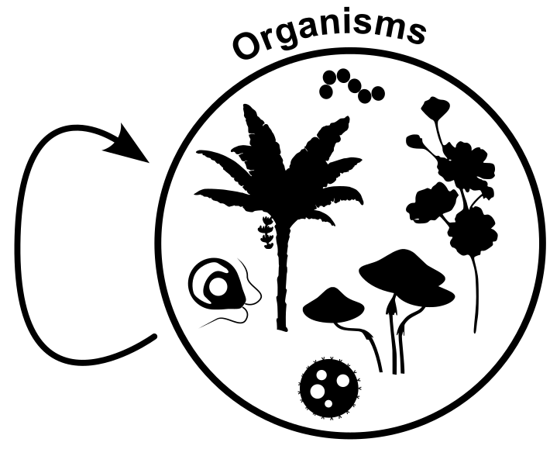
Mechanistic models
Phenomenological models
?
+ Realistic constraints on mechanistic processes
- Difficult to generalise
- Require expensive/slow measurements of resource dynamics
+ Simple to parameterise from pairwise measurements
- Multiple phenomena aren’t captured by pairwise data (HOIs, context-dependencies, time lags…)
- Generate paradoxes that appear to contradict observations

Slide 6

Talk outline
Part 1
Part 2
Density dependence
Modern coexistence theory
Context dependencies
Diversity-stability paradox
HOIs
Cooperation-stability paradox

Slide 7
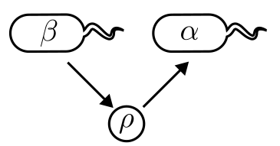
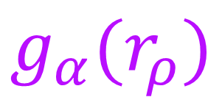
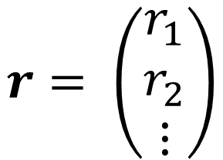
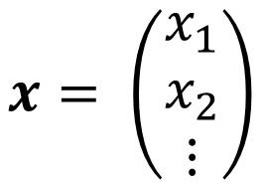
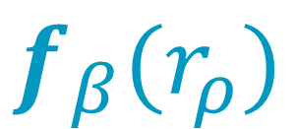
Introducing Environment-Organism models
Density vector
Effector species
Target species
$$x= \left(\begin{matrix}x_{1} \\ x_{2} \\ ⋮\end{matrix}\right)$$
Environment vector
Sensitivity function, effect of ρ on growth rate of α
Impact function of β on ρ
$$r= \left(\begin{matrix}r_{1} \\ r_{2} \\ ⋮\end{matrix}\right)$$
$$f_{β}(r_{ρ})$$
$$g_{α}(r_{ρ})$$
Intermediate compound

Slide 8

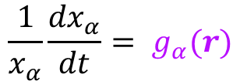

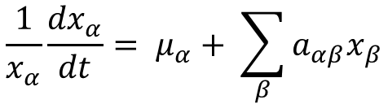


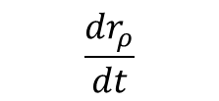
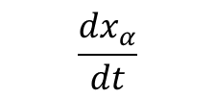
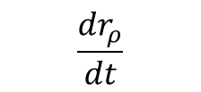
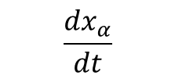
Deriving a general gLV/EO mapping
Environment-Organism models
Phenomenological model
$$\frac{{dx}_{α}}{dt}$$
$$\frac{{dr}_{ρ}}{dt}$$
Organisms
Organisms
Environmental factors
$$x$$
$$x$$
$$r$$
$$\frac{{dr}_{ρ}}{dt}$$
Generalised Lotka-Volterra (gLV)
$$\frac{{dx}_{α}}{dt}$$
Impact functions
$$\frac{dr}{dt}=\sum_{β}{x_{β}f_{β}(r)+ σ(r)}$$
$$\frac{1}{x_{α}}\frac{{dx}_{α}}{dt}= μ_{α}+ \sum_{β}{{a_{αβ}x}_{β}}$$
Allogenic function
Per-capita growth rate (PCGR)
Intrinsic growth rates
Interaction strengths
$$\frac{1}{x_{α}}\frac{{dx}_{α}}{dt}= g_{α}(r)$$
Sensitivity functions

Slide 9
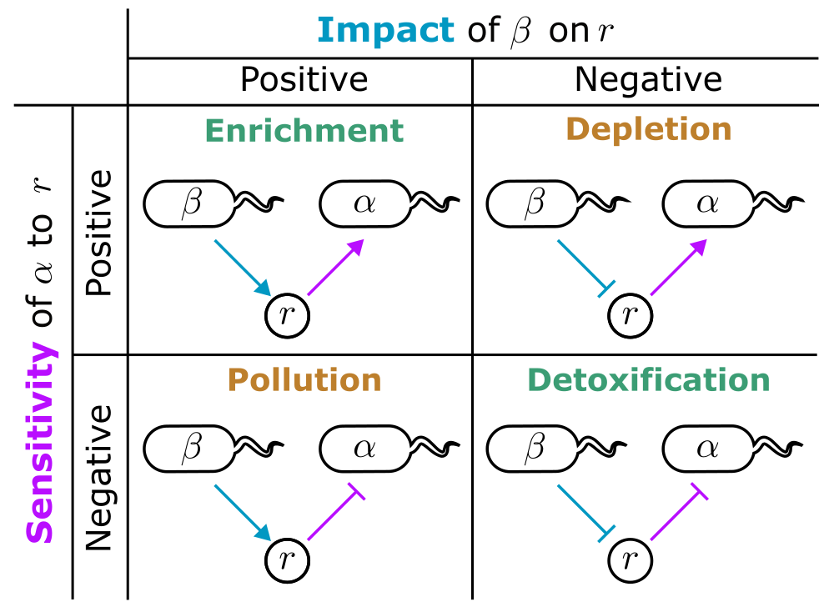
Interactions in mechanistic models
Meacock & Mitri (2025) Eco. Letts.

Slide 10
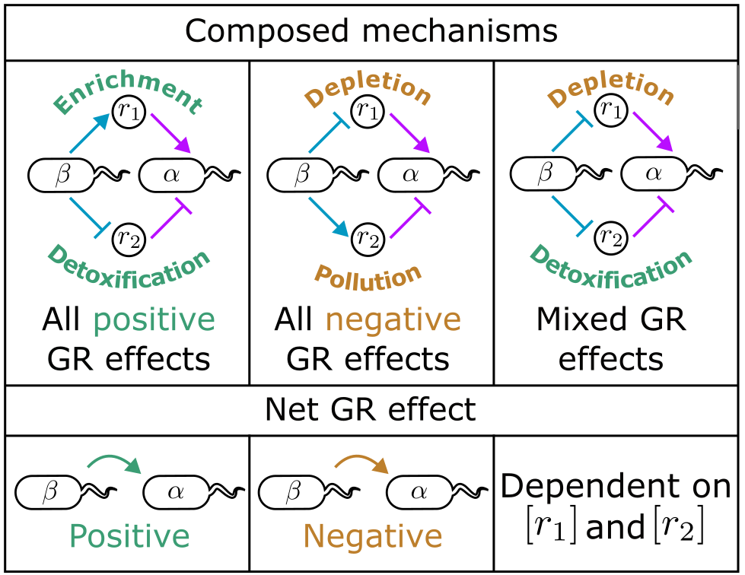
Composite interactions are net effects of individual mechanisms
Meacock & Mitri (2025) Eco. Letts.

Slide 11
Deriving a general gLV/EO mapping
Environment-Organism models
Phenomenological model
$$\frac{{dx}_{α}}{dt}$$
$$\frac{{dr}_{ρ}}{dt}$$
Organisms
Organisms
Environmental factors
$$x$$
$$x$$
$$r$$
$$\frac{{dr}_{ρ}}{dt}$$
Generalised Lotka-Volterra (gLV)
$$\frac{{dx}_{α}}{dt}$$
Impact functions
$$\frac{dr}{dt}=\sum_{β}{x_{β}f_{β}(r)+ σ(r)}$$
$$\frac{1}{x_{α}}\frac{{dx}_{α}}{dt}= μ_{α}+ \sum_{β}{{a_{αβ}x}_{β}}$$
Allogenic function
Per-capita growth rate (PCGR)
Intrinsic growth rates
Interaction strengths
$$\frac{1}{x_{α}}\frac{{dx}_{α}}{dt}= g_{α}(r)$$
Sensitivity functions

Slide 12

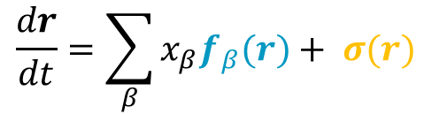

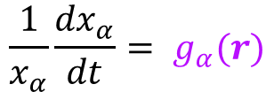
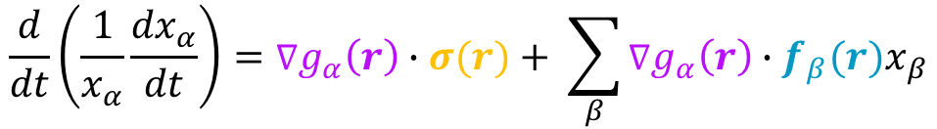
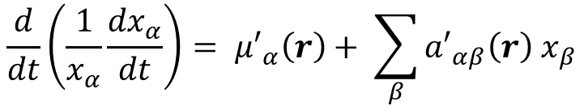
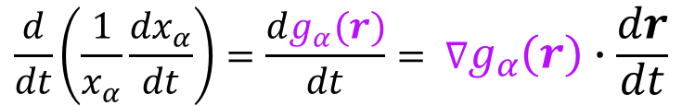
Deriving a general gLV/EO mapping
$$\frac{1}{x_{α}}\frac{{dx}_{α}}{dt}= g_{α}(r)$$
Sensitivity functions define per-capita growth rates (PCGRs) in environment r
$$\frac{d}{dt}\left(\frac{1}{x_{α}}\frac{{dx}_{α}}{dt}\right)=\frac{dg_{α}(r)}{dt}= ∇g_{α}\left(r\right)∙\frac{dr}{dt}$$
Temporal derivative of sensitivity function and multivariate chain rule
$$\frac{dr}{dt}=\sum_{β}{x_{β}f_{β}(r)+ σ(r)}$$
$$\frac{d}{dt}\left(\frac{1}{x_{α}}\frac{{dx}_{α}}{dt}\right)=∇g_{α}\left(r\right)∙σ(r)+ \sum_{β}{{∇g_{α}\left(r\right)∙f_{β}(r)x}_{β}}$$
$${{μ′}_{α}\left(r\right)=∇g}_{α}(r)∙σ(r)$$
$${a′}_{αβ}\left(r\right)= {∇g}_{α}(r)∙f_{β}(r)$$
$$\frac{d}{dt}\left(\frac{1}{x_{α}}\frac{{dx}_{α}}{dt}\right)= {μ′}_{α}\left(r\right)+ \sum_{β}{{{a′}_{αβ}\left(r\right) x}_{β}}$$
Abiotic accelerations
Biotic accelerations

Slide 13
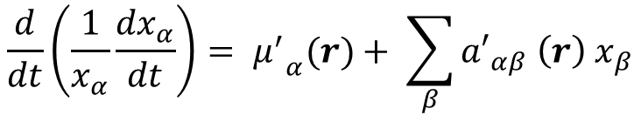
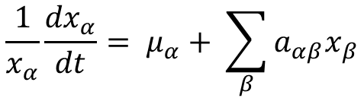


Deriving a general gLV/EO mapping
Accelerational Environment-Organism (aEO) equation
Generalised Lotka-Volterra (gLV) equation
$$\frac{d}{dt}\left(\frac{1}{x_{α}}\frac{{dx}_{α}}{dt}\right)= {μ^{′}}_{α}(r)+ \sum_{β}{{{a′}_{αβ} \left(r\right) x}_{β}}$$
$$\frac{1}{x_{α}}\frac{{dx}_{α}}{dt}= μ_{α}+ \sum_{β}{{a_{αβ}x}_{β}}$$
Per-capita growth rate (PCGR)
Intrinsic growth rates
Interaction strengths
$${∇g}_{α}(r)∙σ(r)$$
$${∇g}_{α}(r)∙f_{β}(r)$$
Per-capita growth acceleration (PCGA)
Abiotic accelerations
Biotic accelerations
At equilibrium, these are algebraically equivalent!

Slide 14

Composite interactions are net effects of individual mechanisms
Biotic accelerations
$${a′}_{αβ}\left(r\right)= {∇g}_{α}(r)∙f_{β}(r)$$
Meacock & Mitri (2025) Eco. Letts.

Slide 15
Application 1: Why are interactions context-dependent?

Slide 16
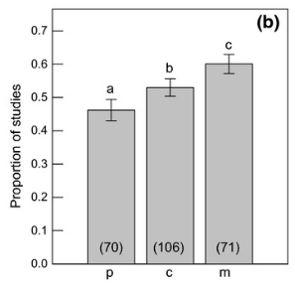
The problem of context-dependency
Generalised Lotka-Volterra (gLV) model
Fraction of studies finding changes in sign of interaction
Chamberlain et al. (2014) Eco. Letts.
Coyte et al. (2015) Science
Ecological parameters (e.g. interaction strengths) are fixed values

Slide 17
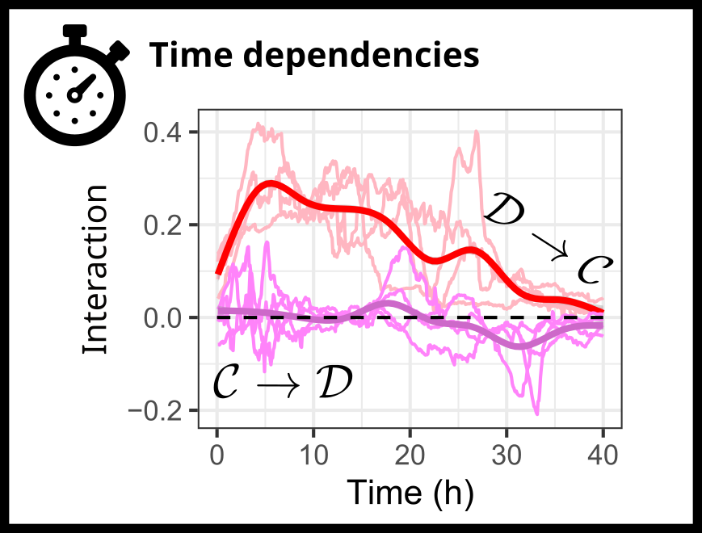
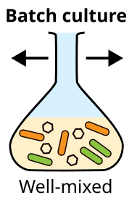
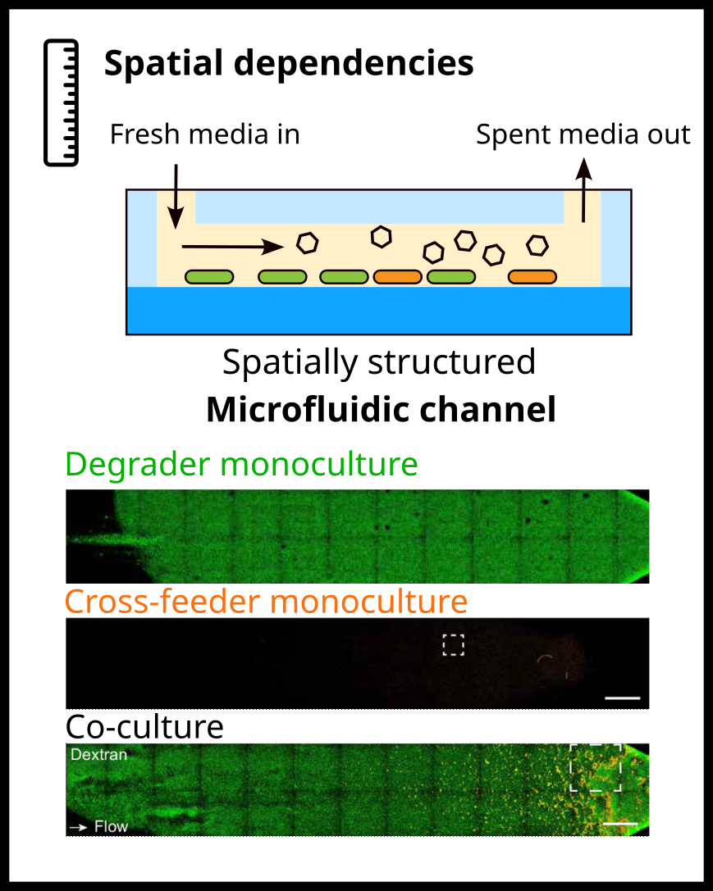
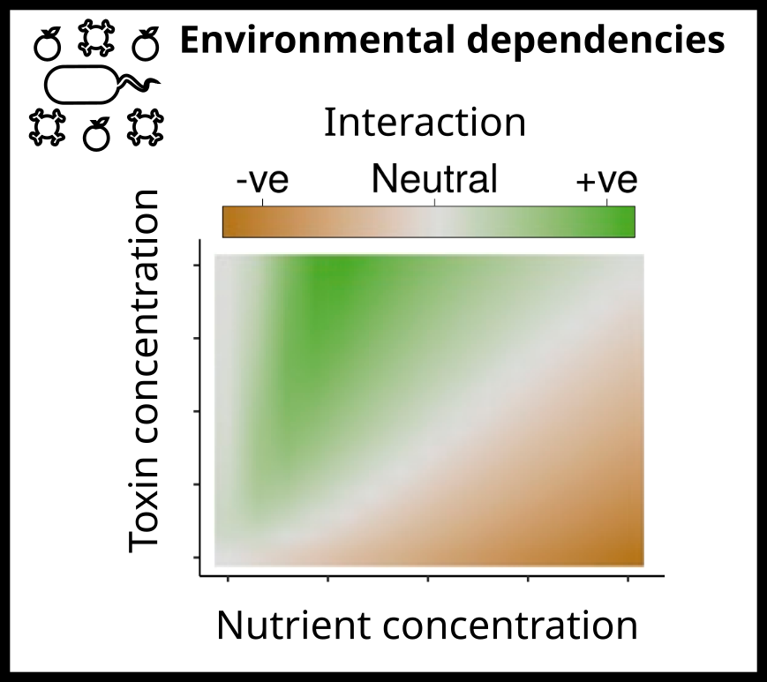

Types of context-dependency
Wong et al. (2023) PNAS
Daniels et al. (2023) ISME J.
Piccardi et al. (2019) PNAS

Slide 18
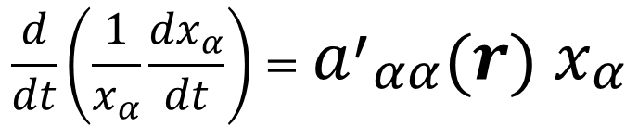
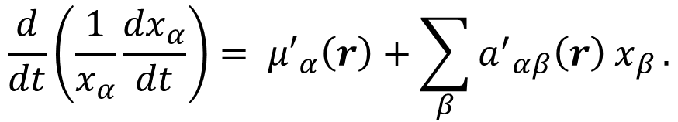
The aEO equation without inputs
In many systems (e.g. batch culture, closed microcosms), allogenic processes do not occur.
$$\frac{d}{dt}\left(\frac{1}{x_{α}}\frac{{dx}_{α}}{dt}\right)= {μ′}_{α}\left(r\right)+\sum_{β}{{{a^{′}}_{αβ}\left(r\right) x}_{β}}.$$
0
In the single species case, this becomes
$$\frac{d}{dt}\left(\frac{1}{x_{α}}\frac{{dx}_{α}}{dt}\right)={{a^{′}}_{αα}\left(r\right) x}_{α}$$
How does this single species intra-specific biotic acceleration behave?
Batch culture

Slide 19
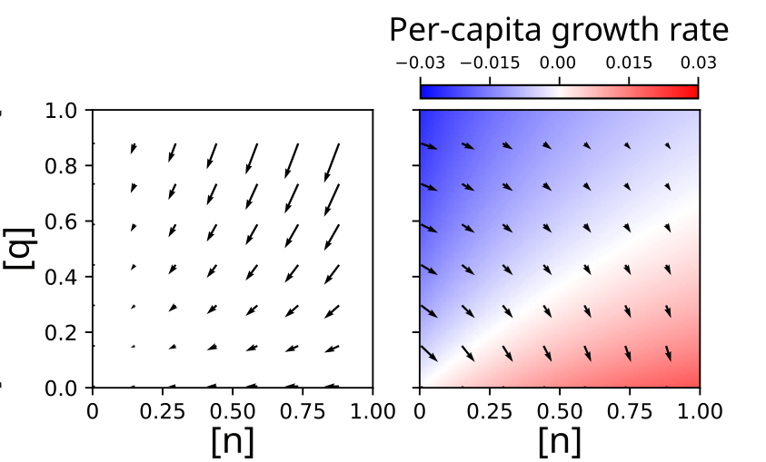
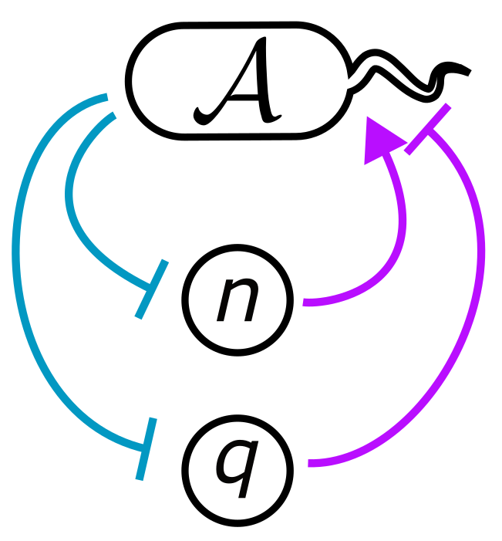

Illustrating the biotic acceleration
Meacock & Mitri (2025) Eco. Letts.
Impact function
Sensitivity function
$$f_{A}(r)$$
$$g_{A}(r)$$

Slide 20
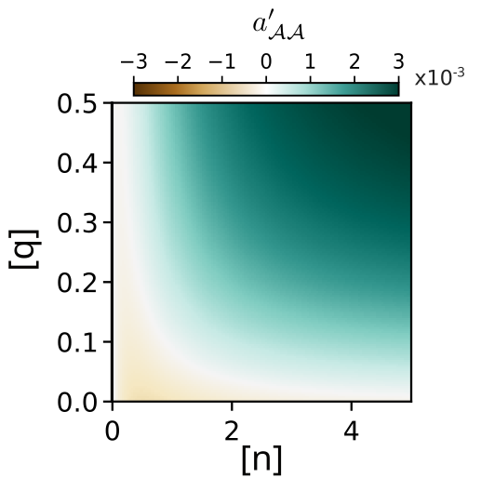
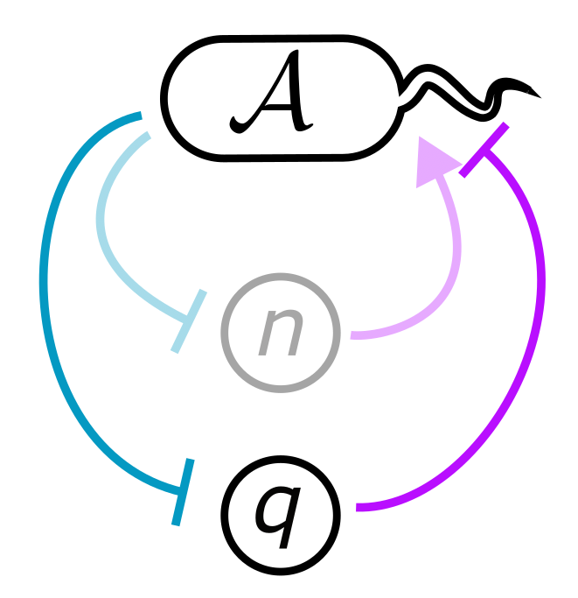
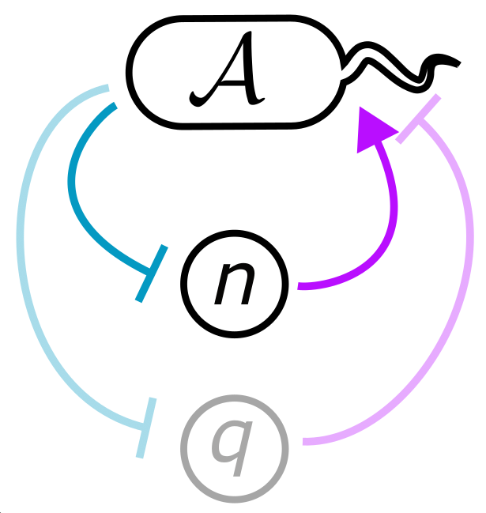
Illustrating the biotic acceleration
Context-dependence
Biotic acceleration
$${a′}_{AA}\left(r\right)= {∇g}_{A}(r)∙f_{A}(r)$$

Slide 21


Interaction time-dependencies arise from the changing environment

Slide 22

Interaction time-dependencies arise from the changing environment

Slide 23



The accelerational viewpoint explains time-dependent interactions
A = Comamonas testosteroni
n = proline
q = ampicillin
Meacock & Mitri (2025) Eco. Letts.

Slide 24

The accelerational viewpoint explains time-dependent interactions
Experiment
Model
Meacock & Mitri (2025) Eco. Letts.

Slide 25


Comparing temporal and spatial interaction dependencies

Slide 26
Application 2: Why are microbial mutualisms stable?

Slide 27






Mutualistic mechanisms in macroscopic ecosystems

Slide 28



Mutualistic blowup and instability of cooperative communities
Fraction of cooperative interactions
‘It is evident that in a limited microcosm we can not expect infinite populations, and certain observations indicate that the coefficient of mutual aid can considerably decrease in the course of growth of the culture.’
Coyte et al. (2015) Science
Gause and Witt (1935) Am. Nat.

Slide 29




Microbial mutualisms: Widespread microbial cross-feeding
Kost et al. (2023) Nat. Microbiol.

Slide 30

Recipes for stabilising mutualisms in phenomenological models
Holland et al. (2002), Am. Nat.

Slide 31



A model cross-feeding mutualism

Slide 32




$$\frac{d}{dt}\left(\frac{1}{x_{α}}\frac{{dx}_{α}}{dt}\right)= {μ′}_{α}\left(r\right)+\sum_{β}{{{a^{′}}_{αβ}\left(r\right) x}_{β}}.$$
$${{μ′}_{α}\left(r\right)=∇g}_{α}(r)∙σ(r)$$
$${a′}_{αβ}\left(r\right)= {∇g}_{α}(r)∙f_{β}(r)$$
Abiotic accelerations
Biotic accelerations

Slide 33


The aEO equation at equilibrium
In equilibrium systems, growth accelerations are equal to zero.
$$\frac{d}{dt}\left(\frac{1}{x_{α}}\frac{{dx}_{α}}{dt}\right)= {μ′}_{α}\left(r\right)+\sum_{β}{{{a^{′}}_{αβ}\left(r\right) x}_{β}}.$$
0
Thus,
$${−μ′}_{α}\left(r^{∗}\right)=\sum_{β}{{a^{′}}_{αβ}\left(r^{∗}\right)}x_{β}^{∗}$$
How do these effective gLV parameters behave as we vary mutualistic mechanisms?
Chemostat

Slide 34


When cooperation isn’t cooperative
Naïve expectation
Observed
Biotic acceleration
0
(homologous to interaction strengths)
(homologous to intrinsic growth rates)
Abiotic acceleration
0
Amino acid secretion rate
Amino acid secretion rate

Slide 35

Effective gLV parameters cannot be interpreted using gLV intuition

Slide 36

Effective gLV parameters cannot be interpreted using gLV intuition

Slide 37





Stabilisation mechanism is consistent across community sizes
Mee et al (2014) PNAS.

Slide 38





Reconciling the camps
Palmer & Foster (2022) Science

Slide 39
Application 3: Modern coexistence theory

Slide 40









What is Modern Coexistence Theory (MCT)?
Species 1 wins
For a two-species gLV system:
Coexistence
Log(Fitness ratio)
Niche overlap
Fitness ratio
1/Niche overlap
Chesson (1990) Theo. Pop. Bio.
For a two-species EO system at equilibrium:
Species 2 wins
Niche overlap

Slide 41

Applying MCT to mutualisms

Slide 42



Obtaining mechanistic insight into mutualistic coexistence

Slide 43


Experimental support for accelerational approach
Data from Ho et al. Nat. Microbiol. (2024)

Slide 44

Summary
$$\frac{d}{dt}\left(\frac{1}{x_{α}}\frac{{dx}_{α}}{dt}\right)$$
Growth in mechanistic ecological models is a second order process (accelerational)
Changes in interaction mechanisms don’t necessarily have an intuitive effect on net interactions
Taking account of second order dynamics allows us to accurately resolve microbial coexistence
Biotic acceleration
Amino acid secretion rate

Slide 45







LT0020/2022
Thank you!
Mitri lab (UNIL)
Afra Salazar
Alessia Del Panta
Andrea Dos Santos
Clément Vulin
Eric Ulrich
Julien Luneau
Margaret Vogel
Massimo Amicone
Samuele Testa
Sara Mitri
Snorre Sulheim

Slide 46
Some ground rules
In this talk, I will be assuming:
Ecosystems are well-mixed (mostly – I’ll briefly mention a spatial model)
Populations impact each others’ growth indirectly through modifications to environmental parameters such as nutrient availability, salinity or pH (so no predator-prey interactions or contact-dependent weapon systems)
Dynamics are deterministic (so no neutral theory here!)
Growth rates are a smooth function of environmental composition (a technical point, but important for preventing singularities in some equations)

Slide 47





What is a per-capita growth acceleration (PCGA)?
Fixed PCGAs
Fixed PCGRs

Slide 48

Spatial structure and time-dependence arise from the same process
Meacock & Mitri (2023) Under review

Slide 49



Summary of cEO framework
Biotic acceleration
$$\frac{1}{x_{α}}\frac{dx_{α}}{dt}=g_{α}\left(r_{0}\right)+\sum_{β}{\int_{0}^{t}{a_{αβ}^{′}\left(r_{t}\right)x_{β}∙dτ}}$$
closed Environment-Organism (cEO) equation

Slide 50

How are microbial interactions usually measured?
Kehe et al. (2021) Sci. Advances
Compare monoculture and co-culture growth
‘One can, in principle, test this prediction [the predominance of negative interactions] using genomic data and computational methods that try to infer how different bacteria will interact. However, the gold standard is to culture bacterial species alone and together and directly assess their ecological interactions.’
-Palmer and Foster (2022) Science

Slide 51

How are microbial interactions usually measured?

Slide 52

Time-dependencies in plant primary succession

Slide 53


Slide 54


