Slide 1
The Laser Hunter’s Game
ECE532: Digital Systems Design, Final Project Demonstration
Instructor: Prof. Paul Chow, University of Toronto
Group 18: Deng Pan, Bill Yu, Mingwei Ding, Ming Hsu
March 31st 2017

Slide 2

Background: Vision and objectives
Conceptualization: To create an interactive environment between human users and custom digital systems that allows properties of laser pointers to be used in clearing random-moving targets on the display screen.
Mission Statement: Using Vivado simulation software to design an interactive environment that supports:
Detection of laser pointer coordinates
Generation of pseudo-random moving targets
Clearing of targets using the detected lasers
Counting and display of user score
Adjustment of gameplay duration and difficulty
Audio input for parsing speech
Background and interactive music

Slide 3

Final outcomes
Envisioned concept realized with few simplifying modifications
VGA replaced HDMI as video output
Video processing implemented in hardware without VDMA
Audio input replaced due to FFT microphone complexities
Keyboard UART input for user commands with interrupts
Laser detection implemented in hardware
Developed frame averaging custom IP for stable coordinate output used in gameplay
Audio output with background music customized for target hits
Score and timer display along with game difficulty customization all materialized as planned
Multiplayer support implemented

Slide 4
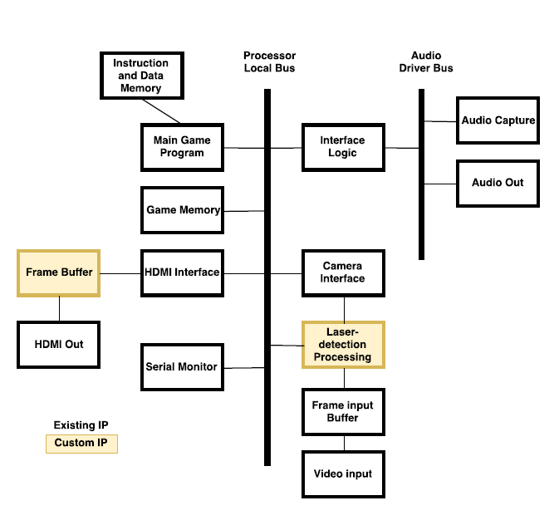
Initial Block Design
Originally envisioned HDMI video-out display
Game memory implemented with DDR4 to be used with VDMA
Laser detection planned with feedback to camera interface
Audio capture intended for user voice commands interfaced along with background music output
Serial monitor used for USB-UART connections from user
Fig. 1) Initial System Block Design Envisioned

Slide 5
Final block design
Audio output based on frequency of notes, 60 bpm hardware note and tune selection to loop music
Game logic, audio output, and serial monitor remains the same or similar to initial block design
Laser IP uses effective thresholds and averaging algorithms for pixel processing
VGA implemented with compositor for video overlay with images from various origins:
Camera Module
Custom Sources:
Score
Timer
Menu Displays
Keyboard to enable interrupts for pausing, restart, other menu navigation features
Compositor sends out final overlapped RGB value
Frame Averaging IP
OV7670
Module
VGA input used for pixel threshold detection
Fig. 2) Final System Block Design Implemented

Slide 6
Design Process – overview
Group Design
Individual Peripherals
Integration
Convergence Phase
Team planning on project ideas, collective brainstorming, and gaining initial familiarity with the IPs and system-level design
Divergence Phase
Design, test, fine-tune each peripheral. Upgraded with one another for latest versions and made modifications (replaced VDMA & Audio In)
Convergence Phase
Create final block design by integrating with the finished peripherals. Built the software controlling game logic and take user inputs.

Slide 7


Reflection – Design summary
Debugging in hardware consumes more time than in software and is more tedious to implement
Shifting the testing and design into software can yield results much faster
Integration between the different components can take a long time since IP upgrades can be buggy and the synthesizing the project can take more than 30 minutes
Using existing IP takes long time to get through documentation, sometimes better to write your own customized IP

Slide 8
ACKNOWLEDGEMENTS
We would like to extend our sincere thanks toward Professor Paul Chow for sharing his knowledge and design expertise throughout the course of this project.
We would also like to thank Daniel Ly-Ma for generously devoting his time and effort in helping us move forward during our design process and providing technical assistance during the lab sessions.
Gratitude also goes toward the ECE department at Univ. of Toronto for allowing us to use lab equipment and providing a nurturing environment for undertaking the project

