Slide 1

Product Recommendation System Using TF-IDF and Cosine Similarity
NAME-CHANDNI WAKIL
ROLL NUMBER-16500222027
REGISTRATION NUMBER-221650110122
PAPER NAME-PROJECT-III
Paper Code-PROJ-CS881
GUIDE NAME-AMIT DUTTA
COLLEGE NAME-ST. THOMAS' COLLEGE OF ENGINEERING AND TECHNOLOGY

Slide 2
The Problem: Too Many Products, Too Little Precision
Modern e-commerce platforms host thousands of products, making it difficult for users to quickly find relevant items. Current search tools fall short.
Large Catalogs
Inaccurate Search
Thousands of SKUs make manual browsing impractical.
Keyword matching fails when similar products use different wording.
Wasted Time
The Need
Users spend excessive time searching instead of discovering.
A smarter, content-aware recommendation system is essential.

Slide 3
Existing System vs. Proposed System
Existing System
Proposed System
Keyword-based search only
Exact word matching
Less accurate results
Time-consuming discovery
Content-Based Recommendation
Understands textual similarity
More relevant recommendations
Faster product discovery
Core Techniques
TF-IDF
Cosine Similarity
Term Frequency–Inverse Document Frequency — converts product descriptions into weighted feature vectors
Measures the angle between vectors to quantify how similar two product descriptions are

Slide 4

Project Objectives
Build a Recommendation Engine
1
Develop a content-based system that recommends products using description similarity.
Improve Product Discovery
2
Reduce user search effort by surfacing relevant items automatically.
Top-5 Recommendations
3
Generate and display the five most similar products for any selected item.
Simple Web Interface
4
Deliver a clean, accessible Flask-based web application for end users.

Slide 5




Technology Stack
Frontend
Backend
HTML · CSS · JavaScript — responsive, user-friendly interface for product selection and results display.
Flask · Python — lightweight web framework handling API logic and recommendation processing.
Libraries
Dataset
Pandas · NumPy · Scikit-learn — data manipulation, numerical computing, and ML vectorization.
Kaggle Product Dataset — real-world product catalog with descriptions, categories, and metadata.

Slide 6
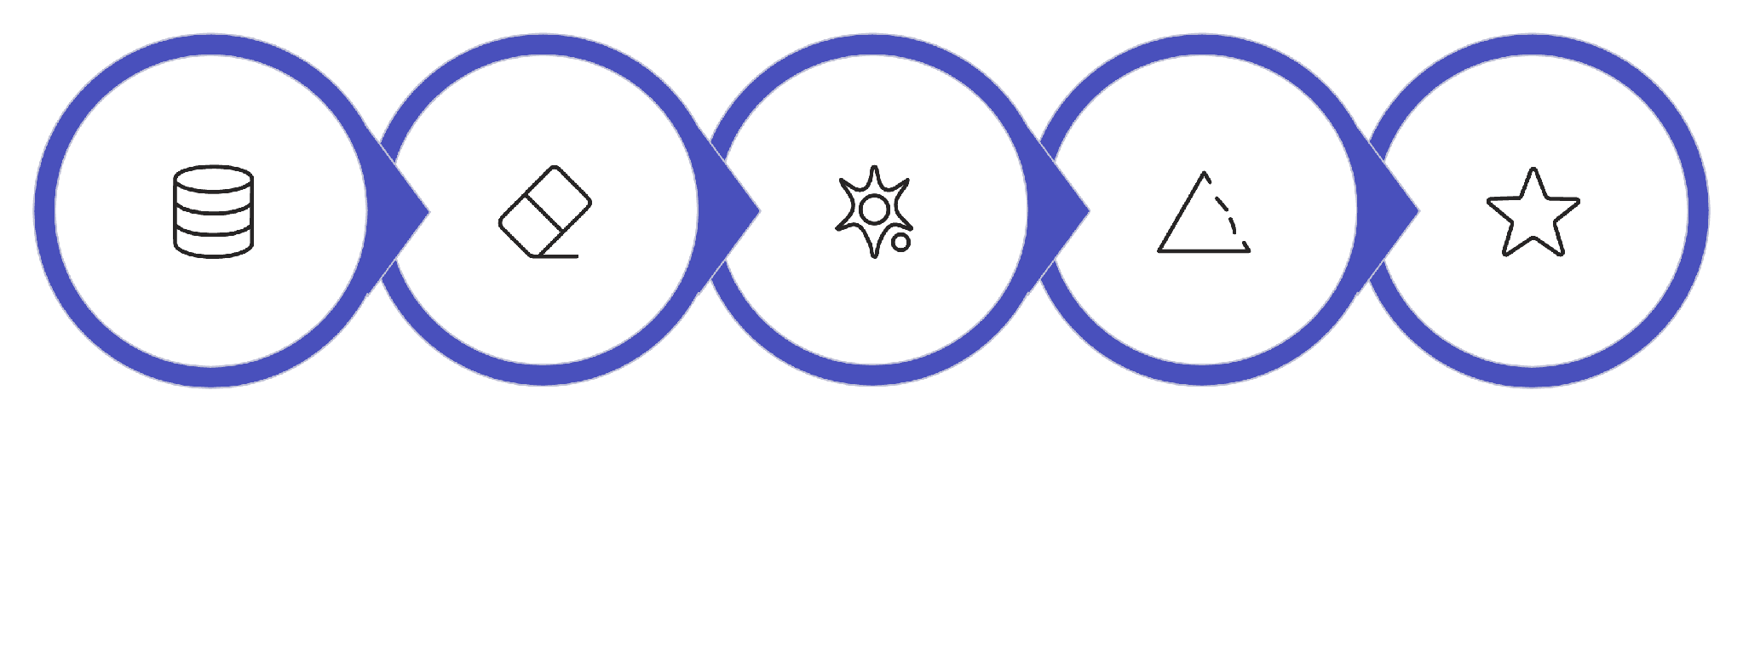
System Workflow
The recommendation pipeline transforms raw product data into ranked, relevant suggestions through six sequential stages.
Preprocess Data
TF-IDF Vectorize
Compute Cosine
Top-5 Recommend
Load Dataset
Each product description is cleaned, vectorized, and compared against the entire catalog — delivering ranked recommendations in seconds.

Slide 7
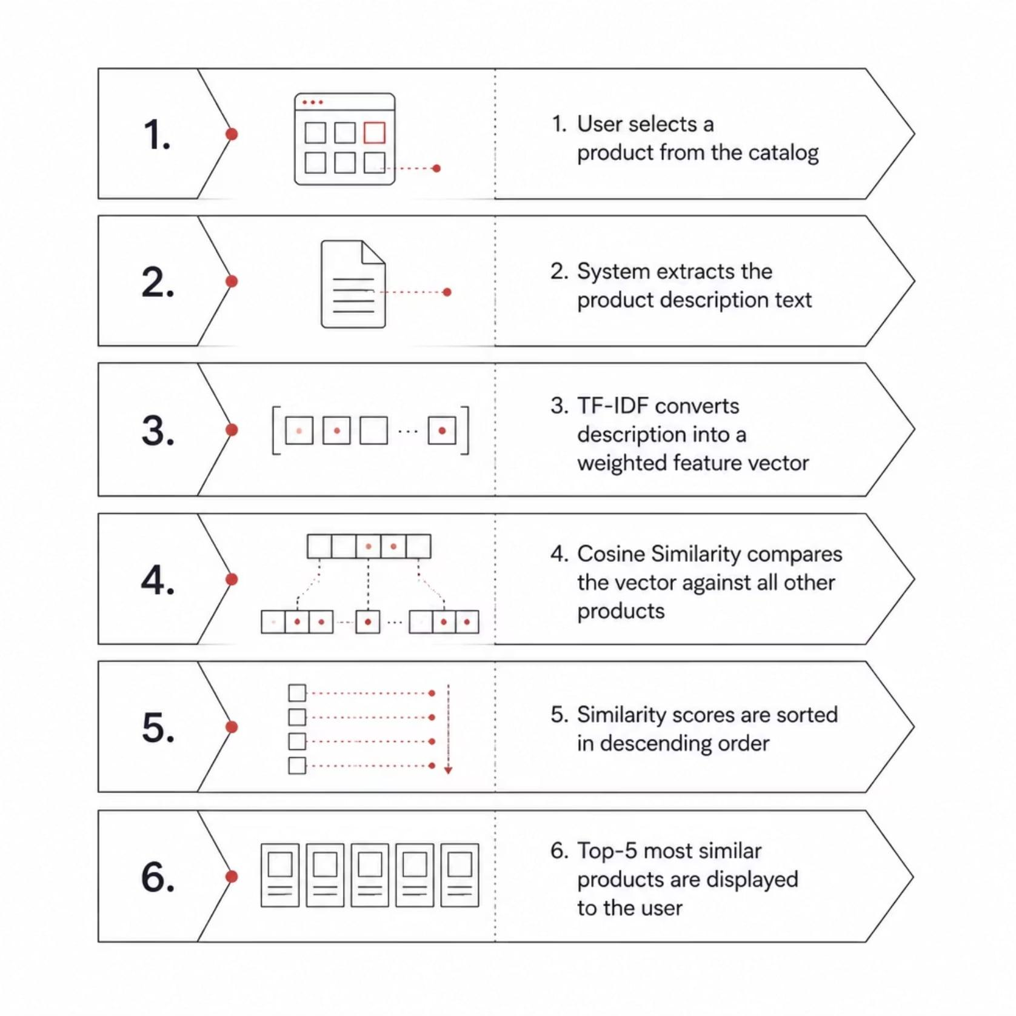
How the Recommendation Engine Works
From Selection to Suggestion
The system operates entirely on product content — no user history or ratings required. TF-IDF captures the uniqueness of each word in a description, while Cosine Similarity quantifies how closely two products align semantically.
This content-based approach works even for new products with no interaction history — solving the cold-start problem.

Slide 8
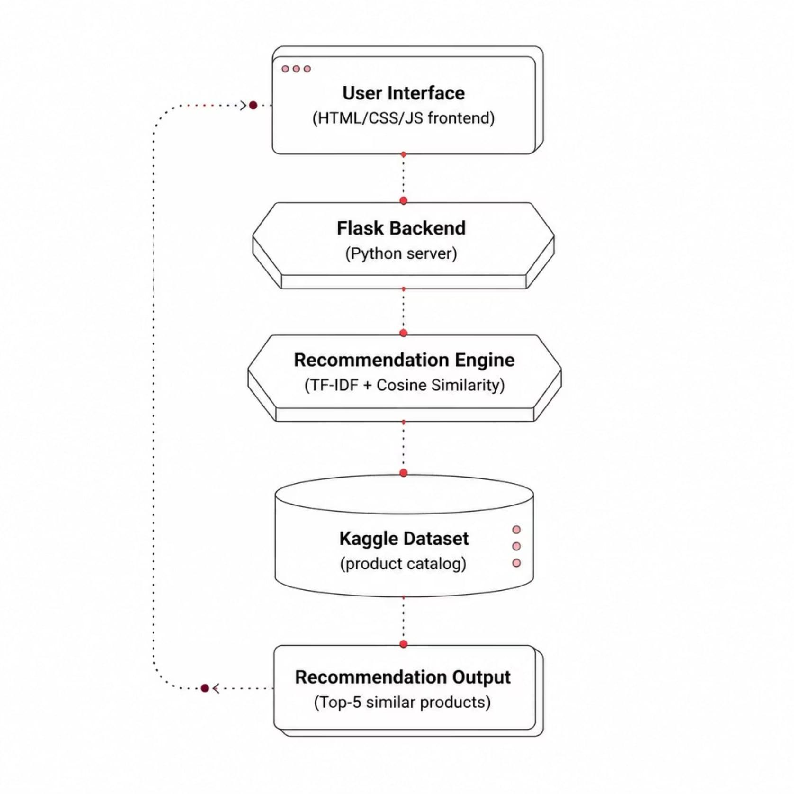

System Architecture
Architecture Layers
User Interface
Flask Backend
Browser-based frontend for product selection and result display.
Python server orchestrating requests and responses.
Recommendation Engine
Kaggle Dataset
Source of product descriptions and metadata.
TF-IDF vectorization and Cosine Similarity computation core.
Recommendation Output
Ranked Top-5 similar products returned to the user.

Slide 9
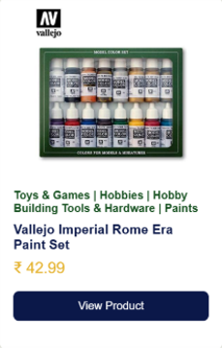
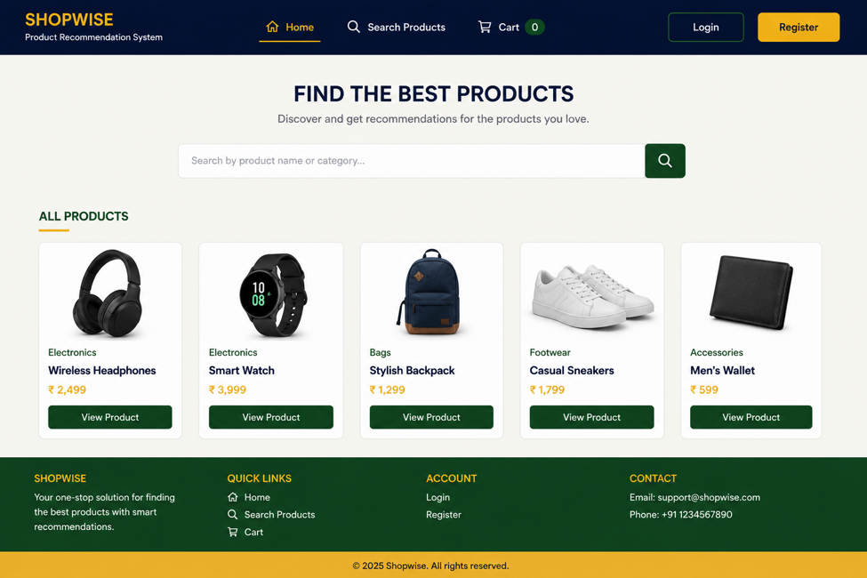
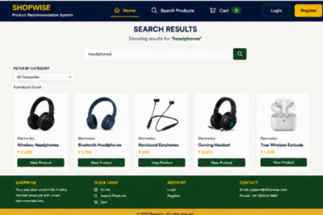
Results & Demonstration
The deployed system successfully generates relevant product recommendations with a responsive, intuitive interface.
Home Page
Product Details
Recommendation Output
Intuitive landing interface allowing users to browse and select products.
Selected product displayed with full description used for similarity matching.
Top-5 similar products ranked and displayed instantly after selection.

Slide 10

Advantages & Applications
Key Advantages
Real-World Applications
No user history required — works purely on product content
E-commerce platforms
Online shopping website
Retail inventory system
Educational projects
Fast generation — lightweight computation, near-instant results
Future Scope
Simple & scalable — easy to implement and extend
Personalization: Integrate user ratings and purchase history.
Advanced NLP: Improve recommendation accuracy.
Enhanced Features: Add search and product filters.
Online Deployment
Improves discovery — surfaces relevant items users might miss

Slide 11
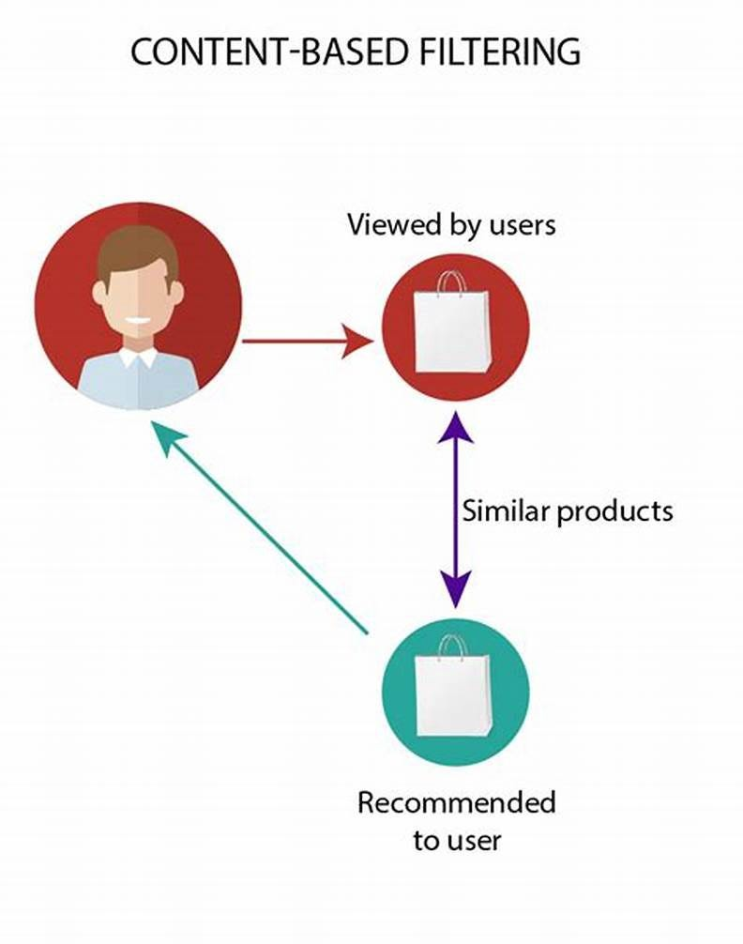
Conclusion
Core Development: Successfully developed a content-based Product Recommendation System using TF-IDF and Cosine Similarity.
Top-5 Recommendations: Recommends the Top-5 similar products without requiring user ratings or purchase history.
Validated Results: Recommendations were manually verified and found to be relevant across different product categories.
Improved Discovery: Enhances product discovery by recommending items with similar textual descriptions.
Practical Implementation: Demonstrates the practical application of Machine Learning, NLP, and Flask in a simple web-based system.

Slide 12
References
[1] Aggarwal, C. C. (2016). Recommender Systems: The Textbook. Springer.
[2] Géron, A. (2019). Hands-On Machine Learning with Scikit-Learn, Keras & TensorFlow (2nd ed.). O'Reilly Media.
[3] Jurafsky, D., & Martin, J. H. (2023). Speech and Language Processing (3rd ed. draft).
[4] Lops, P., de Gemmis, M., & Semeraro, G. (2011). Content-Based Recommender Systems: State of the Art and Trends. In Recommender Systems Handbook. Springer.
[5] Manning, C. D., Raghavan, P., & Schütze, H. (2008). Introduction to Information Retrieval. Cambridge University Press.
[6] Pallets Projects. (2024). Flask Documentation.

