Slide 1

Factory Machine Prediction
GOH KUN MING
P2415691
DAAA/FT/02/1B

Slide 2
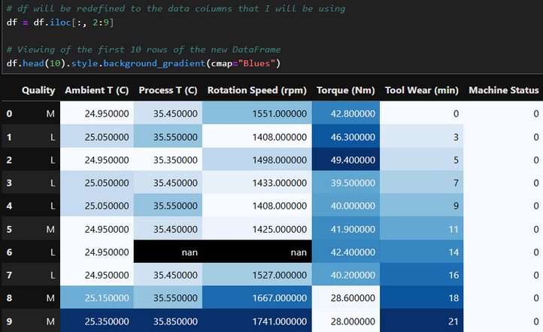
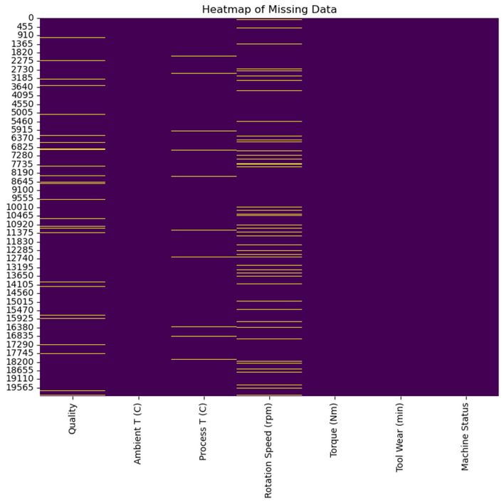
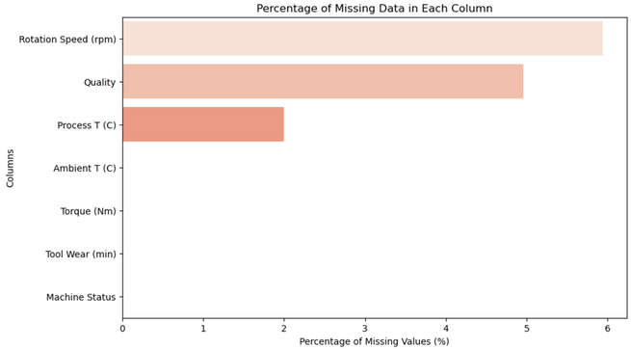
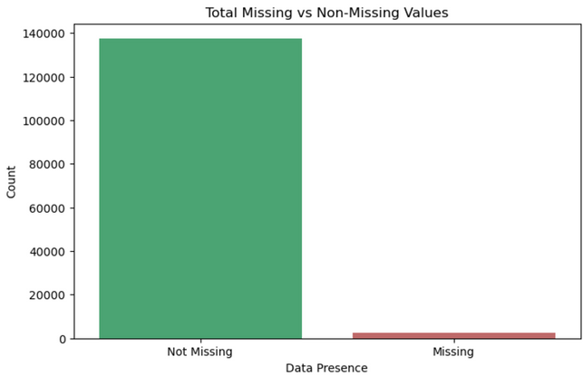
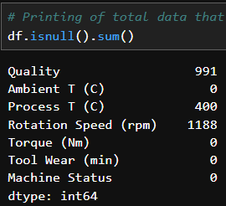
Data Cleaning and Analysis
Dropping Exclusive Data
Missing Data Visualisations
Checking Missing Data

Slide 3
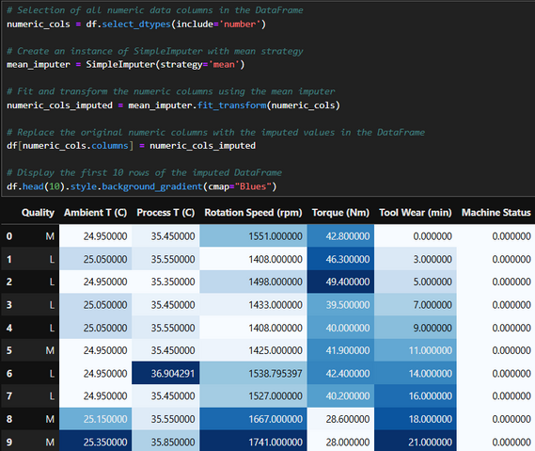
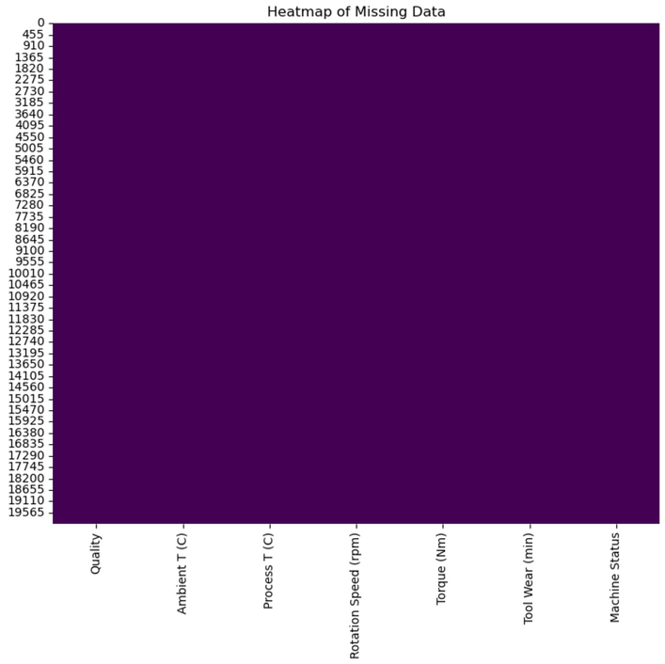
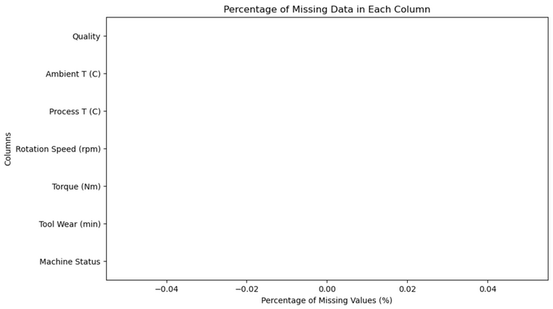
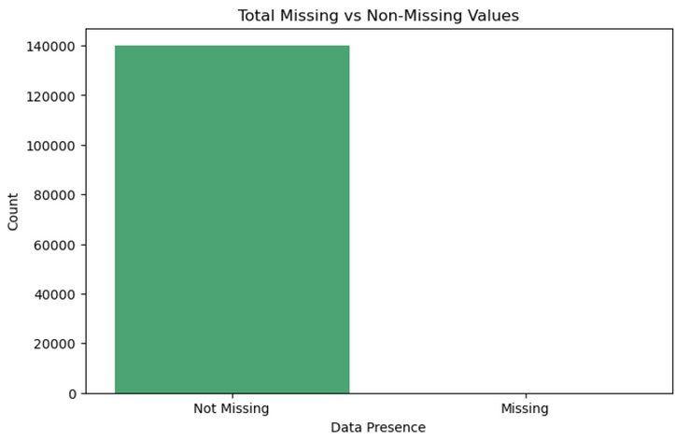
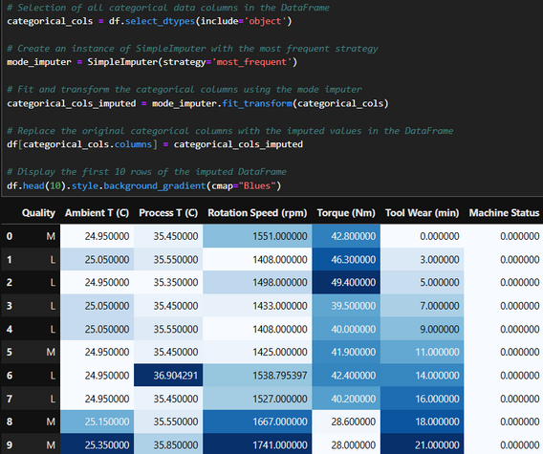

Data Cleaning and Analysis
Imputing Missing Data
Verifying Data’s Presence
Checking Duplicated Data

Slide 4
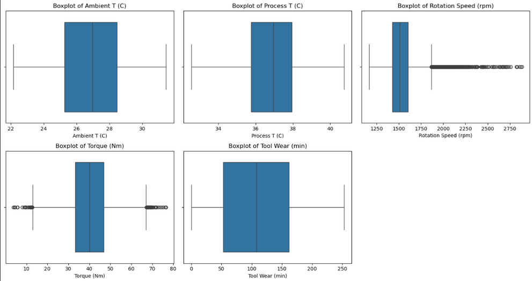
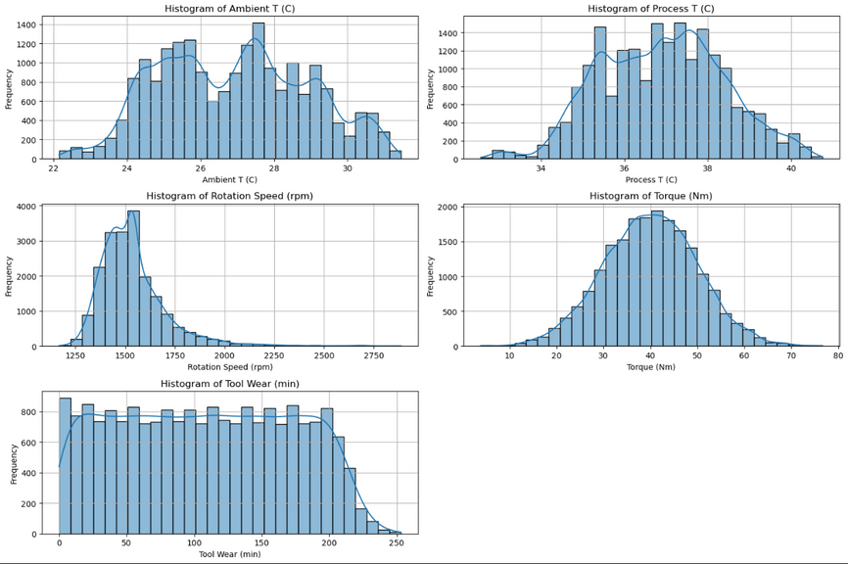
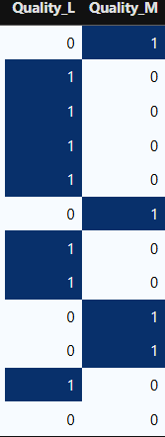

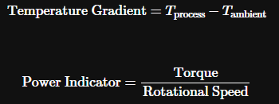
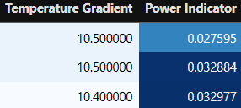
Feature Engineering
Dummy Variables
(For Quality)
Verifying Outliers
Verifying Removal of Some Outliers
New Features

Slide 5

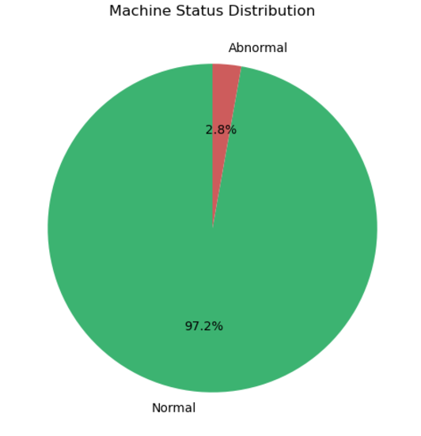
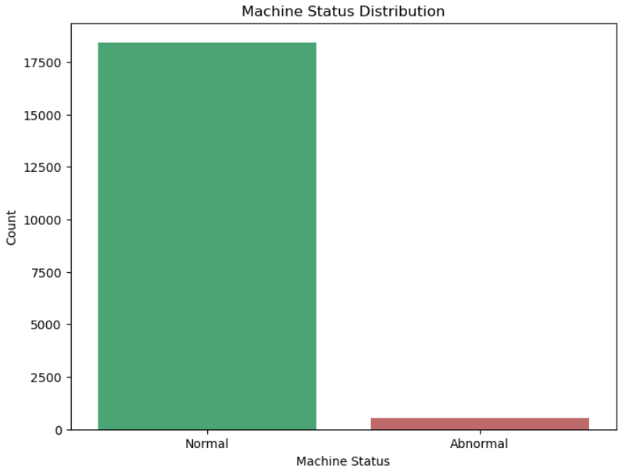
Data Visualisation (Machine Status)

Slide 6
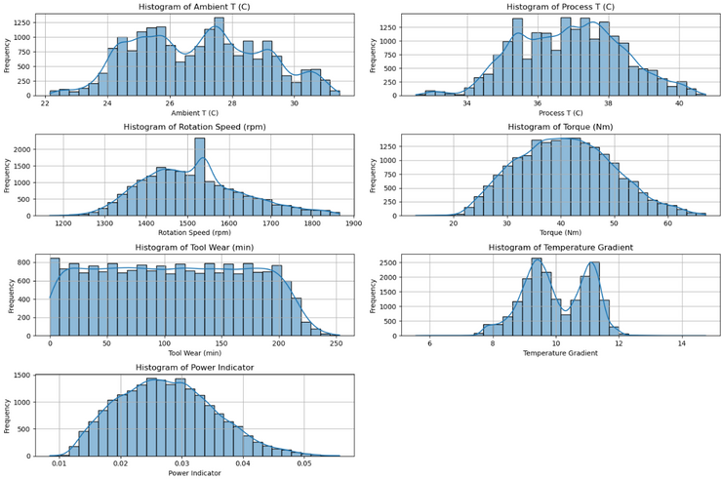
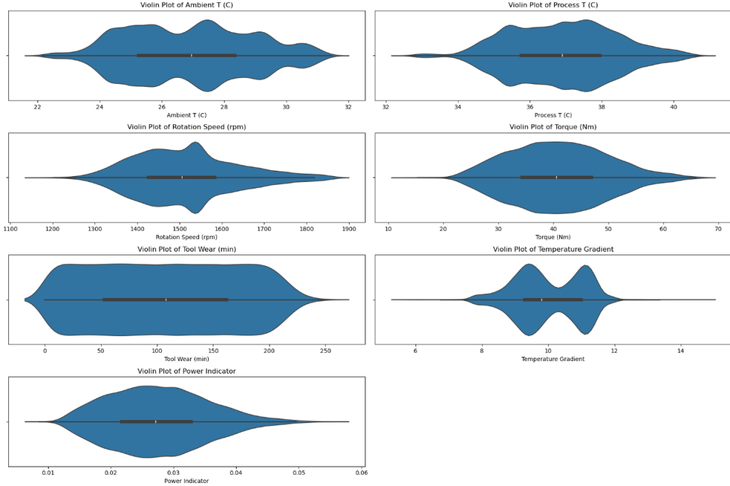
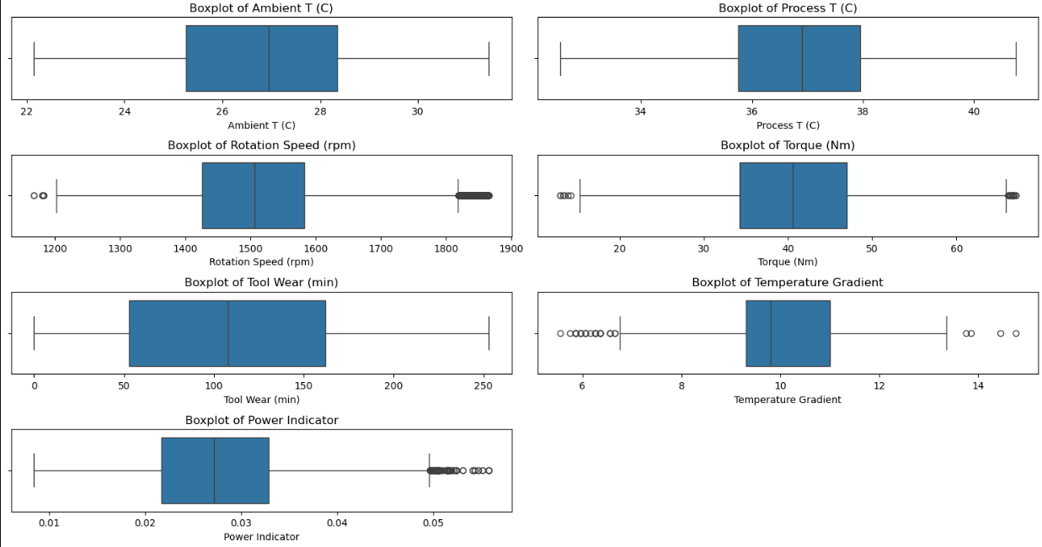
Data Visualisation (Univariate Analysis)
Histograms
Violin Plots
Box Plots

Slide 7
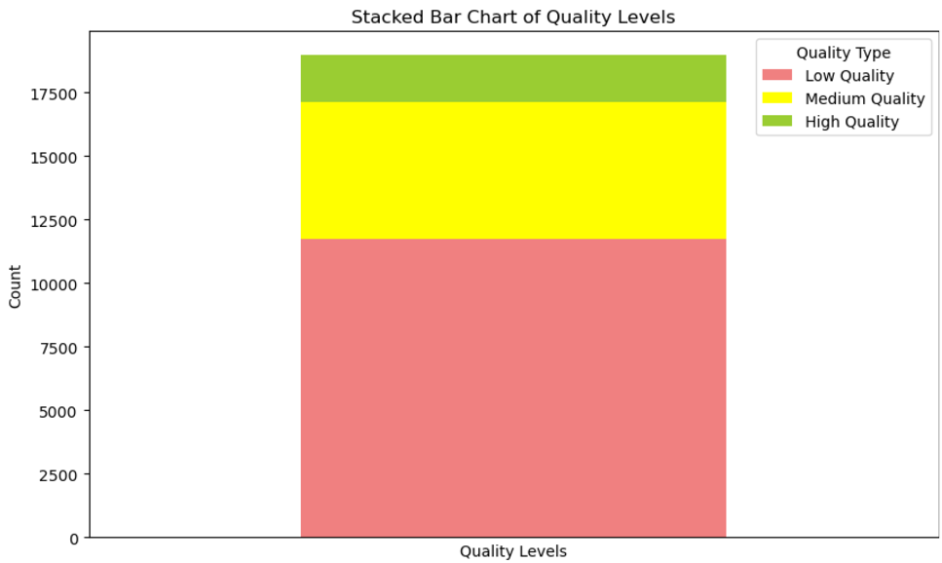
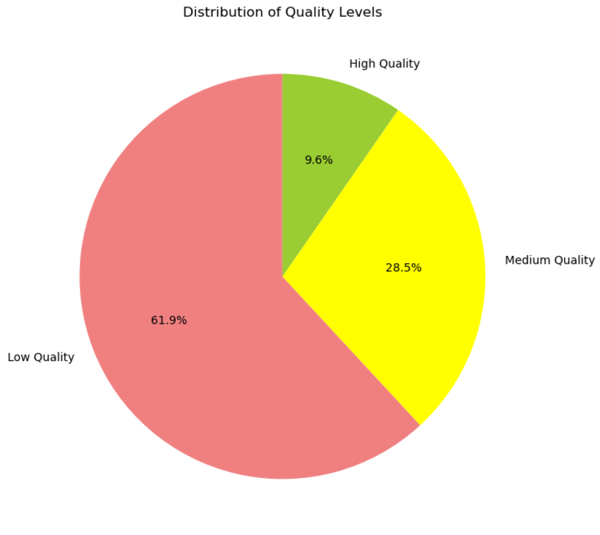
Data Visualisation (Univariate Analysis)
Quality Stacked Bar Chart
Quality Pie Chart

Slide 8
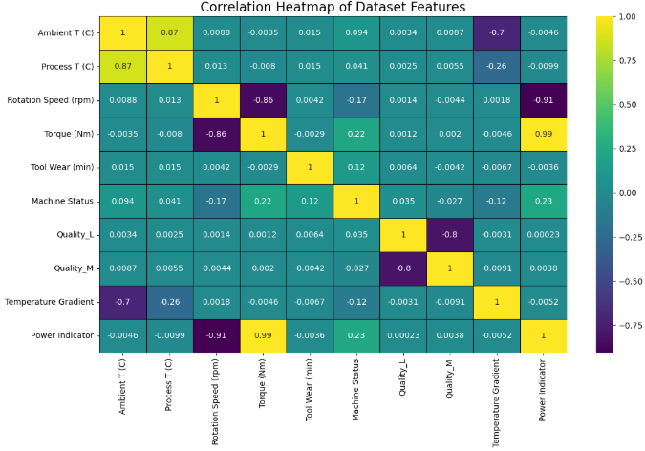
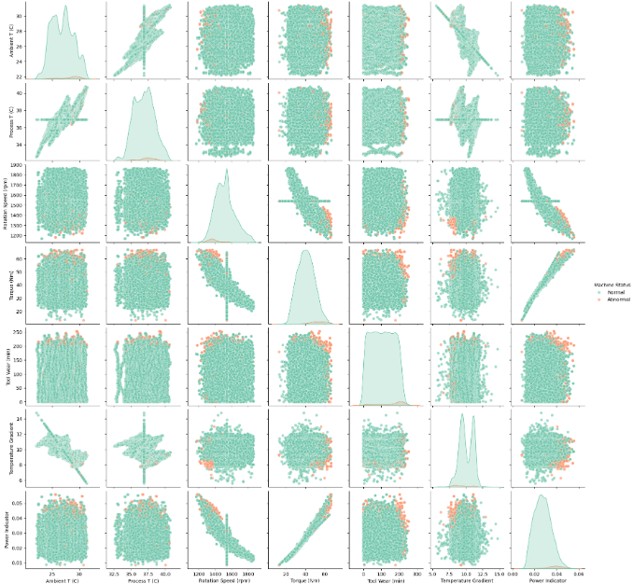
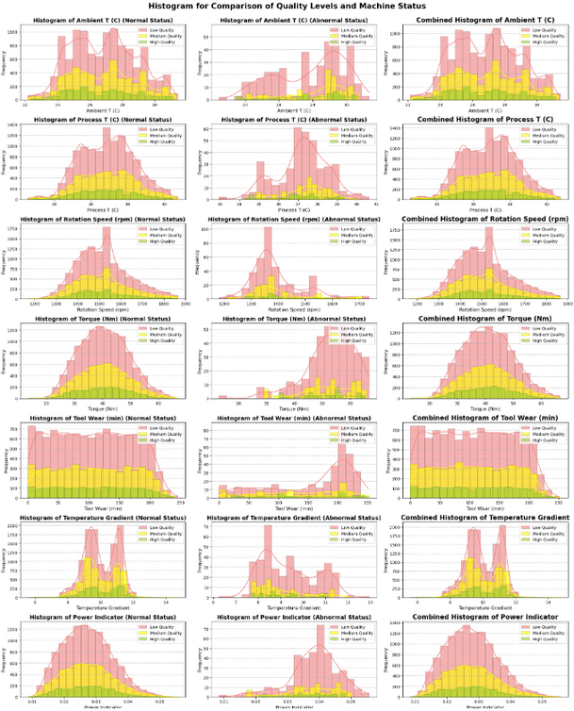
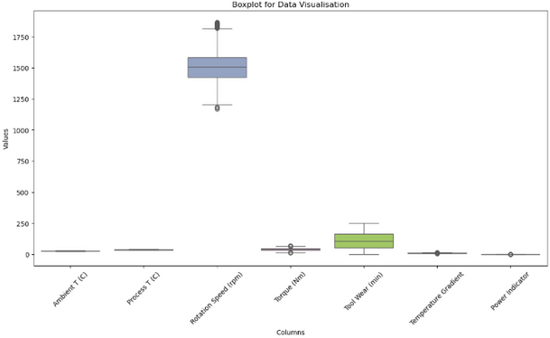
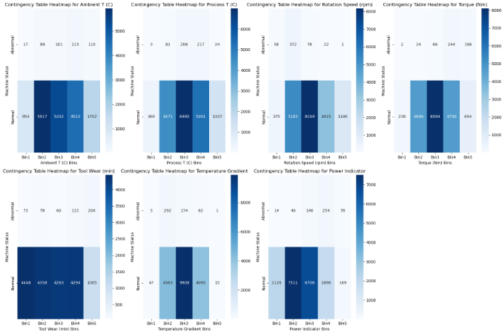
Data Visualisation (Bivariate Analysis)
Correlation Heatmap
Pairplot
Different Quality Relationship with Machine Status
Box Plot
Contingency Table

Slide 9
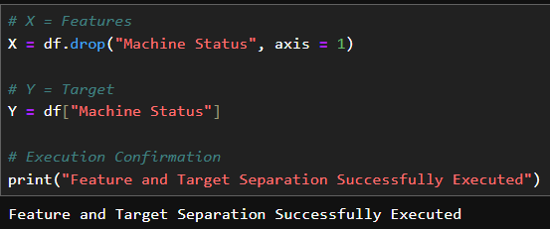


Data Preprocessing and Dummy Baseline
Separation of Feature and Target
Train-Test Split
Dummy Baseline

Slide 10
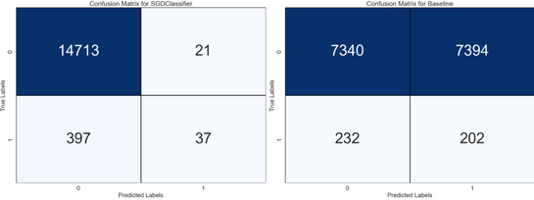
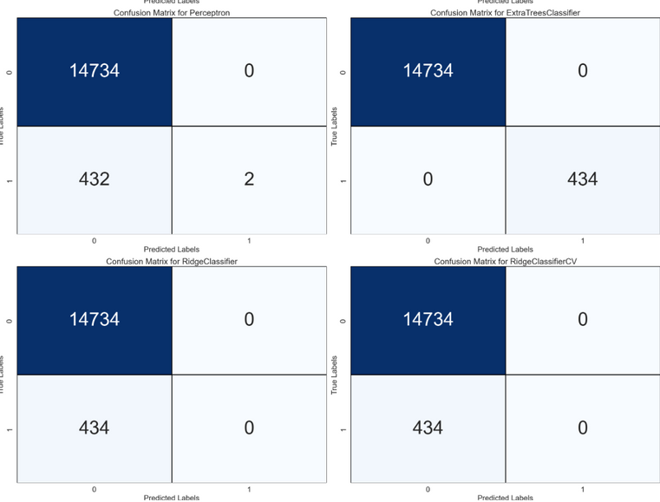
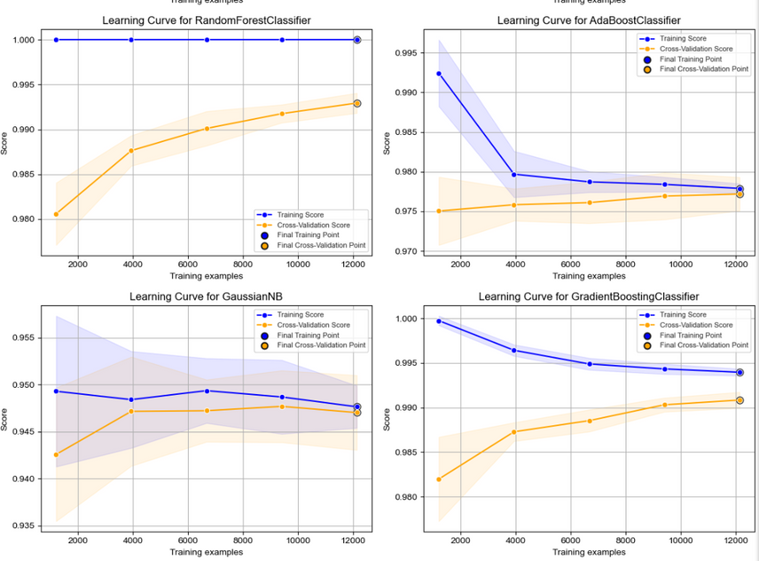
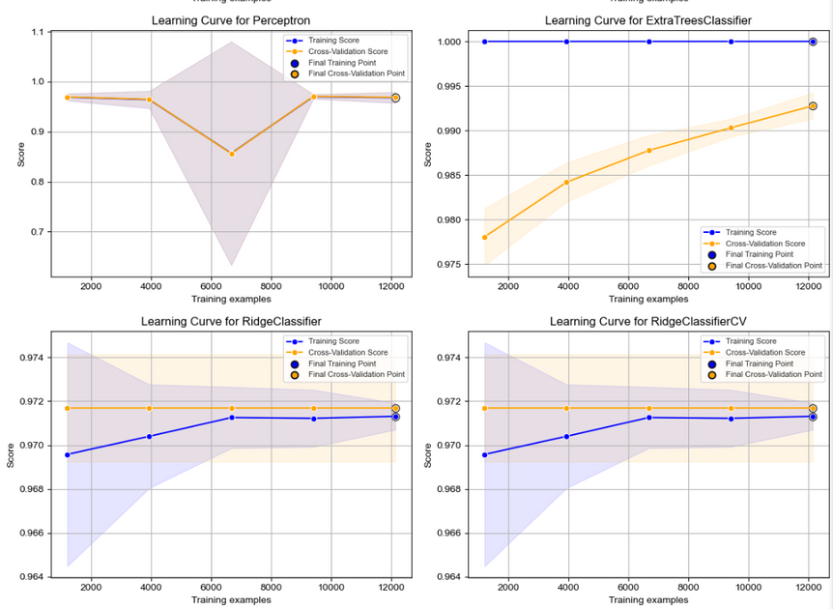
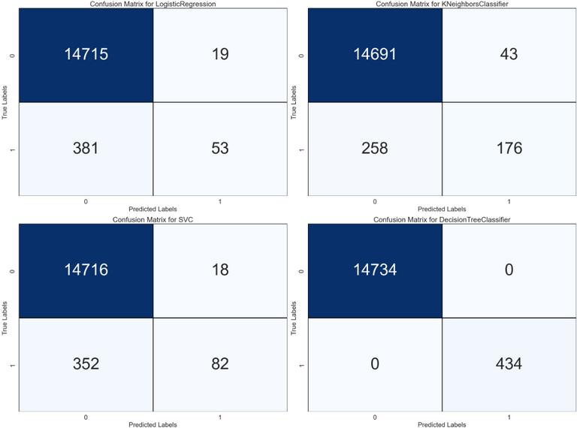
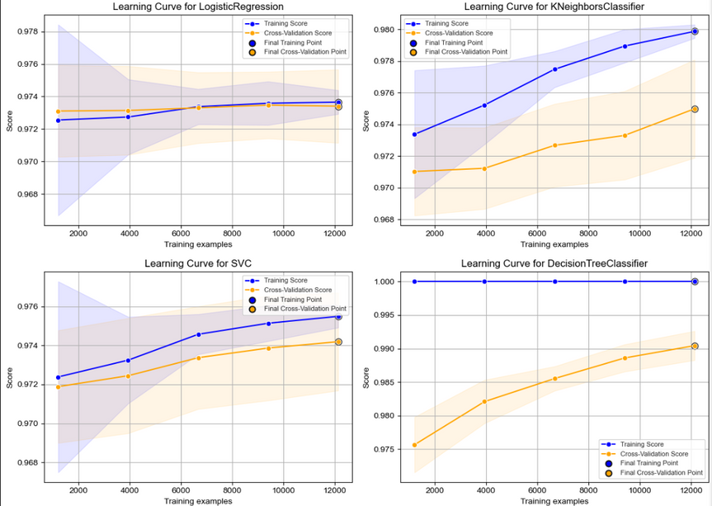
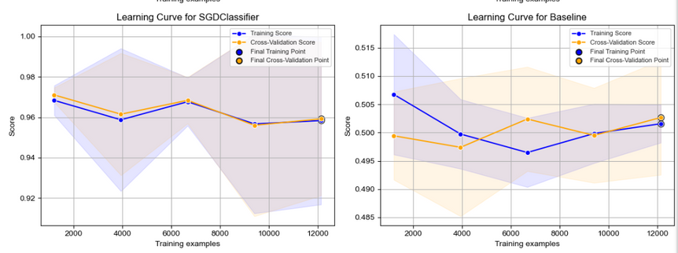
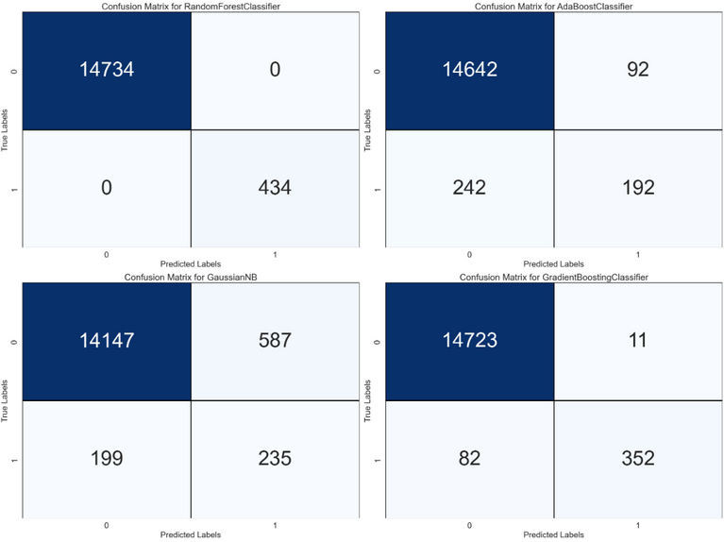
Model Training

Slide 11
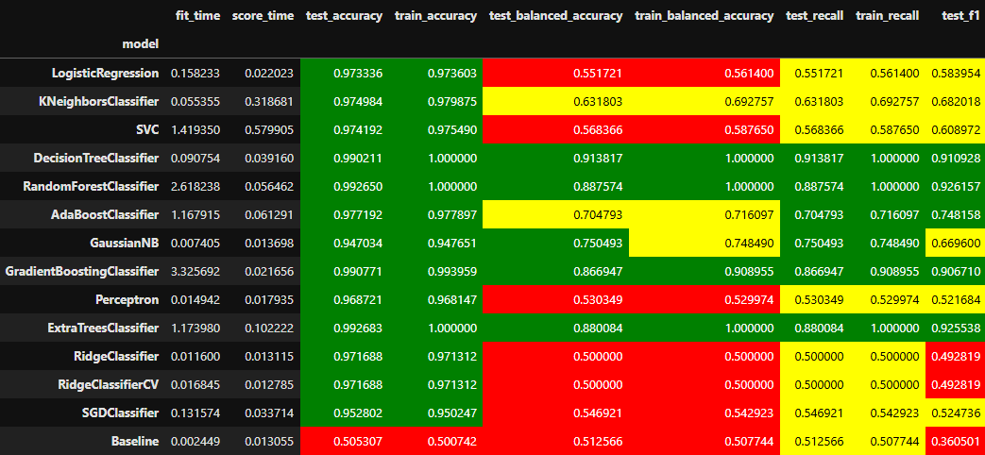
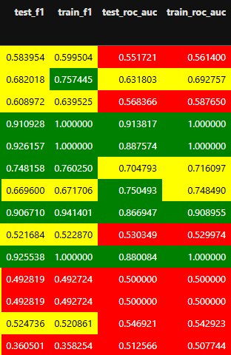
Model Training
Training Scores for All Models

Slide 12
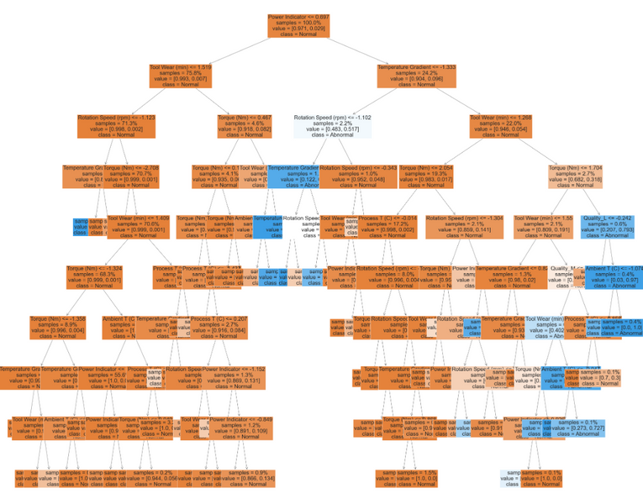
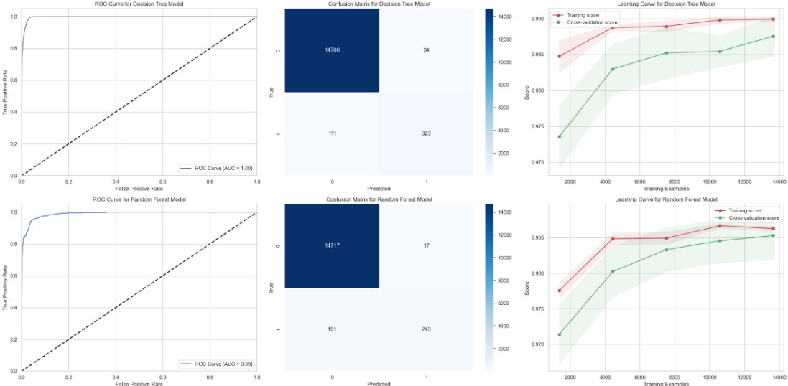

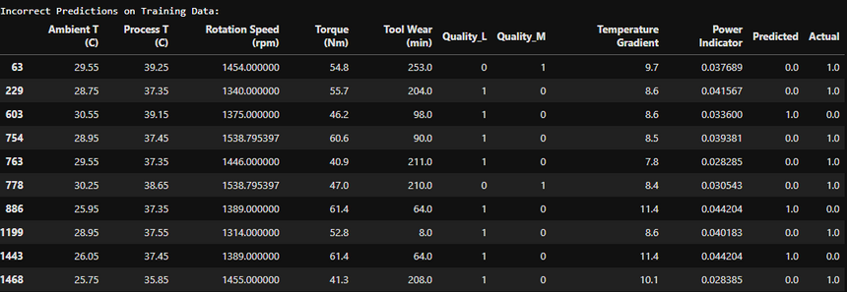
Model Comparison (RFC and DT)
DT:
RFC:
Decision Tree Incorrect Data

Slide 13




Models Selection and Improvement
Logistics Regression
Gradient Booster Classifier

Slide 14




Models Selection and Improvement
AdaBoost Classifier
K Neighbors Classifier

Slide 15

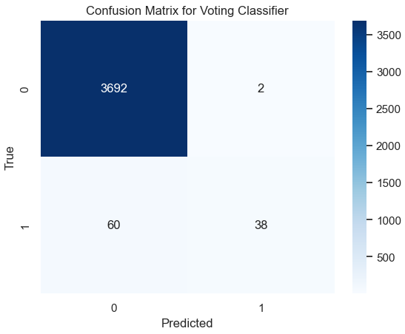
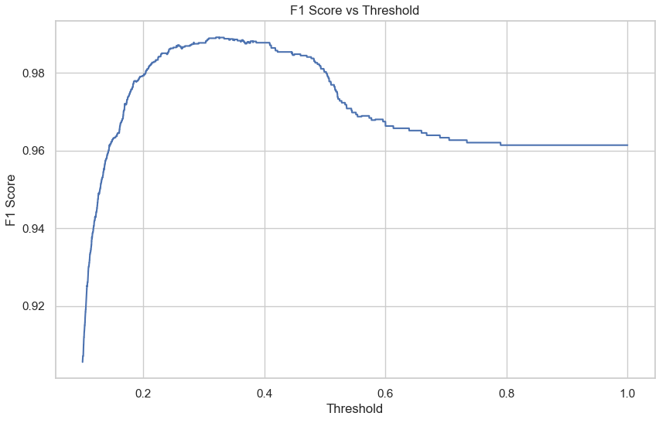
Voting Classifier
Initial Test Results
Initial Confusion Matrix
Threshold Improvement

Slide 16

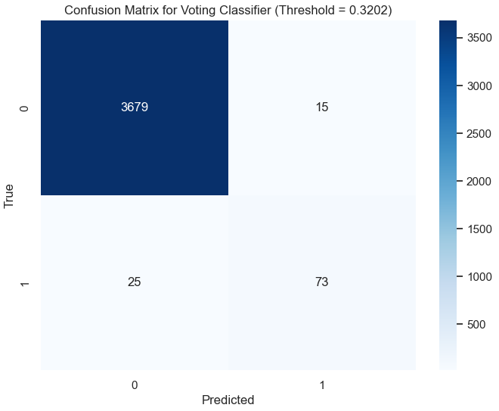
Voting Classifier
Improved Test Result
Improved Confusion Matrix

Slide 17
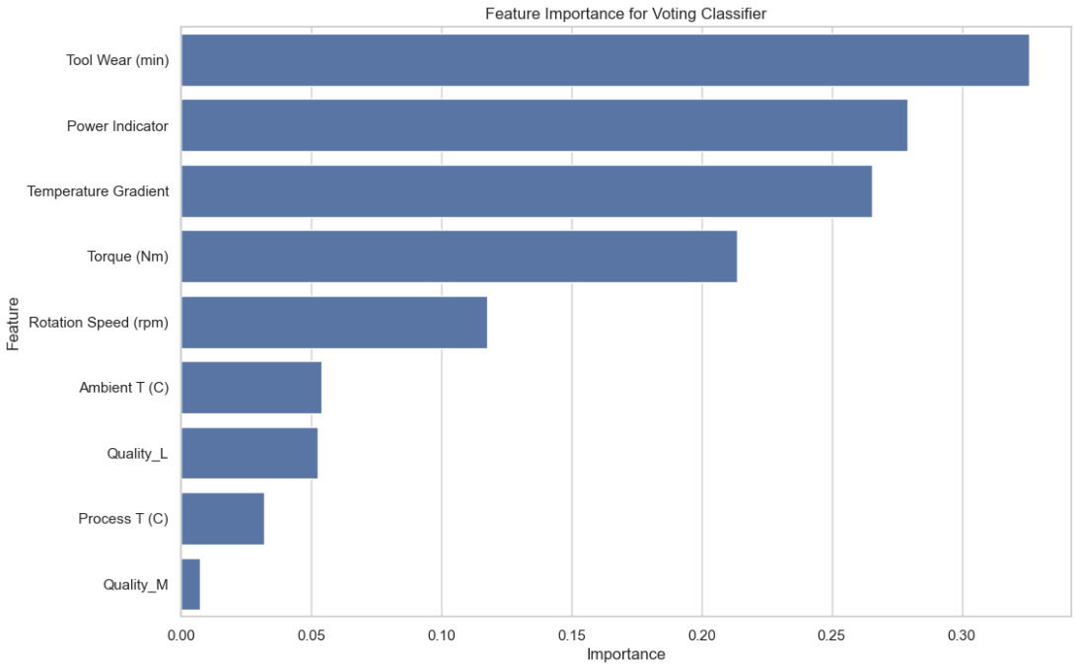
Voting Classifier’s Feature Importance

Slide 18
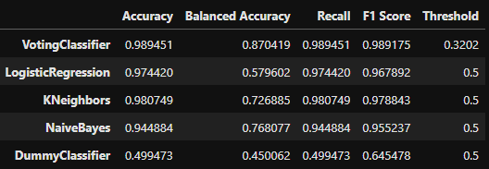
Voting Classifier’s Performance Comparison

Slide 19

Saving of Voting Classifier

Slide 20

Thank you

