Slide 1



Programming for Data Analysis (PDAS)
ST1510
CA1 PROJECT
What factors make job postings more visible and increase application rates, and how can job seekers use these insights to improve their job search?
Name: Goh Kun Ming
Admin No: P2415691
Class: DAAA/FT/1B/02

Slide 2


SUMMARY OF STEPS
Merging Dataframes
Merging Dataframes
All 5 datasets were imported as Dataframes and merged together using Job ID. Subsequently, some Data Columns were dropped.
Imputing Missing Data
Imputing Missing Data
Data Columns with Missing Data were imputed using various techniques such as median, interpolate, etc.
Feature Engineering
Feature Engineering
New Features were created to summarised certain data columns which aided in Data Analysis.
Removing Outliers
Removing Outliers
Outliers from normalised salary were removed using the IQR Method to prevent inaccurate Data Analysis.
Data Analysis & Visualisation
Data Analysis & Visualisation
Data Analysis and Visualisation were conducted on the cleaned data which showed proportions and relationships

Slide 3
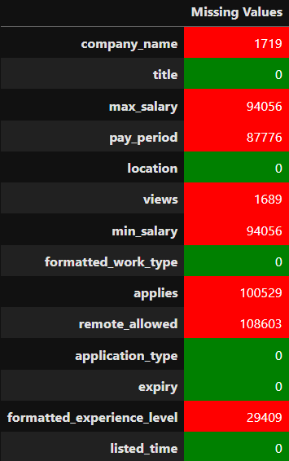
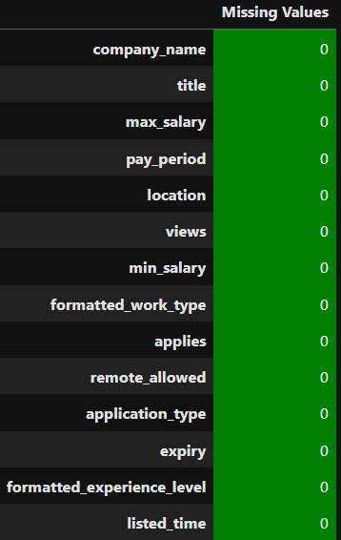
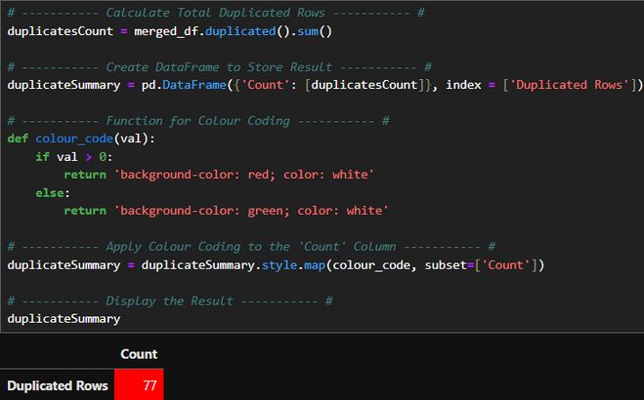
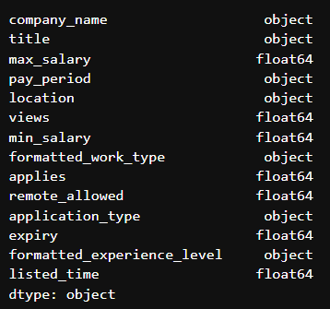

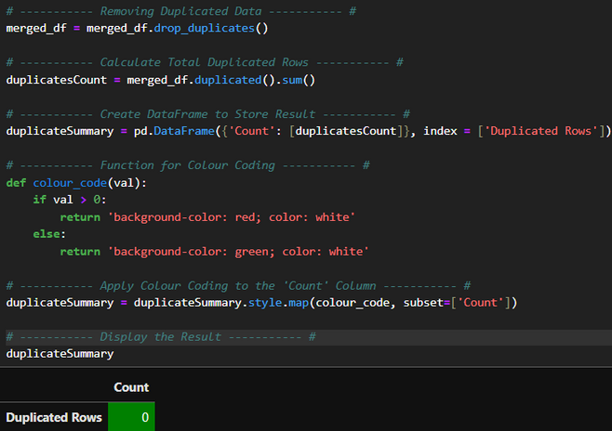
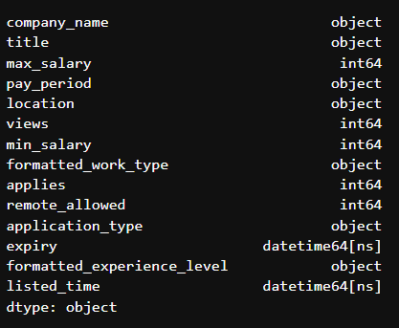
DATA WRAGLING & ANALYSIS USING PANDAS
IMPUTING MISSING DATA
REMOVING DUPLICATED DATA
CORRECTING DATA TYPES

Slide 4
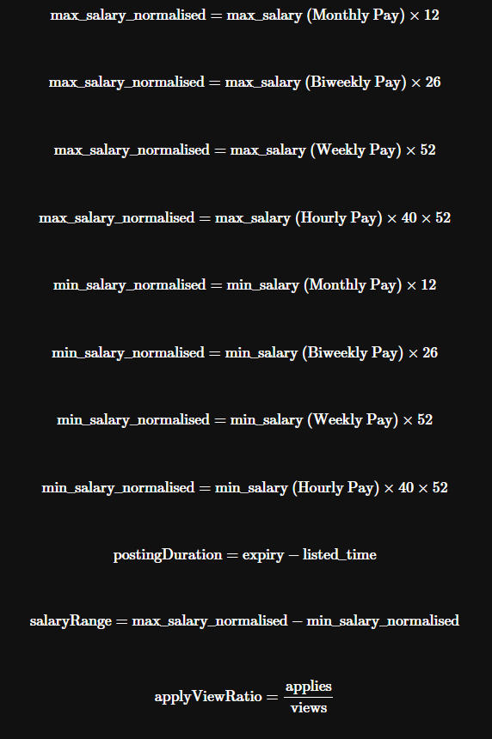
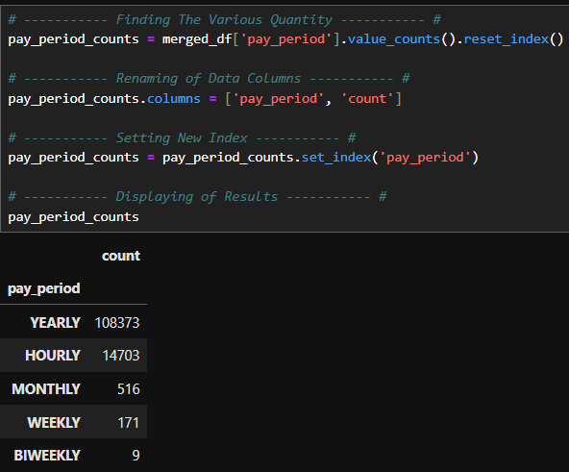


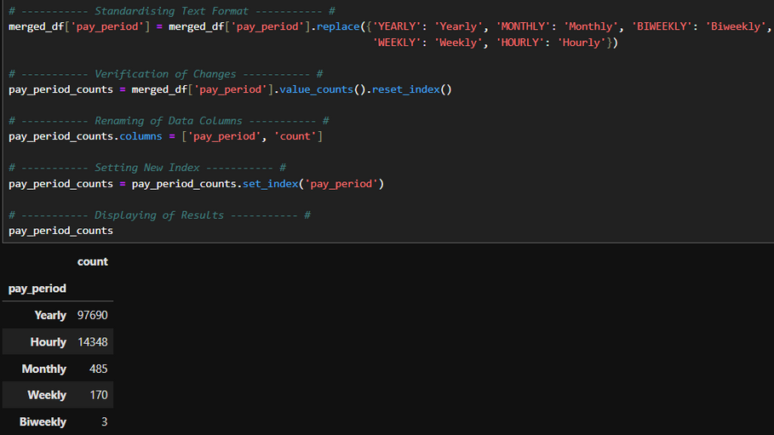
DATA WRAGLING & ANALYSIS USING PANDAS
STANDARDISING FORMAT
FEATURE ENGINEERING

Slide 5
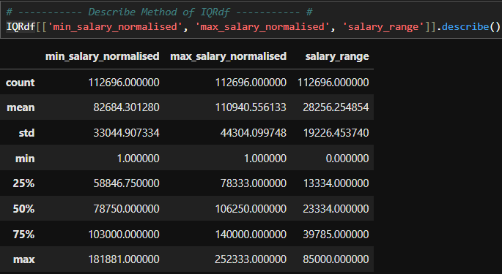
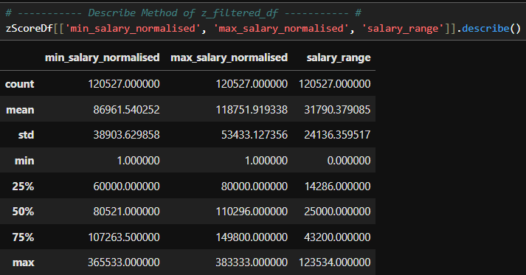

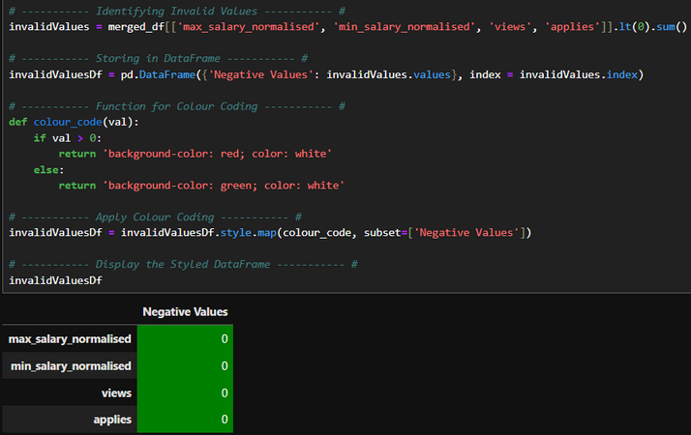
DATA WRAGLING & ANALYSIS USING PANDAS
OUTLIERS REMOVAL (IQR)
OUTLIERS REMOVAL (Z-SCORE)
VALIDATING NUMERICAL DATA

Slide 6
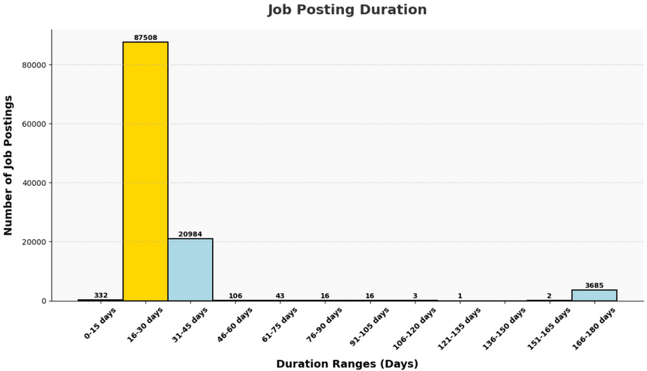
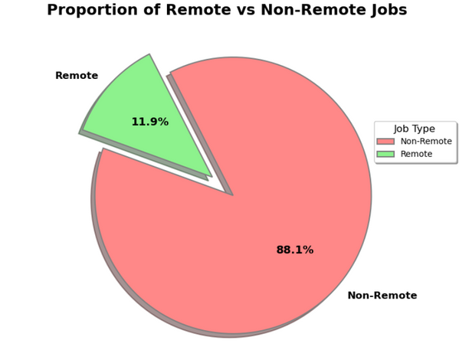
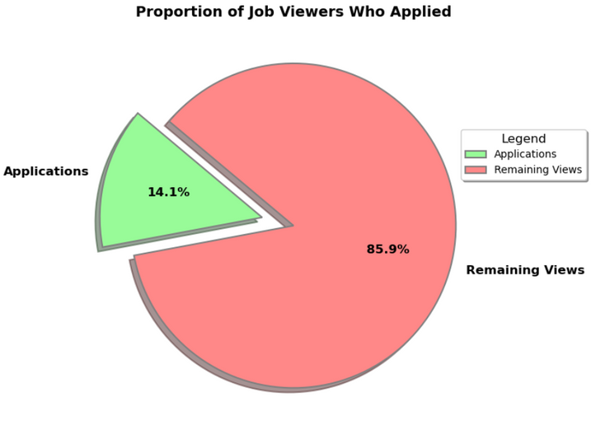
DATA VISUALISATION USING MATPLOTLIB
JOB POSTING DURATION
JOB TYPE PROPORTION
VIEWERS TO APPLICANTS RATIO

Slide 7
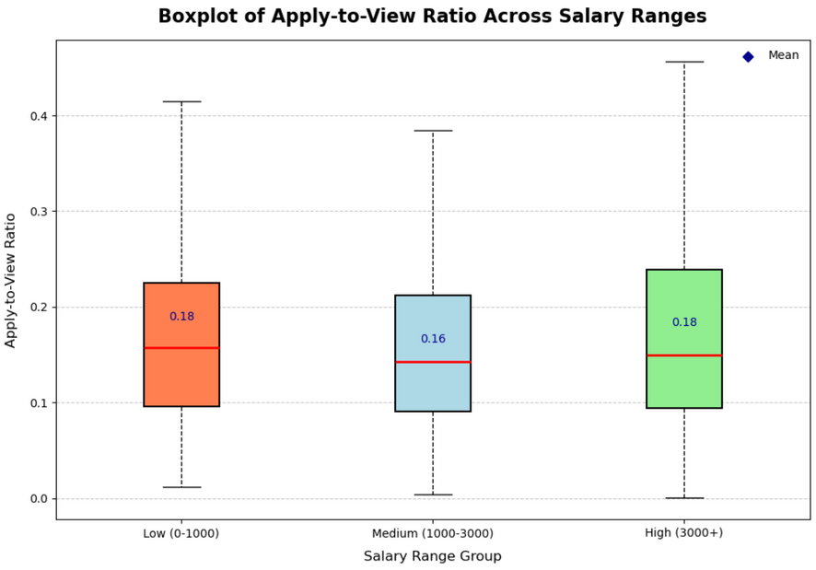
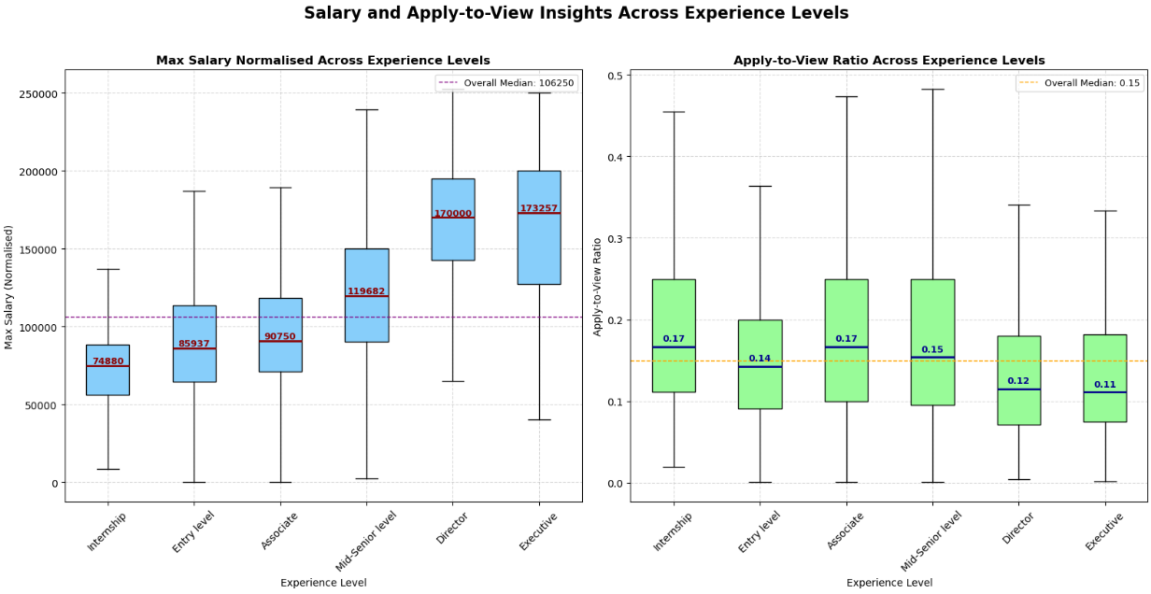
DATA VISUALISATION USING MATPLOTLIB
APPLY-TO-VIEW RATIO ACROSS SALARY RANGES
SALARY INSIGHTS ACROSS EXPERIENCE LEVEL AND APPLY-TO-VIEW RATIO

Slide 8
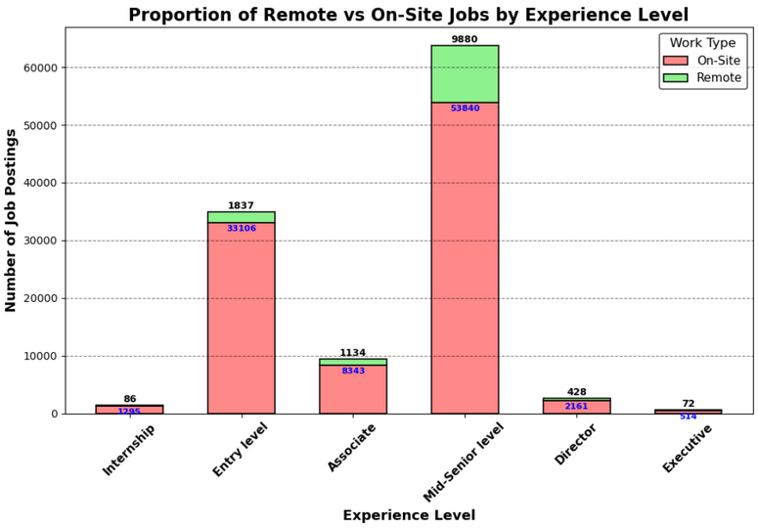
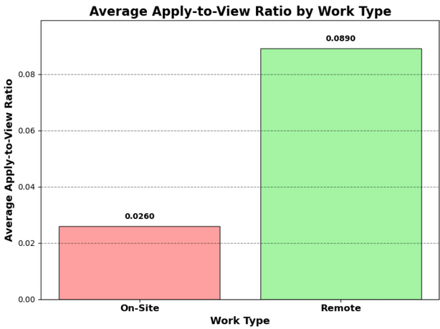
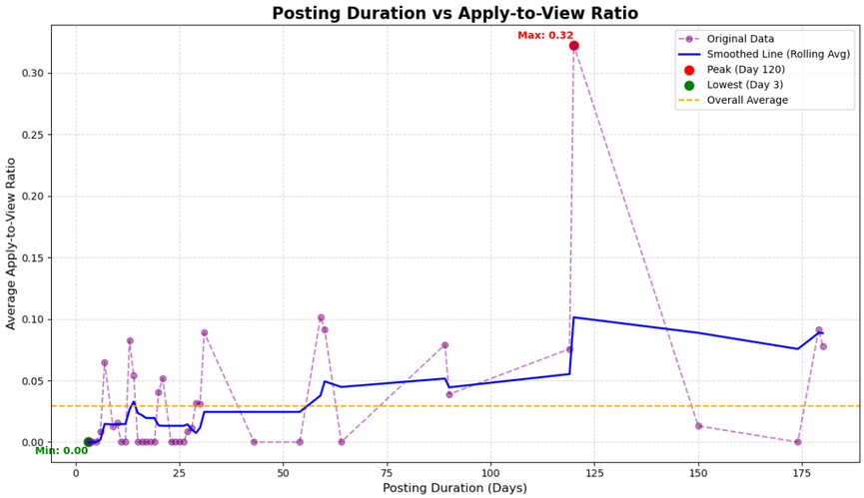
DATA VISUALISATION USING MATPLOTLIB
WORK TYPE PROPORTION ACROSS EXPERIENCE LEVEL
APPLY-TO-VIEW RATIO BY WORK TYPE
POSTING DURATION RELATION TO APPLY-TO-VIEW RATIO

Slide 9
KEY INSIGHTS GATHERED
JOB POSTINGS TYPICALY LAST FOR 1 MONTH
NOT ALL VIEWERS ARE APPLICANTS
VERY FEW COMPANIES OFFER REMOTE WORKING ARRANGEMENTS
LOWER AND HIGHER SALARY RANGE HAS MORE APPLY-TO-VIEW RATIO
HIGHER EXPERIENCE LEVEL POSITIONS PAY MORE BUT HAVE LOWER APPLY TO VIEW RATIO AS COMPARED TO LOWER EXPERIENCE LEVEL POSITION
REMOTE WORK ARE EXTREMELY RARE FOR INTERNSHIP AND HIGHER EXPERIENCE LEVEL POSITIONS DESPITE HIGH DEMAND.
THERE ARE MORE APPLICANTS FOR REMOTE WORK ARRANGEMENT THAN ON-SITE WORK ARRANGEMENT
JOB POSTINGS HAS HIGHEST APPLY-TO-VIEW RATIO ON 120 DAYS OF POSTING DURATION.

Slide 10
THANK
YOU

