Slide 1
Official (Closed), Sensitive (Normal)
DAVI CA2
Goh Kun Ming, Goh Jenson
P2415691, P2401380
DAAA/FT/2B/02

Slide 2
Official (Closed), Sensitive (Normal)
ASSIGNMENT OBJECTIVE
Understand how academic outcomes, engagement, and learning behaviours interact to identify at-risk cohorts and guide targeted support.
Dashboard Link:
localhost:8050
Kun Ming Charts for Grading: A1 (PX), A2, A3, A4 (GO)
Jenson Charts for Grading: B1 (PX), B3, B4, B8(GO)

Slide 3
Official (Closed), Sensitive (Normal)
DATA ISSUES - COURSE CODE AND STUDENT RESULTS
Field Name | No. of Records Affected | Action Taken to Clean the Data
CODE | 7 | Converted ‘int64’ to ’int16’
COURSE NAME | 7 | Converted ‘object’ to ‘string’
All Columns (Duplicates) | 12 | Dropped duplicates
STUDENT ID + PERIOD | 21 | Dropped rows as they violate entity integrity rule
STUDENT ID | 543 | Converted ‘object’ to ‘string’
GPA | 543 | Converted ‘int64’ to ‘float32’
PERIOD | 412 | Standardised (e.g. Sem1, Sem 1 -> Semester 1), Converted ‘object’ to ‘string’
Attendance | 543 | Converted ‘int64’ to ‘int16’

Slide 4
Official (Closed), Sensitive (Normal)
Data Issues – Student Survery
Field Name | Number of Records Affected | Action Taken to Clean the Data
All Columns (Duplicates) | 12 | Dropped duplicates
STUDENT ID | 531 | Converted ‘object’ to ‘string’
PERIOD | 423 | Standardised (e.g. Sem1, Sem 1 -> Semester 1), Converted ‘object’ to ‘string’
PRIOR KNOWLEDGE | 531 | Converted ‘int64’ to ’int8’
COURSE RELEVANCE | 531 | Converted ‘int64’ to ’int8’
TEACHING SUPPORT | 531 | Converted ‘int64’ to’int8’
COMPANY SUPPORT | 531 | Converted ‘int64’ to ’int8’
FAMILY SUPPORT | 531 | Converted ‘int64’ to ’int8’
SELF-STUDY HRS | 531 | Converted ‘int64’ to ’int8’

Slide 5
Official (Closed), Sensitive (Normal)
Data Issues – Student Profile
Field Name | Number of Records Affected | Action Taken to Clean the Data
All Columns (Duplicates) | 10 | Dropped duplicates
STUDENT ID | 2 | Dropped Duplicates Converted ‘object’ to ‘string’
GENDER | 297 | Converted ‘object’ to ‘string’
SG CITIZEN | 39 | Converted missing values to ‘N’ Converted ‘object’ to ‘string’
SG PR | 275 | Converted missing values to ‘N’ Converted ‘object’ to ‘string’
FOREIGNER | 271 | Converted missing values to ‘N’ Converted ‘object’ to ‘string’
COUNTRY OF OTHER NATIONALITY | 151 | Converted missing values to ‘N.A.’ Converted ‘Malaysian’ to ‘Malaysia’ Converted ‘object’ to‘string’
DOB | 297 | Converted ‘object’ to ‘string’
HIGHEST QUALIFICATION | 1 | Filled missing value with the mode Converted ‘object’ to ‘string’
NAME OF QUALIFICATION AND INSTITUTION | 153 | Standardised (e.g. O’ level à O’ Level) Converted ‘object’ to ‘string

Slide 6
Official (Closed), Sensitive (Normal)
Data Issues – Student Profile
Field Name | Number of Records Affected | Action Taken to Clean the Data
DESIGNATION | 59 | Standardised (e.g. HR/Admin, HR & ADMIN to HR & Admin) Converted ‘object’ to ‘string’
COMMENCEMENT DATE | 5 | Converted missing values to ‘N.A.’
COMMENCEMENT DATE | 18 | Standardised (e.g. '10th Apr 2023’ to '2023-04-10’)
COMPLETION DATE | 20 | Converted missing values to ‘N.A.’
COMPLETION DATE | 15 | Standardised (e.g. '15th Sep 2025’ to '2025-9-15’)
FULL-TIME OR PART-TIME | 28 | Standardised (e.g. ‘Part Time’ to ‘Part-Time’)
COURSE FUNDING | 26 | Standarised (e.g. 'Sponsored-no SDF’ , 'Sponsored - SDF’ , 'Sponsored - no SDF’ to 'Sponsored’) Converted ‘object’ to ‘string’

Slide 7
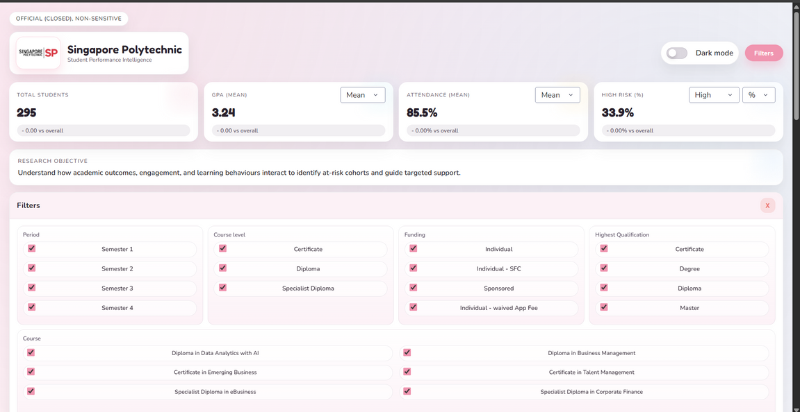
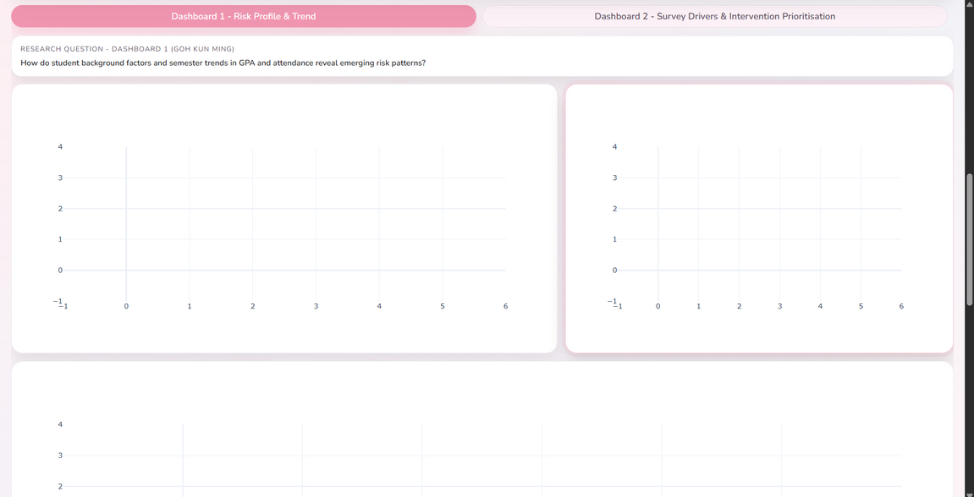
Official (Closed), Sensitive (Normal)
DASHBOARD TEMPLATE

Slide 8
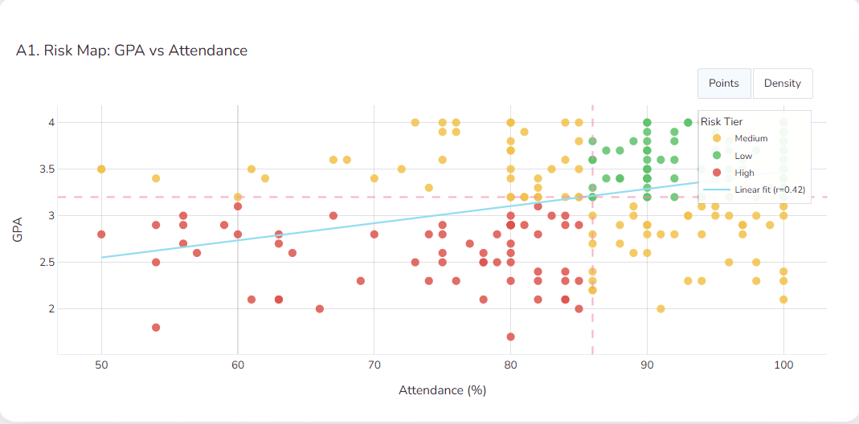
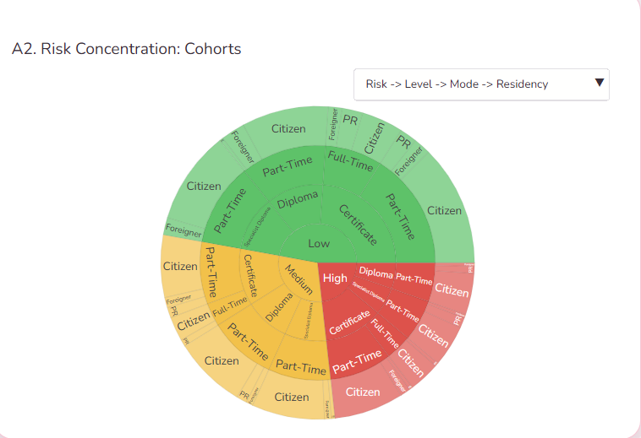
Official (Closed), Sensitive (Normal)
KUN MING CHART INSIGHTS
A1: Risk Map – GPA vs Attendance
Attendance and GPA show a moderate positive relationship (r ≈ 0.42), but attendance alone does not explain performance.
Low-risk students cluster at high attendance and high GPA, showing effective conversion of engagement into results.
High-risk students include not only low-attendance cases, but also students with adequate attendance yet low GPA, indicating hidden academic risk.
Medium-risk students form a broad middle band and represent the best group for early intervention.
Takeaway:
Attendance is a useful filter, but GPA must be monitored even when attendance is acceptable to avoid missing at-risk students.
A2: Risk Concentration – Cohort Sunburst
Academic risk is unevenly concentrated in specific cohort combinations rather than evenly spread.
Part-time pathways appear more frequently in medium- and high-risk segments, suggesting structural constraints.
Risk increases through interactions between qualification level, study mode, and residency, not single factors.
Medium-risk cohorts dominate several pathways, offering strong prevention leverage.
Takeaway:
Target interventions at high-risk cohort intersections, not the entire student population, to maximise impact.

Slide 9
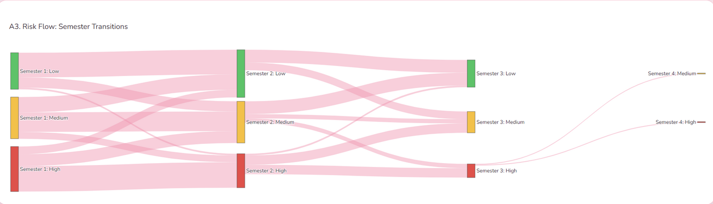
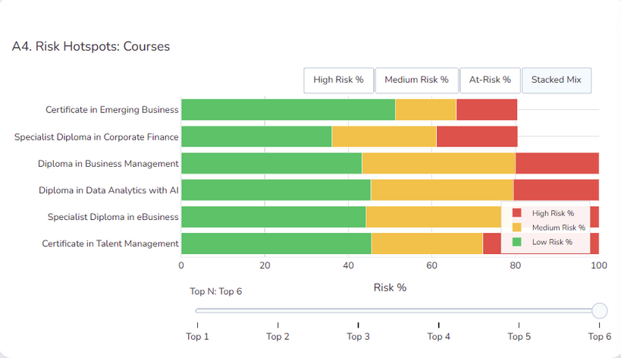
Official (Closed), Sensitive (Normal)
KUN MING CHART INSIGHTS
A3: Risk Flow – Semester Transitions
Most students remain in the same risk tier across semesters, showing strong risk persistence.
High-risk students rarely transition directly to low risk, indicating recovery is gradual.
Medium risk acts as a transition state, with movement both upward and downward.
Small but visible escalation into high risk suggests missed early intervention windows.
Takeaway:
Early action in Semester 1–2 is critical to prevent long-term entrenchment in high risk.
A4: Risk Hotspots – Courses
Risk is concentrated in specific courses, not evenly distributed.
Several programmes show large medium-risk proportions, signalling vulnerability rather than failure.
High-risk percentages vary by course, indicating programme-level structural effects.
Low-risk dominance in some courses suggests transferable best practices.
Takeaway:
Prioritise course-level interventions, starting with programmes where medium and high risk dominate.

Slide 10
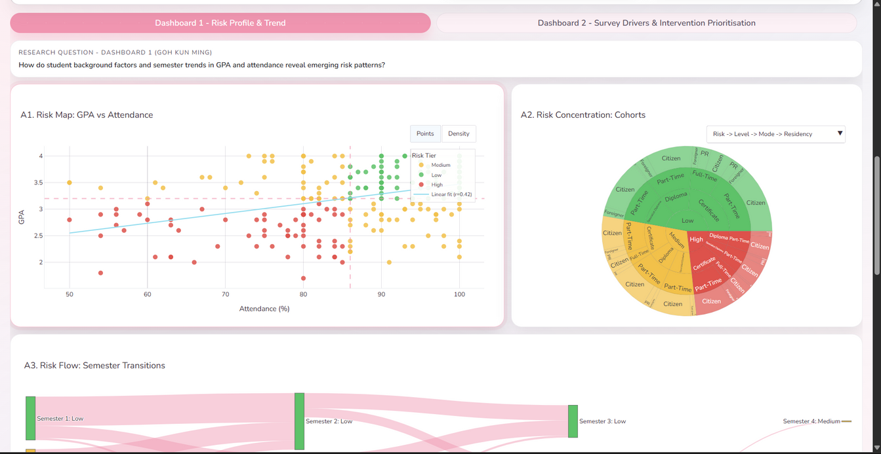
Official (Closed), Sensitive (Normal)
KUN MING DASHBOARD INSIGHTS
Across the dashboard, a consistent pattern emerges: academic risk is driven by the interaction of performance, engagement, background factors, and time, rather than any single variable.
While attendance is positively associated with GPA, multiple charts show that attendance alone does not guarantee good outcomes, revealing a group of students with hidden academic risk.
Risk trajectories are sticky across semesters—students who enter medium or high risk tend to remain there, indicating that delayed intervention reduces recovery potential.
Risk is unevenly distributed across cohorts and courses, suggesting that structural and contextual factors (e.g. study mode, course design) amplify individual risk.
Medium-risk students appear consistently as a transition group, representing the strongest opportunity for early, preventative support.
Overall, the dashboard highlights that effective risk management requires early, targeted, and cohort-aware interventions, rather than broad, attendance-focused monitoring.

Slide 11
Official (Closed), Sensitive (Normal)
KUN MING RECOMMENDATIONS
1) High effort but low GPA (Hidden risk)
Run targeted study-skills workshops (active recall, assessment strategies) and offer short academic consultations to diagnose learning gaps beyond attendance.
2) Medium-risk students (Prevention focus)
Intervene early in Semester 1–2 with check-ins, peer mentoring, and light academic coaching before risk escalates.
3) Persistent risk across semesters
Track risk trajectories over time and escalate support for students who remain medium/high risk across multiple semesters.
4) High-risk courses and constrained cohorts
Prioritise course-level support (clearer rubrics, pacing review) and flexible, asynchronous help for part-time or higher-constraint students.

Slide 12
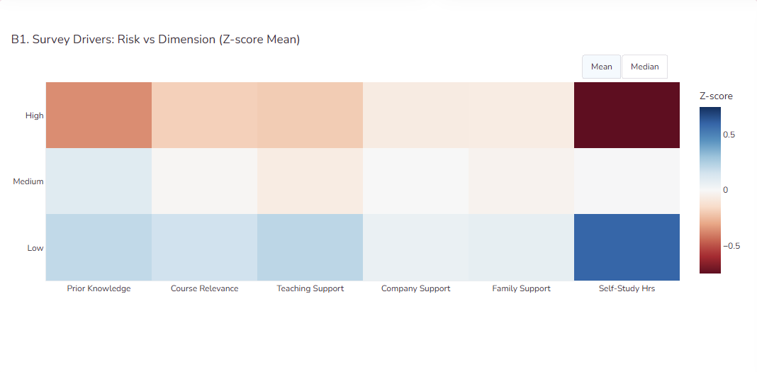
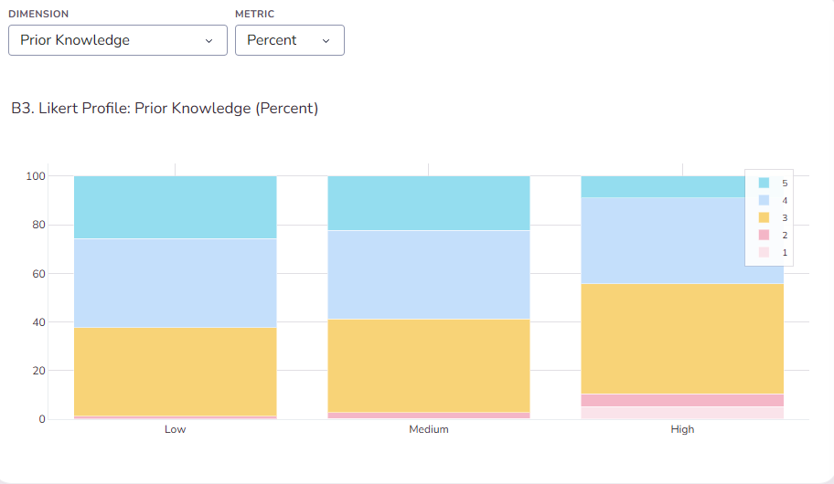
Official (Closed), Sensitive (Normal)
JENSON CHART INSIGHTS
B1: Survey Drivers – Risk vs Dimension (Z-score Mean)
Self-study hours show the strongest separation across risk levels, making it the most influential and modifiable factor.
Prior knowledge and teaching support decrease steadily as risk increases, indicating foundational and instructional alignment gaps.
Family and company support show weaker differentiation, suggesting they are less direct drivers of academic risk.
Overall, behavioural and academic factors dominate over external support factors.
Insight:
Risk is primarily driven by study behaviour and academic preparedness, not access to support alone.
B3: Likert Profile – Prior Knowledge (Percent)
High-risk students cluster in mid-to-low agreement responses, indicating weaker academic foundations.
Low-risk students show a higher concentration of strong agreement, reflecting confidence and preparedness.
Medium-risk students sit between both groups, suggesting partial foundations and recovery potential.
Insight:
Gaps in prior knowledge are progressive rather than binary, making early reinforcement effective.

Slide 13
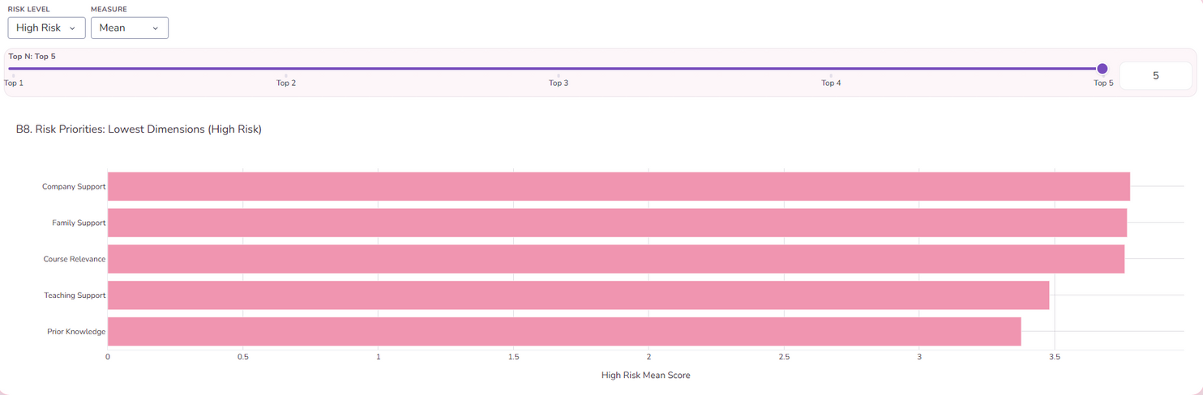
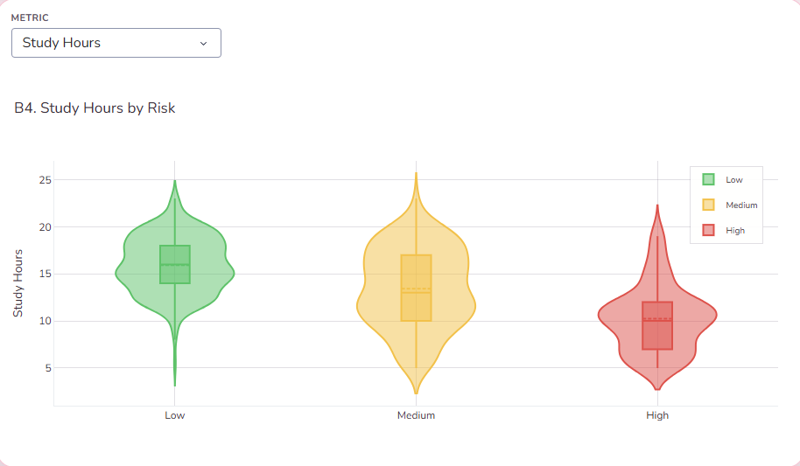
Official (Closed), Sensitive (Normal)
JENSON CHART INSIGHTS
B4: Study Hours by Risk
Study hours decrease sharply as risk increases, with high-risk students showing the lowest median and tight clustering at low values.
Low-risk students consistently report higher and more stable study time, indicating disciplined study habits.
Medium-risk students show wide spread, suggesting inconsistent or inefficient study patterns.
Insight:
Self-study time is the strongest behavioural differentiator between risk groups and a key intervention lever.
B8: Risk Priorities – Lowest Dimensions (High Risk)
High-risk students score lowest on prior knowledge and teaching support, highlighting foundational and instructional gaps.
Course relevance also ranks low, suggesting disengagement or misalignment with programme content.
Family and company support rank lowest but are less directly modifiable, limiting their usefulness as primary intervention targets.
Insight:
The most actionable priorities for high-risk students are strengthening academic foundations and instructional support, not external support factors.

Slide 14
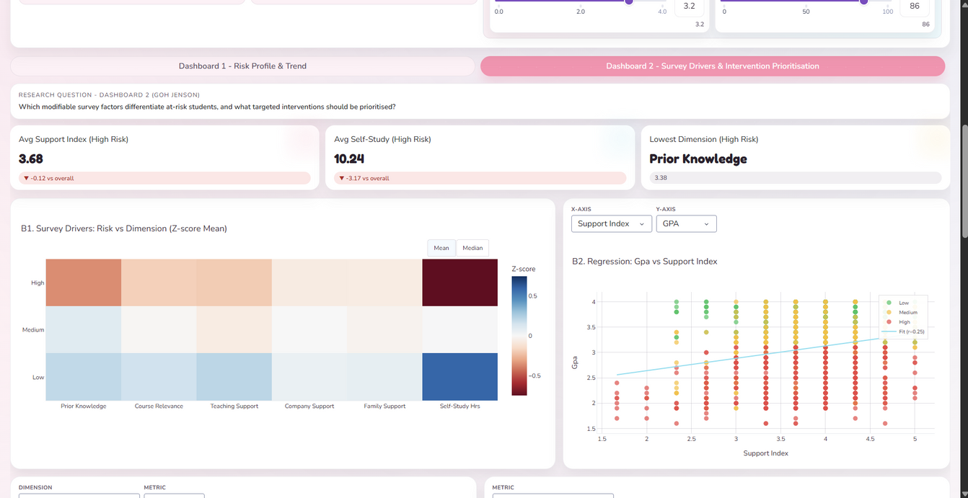
Official (Closed), Sensitive (Normal)
JENSON DASHBOARD INSIGHTS
Across the dashboard, learning behaviours are the strongest differentiators of academic risk, outweighing external support factors.
Self-study hours consistently show the largest gap between risk groups and the strongest association with GPA, making it the most actionable intervention lever.
Prior knowledge and teaching support decline steadily as risk increases, indicating foundational gaps and instructional alignment issues rather than lack of motivation.
Course relevance emerges as a key disengagement signal among high-risk students, suggesting misalignment between student expectations and curriculum demands.
In contrast, family and company support show weaker correlations with outcomes, making them lower-priority targets for direct academic intervention.
Overall, the dashboard indicates that targeted academic and behavioural interventions (study habits, foundations, instructional support) are likely to be more effective than broad support-based approaches.

Slide 15
Official (Closed), Sensitive (Normal)
JENSON RECOMMENDATIONS
1) Prioritise self-study behaviour as the primary intervention lever
B1 and B4 show self-study hours as the strongest and most consistent differentiator of risk.
Implement structured study plans, guided weekly targets, and study-skills workshops (active recall, time planning).
2) Address foundational knowledge gaps early
B1 and B3 indicate declining prior knowledge as risk increases, with high-risk students clustering in lower confidence bands.
Introduce bridging modules, prerequisite refreshers, or early diagnostic quizzes with targeted remediation.
3) Strengthen instructional alignment rather than external support
B1 shows teaching support and course relevance separating risk groups more clearly than family or company support.
Review course pacing, assessment clarity, and feedback mechanisms, especially for cohorts with high perceived misalignment.
4) De-prioritise broad external support as a primary academic intervention
Family and company support show weaker differentiation and lower outcome correlation.
Treat these as supplementary, not core, levers for reducing academic risk.

Slide 16
Official (Closed), Sensitive (Normal)
APPENDIX:
ADDITIONAL CHARTS

Slide 17
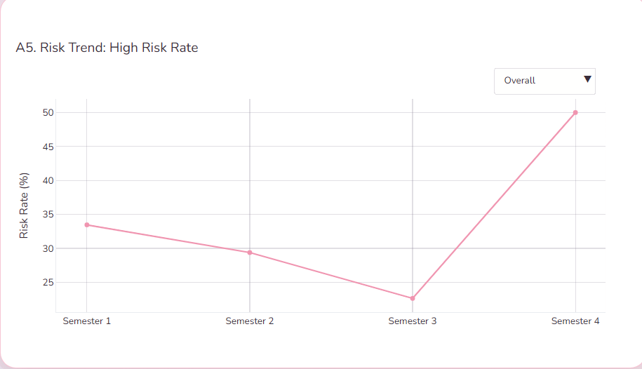
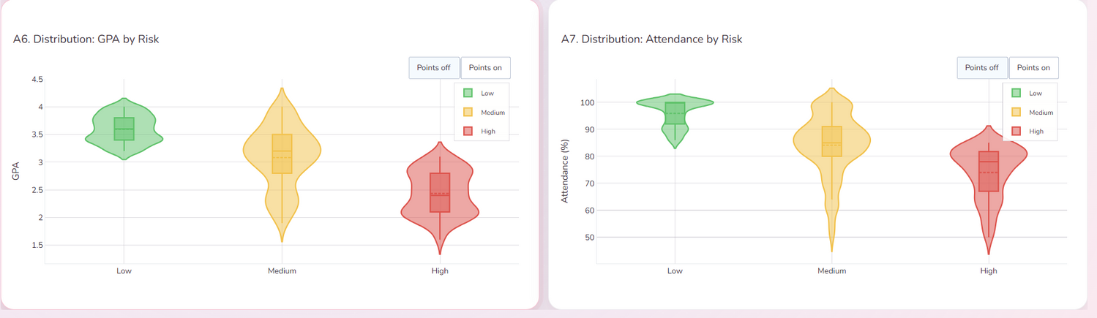
Official (Closed), Sensitive (Normal)
APPENDIX: KUN MING CHARTS

Slide 18
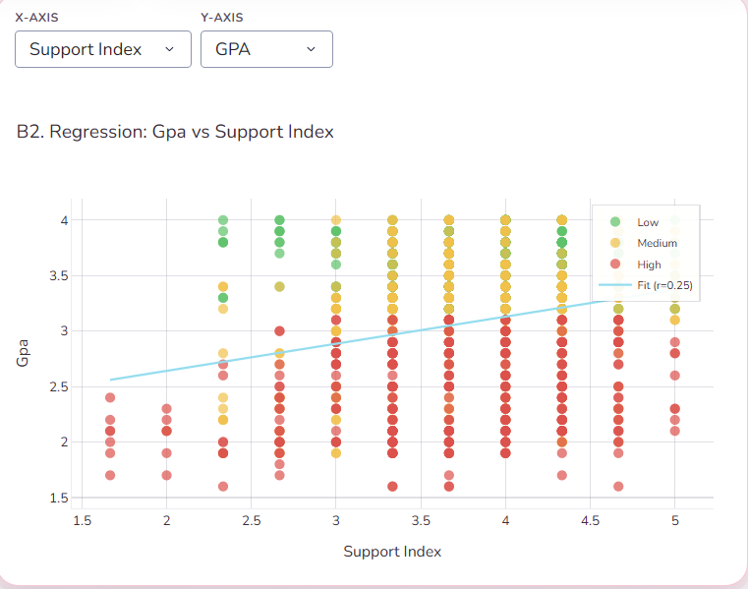
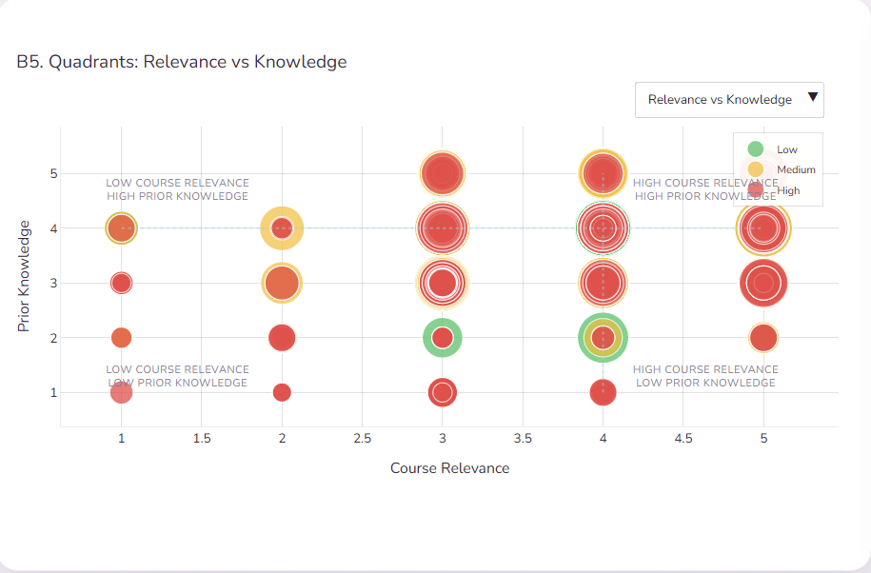
Official (Closed), Sensitive (Normal)
APPENDIX: JENSON CHARTS

Slide 19
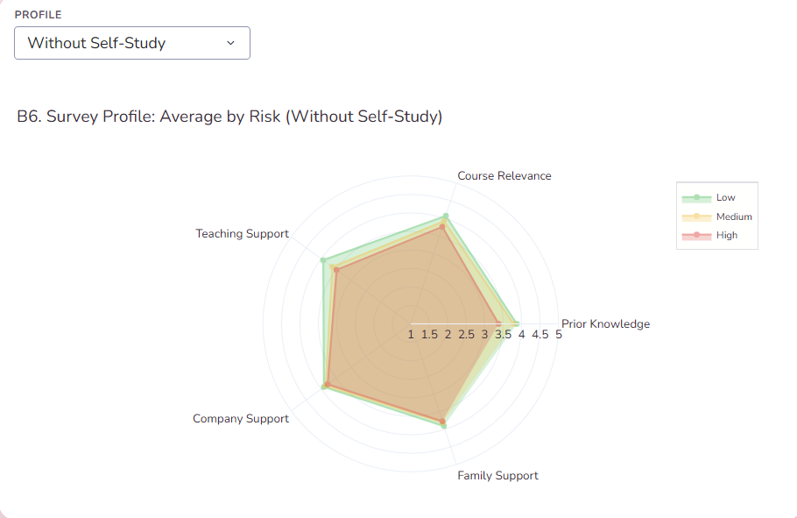
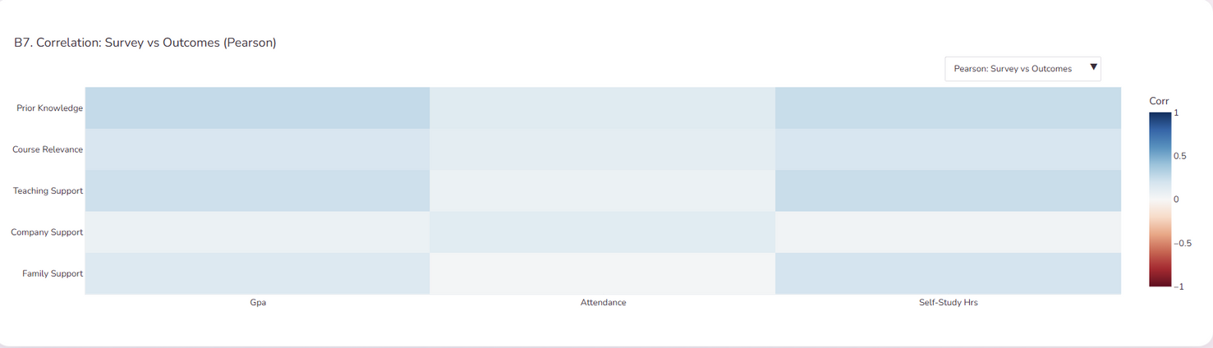
Official (Closed), Sensitive (Normal)
APPENDIX: JENSON CHARTS 2

