Slide 1



Official (Closed), Sensitive (Normal)
DOAA
CA2 PART B
MLOPS FOR DL WEB APPLICATION
Presented By
Admin Number
Goh Kun Ming
P2415691
https://orcid.org/0009-0008-7666-781X
1

Slide 2

Official (Closed), Sensitive (Normal)
BUSINESS
VALUE
  Faster vegetable identification for consumers and staff (image classifier + live detection).
  Better buying decisions through confidence-scored predictions, not guesswork.
  Real-time support at point-of-sale or market visits with camera-based live detection.
  Price transparency via Price Evaluator and searchable/filterable price views.
  Smarter shopping and budgeting by comparing produce options quickly.
  RAG assistant gives contextual guidance (produce info, usage, selection support) grounded in your app data.
  Reduced manual effort for identifying characteristics in produce.
  Improved consistency and accuracy versus human-only visual checks.
  Stronger trust and compliance posture (auth, captcha/OTP, security gates in CI/CD).
  Deployment-ready architecture (containerized services + automated pipeline + Render deploy hooks).
2

Slide 3
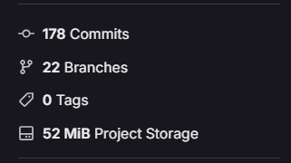
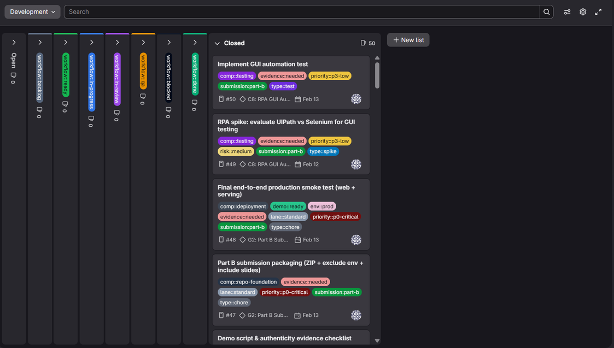
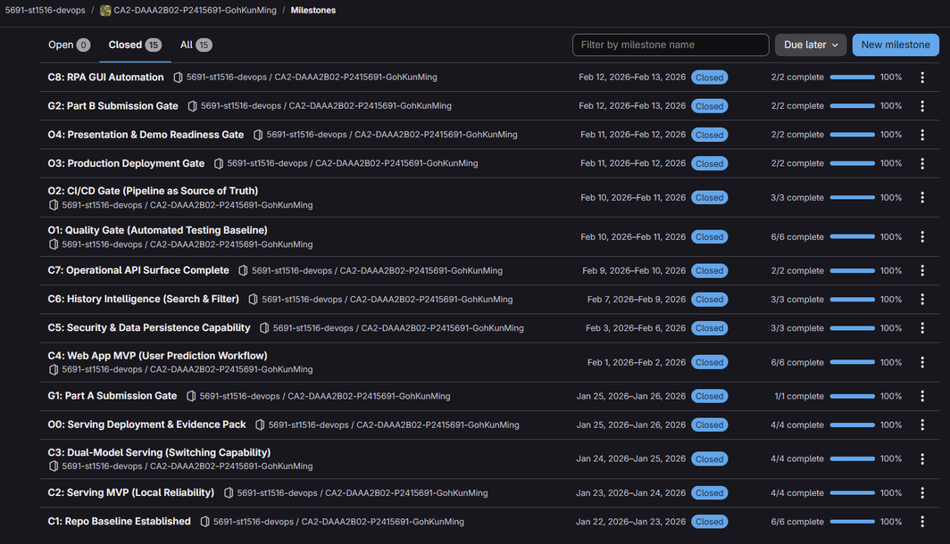
Official (Closed), Sensitive (Normal)
DEVOPS
GitLab Information
PROCESS
Scrum Board Setup
Milestones
C: Content
O: Operation
G: Gate
https://gitlab.com/5691-st1516-devops/ca2-daaa2b02-p2415691-gohkunming
3

Slide 4
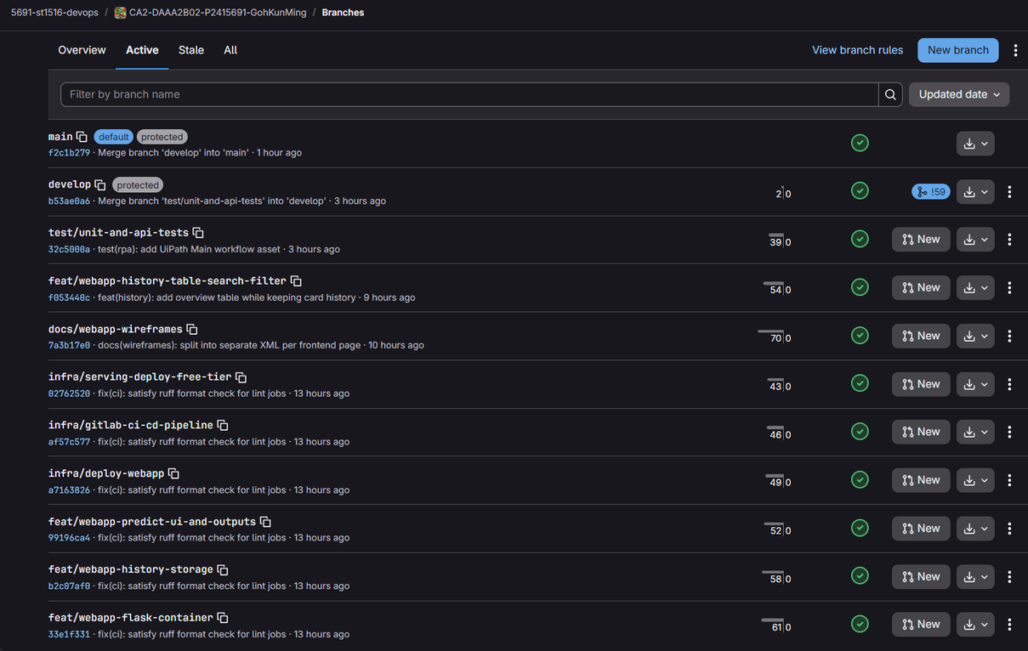
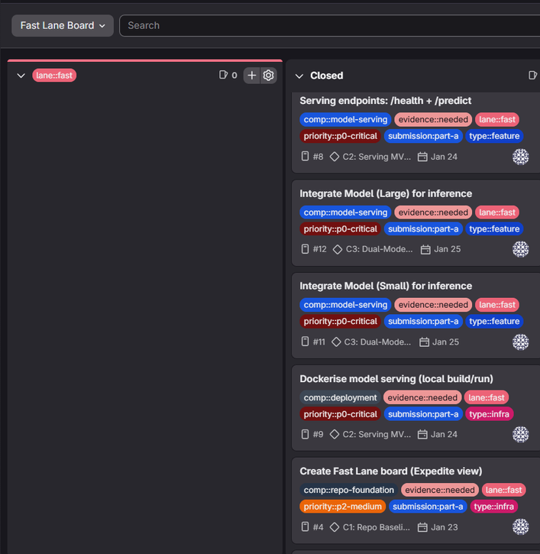
Official (Closed), Sensitive (Normal)
DEVOPS
PROCESS
Branches (20 excl. main / develop)
Fast Lane
All development branch merge to develop before merging to main for each release gate (Submission A & Submission B)
Used primarily for Part A due to urgency
https://gitlab.com/5691-st1516-devops/ca2-daaa2b02-p2415691-gohkunming
4

Slide 5
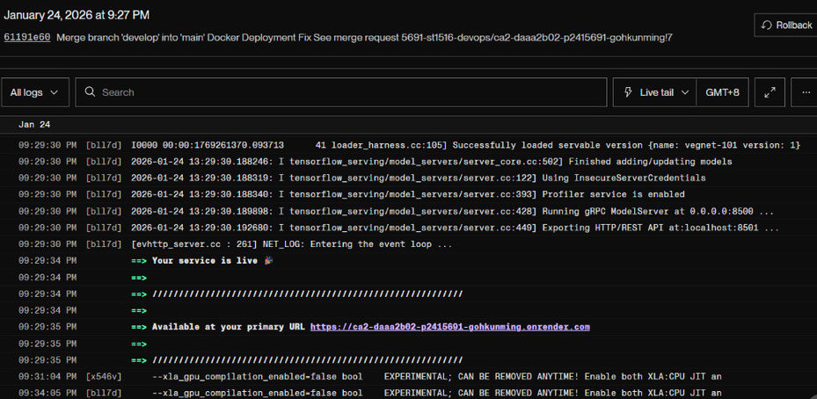
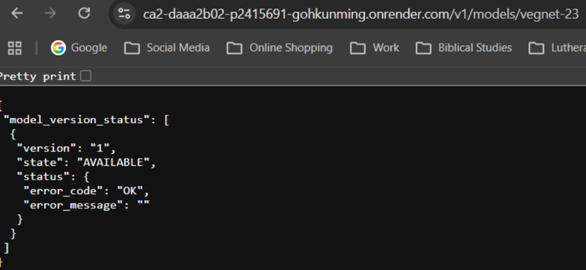
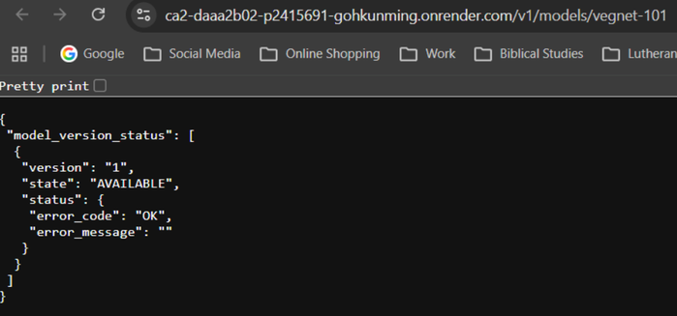
Official (Closed), Sensitive (Normal)
MODEL
SERVICE
Deployment on Render
Vegnet (23x23)
Vegnet (101x101)
https://ca2-daaa2b02-p2415691-gohkunming.onrender.com/v1/models/vegnet-23
https://ca2-daaa2b02-p2415691-gohkunming.onrender.com/v1/models/vegnet-101
5

Slide 6
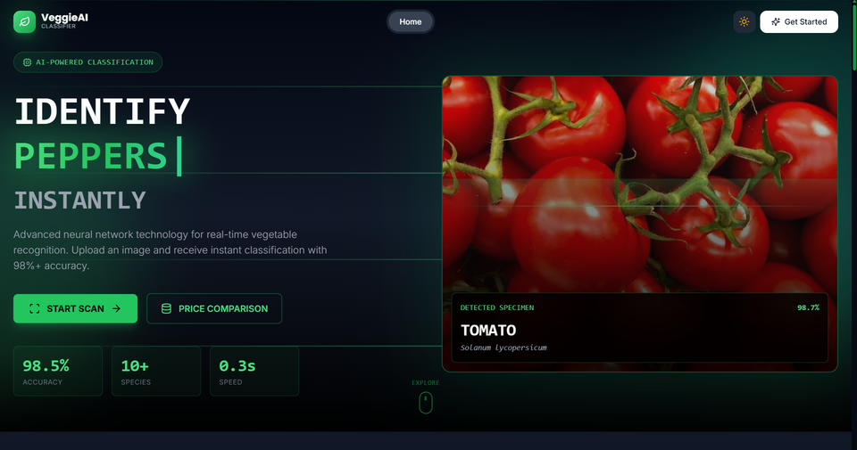
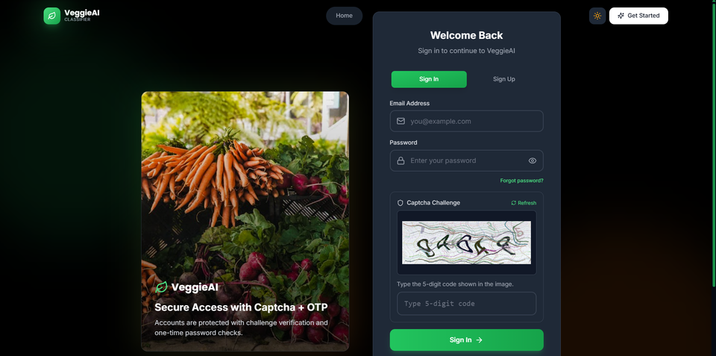
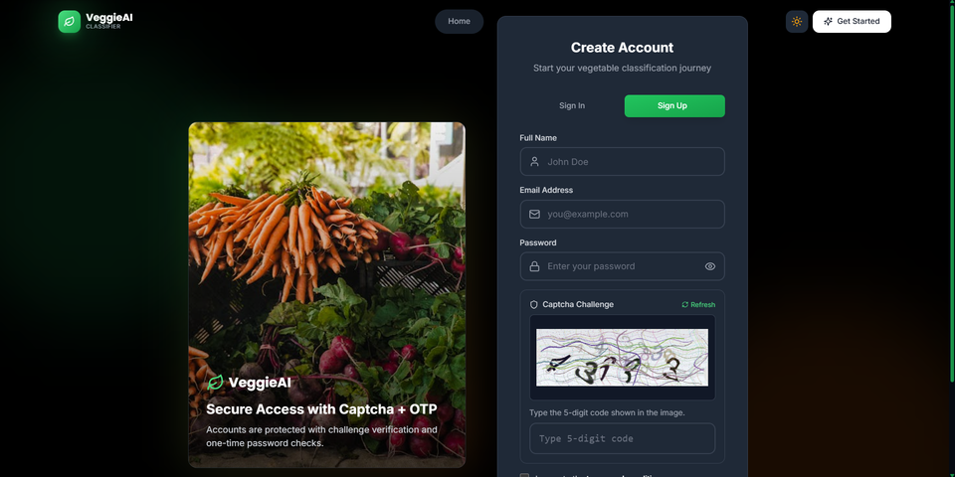
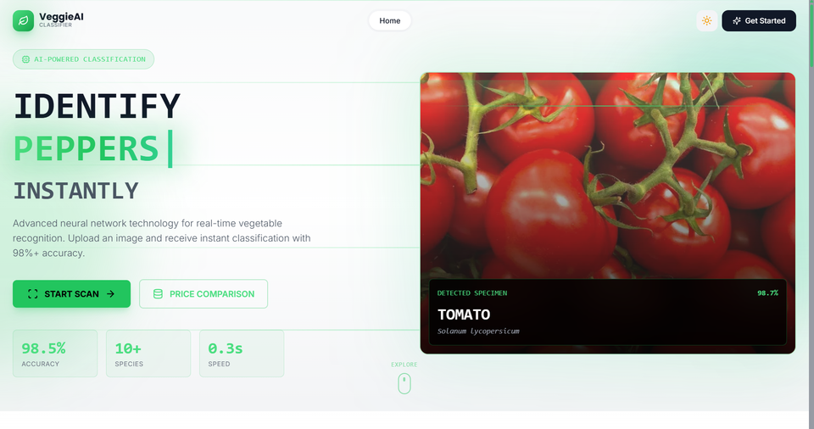
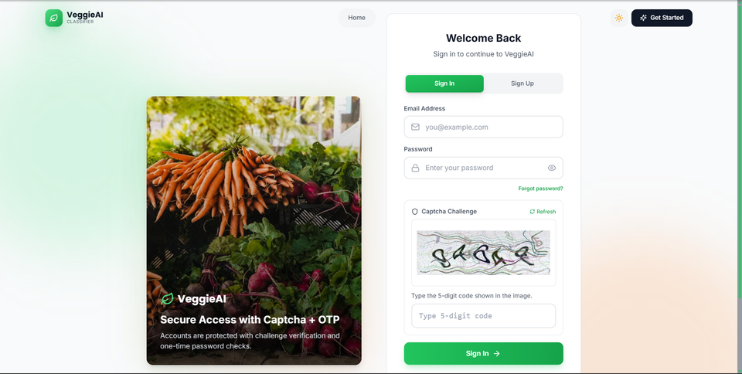
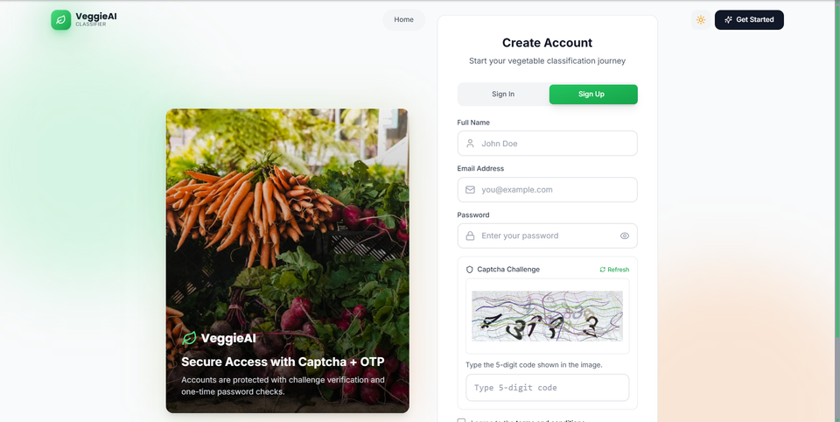
Official (Closed), Sensitive (Normal)
WEB APPLICATION
DEVELOPMENT
Homepage (Dark / Light)
Sign In Page (Dark / Light)
Sign Up Page (Dark / Light)
https://ca2-daaa2b02-p2415691-gohkunming-1.onrender.com
6

Slide 7
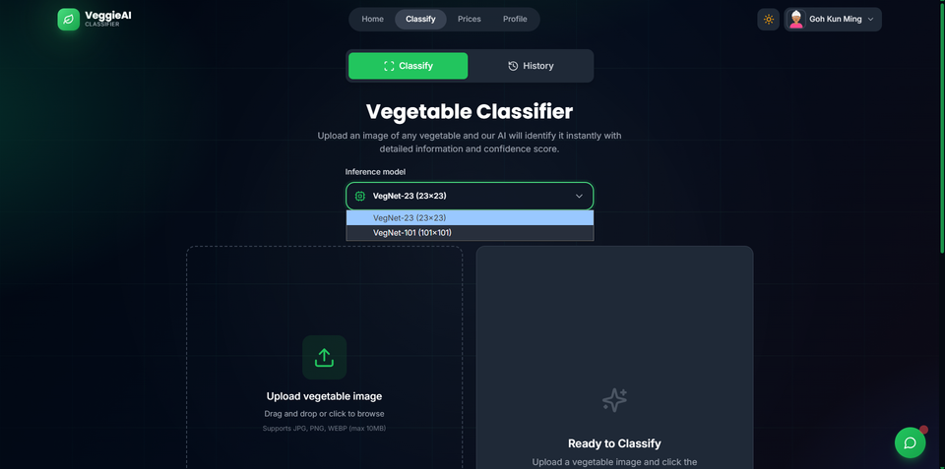
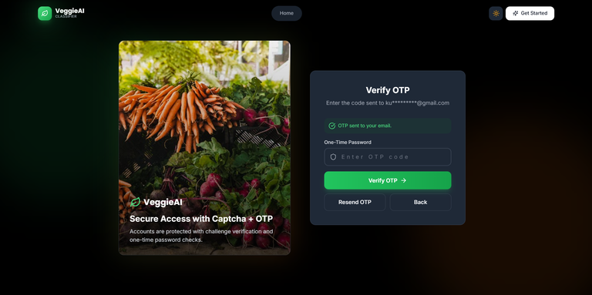
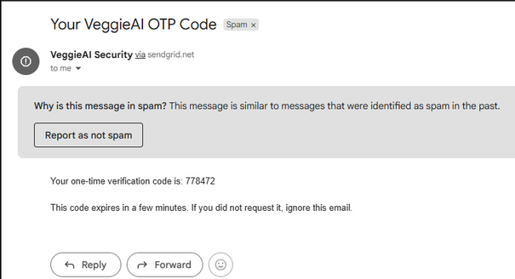
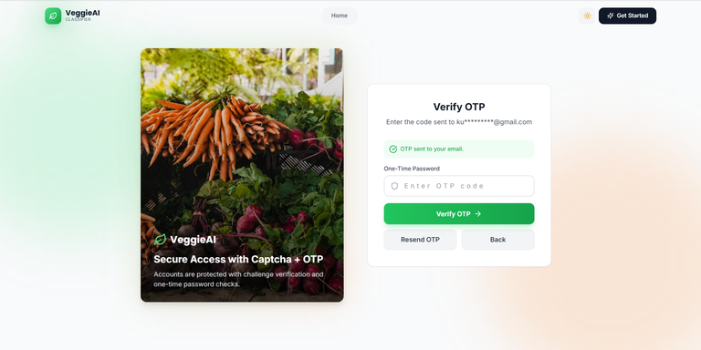
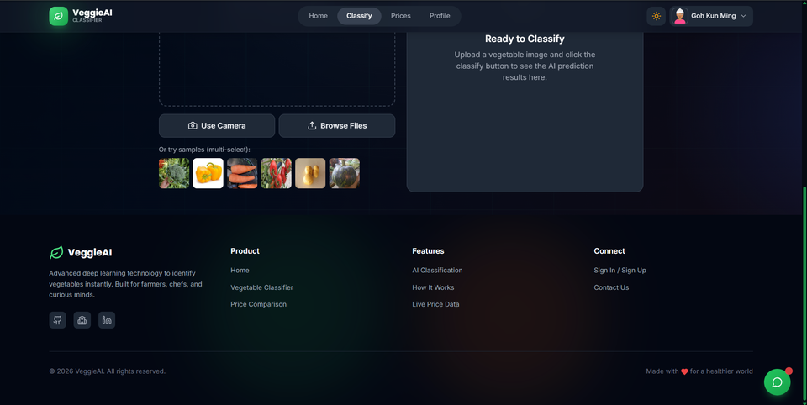
Official (Closed), Sensitive (Normal)
WEB APPLICATION
DEVELOPMENT
Prediction Page (Dark / Light)
OTP (Dark / Light)
OTP Email (SMTP)
https://ca2-daaa2b02-p2415691-gohkunming-1.onrender.com
7

Slide 8
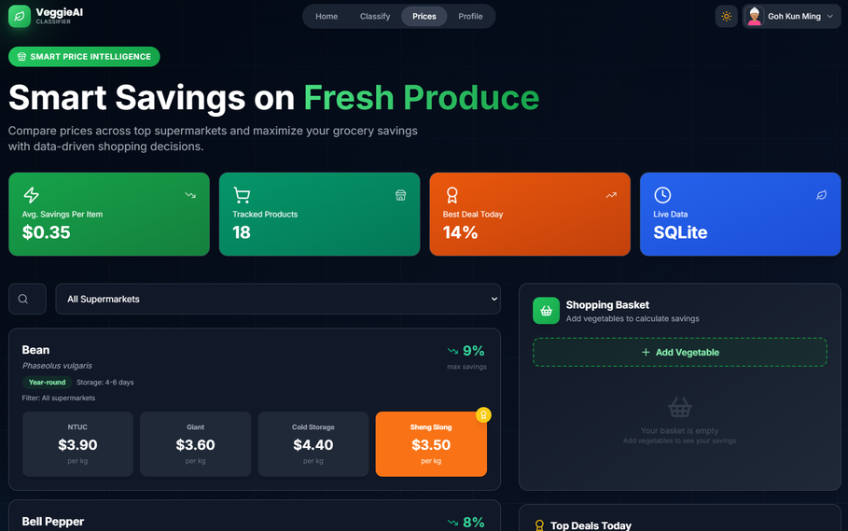
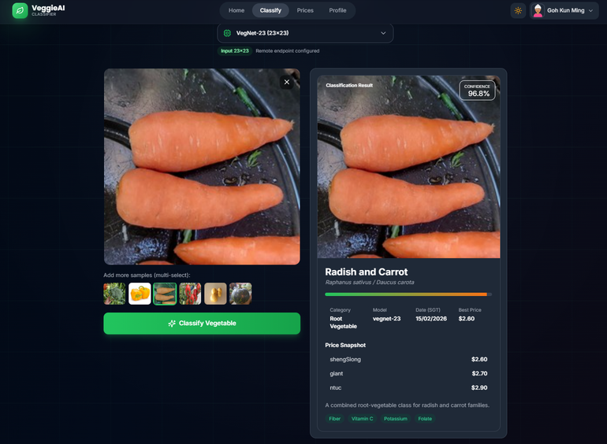
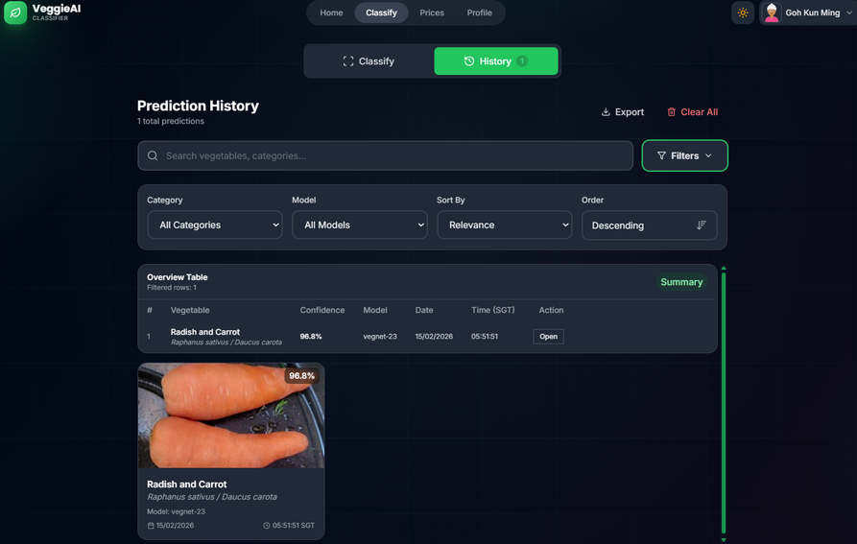
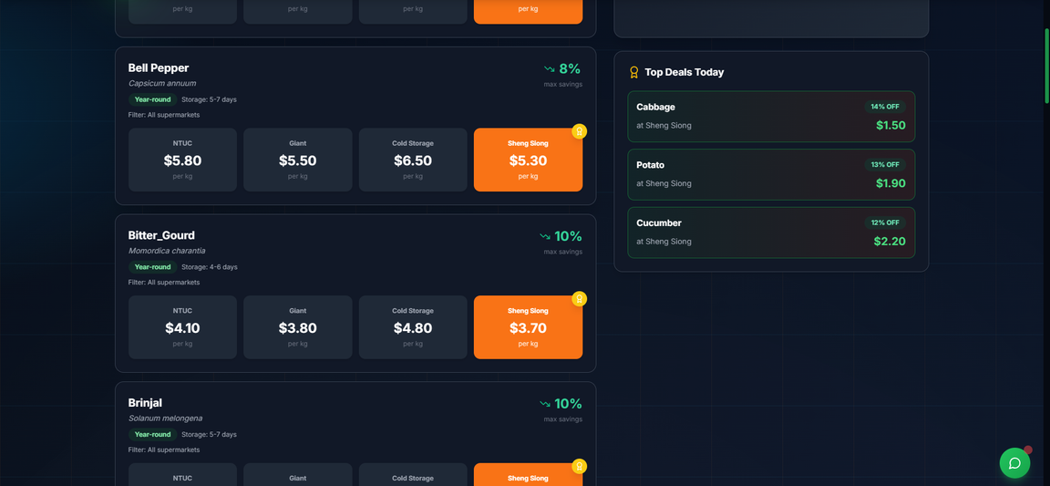
Official (Closed), Sensitive (Normal)
WEB APPLICATION
DEVELOPMENT
Prediction
History & Search / Filter
Price Intelligence
https://ca2-daaa2b02-p2415691-gohkunming-1.onrender.com
8

Slide 9
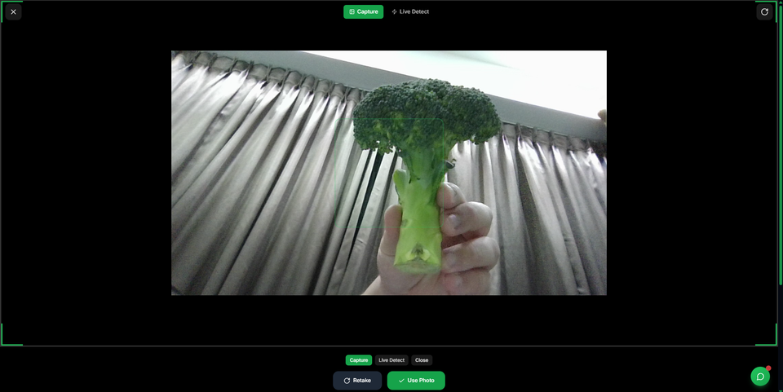
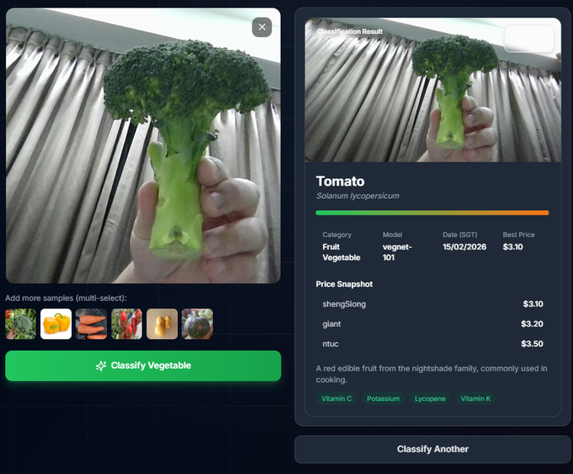
Official (Closed), Sensitive (Normal)
WEB APPLICATION
DEVELOPMENT
Camera Capture
Prediction using Camera Captured Image
Poor Accuracy due to Image Noise / Poor Model
https://ca2-daaa2b02-p2415691-gohkunming-1.onrender.com
9

Slide 10
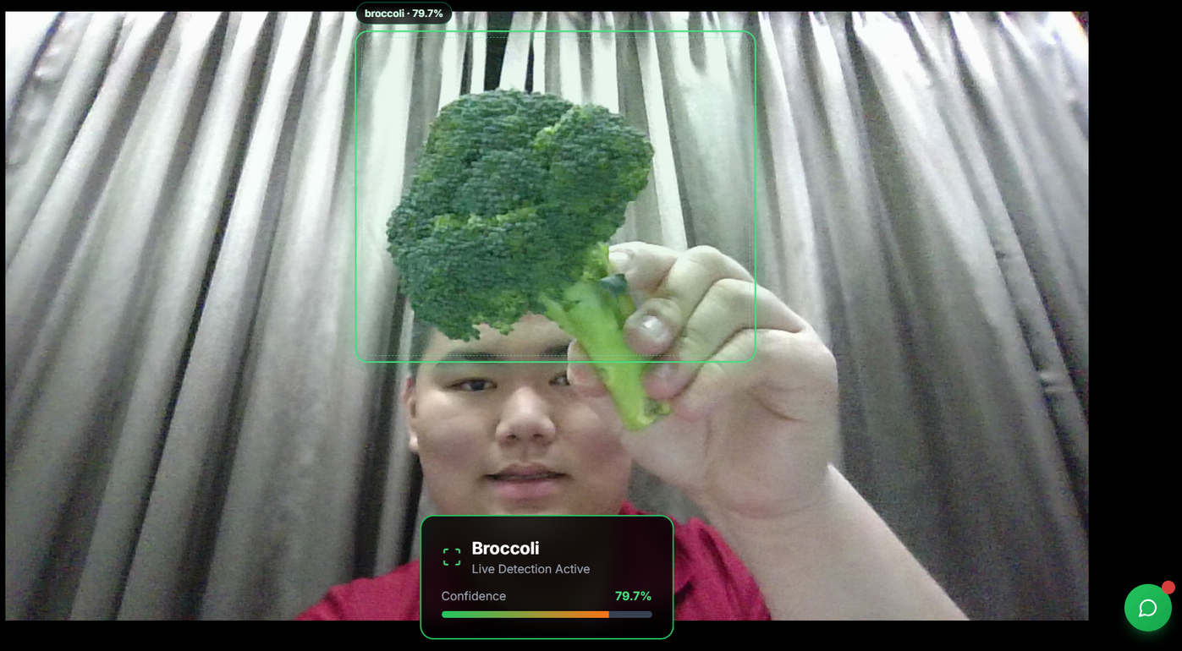
Official (Closed), Sensitive (Normal)
WEB APPLICATION
DEVELOPMENT
Live Detection
https://ca2-daaa2b02-p2415691-gohkunming-1.onrender.com
10

Slide 11
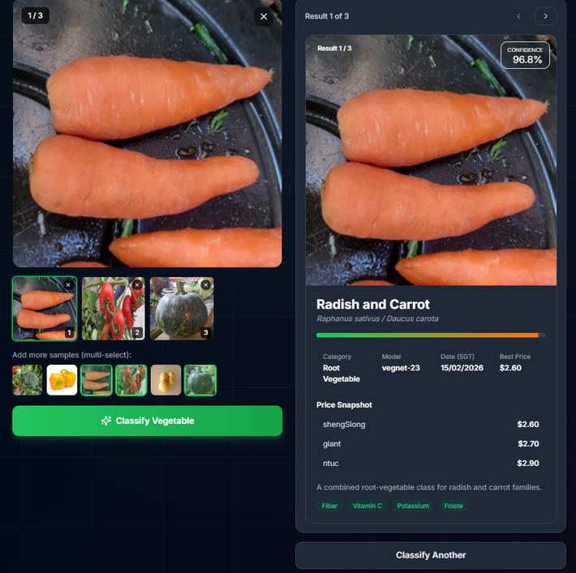
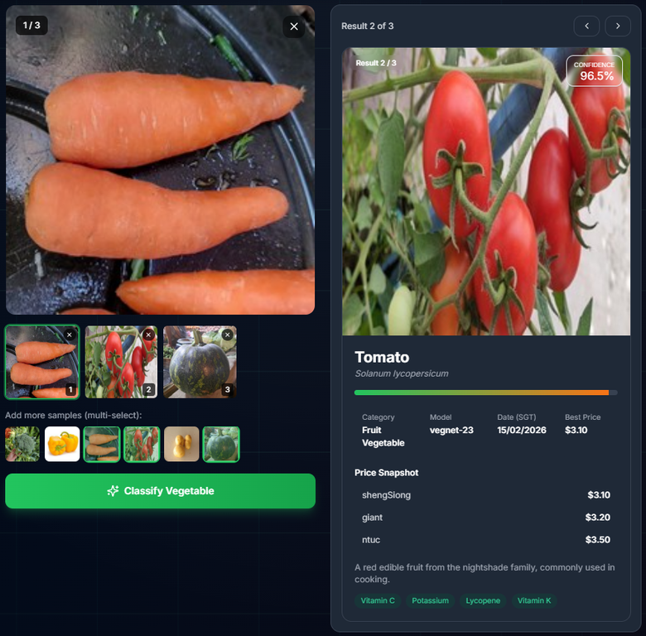
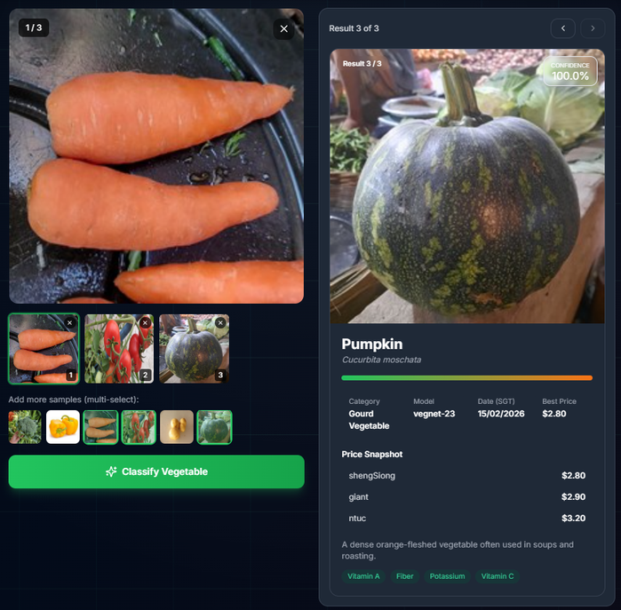
Official (Closed), Sensitive (Normal)
WEB APPLICATION
DEVELOPMENT
Model Batch Prediction
https://ca2-daaa2b02-p2415691-gohkunming-1.onrender.com
11

Slide 12
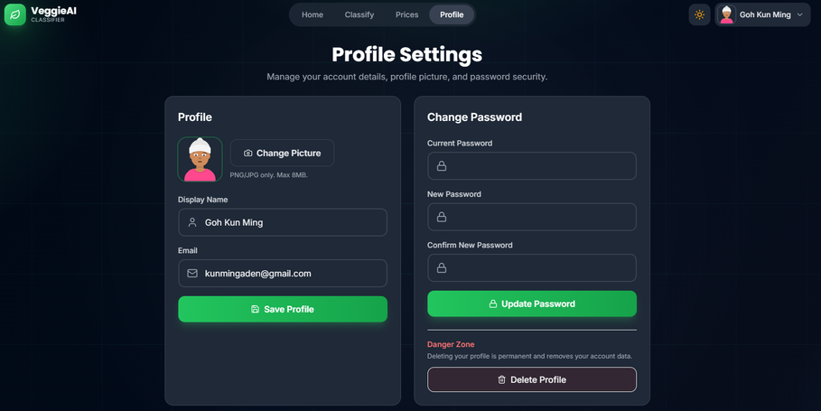
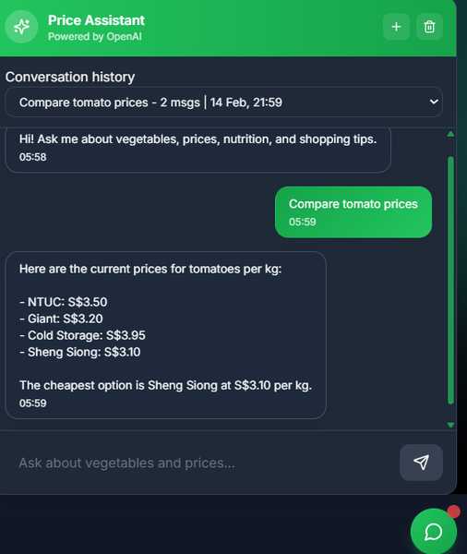
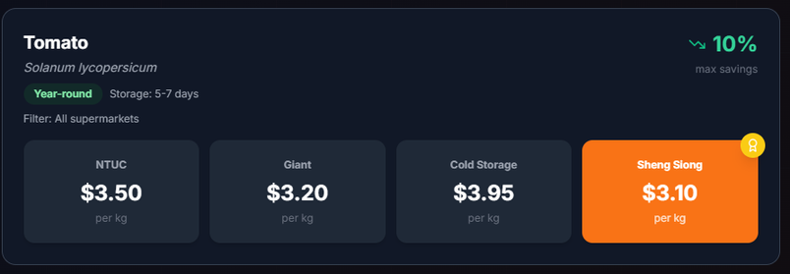
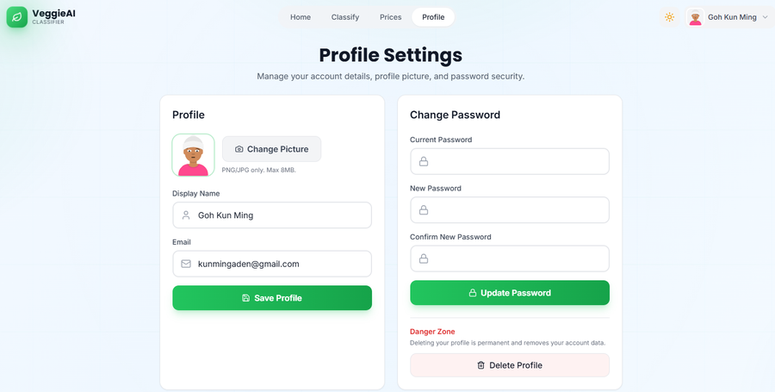
Official (Closed), Sensitive (Normal)
WEB APPLICATION
DEVELOPMENT
Profile
RAG-Capabilities
Source of Truth Reference
https://ca2-daaa2b02-p2415691-gohkunming-1.onrender.com
12

Slide 13
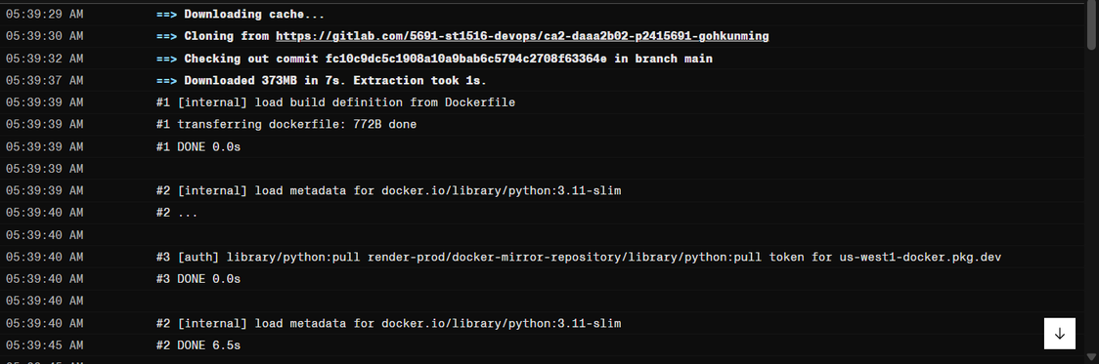
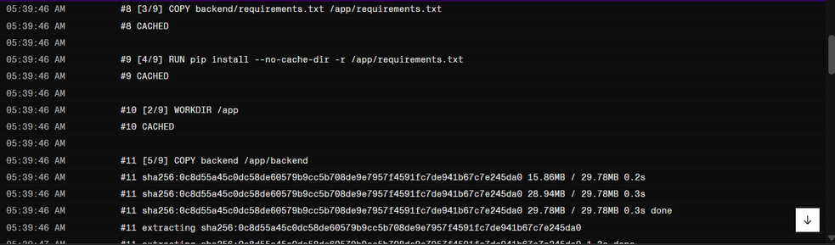
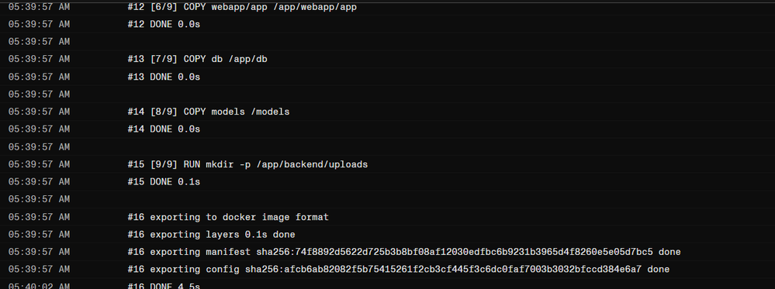
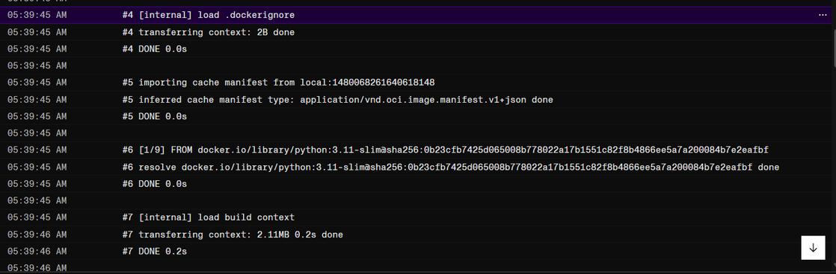
Official (Closed), Sensitive (Normal)
WEB APPLICATION
DEVELOPMENT
Docker Deployment Logs
https://ca2-daaa2b02-p2415691-gohkunming-1.onrender.com
13

Slide 14
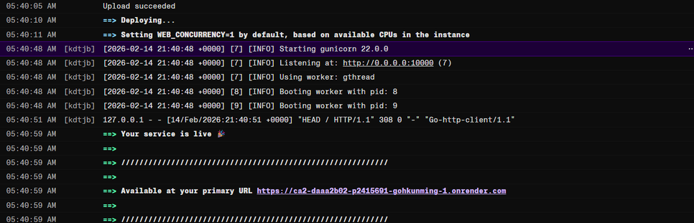
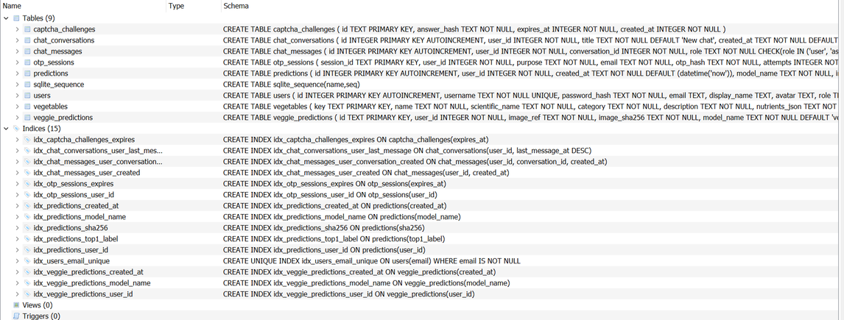
Official (Closed), Sensitive (Normal)
WEB APPLICATION
DEVELOPMENT
Docker Deployment Success Logs
SQLite Database Structure
Password Hashing + Salting (One-Way Cryptography)
https://ca2-daaa2b02-p2415691-gohkunming-1.onrender.com
14

Slide 15
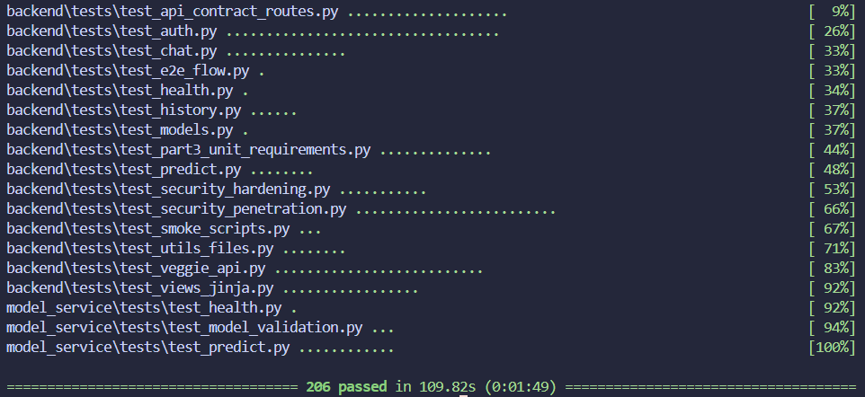
Official (Closed), Sensitive (Normal)
AUTOMATIC
TESTING
Overall Test
https://ca2-daaa2b02-p2415691-gohkunming-1.onrender.com
15

Slide 16
Official (Closed), Sensitive (Normal)
AUTOMATIC
TESTING
Unit tests
  Core validation/preprocessing logic (image parsing, input-size rules, probability extraction, deterministic outputs).
  Covers validity, range, consistency, expected-failure, and unexpected-failure scenarios.
API tests (backend + model service)
  Auth APIs: login/signup/register/logout/me, captcha/OTP, password reset, profile flows.
  Prediction APIs: /api/predict, /api/veggie/predict, /api/veggie/detect.
  History APIs: list/detail/image/delete, pagination/filter bounds, user isolation.
  Prices/catalog/model list APIs.
  Chat/RAG APIs: message, history, conversations.
  Model service APIs: /health, /predict (multipart/base64, invalid model/input, top_k validation).
Contract tests
  Route registration test to ensure crucial REST endpoints exist and are correctly exposed.
https://ca2-daaa2b02-p2415691-gohkunming-1.onrender.com
16

Slide 17
Official (Closed), Sensitive (Normal)
AUTOMATIC
TESTING
Security tests
  Auth guarding and unauthorized access rejection.
  Brute-force/rate-limit and invalid credential behavior.
  CORS/security-header hardening checks.
  IDOR-style access controls (cross-user access blocked).
  Captcha/OTP misuse/replay and negative-path scenarios.
  Vulnerability scanning in CI: Bandit, pip-audit, gitleaks.
E2E tests
  Full secure flow: captcha -> signup/login -> OTP verify -> model predict -> history -> chat interaction.
  Includes cross-boundary behavior between auth, prediction, persistence, and chat modules.
https://ca2-daaa2b02-p2415691-gohkunming-1.onrender.com
17

Slide 18
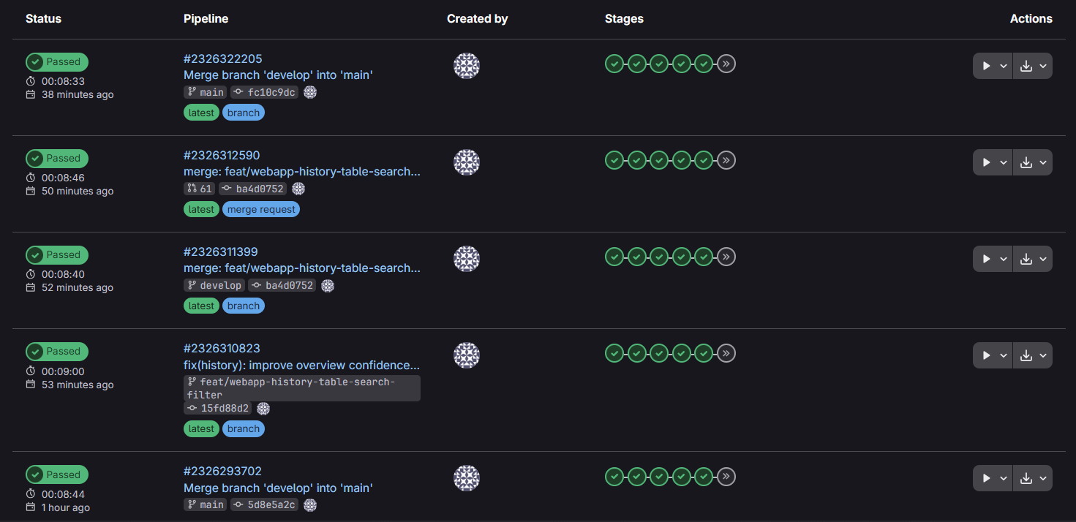
Official (Closed), Sensitive (Normal)
MACHINE LEARNING
OPERATIONS
CI Pipeline Checks Before Merge
https://gitlab.com/5691-st1516-devops/ca2-daaa2b02-p2415691-gohkunming
18

Slide 19
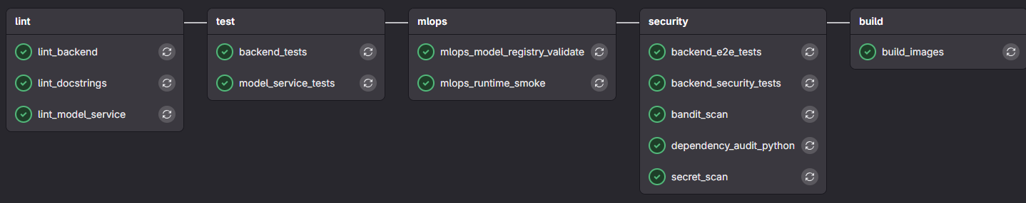
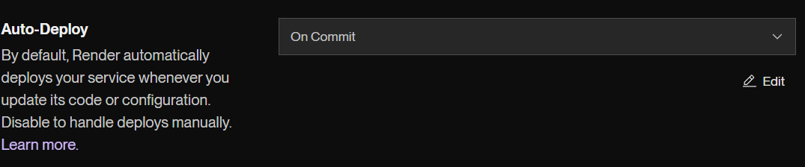
Official (Closed), Sensitive (Normal)
MACHINE LEARNING
OPERATIONS
CI Pipeline Stages
Docker Deployment Success Logs
Docker Deployment Auto-Deploy Config
https://gitlab.com/5691-st1516-devops/ca2-daaa2b02-p2415691-gohkunming
https://ca2-daaa2b02-p2415691-gohkunming-1.onrender.com
19

Slide 20
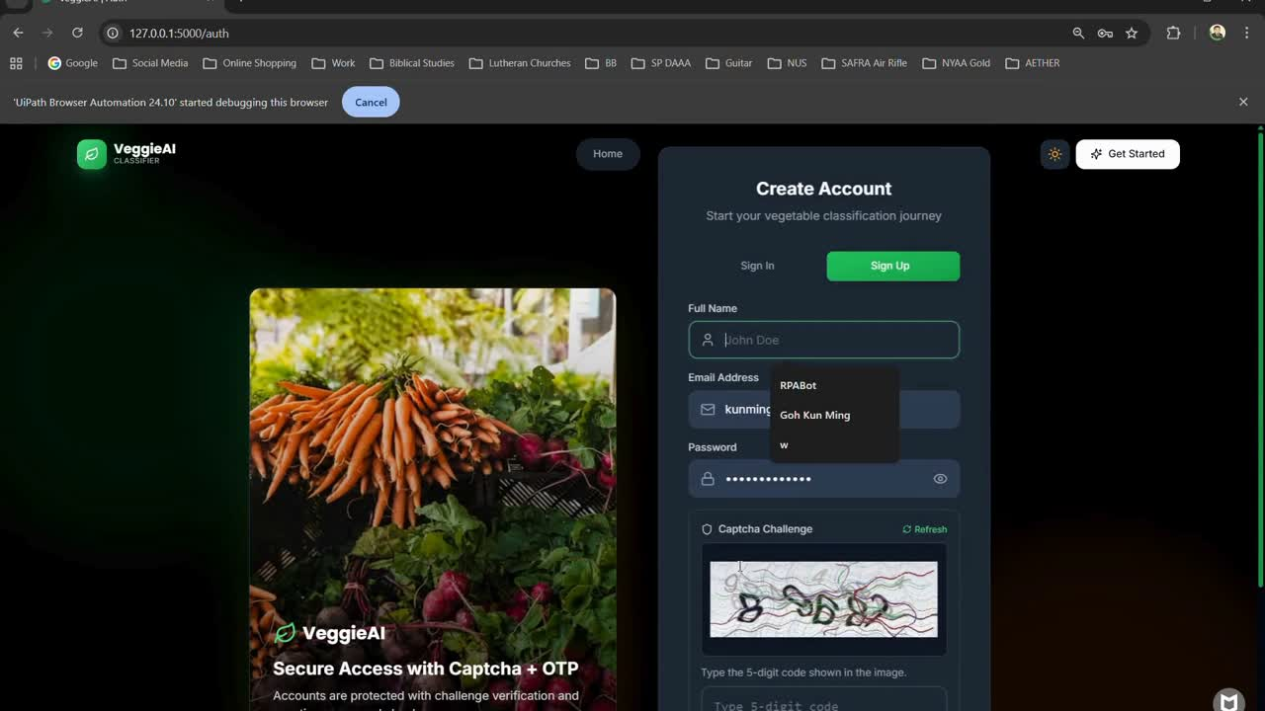
Official (Closed), Sensitive (Normal)
ROBOT PROCESS
AUTOMATION
RPA For Testing of Application
RPA done on localhost so as to bypass Captcha & OTP with ‘00000’
20

Slide 21
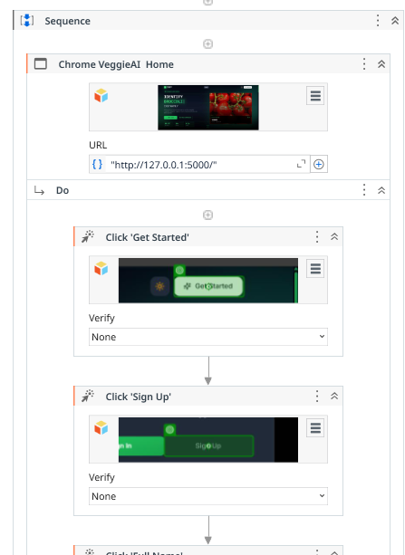
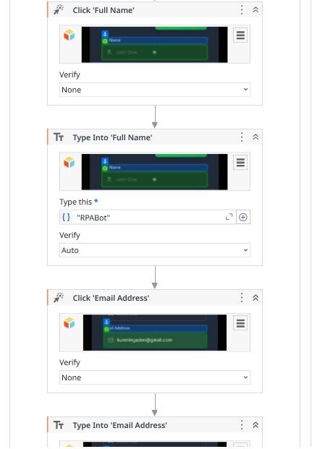
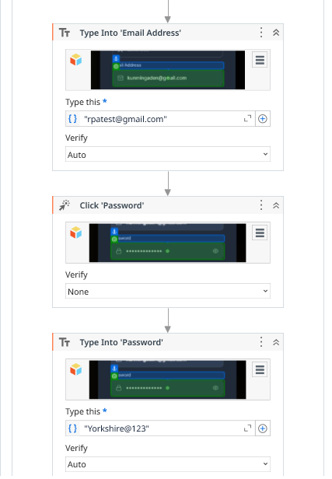
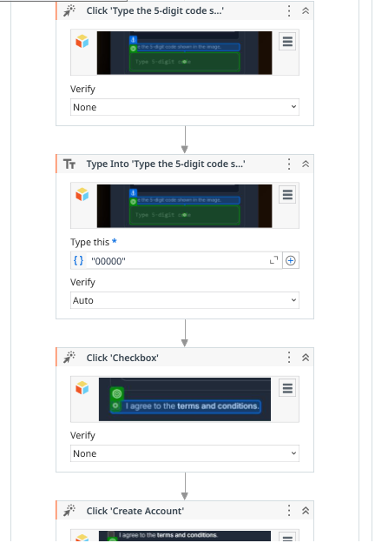
Official (Closed), Sensitive (Normal)
ROBOT PROCESS
AUTOMATION
RPA Workflow
21

Slide 22
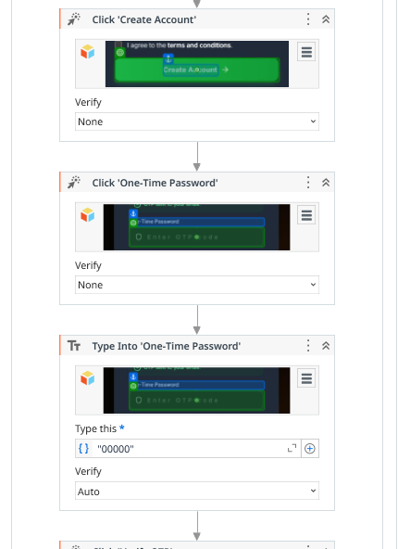
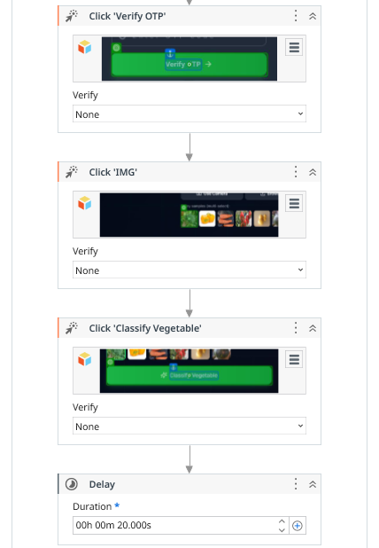
Official (Closed), Sensitive (Normal)
ROBOT PROCESS
AUTOMATION
RPA Workflow
22

Slide 23
Official (Closed), Sensitive (Normal)
IMPORTANT
LINKS
GitLab
https://gitlab.com/5691-st1516-devops/ca2-daaa2b02-p2415691-gohkunming
Application
https://ca2-daaa2b02-p2415691-gohkunming-1.onrender.com
Model Serving (23x23)
https://ca2-daaa2b02-p2415691-gohkunming.onrender.com/v1/models/vegnet-23
Model Serving (101x101)
https://ca2-daaa2b02-p2415691-gohkunming.onrender.com/v1/models/vegnet-101
23

Slide 24
Official (Closed), Sensitive (Normal)
REFERENCES
vegetables (2023). vegetable Object Detection Model by vegetables. [online] Roboflow. Available at: https://universe.roboflow.com/vegetables-zdlas/vegetable-cihx0 [Accessed 9 Feb. 2026].
24

Slide 25

Official (Closed), Sensitive (Normal)
THANK YOU
FOR YOUR ATTENTION
Presented By
Admin Number
Goh Kun Ming
P2415691
https://orcid.org/0009-0008-7666-781X
25

