Slide 1






Presented By
Group 1
Practical AI CA1
Made by: Goh Jenson, Goh Kun Ming, Law Wei Tin, Liu Xingyu
Singapore Polytechnic

Slide 2
Project Objectives
  Set up MySQL databases for staging & warehouse
  Build reliable ETL between MySQL and Python/Spark for drivers, sensors and safety data
  Perform data wrangling & EDA to understand dangerous vs safe trips
  Build interactive dashboards for driver profile, trips & sensor behaviour for business decision makers

Slide 3
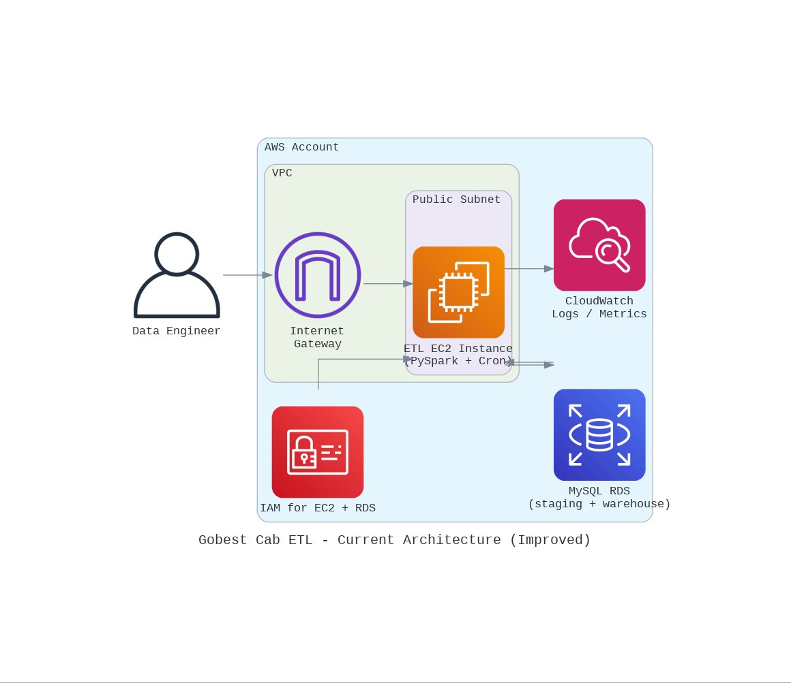

Data & System Overview
  Drivers dataset: driver profile, experience, rating, car brand, model year
  Sensors dataset: per-trip speed, acceleration (x, y, z), jerk, gyroscope, turning angles
  Safety dataset: trip IDs with labels (Safe / Dangerous)
  Staging DB (MySQL) > Spark cleaning scripts > Warehouse (Dim / Fact tables) for analytics

Slide 4
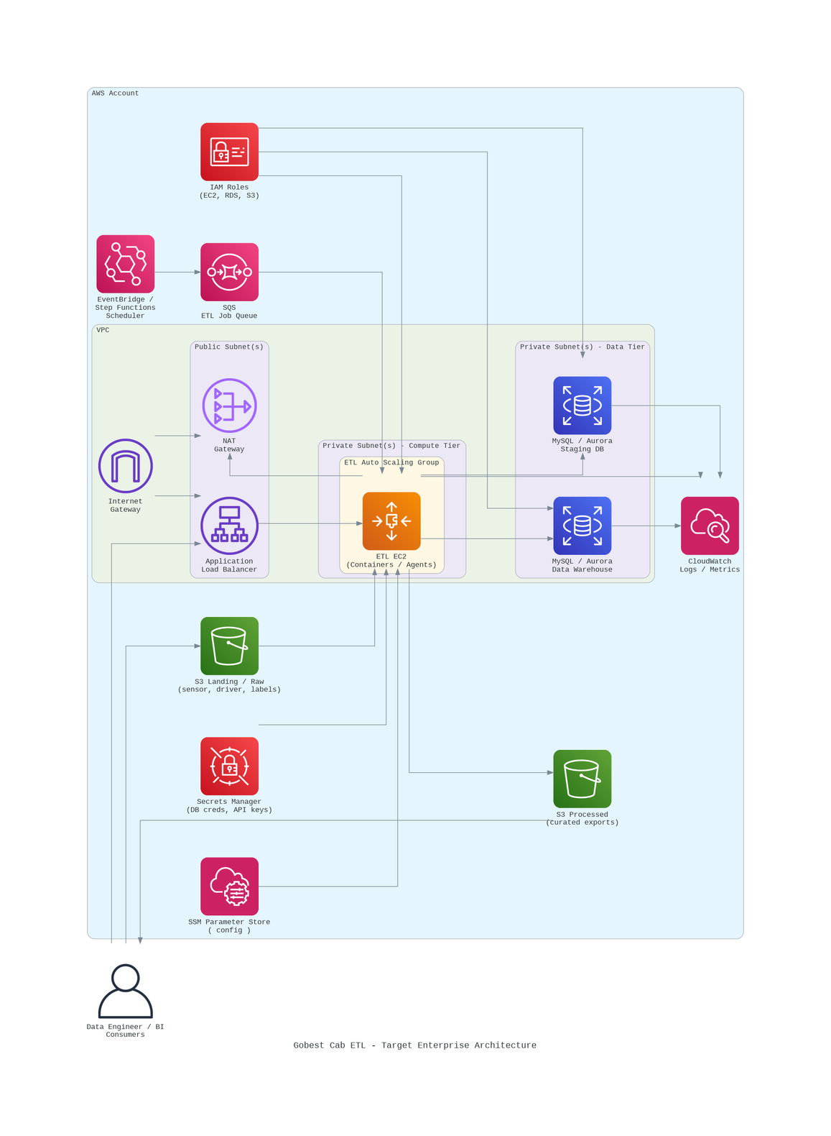
Theoretical Data & System
  Event-driven automation ensures ETL runs reliably with zero manual intervention.
  Auto-scaling compute tier handles workload spikes efficiently and reduces cost.
  Staging → Warehouse separation improves data quality, governance, and analytics readiness.
  Strong security + monitoring via Secrets Manager, Parameter Store, and CloudWatch enhances system resilience.

Slide 5

ETL & EDA

Slide 6


EXTRACT
ETL & Cleaning Design (Common Pattern)
Read from MySQL staging tables via Spark JDBC with server-side trimming and NULL coercion (e.g. handling "", 'na', 'null', '.' as NULL)
BASELINE AUDIT:
Missingness profile, data type snapshot, duplicate summary for each table
TRANSFORM:
  Drop exact duplicates (ignoring cleaned_date)
  Normalise schema (renames, type casting, trimming strings)
  Rule-based validation for business logic (e.g. valid gender values, rating ranges, future dates)
  Simple missing value imputation (numeric → mean/median; categoricals → mode)
LOAD:
Insert cleaned records into warehouse tables and mark staging rows as cleaned_date = NOW()

Slide 7
Driver: Data Cleaning (Dim_Driver)
1
Extraction: Pull rows from drivers_source in staging where cleaned_date IS NULL via Spark JDBC; server-side handling of noisy strings → NULL before loading into Spark
4
Rule-based validation:
  DOB must not be in the future
  gender must be Male/Female (case-insensitive) or set to NULL
  car_model_year must not exceed current year
  driver_rating constrained to [2, 5]; out-of-range values → NULL
2
Duplicates: Drop exact duplicates (excluding cleaned_date), confirm remaining unique rows
3
Type casting & schema:
  Standardise numeric fields (no_of_years_driving_exp, car_model_year, driver_rating) as doubles
  Treat ID, name, gender, car brand as trimmed strings
  Keep date_of_birth as a cleaned string first, then parse to date only at load step for robustness
5
Imputation:
  Numeric: choose mean or median based on skewness; use Spark skewness + approxQuantile to decide
  Categorical: fill NULLs with the mode per column

Slide 8
Driver: Outlier Handling & Load
1
Univariate outliers:
  Automatically choose Z-score or IQR method based on skewness/kurtosis per column
  Add boolean flags like driver_rating__is_uni_outlier for key numeric features
3
Warehouse load (Dim_Driver):
  Build Dim_Driver rows with driver profile + car attributes + outlier flags + mv_score
  Drop duplicates within batch by (driver_id, car_brand, car_model_year)
  Left-anti join to existing Dim_Driver to avoid re-inserting existing driver–car combos
  Append only new rows; then update staging drivers_source.cleaned_date with NOW()
2
Multivariate outlier score:
  Use PCA reconstruction error on scaled numeric features to compute _mv_score
  Flag top 5% as multivariate outliers (_mv_is_outlier) for documentation, not removal

Slide 9
Safety Status: Data Cleaning (Fact_Label)
1
Similarities with Driver cleaning:
  Source & extraction
    Reads from staging.safety_labels_source where cleaned_date IS NULL.
    Uses a server-side SQL layer to:
      Convert blanks / placeholders to NULL.
      Cast driver_id and label to DOUBLE.
      Keep bookingId as a cleaned string ID.
3
Very small schema (3 key columns only)
  bookingId (trip ID)
  driver_id
  label (0 = Safe, 1 = Dangerous)
  → Because there’s no “extra” info, every field is critical.
2
  Baseline audit
    Missingness profile, dtype snapshot, and duplicate audit before any cleaning.
    Exact duplicate rows (same bookingId, driver_id, label) are dropped.

Slide 10
Safety Labels: Data Cleaning
4
Rule-based validation (domain rules):
  bookingId must be non-null, non-empty string.
  driver_id must be numeric and ≥ 1.
  label must be 0 or 1 – any other value is treated as invalid and set to NULL.
6
Load into Fact_Label (fact table, not a dimension):
  Cleaned Spark DF is converted to pandas and loaded into DW Fact_Label.
  Joins with:
    Dim_Driver (via driver_id → driver_key).
    Dim_Sensor (via booking_id → sensor_key).
  Uses booking_id as a business key with ON DUPLICATE KEY UPDATE:
    New trips → inserted with a new label_key (AUTO_INCREMENT).
    Existing trips → label updated, not duplicated.
  This is different from driver/sensor, which mainly append new dimension rows.
5
Missing data policy is STRICT (unlike Driver/Sensor):
  After validation, any row with NULL in bookingId, driver_id or label is dropped.
  No imputation is done here because:
    You can’t “guess” a missing driver_id or trip ID.
    You shouldn’t fabricate safety labels.

Slide 11
2
Richer schema & ingestion path
  Source: staging.sensor_data_source where cleaned_date IS NULL.
  Loaded via MySQL → pandas (typed) → Spark instead of direct Spark JDBC.
  Columns include:
    IDs/keys: csv_index, booking_id
    GPS: accuracy, bearing
    Accelerometer: acceleration_x, acceleration_y, acceleration_z
    Gyroscope: gyro_x, gyro_y, gyro_z
    Temporal/speed: second, speed
  Explicit dtype fixing in pandas before converting to Spark.
Sensor: Data Cleaning (Dim_Sensor)
1
Similarities with Driver cleaning:
  General pipeline: extract → audit → drop exact duplicates → cast dtypes → rule-based validation → handle missing → flag outliers → feature engineering → audit → load to warehouse.
  Outlier handling: Both driver and sensor pipelines:
    Use univariate IQR-based flags per numeric column.
    Use PCA reconstruction error to compute a multivariate _mv_score and _mv_is_outlier flag (for documentation / later use, not hard-deleting rows).
3
Rule-based validation focuses on physical constraints (not demographics):
  Invalid accuracy (< 0) → set to NULL.
  Invalid bearing (< 0 or > 360) → NULL.
  Invalid speed (< 0) → NULL.
  Invalid second (< 0) → NULL.
  Unlike Driver cleaning, there’s no gender/DOB logic here; it’s all about physical sensor ranges.

Slide 12
5
Advanced feature engineering (trip-level profiles):
  Compute row-level signals:
    acc_magnitude = sqrt(ax² + ay² + az²)
    gyro_magnitude = sqrt(gx² + gy² + gz²)
  Then aggregate per booking_id (per trip):
    Speed profile: speed_mean, speed_std, speed_max, speed_min, speed_p90
    Acceleration magnitude profile: mean/std/max
    Axis context: mean acceleration per axis (x, y, z)
    Jerk profile: median and 95th percentile (based on changes in acceleration magnitude over time)
    Gyro profile: mean/std/95th percentile gyro magnitude
    Trip meta: FE_n_samples, FE_trip_duration_s, sampling_rate_hz
    Start/end speed: FE_start_speed, FE_end_speed
    GPS accuracy stats: FE_gps_acc_mean, FE_gps_acc_std
  All engineered features are stored with FE_ prefixes and then aligned to the Dim_Sensor schema.
Sensor: Data Cleaning (Dim_Sensor)
4
Missing data handling is tolerant + ML-style imputation:
  Drop rows that are all NULL across key numeric sensor columns (pure junk).
  Keep partial rows and impute missing numeric values using:
    pyspark.ml.feature.Imputer with median per column.
  booking_id is never imputed.
  This is more advanced than the driver script’s simple rule-based mean/median/mode imputation.

Slide 13
EDA
Approach
DATA DISTRIBUTIONS AND BALANCE
SKEWNESS AND OUTLIERS
GUIDING DASHBOARD
For each key table (Driver, Trips/Safety, Sensor-aggregated):
  Compute numeric summaries (count, mean, std, min, max, quartiles)
  Inspect categorical distributions (e.g. gender, car brand, safety label, experience bands)
  Check class balance for Safe vs Dangerous trips
Use visual EDA (histograms, boxplots, bar charts) to:
  Spot skewness and outliers
  Understand driver demographics, car composition and safety label patterns
EDA outputs then guided what we chose to highlight in the three dashboards

Slide 14
Dashboard & Insights

Slide 15
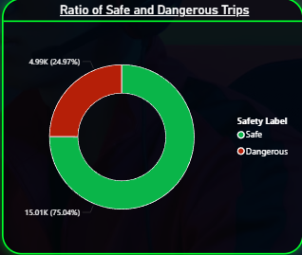
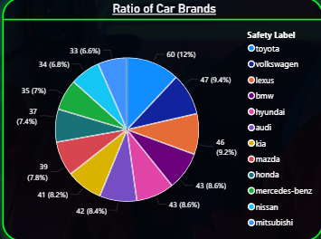
Dashboard 1: Overview
DRIVER OVERVIEW:
  500 active drivers, average ~15 years of driving experience → mature, experienced base
  Average driver rating ≈ 4.0, showing generally good but improvable performance
DISTRIBUTION OF CAR BRANDS:
Fleet contains 12 car brands; distribution is fairly balanced and brand does not show clear safety differences
TRIP SAFETY
  Overall trip safety:
  ~75% Safe vs ~25% Dangerous → roughly 1 in 4 trips involves dangerous behaviour
  Early conclusion: safety issues are significant enough to justify an AI-based monitoring system

Slide 16
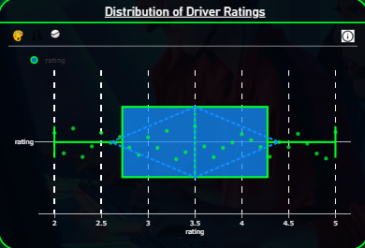
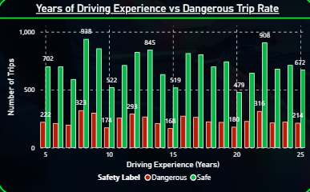
Dashboard 1: Experience, Ratings & Cars
DRIVER RATINGS:
  Most ratings fall between 3.0 and 4.5, median around 3.5
  Majority of drivers deliver satisfactory to good service, with a few outliers on both ends
DISTRIBUTION OF CAR BRANDS:
  Dangerous trips appear across all experience levels
  No strong downward trend in dangerous trip rate with more years of driving
  Even drivers with 15–25 years of experience still record noticeable dangerous trips
CAR MODEL YEAR:
  Most vehicles are from 1990–2010 (especially 1995–2005); few cars after 2010
  Raises concerns about older hardware/safety features, but older years do not clearly drive higher dangerous trip rates in this dashboard

Slide 17
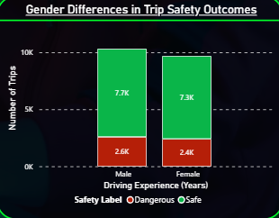
Dashboard 1: Gender & Overall Takeaways
GENDER BREAKDOWN:
  Male drivers: ~10.3K trips (≈ 2.6K dangerous, 7.7K safe)
  Female drivers: ~9.7K trips (≈ 2.4K dangerous, 7.3K safe)
  Proportion of dangerous trips is very similar between genders
KEY IMPLICATIONS FROM DASHBOARD 1:
  Dangerous trips are common (25%) and need targeted intervention
  Experience is not a strong predictor of safety – both new and veteran drivers can drive dangerously
  Vehicle brand/model year show limited impact on dangerous behaviour in this view
  Ratings alone don’t fully capture safety – sensor data will be needed in Sprint 2
  Gender is not a meaningful risk factor; interventions should be behaviour-based, not demographic

Slide 18
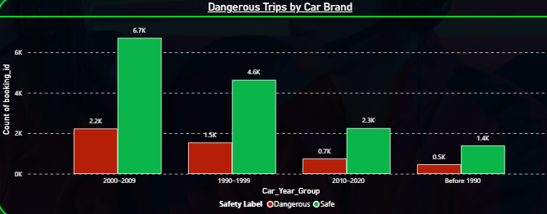
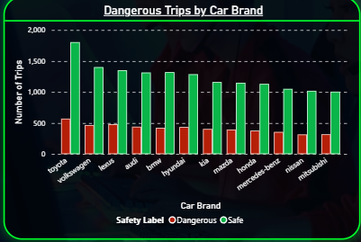
Dashboard 2: Trips, Brands & Car Age
OVERALL TRIP STATS:
  20,000 trips in total.
  15,000 Safe, 5,000 Dangerous → 25% dangerous rate, matching Dashboard 1.
  Confirms that 1 in 4 trips involves unsafe behaviour – not a rare edge case.
DANGEROUS TRIPS BY CAR BRAND:
  Every brand shows more safe than dangerous trips, but dangerous trips are present for all.
  Example patterns:
  Toyota ≈ 1,800 safe vs ~550 dangerous.
  Volkswagen ≈ 1,400 safe vs ~500 dangerous.
  Brands like Toyota, Volkswagen, Lexus, Audi, BMW have higher total trip volumes, but dangerous shares remain proportionate.
  Conclusion: brand does not strongly influence dangerous behaviour – driver habits matter more.
DANGEROUS TRIPS BY CAR YEAR GROUP:
  1990–1999 and 2000–2009: highest volumes of trips and dangerous trips (around 1.5K and 2.2K dangerous respectively).
  2010–2020: fewer trips overall, ≈ 0.7K dangerous trips.
  Pre-1990: least trips but still ≈ 0.5K dangerous.
  Newer cars may look slightly safer, but differences are not dramatic → car age is, at most, a secondary factor.

Slide 19
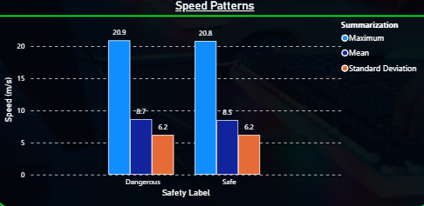
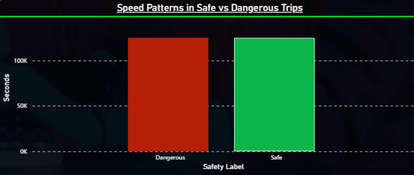
Dashboard 2: Speed Metrics & Key Takeaways
SPEED MAGNITUDE PATTERNS:
  Max, mean, variablility for speed are about the same.
  Interpretation: dangerous trips are not about sustained high speed; they are more about how speed changes during the trip (surges, fluctuations).
TRIP SAFETY
Overall Dashboard 2 key insights
  Speed volatility > raw speed
  Dangerous trips aren’t just “faster” — they involve bursts and fluctuations, not much difference in peak or average speeds.
  Brand & model year stay low-impact
  Across brands and age groups, the proportions of dangerous trips are fairly stable; driver behaviour dominates.
  Risk level is operationally significant
  5,000 dangerous trips is a large absolute number, reinforcing the need for real-time safety monitoring, driver coaching, and potential cost reduction from fewer incidents.

Slide 20
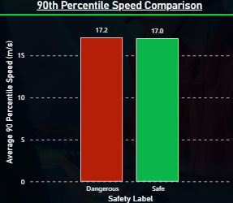
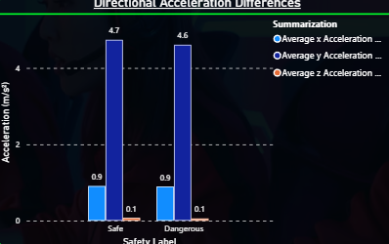
Dashboard 3: Sensor Baselines & Speed
OVERALL SENSOR BEHAVIOUR SUMMARY:
  Average speed: 8.54 m/s → consistent with urban driving.
  Average acceleration magnitude: 9.87 m/s² → normal range, with occasional moderate acceleration.
  Median jerk: 0.217 → most trips have mild changes in acceleration.
  Average gyroscope magnitude: 0.127 rad/s → generally stable turning and steering.
  These metrics set the baseline for comparing safe vs dangerous trips.
90TH PERCENTILE SPEED:
  Safe trips: 17.2 m/s
  Dangerous trips: 17.0 m/s
  Safe trips actually have slightly higher high-end speeds.
  Conclusion: top-end speed does not distinguish safe from dangerous behaviour – speeding alone is not the defining factor.
DIRECTIONAL ACCELERATION (X, Y, Z):
  X-axis: 0.9 m/s² for both safe and dangerous.
  Y-axis: around 4.6–4.7 m/s².
  Z-axis: 0.1 m/s².
  Patterns across all three axes are almost identical between safe and dangerous trips.
  This suggests unsafe behaviour is not strongly expressed through average directional acceleration differences.

Slide 21
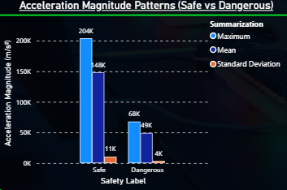
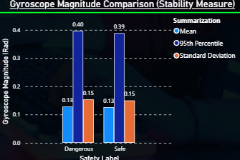
Dashboard 3: Jerk, Magnitude, Gyro & Key Takeaways
ACCELERATION MAGNITUDE PATTERNS:
Acceleration magnitude patterns
Mean acceleration magnitude:
  Safe: 148K
  Dangerous: 49K
Std dev:
  Safe: ~11K
  Dangerous: ~4K
  Safe trips show higher totals mainly because they cover more movement overall; the key difference is in consistency rather than peak intensity.
KEY INSIGHTS:
  Danger ≠ higher speed
  Speeds (mean and p90) are very similar between safe and dangerous trips; dangerous driving is not about being constantly faster.
  Instability is subtle and localised
  Jerk and gyroscope show tiny but consistent differences at higher percentiles, pointing to brief moments of harsher braking, acceleration or turning.
  Whole-trip averages look similar
  Directional acceleration and turning degrees are almost identical, so unsafe behaviour is likely tied to short micro-events, not to the overall average profile.
  Safe trips still look smoother overall
  When looking at acceleration magnitude and variability across the whole trip, safe trips tend to present more predictable, stable patterns, aligning with controlled driving.

Slide 22
Conclusion:
Across all user roles, the Sprint 1 solution delivers a cohesive safety analytics platform that turns raw driver, sensor, and safety-label data into actionable insights.
For managers, the dashboards provide intuitive views of overall safety trends, risky drivers, and aggregated statistics by region and time of day, enabling them to monitor safety KPIs, spot high-risk patterns, and plan targeted safety campaigns and platform features. For operations supervisors, trip-level linkage between drivers, safety labels, and sensor features makes it possible to trace unsafe behaviour back to specific trips and drivers, compare sensor patterns across journeys, and generate performance reports to guide feedback and retraining.
Behind the scenes, data scientists benefit from a normalised SQL schema and automated ETL pipelines that reliably feed clean, consistent data into Jupyter, supporting thorough EDA and feature selection for Sprint 2’s predictive models. Software developers gain a modular, reusable ETL codebase and well-structured SQL query scripts that make the analytics layer easy to extend, integrate, and productionise in future AI applications. Finally, safety analysts can visualise correlations between sensor metrics and trip outcomes, helping them interpret behavioural risk factors and translate technical patterns into concrete safety recommendations.
Together, these outcomes show that Sprint 1 not only satisfies the current user stories across business, operations, data, and engineering roles, but also lays a solid, production-oriented foundation for building real-time, AI-driven fraud and safety detection in Sprint 2.

Slide 23
Thank You!

