Slide 1
Yelpy
Fisher Ramsev, Jorge Castaneda Ribence Kadel, Austin Robinson

Slide 2
Our Mission
Increasing Emphasis On Reviews
An online presence nowadays is extremely important for business visibility, sales, and influencing customer trust and purchasing decisions
Struggling New Businesses: The Challenge of Visibility
New restaurants face significant hurdles establishing themselves, mainly due to a weak or non-existent online presence. This lack of visibility severely limits their ability to attract initial customers. Consequently, the absence of customers directly translates to a lack of crucial online reviews.
Our Solution
Yelpy, an AI solution to batch produce tailored fake reviews.

Slide 3
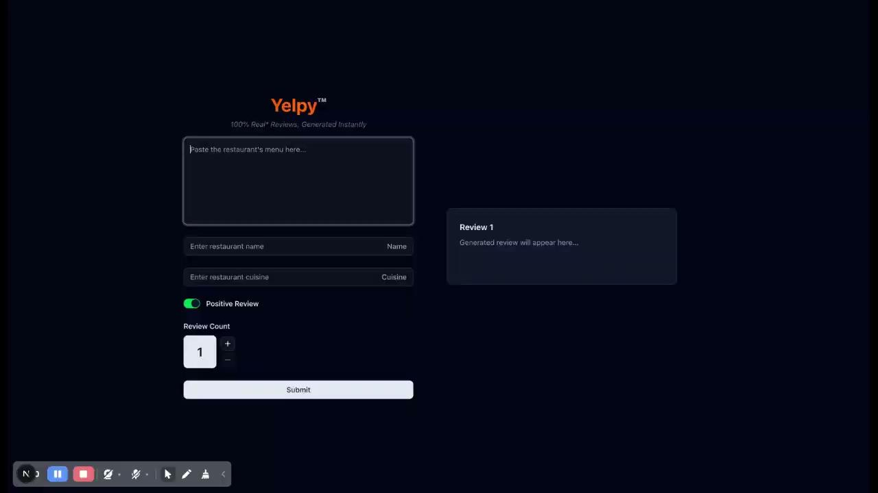
Demo

