Slide 1
VBGC
Typical von Bertalanffy Growth Model

Slide 2
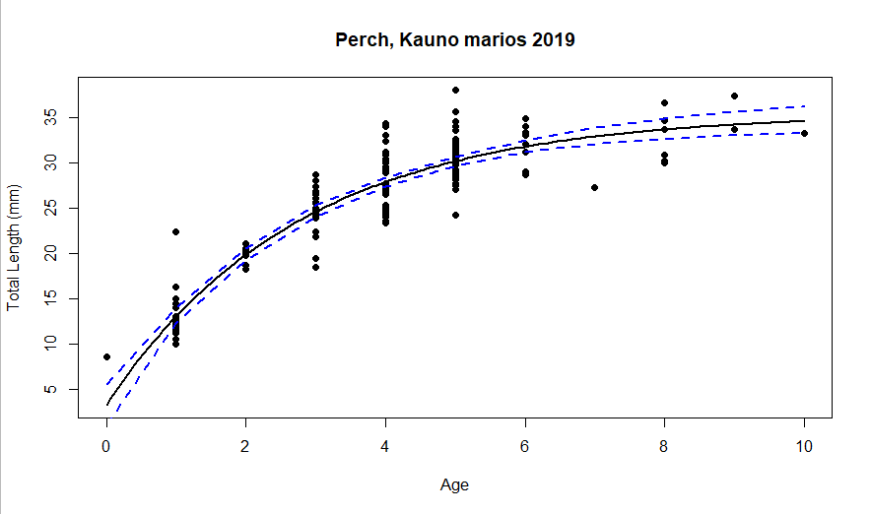
95% LCI 95% UCI
Linf 33.6495193 38.02331992
K 0.2894652 0.44203255
t0 -0.5319595 -0.06924498
Notes:
Age from otoliths

Slide 3
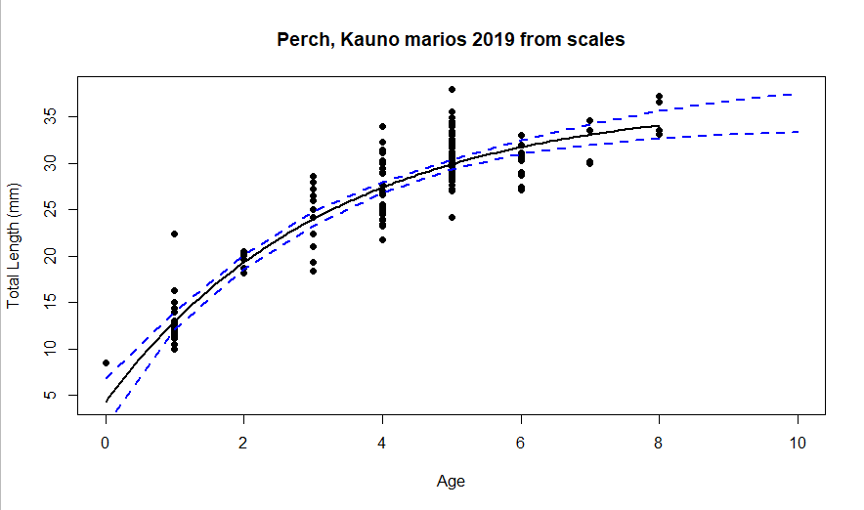
95% LCI 95% UCI
Linf 33.9761658 41.0520162 K 0.2265065 0.4033511
t0 -0.7857861 -0.1380057

Slide 4
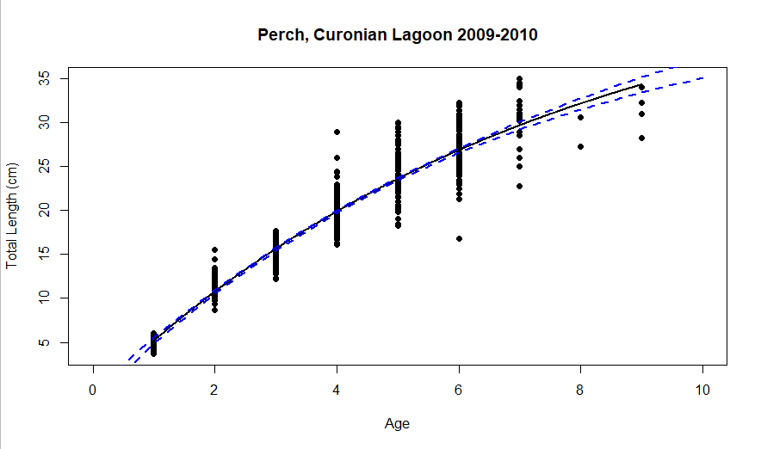
95% LCI 95% UCI
Linf 44.82617065 55.2391230
K 0.11377825 0.1580049
t0 0.07983783 0.2721035
Notes:
Age from otoliths

Slide 5
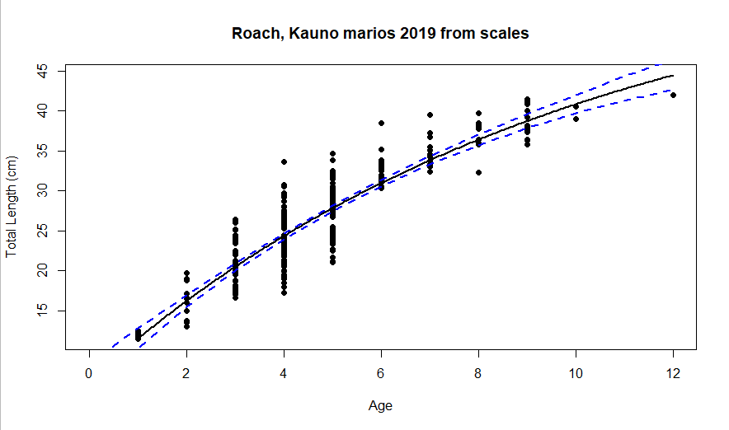
95% LCI 95% UCI
Linf 52.70015151 77.1049720
K 0.06683762 0.1349316
t0 -1.71822841 -0.6428268

Slide 6
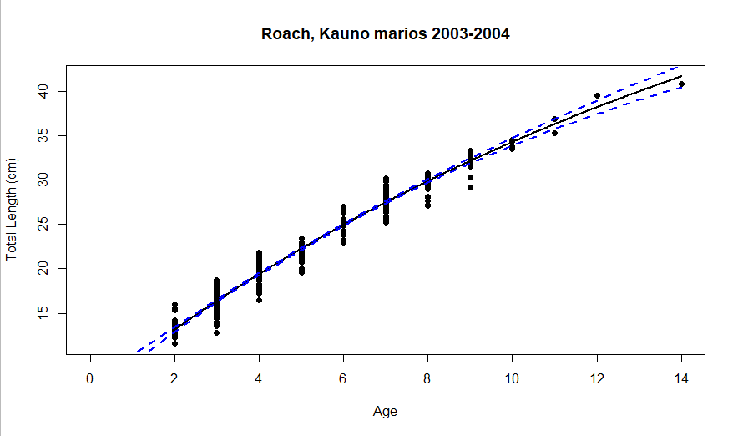
95% LCI 95% UCI
Linf 58.95861402 88.0260536
K 0.04180366 0.0757972
t0 -1.94446645 -1.2585423
Notes:
From scales?

Slide 7
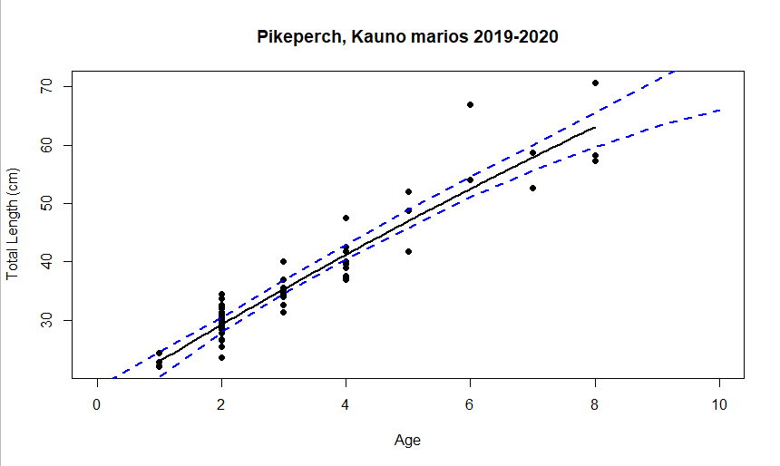
95% LCI 95% UCI
Linf 87.70307164 496.7378383
K 0.01263441 0.1280882
t0 -3.00778560 -1.0998945

Slide 8
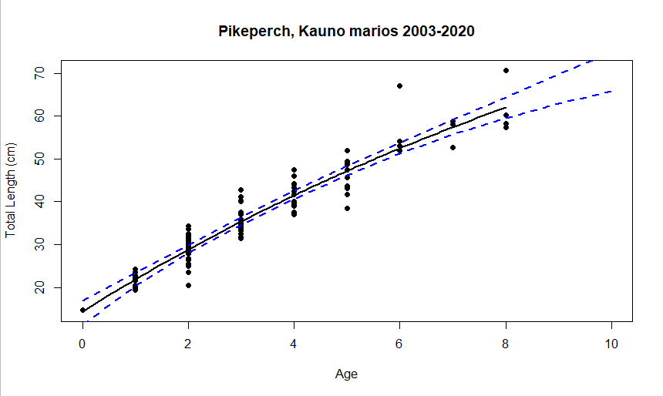
95% LCI 95% UCI
Linf 86.72517159 313.6373402
K 0.02187029 0.1272168
t0 -2.55812070 -1.0622578

Slide 9
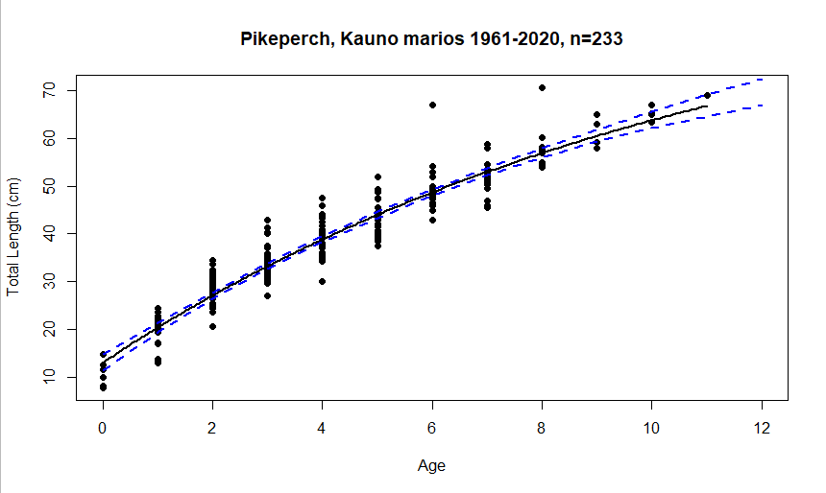
95% LCI 95% UCI
Linf 84.87882886 126.0372407
K 0.06032473 0.1184014
t0 -2.03847601 -1.2153519

Slide 10
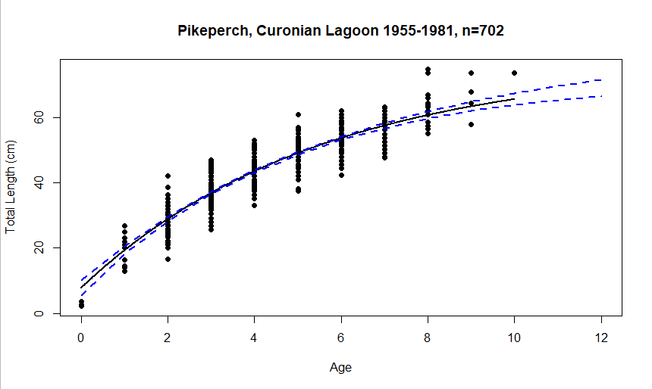
95% LCI 95% UCI
Linf 71.9016935 83.1880489
K 0.1543840 0.2118817
t0 -0.8365354 -0.3728330
Notes:
Life history parameters: VBGC has been estimated based on available aging data (n=702, see Supplementary material?). Thus, Linf=76.6 (72 - 83 cm, low and upper 95%conf int), K=0.18 (0.15 - 0.21)

Slide 11
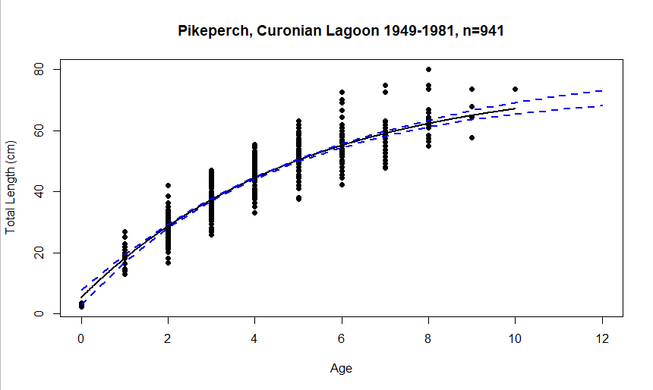
95% LCI 95% UCI
Linf 72.7739294 83.3969535
K 0.1658078 0.2256490
t0 -0.5878594 -0.1849358

