Slide 1
GOOGLE DATA ANALYTICS CAPSTONE PROJECT· BELLABEAT
Bellabeat Smart
Device Analysis
33
FitBit users
analysed
31 DAYS OF DATA
How consumers use smart wellness devices
and what it means for Bellabeat Leaf
Peter Francis Muthukkalai

Slide 2
BACKGROUND
Background & Business Task
"Analyze smart device usage data to gain insight into how consumers use non-Bellabeat smart devices — then apply these insights to one Bellabeat product."
— Urška Sršen, Co-founder & CCO
The company
The opportunity
Our focus
Bellabeat is a high-tech wellness company for women, founded in 2013. Products track activity, sleep, stress and reproductive health.
Bellabeat has potential to become a major player in the global smart device market. Consumer behaviour insights will unlock growth.
Analysing FitBit user data to find trends in smart device usage — then applying findings to the Bellabeat Leaf wellness tracker.

Slide 3
DATA SOURCE
Prepare — Data Source & Limitations
DATA SOURCE
LIMITATIONS
FitBit Fitness
Tracker Data
Small sample size
Only 33 users — not statistically representative of the broader population
— Source: Kaggle — CC0 Public Domain (Möbius)
Outdated data
Data from 2016 — smart device usage patterns have evolved significantly
— 33 eligible FitBit users, April–May 2016
— Includes daily activity, hourly steps, sleep and weight
No demographics
No age, gender or location data — cannot confirm users are Bellabeat's target audience (women)
— Minute-level data available but not used — daily/hourly sufficient
Sleep & weight gaps
Only 24 of 33 users tracked sleep. Only 8 tracked weight — these findings less reliable

Slide 4
PROCESS
Data Cleaning — Assumptions & Decisions
Tool: BigQuery (SQL) — chosen for handling ~22,000 hourly records.
3 duplicate records
REMOVED
Identified and removed duplicate data from sleep activity data.
65 nulls in Fat column
EXCLUDED
97% of Fat column null — only 2 users had smart scales. Column excluded from analysis entirely.
84 invalid activity days
REMOVED
Zero steps + 1440 sedentary minutes = device not worn. Confirmed by BMR-only calories (~1347). Removed from daily activity data.
Mixed date formats
CONVERTED
FitBit exported two formats (MM/dd/yyyy AM/PM and MM-dd-yyyy HH:MM). Standardised to TIMESTAMP.
Sedentary includes sleep
NOTED
FitBit records sleep as sedentary. Absolute values reflect 24hr inactivity. Analysis focuses on relative differences between segments.

Slide 5
KEY FINDINGS
What the data tells us
8,329
15.9hrs
7.0hrs
avg daily steps
avg sedentary/day
avg sleep/night
17% below WHO 10K goal
66% of 24hr day inactive
Minimum recommended
39 mins
78.7%
6pm
awake in bed nightly
not meeting step goal
peak activity hour
Poor sleep quality signal
Only 7 of 33 users active
599 avg steps — post work

Slide 6
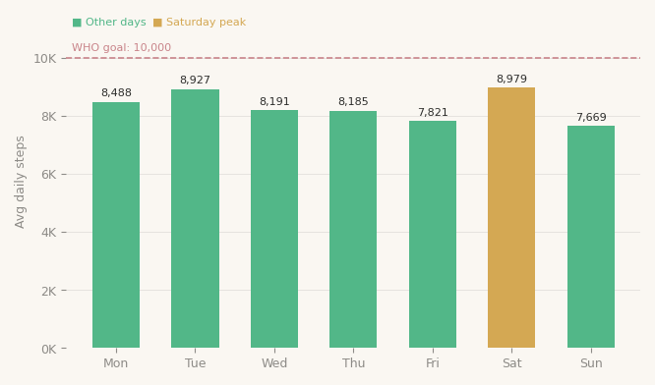
ANALYSIS 1 / 6
Activity Varies Significantly by Day of Week
Key insight
Saturday peak
Most active day at 8,979 steps — users exercise more when not at work.
Sunday & Friday dip
Lowest activity days. Friday shows end-of-week fatigue. Sunday recovery day.
Monday most sedentary
16.4 hrs sedentary on Mondays — start of work week effect.

Slide 7
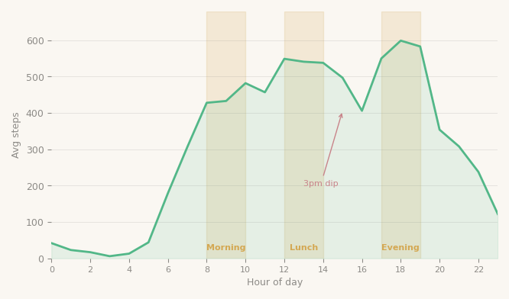
ANALYSIS 2 / 6
Three Clear Activity Peaks Throughout the Day
Key insight
Morning peak 8–10am
Users active during morning commute and early work hours.
Lunch peak 12–2pm
Mid-day activity surge — users walking during lunch break.
Evening peak 5–7pm
Highest activity at 6pm (599 steps). Post-work exercise.
3pm dip
Activity drops at 3pm — optimal time for Leaf movement reminders.

Slide 8
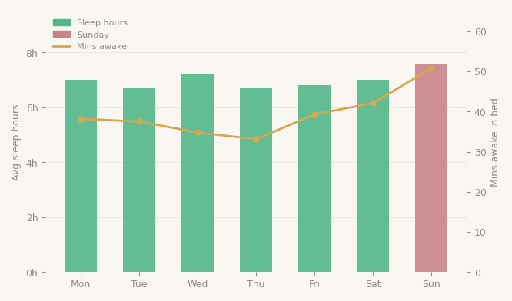
ANALYSIS 3 / 6
Users Sleep Enough But Sleep Quality is Poor
Key insight
7.0hrs avg sleep
Just meeting the 7hr minimum. Many nights will fall below.
39 mins awake nightly
Users lie awake 39 mins every night — poor wind-down routine.
The Sunday paradox
Most time in bed Sunday (8.4hrs) but worst quality — 50.8 mins awake. Anticipatory work-week stress.

Slide 9
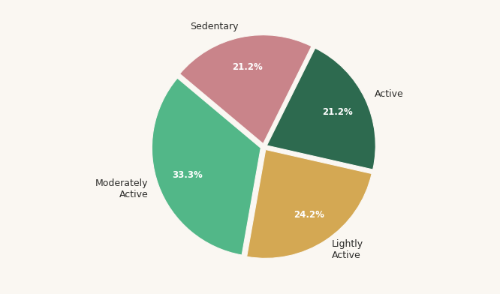
ANALYSIS 4 / 6
78.7% of Users Are Not Meeting Their Step Goal
Active
21.2% · 12,683 avg steps
Moderately Active
33.3% · 8,685 avg steps
Lightly Active
24.2% · 6,437 avg steps
Sedentary
21.2% · 3,687 avg steps

Slide 10
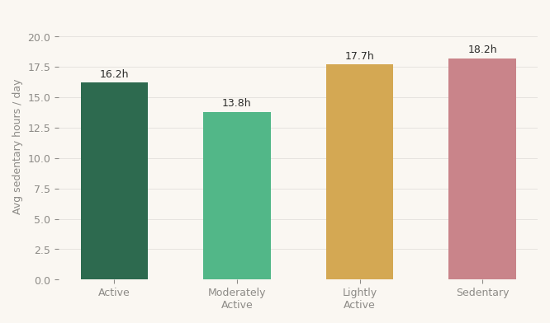
ANALYSIS 5 / 6
Sedentary Behaviour Affects Every User Segment
Key insight
Active users: 16.2hrs
Even the most active users sit for 16+ hours daily — sedentary problem crosses all segments.
Sedentary users: 18.2hrs
Nearly 3/4 of the day completely inactive.
Lightly Active: 17.7hrs
More sedentary than Moderately Active despite similar activity labels.

Slide 11
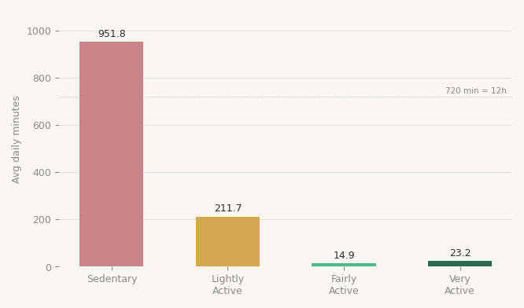
ANALYSIS 6 / 6
Sedentary Minutes Dominate the Average Day
Key insight
951.8 mins sedentary every day That's 15.9 hours — 66% of a 24-hour day. Very active mins: only 23.2/day Users are close to the 20–30 min exercise recommendation but spend the rest of the day completely inactive.

Slide 12
RECOMMENDATIONS
Three Strategies for Bellabeat Leaf
01 · SEDENTARY BEHAVIOUR · HIGHEST PRIORITY
Smart Movement Reminders Throughout the Day
Users are sedentary for 15.9 hours daily — across ALL activity segments. Bellabeat Leaf should send personalised movement nudges timed to the 3pm activity dip and Monday sedentary spike. Messaging: 'You've been still for 2 hours — a 5-minute walk makes a difference.'
02 · SLEEP QUALITY · MEDIUM PRIORITY
Sunday Wind-Down Programme for Better Sleep
Users spend 50.8 mins awake in bed on Sunday nights — the worst sleep quality of the week. Bellabeat app should trigger a guided Sunday evening wind-down routine (meditation, breathing exercises) targeting anticipatory work-week stress. Messaging: 'Prepare your mind for the week ahead.'
03 · USER SEGMENTATION · GROWTH OPPORTUNITY
Personalised Goals for Each Activity Segment
78.7% of users are not meeting step goals but for very different reasons. Moderately Active users (33%) are closest to the goal and most convertible with small nudges. Bellabeat membership should offer segment-specific coaching: 'You're 1,315 steps from your goal — here's a 10-min walk route near you.'

Slide 13
NEXT STEPS
Applying These Insights
Collect Bellabeat-specific user data
A/B test the movement reminder timing
FitBit data is from 2016 with only 33 users. Bellabeat should analyse its own app data — larger, more recent, and confirmed female demographic — for more reliable insights.
Test notification timing at 3pm vs other hours to confirm the optimal nudge window. Measure step count increase in the hour following the notification.
Investigate the Sunday sleep problem
Build segment-aware onboarding
Survey users about Sunday night sleep quality and stress levels. Validate the anticipatory stress hypothesis before building the wind-down feature.
Classify new Bellabeat Leaf users into activity segments during onboarding and immediately personalise their goals, reminders and coaching content.

Slide 14
Thank You
Peter Francis Muthukkalai
Bellabeat Smart Device Analysis · Google Data Analytics Capstone Project
Tableau: public.tableau.com/app/profile/peter.francis.muthukkalai · BigQuery: Google Cloud

