Slide 1
Open data analysis
Sample 7
Nadia Mariana Leal Reyes.

Slide 2
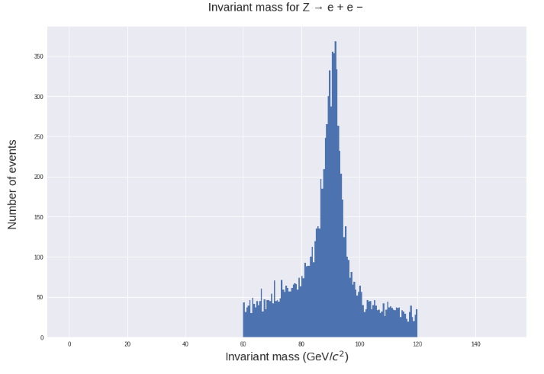
Invariant mass
The particles analyzed are electron pairs. As the figure shows, the peak of the invariant mass is around 90 GeV which indicates the particles are Z candidates.

Slide 3
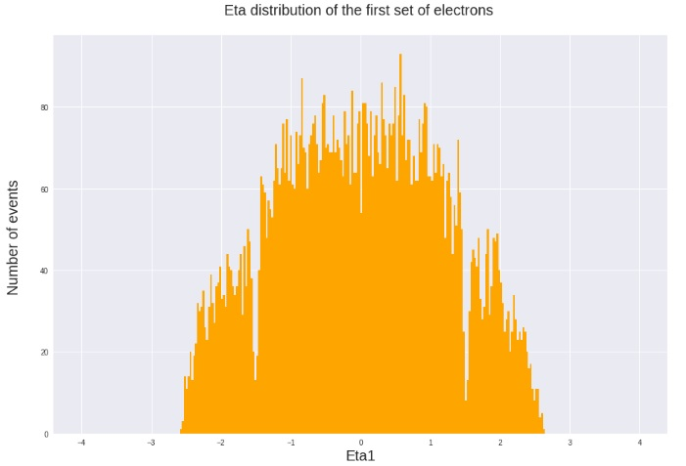
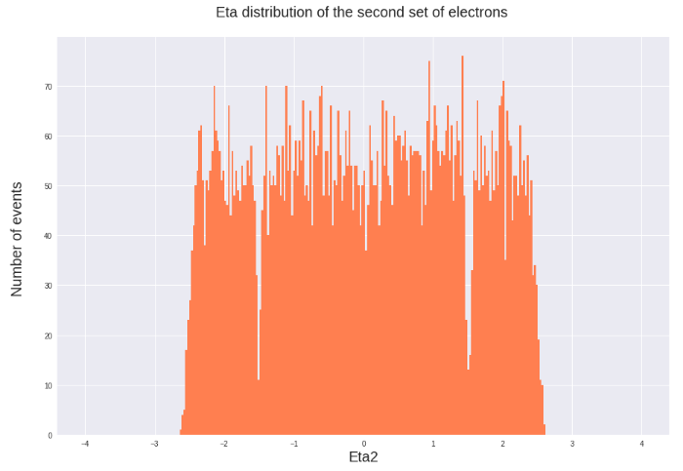
η distribution
The η distribution is aproximately between -2.4 and 2.4 and there are wholes around -1.5 and 1.5 as the detector is blind in that section.

Slide 4
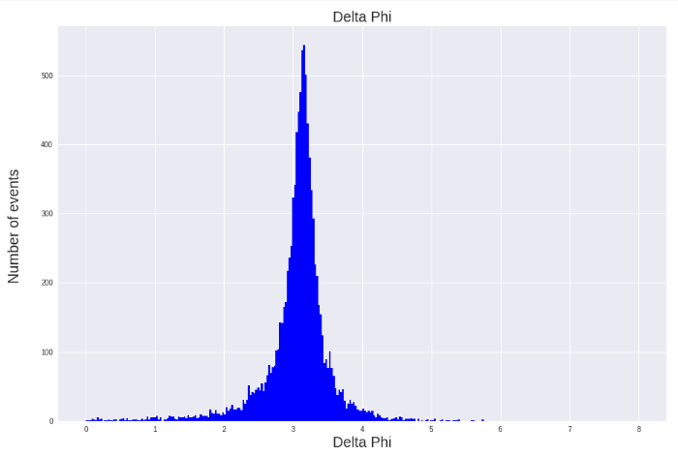
deltaphi
The graph shows the data of the absolute value of delta phi, were it is clearly seen that the there are cases were delta eta is bigger than pi, so this is a variable that will be restricted.

Slide 5
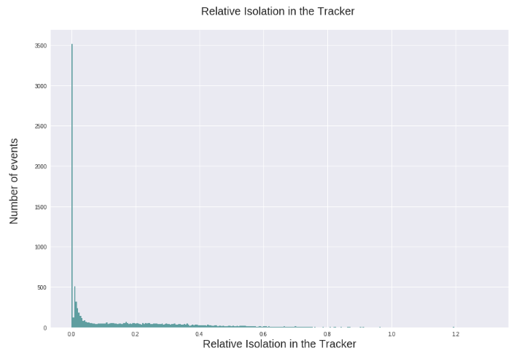
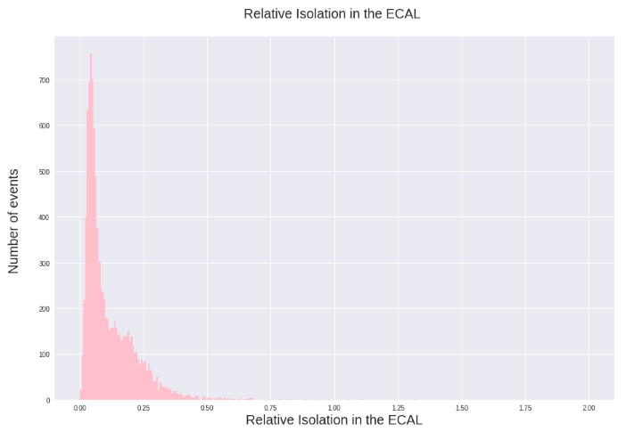
Relative Isolation in the tracker, ecal and hcal

Slide 6
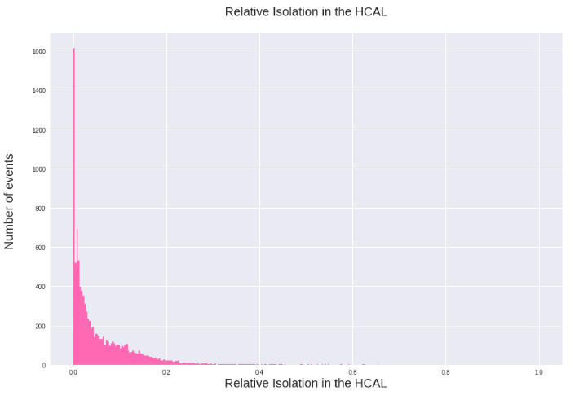
Using these variables, only the data that has its relative isolation in the tracker smaller than 0.2, its relative isolation in the ECAL smaller than 0.5 and its relative isolation in the HCAL smaller than 0.2 will be used.

Slide 7
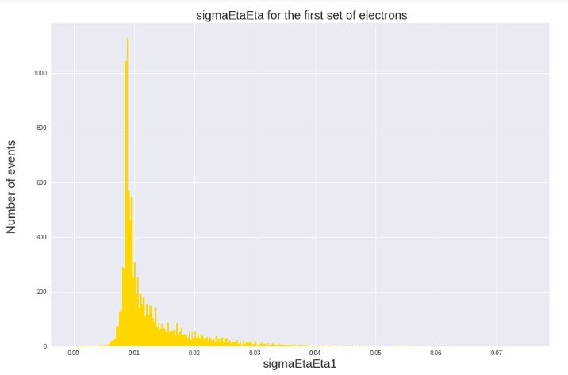
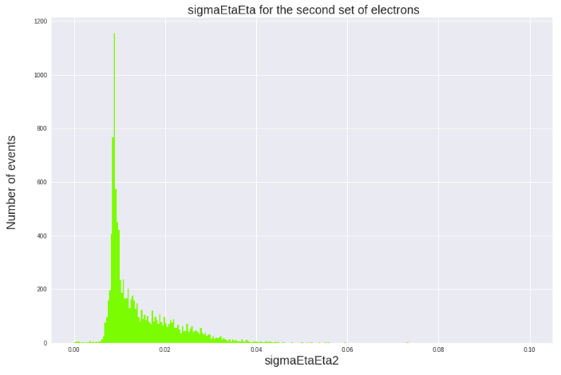
σηη
For these variables only the data that is smaller than 0.02 will be used

Slide 8
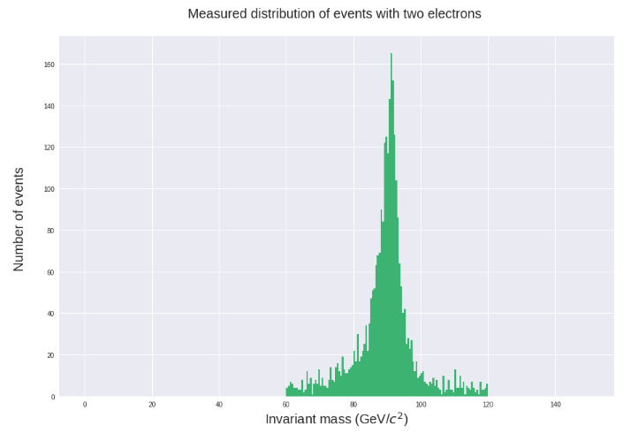
Invariant mass taking into account all variables
Taking into account all the variables and their respective restrictions the number of events decresease from 10000 to 2811, getting an acceptance of 28.11%

