Slide 1
Upsilon Meson ϒ

Slide 2
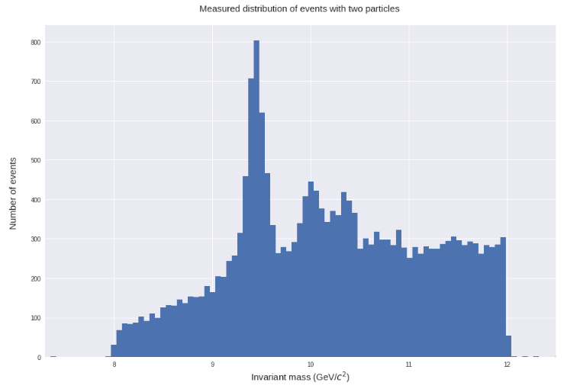
We have the reconstruction of the invariant mass of 20,000 events.

Slide 3
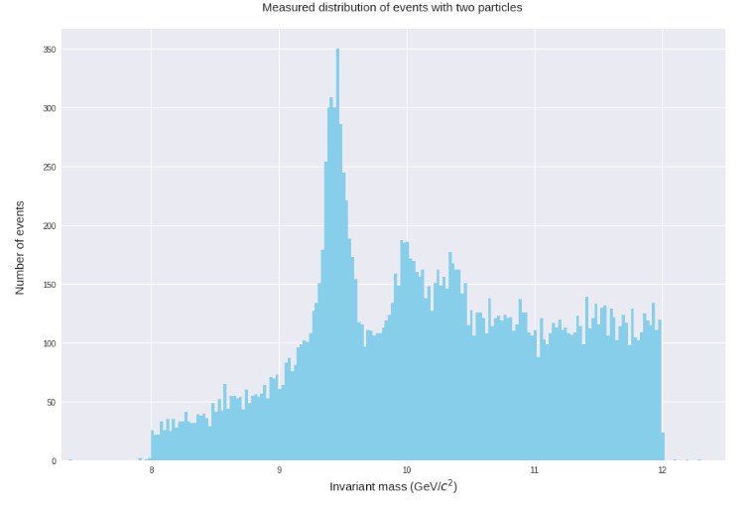
After the first cut, we have 18881 events considering only global muons.

Slide 4
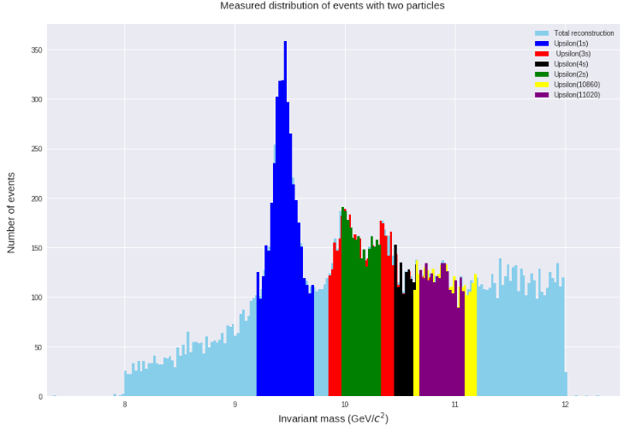
We have:
4117 candidates to Upsilon(1S)
2395 candidates to Upsilon(2S)
6008 candidates to Upsilon(3S)
1240 candidates to Upsilon(4S)
2822 candidates to Upsilon(10860)
2013 candidates to Upsilon(11020)

