Slide 1
White Wine Quality Classification
76.67%
final test accuracy
CAN MACHINES “TASTE” WINE QUALITY?
Using physicochemical measurements to support a quality-screening decision
70% objective exceeded
Angelica Roa, Project Manager | Paul Obamwonyi, Analyst
Notes:
[Sources]
- https://archive.ics.uci.edu/dataset/186/wine+quality
- Project notebook analysis
[/Sources]

Slide 2
WHITE WINE QUALITY
MAIN QUESTION
Can 11 physicochemical properties predict whether a white wine is lower quality or acceptable/higher quality?
70%
The objective is to develop a classification model that predicts whether a white wine belongs to the lower-quality class or the acceptable/higher-quality class based on its physicochemical properties.
Minimum test-accuracy objective
A screening model must be accurate and responsible, this model is fit to data from Portuguese Vino Verde
Decision support - not a replacement for sensory experts
02
Notes:
[Sources]
- Project notebook analysis
[/Sources]

Slide 3
WHITE WINE QUALITY
Cleaning left 3,961 unique white-wine records
4,898
937
3,961
-
=
original observations
duplicate rows removed
cleaned observations
11 numeric physicochemical predictors
No missing values
Alcohol | Density | Acidity | Sugar | Chlorides | Sulfur dioxide | pH | Sulphates
P. Cortez, A. Cerdeira, F. Almeida, T. Matos and J. Reis. Modeling wine preferences by data mining from physicochemical properties. In Decision Support Systems, Elsevier, 47(4):547-553. ISSN: 0167-9236.
Available at: [@Elsevier] http://dx.doi.org/10.1016/j.dss.2009.05.016
03
Notes:
[Sources]
- https://archive.ics.uci.edu/dataset/186/wine+quality
- Project notebook analysis
[/Sources]

Slide 4
WHITE WINE QUALITY
A stratified split protected the final evaluation
Class 0
Class 1
Leakage prevention
Quality scores 3-5
34.03% of cleaned data
Quality scores 6-9
65.97% of cleaned data
Original quality score excluded from X.
Scaling fitted on training data only.
Grid Search used training folds only.
80% training
20% test
3,168 wines
793 untouched wines
Stratification kept class proportions nearly identical across train and test sets.
04
Notes:
[Sources]
- Project notebook analysis
[/Sources]

Slide 5
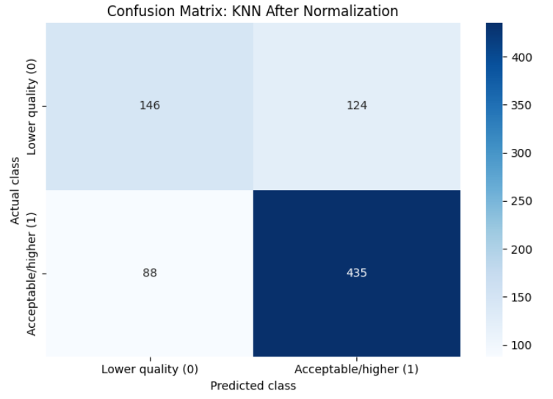
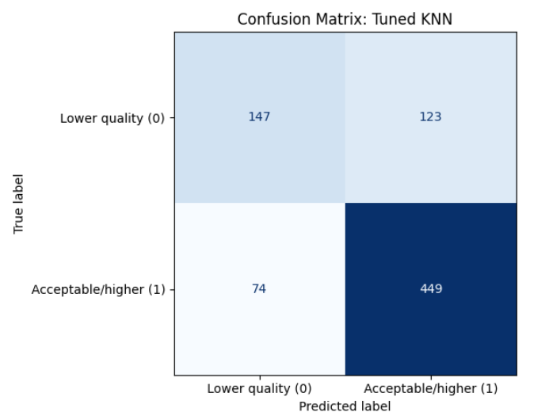
WHITE WINE QUALITY
Normalization helped KNN cross the 70% objective
Data Balance
Scaling: KNN uses distances. Features with large numeric ranges can dominate unless scales are aligned.
Tuning of KNN using Grid Search and Cross-Validation
The imbalance was moderate, not extreme. We preserved the observed distribution and addressed class performance through stratification and profit from it to set the Baseline. Our Label is Acceptable-High quality. Lower-quality will need to be further analyzed.
05
Notes:
[Sources]
- Project notebook analysis
[/Sources]

Slide 6
WHITE WINE QUALITY
Gradient Boosting delivered the strongest overall result
77.43%
five-fold cross-validation accuracy
76.67%
test accuracy
The initial Random Forest achieved 76.29 percent test accuracy. Gradient Boosting works differently: it builds trees sequentially so each new tree helps correct remaining errors.
We used five-fold stratified cross-validation and Grid Search for model tuning.
Grid Search: 72 combinations x 5 folds = 360 fits
06
Notes:
[Sources]
- Project notebook analysis
[/Sources]

Slide 7
WHITE WINE QUALITY
Lower-quality recall changed the model ranking
Recall asks
Of all genuinely lower-quality wines, how many did the model detect?
Tuned RF: 65%
Accuracy remains highest for tuned Gradient Boosting.
07
Notes:
[Sources]
- Project notebook analysis
[/Sources]

Slide 8
WHITE WINE QUALITY
Threshold 0.68 trades accuracy for stronger quality control
Default threshold 0.50
Quality-control threshold 0.68
76.67%
60.74%
71.88%
76.67%
->
test accuracy
lower-quality recall
test accuracy
lower-quality recall
+15.93 points in lower-quality recall | -4.79 points in overall accuracy
08
Notes:
[Sources]
- Project notebook analysis
[/Sources]

Slide 9
WHITE WINE QUALITY
The accuracy interval remains entirely above 70%
95% bootstrap confidence interval
76.67% observed
73.52%
79.57%
70% objective
Lower-quality recall
60.74%
95% CI: 54.58% to 66.30%
09
Notes:
[Sources]
- Project notebook analysis
[/Sources]

Slide 10
WHITE WINE QUALITY
Alcohol leads the explanation - but the surrogate is approximate
Surrogate Decision Tree
87.14%
test fidelity
Main splits: alcohol, volatile acidity and free sulfur dioxide
Fidelity measures agreement with the complex model - not causal truth.
10
Notes:
[Sources]
- Project notebook analysis
[/Sources]

Slide 11
WHITE WINE QUALITY
The best operating point depends on the cost of errors
76.67%
Three conclusions
1. The model can predict with 76.67% of accuracy whether a Portuguese White Wine (Vino Verde) is acceptable-high quality or low quality.
2.Tuned Gradient Boosting is the final general-purpose model. Threshold 0.68 raises lower-quality recall to 76.67%.
3. External validation is required before real deployment. And other wine variances need further studies.
best general-purpose test accuracy
Machine learning supports quality screening; it does not replace sensory expertise.
Thank you - questions are welcome
11
Notes:
[Sources]
- Project notebook analysis
[/Sources]

