Slide 1
OPERATIONAL TOOLING FOR ENTERPRISE BTP
BTP Architecture
& Governance
An 11-app advisory arsenal that turns governance reviews into running dashboards your customers keep.
CIS · IAS · Subaccount · Clean Core · BTP AI Services

Slide 2
WHY NOW
The governance gap your customers don't know they have
83%
€127K
6 mo.
of BTP customers
average annual waste
silent failure window
cannot answer "who can deploy to production" without manually walking the cockpit.
in idle subaccount entitlements per global account at €100M+ revenue customers.
between a misconfigured IAS trust and the access-review incident that surfaces it.
SAP gives them the platform. SAP does not give them the operational visibility to run it.
BTP Architecture & Governance Advisory
2 / 20

Slide 3
THE ADVISORY MODEL
We don't leave a PDF behind. We leave running dashboards.
01
02
03
04
Workshop
Assess
Recommend
Hand over
Senior EA on-site or remote. Open the apps against the customer's tenant in front of them.
The Compliance Scorecard runs against their landscape. Findings are concrete, not opinion.
Tune rules and baselines live in the workshop. Snapshot before-state.
Leave the apps running in their tenant. Snapshot after-state at the next QBR.
Conventional advisory ends when the deck closes. Ours ends when the customer rebuilds their cockpit on what we shipped them.
BTP Architecture & Governance Advisory
3 / 20

Slide 4
THE ARSENAL
11 apps. 4 tiers of fit. One MTA shape.
01
02
03
04
Subaccount Lifecycle & Drift
Destination & Connectivity
Compliance Scorecard
Identity Federation Health
TIER 1 · IMPLEMENTED
TIER 1 · IMPLEMENTED
★ IP CENTERPIECE
TIER 2 · IMPLEMENTED
05
06
07
08
Role-Collection & Identity Map
Audit-Log & Change Inventory
Entitlement Optimization
BTP AI Services Governance
TIER 2 · IMPLEMENTED
TIER 2 · IMPLEMENTED
TIER 2 · IMPLEMENTED
TIER 3 · IMPLEMENTED
09
10
11
Trust Config & Cert Expiry
Cost Allocation & Showback
Clean Core Compliance
TIER 3 · IMPLEMENTED
TIER 3 · IMPLEMENTED
TIER 4 · IMPLEMENTED
▆ All 11 apps implemented ★ IP centerpiece ▎ Tier color (1 coral · 2 gold · 3 ice · 4 grey)

Slide 5
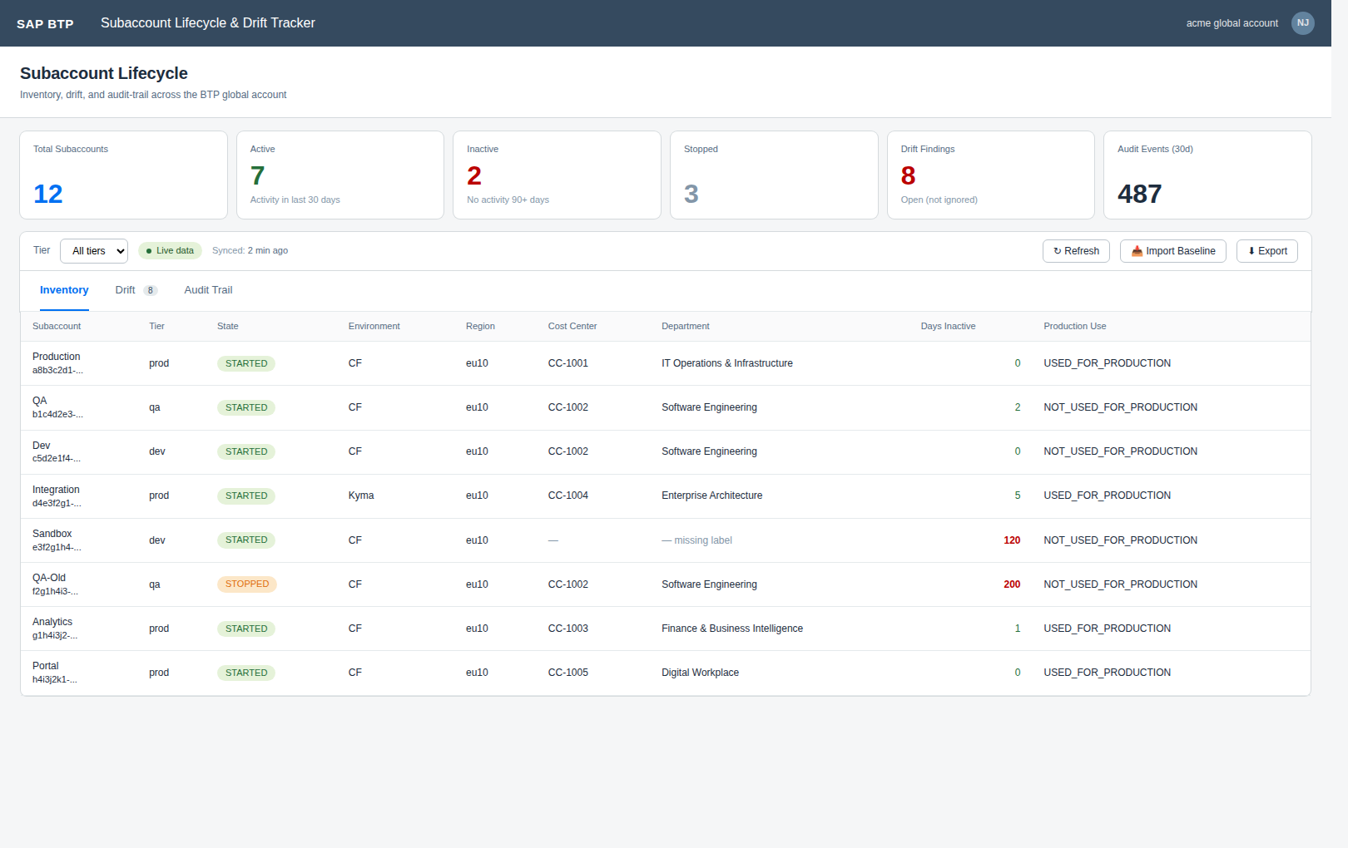
APP 01
TIER 1 · UNIVERSAL OPENER · IMPLEMENTED
Subaccount Lifecycle & Drift Tracker
The day-1 demo every engagement opens with — "show me my real estate."
WHAT IT SHOWS
Live inventory of every subaccount via CIS Accounts API.
Activity timestamps from Audit Log Retrieval — flags 90+ day inactive.
Drift detection: labels, service instances, role-collections vs tier baseline.
Tier inferred from labels (prod / qa / dev) with override per subaccount.
CUSTOMER VALUE
Customers cannot answer "what subaccounts do we have, and which can be turned off?" without this.
Identifies idle subaccounts within 5 minutes — typical first-week saving: €15-40K/yr.
The single-source-of-truth inventory their cockpit doesn't give them.
BTP Architecture & Governance Advisory
5 / 20

Slide 6
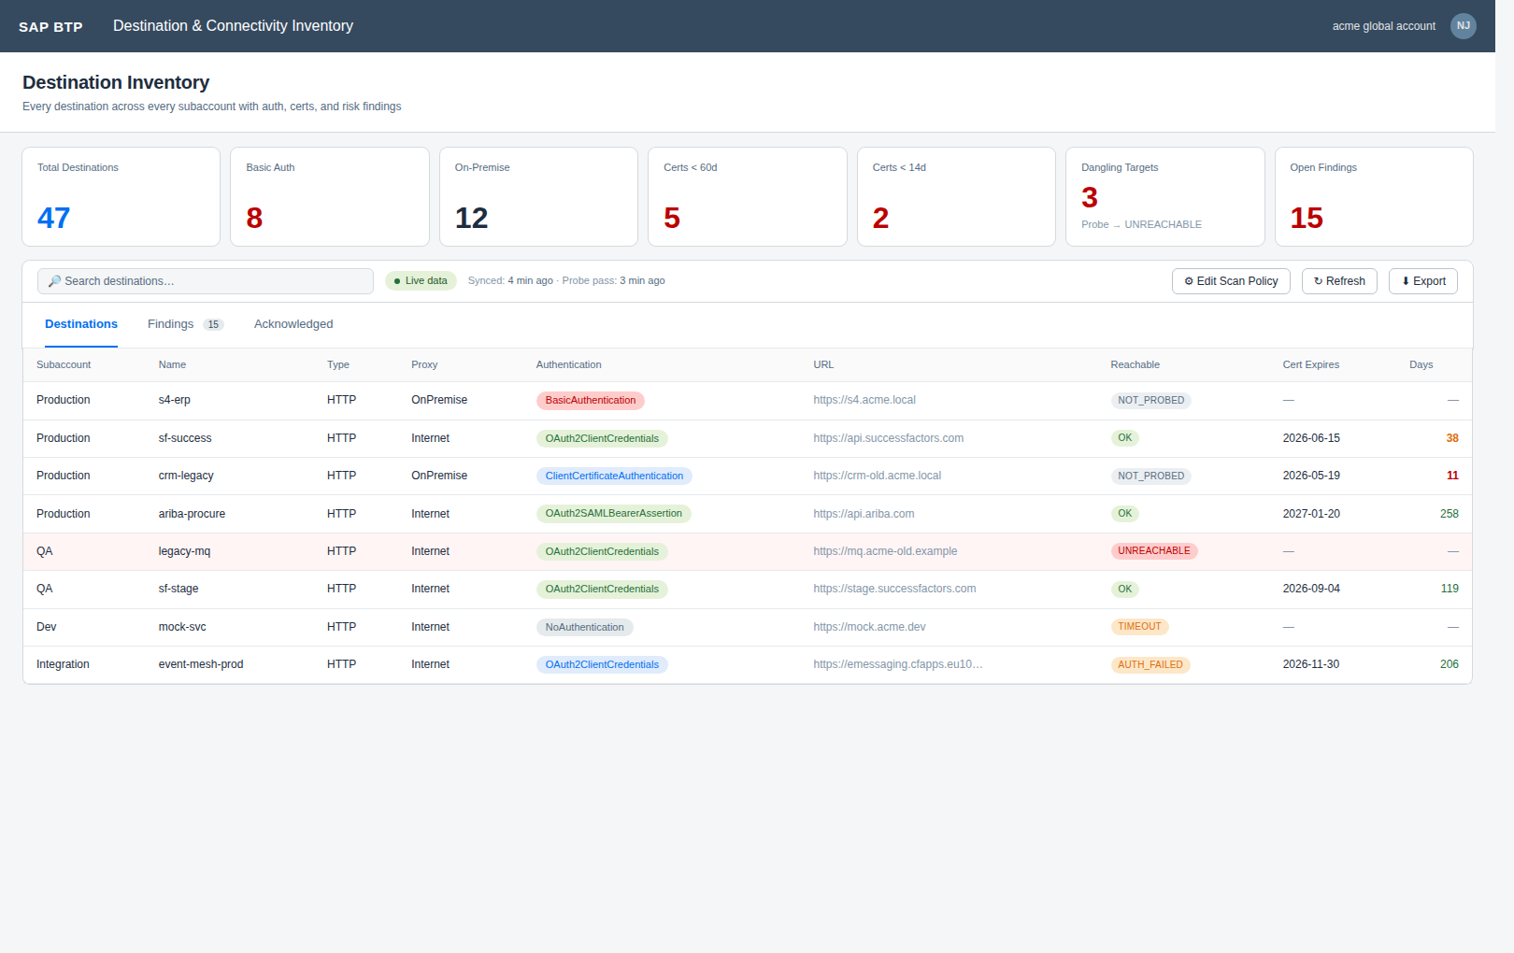
APP 02
TIER 1 · HIGHEST INSIGHT-PER-EFFORT · IMPLEMENTED
Destination & Connectivity Inventory
Every destination across every subaccount with risk scoring — basic auth, expiring certs, dangling targets.
WHAT IT SHOWS
Walks every subaccount's destination service via SUBACCOUNT_KEYS.
Parses x509 certificate content (Certificates[].Content) for expiry dates.
Findings: BasicAuth-in-prod, certs <14d, certs <60d.
Acknowledgement workflow with snooze-until — preserves audit trail.
CUSTOMER VALUE
Average customer has 200+ destinations and zero visibility — guaranteed material findings on day one.
Catches the cert-expiry incident before it takes prod down.
Hard ROI for the security review conversation.
BTP Architecture & Governance Advisory
6 / 20

Slide 7
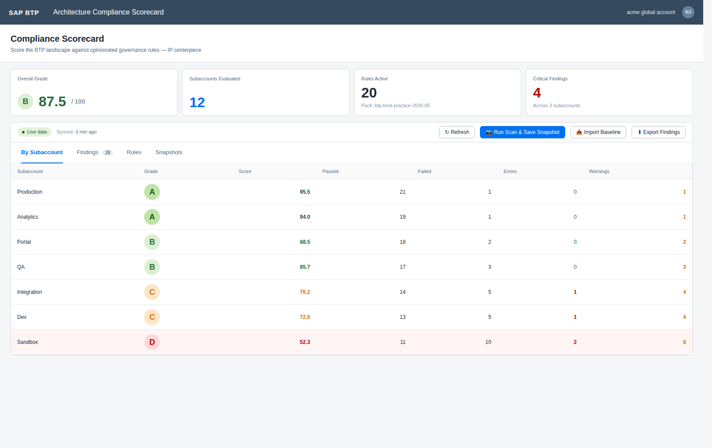
APP 03
★ IP CENTERPIECE · TIER 1 · HIGHEST MARGIN
Architecture Compliance Scorecard
Your codified governance opinion, running on the customer's real data, exporting the engagement deck.
WHAT IT SHOWS
Rule engine with 4 evaluators + 6 baseline rules out of the box.
Per-subaccount A/B/C/D/F grading; overall global-account score.
ScoreAdmin can edit rules in the workshop — tuned ruleset stays with the customer.
Snapshot persistence enables "before vs after" deliverable at every QBR.
CUSTOMER VALUE
Hardest to copy — codifies *your* IP, not SAP's.
Auto-generates the engagement's headline slide. Justifies the engagement on its own.
Demos extraordinarily well: tweak a rule live, watch grade change in real time.
BTP Architecture & Governance Advisory
7 / 20

Slide 8
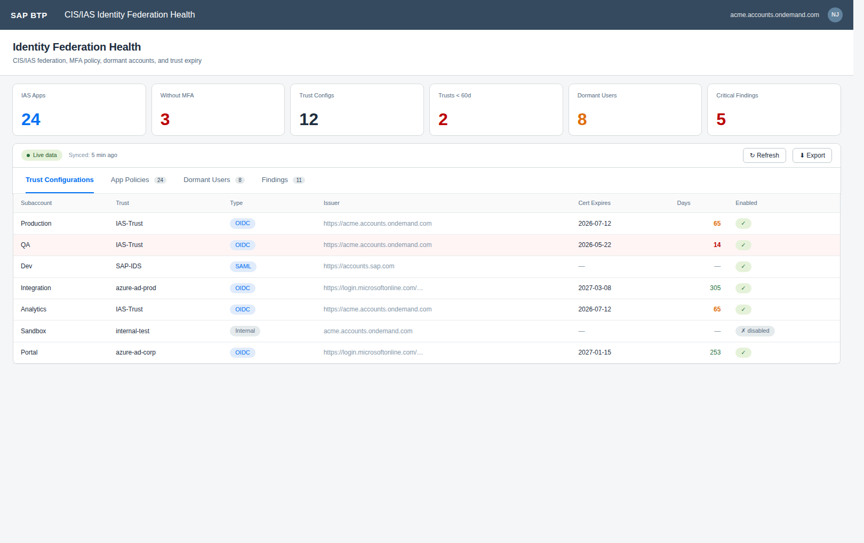
APP 04
TIER 2 · SECURITY/COMPLIANCE BUYER · IMPLEMENTED
CIS/IAS Identity Federation Health Check
The silent failures in IAS↔XSUAA federation — surfaced before they become an audit finding.
WHAT IT SHOWS
Trust configurations enumerated per subaccount with cert expiry parsing.
IAS Application list with MFA-enforcement detection per app.
SCIM dormant-user detection (90+ days from custom lastLogin extension).
Findings: TRUST_CERT_EXPIRING, MFA_MISSING_ON_ADMIN_APP, DORMANT_USER.
CUSTOMER VALUE
Identity is the #1 audit finding in BTP reviews — you arrive with the data already laid out.
Sells into CISOs and security architects, not just platform admins.
Pairs with app #5 to close the "who can do what" question end-to-end.
BTP Architecture & Governance Advisory
8 / 20

Slide 9
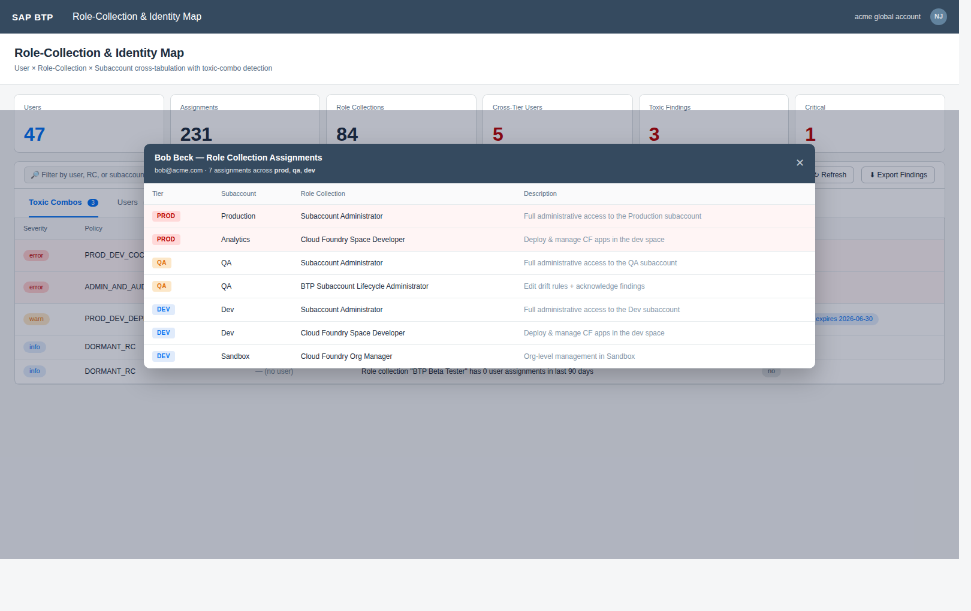
APP 05
TIER 2 · "WHO CAN DEPLOY TO PROD" · IMPLEMENTED
Role-Collection & Identity Map
User × Role-Collection × Subaccount cross-tab with toxic-combo detection. Most customers cannot answer this — and now they have to.
WHAT IT SHOWS
Walks every subaccount's XSUAA Authorization API for RC enumeration + per-RC user lists.
Email-keyed cross-tabulation aggregates "the same human" across tenants.
3 baseline toxic-combo policies: prod-dev admin, prod-dev deployer, admin-and-auditor.
Per-user assignment drill-down dialog. Admin can author new policies in-app.
CUSTOMER VALUE
Sellable as a standalone deliverable — one report scoped purely around access governance.
Audit committees pay for the report this app generates in one click.
The compliance-hour question that haunts every BTP customer over €1B revenue.
BTP Architecture & Governance Advisory
9 / 20

Slide 10
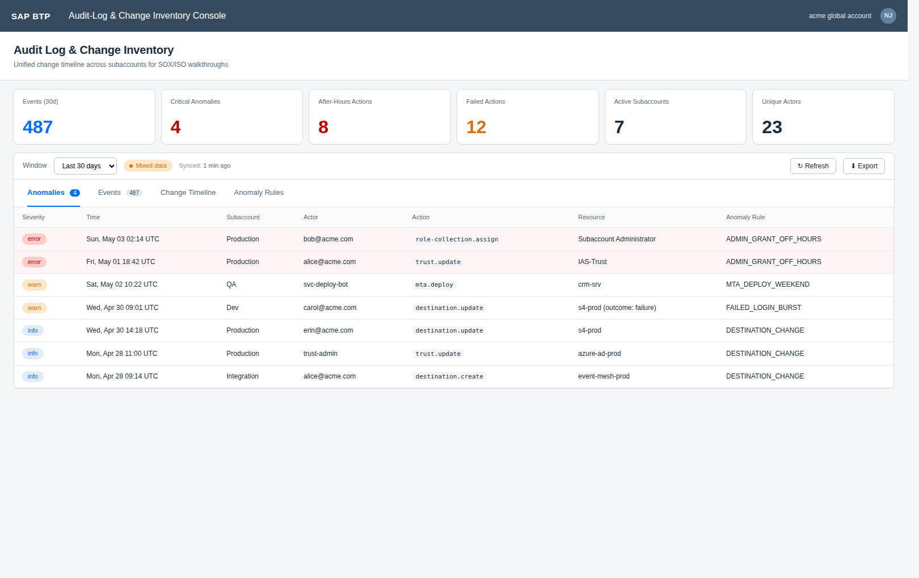
APP 06
TIER 2 · COMPLIANCE-DRIVEN ENGAGEMENTS · IMPLEMENTED
Audit-Log & Change Inventory Console
Unified change timeline across subaccounts. The deliverable a SOX walkthrough is built around.
WHAT IT SHOWS
Aggregates Audit Log Retrieval Service + cTMS deployment history + Cloud Transport Management.
Filter by actor, action, resource type. Exportable for SOX/ISO/internal audit.
Anomaly detection: admin role granted outside change window, after-hours deploys.
Pairs naturally with app #1 — same Audit Log binding, different lens.
CUSTOMER VALUE
Often the headline deliverable for compliance-driven engagements.
Customer's internal-audit team becomes a recurring stakeholder.
Estimated build time: 1 week using shared srv/lib.
BTP Architecture & Governance Advisory
10 / 20

Slide 11
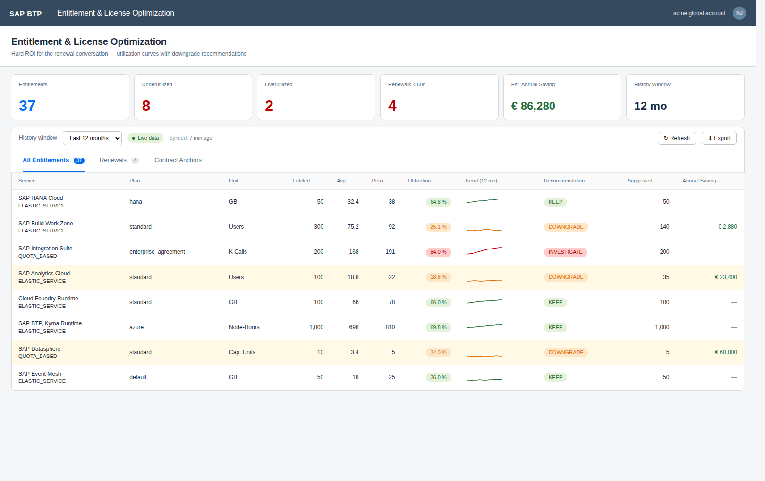
APP 07
TIER 2 · CFO-TIER ROI · IMPLEMENTED
Entitlement & License Optimization Advisor
Hard ROI for the renewal conversation. Gives procurement a number; gives you the next engagement.
WHAT IT SHOWS
CIS Entitlements + UAS 12-24 month utilization history.
"Approaching renewal" highlighting; downgrade recommendations with €/yr saving.
Different from BTPbilling: temporal not snapshot — sees the whole curve.
Direct extension of BTPbilling skeleton — fastest tier-2 build.
CUSTOMER VALUE
Procurement and CFO become economic buyers, not just IT.
Typical finding: €X00K/yr in headroom optimization.
Engagement self-funds inside one renewal cycle.
BTP Architecture & Governance Advisory
11 / 20

Slide 12
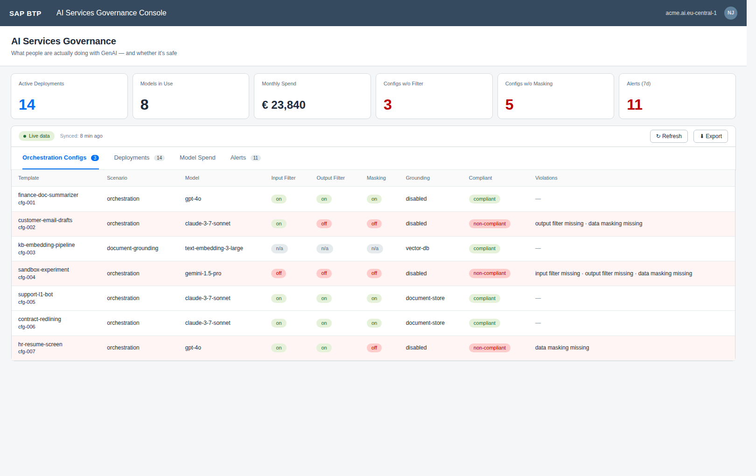
APP 08
TIER 3 · 2026 CISO BUDGET · IMPLEMENTED
BTP AI Services Governance Console
"What are people actually doing with GenAI?" — the question every CISO is being asked in board meetings.
WHAT IT SHOWS
Generative AI Hub orchestration prompts deployed where, by whom.
Model spend by subaccount/team/cost-center.
Content-filter & data-masking config per scenario.
Prompt-injection alerts; prohibited-data egress detection.
CUSTOMER VALUE
Credibility wedge for AI-curious CIOs with fresh budget.
Pairs with the AI swarm offering for full-stack AI governance.
Higher engineering risk: AI Core APIs still maturing — built when an engagement specifically scopes it.
BTP Architecture & Governance Advisory
12 / 20

Slide 13
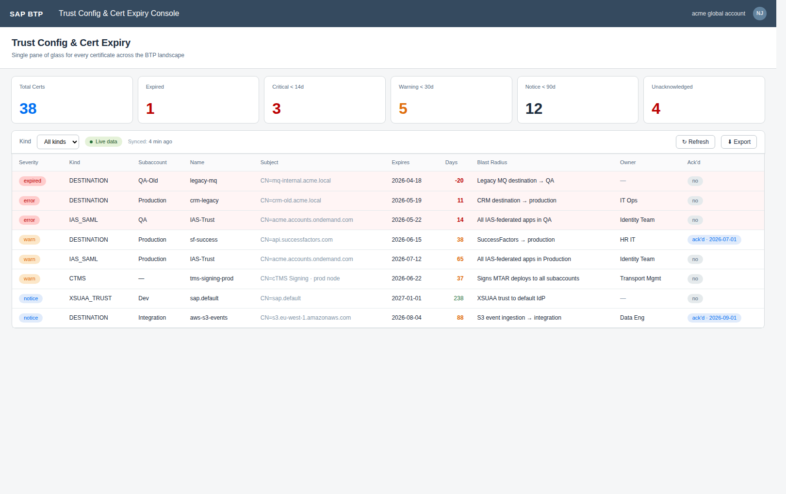
APP 09
TIER 3 · INCIDENT PREVENTION · IMPLEMENTED
Trust Config & Cert Expiry Console
Every certificate across the BTP landscape with rotation owner, blast radius, and acknowledgement workflow.
WHAT IT SHOWS
Aggregates from destinations, IAS SAML/OIDC, XSUAA trust configs, cTMS keys.
Severity ladder: notice (90d) → warn (30d) → critical (14d) → expired.
Per-engagement rotation-owner registry maps cert patterns to named humans.
Acknowledge-until workflow suppresses noise during planned rotation windows.
CUSTOMER VALUE
Prevents the kind of incident that becomes a referral story.
Universally relevant — every BTP customer has an expiring cert they don't know about.
Word-of-mouth multiplier: prevents one incident, sells the next three engagements.
BTP Architecture & Governance Advisory
13 / 20

Slide 14
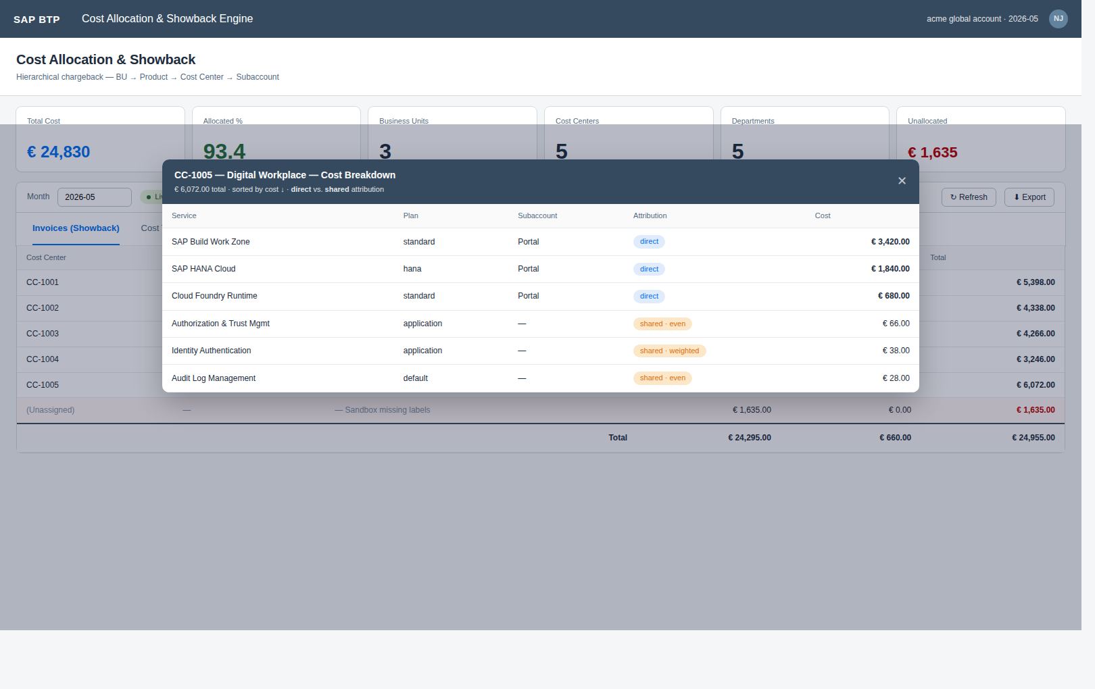
APP 10
TIER 3 · CFO CONVERSATION · IMPLEMENTED
Landscape Cost-Allocation & Showback Engine
Moves the CFO from "show me costs" to "approved, here's the chargeback policy."
WHAT IT SHOWS
Hierarchical cost tree: BU → product → environment → subaccount.
Per-cost-center invoices generated from CIS labels.
Configurable shared-service allocation (XSUAA, audit log, IAS) with split rules.
Goes beyond BTPbilling's subaccount-flat view — full chargeback semantics.
CUSTOMER VALUE
Approval-grade reporting for IT chargeback to the business.
Often justifies the engagement on its own.
Direct extension of BTPbilling — fastest tier-3 build.
BTP Architecture & Governance Advisory
14 / 20

Slide 15
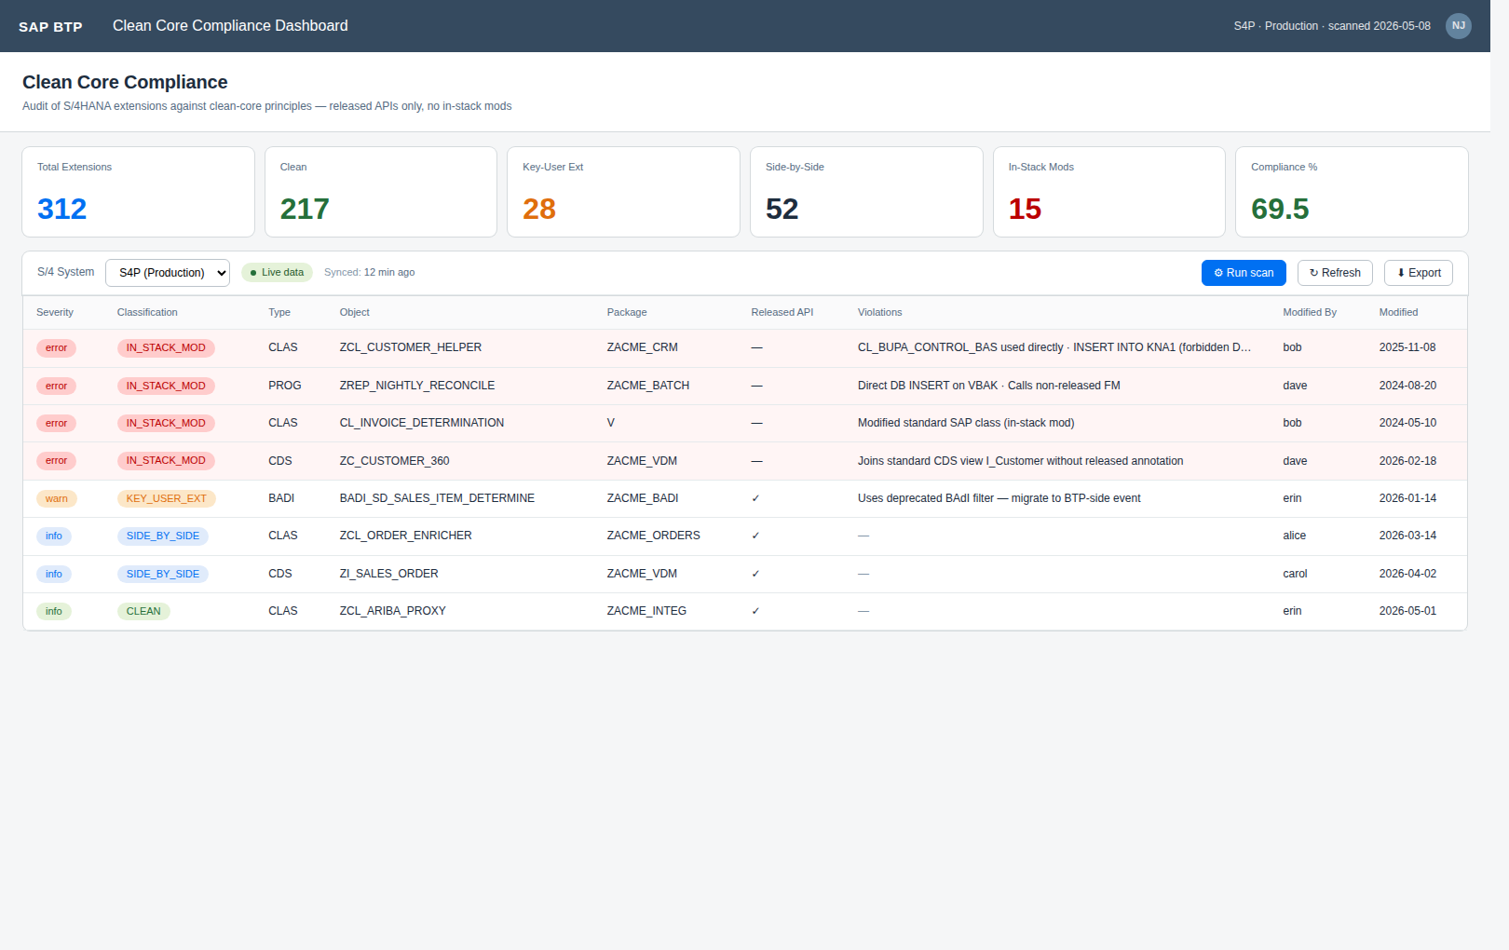
APP 11
TIER 4 · SEPARATE STACK (S/4 + Cloud Connector) · IMPLEMENTED
Clean Core Compliance Dashboard
The single most-asked question in any clean-core engagement — answered with code, not opinion.
WHAT IT SHOWS
Per-extension audit: unreleased SAP API usage, classic in-stack mods, ABAP Cloud violations.
Maps each finding to SAP's side-by-side vs in-stack guidance.
Separate architecture: requires Cloud Connector + ABAP scanner package transported into S/4.
CAP/UI5 frontend reused; data acquisition is bespoke per S/4 estate.
CUSTOMER VALUE
Only built when an engagement specifically scopes it — bills for the extra setup.
Most-asked question in clean-core conversations; nobody else has tooling for it.
AI swarm covers the *advisory* angle today; this app covers the *evidence* angle when needed.
BTP Architecture & Governance Advisory
15 / 20

Slide 16
TECHNICAL ARCHITECTURE
One MTA shape. One auth pattern. Eleven apps.
1
Leave-behind, not consultant-hosted
SAPUI5 1.120 freestyle
Each app deploys to the customer's own subaccount. They keep it after the engagement. No multitenancy, no data leaving their tenant.
KPI tiles · table · Excel/PPTX export
CAP @sap/cds ^9 (Node.js)
2
Mock mode out of the box
OData v4 service · XSUAA roles · CDS persistence
Every app boots with rich mock data. Real data turns on the moment SUBACCOUNT_KEYS / IAS_* env vars are set.
srv/lib (shared)
Per-clientid OAuth token cache
oauth-cache · cis-client · subaccount-clients
3
The same proven token-cache pattern from BTPbilling. One implementation, shared across all apps.
Customer BTP APIs
CIS · UAS · Audit Log · Destination · XSUAA Authz · IAS
4
XSUAA scope split: Viewer / Admin
Read access for workshop attendees; tuning rights for the lead architect during the engagement.
BTP Architecture & Governance Advisory
16 / 20

Slide 17
ENGAGEMENT TIMELINE
A 4-week engagement that ships something on day five
WEEK 1
WEEK 2
WEEK 3
WEEK 4
1
2
3
4
Discover & deploy
Workshop & assess
Recommend & remediate
Hand-over & QBR
Stand up apps #1, #2, #3 in customer's lab subaccount. SUBACCOUNT_KEYS configured. Live data on day five.
Open the Compliance Scorecard with stakeholders. Tune rules to the customer's standards. Snapshot the day-one baseline.
Joint backlog of high-impact fixes. Customer team executes; we shadow. Apps #4, #5, #9 brought online for security/cert review.
Snapshot the after-state. Generate the "before vs after" deliverable. Hand over MTA repos + runbook. Schedule next QBR.
A typical traditional advisory engagement spends weeks 1-3 on interviews. Ours spends week 1 building reality.
BTP Architecture & Governance Advisory
17 / 20

Slide 18
PER-APP DEPLOYMENT TIME
How long the apps take to deploy into a customer tenant
#
App
Tier
Deploy time
What drives it
ENGAGEMENT-LEVEL TOTALS
01
Subaccount Lifecycle
T1
1.5 hr
CIS + Audit Log keys per subaccount
Day-1 demo (#1 only)
02
Destination Inventory
T1
1 hr
DESTINATION_KEYS array
90 min
03
Compliance Scorecard
T1
30 min
Reuses #1+#2 data; rule editing
A working app against the customer's lab subaccount inside 90 minutes.
04
Identity Federation
T2
2 hr
IAS "API access" app + scope grants
Tier 1 pilot (#1, #2, #3)
05
Role-Collection Map
T2
1.5 hr
Per-subaccount XSUAA apiaccess keys
3 hr
The IP-centerpiece scorecard live; ready for the first workshop.
06
Audit-Log Console
T2
1 hr
audit-log-management instance per subaccount
07
Entitlement Optimization
T2
1 hr + seed
UAS bound; +3h to seed ContractAnchors
First-wave engagement (#1–#5, #9)
~1 day
08
AI Governance
T3
1 hr
AI Core service-key + OAuth
The first five apps + cert expiry. Sells as a 4-week engagement.
09
Cert Expiry Console
T3
30 min
Reuses DESTINATION_KEYS + IAS keys
Full BTP-native (#1–#10)
10
Cost Allocation & Showback
T3
1 hr + seed
UAS bound; +3h to import org hierarchy
2 days + seed
11
Clean Core Compliance
T4
1 day
ABAP transport + Cloud Connector + virtual host
Everything except Clean Core. Add 6 hours seeding contract anchors and org hierarchy.
Full arsenal incl. #11
3–4 days
Add 1 day for ABAP scanner transport + Cloud Connector wiring.
BTP Architecture & Governance Advisory
18 / 20

Slide 19
DIFFERENTIATION
Three things nobody else in the BTP advisory space ships
11 apps
1 MTA
< 2 hr
all shipping today
one productized arsenal
per-app per-client deploy
Operational tooling, not narrative deliverables.
A skeleton, not a reinvented wheel.
A delivery team that scales with the practice.
Every other BTP advisory practice walks out with a Word doc. We walk out with an MTA archive in production.
Same MTA shape, same auth, same shared srv/lib across the 10 BTP-native apps. Every engagement compounds onto the next.
A delivery colleague who has not built the app can deploy it cold in under 2 hours from the runbook. Not bound to one Architect.
BTP Architecture & Governance Advisory
19 / 20

Slide 20
NEXT STEPS
Pick one subaccount.
See what we find in 90 minutes.
Discovery workshop
4-week pilot
Practice partnership
90-minute remote session against one of your customer's lab subaccounts. We arrive with the apps already running. You see findings live.
A scoped pilot engagement: apps #1, #2, #3 deployed to the customer's tenant, before/after snapshot, hand-over runbook.
White-label the arsenal under your brand. We co-own the roadmap. Customers see one consultant, you keep the relationship.

