Slide 1
FISPACT-II
FISPACT-II API to aid complex activation analysis
FISPACT-II workshop

Slide 2
Activation analysis and nuclear responses
Often predictions of radiological observables across complex geometry are desired.
Studying complex geometries with transport codes (such as MCNP, OpenMC, Serpent etc) is a well-established approach.
Performing detailed activation analysis on such geometries is often cumbersome.
The FISPACT-II API has been developed to aid such calculations:
No multiple input files. ✔️
Nuclear data only needs to be loaded once. ✔️
Only output precisely what is required. ✔️
Analysis can be automated and included within the same script. ✔️

Slide 3
A simple example:
An imaginary component
An imaginary component is made up of 10 cells.
It will experience neutron irradiation and is expected to become activated.
To run any FISPACT-II calculation the following is required:
The neutron flux experienced by each cell (fluxes file).
The elemental/nuclide make up of each cell (input file).
The irradiation schedule each cell experiences (input file).
The chosen nuclear data for the calculation (files file).
Each standard FISPACT-II calculation will require minimum 3 files and produce minimum 4 files (ARRAYX, COLLAPX, log and out).
The 10 cell component will require 70 files (61 if the same files file is used) before analysis can start. Would have to be automated via separate scripts.
Need a better workflow.
1
2
3
4
5
6
7
8
9
10

Slide 4
FISPACT-II API: A better workflow
An imaginary component
The API is a toolbox allowing users to develop their own scripts and workflows for straight forward activation analysis.
How would this work for the imaginary component?
A single script can be produced which iterates through the cells
Sets up the required inputs.
preforms the activation calculation.
extracting the relevant data from the output.
A user will still need to provide the flux and material from each cell. These can be read directly from the transport calculation output.
1
2
3
4
5
6
7
8
9
10

Slide 5
Building an API script
What is the same for all calculations:
Nuclear data
Irradiation schedule (assuming all cells experience the same irradiation)
Lets assume:
The component that we are studying experiences 2 years of irradiation, with 100 years of cooling.
Each cell experiences a different flux spectrum, but all cells experience 1⨉10¹² n/cm²/s.
Of interest is the components total decay heating (in kW kg⁻¹) for 10 years after irradiation and each cells ⁶⁰Co activity (in Bq kg⁻¹) during and after irradiation.
For the example the script requires:
flux and material getters
A nuclear data loader
A schedule setter
A heating extraction methods
A ⁶⁰Co activity extract method

Slide 6
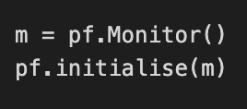
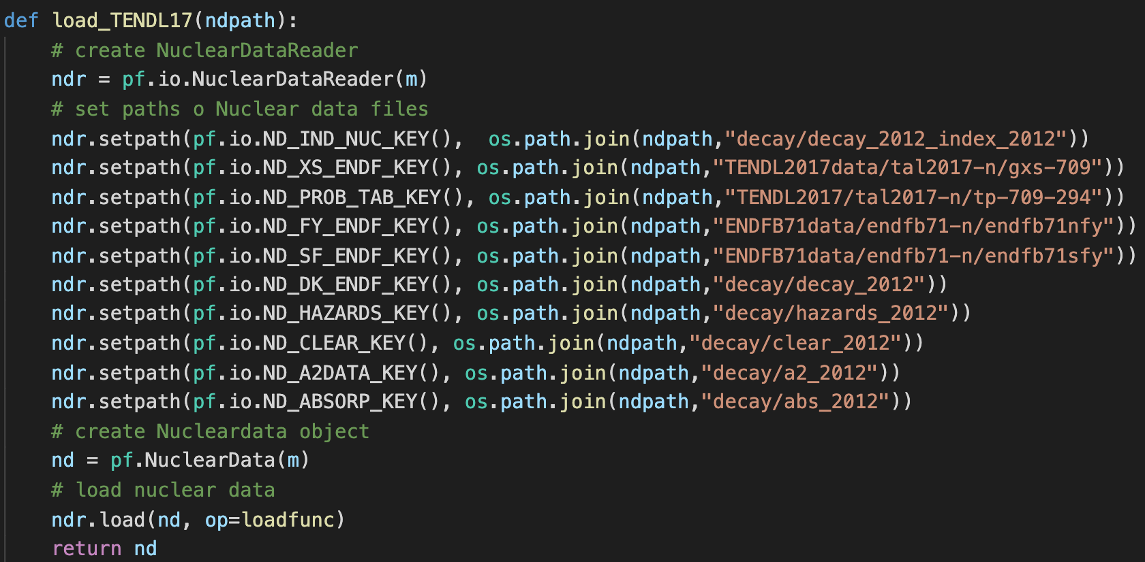
Initialisation and nuclear data loading
Initialise the Monitor (error handling) and FISPACT global data.
Load nuclear data function, assume this hypothetical project requires TENDL2017
Here base Nuclear Data directory path (ndpath) is read into the function.
It is the appended to to point to the correct files/folders.
A callback function called to provide progress information to the screen.
This is the same as that used in the nuclear data example.

Slide 7
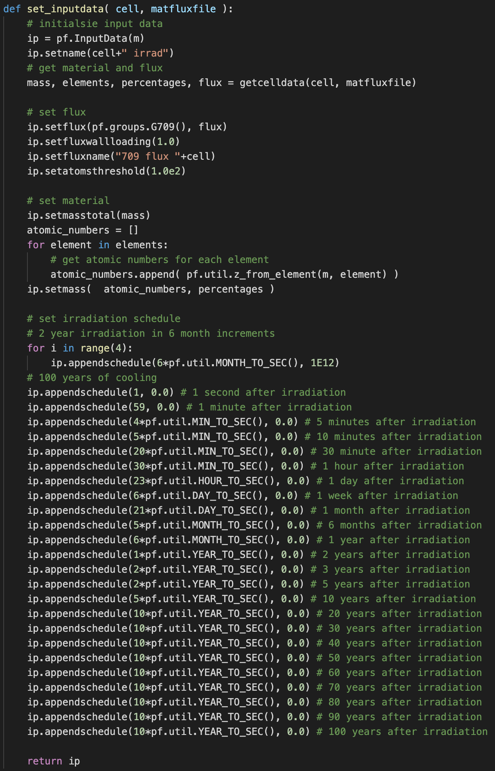
Setting the InputData from cells
Read the flux and material information form external source. This could be a transport code output file
Setting the extracted flux and material composition.
Note that the setmass methods of the InputData class take atomic numbers not element strings.
Methods to convert are included.
The Irradiation schedule is eth same for all cells

Slide 8
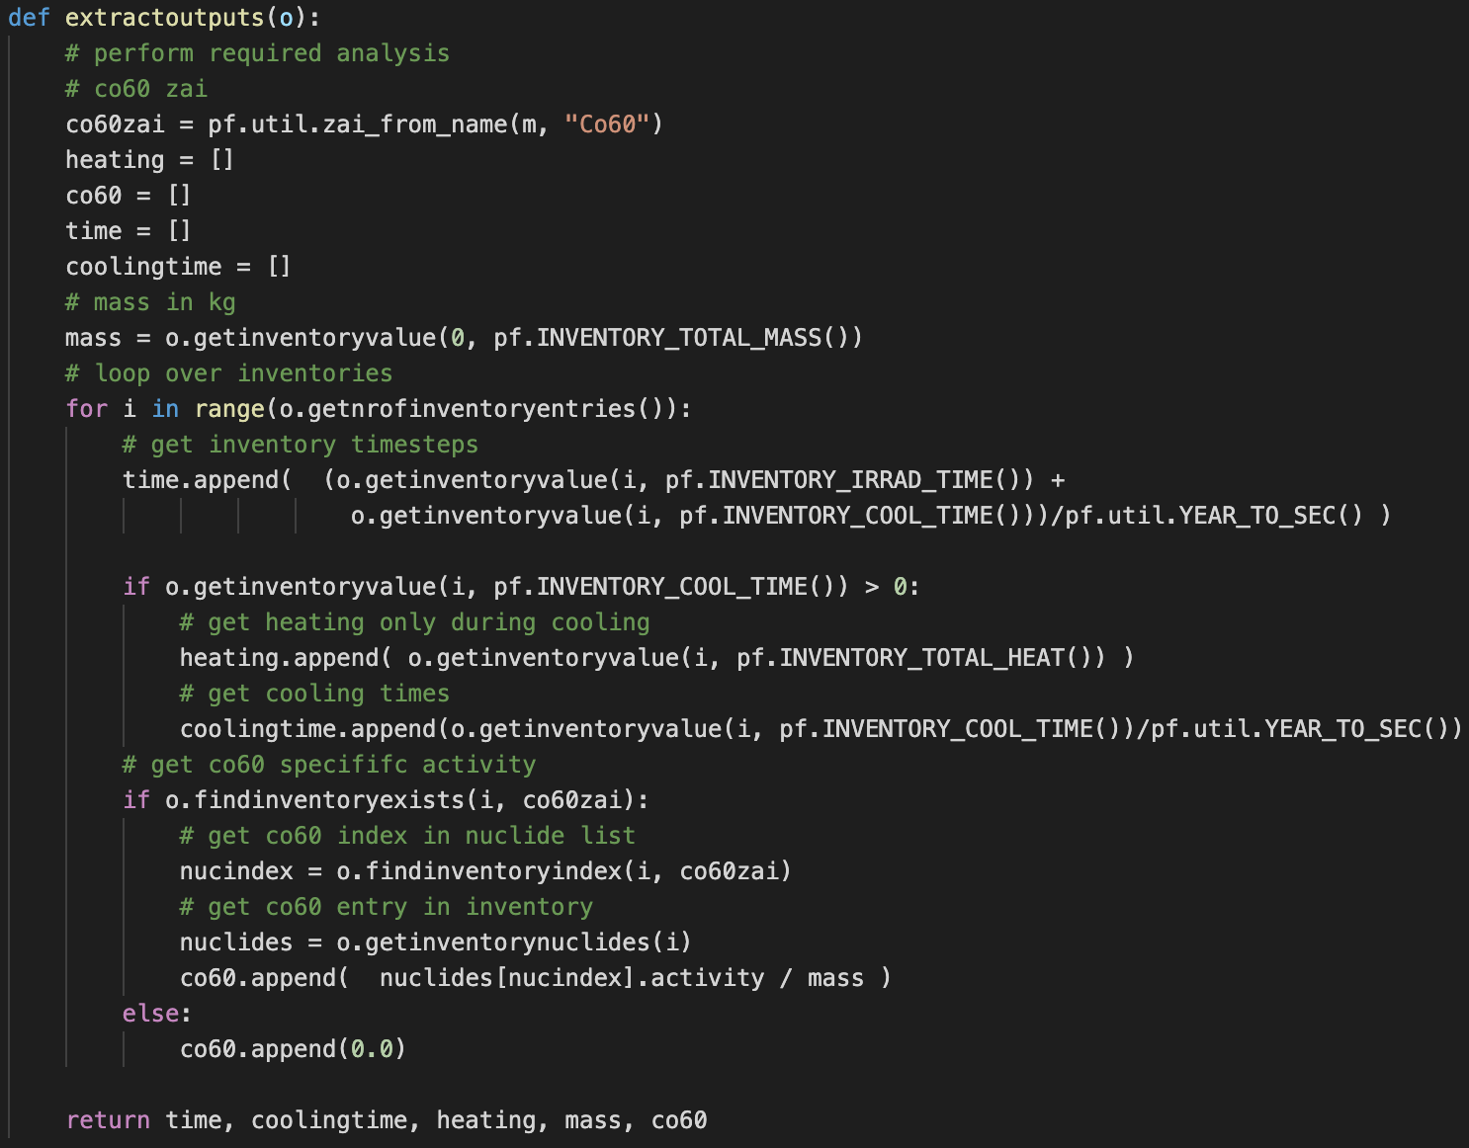
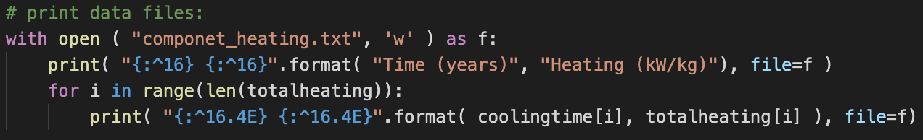
Building OutputData tools and storing data
Once a cell calculation has completed the produce OutputData need to be probed. The desired data can then be extracted.
Complete inventory contents can be output in a JSON format.
A FISPACT log file can be output as well.
Specific information can be printed using standard file writing methods
Extract decay heating at cooling times
Extract ⁶⁰Co activity

Slide 9
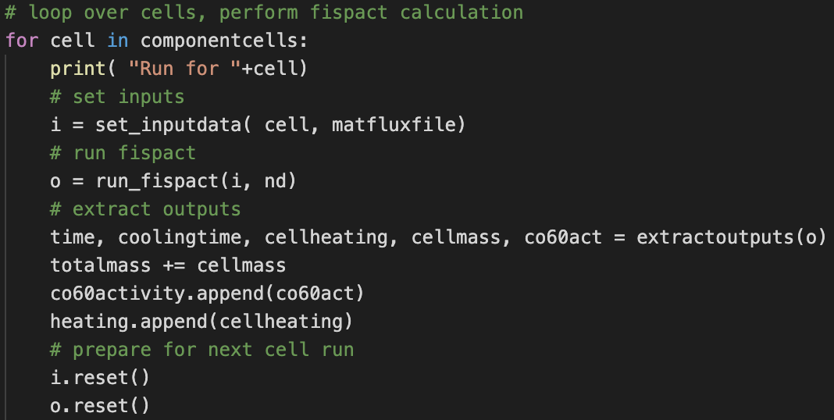
Running for all cells
The routines are simply called in sequence using existing loop structures.
Nuclear data is not loaded every time, so its not in loop
Set InputData
Run FISPACT-II, get OutputData
Extract relevant outputs
Reset data object for next cell run
Let look at the script in detail and generate some data

Slide 10
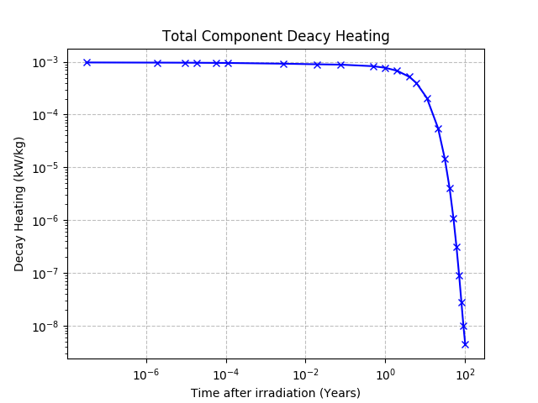
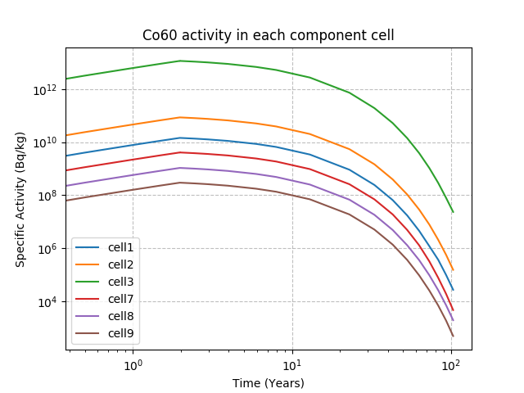
Results for the imaginary component
These results are simple but demonstrate that preforming complete activation analysis can be straight forward with the FISPACT-API.
Could add heating from each cell to study contributions across component
Some cells do not produce any ⁶⁰Co.

