Slide 1
FISPACT-II
Example: flux spectra group structure conversion
FISPACT-II workshop 2022

Slide 2
What is Group Convert
FISPACT-II requires that the flux spectra input in is the same energy bins as the nuclear data chosen.
For example TENDL2019 is in the 1102 group structure, so will require a 1102 group flux spectrum.
What if the group structure of a users flux spectrum does not match the energy bins of the desired nuclear data?
For example, a user may have a 175 group flux but want to perform activation calculations with TENDL2017 (709 groups)
FISPACT-II includes functionality to re-bin flux spectra, so that can match which ever nuclear data set is chosen
Group Convert. Available in both standard FISPACT-II and the API.

Slide 3
Group Convert: Some details
Two types of spectra conversion are available in FISPACT-II:
Equal-lethargy per bin approximation (default).
Equal-energy approximation.
Group Convert can be performed as part of any FISPACT calculation. Here we will focus on examples purely performing spectra conversion.
Important to note: Group convert cannot add physics!
Moving from a coarse grid to a fine grid will not yield extra detail in the resulting spectrum. Some fine bins will be over/under predicted.
Flux spectra resulting form group convert are an approximation.
Where possible it is recommended that flux spectra are tallied in the same group structure as the expected nuclear data.

Slide 4
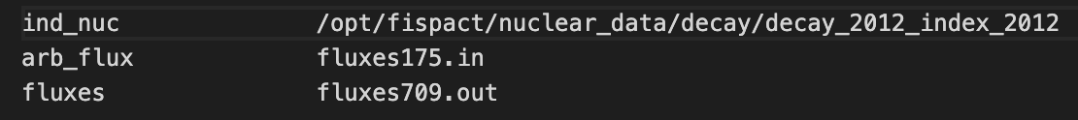
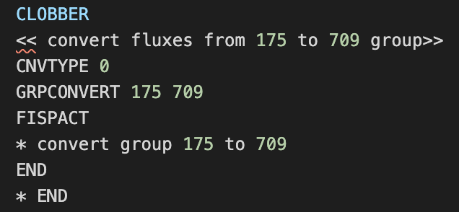
Standard FISPACT-II:
FISPACT-II will require the following input files for group convert:
Input file (.i)
Files file
Arb flux file
The arb flux file contains the flux to be converted and its original energy group structure.
The path to this need to be given in the files file
Files file for purely group convert is simple as no nuclear data is needed
Input file. This example does not contain any irradiation
CNVTYPE determines which approximation is used:
0 for equal-lethargy per bin approximation (default).
1 for equal-energy approximation.
GRPCONVERT preforms the conversion from the first groups to the second groups. Here 175 to 709

Slide 5
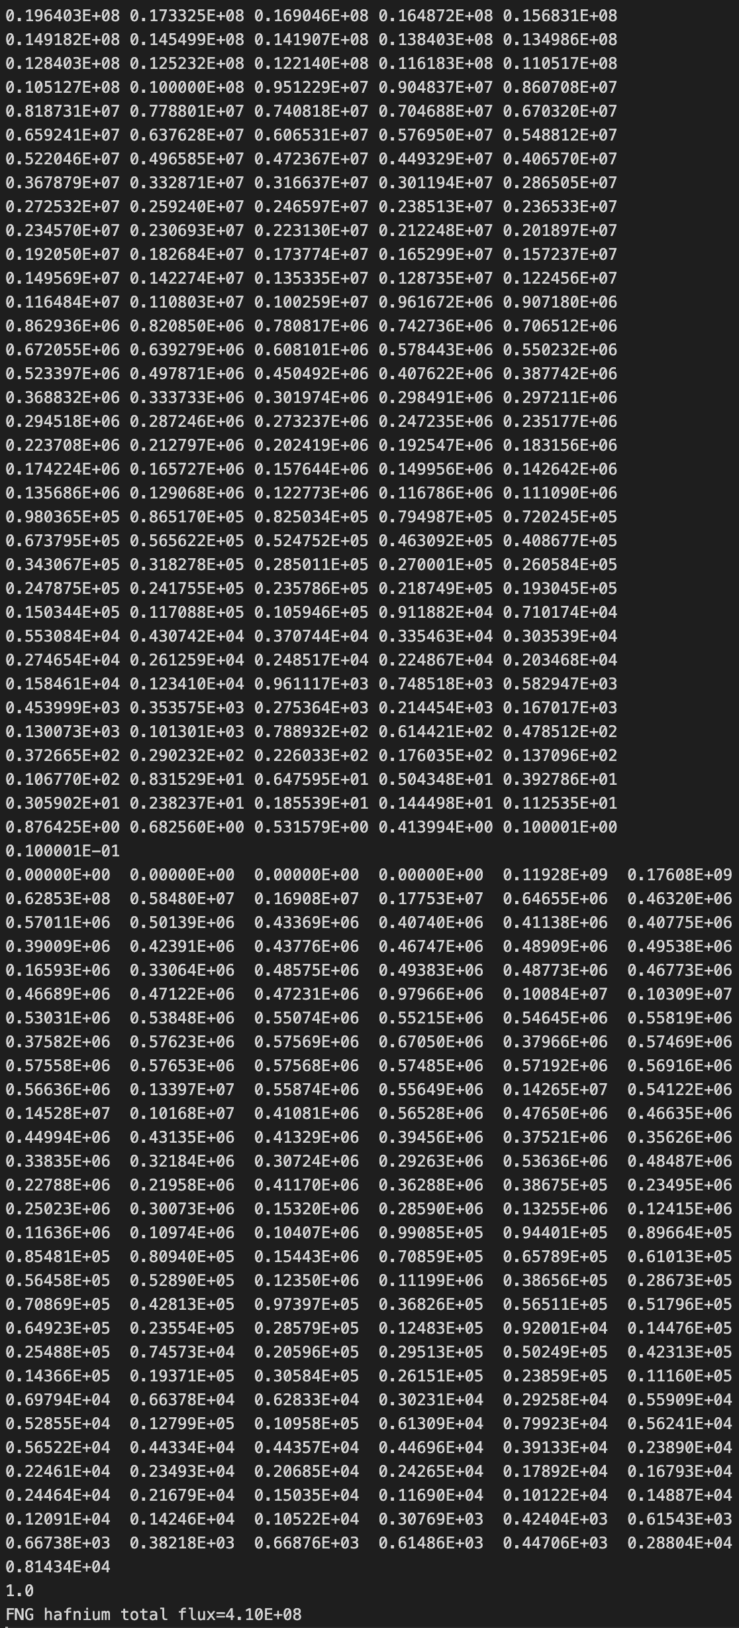
Structure of an arb flux file
The arb flux file contains the flux spectrum which will be converted and its group structure.
The group structure the original flux is binned in, descending energy.
These are given in the FISPACT-II manual and can be found on the FISPACT wiki and in ebins files.
175 group structure and flux
The rest follows the same structure as a normal fluxes file.
Flux spectrum in descending energy bins.
Wall loading
Naming string

Slide 6
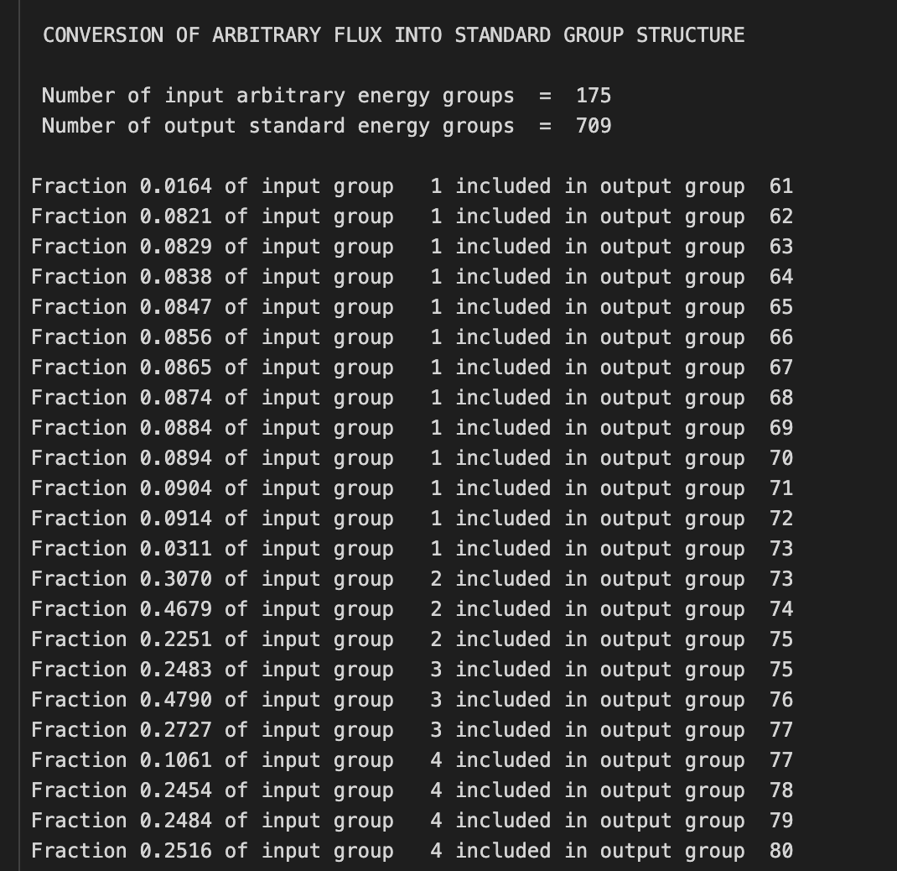
Outputs from Group Convert
Output file group convert summary
The converted flux in output in two places:
Firstly in file, formatted to match FISPACT-II’s fluxes input, in the location defined by the fluxes stream in the files file. This can be directly used in future FISPACT-II calculations.
Second in the standard FISPACT-II output file. Also included in the output (.out) file are details of conversion itself. Fractions of input bin in output bins.

Slide 7
FISPACT-II API:
The API contains routines for group conversion by lethargy and energy
This take the original group structure, the original flux and the group structure to be converted to as input.
They return the converted flux.
Single line in a API script
Equivalent byenergy also available
Input flux
Converted flux
The methods are part of the groupconvert module
Arrays/lists of the standard FISPACT-II group structures are included in the API
G : ascending energy order
g : descending energy order

Slide 8
Example
Here a 175 group structure flux spectrum (taken from FNS experiments) is converted into a 709 group structure spectrum.
Let see this for both the input file method and API approach.

Slide 9
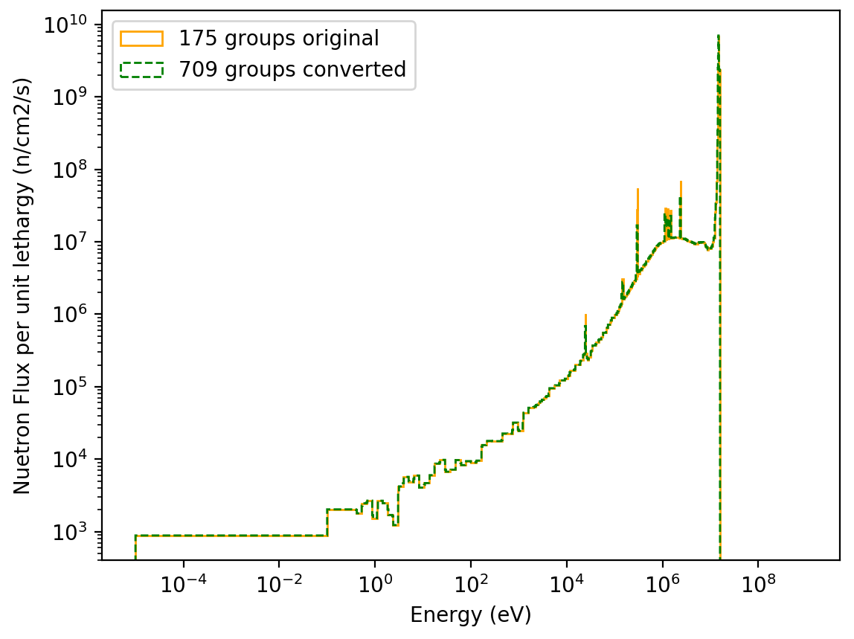
Results
Plotting both fluxes by unit lethargy shows agreement between the spectra
Notice the large flat low energy behaviour of both spectra.
This a result of the 175 group structure which only has a single bin at these energies.
The 709 group structure has more bins in this energy range, but group convert is limited by the available 175 bin data.

