Slide 1

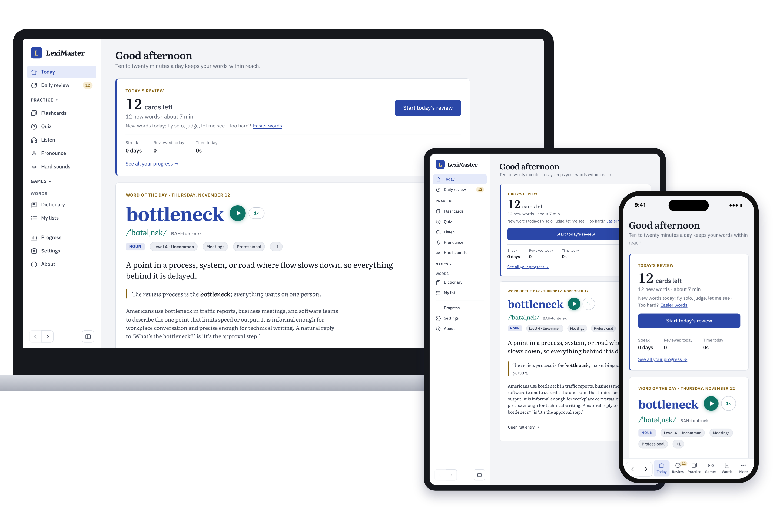
Install LexiMaster on any device
LexiMaster
A step-by-step guide for Mac, Windows, iPhone, Android phones and tablets. Free, no app store, about one minute.
fissehab.github.io/leximaster
Notes:
LexiMaster is a web app: you install it from your web browser, not from an app store. This guide shows where to tap on each kind of device and what you will see.

Slide 2





Why install it instead of using a browser tab
Installing puts LexiMaster on your device like any other app. It takes about a minute and costs nothing.
Its own window or full screen
No address bar or browser tabs: just LexiMaster, with its own icon.
Start here
Open this address in your web browser, or scan the code with your phone's camera:
One tap to open
An icon on your Home Screen, Dock, Start menu or taskbar.
Your progress is kept safe
iPhone and iPad delete a website's saved data after 7 days without a visit. An installed app keeps it.
Always up to date
New words and fixes arrive by themselves. There is nothing to download again.
fissehab.github.io/leximaster

Slide 3
Find your device
Every device uses its own web browser. Find your row, then turn to that page for pictures.
Device | Browser | What to tap | Page
Mac or Windows computer | Chrome | Install icon in the address bar, then Install | 5
Mac | Safari | File menu, then Add to Dock | 6
Windows computer | Microsoft Edge | App available icon in the address bar, then Install | 7
iPhone | Safari | Share, then Add to Home Screen, then Add | 10
Android phone | Chrome | Menu (three dots), then Add to Home screen, then Install | 12
iPad or Android tablet | Safari or Chrome | Same as on the phone | 15
Chromebook, Linux, others | Chrome or Edge | Install icon in the address bar | 16

Slide 4
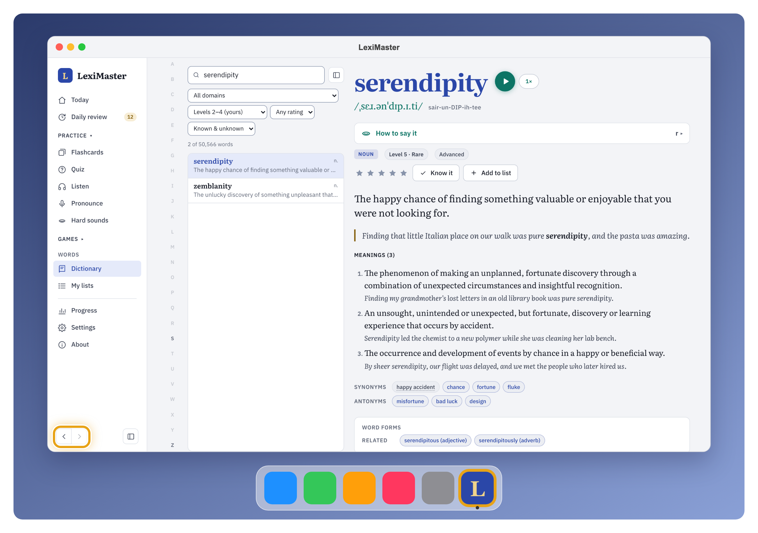
On a computer
01
Mac and Windows: install from Chrome, Microsoft Edge or Safari. LexiMaster then opens in its own window.

Slide 5
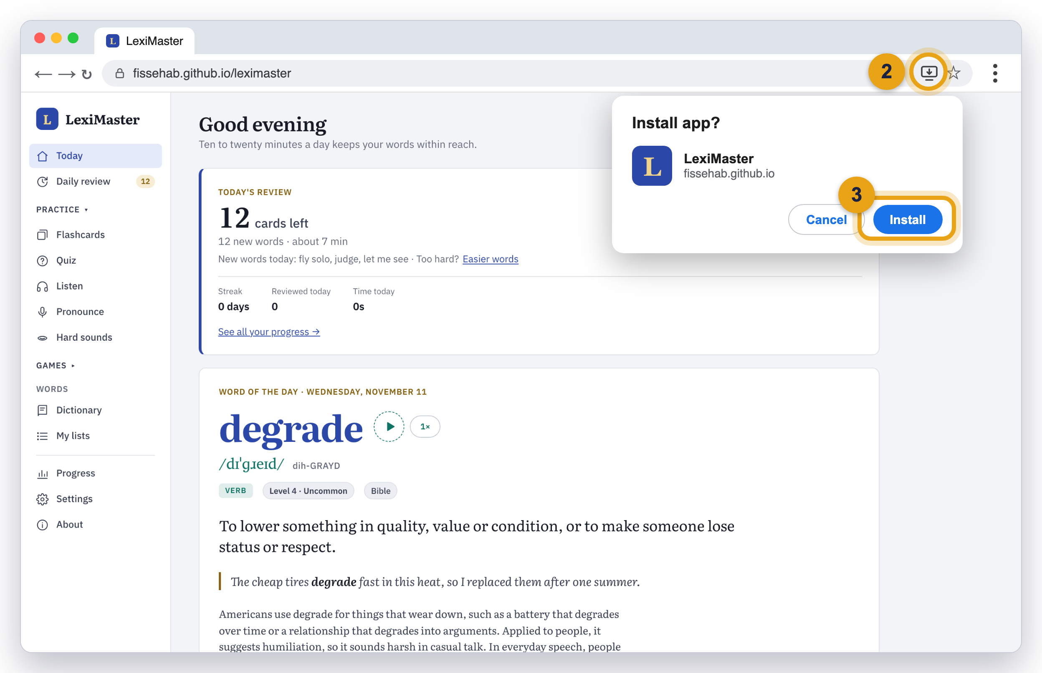
Mac or Windows: Google Chrome
1
Open Chrome and go to the site
Type fissehab.github.io/leximaster in the address bar and press Enter.
2
Click the install icon
It looks like a small screen with a down arrow, at the right end of the address bar.
3
Click Install
A small box asks “Install app?”. Click the blue Install button.
4
That’s it
LexiMaster opens in its own window. No icon? Click ⋮ (top right) → Cast, save, and share → Install page as app.
Illustration: the numbered circles match the steps. Your screen may look slightly different.

Slide 6
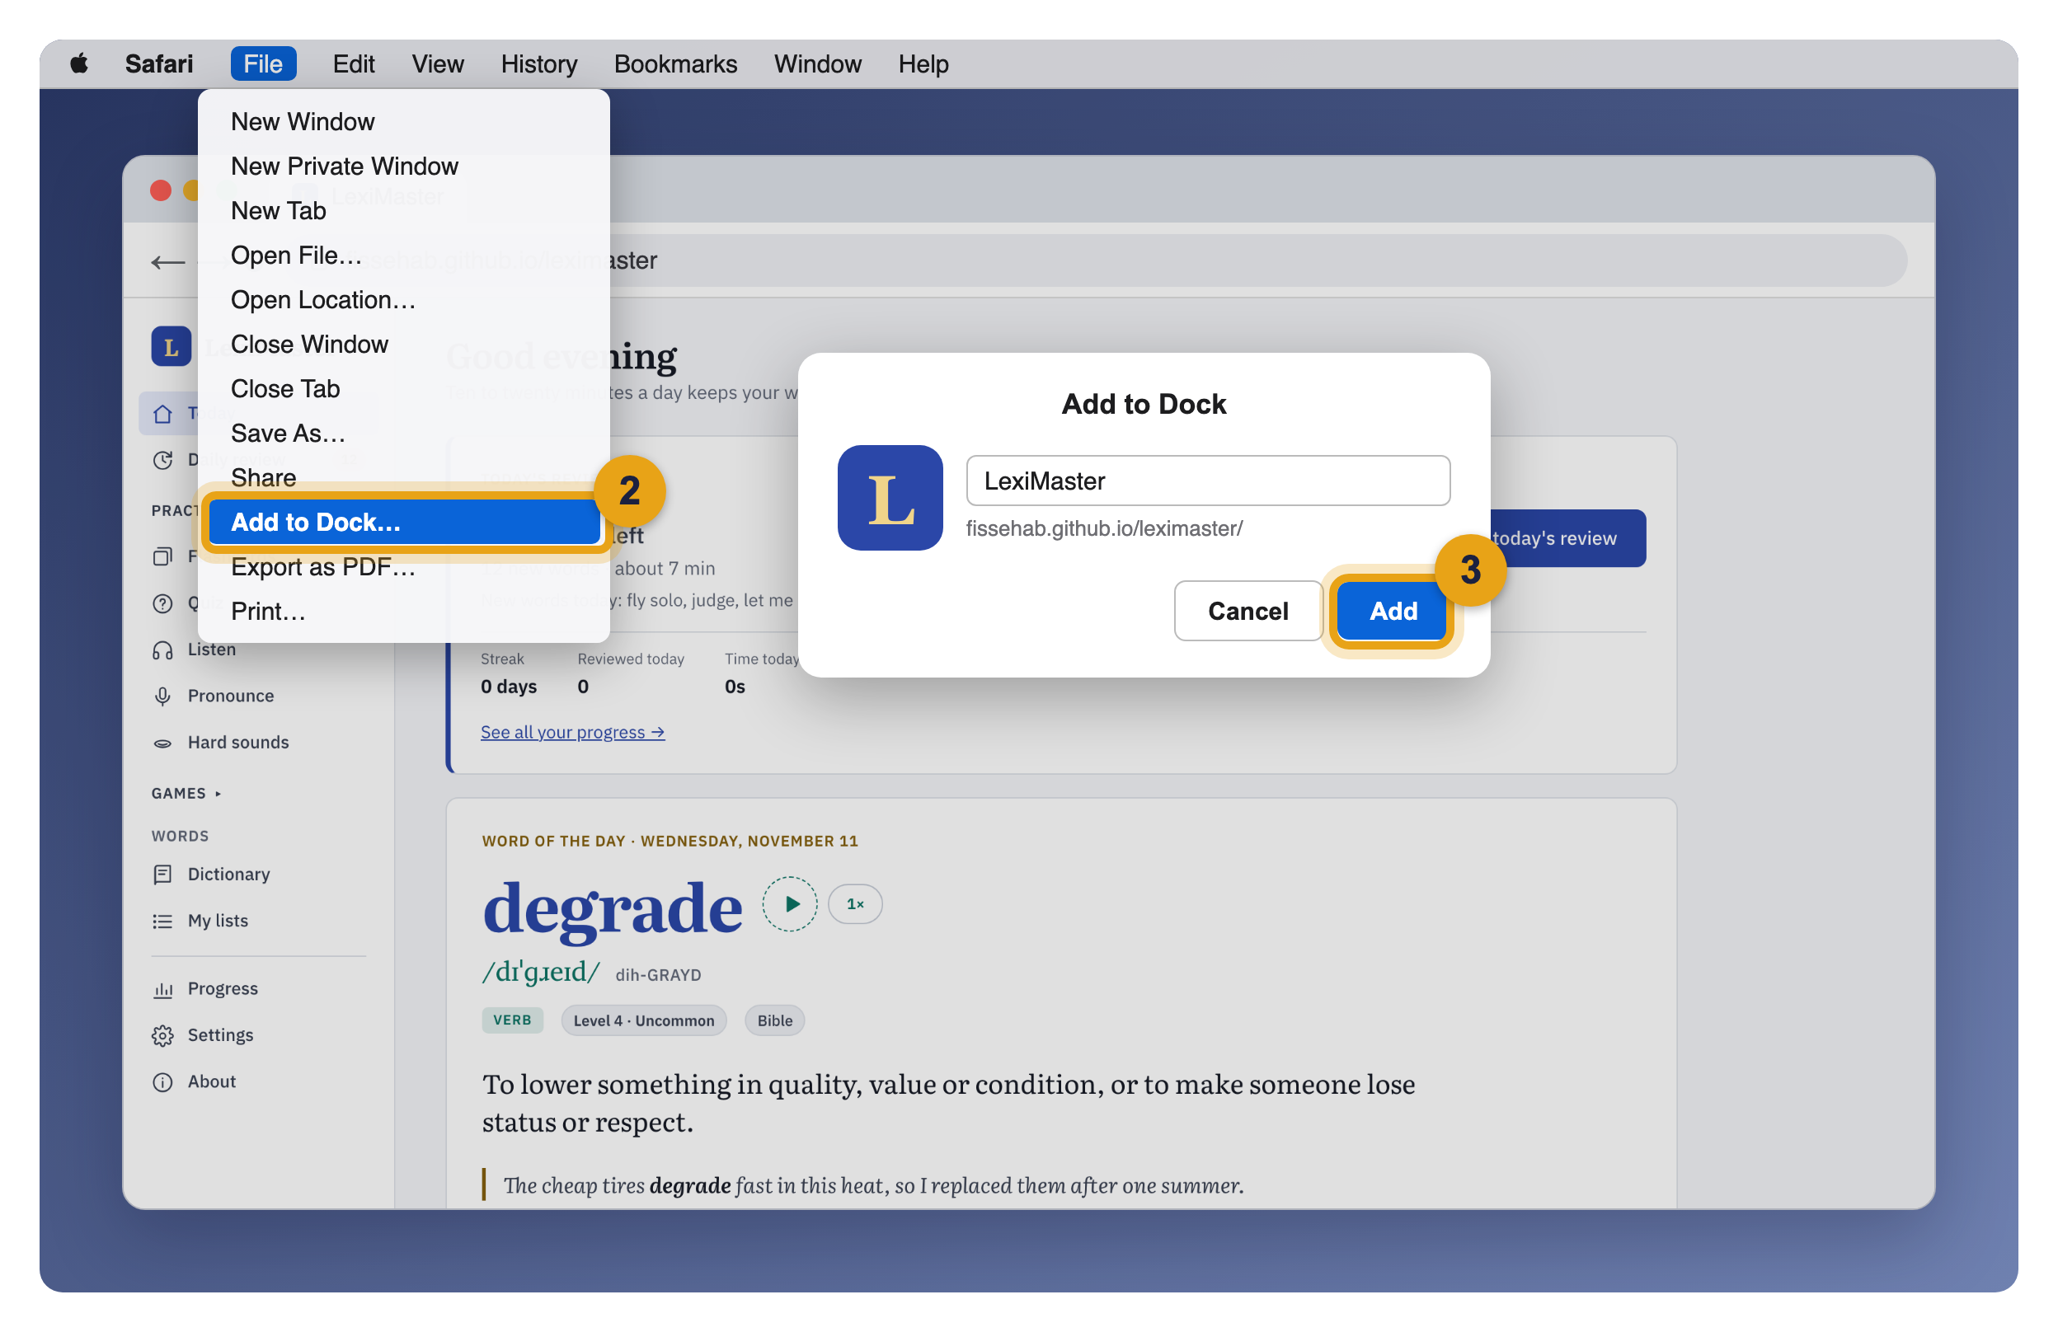
Mac: Safari
1
Open Safari and go to the site
Type fissehab.github.io/leximaster and press Return.
2
Open the File menu
At the top of the screen, click File, then Add to Dock…
3
Click Add
Keep the name LexiMaster and click Add.
4
Open it from the Dock
The LexiMaster icon now sits in your Dock and in Launchpad. Needs macOS Sonoma (14) or later.
Illustration: the numbered circles match the steps.

Slide 7
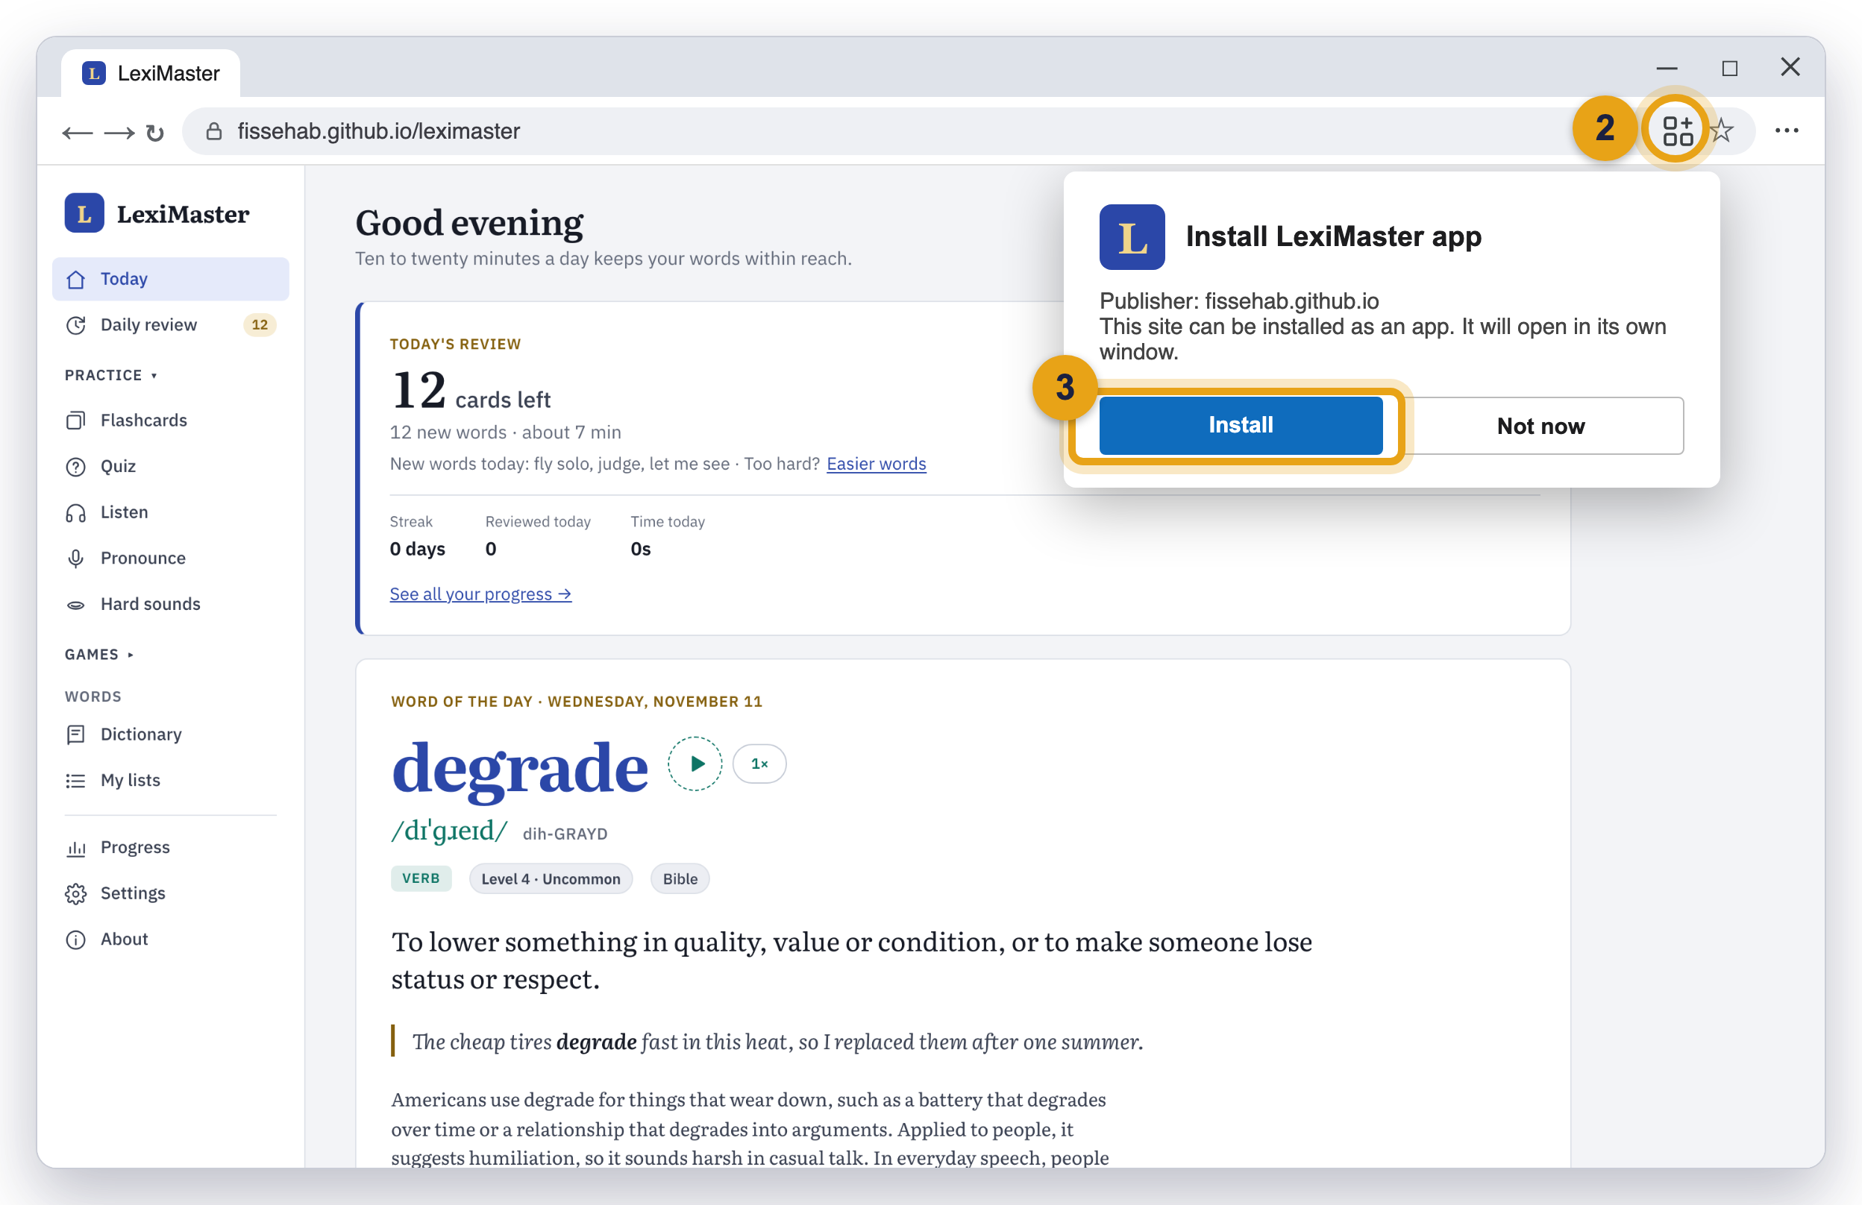
Windows: Microsoft Edge
1
Open Edge and go to the site
Type fissehab.github.io/leximaster in the address bar and press Enter.
2
Click “App available”
A small icon of four squares appears at the right end of the address bar.
3
Click Install
In the box “Install LexiMaster app”, click Install.
4
Pin it if you like
Windows offers to pin it to the taskbar and Start. No icon? Click ··· → Apps → Install LexiMaster.
Illustration: the numbered circles match the steps. Chrome on Windows works like page 5.

Slide 8
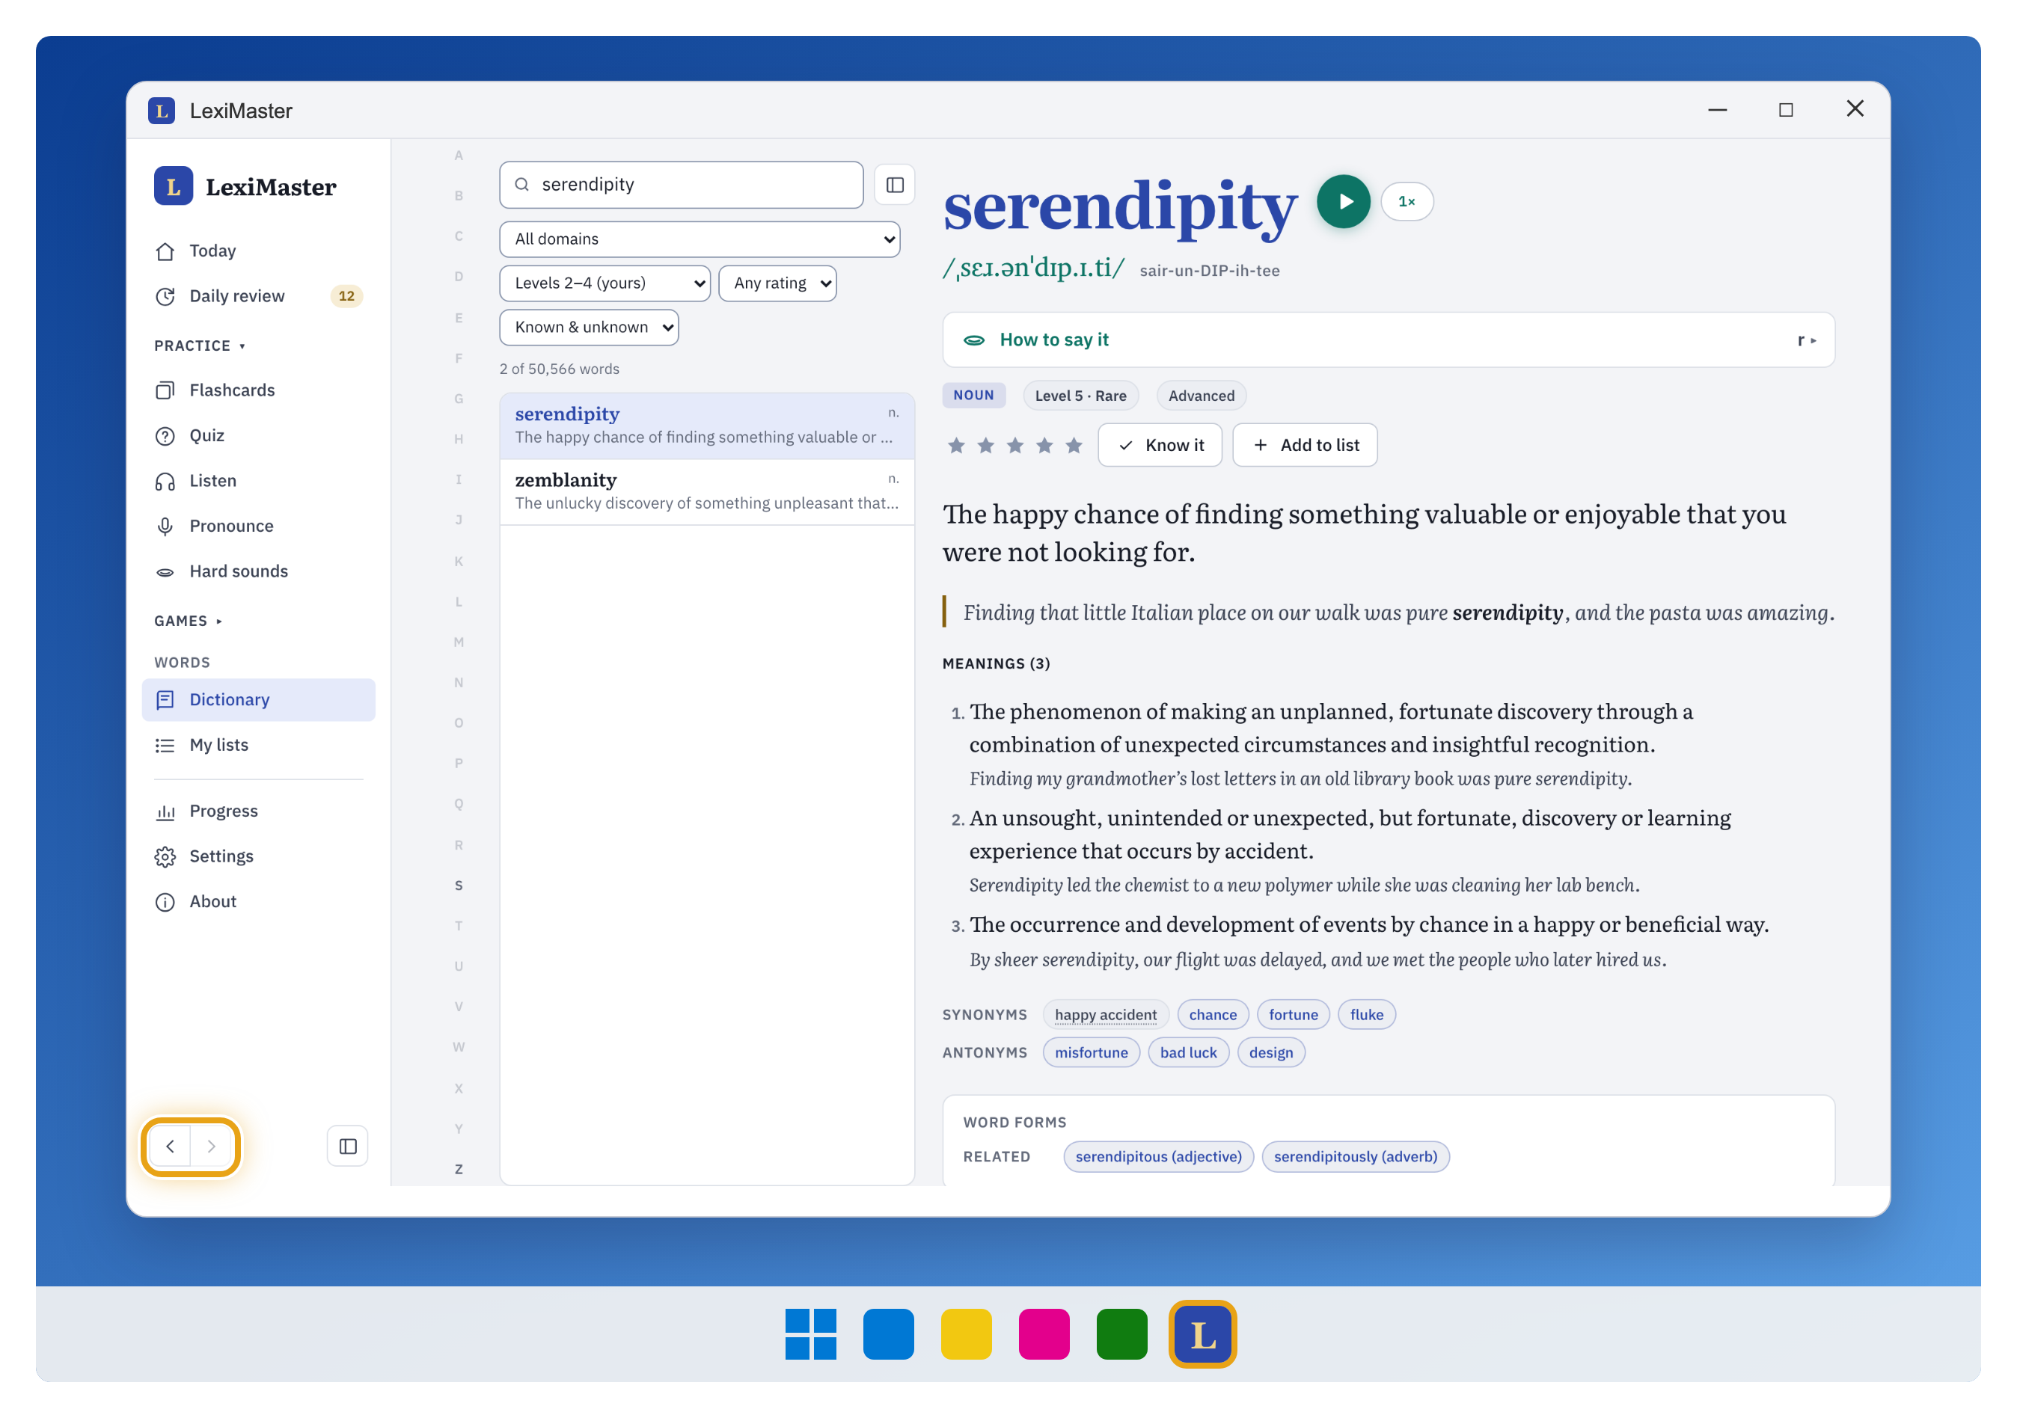
What it looks like on a computer
LexiMaster opens in its own window. Its own Back and Forward buttons sit at the bottom left of the side menu (circled).
Mac: the icon sits in the Dock. To keep it there, right-click it → Options → Keep in Dock.
Windows: find it in the Start menu. Right-click the taskbar icon → Pin to taskbar.

Slide 9
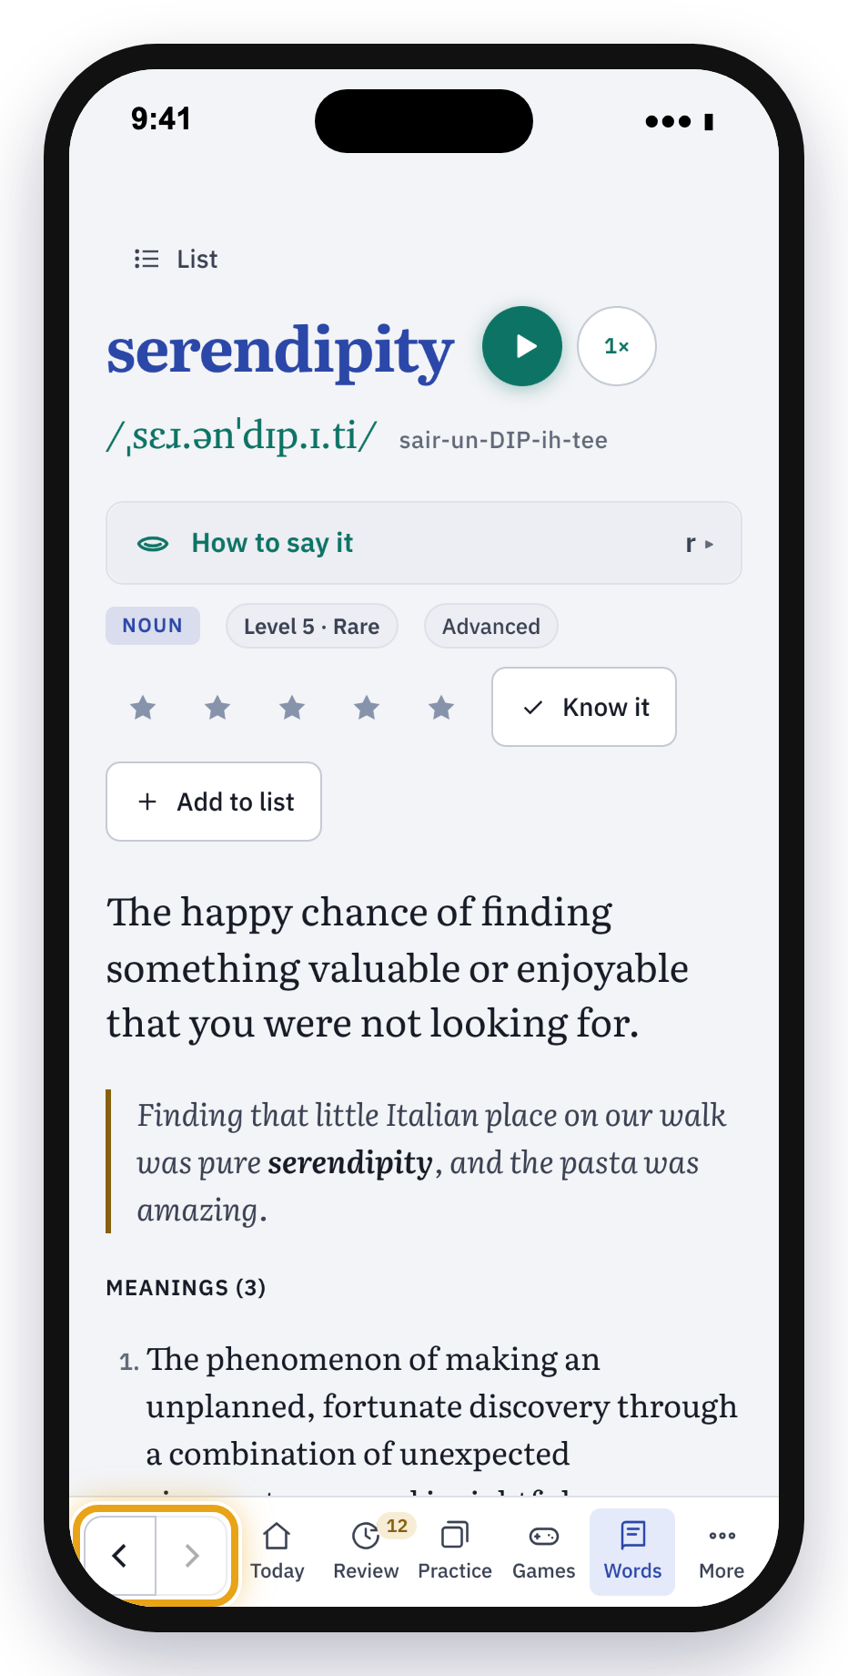
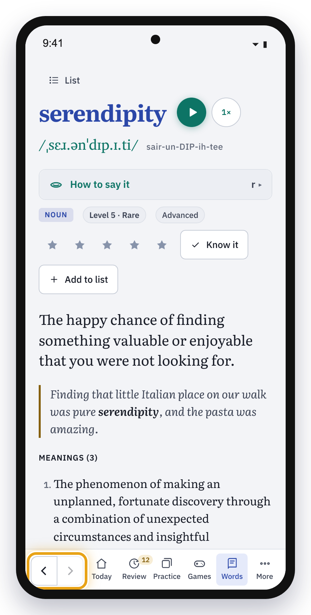
On a phone
02
iPhone: add it from Safari. Android: install it from Chrome. The icon then sits on your Home Screen next to your other apps.

Slide 10
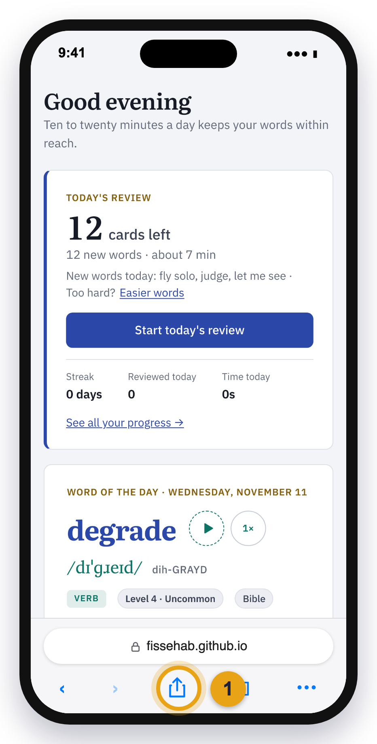
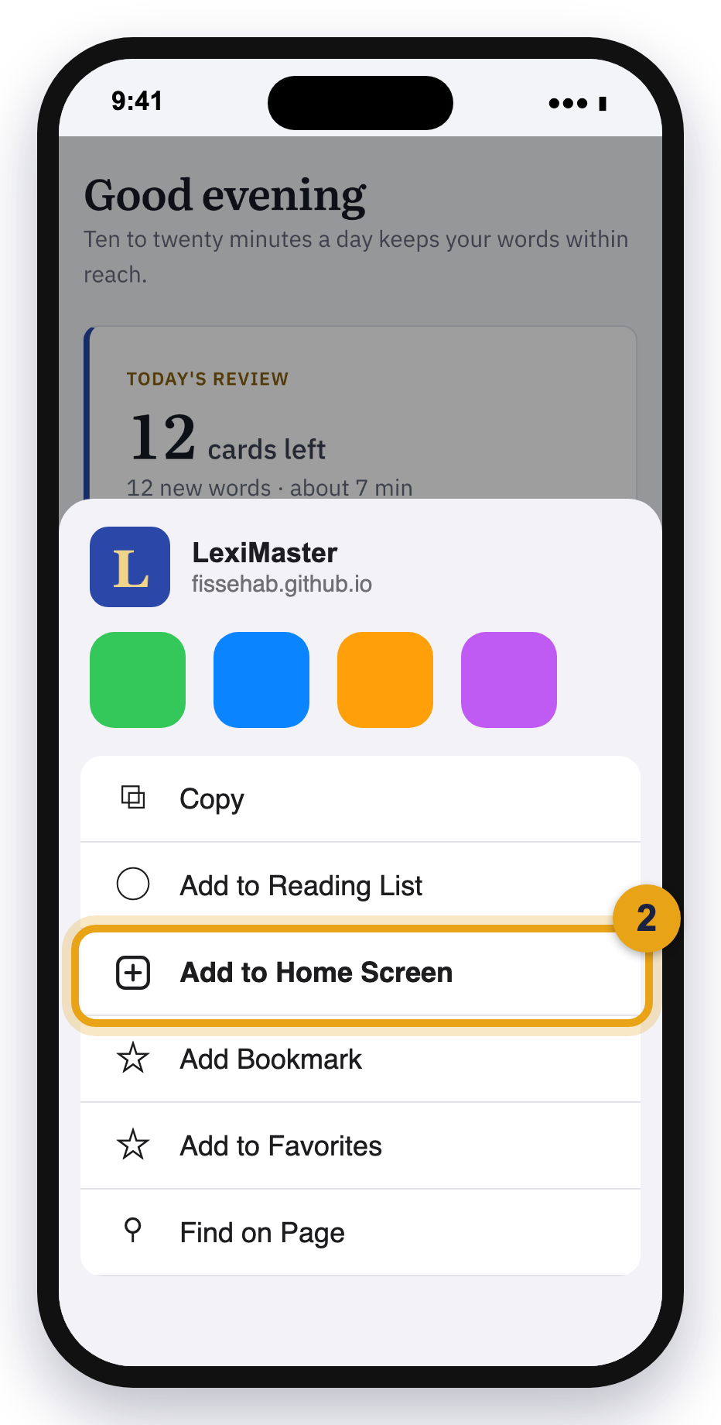
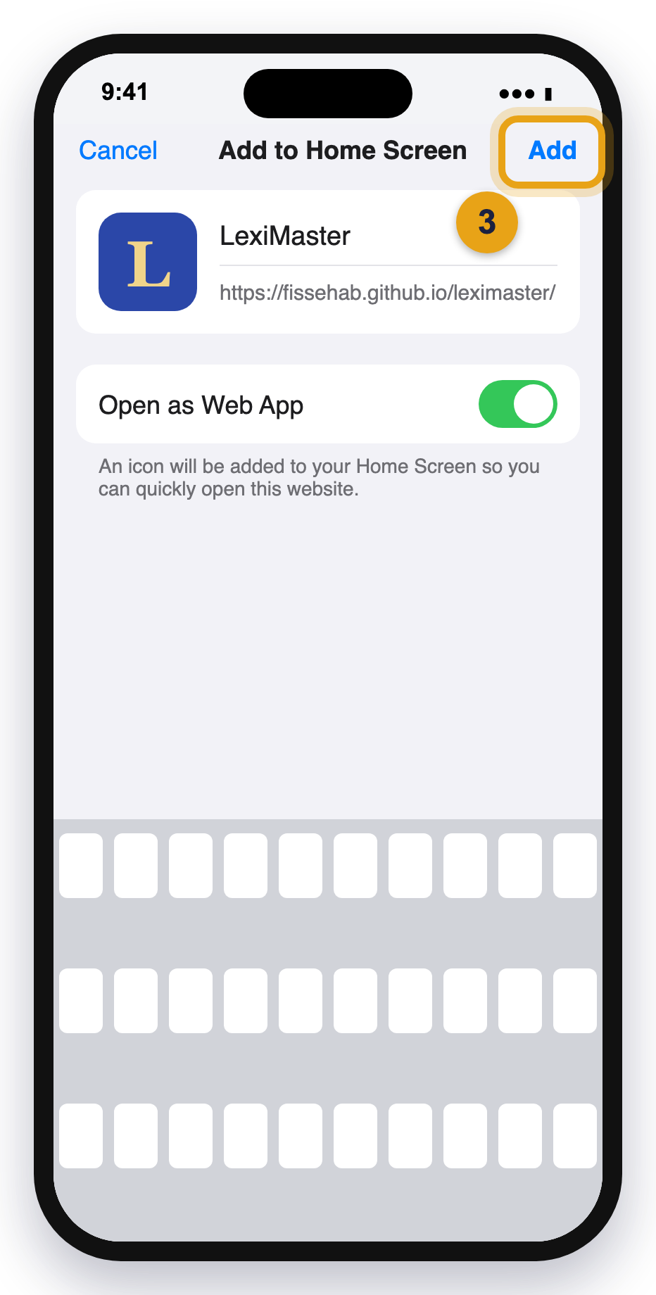
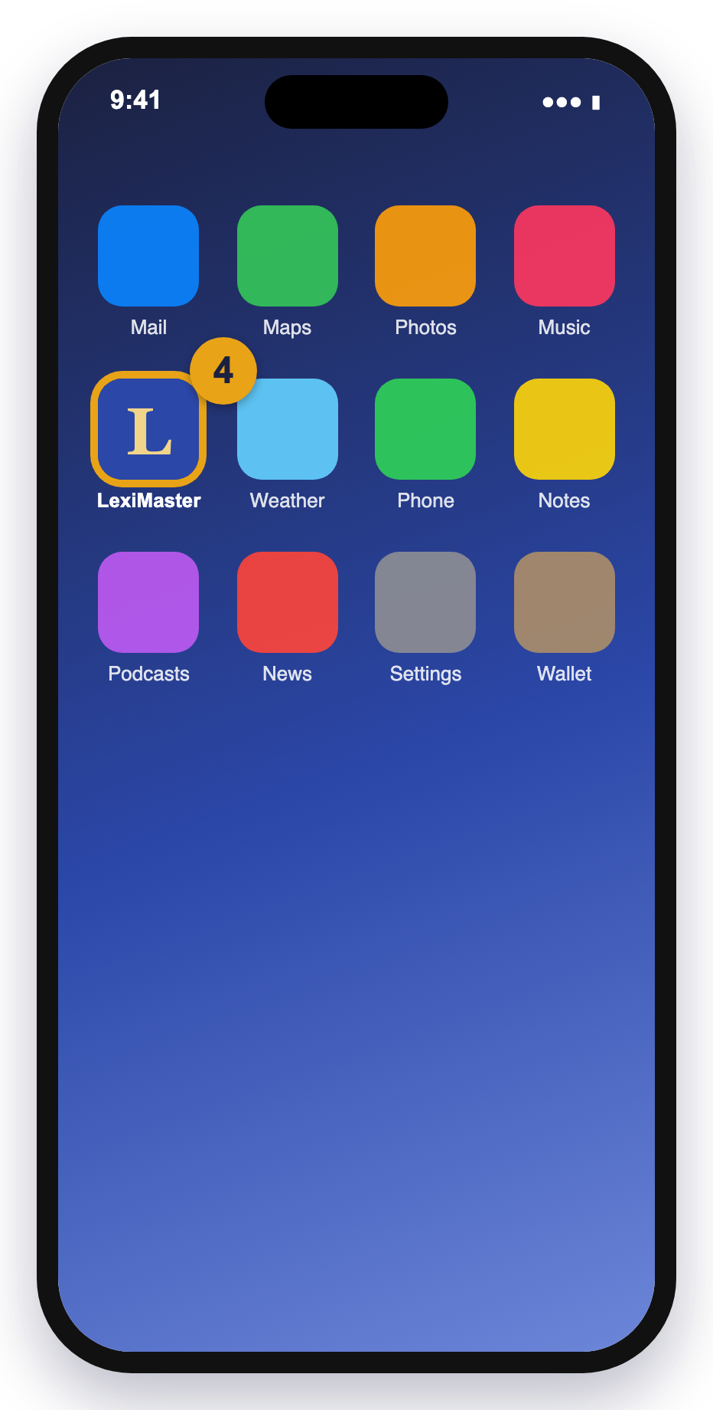
iPhone: add it from Safari
Open Safari (the blue compass) and go to fissehab.github.io/leximaster. Then:
1
Tap the Share button: a square with an arrow pointing up.
2
Scroll down and tap Add to Home Screen.
3
Leave “Open as Web App” on and tap Add.
4
The LexiMaster icon is now on your Home Screen.

Slide 11
iPhone: if your screen looks different
Newer iPhones (iOS 26)
The Share button is inside the ••• button at the bottom right of Safari. Tap •••, then Share, then View More if needed, then Add to Home Screen.
Chrome or Edge on iPhone
Tap the Share button next to the address bar, then Add to Home Screen. This needs iOS 16.4 or later.
Can’t see Add to Home Screen?
Scroll down the list. At the very bottom, tap Edit Actions to add it.
Opening it
Tap the LexiMaster icon. It fills the whole screen, without Safari’s address bar. Back and Forward are at the bottom left (circled).

Slide 12
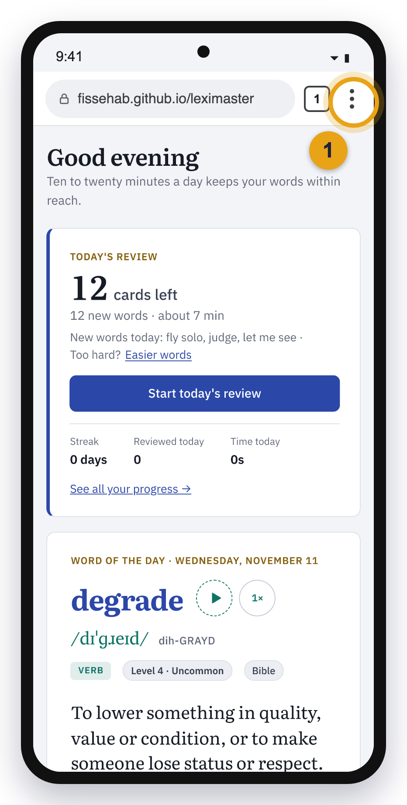
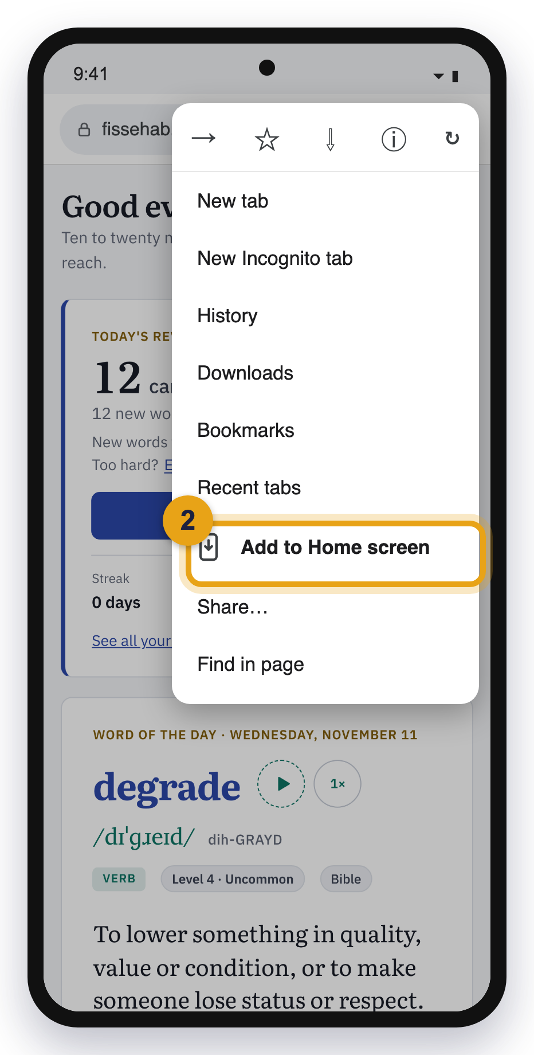
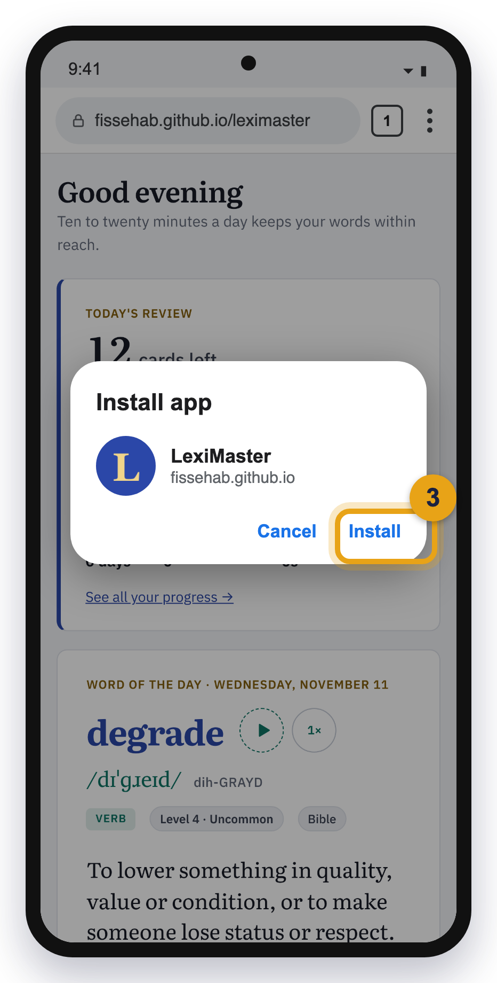
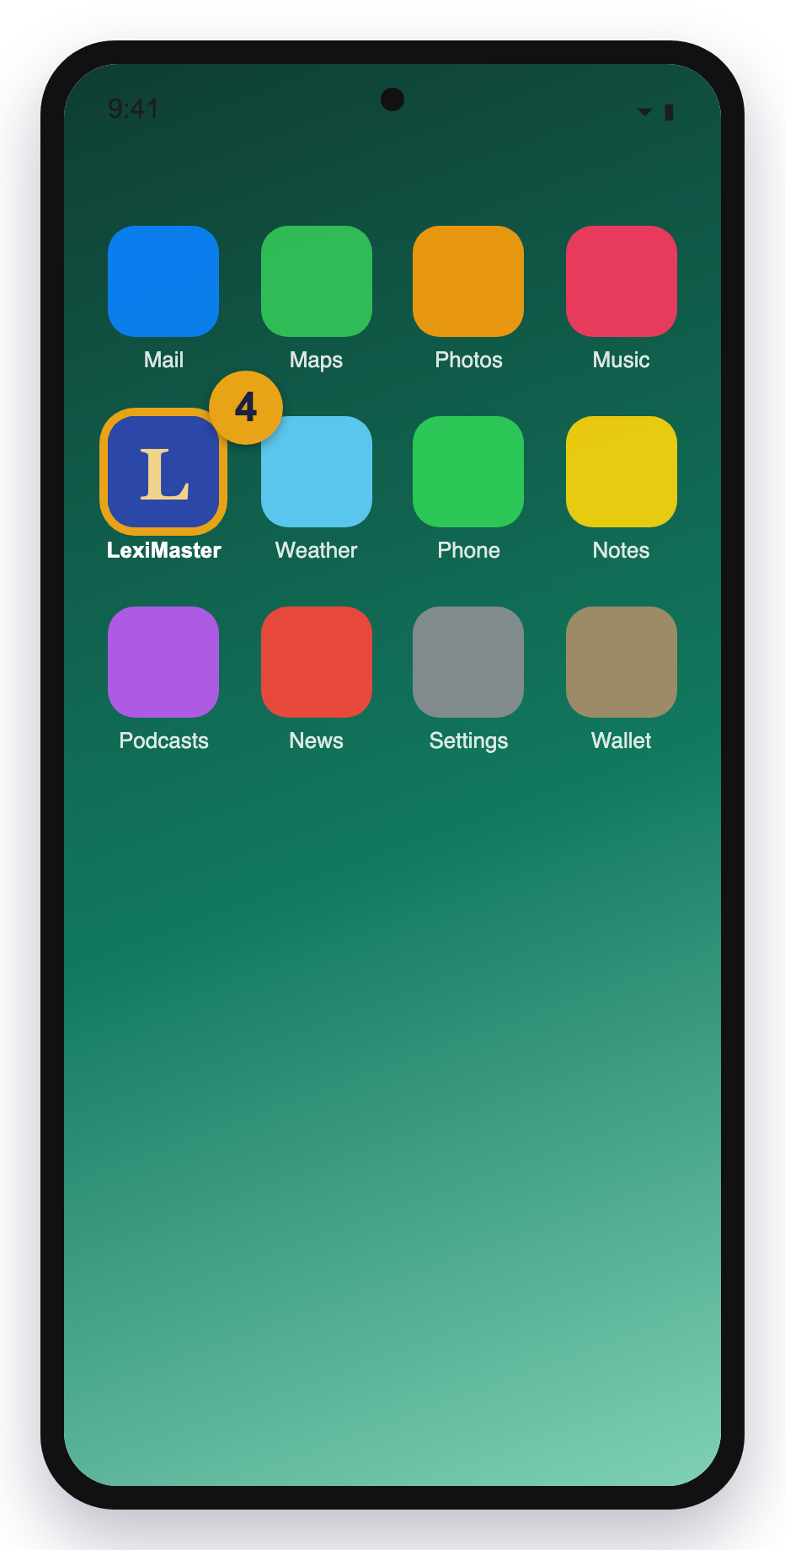
Android: install it from Chrome
Open Chrome and go to fissehab.github.io/leximaster. Then:
1
Tap the menu: three dots at the top right.
2
Tap Add to Home screen (on some phones: Install app).
3
Tap Install. If asked, choose Install, not Create shortcut.
4
LexiMaster is on your Home screen and in your apps list.

Slide 13
Android: other browsers
Other Android browsers can install it too. In the app, Back and Forward are at the bottom left (circled).
Samsung Internet
Tap the menu (three lines, bottom right) → Add page to → Home screen. Or tap the install icon in the address bar if you see one.
Firefox
Tap the menu (three dots) → Install, or Add to Home screen → Add.
Microsoft Edge
Tap the menu (three lines, bottom) → Add to phone → Install.
Chrome shortcut prompt
Some phones show a banner “Install LexiMaster” at the bottom. Tapping it does the same thing.

Slide 14
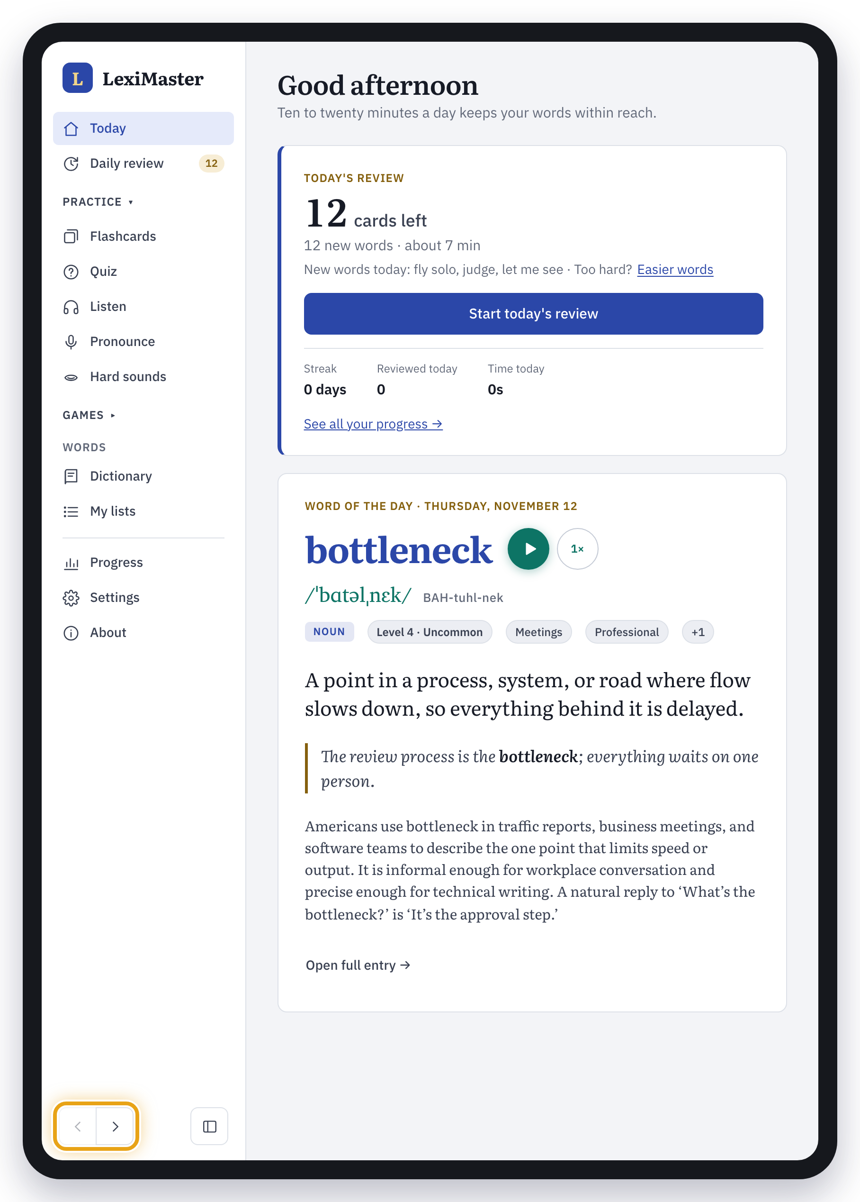
Tablets and more
03
iPad, Android tablets, Chromebooks and Linux: the same few taps, with a bigger screen.

Slide 15
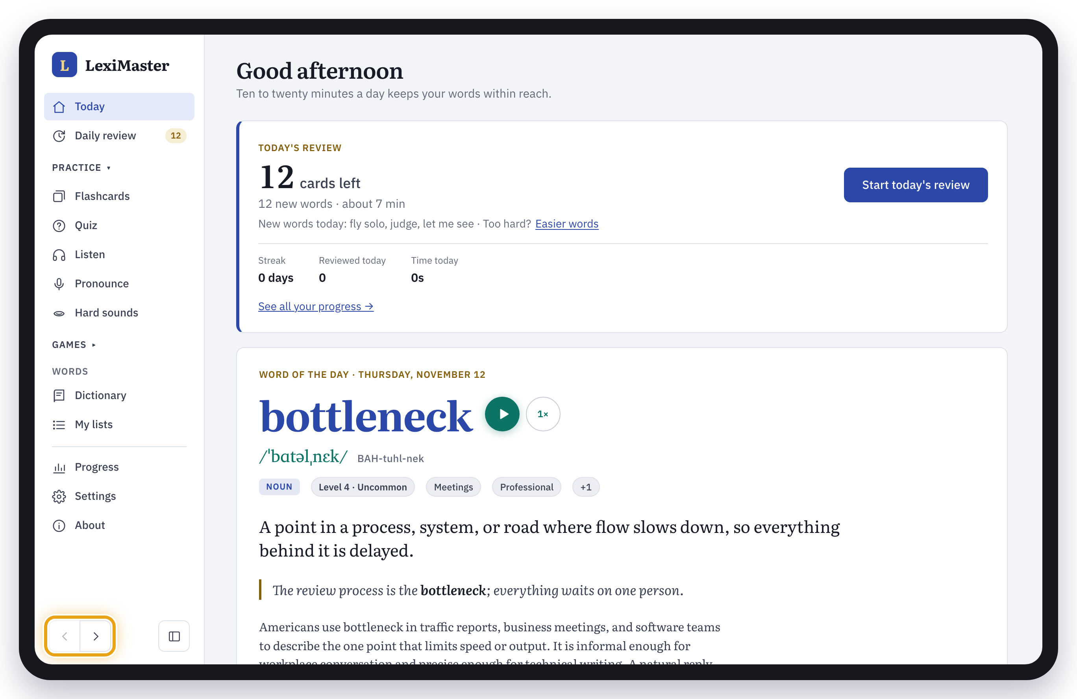

iPad and Android tablets
iPad (Safari)
Tap the Share button at the top right, next to the address bar.
Tap Add to Home Screen.
Tap Add.
Android tablet (Chrome): tap ⋮ at the top right → Add to Home screen → Install. Exactly as on an Android phone.
On a tablet LexiMaster shows the full side menu, like on a computer, with Back and Forward at its bottom left (circled). Turn the tablet sideways for the most room.

Slide 16




Other devices and browsers
Most modern browsers can install LexiMaster. One cannot.
Chromebook
Linux
Open Chrome, go to the site and click the install icon in the address bar → Install. It appears in your launcher.
Use Chrome, Chromium or Edge: install icon in the address bar → Install.
Brave, Opera, Vivaldi
Firefox on a computer
These are built on Chrome. Look for the install icon in the address bar, or for Install in the main menu.
Firefox on Mac, Windows and Linux cannot install web apps. Bookmark the page, or use Chrome, Edge or Safari.

Slide 17



Good to know after installing
Updates come by themselves
Use it without internet
When a new version is ready, LexiMaster switches to it the next time you are on the Today screen. You never reinstall.
Settings → Download for offline use saves every word on the device. Recordings play offline once you have heard them.
Back up your progress
To remove it
Progress stays on each device; it does not sync. Settings → Export progress saves a file. Import progress on another device to continue there.
Phone or tablet: press and hold the icon → Remove App or Uninstall. Computer: open LexiMaster, click ⋮ or ··· at the top → Uninstall. Safari Dock app: drag it from Applications to the Trash.

Slide 18

Don’t see Install or Add to Home Screen?
Almost always one of these. Fix it and try again.
You opened the link inside Facebook, Messenger, Instagram or WhatsApp
Those apps show web pages in their own small browser, which can’t install apps. Tap ••• or the compass icon → Open in Safari, Open in Chrome, or Open in browser.
You are in a private or incognito window
Installing is turned off there. Open a normal window and visit the site again.
You are using the wrong browser
iPhone and iPad: Safari works best. Android: Chrome. Computers: Chrome, Edge or Safari. Firefox on a computer can’t install apps.
It is already installed
The browser shows “Open in app” instead of Install. Look for the LexiMaster icon on your device.

Slide 19
Scan, install, start learning
LexiMaster
Point your phone’s camera at the code to open LexiMaster, then follow the steps for your device. Ten to twenty minutes a day keeps your words within reach.
fissehab.github.io/leximaster

