Slide 1
Programmering og Problemløsning
4.2: Moduler og afprøvning

Slide 2


Repetition af Nøglekoncepter
Stakken og bunken
Referenceceller
Højere-ordens funktioner
Anonyme funktioner
Tupler
Betingelser
/// Estimate the integral of f
/// from a to b with stepsize d
let integrate f a b d =
let mutable sum = 0.0
let mutable x = a
while x < b do
sum <- sum + d * (f x)
x <- x + d
sum
let a = 0.0
let b = 1.0
let d = 1e-5
let result = integrate (fun x -> x * exp(x)) a b d
printfn "Int_%g^%g f(x) dx = %g" a b result

Slide 3
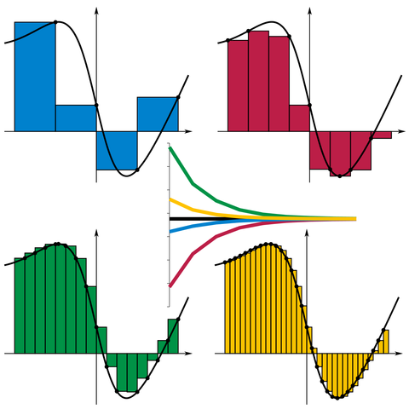
Højere-ordens funktioner
/// Estimate the integral of f
/// from a to b with stepsize d
let integrate f a b d =
let mutable sum = 0.0
let mutable x = a
while x < b do
sum <- sum + d * (f x)
x <- x + d
sum
let a = 0.0
let b = 1.0
let d = 0.01
let result = integrate exp a b d
printfn "Int_%g^%g exp(x) dx = %g" a b result
By I, KSmrq, CC BY-SA 3.0,
https://commons.wikimedia.org/w/index.php?curid=2347919

