Slide 1
Grafiske brugergrænseflader i F#
Programmering og problemløsning
Jon Sporring

Slide 2
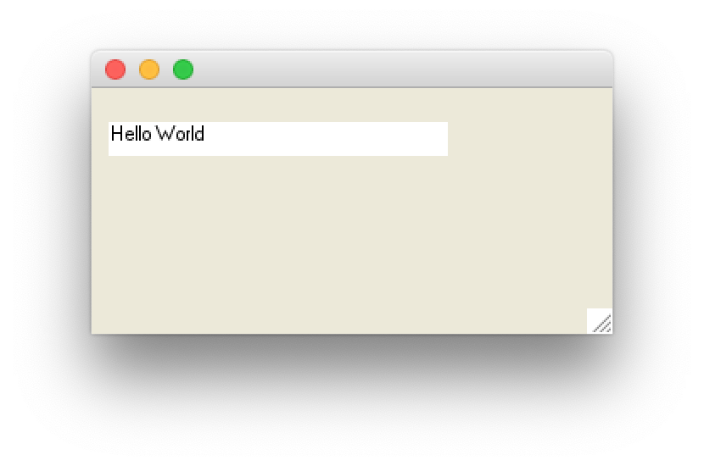
Skrive på skærmen
label.fsx
open System.Windows.Forms
open System.Drawing
let win = new Form () // make a window form
win.ClientSize <- Size (200, 100)
// make a label to show time
let label = new Label()
win.Controls.Add label
label.Width <- 200
label.Location <- new Point (10, 20)
label.Text <- "Hello World"
label.BackColor <- Color.White
label.Height <- 20
Application.Run win // start event-loop

Slide 3
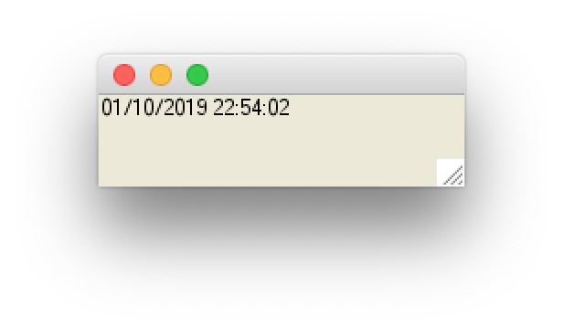
System.Windows.Forms
clock.fsx
open System.Windows.Forms
open System.Drawing
let win = new Form () // make a window form
win.ClientSize <- Size (200, 50)
// make a label to show time
let label = new Label()
win.Controls.Add label
label.Width <- 200
label.Text <- string System.DateTime.Now // get present time and date
// make a timer and link to label
let timer = new Timer()
timer.Interval <- 1000 // create an event every 1000 millisecond
timer.Enabled <- true // activiate the timer
timer.Tick.Add (fun e -> label.Text <- string System.DateTime.Now)
Application.Run win // start event-loop

Slide 4
System.Windows.Forms
movingClock.fsx
open System.Windows.Forms
open System.Drawing
let win = new Form () // make a window form
win.ClientSize <- Size (200, 50)
// make a label to show time
let label = new Label()
win.Controls.Add label
label.Text <- string System.DateTime.Now // get present time and date
let textSz = TextRenderer.MeasureText(label.Text,label.Font)
label.Width <- textSz.Width
label.Height <- textSz.Height
label.BackColor <- Color.White

Slide 5
System.Windows.Forms
movingClock.fsx
// make a timer and link to label
let timer = new Timer()
timer.Interval <- 100 // create an event every 1000 millisecond
timer.Enabled <- true // activiate the timer
let mutable pos = (0,0)
let mutable dir = (1,1)
let performTick (e : System.EventArgs) =
printfn "%A %A" pos dir
if fst pos + fst dir > win.ClientSize.Width - label.Width - 1
|| fst pos + fst dir < 0 then
dir <- (-fst dir, snd dir);
if snd pos + snd dir > win.ClientSize.Height - label.Height – 1
|| snd pos + snd dir < 0 then
dir <- (fst dir, -snd dir);
pos <- (fst pos + fst dir, snd pos + snd dir)
label.Location <- Point (fst pos, snd pos);
label.Text <- string System.DateTime.Now
timer.Tick.Add performTick
Application.Run win // start event-loop

Slide 6
System.Windows.Forms
movingSquare.fsx
open System.Windows.Forms
open System.Drawing
let win = new Form () // make a window form
win.ClientSize <- Size (200, 50)
. . .
// make a timer
let timer = new Timer()
timer.Interval <- 10 // create an event every 10 millisecond
timer.Enabled <- true // activiate the timer
timer.Tick.Add (fun e -> win.Refresh())
Application.Run win // start event-loop

Slide 7
System.Windows.Forms
Square
movingSquare.fsx
delta
let mutable delta = Point (0,0)
let mutable dir = Point (1,1)
let polygonSz = Point (10,10);
let polygon = [|Point (0,0); Point (polygonSz.X,0); polygonSz; Point (0,polygonSz.Y); Point (0,0)|]
let paint (e : PaintEventArgs) : unit =
let pen = new Pen (Color.Black)
if delta.X + dir.X < 0
|| delta.X + dir.X + polygonSz.X > win.ClientSize.Width - 1 then
dir <- Point (-dir.X, dir.Y);
if delta.Y + dir.Y < 0
|| delta.Y + dir.Y + polygonSz.Y > win.ClientSize.Height - 1 then
dir <- Point (dir.X, -dir.Y);
delta <- Point (delta.X + dir.X, delta.Y + dir.Y)
let add (p : Point) -> Point (p.X + delta.X, p.Y + delta.Y)
let points = Array.map add polygon
e.Graphics.DrawLines (pen, points)
win.Paint.Add paint
dir

Slide 8
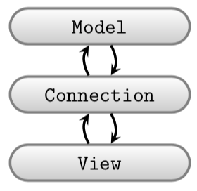
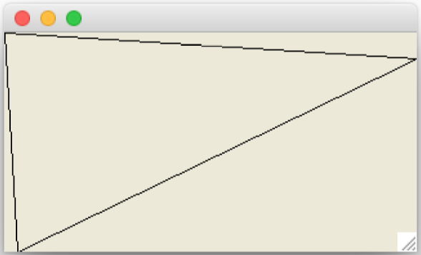
Adskil model og view
triangleClientSize.fsx
// Open often used libraries, beware of namespace pollution!
open System.Windows.Forms
open System.Drawing
// Prepare window form
let win = new Form ()
win.ClientSize <- Size (320, 170)
// Set paint call-back function
let paint (e : PaintEventArgs) : unit =
let pen = new Pen (Color.Black)
let points =
[|Point (0,0); Point (10,170); Point (320,20); Point (0,0)|]
e.Graphics.DrawLines (pen, points)
win.Paint.Add paint
Application.Run win // Start the event-loop.

Slide 9
open System.Windows.Forms
open System.Drawing
///////////// WinForm specifics /////////////
/// Setup a window form and return function which can activate it
let view (sz : Size) (pen : Pen) (pts : Point []) : (unit -> unit) =
let win = new Form ()
win.ClientSize <- sz
win.Paint.Add (fun e -> e.Graphics.DrawLines (pen, pts))
fun () -> Application.Run win // function as return value
///////////// Model /////////////
// A black triangle, using winform primitives for brevity
let model () : Size * Pen * (Point []) =
let size = Size (320, 170)
let pen = new Pen (Color.FromArgb (0, 0, 0))
let lines =
[|Point (0,0); Point (10,170); Point (320,20); Point (0,0)|]
(size, pen, lines)
///////////// Connection //////////////
// Tie view and model together and enter main event loop
let (size, pen, lines) = model ()
let run = view size pen lines
run ()
triangleOrganied.fsx

Slide 10
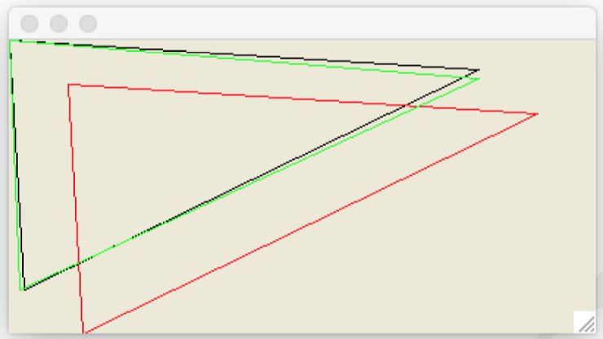
Tegn og transformer mange linjer

Slide 11
Model
transformWindows.fsx
///////////// Model /////////////
// A black triangle, using WinForm primitives for brevity
let model () : Size * ((Pen * (Point [])) list) =
/// Translate a primitive
let translate (d : Point) (arr : Point []) : Point [] =
let add (d : Point) (p : Point) : Point =
Point (d.X + p.X, d.Y + p.Y)
Array.map (add d) arr
/// Rotate a primitive
let rotate (theta : float) (arr : Point []) : Point [] =
let toInt = int << round
let rot (t : float) (p : Point) : Point =
let (x, y) = (float p.X, float p.Y)
let (a, b) = (x * cos t - y * sin t, x * sin t + y * cos t)
Point (toInt a, toInt b)
Array.map (rot theta) arr
let size = Size (400, 200)
let lines =
[|Point (0,0); Point (10,170); Point (320,20); Point (0,0)|]
let black = new Pen (Color.FromArgb (0, 0, 0))
let red = new Pen (Color.FromArgb (255, 0, 0))
let green = new Pen (Color.FromArgb (0, 255, 0))
let shapes =
[(black, lines);
(red, translate (Point (40, 30)) lines);
(green, rotate (1.0 *System.Math.PI / 180.0) lines)]
(size, shapes)

Slide 12
View+forbindelse
transformWindows.fsx
// Open often used libraries, beware of namespace polution!
open System.Windows.Forms
open System.Drawing
///////////// WinForm specifics /////////////
/// Setup a window form and return function to activate
let view (sz : Size) (shapes : (Pen * (Point [])) list) : (unit -> unit) =
let win = new Form ()
win.ClientSize <- sz
let paint (e : PaintEventArgs) ((p, pts) : (Pen * (Point []))) : unit =
e.Graphics.DrawLines (p, pts)
win.Paint.Add (fun e -> List.iter (paint e) shapes)
fun () -> Application.Run win // function as return value
///////////// Connection //////////////
// Tie view and model together and enter main event loop
let (size, shapes) = model ()
let run = view size shapes
run ()

Slide 13
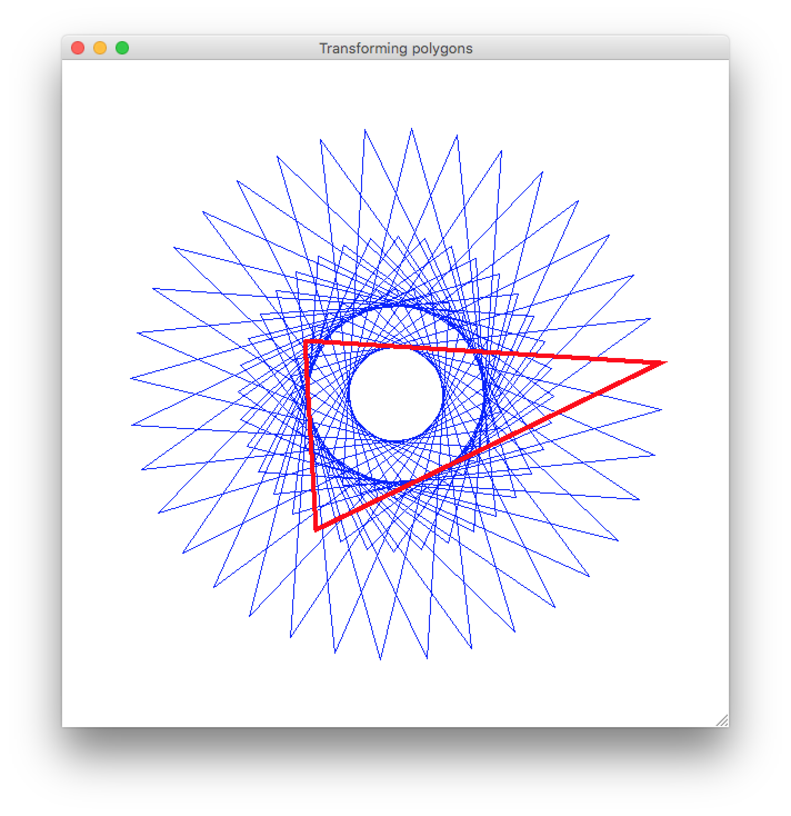
rotationalSymmetry.fsx

Slide 14
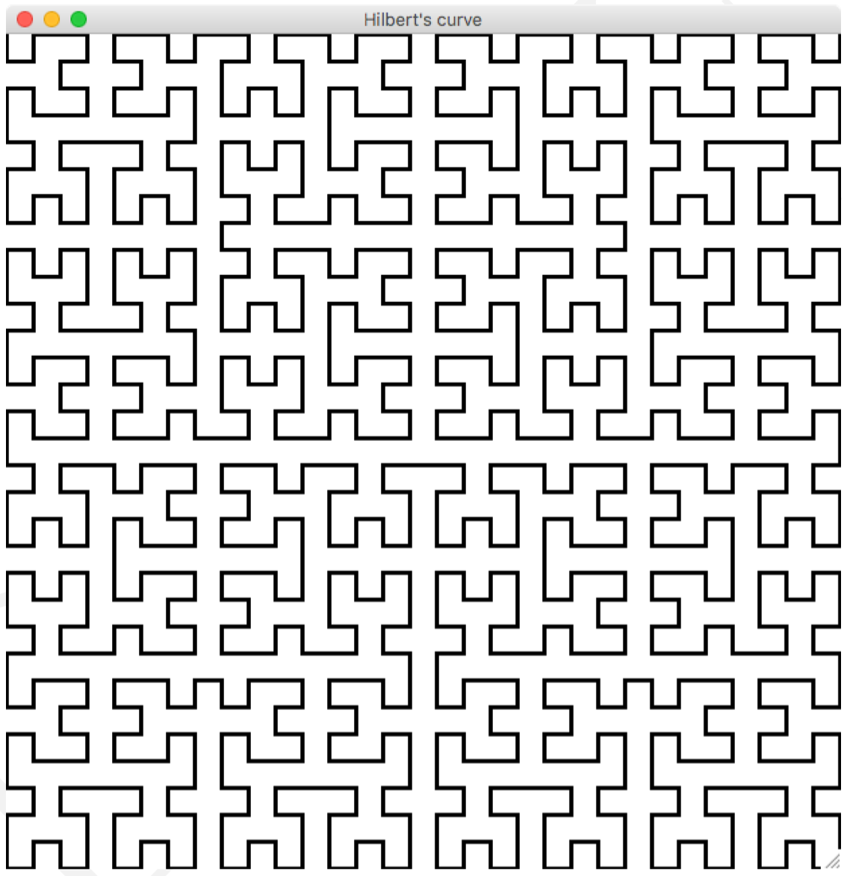
hilbert.fsx

Slide 15
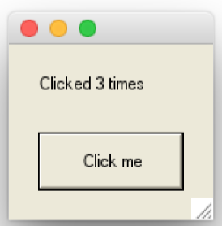
Input fra brugeren via Controls
buttonControl.fsx
open System.Windows.Forms
open System.Drawing
let win = new Form () // make a window form
win.ClientSize <- Size (140, 120)
// Create a label
let label = new Label()
win.Controls.Add label
label.Location <- new Point (20, 20)
label.Width <- 120
let mutable clicked = 0
let setLabel clicked =
label.Text <- sprintf "Clicked %d times" clicked
setLabel clicked
// Create a button
let button = new Button ()
win.Controls.Add button
button.Size <- new Size (100, 40)
button.Location <- new Point (20, 60)
button.Text <- "Click me"
button.Click.Add (fun e -> clicked <- clicked + 1; setLabel clicked)
Application.Run win // Start the event-loop.

Slide 16
Input fra brugeren via Controls
buttonControlCompact.fsx
open System.Windows.Forms
open System.Drawing
// Model: a state 'clicked' that counts how many times an event has occurred
let mutable clicked = 0
let message () = sprintf "Clicked %d times" clicked
let update () = clicked <- clicked + 1
// View: A window containing a label and a button
let win = new Form(ClientSize=Size(140, 120))
let label = new Label(Location=new Point(20, 20), Width=120)
let button = new Button(Size=new Size(100, 40), Location=new Point(20, 60), Text="Click me")
win.Controls.Add label
win.Controls.Add button
// Connect model and view and start the event-loop
label.Text <- message ()
button.Click.Add (fun e -> update (); label.Text <- message ())
Application.Run win

Slide 17
Evaluering: Målbeskrivelse
Viden
Grundlæggende begreber indenfor imperativ, objektorienteret og funktionsprogrammeringsparadigmerne: Funktioner og metoder, variabler, udtryk, typer, kontrolstrukturer, løkker, blokstruktur, klasser og objekter, objektinteraktion, nedarvning, rekursion, polymorfi, abstraktion, undtagelser, pattern matching over rekursive datatyper, m.m.
God programmeringsskik: Dokumentation i koden, design patterns, afprøvning inkl. unit testing, håndtering af køretidsfejl, m.m.
Teknikker til problemløsning: Teknisk analyse af naturligsprogsproblemer, objektorienteret design, modelleringssprog, håndkøring, m.m.
God rapportskrivningsteknik.
Færdigheder
At kunne lave mindre programmer (op til ca. 1000 linjer) i de programmeringsparadigmer, der undervises i på kurset, med overholdelse af god programmeringsskik og -stil.
At kunne evaluere fordele og ulemper ved at opskrive løsningen i de underviste programmeringsparadigmer, og at kunne implementere, afprøve, dokumentere, og evaluere løsningens kvalitet.
Et sideordnet mål er, at den studerende opnår passende studieteknik således, at dette og parallelkurser bestås svarende til et fuldtidsstudium.
Kompetencer
Ud fra en præcist defineret problemformulering at kunne analysere problemet, udforme et program til løsning af dette, samt at verificere, afprøve, og dokumentere løsningen.

Slide 18
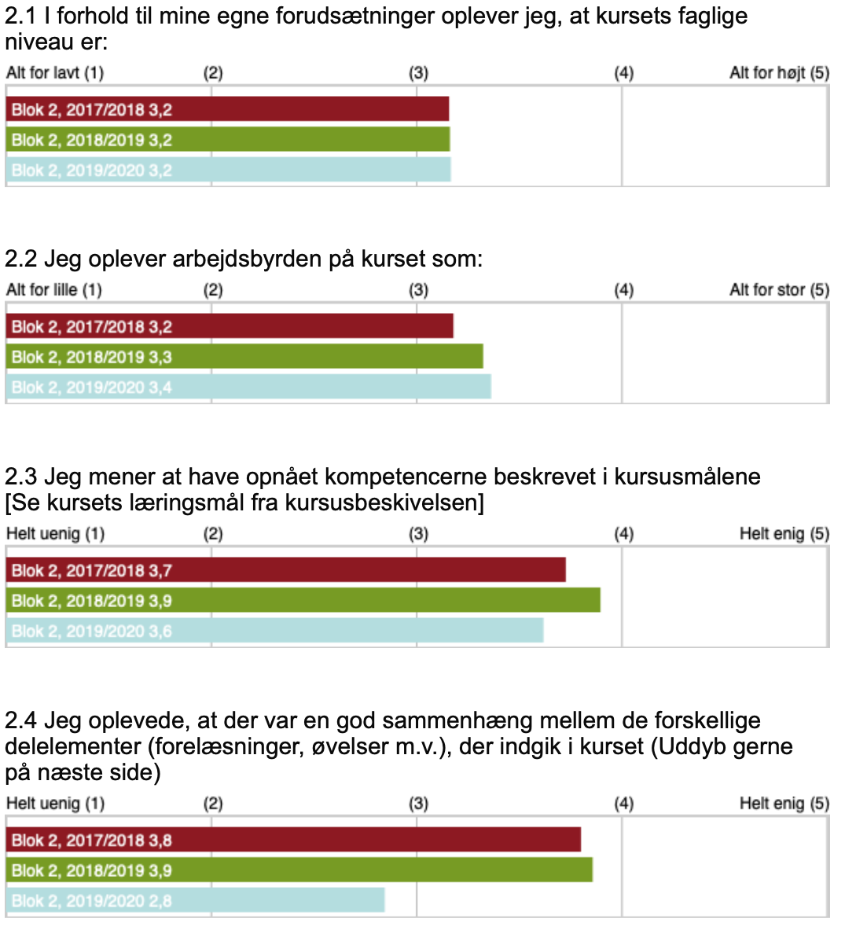

2017/18
2018/19
2019/20

Slide 19
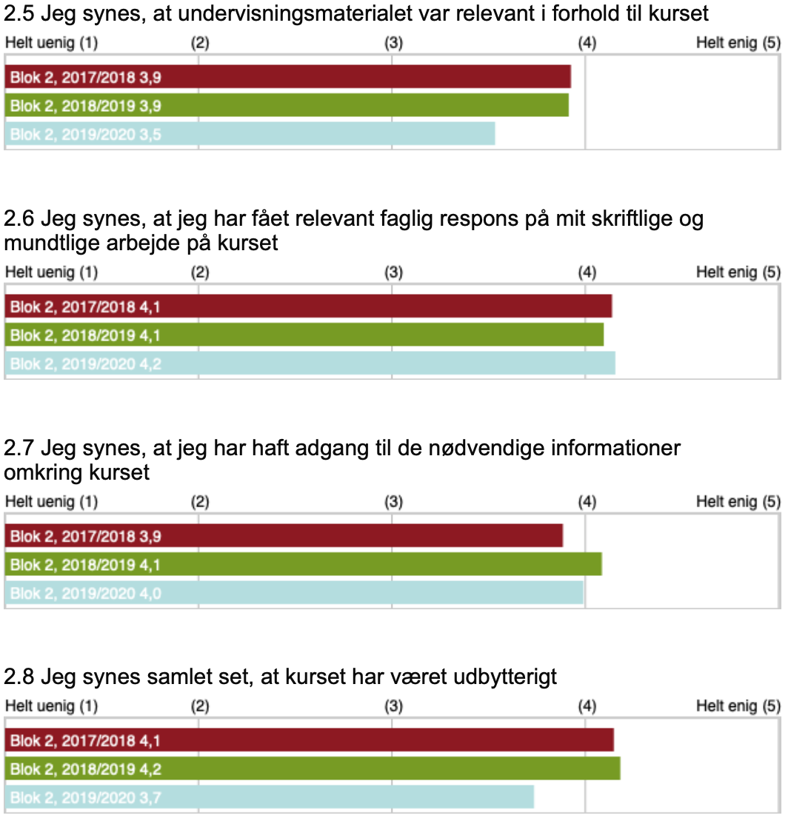
2017/18
2018/19
2019/20

Slide 20
Forbedring af kurset
Lille følgegruppe:
Jon, 1 instruktor, (mindst) 1 studerende fra hver af de 3 uddannelser: Datalogi, DS&ML, Dat-øk
Mødes 3 gange
1. møde: Identifikation af mulige forbedringerspunkter
2. møde: F.eks. diskussion af eksempler på forbedrede opgaver og ugesedler
3. møde: F.eks. diskussion af eksempler på forbedret pensum og forelæsninger
Hvis du er interesseret, så skriv til sporring@di.ku.dk

Slide 21
Husk:
Hvis I ikke har bestået mindst 11 ud af 12 opgaver, så har I mulighed for at genaflevere gamle opgaver lidt endnu
Reeksamen er 15-16 April
Det var det!

Slide 22
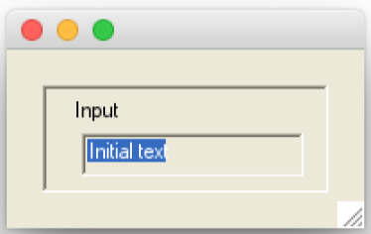
Organisering af Controls i grupper: Panels
panel.fsx
open System.Drawing
open System.Windows.Forms
// Create a window with a panel, label and a textbox
let win = new Form(ClientSize=new Size (200, 100))
let panel = new Panel(ClientSize=new Size(160, 60), Location=new Point(20,20), BorderStyle=BorderStyle.Fixed3D)
let label = new Label(ClientSize=new Size(120, 20), Location=new Point(15,5), Text="Input")
let textBox = new TextBox(ClientSize=new Size(120, 20), Location=new Point(20,25), Text="Initial text")
win.Controls.Add panel // Add panel to window
panel.Controls.Add label // add label to panel
panel.Controls.Add textBox // add textbox to panel
Application.Run win // Start the event-loop

Slide 23
Automatisk tildeling af position i paneler
flowLayoutPanel.fsx
open System.Windows.Forms
open System.Drawing
// Create a window, a FlowLayoutPanel, 4 buttons, a checkbox, a panel, and 4 radiobuttons
let win = new Form(ClientSize=new Size(302, 356), Text="A Flowlayout Example")
let flowLayoutPanel = new FlowLayoutPanel(Location=new Point(47, 55), BorderStyle=BorderStyle.Fixed3D, WrapContents=true)
let buttonLst =
[new Button(Text="Button0");
new Button(Text="Button1");
new Button(Text="Button2");
new Button(Text="Button3")]
let panel = new Panel(Location=new Point (47, 190),BorderStyle=BorderStyle.Fixed3D)
let wrapContentsCheckBox = new CheckBox(Location=new Point (3, 3), Text="Wrap Contents")
let radioButtonLst =
[(new RadioButton(Location=new Point(3, 34), Text="TopDown"), FlowDirection.TopDown);
(new RadioButton(Location=new Point(3, 62), Text="BottomUp"), FlowDirection.BottomUp);
(new RadioButton(Location=new Point(111, 34), Text="LeftToRight"), FlowDirection.LeftToRight);
(new RadioButton(Location=new Point(111, 62), Text="RightToLeft"), FlowDirection.RightToLeft)]

Slide 24
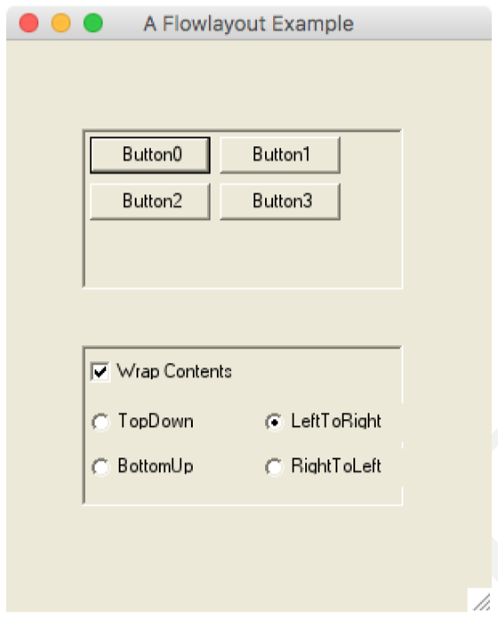
Automatisk tildeling af position i paneler
flowLayoutPanel.fsx
// The window contains the panels which in turn contains the buttons, checkbox and radio buttons.
win.Controls.Add flowLayoutPanel
for btn in buttonLst do
flowLayoutPanel.Controls.Add btn
win.Controls.Add panel
panel.Controls.Add (wrapContentsCheckBox)
for btn, dir in radioButtonLst do
panel.Controls.Add (btn)
// Link wrapContentsCheckBox and flowLayoutPanel.WrapContents
wrapContentsCheckBox.Checked <- flowLayoutPanel.WrapContents
wrapContentsCheckBox.CheckedChanged.Add (fun _ -> flowLayoutPanel.WrapContents <- wrapContentsCheckBox.Checked)
// Link radio buttons and flowLayoutPanel.FlowDirection
for (btn, dir) in radioButtonLst do
btn.Checked <- flowLayoutPanel.FlowDirection = dir
btn.CheckedChanged.Add (fun _ -> flowLayoutPanel.FlowDirection <- dir)
// Create a window, add controls, and start event-loop
Application.Run win

