Slide 1
Programmering og Problemløsning
14.1: Nedarvning

Slide 2
Resumé
Med overloading kan vi genbruge navne til små variationer i inputparametre
Association: “kender-til” - besked relation
Aggregation: “har-en/flere” – udveksling af ejeskab
Composition: “har-en/flere” – een ejer
Overshadow: Navnesammenfald i nedarvning skygger i underklassen
Abstrakte klasser og override: Abstrakte klasser kan kræve nedarvning og metodedefinitioner.

Slide 3
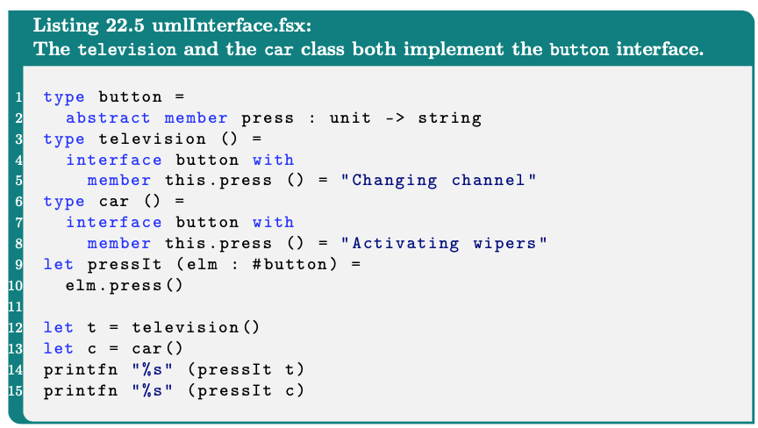
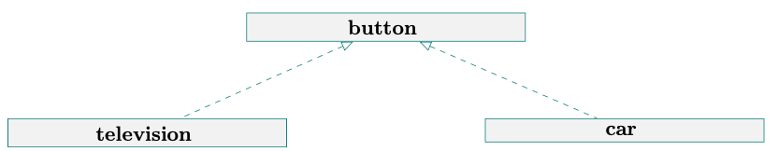
Interface (is-a)
Et fjernsyn og en bil har begge en knap. Man kan trykke på knappen, og resultatet er ganske forskelligt.
Fordele: Angiver egenskaber, semantisk graf
Bagdele: Risiko for megen up- og downcasting

Slide 4
Operatorer: Komplekse tal
For reelle tal:
0 løsninger
1 løsning
2 løsninger
Imaginært tal:
Altid 2 løsninger!

Slide 5
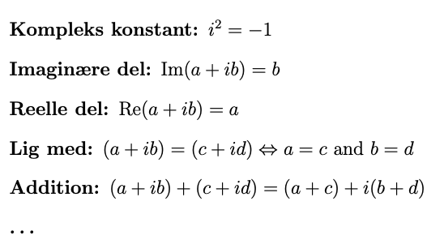
Komplekse tal
https://en.wikipedia.org/wiki/Complex_number

Slide 6
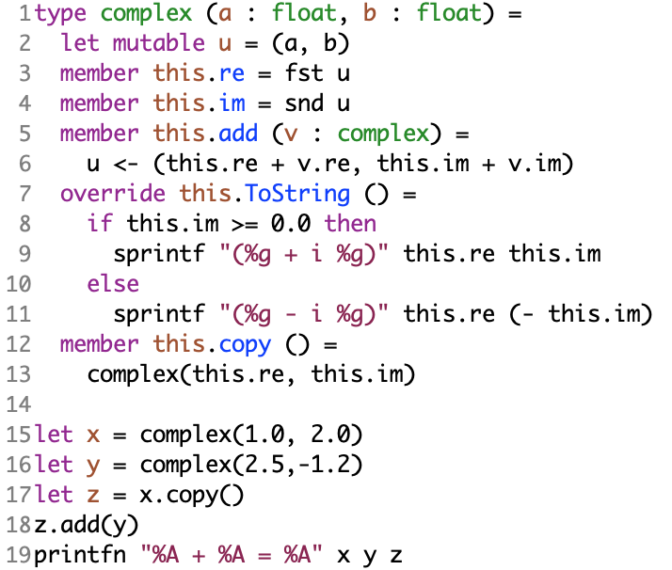
Komplekse tal: Mutable
Mutable: copy needed, difficult to remember state
complexSideEffect.fsx

Slide 7
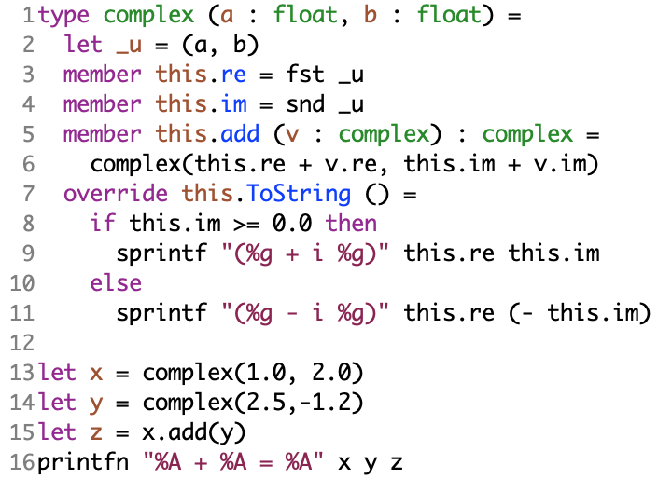
Komplekse tal: This
Mutable: copy needed, difficult to remember state
This: No state to remember, operator difficult
complexThis.fsx

Slide 8
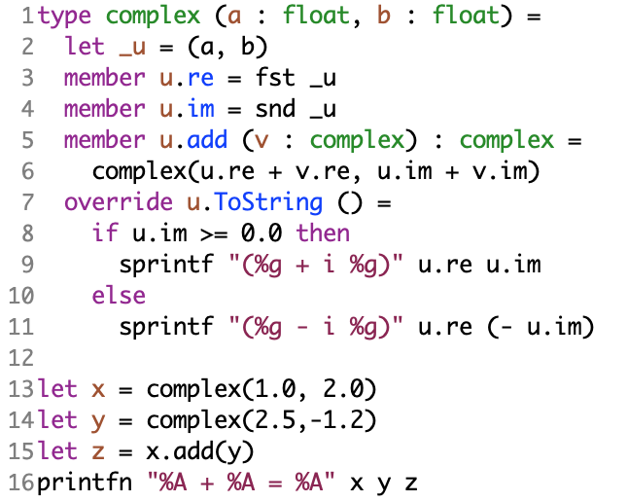
Komplekse tal: U
Mutable: copy needed, difficult to remember state
This: No state to remember, operator difficult
U: programming notation easier
complexU.fsx

Slide 9
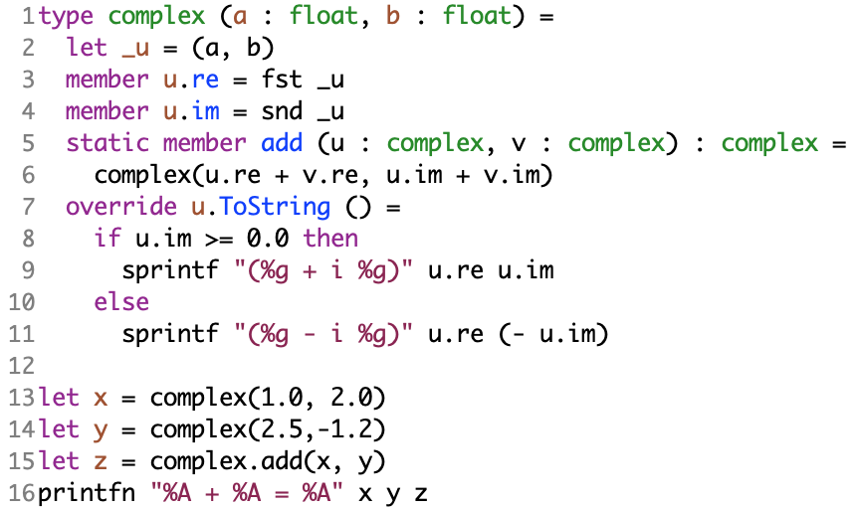
Komplekse tal: Static
Mutable: copy needed, difficult to remember state
This: No state to remember, operator difficult
U: programming notation easier
Static: Like a module, usage slightly more natural
complexStatic.fsx

Slide 10
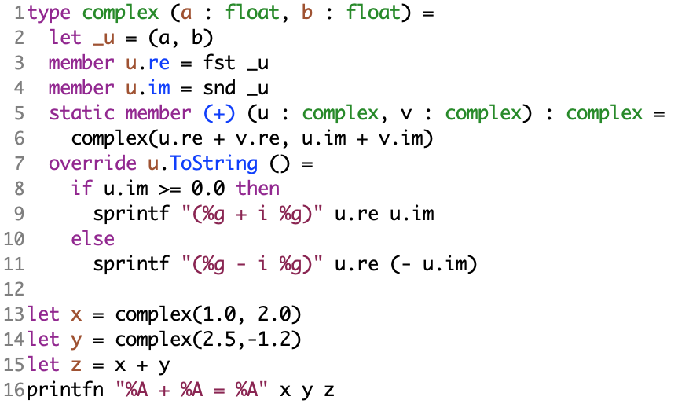
Komplekse tal: Operator
Mutable: copy needed, difficult to remember state
This: No state to remember, operator difficult
U: programming notation easier
Static: Like a module, usage slightly more natural
Operator: ‘normal’ usage
complexOperator.fsx

Slide 11
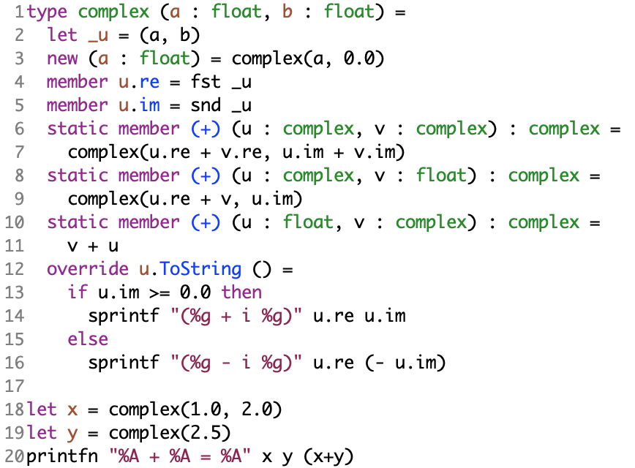
Komplekse tal: Constructors
Mutable: copy needed, difficult to remember state
This: No state to remember, operator difficult
U: programming notation easier
Static: Like a module, usage slightly more natural
Operator: ‘normal’ usage
New: easier creation
complexNew.fsx

Slide 12
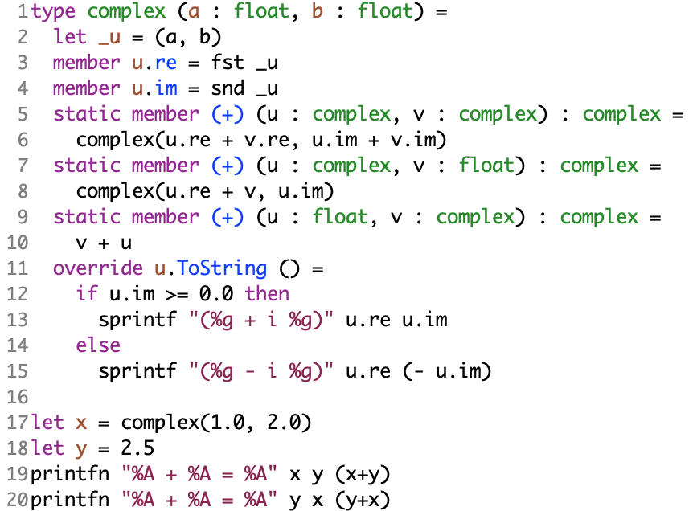
Komplekse tal: Overload
Mutable: copy needed, difficult to remember state
This: No state to remember, operator difficult
U: programming notation easier
Static: Like a module, usage slightly more natural
Operator: ‘normal’ usage
New: easier creation
Overload: type mixing in usage
complexOverload.fsx

Slide 13
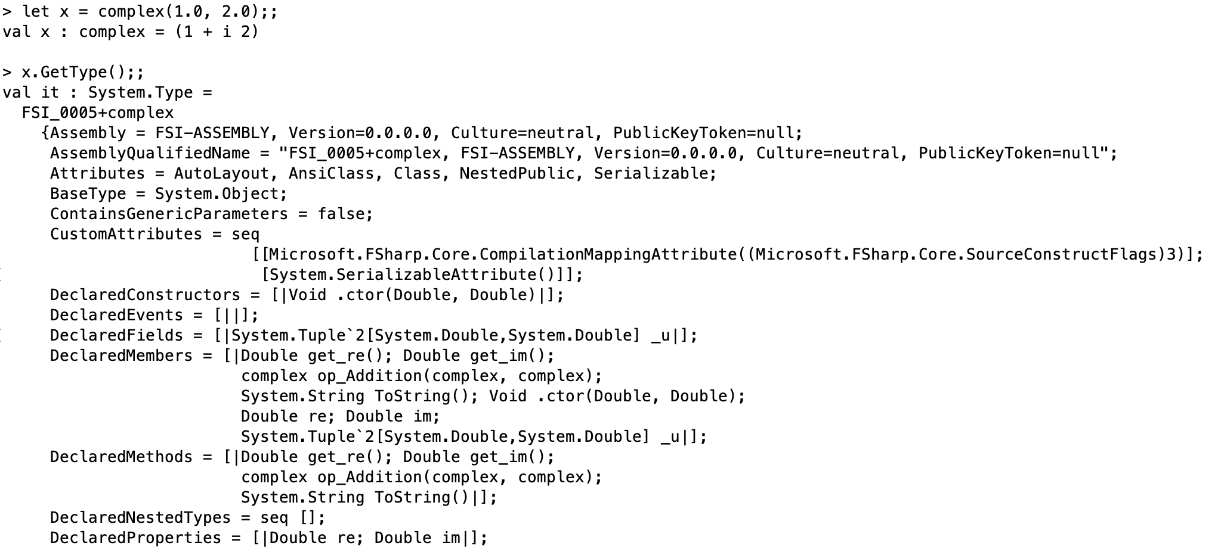
Komplekse tal: equality
System.object klassen:
Equals
Finalize
GetHashCode
GetType
ToString
(=) operator eksisterer ikke!
complexOperator.fsx

Slide 14
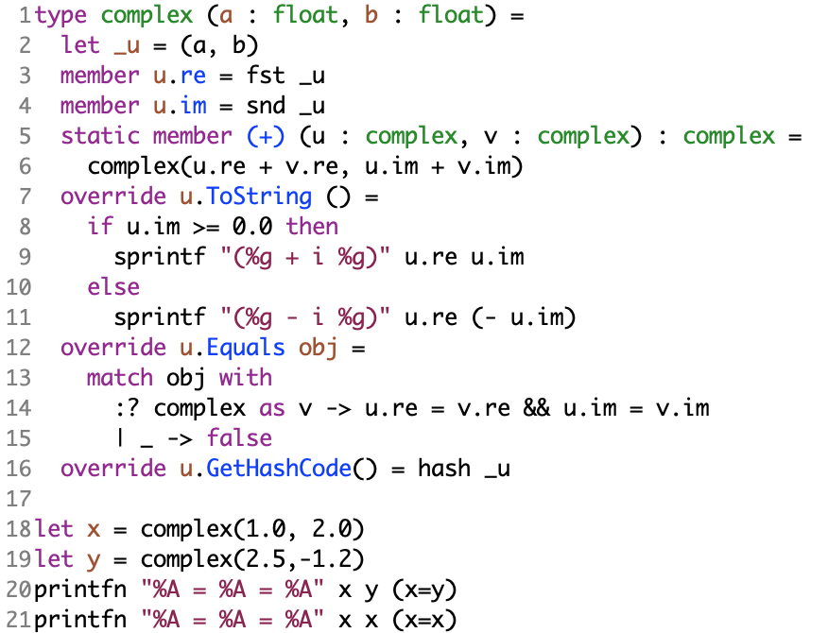
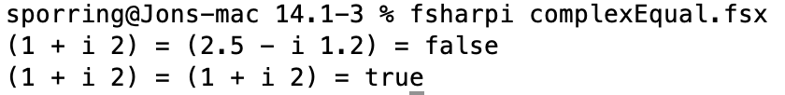
Komplekse tal: equality
System.object klassen:
Equals
Finalize
GetHashCode
GetType
ToString
Compare types operator: “:?”
Hash function: map from infinite domain to fixed sized domain. For computational and storage efficient data access
https://en.wikipedia.org/wiki/Hash_function

Slide 15
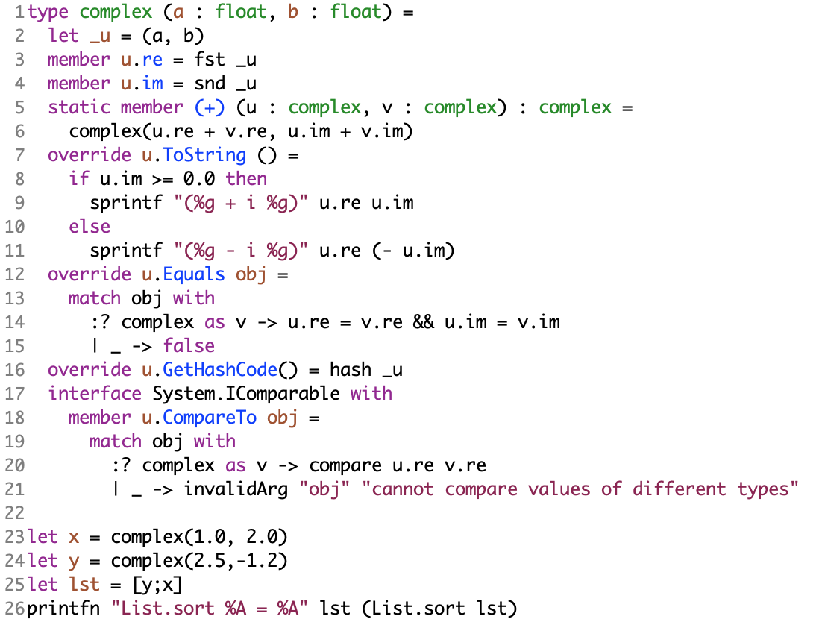
Komplekse tal: List.sort (comparable)
System.object klassen:
Equals
Finalize
GetHashCode
GetType
ToString
System.IComparable
CompareTo

Slide 16
Opsummering
Interfaces: angiver egenskaber på tværs af klasser
Komplekse tal:
Mutable,
immutable,
self-identifier,
static,
operator,
extra constructors,
operator overloading
Copy constructor
equality og comparable type begrænsninger
God Jul

