Slide 1
Programmering og Problemløsning
3.1: Funktioner, dokumentation og løkker

Slide 2
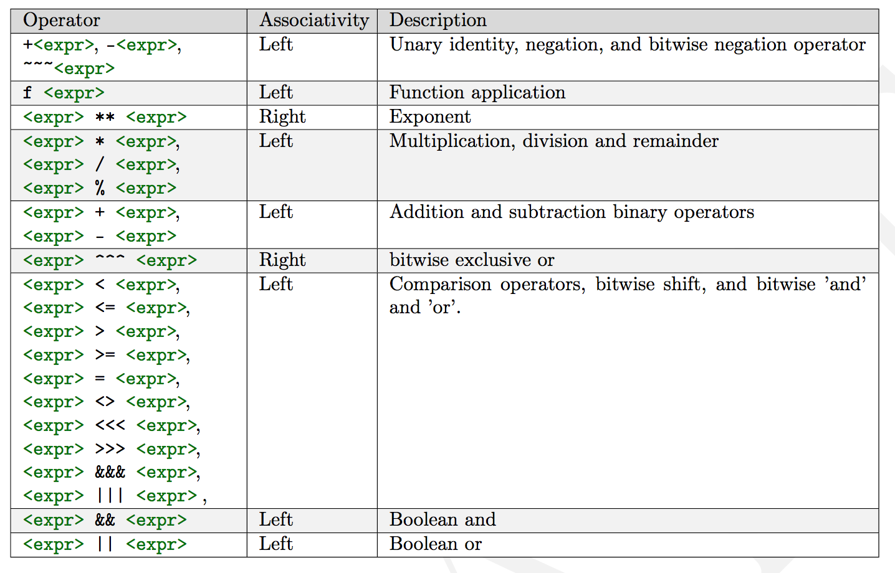
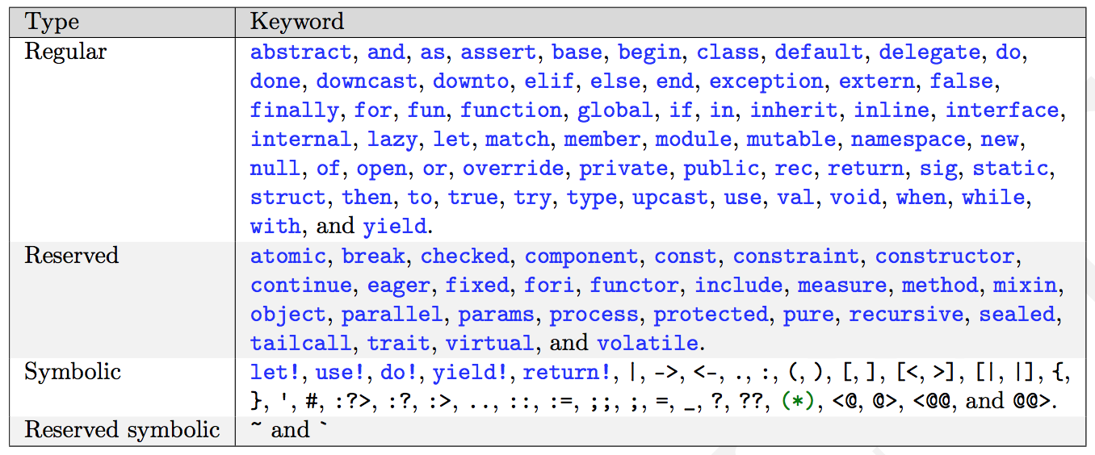
Repetition af Nøglekoncepter
Heltal, flydende tal, tegn, strenge
Typer og operatorer
Præcedens og association
Verbose og letvægtssyntaks
Virkefelter
Nøgleord
https://tinyurl.com/yc3or9fh

Slide 3
Virkefelter (scope)
Virkefelter via parenteser
name = "Jon" greeting = "Hello"
name = "Anders"
...
...
0
1
2
...
0
let greeting = "Hello"
let name = "Jon"
do printfn "%s %s" greeting name
(
let name = "Anders"
do printfn "%s %s" greeting name
)
do printfn "%s %s" greeting name
1

Slide 4
Funktioner
Organisering = nemmere at forstå og vedligeholde
let greetings (name : string) : string =
"Hello " + name
let str = greetings "Jon"
do printfn "%s" str
do printfn "%s" (greetings "World")
let greetings name =
"Hello " + name
let str = greetings "Jon"
do printfn "%s" str
do printfn "%s" (greetings "World")

Slide 5
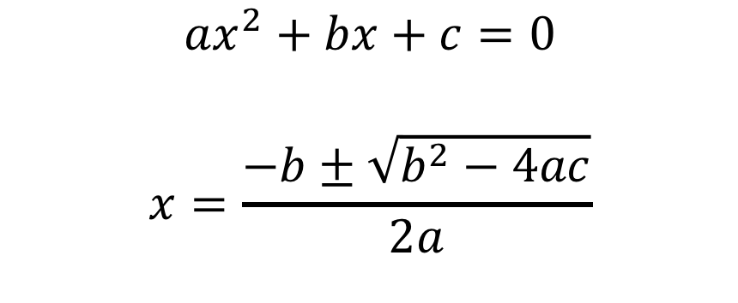
Løs en andengradsligning (baglæns!)
let discriminant a b c =
b ** 2.0 - 4.0 * a * c
let solution a b c sgn =
let d = discriminant a b c
(-b + sgn * sqrt d) / (2.0 * a)
$${ax}^{2}+bx+c=0$$
$$x=\frac{−b±\sqrt{b^{2}−4ac}}{2a}$$
let a = 1.0
let b = 0.0
let c = -1.0
let xp = (solution a b c +1.0)
printfn "0 = %.1fx^2 + %.1fx + %.1f => x_+ = %.1f" a b c xp

Slide 6
Dokumentation - simpel
/// The discriminant of a quadratic equation with parameters a, b, and c
let discriminant a b c = b ** 2.0 - 4.0 * a * c

Slide 7
Dokumentation - grundig
/// <summary>Find x when 0 = ax^2+bx+c.</summary>
/// <remarks>Negative discriminants are not checked.</remarks>
/// <example>
/// The following code:
/// <code>
/// let a = 1.0
/// let b = 0.0
/// let c = -1.0
/// let xp = (solution a b c +1.0)
/// printfn "0 = %.1fx^2 + %.1fx + %.1f => x_+ = %.1f" a b c xp
/// </code>
/// prints <c>0 = 1.0x^2 + 0.0x + -1.0 => x_+ = 0.7</c> to the console.
/// </example>
/// <param name="a">Quadratic coefficient.</param>
/// <param name="b">Linear coefficient.</param>
/// <param name="c">Constant coefficient.</param>
/// <param name="sgn">+1 or -1 determines the solution.</param>
/// <returns>The solution to x.</returns>
let solution a b c sgn =
let d = discriminant a b c
(-b + sgn * sqrt d) / (2.0 * a)

Slide 8
XML dokumentationspipeline
mdoc update
commentExample.fsx
commentExample.xml
commentExampleHTML
index.html
fsharp --doc
mdoc export-html
fsharpc --doc:commentExample.xml commentExample.fsx
mdoc update -o commentExample -i commentExample.xml commentExample.exe
mdoc export-html -out commentExampleHTML commentExample

Slide 9

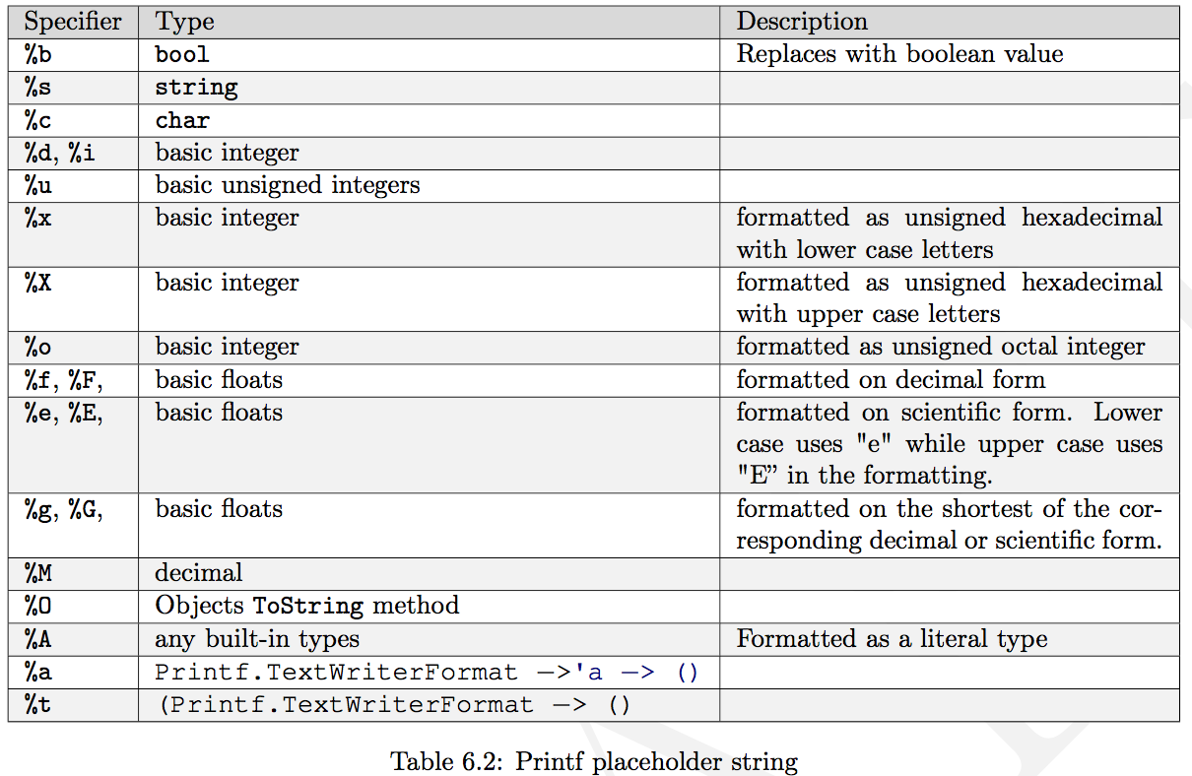
printf familien
printf "The number is %d" 3
printfn "The number is %d" 3
sprintf "The number is %d" 3

Slide 10
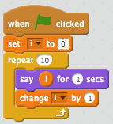
Muterbare værdier og løkker
let mutable x = 5
printfn "%d" x
x <- -3
printfn "%d" x
for i = 1 to 10 do
printf "%d " i
printfn ""
let mutable i = 1
while i <= 10 do
printf "%d " i
i <- i + 1
printf "\n"

