Slide 1
Programmering og Problemløsning
3.1: Funktioner, dokumentation og løkker

Slide 2
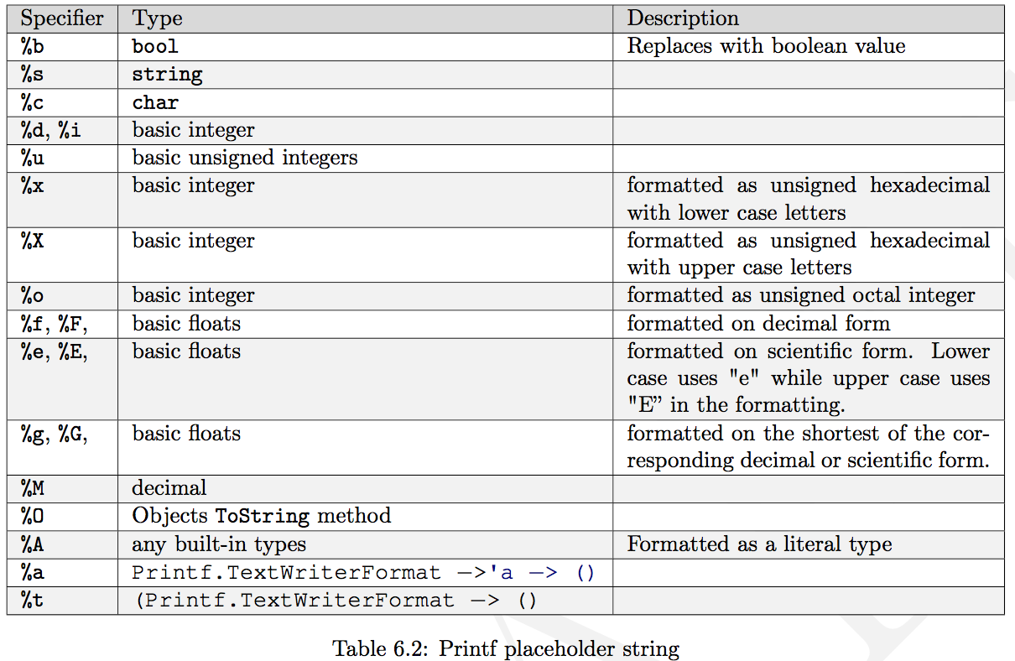
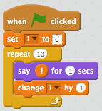
Repetition af Nøglekoncepter
Virkefelter
Funktioner
Programmer ‘baglæns’
Dokumentation
Løkker
Præcedens og association
Verbose og letvægtssyntaks
Virkefelter
Nøgleord
https://tinyurl.com/y923467c
https://tinyurl.com/y8yuuyy4

Slide 3
Fibonacci
For-løkke
While-løkke
let mutable m = 1
let mutable n = 1
let N = 5
for i = 3 to N do
let p = m + n
m <- n
n <- p
printfn "%d: %d" N n
let mutable m = 1
let mutable n = 1
let mutable i = 3
let N = 5
while i <= 5 do
let p = m + n
m <- n
n <- p
i <- i + 1;
printfn "%d: %d" N n

Slide 4
Tupler
Venstre side af en binding kan have navngivne tuple-elementer
$fsharpi
…
> let a = (1, 1.0);;
val a : int * float = (1, 1.0)
> let (b1, b2, b3) = b;;
val b3 : char = '1'
val b2 : string = "en"
val b1 : int = 1
Produkttype
Funktioner til at indicerer i par
Hele typen - ikke enkelt - elementer kan være mutérbare
> printfn "%A %A" (fst a) (snd a);;
1 1.0
val it : unit = ()
> let mutable c = (1,2)
- c <- (2,3)
- printfn "%A" c;;
(2, 3)
val mutable c : int * int = (2, 3)
val it : unit = ()
Parentes unødvendig men anbefalelses
> let b = 1, "en", '\049'
val b : int * string * char = (1, "en", '1’)

Slide 5
Fibonacci
For-løkke
While-løkke
Tupple + for-løkke
let mutable m = 1
let mutable n = 1
let N = 5
for i = 3 to N do
let p = m + n
m <- n
n <- p
printfn "%d: %d" N n
let mutable m = 1
let mutable n = 1
let mutable i = 3
let N = 5
while i <= 5 do
let p = m + n
m <- n
n <- p
i <- i + 1;
printfn "%d: %d" N n
let mutable pair = (1,1)
let N = 5
for i = 3 to N do
pair <- (snd pair, fst pair + snd pair)
printfn "%d: %d" N (snd pair)
let fib N =
let mutable pair = (1,1)
for i = 3 to N do
pair <- (snd pair, fst pair + snd pair)
snd pair
let N = 5
printfn "%d: %d" N (fib N)

Slide 6
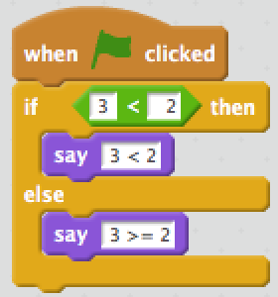
Betingelser
If-then-else
Kæde af betingelser
if 3 < 2 then
printfn "3 < 2"
else
printfn "3 >= 2";;
3 >= 2
val it : unit = ()
let str =
if 3 < 2 then
"3 < 2"
elif 3 = 2
"3 = 2"
else
"3 > 2";;
val str : string = "3 > 2"
let str =
if 3 < 2 then
"3 < 2"
else
"3 >= 2";;
val str : string = "3 >= 2"

Slide 7
Decimal til Binær
let N = 116
let mutable n = N
let mutable str = ""
while n > 0 do
let rest = n % 2
n <- n / 2
if rest > 0 then
str <- "1"+str
else
str <- "0"+str
printfn "%d_10 = %s_2" N str
let N = 116
let mutable n = N
let mutable str = ""
while n > 0 do
str <- (if n % 2 > 0 then "1" else "0") + str
n <- n / 2
printfn "%d_10 = %s_2" N str

Slide 8
Hvad gør programmet?
i på højre side er altid 0
let i = 0
while i < 3 do
let i = i + 1
printfn "%d" i

Slide 9
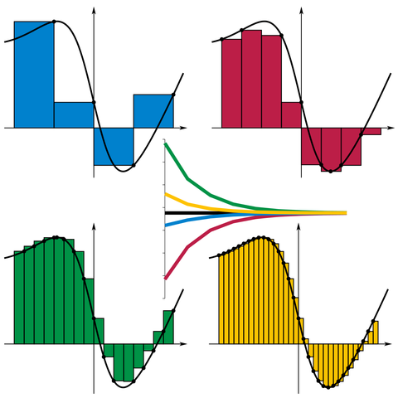
Højere ordens funktioner
/// Estimate the integral of f
/// from a to b with stepsize d
let integrate f a b d =
let mutable sum = 0.0
let mutable x = a
while x < b do
sum <- sum + d * (f x)
x <- x + d
sum
let a = 0.0
let b = 1.0
let d = 0.01
let result = integrate exp a b d
printfn "Int_%g^%g exp(x) dx = %g" a b result
By I, KSmrq, CC BY-SA 3.0,
https://commons.wikimedia.org/w/index.php?curid=2347919

Slide 10
Højere ordens funktioner
/// Estimate the integral of f
/// from a to b with stepsize d
let integrate f a b d =
let mutable sum = 0.0
let mutable x = a
while x < b do
sum <- sum + d * (f x)
x <- x + d
sum
let a = 0.0
let b = 1.0
let d = 0.01
let result = integrate exp a b d
printfn "Int_%g^%g exp(x) dx = %g" a b result
/// Estimate the integral of f
/// from a to b with stepsize d
let integrate f a b d =
let mutable sum = 0.0
let mutable x = a
while x < b do
sum <- sum + d * (f x)
x <- x + d
sum
let a = 0.0
let b = 1.0
let truth = exp 1.0 - 1.0
for e = 0 to 6 do
let d = 10.0**(float -e)
let result = truth - integrate exp a b d
printfn "d = %e: exp 1.0 - 1.0 - Int_%g^%g exp(x) dx = %g" d a b result
By I, KSmrq, CC BY-SA 3.0,
https://commons.wikimedia.org/w/index.php?curid=2347919

Slide 11
Anonyme funktioner
let f x = x * exp(x)
f 3.0
/// Estimate the integral of f
/// from a to b with stepsize d
let integrate f a b d =
let mutable sum = 0.0
let mutable x = a
while x < b do
sum <- sum + d * (f x)
x <- x + d
sum
let a = 0.0
let b = 1.0
let d = 1e-5
let result = integrate (fun x -> x * exp(x)) a b d
printfn "Int_%g^%g f(x) dx = %g" a b result
let f = fun x -> x * exp(x)
f 3.0

Slide 12

Tid: 24. september 2018 kl. 12.15-13.00
Sted: Lille UP1

Slide 13
Virkefelter (scope)
Virkefelter via parenteser
name = "Jon" greeting = "Hello"
name = "Anders"
...
...
0
1
2
...
0
let greeting = "Hello"
let name = "Jon"
do printfn "%s %s" greeting name
(
let name = "Anders"
do printfn "%s %s" greeting name
)
do printfn "%s %s" greeting name
1

Slide 14
Funktioner
Organisering = nemmere at forstå og vedligeholde
let greetings (name : string) : string =
"Hello " + name
let str = greetings "Jon"
do printfn "%s" str
do printfn "%s" (greetings "World")
let greetings name =
"Hello " + name
let str = greetings "Jon"
do printfn "%s" str
do printfn "%s" (greetings "World")

Slide 15
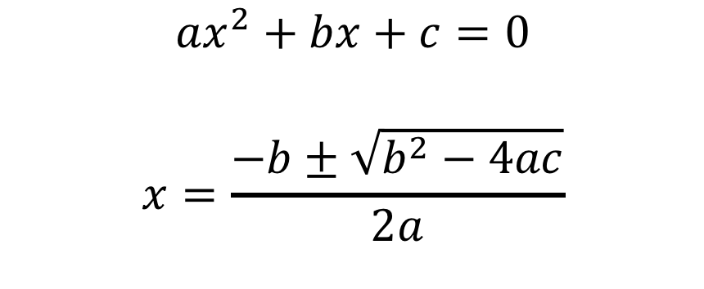
Løs en andengradsligning (baglæns!)
let discriminant a b c =
b ** 2.0 - 4.0 * a * c
let solution a b c sgn =
let d = discriminant a b c
(-b + sgn * sqrt d) / (2.0 * a)
$${ax}^{2}+bx+c=0$$
$$x=\frac{−b±\sqrt{b^{2}−4ac}}{2a}$$
let a = 1.0
let b = 0.0
let c = -1.0
let xp = (solution a b c +1.0)
printfn "0 = %.1fx^2 + %.1fx + %.1f => x_+ = %.1f" a b c xp

Slide 16
Dokumentation - simpel
/// The discriminant of a quadratic equation with parameters a, b, and c
let discriminant a b c = b ** 2.0 - 4.0 * a * c

Slide 17
Dokumentation - grundig
/// <summary>Find x when 0 = ax^2+bx+c.</summary>
/// <remarks>Negative discriminants are not checked.</remarks>
/// <example>
/// The following code:
/// <code>
/// let a = 1.0
/// let b = 0.0
/// let c = -1.0
/// let xp = (solution a b c +1.0)
/// printfn "0 = %.1fx^2 + %.1fx + %.1f => x_+ = %.1f" a b c xp
/// </code>
/// prints <c>0 = 1.0x^2 + 0.0x + -1.0 => x_+ = 0.7</c> to the console.
/// </example>
/// <param name="a">Quadratic coefficient.</param>
/// <param name="b">Linear coefficient.</param>
/// <param name="c">Constant coefficient.</param>
/// <param name="sgn">+1 or -1 determines the solution.</param>
/// <returns>The solution to x.</returns>
let solution a b c sgn =
let d = discriminant a b c
(-b + sgn * sqrt d) / (2.0 * a)

Slide 18
XML dokumentationspipeline
mdoc update
commentExample.fsx
commentExample.xml
commentExampleHTML
index.html
fsharp --doc
mdoc export-html
fsharpc --doc:commentExample.xml commentExample.fsx
mdoc update -o commentExample -i commentExample.xml commentExample.exe
mdoc export-html -out commentExampleHTML commentExample

Slide 19

printf familien
printf "The number is %d" 3
printfn "The number is %d" 3
sprintf "The number is %d" 3

Slide 20
Muterbare værdier og løkker
let mutable x = 5
printfn "%d" x
x <- -3
printfn "%d" x
for i = 1 to 10 do
printf "%d " i
printfn ""
let mutable i = 1
while i <= 10 do
printf "%d " i
i <- i + 1
printf "\n"

