Slide 1
Grafiske brugergrænseflader i F#
Programmering og problemløsning
Jon Sporring

Slide 2
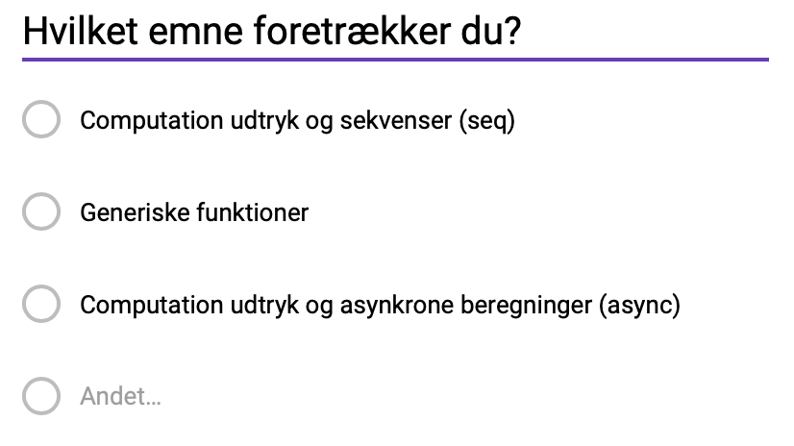
Fredagens forelæsning
https://tinyurl.com/yd93a8g6

Slide 3
System.Timers
fsharpi
let t = new System.Timers.Timer()
t.Interval <- 1000.0
t.Elapsed.Add (fun e -> printfn "%s" (string System.DateTime.Now));;
t.Start();;
t.Stop();;

Slide 4
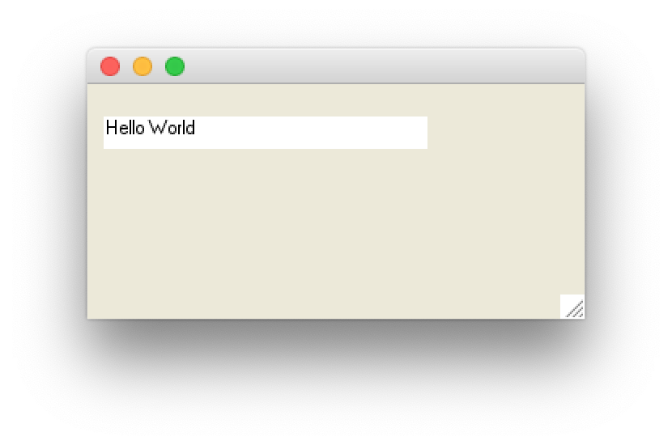
Skrive på skærmen
label.fsx
open System.Windows.Forms
open System.Drawing
let win = new Form () // make a window form
win.ClientSize <- Size (200, 100)
// make a label to show time
let label = new Label()
win.Controls.Add label
label.Width <- 200
label.Location <- new Point (10, 20)
label.Text <- "Hello World"
label.BackColor <- Color.White
label.Height <- 20
Application.Run win // start event-loop

Slide 5
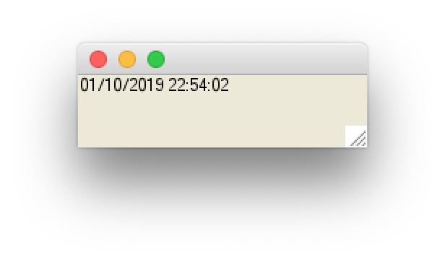
System.Windows.Forms
clock.fsx
open System.Windows.Forms
open System.Drawing
let win = new Form () // make a window form
win.ClientSize <- Size (200, 50)
// make a label to show time
let label = new Label()
win.Controls.Add label
label.Width <- 200
label.Text <- string System.DateTime.Now // get present time and date
// make a timer and link to label
let timer = new Timer()
timer.Interval <- 1000 // create an event every 1000 millisecond
timer.Enabled <- true // activiate the timer
timer.Tick.Add (fun e -> label.Text <- string System.DateTime.Now)
Application.Run win // start event-loop

Slide 6
System.Windows.Forms
movingClock.fsx
open System.Windows.Forms
open System.Drawing
let win = new Form () // make a window form
win.ClientSize <- Size (200, 50)
// make a label to show time
let label = new Label()
win.Controls.Add label
label.Text <- string System.DateTime.Now // get present time and date
let textSz = TextRenderer.MeasureText(label.Text,label.Font)
label.Width <- textSz.Width
label.Height <- textSz.Height
label.BackColor <- Color.White

Slide 7
System.Windows.Forms
movingClock.fsx
// make a timer and link to label
let timer = new Timer()
timer.Interval <- 100 // create an event every 1000 millisecond
timer.Enabled <- true // activiate the timer
let mutable pos = (0,0)
let mutable dir = (1,1)
let performTick (e : System.EventArgs) =
printfn "%A %A" pos dir
if fst pos + fst dir > win.ClientSize.Width - label.Width - 1
|| fst pos + fst dir < 0 then
dir <- (-fst dir, snd dir);
if snd pos + snd dir > win.ClientSize.Height - label.Height – 1
|| snd pos + snd dir < 0 then
dir <- (fst dir, -snd dir);
pos <- (fst pos + fst dir, snd pos + snd dir)
label.Location <- Point (fst pos, snd pos);
label.Text <- string System.DateTime.Now
timer.Tick.Add performTick
Application.Run win // start event-loop

Slide 8
System.Windows.Forms
movingSquare.fsx
open System.Windows.Forms
open System.Drawing
let win = new Form () // make a window form
win.ClientSize <- Size (200, 50)
. . .
// make a timer
let timer = new Timer()
timer.Interval <- 10 // create an event every 10 millisecond
timer.Enabled <- true // activiate the timer
timer.Tick.Add (fun e -> win.Refresh())
Application.Run win // start event-loop

Slide 9
System.Windows.Forms
Square
movingSquare.fsx
delta
let mutable delta = Point (0,0)
let mutable dir = Point (1,1)
let polygonSz = Point (10,10);
let polygon = [|Point (0,0); Point (polygonSz.X,0); polygonSz; Point (0,polygonSz.Y); Point (0,0)|]
let paint (e : PaintEventArgs) : unit =
let pen = new Pen (Color.Black)
if delta.X + dir.X < 0
|| delta.X + dir.X + polygonSz.X > win.ClientSize.Width - 1 then
dir <- Point (-dir.X, dir.Y);
if delta.Y + dir.Y < 0
|| delta.Y + dir.Y + polygonSz.Y > win.ClientSize.Height - 1 then
dir <- Point (dir.X, -dir.Y);
delta <- Point (delta.X + dir.X, delta.Y + dir.Y)
let add (p : Point) -> Point (p.X + delta.X, p.Y + delta.Y)
let points = Array.map add polygon
e.Graphics.DrawLines (pen, points)
win.Paint.Add paint
dir

Slide 10
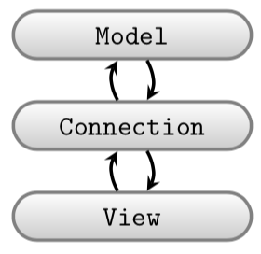
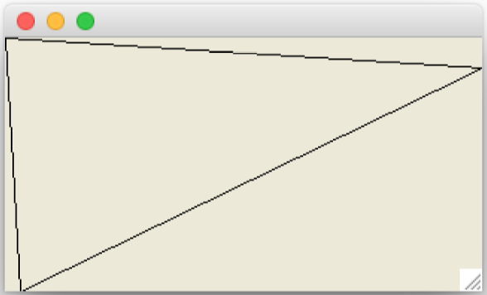
Adskil model og view
triangleClientSize.fsx
// Open often used libraries, beware of namespace pollution!
open System.Windows.Forms
open System.Drawing
// Prepare window form
let win = new Form ()
win.ClientSize <- Size (320, 170)
// Set paint call-back function
let paint (e : PaintEventArgs) : unit =
let pen = new Pen (Color.Black)
let points =
[|Point (0,0); Point (10,170); Point (320,20); Point (0,0)|]
e.Graphics.DrawLines (pen, points)
win.Paint.Add paint
Application.Run win // Start the event-loop.

Slide 11
open System.Windows.Forms
open System.Drawing
///////////// WinForm specifics /////////////
/// Setup a window form and return function which can activate it
let view (sz : Size) (pen : Pen) (pts : Point []) : (unit -> unit) =
let win = new Form ()
win.ClientSize <- sz
win.Paint.Add (fun e -> e.Graphics.DrawLines (pen, pts))
fun () -> Application.Run win // function as return value
///////////// Model /////////////
// A black triangle, using winform primitives for brevity
let model () : Size * Pen * (Point []) =
let size = Size (320, 170)
let pen = new Pen (Color.FromArgb (0, 0, 0))
let lines =
[|Point (0,0); Point (10,170); Point (320,20); Point (0,0)|]
(size, pen, lines)
///////////// Connection //////////////
// Tie view and model together and enter main event loop
let (size, pen, lines) = model ()
let run = view size pen lines
run ()
triangleOrganied.fsx

Slide 12
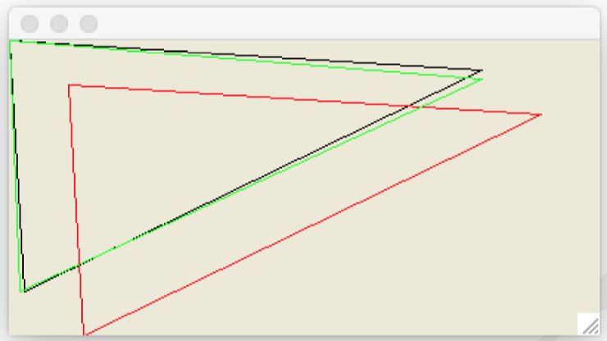
Tegn og transformer mange linjer

Slide 13
Model
transformWindows.fsx
///////////// Model /////////////
// A black triangle, using WinForm primitives for brevity
let model () : Size * ((Pen * (Point [])) list) =
/// Translate a primitive
let translate (d : Point) (arr : Point []) : Point [] =
let add (d : Point) (p : Point) : Point =
Point (d.X + p.X, d.Y + p.Y)
Array.map (add d) arr
/// Rotate a primitive
let rotate (theta : float) (arr : Point []) : Point [] =
let toInt = int << round
let rot (t : float) (p : Point) : Point =
let (x, y) = (float p.X, float p.Y)
let (a, b) = (x * cos t - y * sin t, x * sin t + y * cos t)
Point (toInt a, toInt b)
Array.map (rot theta) arr
let size = Size (400, 200)
let lines =
[|Point (0,0); Point (10,170); Point (320,20); Point (0,0)|]
let black = new Pen (Color.FromArgb (0, 0, 0))
let red = new Pen (Color.FromArgb (255, 0, 0))
let green = new Pen (Color.FromArgb (0, 255, 0))
let shapes =
[(black, lines);
(red, translate (Point (40, 30)) lines);
(green, rotate (1.0 *System.Math.PI / 180.0) lines)]
(size, shapes)

Slide 14
View+forbindelse
transformWindows.fsx
// Open often used libraries, beware of namespace polution!
open System.Windows.Forms
open System.Drawing
///////////// WinForm specifics /////////////
/// Setup a window form and return function to activate
let view (sz : Size) (shapes : (Pen * (Point [])) list) : (unit -> unit) =
let win = new Form ()
win.ClientSize <- sz
let paint (e : PaintEventArgs) ((p, pts) : (Pen * (Point []))) : unit =
e.Graphics.DrawLines (p, pts)
win.Paint.Add (fun e -> List.iter (paint e) shapes)
fun () -> Application.Run win // function as return value
///////////// Connection //////////////
// Tie view and model together and enter main event loop
let (size, shapes) = model ()
let run = view size shapes
run ()

Slide 15
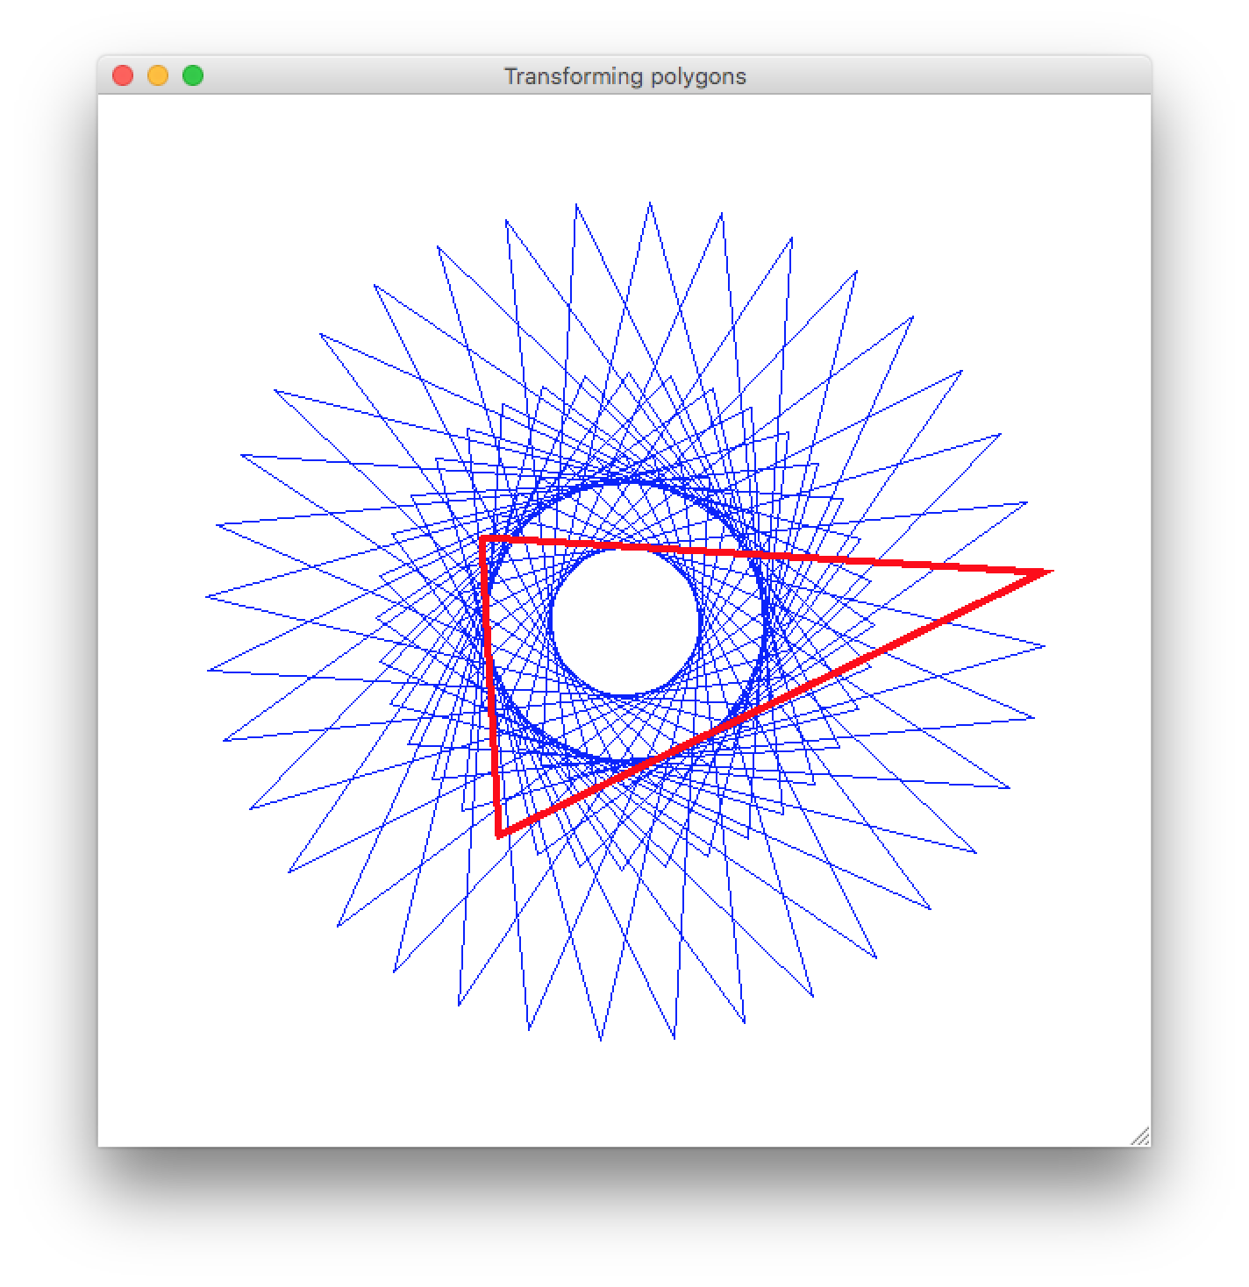
rotationalSymmetry.fsx

Slide 16
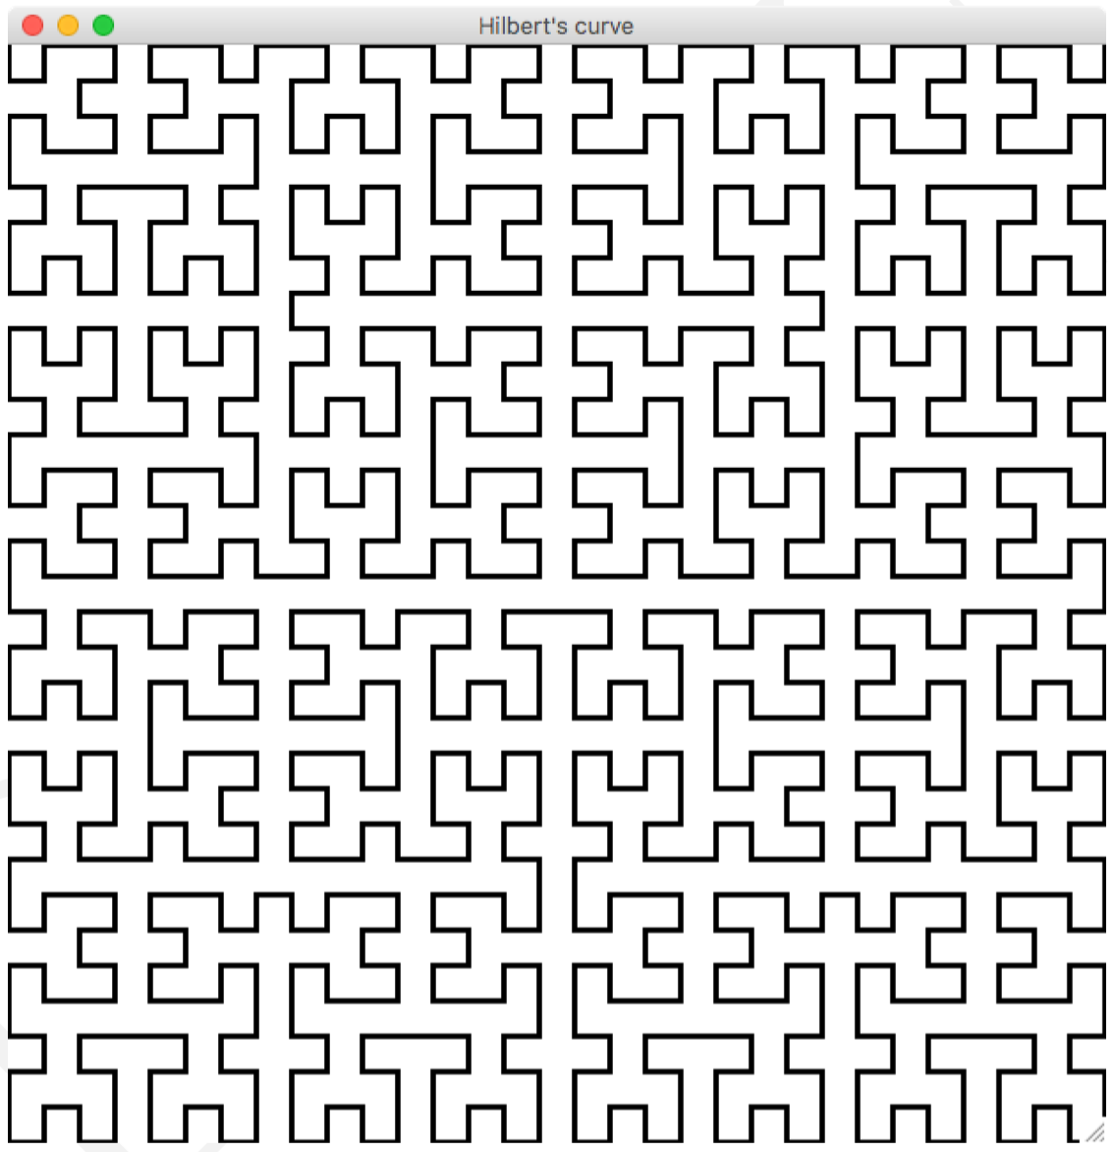
hilbert.fsx

