Slide 1
Grafiske brugergrænseflader i F#
Programmering og problemløsning
Jon Sporring

Slide 2
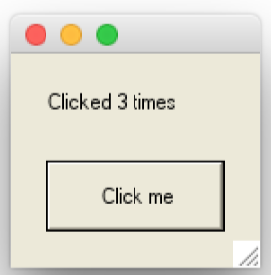
Input fra brugeren via Controls
buttonControl.fsx
open System.Windows.Forms
open System.Drawing
let win = new Form () // make a window form
win.ClientSize <- Size (140, 120)
// Create a label
let label = new Label()
win.Controls.Add label
label.Location <- new Point (20, 20)
label.Width <- 120
let mutable clicked = 0
let setLabel clicked =
label.Text <- sprintf "Clicked %d times" clicked
setLabel clicked
// Create a button
let button = new Button ()
win.Controls.Add button
button.Size <- new Size (100, 40)
button.Location <- new Point (20, 60)
button.Text <- "Click me"
button.Click.Add (fun e -> clicked <- clicked + 1; setLabel clicked)
Application.Run win // Start the event-loop.

Slide 3
Input fra brugeren via Controls
buttonControlCompact.fsx
open System.Windows.Forms
open System.Drawing
// Model: a state 'clicked' that counts how many times an event has occurred
let mutable clicked = 0
let message () = sprintf "Clicked %d times" clicked
let update () = clicked <- clicked + 1
// View: A window containing a label and a button
let win = new Form(ClientSize=Size(140, 120))
let label = new Label(Location=new Point(20, 20), Width=120)
let button = new Button(Size=new Size(100, 40), Location=new Point(20, 60), Text="Click me")
win.Controls.Add label
win.Controls.Add button
// Connect model and view and start the event-loop
label.Text <- message ()
button.Click.Add (fun e -> update (); label.Text <- message ())
Application.Run win

Slide 4
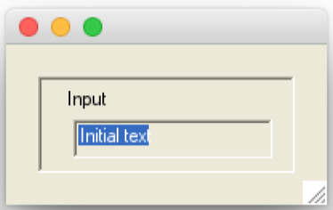
Organisering af Controls i grupper: Panels
panel.fsx
open System.Drawing
open System.Windows.Forms
// Create a window with a panel, label and a textbox
let win = new Form(ClientSize=new Size (200, 100))
let panel = new Panel(ClientSize=new Size(160, 60), Location=new Point(20,20), BorderStyle=BorderStyle.Fixed3D)
let label = new Label(ClientSize=new Size(120, 20), Location=new Point(15,5), Text="Input")
let textBox = new TextBox(ClientSize=new Size(120, 20), Location=new Point(20,25), Text="Initial text")
win.Controls.Add panel // Add panel to window
panel.Controls.Add label // add label to panel
panel.Controls.Add textBox // add textbox to panel
Application.Run win // Start the event-loop

Slide 5
Automatisk tildeling af position i paneler
flowLayoutPanel.fsx
open System.Windows.Forms
open System.Drawing
// Create a window, a FlowLayoutPanel, 4 buttons, a checkbox, a panel, and 4 radiobuttons
let win = new Form(ClientSize=new Size(302, 356), Text="A Flowlayout Example")
let flowLayoutPanel = new FlowLayoutPanel(Location=new Point(47, 55), BorderStyle=BorderStyle.Fixed3D, WrapContents=true)
let buttonLst =
[new Button(Text="Button0");
new Button(Text="Button1");
new Button(Text="Button2");
new Button(Text="Button3")]
let panel = new Panel(Location=new Point (47, 190),BorderStyle=BorderStyle.Fixed3D)
let wrapContentsCheckBox = new CheckBox(Location=new Point (3, 3), Text="Wrap Contents")
let radioButtonLst =
[(new RadioButton(Location=new Point(3, 34), Text="TopDown"), FlowDirection.TopDown);
(new RadioButton(Location=new Point(3, 62), Text="BottomUp"), FlowDirection.BottomUp);
(new RadioButton(Location=new Point(111, 34), Text="LeftToRight"), FlowDirection.LeftToRight);
(new RadioButton(Location=new Point(111, 62), Text="RightToLeft"), FlowDirection.RightToLeft)]

Slide 6
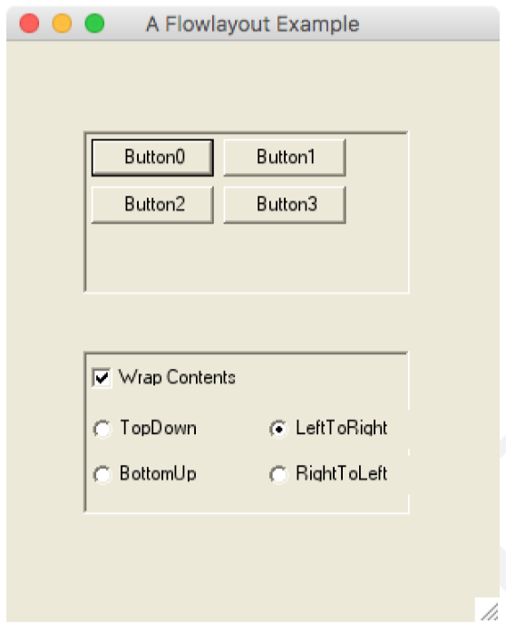
Automatisk tildeling af position i paneler
flowLayoutPanel.fsx
// The window contains the panels which in turn contains the buttons, checkbox and radio buttons.
win.Controls.Add flowLayoutPanel
for btn in buttonLst do
flowLayoutPanel.Controls.Add btn
win.Controls.Add panel
panel.Controls.Add (wrapContentsCheckBox)
for btn, dir in radioButtonLst do
panel.Controls.Add (btn)
// Link wrapContentsCheckBox and flowLayoutPanel.WrapContents
wrapContentsCheckBox.Checked <- flowLayoutPanel.WrapContents
wrapContentsCheckBox.CheckedChanged.Add (fun _ -> flowLayoutPanel.WrapContents <- wrapContentsCheckBox.Checked)
// Link radio buttons and flowLayoutPanel.FlowDirection
for (btn, dir) in radioButtonLst do
btn.Checked <- flowLayoutPanel.FlowDirection = dir
btn.CheckedChanged.Add (fun _ -> flowLayoutPanel.FlowDirection <- dir)
// Create a window, add controls, and start event-loop
Application.Run win

Slide 7
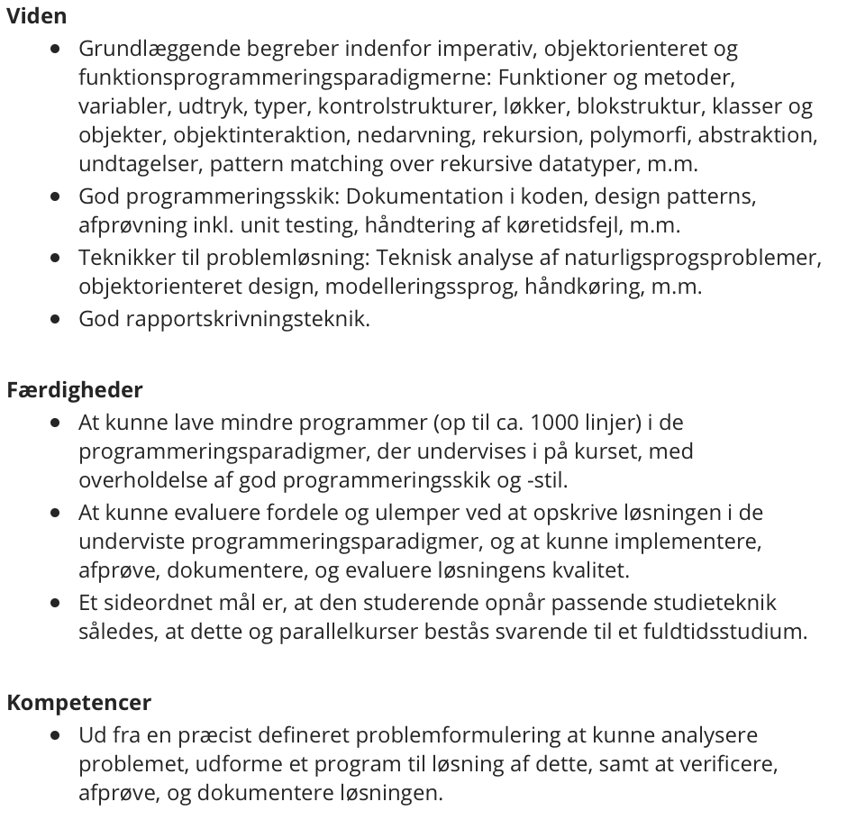
Evaluering

Slide 8
Evaluering af Learning to program with F#
https://tinyurl.com/y7esr4b6

Slide 9
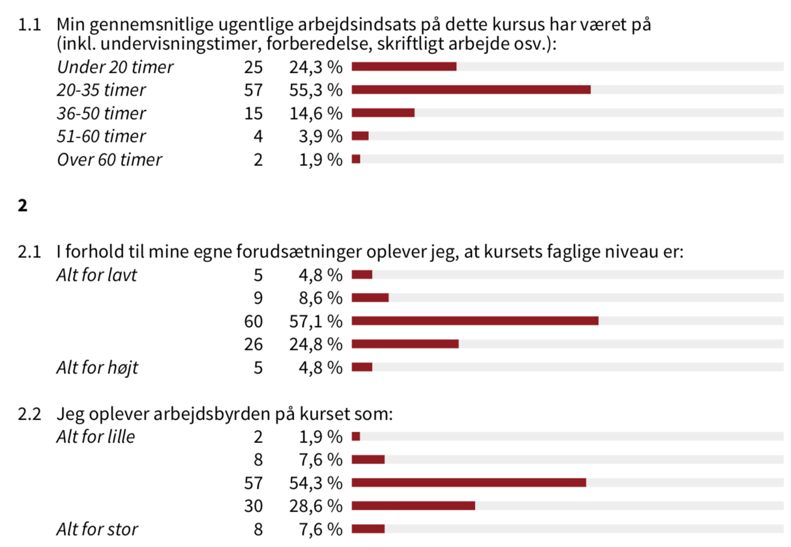

Slide 10
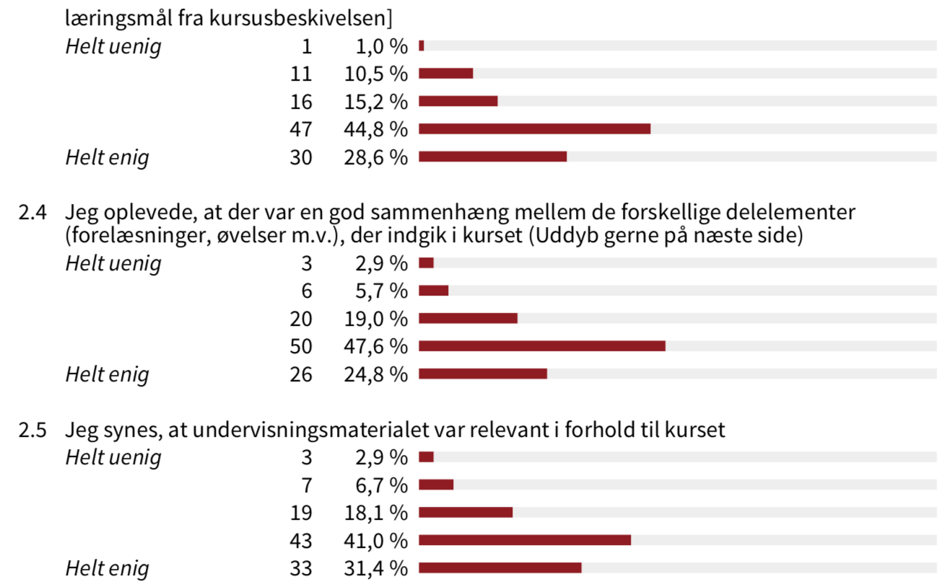

Slide 11
