Slide 1
Grafiske brugergrænseflader i F#
Programmering og problemløsning
Jon Sporring

Slide 2
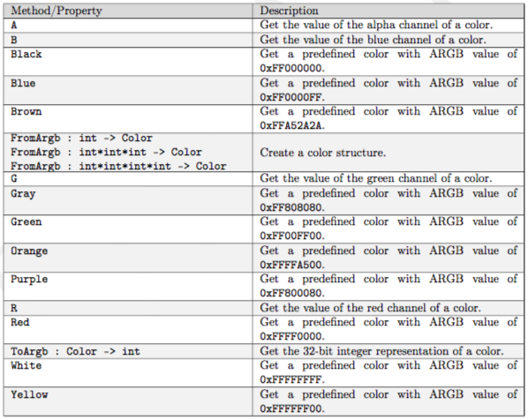
Simpel grafik med System.Drawing: Farver
https://msdn.microsoft.com/en-us/library/system.drawing.color(v=vs.110).aspx

Slide 3
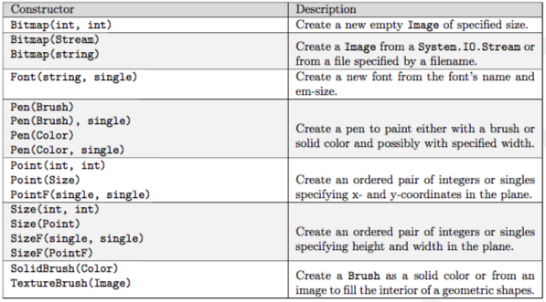
System.Drawing: Andre structurer
https://msdn.microsoft.com/en-us/library/system.drawing(v=vs.110).aspx

Slide 4
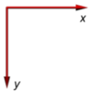
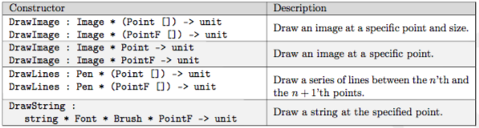
Graphics metoder
https://msdn.microsoft.com/en-us/library/system.drawing.graphics_methods(v=vs.110).aspx

Slide 5
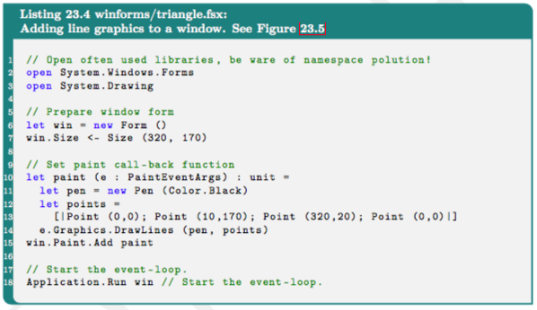
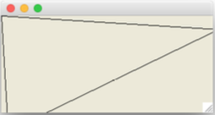
My first drawing

Slide 6
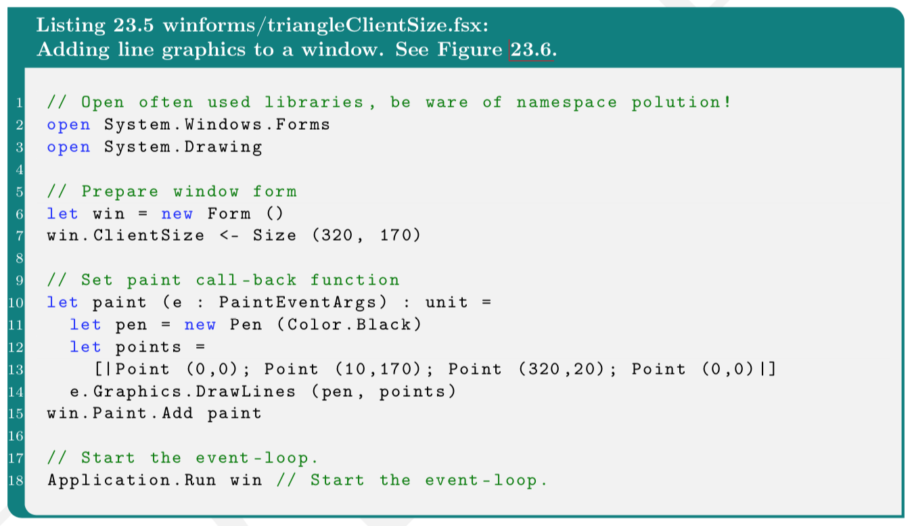
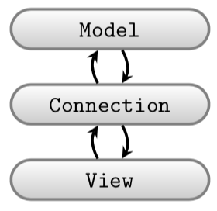
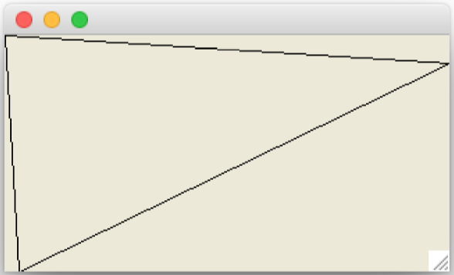
Winforms, Gtk#, Cocoa: Adskil model og view

Slide 7
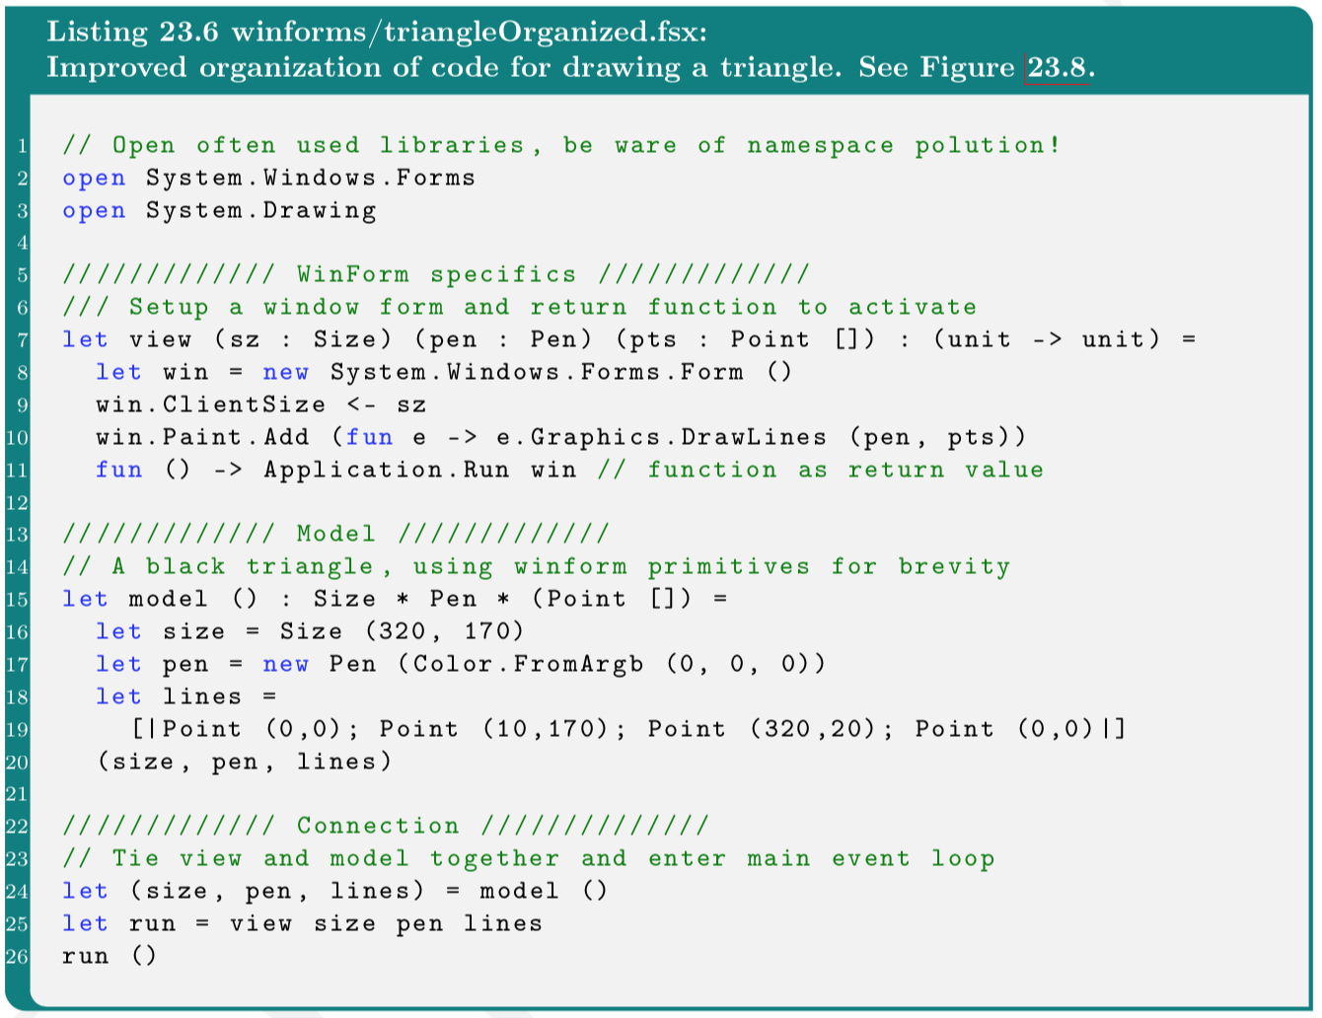

Slide 8
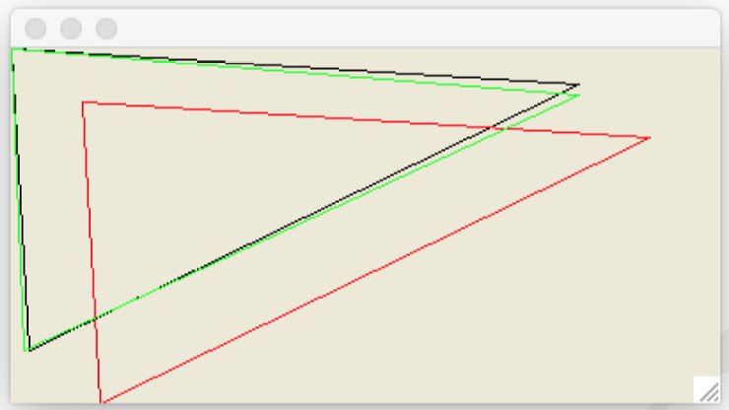
Tegn og transformer mange linjer

Slide 9
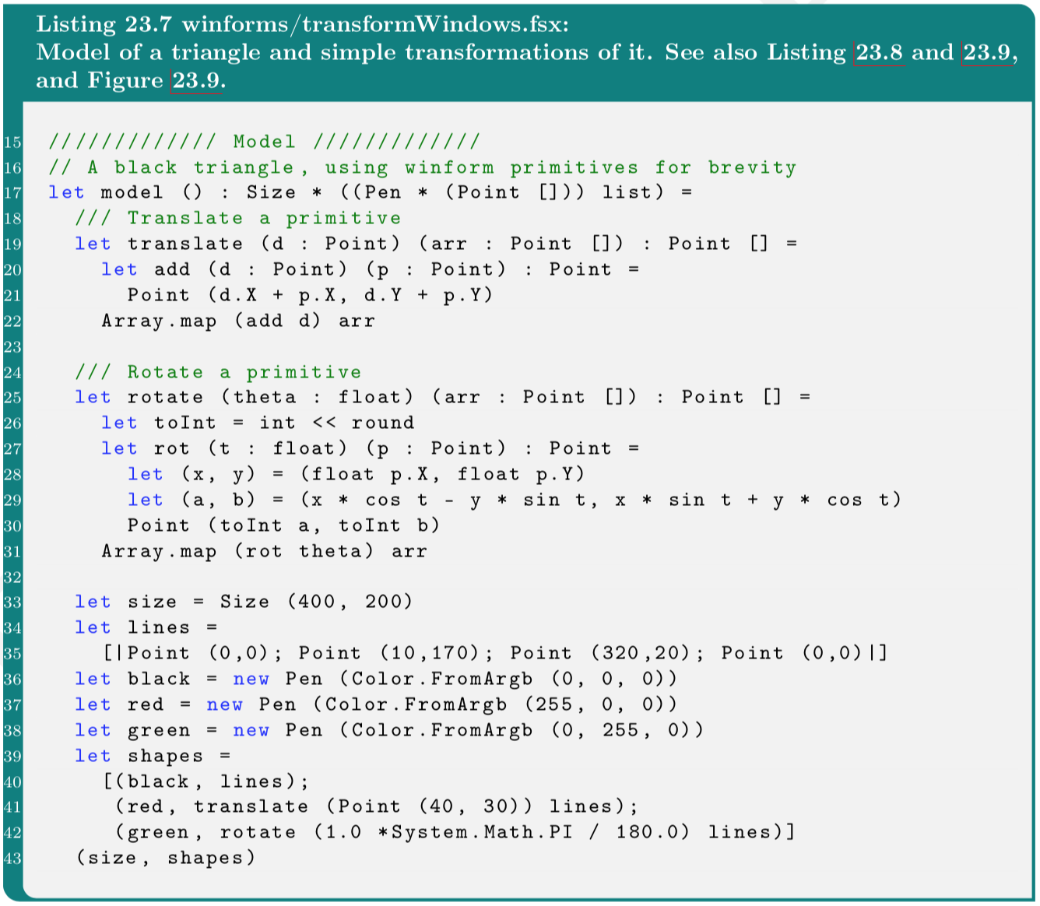
Model

Slide 10
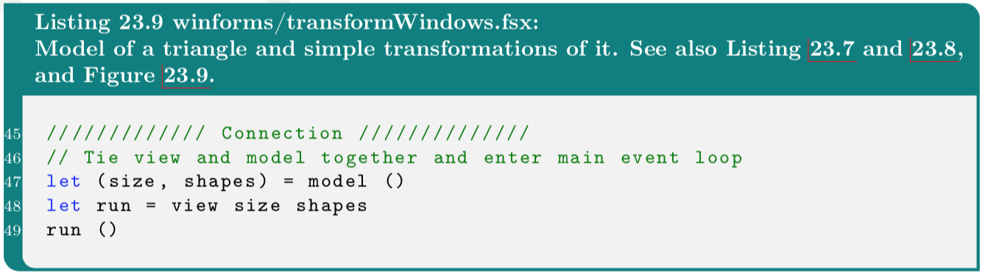
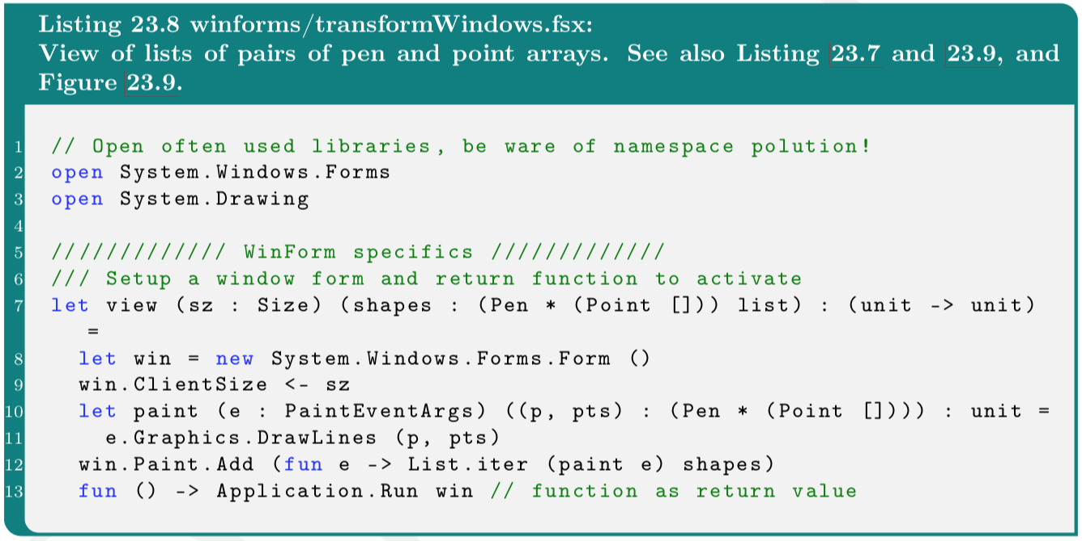
View+control

Slide 11
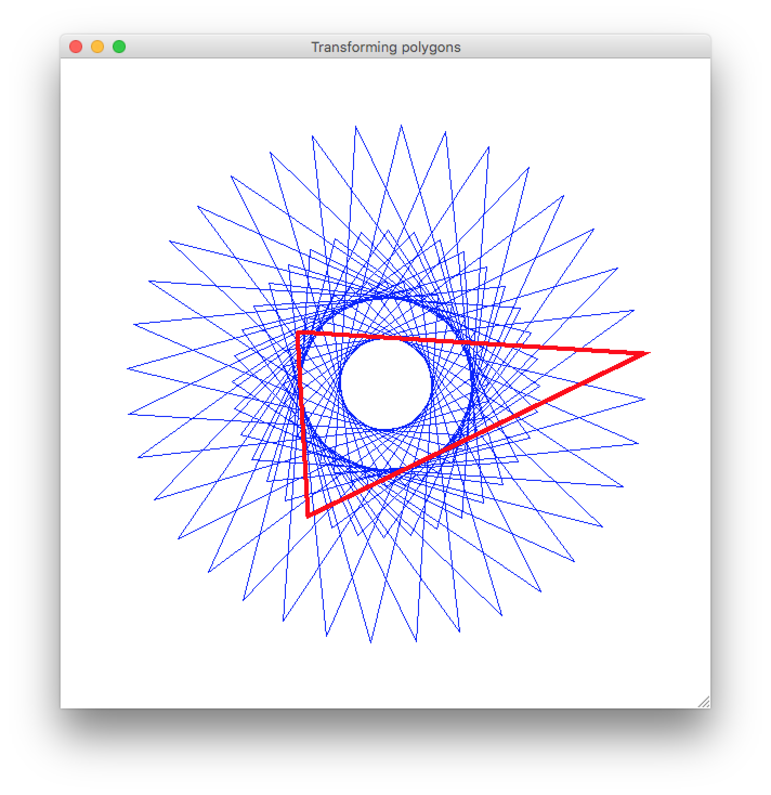

Slide 12
Event-styret programmering
Window callback | Kaldes når brugeren ….
Move | flytter vinduet
Resize | ændrer vinduets størrelse
MouseMove | flytter musen i forhold til et aktivt vindue
MouseDown | trykker venstre musetast ned
MouseUp | slipper venstre musetast
MouseClick | klikker i et vindue
KeyPress | trykker på en tast
windowEvents.fsx

Slide 13
DateTime Class
Properties | Description
Day | The day of month as a number (0..31)
Hour | The hour in (0..23)
Millisecond | The millisecond as a number (0..999)
Minute | The minute (0..59)
Month | The month as a number (1..12)
Now | Return a new DateTime instance of current time and date
Year | The year (1..9999)
let now = System.DateTime.Now
printf "%d/%d/%d" now.Year now.Month now.Day
printfn " %d:%02d:%02d:%03d" now.Hour now.Minute now.Second now.Millisecond;;

Slide 14
Stopur (Timer Class)
let t = new System.Timers.Timer()
t.Interval <- 1000.0
t.Elapsed.Add (fun e -> printfn "%s" (string System.DateTime.Now));;
t.Start();;
t.Stop();;

Slide 15
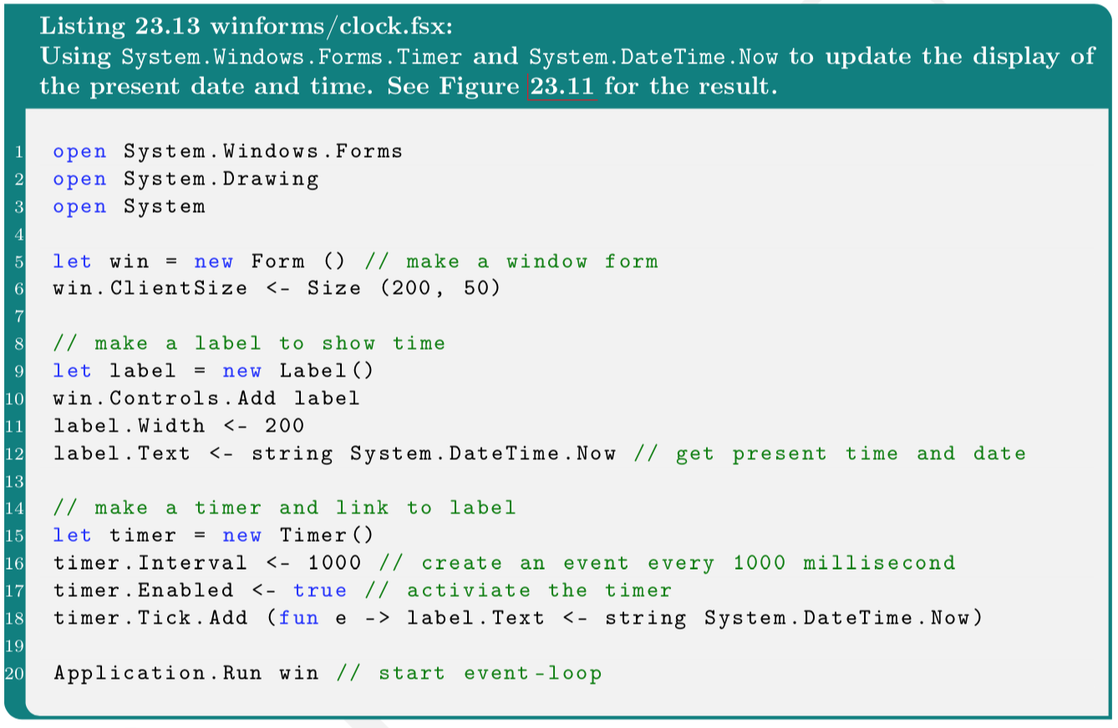
Stopur og WinForms
Refresh
clock.fsx

Slide 16
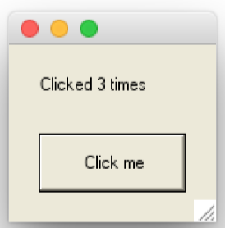
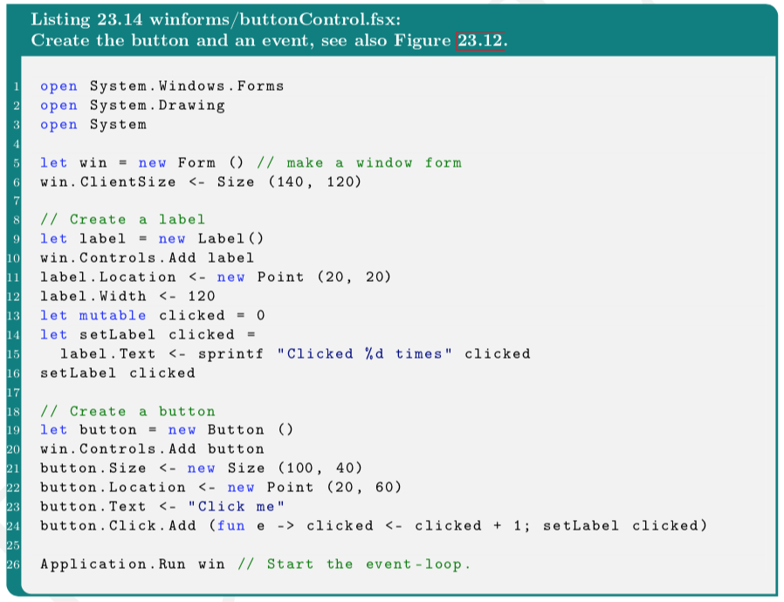
Input fra brugeren via Controls
buttonControl.fsx

Slide 17
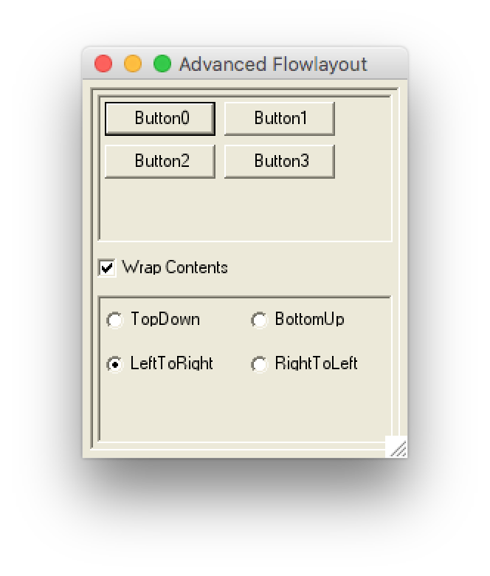
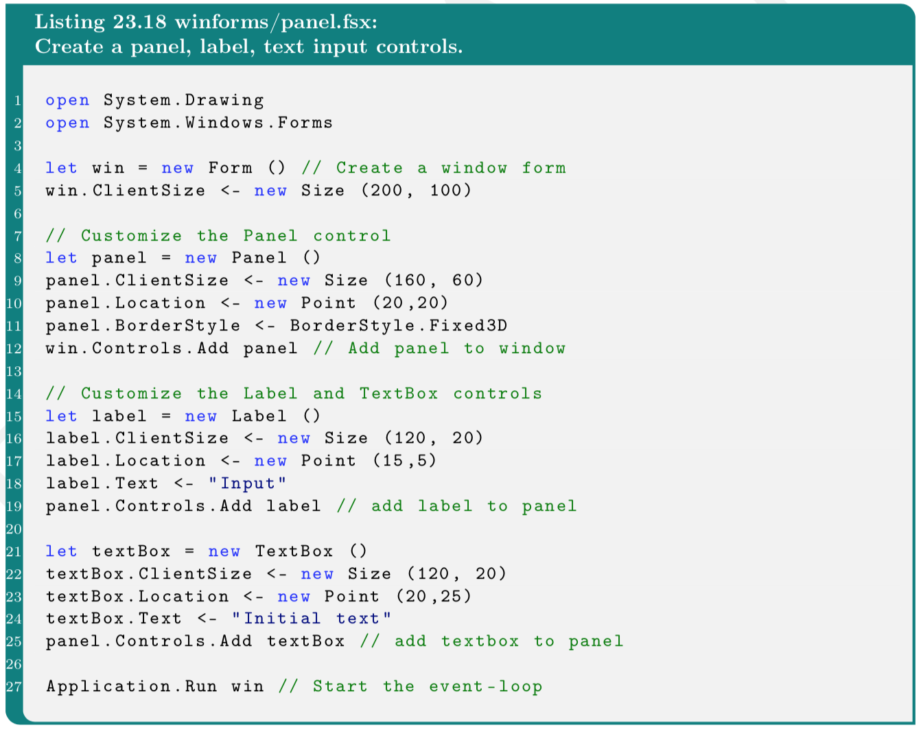
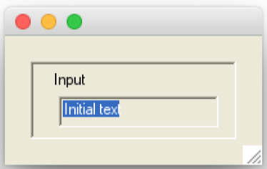
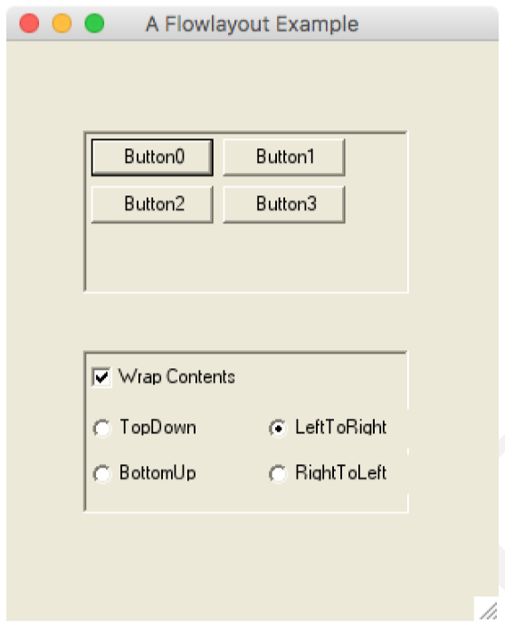
Organisering af Controls i grupper: Panels
flowLayoutPanel.fsx
flowLayoutPanelAdvanced.fsx

Slide 18
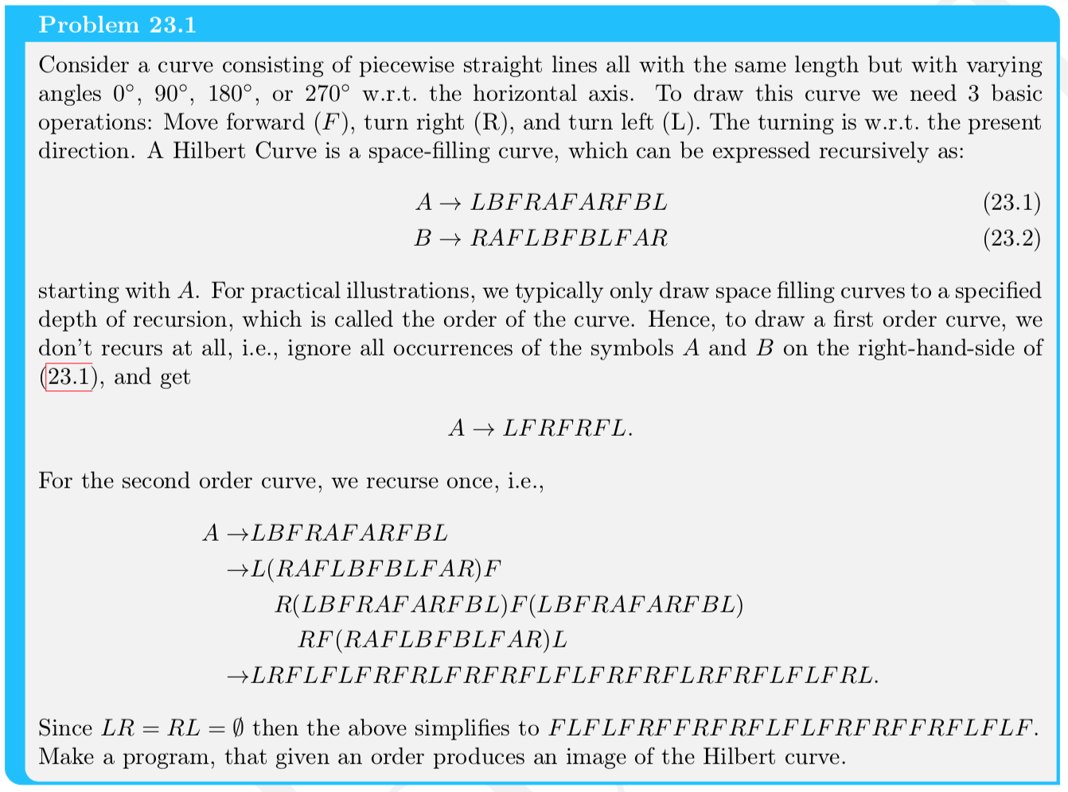
Hilberts kurve

Slide 19
