Slide 1
Grafiske brugergrænseflader i F#
Programmering og problemløsning
Jon Sporring

Slide 2
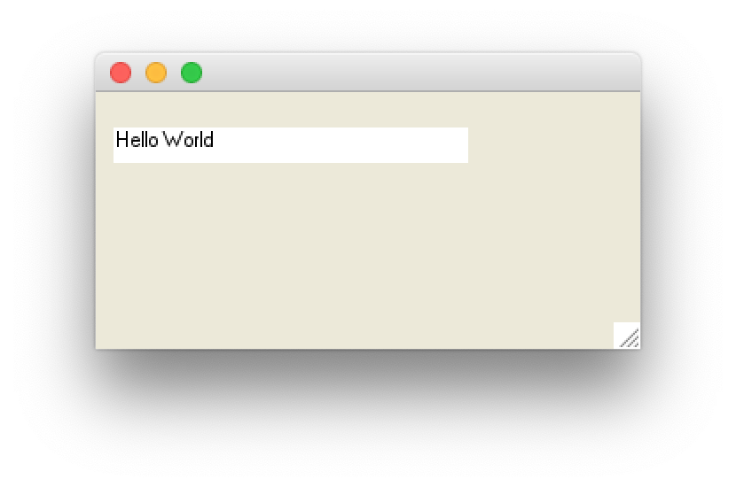
Skrive på skærmen
label.fsx
open System.Windows.Forms
open System.Drawing
let win = new Form () // make a window form
win.ClientSize <- Size (200, 100)
// make a label to show time
let label = new Label()
win.Controls.Add label
label.Width <- 200
label.Location <- new Point (10, 20)
label.Text <- "Hello World"
label.BackColor <- Color.White
label.Height <- 20
Application.Run win // start event-loop

Slide 3
System.Timers
fsharpi
let t = new System.Timers.Timer()
t.Interval <- 1000.0
t.Elapsed.Add (fun e -> printfn "%s" (string System.DateTime.Now));;
t.Start();;
t.Stop();;

Slide 4
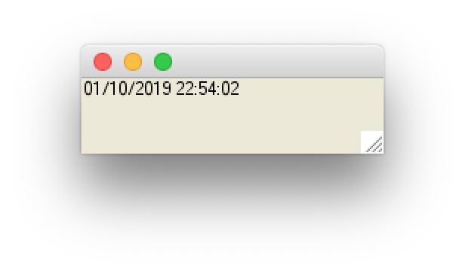
System.Windows.Forms
clock.fsx
open System.Windows.Forms
open System.Drawing
let win = new Form () // make a window form
win.ClientSize <- Size (200, 50)
// make a label to show time
let label = new Label()
win.Controls.Add label
label.Width <- 200
label.Text <- string System.DateTime.Now // get present time and date
// make a timer and link to label
let timer = new Timer()
timer.Interval <- 1000 // create an event every 1000 millisecond
timer.Enabled <- true // activiate the timer
timer.Tick.Add (fun e -> label.Text <- string System.DateTime.Now)
Application.Run win // start event-loop

Slide 5
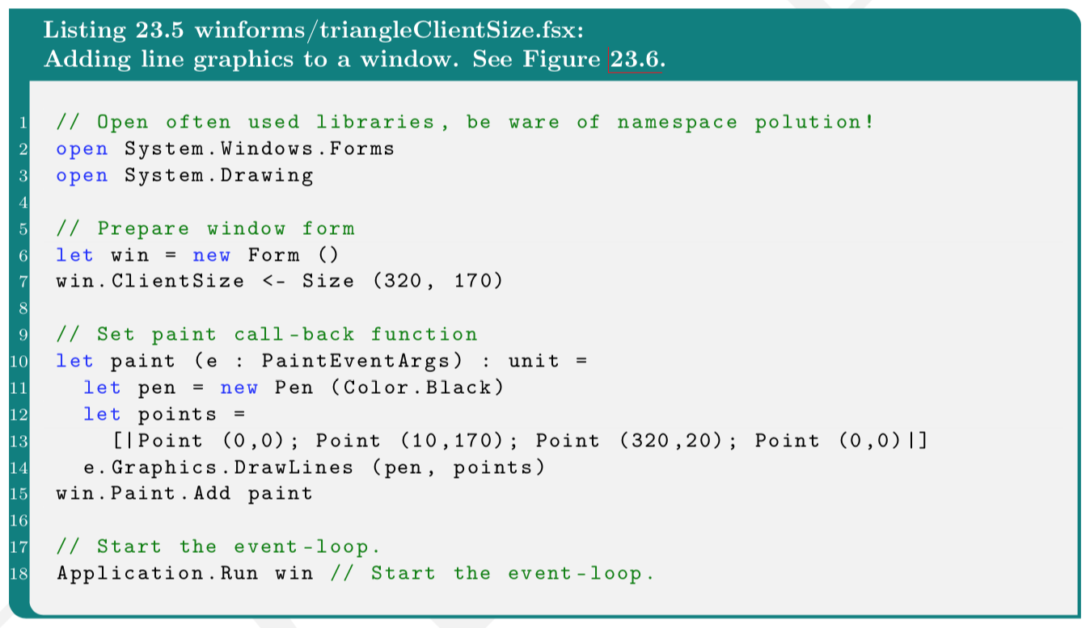
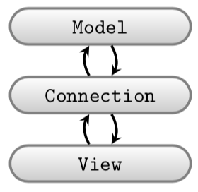
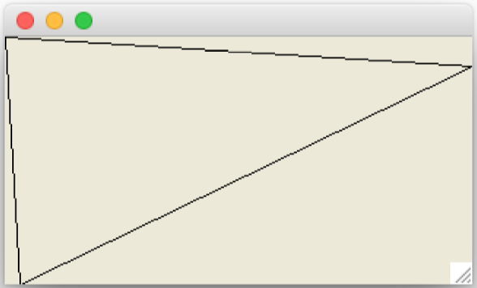
Winforms, Gtk#, Cocoa: Adskil model og view

Slide 6
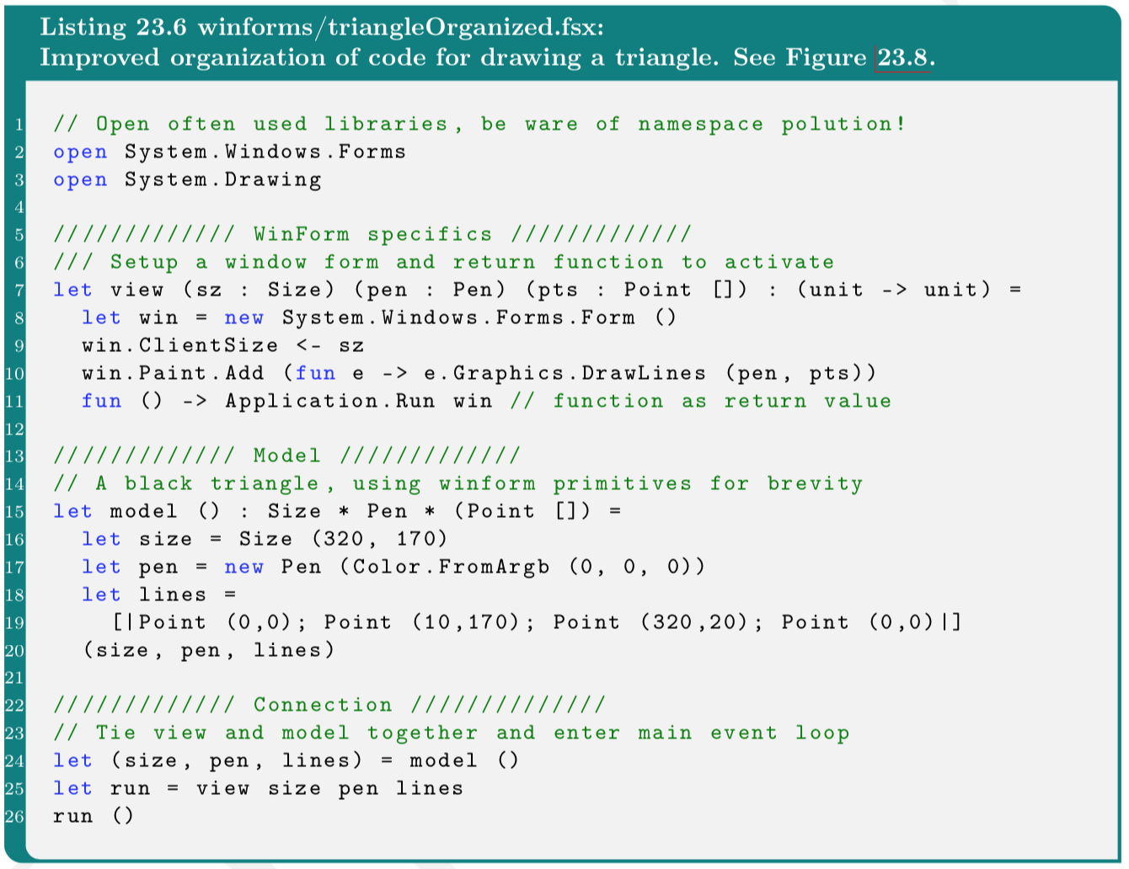

Slide 7
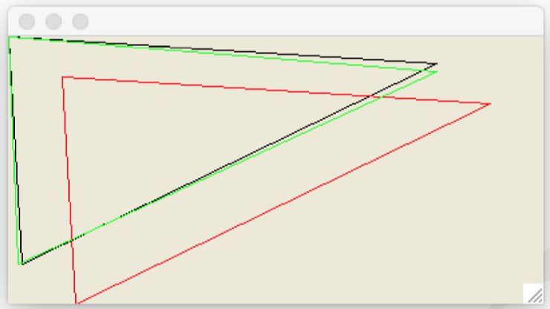
Tegn og transformer mange linjer

Slide 8
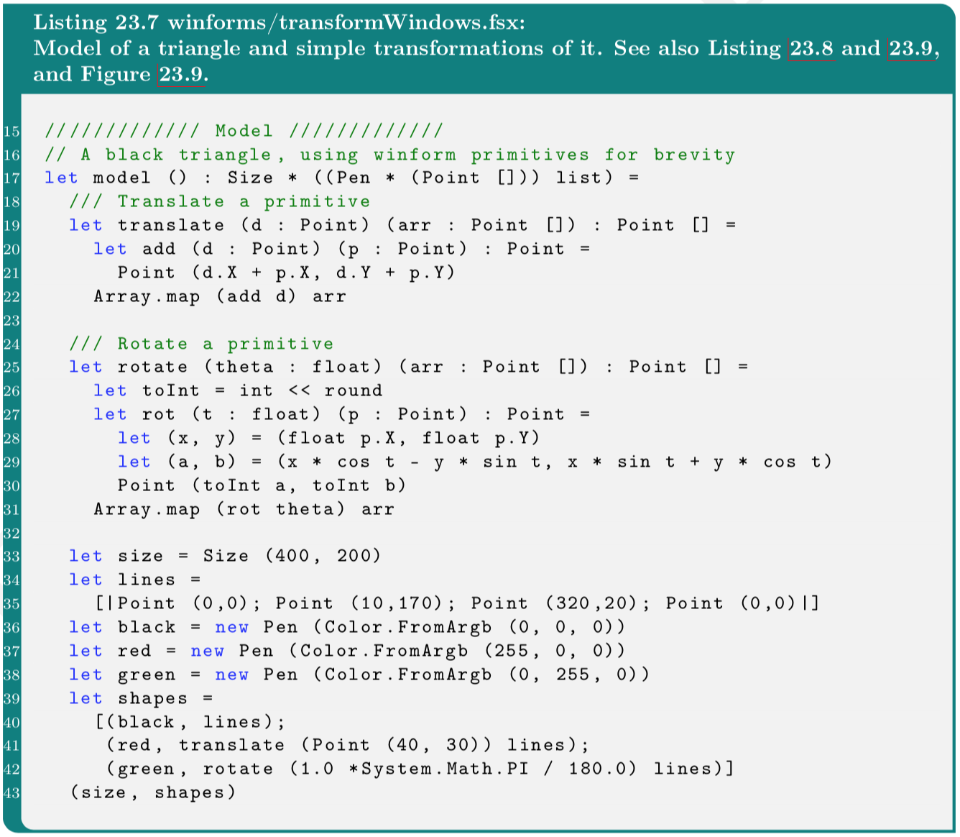
Model

Slide 9
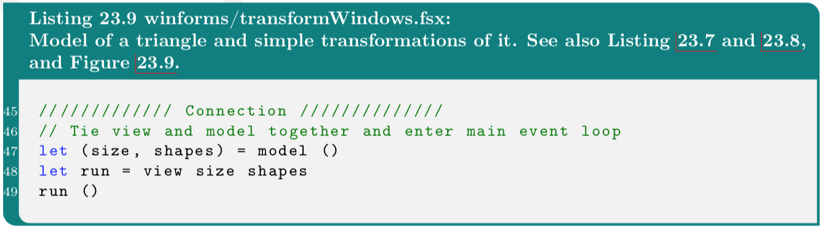
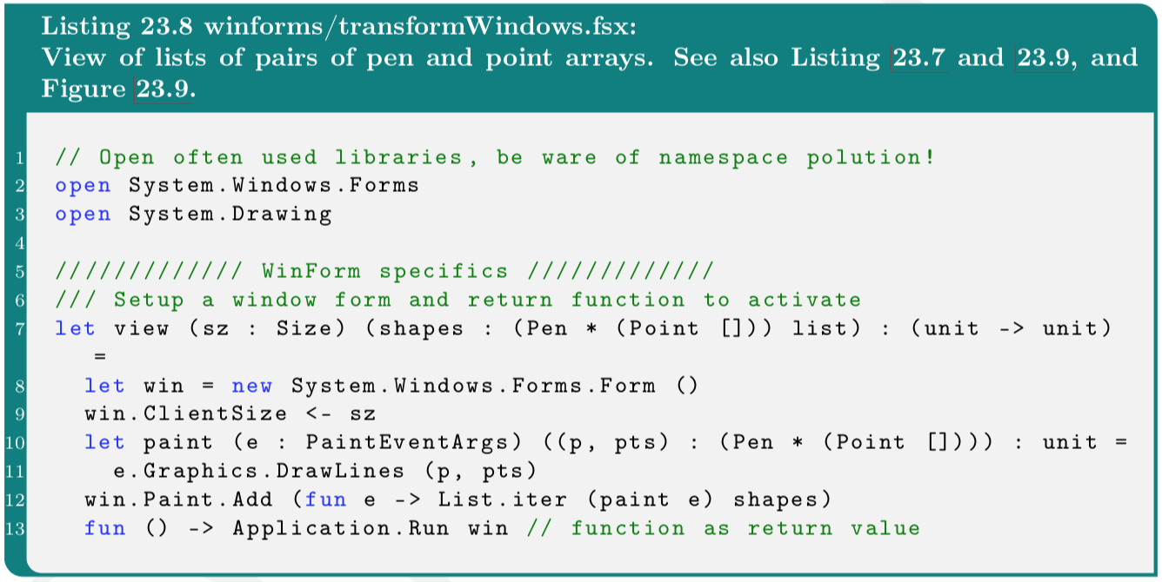
View+control

Slide 10
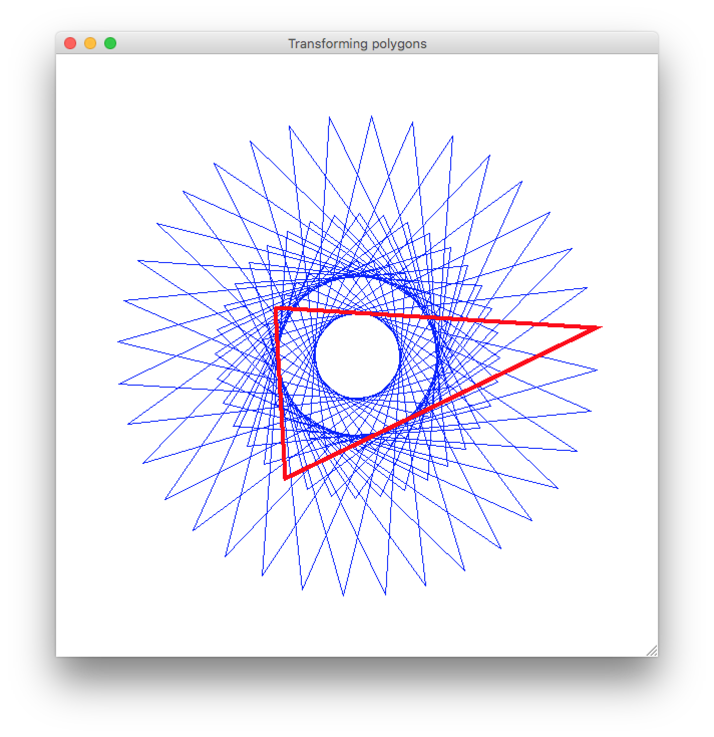

Slide 11
Event-styret programmering
Window callback | Kaldes når brugeren ….
Move | flytter vinduet
Resize | ændrer vinduets størrelse
MouseMove | flytter musen i forhold til et aktivt vindue
MouseDown | trykker venstre musetast ned
MouseUp | slipper venstre musetast
MouseClick | klikker i et vindue
KeyPress | trykker på en tast
windowEvents.fsx

Slide 12
DateTime Class
Properties | Description
Day | The day of month as a number (0..31)
Hour | The hour in (0..23)
Millisecond | The millisecond as a number (0..999)
Minute | The minute (0..59)
Month | The month as a number (1..12)
Now | Return a new DateTime instance of current time and date
Year | The year (1..9999)
let now = System.DateTime.Now
printf "%d/%d/%d" now.Year now.Month now.Day
printfn " %d:%02d:%02d:%03d" now.Hour now.Minute now.Second now.Millisecond;;

Slide 13
Stopur (Timer Class)
let t = new System.Timers.Timer()
t.Interval <- 1000.0
t.Elapsed.Add (fun e -> printfn "%s" (string System.DateTime.Now));;
t.Start();;
t.Stop();;

Slide 14
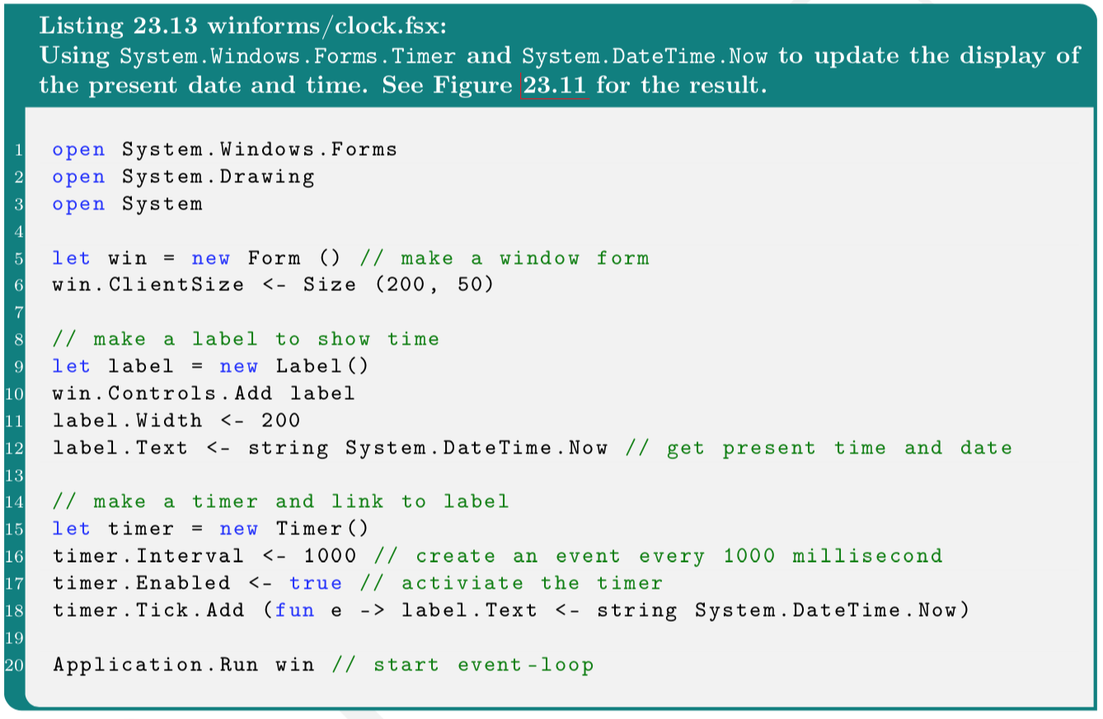
Stopur og WinForms
Refresh
clock.fsx

Slide 15
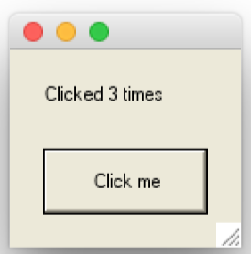
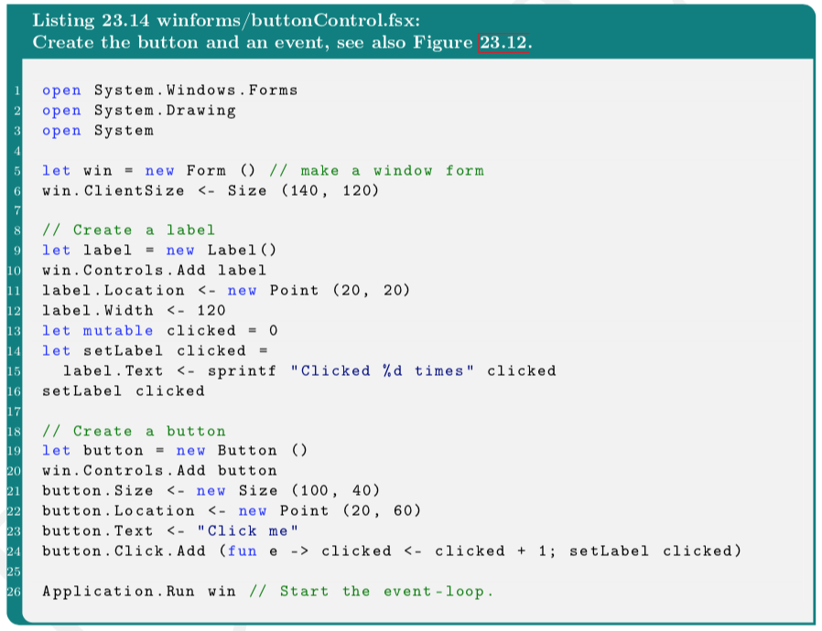
Input fra brugeren via Controls
buttonControl.fsx

Slide 16
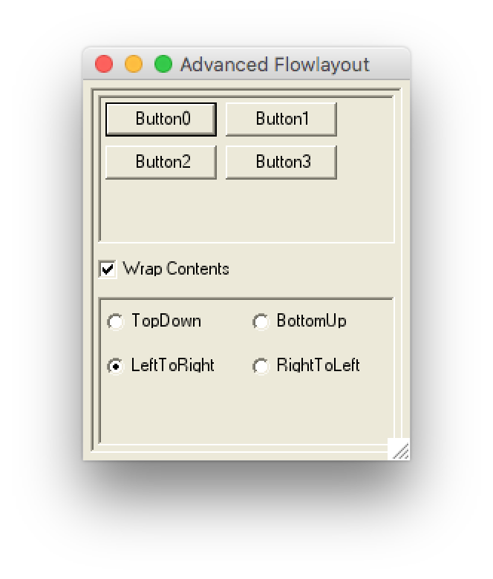
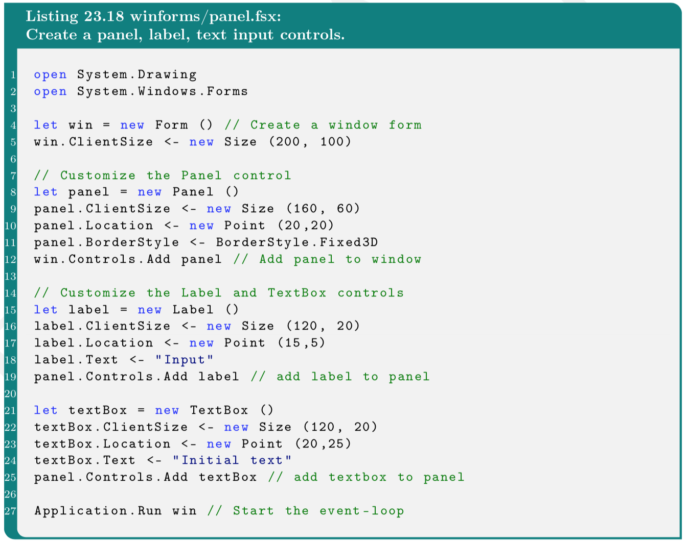
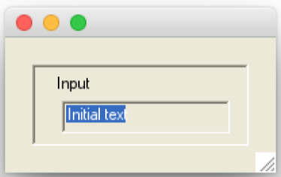
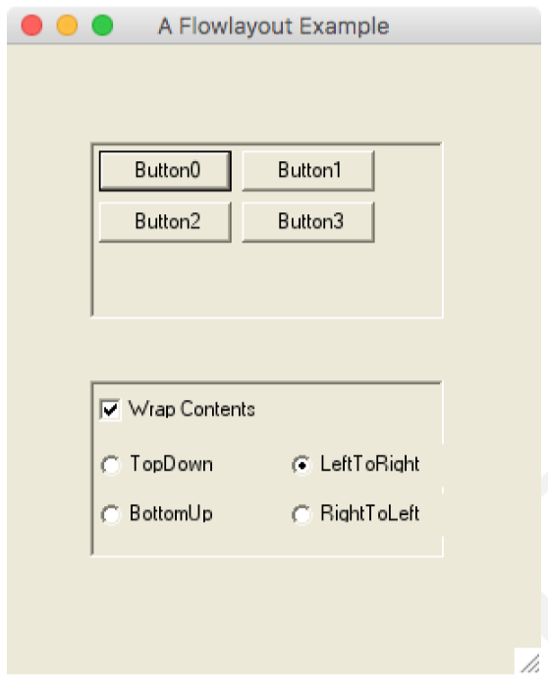
Organisering af Controls i grupper: Panels
flowLayoutPanel.fsx
flowLayoutPanelAdvanced.fsx

Slide 17
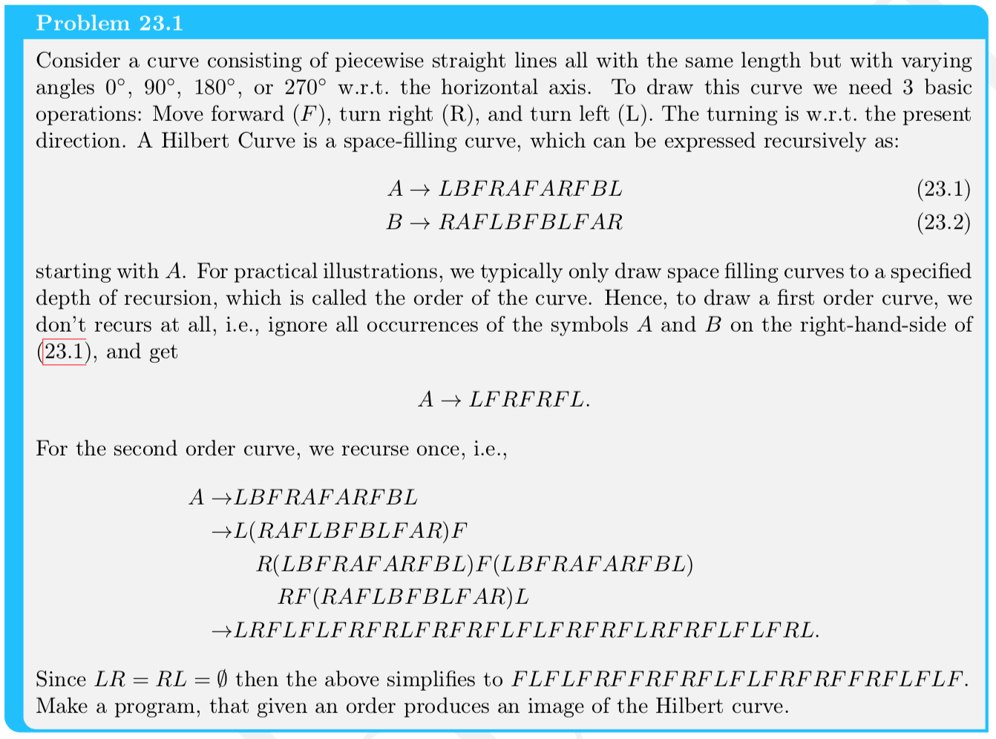
Hilberts kurve

Slide 18
