Slide 1
Programmering og Problemløsning
4.2+3: White-box testing, håndkøring, kaldestakken og -bunken, højereordens- og anonyme funktioner

Slide 2
White-box (unit) testing
Beslut hvilke units, der skal afprøves
Identificer forgreningspunkter
Lav inputeksempler for alle units, som afprøver hver forgreningsvej, og notér det forventede output
Skriv et program, som kører koden med alle inputeksempler, og sammenlign resultatet med det forventede output
(* WB: 1 *)
(* WB: 2 *)
(* WB: 3 *)
Unit | Branch | Condition | Input | Expected output | Comment
dec2bin | 1 | n < 0
 | 1a | true | -1 | "Illegal value"
 | 1b | false |  |  | -> Branch 2
 | 2 (n>=0) | n = 0
 | 2a | true | 0 | "0b0"
 | 2b | false |  |  | -> Branch 3
 | 3 (n>0) | v > 0
 | 3a | true | 1 | "0b1" | 1 or more
 | 3b | false |  |  | 0 times, impossible.
module convert
/// Convert a non-negative integer into its
/// binary form. E.g., dec2bin 3 = "0b11"
let dec2bin n =
if n < 0
"Illegal value"
elif n = 0 then
"0b0"
else
let mutable v = n
let mutable str = ""
while v > 0 do
str <- (string (v % 2)) + str
v <- v / 2
"0b" + str

Slide 3
White-box (unit) testing
Unit | Branch | Condition | Input | Expected output | Comment
dec2bin | 1 | n < 0
 | 1a | true | -1 | "Illegal value"
 | 1b | false |  |  | -> Branch 2
 | 2 (n>=0) | n = 0
 | 2a | true | 0 | "0b0"
 | 2b | false |  |  | -> Branch 3
 | 3 (n>0) | v > 0
 | 3a | true | 1 | "0b1" | 1 or more
 | 3b | false |  |  | 0 times, impossible.
open convert
printfn "White-box testing of dec2bin.fsx"
printfn " Unit: dec2bin"
printfn " %5b: Branch 1a" (dec2bin -1 = "Illegal value")
printfn " %5b: Branch 2a" (dec2bin 0 = "0b0")
printfn " %5b: Branch 3a" (dec2bin 1 = "0b1")
$ fsharpc -a dec2binWhite.fs
$ fsharpc -r dec2binWhite.dll dec2binWhiteTest.fsx
$ mono dec2binWhiteTest.exe
White-box testing of dec2bin.fsx
Unit: dec2bin
true: Branch 1a
true: Branch 2a
true: Branch 3a

Slide 4
Closures = funktioner som værdier
En simple function:
let N = 3
let doit n =
for i = 1 to n do
let p = i * i
printfn "%d: %d" i p
doit N
Closure notation:
Navn = (input, krop, virkefeltets værdier)
Værdier:
N = 3
doit = ((n), (for i = 1 to n do let p = i * i in printfn "%d: %d" i p), (N=3))
it = ()

Slide 5
Håndkøring: simulér computeren
1
2
3
4
5
6
7
let N = 3
let doit n =
for i = 1 to n do
let p = i * i
printfn "%d: %d" i p
doit N
- E0: ()
1 N = 3
2 doit = ((n), doit-body, (N=3))
7 doit N = ?
()
2 E1: doit-body, (n = 3, N = 3)
3 E2: for-body, (n = 3, N = 3, i = 1)
4 p = 1
5 output = “1: 1”
$ fsharpi simpleForLoop.fsx
1: 1
2: 4
3: 9
3 E3: for-body, (n = 3, N = 3, i = 2)
4 p = 4
5 output = “2: 4”
3 E4: for-body, (n = 3, N = 3, i = 3)
4 p = 9
5 output = “3: 9”
- return = ()
- return = ()

Slide 6
Leksikografisk versus Dynamisk Virkefelt
Leksikografisk
Dynamisk
let testScope x =
let a = 3.0
let f z = a * z
let a = 4.0
f x
printfn "%A" (testScope 2.0)
let testScope x =
let mutable a = 3.0
let f z = a * z
a <- 4.0
f x
printfn "%A" (testScope 2.0)
let testScope x = let a = 3.0 in let f z = a * z in let a = 4.0 in f x in printfn "%A" (testScope 2.0)

Slide 7
Håndkøring: Leksikografisk virkefelt
1
2
3
4
5
6
let testScope x =
let a = 3.0
let f z = a * z
let a = 4.0
f x
printfn "%A" (testScope 2.0)
- E0:
1 testScope = ((x), testScope-body, ())
6 testScope 2.0 = ?
6.0
6 E1: testScope-body, (x = 2.0)
2 a = 3.0
3 f = ((z), a * z, (a –> 3.0))
4 a = 4.0
5 f 2.0 = ?
6.0
5 E2: f-body (z = 2.0, a = 3.0)
3 return = 6.0
$ fsharpi lexicalScopeTracing.fsx
6.0
5 return = 6.0
- return = ()

Slide 8
Håndkøring: Dynamisk virkefelt
1
2
3
4
5
6
let testScope x =
let mutable a = 3.0
let f z = a * z
a <- 4.0
f x
printfn "%A" (testScope 2.0)
Linje Navn Værdi
- E0:
1 testScope = ((x), testScope-body, ())
6 testScope 2.0 = ?
2 alpha 3.0
8.0
4 alpha 4.0
6 E1: testScope-body, (x = 2.0)
2 a = alpha
3 f = ((z), a * z, (a –> alpha))
8.0
5 f 2.0 = ?
5 E2: f-body (z = 2.0, a = alpha)
3 return = 8.0
$ fsharpi dynamicScopeTracing.fsx
8.0
5 return = 8.0
- return = ()

Slide 9
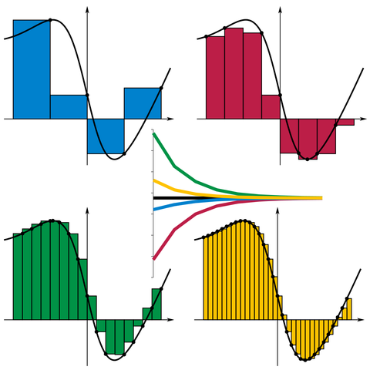
Højereordens funktioner
/// Estimate the integral of f
/// from a to b with stepsize d
let integrate f a b d =
let mutable sum = 0.0
let mutable x = a
while x < b do
sum <- sum + d * (f x)
x <- x + d
sum
let a = 0.0
let b = 1.0
let d = 0.01
let result = integrate exp a b d
printfn "Int_%g^%g exp(x) dx = %g" a b result
By I, KSmrq, CC BY-SA 3.0,
https://commons.wikimedia.org/w/index.php?curid=2347919

Slide 10
Højereordens funktioner
/// Estimate the integral of f
/// from a to b with stepsize d
let integrate f a b d =
let mutable sum = 0.0
let mutable x = a
while x < b do
sum <- sum + d * (f x)
x <- x + d
sum
let a = 0.0
let b = 1.0
let d = 0.01
let result = integrate exp a b d
printfn "Int_%g^%g exp(x) dx = %g" a b result
/// Estimate the integral of f
/// from a to b with stepsize d
let integrate f a b d =
let mutable sum = 0.0
let mutable x = a
while x < b do
sum <- sum + d * (f x)
x <- x + d
sum
let a = 0.0
let b = 1.0
let truth = exp 1.0 - 1.0
for e = 0 to 6 do
let d = 10.0**(float -e)
let result = truth - integrate exp a b d
printfn "d = %e: exp 1.0 - 1.0 - Int_%g^%g exp(x) dx = %g" d a b result
By I, KSmrq, CC BY-SA 3.0,
https://commons.wikimedia.org/w/index.php?curid=2347919

Slide 11
Anonyme funktioner
let f x = x * exp(x)
f 3.0
/// Estimate the integral of f
/// from a to b with stepsize d
let integrate f a b d =
let mutable sum = 0.0
let mutable x = a
while x < b do
sum <- sum + d * (f x)
x <- x + d
sum
let a = 0.0
let b = 1.0
let d = 1e-5
let result = integrate (fun x -> x * exp(x)) a b d
printfn "Int_%g^%g f(x) dx = %g" a b result
let f = fun x -> x * exp(x)
f 3.0
By I, KSmrq, CC BY-SA 3.0,
https://commons.wikimedia.org/w/index.php?curid=2347919

Slide 12
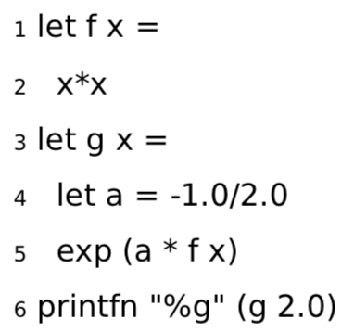

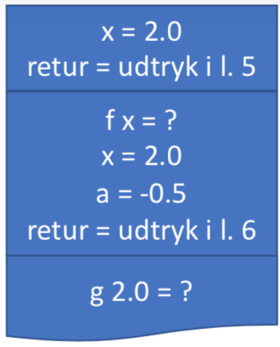
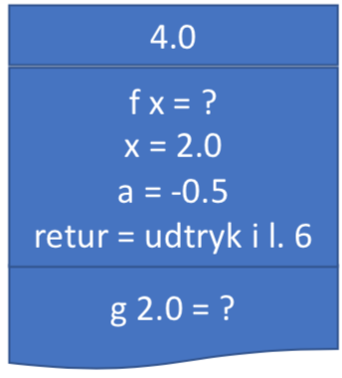
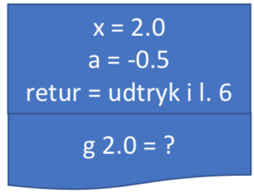
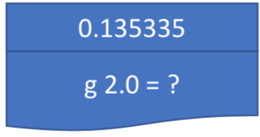

Kald-stakken (værdier og variable)
Stakken (The Stack)

Slide 13

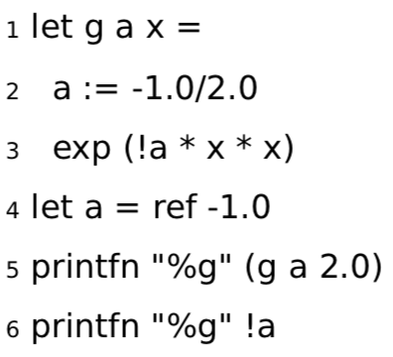
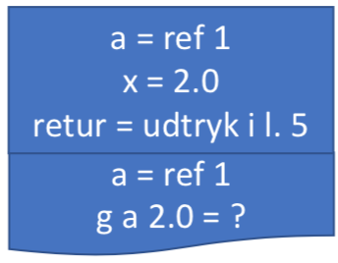
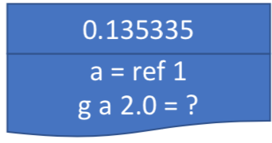

Referenceceller
Bunken (The Heap)
ref 1 = -1.0
-0.5

Slide 14
Til tavlen
Closure i closure
Den virkeligt sværre
let mul x y = x * y
let factor = 2.0
let applyFactor fct x =
let a = fct factor x
string a
printfn "%g" (mul 5.0 3.0)
printfn "%s" (applyFactor mul 3.0)
let incr =
let mutable counter = 0
fun () ->
counter <- counter + 1
counter
printfn "%d" (incr ())
printfn "%d" (incr ())
printfn "%d" (incr ())
$ fsharpi functionFirstClass.fsx
15
6
$ fsharpi inc.fsx
1
2
3

Slide 15
Aliasing (undgå!)
> let a = ref 1.0
- let b = ref 2.0
- let c = a
- printfn "a = %g, b = %g, c = %g" !a !b !c
- b := 3.0
- c := 4.0
- printfn "a = %g, b = %g, c = %g" !a !b !c;;
a = 1, b = 2, c = 1
a = 4, b = 3, c = 4
val a : float ref = {contents = 4.0;}
val b : float ref = {contents = 3.0;}
val c : float ref = {contents = 4.0;}
val it : unit = ()
Værdien c er samme reference til bunken som a
Ændrer hvad reference peger på
Indholdet af a ændrede sig indirekte!

Slide 16
Closures = funktioner som værdier
En højere-ordens function:
let mul x y = x * y
let factor = 2.0
let applyFactor fct x =
let a = fct factor x
string a
printfn "%g" (mul 5.0 3.0)
printfn "%s" (applyFactor mul 3.0)
Closure notation:
Navn -> (input, krop, virkefeltets værdier)
Værdier:
mul -> ((x, y), (x * y), ())
factor -> 2.0
applyFactor -> ((fct, x), let a = fct factor x; string a, (mul -> ((x, y), (x * y), ()), factor -> 2.0))

