Slide 1
Programmering og Problemløsning
3.3: Tupler, betingelser, højere-ordens funktioner

Slide 2
Repetition af Nøglekoncepter
---
Virkefelter
Funktioner
Programmer ‘baglæns’
Dokumentation
Løkker

Slide 3
Muterbare værdier værdi-kopieres
Reference celler og aliasing

Slide 4
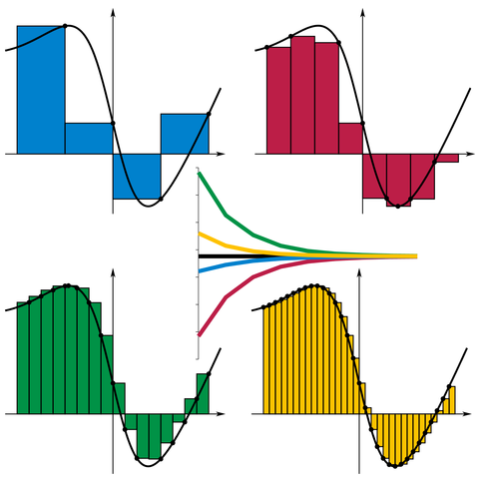
Højere-ordens funktioner
/// Estimate the integral of f
/// from a to b with stepsize d
let integrate f a b d =
let mutable sum = 0.0
let mutable x = a
while x < b do
sum <- sum + d * (f x)
x <- x + d
sum
let a = 0.0
let b = 1.0
let d = 0.01
let result = integrate exp a b d
printfn "Int_%g^%g exp(x) dx = %g" a b result
By I, KSmrq, CC BY-SA 3.0,
https://commons.wikimedia.org/w/index.php?curid=2347919

Slide 5
Højere-ordens funktioner
/// Estimate the integral of f
/// from a to b with stepsize d
let integrate f a b d =
let mutable sum = 0.0
let mutable x = a
while x < b do
sum <- sum + d * (f x)
x <- x + d
sum
let a = 0.0
let b = 1.0
let d = 0.01
let result = integrate exp a b d
printfn "Int_%g^%g exp(x) dx = %g" a b result
/// Estimate the integral of f
/// from a to b with stepsize d
let integrate f a b d =
let mutable sum = 0.0
let mutable x = a
while x < b do
sum <- sum + d * (f x)
x <- x + d
sum
let a = 0.0
let b = 1.0
let truth = exp 1.0 - 1.0
for e = 0 to 6 do
let d = 10.0**(float -e)
let result = truth - integrate exp a b d
printfn "d = %e: exp 1.0 - 1.0 - Int_%g^%g exp(x) dx = %g" d a b result
By I, KSmrq, CC BY-SA 3.0,
https://commons.wikimedia.org/w/index.php?curid=2347919

Slide 6
Anonyme funktioner
let f x = x * exp(x)
f 3.0
/// Estimate the integral of f
/// from a to b with stepsize d
let integrate f a b d =
let mutable sum = 0.0
let mutable x = a
while x < b do
sum <- sum + d * (f x)
x <- x + d
sum
let a = 0.0
let b = 1.0
let d = 1e-5
let result = integrate (fun x -> x * exp(x)) a b d
printfn "Int_%g^%g f(x) dx = %g" a b result
let f = fun x -> x * exp(x)
f 3.0

Slide 7

Tid: 24. september 2018 kl. 12.15-13.00
Sted: Lille UP1

