Slide 1
Programmering og Problemløsning
4.2+3: Kaldestakken, bunken, referenceceller, højere-ordens, anonyme funktioner og håndkøring

Slide 2
White-box (unit) testing
Beslut hvilke units, der skal afprøves
Identificer forgreningspunkter
Lav inputeksempler for alle units, som afprøver hver forgreningsvej, og notér det forventede output
Skriv et program, som kører koden med alle inputeksempler, og sammenlign resultatet med det forventede output
module convert
/// Convert a non-negative integer into its
/// binary form. E.g., dec2bin 3 = "0b11"
let dec2bin n =
if n < 0 then (* WB: 1 *)
"Illegal value"
elif n = 0 then (* WB: 2 *)
"0b0"
else
let mutable v = n
let mutable str = ""
while v > 0 do (* WB: 3 *)
str <- (string (v % 2)) + str
v <- v / 2
"0b" + str
Unit | Branch | Condition | Input | Expected output | Comment
dec2bin | 1 | n < 0
 | 1a | true | -1 | "Illegal value"
 | 1b | branch 2 |  |  | Fall through
 | 2 (n>=0) | n = 0
 | 2a | true | 0 | "0b0"
 | 2b | branch 3 |  |  | Fall through
 | 3 (n>0)
 | 3a | true | 1 | "0b1"
 | 3b | false | 1 | "0b1"

Slide 3
White-box (unit) testing
Unit | Branch | Condition | Input | Expected output | Comment
dec2bin | 1 | n < 0
 | 1a | true | -1 | "Illegal value"
 | 1b | branch 2 |  |  | Fall through
 | 2 (n>=0) | n = 0
 | 2a | true | 0 | "0b0"
 | 2b | branch 3 |  |  | Fall through
 | 3 (n>0)
 | 3a | true | 1 | "0b1"
 | 3b | false | 1 | "0b1"
open convert
printfn "White-box testing of dec2bin.fsx"
printfn " Unit: dec2bin"
printfn " %5b: Branch 1a" (dec2bin -1 = "Illegal value")
printfn " %5b: Branch 2a" (dec2bin 0 = "0b0")
printfn " %5b: Branch 3a" (dec2bin 1 = "0b1")
$ fsharpc -a dec2binWhite.fs
$ fsharpc -r dec2binWhite.dll dec2binWhiteTest.fsx
$ mono dec2binWhiteTest.exe
White-box testing of dec2bin.fsx
Unit: dec2bin
true: Branch 1a
true: Branch 2a
true: Branch 3a

Slide 4
Repetition af Nøglekoncepter
Tupler
Betingelser
Virkefelter
Funktioner
Programmer ‘baglæns’
Dokumentation
Løkker
let fib N =
let mutable pair = (1,1)
for i = 3 to N do
pair <- (snd pair, fst pair + snd pair)
snd pair
let N = 5
printfn "%d: %d" N (fib N)

Slide 5
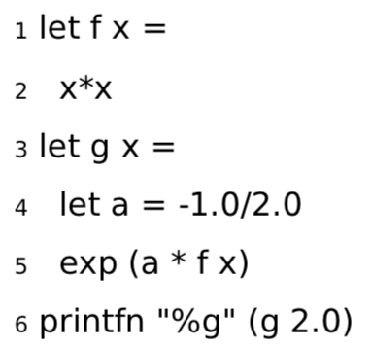

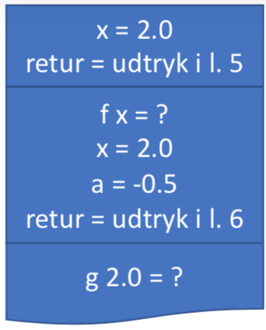
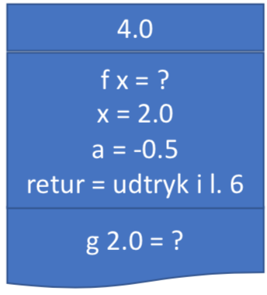
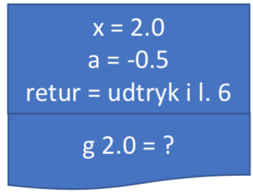
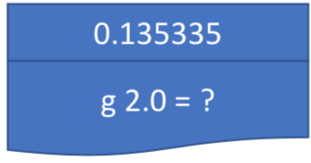

Kald-stakken (værdier og variable)
Stakken (The Stack)

Slide 6

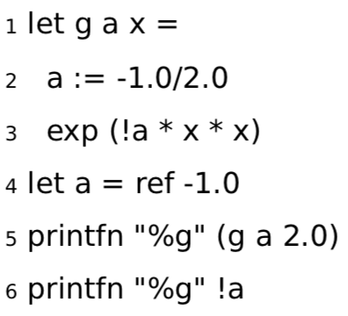
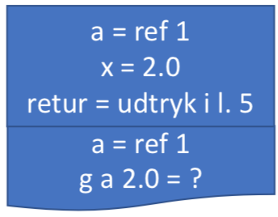
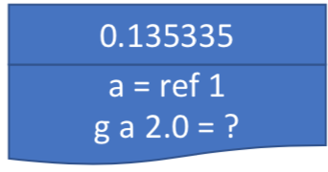
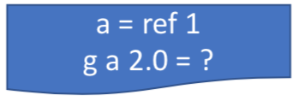
Referenceceller
Bunken (The Heap)
ref 1 = -1.0
-0.5

Slide 7
Aliasing (undgå!)
> let a = ref 1.0
- let b = ref 2.0
- let c = a
- printfn "a = %g, b = %g, c = %g" !a !b !c
- b := 3.0
- c := 4.0
- printfn "a = %g, b = %g, c = %g" !a !b !c;;
a = 1, b = 2, c = 1
a = 4, b = 3, c = 4
val a : float ref = {contents = 4.0;}
val b : float ref = {contents = 3.0;}
val c : float ref = {contents = 4.0;}
val it : unit = ()
Værdien c er samme reference til bunken som a
Ændrer hvad reference peger på
Indholdet af a ændrede sig indirekte!

Slide 8
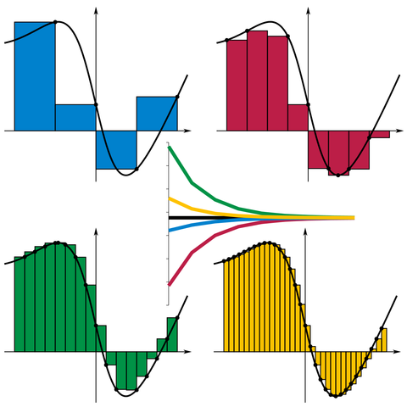
Højere-ordens funktioner
/// Estimate the integral of f
/// from a to b with stepsize d
let integrate f a b d =
let mutable sum = 0.0
let mutable x = a
while x < b do
sum <- sum + d * (f x)
x <- x + d
sum
let a = 0.0
let b = 1.0
let d = 0.01
let result = integrate exp a b d
printfn "Int_%g^%g exp(x) dx = %g" a b result
By I, KSmrq, CC BY-SA 3.0,
https://commons.wikimedia.org/w/index.php?curid=2347919

Slide 9
Højere-ordens funktioner
/// Estimate the integral of f
/// from a to b with stepsize d
let integrate f a b d =
let mutable sum = 0.0
let mutable x = a
while x < b do
sum <- sum + d * (f x)
x <- x + d
sum
let a = 0.0
let b = 1.0
let d = 0.01
let result = integrate exp a b d
printfn "Int_%g^%g exp(x) dx = %g" a b result
/// Estimate the integral of f
/// from a to b with stepsize d
let integrate f a b d =
let mutable sum = 0.0
let mutable x = a
while x < b do
sum <- sum + d * (f x)
x <- x + d
sum
let a = 0.0
let b = 1.0
let truth = exp 1.0 - 1.0
for e = 0 to 6 do
let d = 10.0**(float -e)
let result = truth - integrate exp a b d
printfn "d = %e: exp 1.0 - 1.0 - Int_%g^%g exp(x) dx = %g" d a b result
By I, KSmrq, CC BY-SA 3.0,
https://commons.wikimedia.org/w/index.php?curid=2347919

Slide 10
Anonyme funktioner
let f x = x * exp(x)
f 3.0
/// Estimate the integral of f
/// from a to b with stepsize d
let integrate f a b d =
let mutable sum = 0.0
let mutable x = a
while x < b do
sum <- sum + d * (f x)
x <- x + d
sum
let a = 0.0
let b = 1.0
let d = 1e-5
let result = integrate (fun x -> x * exp(x)) a b d
printfn "Int_%g^%g f(x) dx = %g" a b result
By I, KSmrq, CC BY-SA 3.0,
https://commons.wikimedia.org/w/index.php?curid=2347919
let f = fun x -> x * exp(x)
f 3.0

Slide 11
Repetition af Nøglekoncepter
Moduler og biblioteker
Black- og white-box testing
Højere-ordens funktioner
Anonyme funktioner
Stakken og bunken
Referenceceller
Højere-ordens funktioner
Anonyme funktioner
Unit | Case | Expected output | Comment
dec2bin n | n = -1 | "Illegal value" | negative tal
 | n = 0 | "0b0" | grænsetilfælde
 | n = 1 | "0b1" | 1 bit
 | n = 2 | "0b10" | 2 bit
 | n = 10 | "0b1010" | stort lige tal (venstre bit sat min ikke højre)
 | n = 11 | "0b1011" | stort ulige tal (venstre og højre bit sat)
Unit | Branch | Condition | Input | Expected output | Comment
dec2bin | 1 | n < 0
 | 1a | true | -1 | "Illegal value"
 | 1b | branch 2 |  |  | Fall through
 | 2 (n>=0) | n = 0
 | 2a | true | 0 | "0b0"
 | 2b | branch 3 |  |  | Fall through
 | 3 (n>0)
 | 3a | true | 1 | "0b1"
 | 3b | false | 1 | "0b1"

Slide 12
Closures = funktioner som værdier
En højere-ordens function:
let mul x y = x * y
let factor = 2.0
let applyFactor fct x =
let a = fct factor x
string a
printfn "%g" (mul 5.0 3.0)
printfn "%s" (applyFactor mul 3.0)
Closure notation:
Navn -> (input, krop, virkefeltets værdier)
Værdier:
mul -> ((x, y), (x * y), ())
factor -> 2.0
applyFactor -> ((fct, x), let a = fct factor x; string a, (mul -> ((x, y), (x * y), ()), factor -> 2.0))

Slide 13
Håndkøring: simulér computeren
1
2
3
4
5
6
7
let doit n =
for i = 1 to n do
let p = i * i
printfn "%d: %d" i p
let N = 3
doit N
E0:
doit -> ((n), doit-body, ())
N -> 3
linje 6: doit N -> ?
()
E1: ((n -> 3), doit-body, ())
i -> 1
p -> 1
stdout -> “1: 1”
$ fsharpi simpleForLoop.fsx
1: 1
2: 4
3: 9
i -> 2
p -> 4
stdout -> “2: 4”
i -> 3
p -> 9
stdout -> “3: 9”
return -> ()

Slide 14
Leksikografisk versus Dynamisk Virkefelt
Leksikografisk
Dynamisk
let testScope x =
let a = 3.0
let f z = a * z
let a = 4.0
f x
printfn "%A" (testScope 2.0)
let testScope x =
let mutable a = 3.0
let f z = a * z
a <- 4.0
f x
printfn "%A" (testScope 2.0)

Slide 15
Håndkøring: Leksikografisk virkefelt
1
2
3
4
5
6
let testScope x =
let a = 3.0
let f z = a * z
let a = 4.0
f x
printfn "%A" (testScope 2.0)
E0:
testScope -> ((x), testScope-body, ())
linje 6: testScope 2.0 -> ?
6.0
stdout -> “6.0”
return -> ()
E1: ((x -> 2.0), testScope-body, ())
a -> 3.0
f -> ((z), a * z, (a –> 3.0))
a -> 4.0
f 2.0 -> ?
$ fsharpi lexicalScopeTracing.fsx
6.0
6.0
return -> 6.0
E2: ((z -> 2.0), a * z, (a -> 3.0))
return -> 6.0

Slide 16
Håndkøring: Dynamisk virkefelt
1
2
3
4
5
6
let testScope x =
let mutable a = 3.0
let f z = a * z
a <- 4.0
f x
printfn "%A" (testScope 2.0)
E0:
testScope -> ((x), testScope-body, ())
linje 6: testScope 2.0 -> ?
Linje Navn Værdi
2 alpha 3.0
8.0
stdout -> “8.0”
return -> ()
4 alpha 4.0
E1: ((x -> 2.0), testScope-body, ())
a -> alpha
f -> ((z), a * z, (a –> alpha))
f 2.0 -> ?
8.0
return -> 8.0
$ fsharpi dynamicScopeTracing.fsx
8.0
E2: ((z -> 2.0), a * z, (a -> alpha))
return -> 8.0

Slide 17
Til tavlen
Closure i closure
Den virkeligt sværre
let mul x y = x * y
let factor = 2.0
let applyFactor fct x =
let a = fct factor x
string a
printfn "%g" (mul 5.0 3.0)
printfn "%s" (applyFactor mul 3.0)
let incr =
let mutable counter = 0
fun () ->
counter <- counter + 1
counter
printfn "%d" (incr ())
printfn "%d" (incr ())
printfn "%d" (incr ())
$ fsharpi functionFirstClass.fsx
15
6
$ fsharpi inc.fsx
1
2
3

