Slide 1
Programmering og Problemløsning
4.1: Kaldestakken, bunken, referenceceller, højere-ordens og anonyme funktioner

Slide 2
Repetition af Nøglekoncepter
Tupler
Betingelser
Virkefelter
Funktioner
Programmer ‘baglæns’
Dokumentation
Løkker
let fib N =
let mutable pair = (1,1)
for i = 3 to N do
pair <- (snd pair, fst pair + snd pair)
snd pair
let N = 5
printfn "%d: %d" N (fib N)

Slide 3
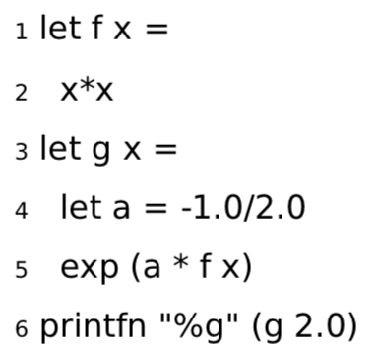

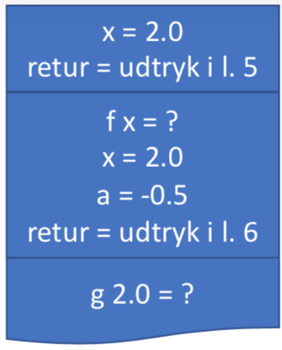
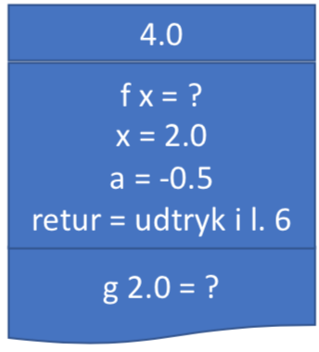
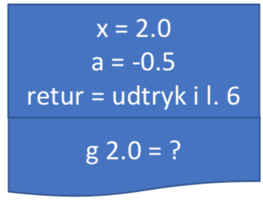
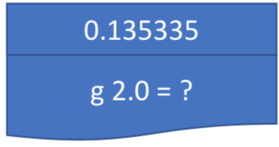

Kald-stakken (værdier og variable)
Stakken (The Stack)

Slide 4

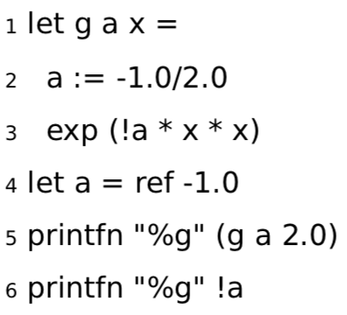
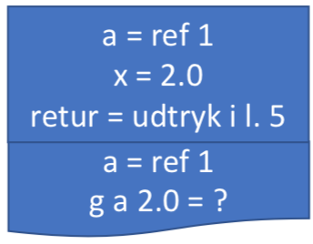
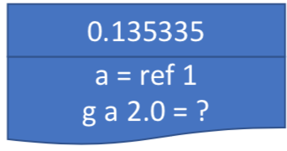
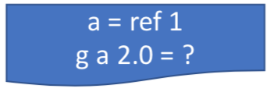
Referenceceller
Bunken (The Heap)
ref 1 = -1.0
-0.5

Slide 5
Aliasing (undgå!)
> let a = ref 1.0
- let b = ref 2.0
- let c = a
- printfn "a = %g, b = %g, c = %g" !a !b !c
- b := 3.0
- c := 4.0
- printfn "a = %g, b = %g, c = %g" !a !b !c;;
a = 1, b = 2, c = 1
a = 4, b = 3, c = 4
val a : float ref = {contents = 4.0;}
val b : float ref = {contents = 3.0;}
val c : float ref = {contents = 4.0;}
val it : unit = ()
Værdien c er samme reference til bunken som a
Ændrer hvad reference peger på
Indholdet af a ændrede sig indirekte!

Slide 6
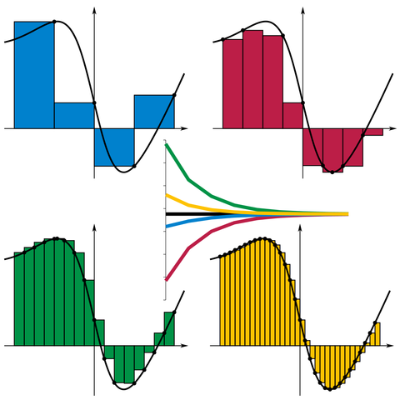
Højere-ordens funktioner
/// Estimate the integral of f
/// from a to b with stepsize d
let integrate f a b d =
let mutable sum = 0.0
let mutable x = a
while x < b do
sum <- sum + d * (f x)
x <- x + d
sum
let a = 0.0
let b = 1.0
let d = 0.01
let result = integrate exp a b d
printfn "Int_%g^%g exp(x) dx = %g" a b result
By I, KSmrq, CC BY-SA 3.0,
https://commons.wikimedia.org/w/index.php?curid=2347919

Slide 7
Højere-ordens funktioner
/// Estimate the integral of f
/// from a to b with stepsize d
let integrate f a b d =
let mutable sum = 0.0
let mutable x = a
while x < b do
sum <- sum + d * (f x)
x <- x + d
sum
let a = 0.0
let b = 1.0
let d = 0.01
let result = integrate exp a b d
printfn "Int_%g^%g exp(x) dx = %g" a b result
/// Estimate the integral of f
/// from a to b with stepsize d
let integrate f a b d =
let mutable sum = 0.0
let mutable x = a
while x < b do
sum <- sum + d * (f x)
x <- x + d
sum
let a = 0.0
let b = 1.0
let truth = exp 1.0 - 1.0
for e = 0 to 6 do
let d = 10.0**(float -e)
let result = truth - integrate exp a b d
printfn "d = %e: exp 1.0 - 1.0 - Int_%g^%g exp(x) dx = %g" d a b result
By I, KSmrq, CC BY-SA 3.0,
https://commons.wikimedia.org/w/index.php?curid=2347919

Slide 8
Anonyme funktioner
let f x = x * exp(x)
f 3.0
/// Estimate the integral of f
/// from a to b with stepsize d
let integrate f a b d =
let mutable sum = 0.0
let mutable x = a
while x < b do
sum <- sum + d * (f x)
x <- x + d
sum
let a = 0.0
let b = 1.0
let d = 1e-5
let result = integrate (fun x -> x * exp(x)) a b d
printfn "Int_%g^%g f(x) dx = %g" a b result
By I, KSmrq, CC BY-SA 3.0,
https://commons.wikimedia.org/w/index.php?curid=2347919
let f = fun x -> x * exp(x)
f 3.0

Slide 9
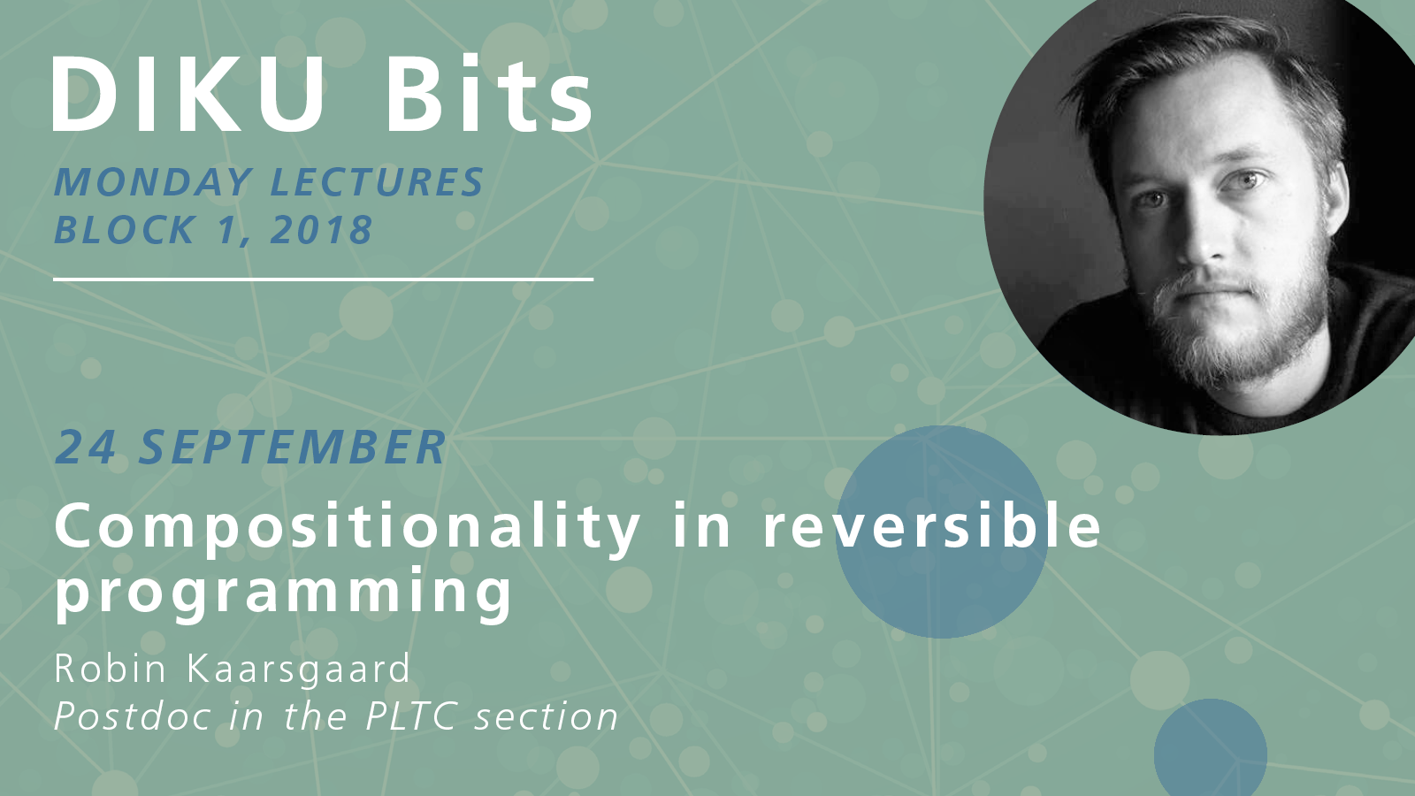
Tid: 24. september 2018 kl. 12.15-13.00
Sted: Lille UP1

