Slide 1
Videregående F#
Programmering og problemløsning
Jon Sporring

Slide 2
Doven evaluering: lazy
Erklæring: let name = lazy ( expr )
Tvungen beregning: name.Force()
Beregning gjort en og kun en gang
let a = 2;
let b = lazy (printfn "calulating"; a*a);
printfn "Before: %A" b
b.Force()
printfn "After: %A" b
b.Force()
printfn "After repeat: %A" b
lazy.fsx

Slide 3
Sekvenser (seq)
En sekvens (sequence) er en ordnet liste af elementer af samme type.
Type: seq<’a> eller System.Collections.Generic.Ienumerable
Støttefunktioner: Seq modulet
Lazy evaluering!
Eksempler:
seq { 0 .. 10 .. 100 }
seq { for i in 1 .. 10 do yield (float i) ** 3.0 }
seq { for i in 1 .. 10 -> (float i)**3.0 }
seq [1; 2; 3]
seqComputationExpr.fsx
seqDelayedEval.fsx

Slide 4
Seq.unfold : ((‘a -> (‘b * ‘a) option) -> ‘a -> seq<‘b>
seq [e₀; e₁; e₂]
lst₀
Some (e₀, lst₁)
Some (e₁, lst₂)
Some (e₂, lst₃)
None
Fibonacci
let fib (n,m) = if m < 1000 then Some (n+m, (m, n+m)) else None;;
let a = Seq.unfold fib (1,1);;
Seq.toList a;;
Sekvenser er dovne, så vi beregner kun dem, vi bruger:
let fib (n,m) = Some (n+m, (m, n+m));;
let a = Seq.unfold fib (1,1);;
a |> Seq.take 15 |> Seq.toList;;

Slide 5
Uendelige sekvenser og yield! (bang)
Elementer i sekvenser bliver udregnet efter behov (lazy evaluation)
let repeat items = seq { while true do yield items }
printfn "%A" (repeat [1;2;3]);;
Bang:
let repeat items = seq { while true do yield! items }
printfn "%A" (repeat [1;2;3]);;
Function with bang:
let rec repeat items = seq { yield! items; yield! repeat items }
printfn "%A" (repeat [1;2;3]);;
Seq.initInfinite:
let s = Seq.initInfinite (fun i -> (float i)**2.0)
printfn "%A" s;;

Slide 6
Prime: heltal n > 2 kun deleligt med 1 og n
let isPrime n =
let sqrtInt = float >> sqrt >> int
List.forall (fun x -> n % x <> 0) [ 2 .. sqrtInt n ]
let s = Seq.initInfinite (fun i -> i+2)
let primes = Seq.filter isPrime s
for i = 0 to 299 do printf "%d " (Seq.item i primes)
printfn "";;

Slide 7
Eratosthenes’ sigte
let s = Seq.initInfinite (fun i -> i+2)
let sieve n = Seq.filter (fun v -> v%n <> 0)
let step s =
let h = Seq.head s
Some(h, sieve h (Seq.tail s))
let primes = Seq.unfold step s
for i = 0 to 299 do printf "%d " (Seq.item i primes)
printfn "";;
https://en.wikipedia.org/wiki/Sieve_of_Eratosthenes

Slide 8
Asynkrone beregninger: async
let comp = async {
for i = 1 to 100 do
printfn "%d" i;
do! Control.Async.Sleep 100;
};;
Control.Async.RunSynchronously comp;; // await
Control.Async.Start comp;; // do not await result

Slide 9
Asynkrone beregninger: Cancel event
let cancellationSource = new System.Threading.CancellationTokenSource()
let comp = async {
for i = 1 to 100 do
printfn "%d" i;
do! Control.Async.Sleep 100;
}
Control.Async.Start (comp, cancellationSource.Token) // allow cancellation
System.Threading.Thread.Sleep(200) // do nothing in 200ms
cancellationSource.Cancel();; // cancel comp

Slide 10
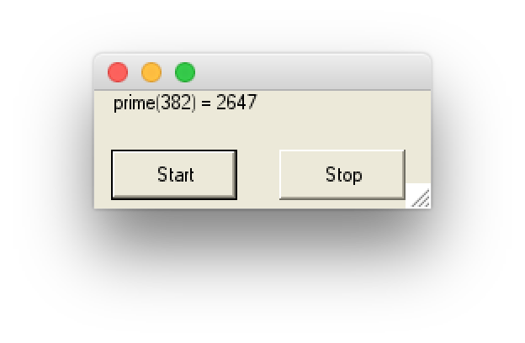
Parallelberegninger: I/O
Jons-mac:20180119SeqNAsync sporring$ i=webDownload; fsharpc $i.fsx && mono32 $i.exe
Microsoft (R) F# Compiler version 4.1
Copyright (c) Microsoft Corporation. All Rights Reserved.
finished downloading http://www.bing.com
finished downloading http://www.google.com
finished downloading http://www.microsoft.com
finished downloading http://www.amazon.com
finished downloading http://www.yahoo.com
00:00:03.2283960 msec
Jons-mac:20180119SeqNAsync sporring$ i=asyncWeb; fsharpc $i.fsx && mono32 $i.exe
Microsoft (R) F# Compiler version 4.1
Copyright (c) Microsoft Corporation. All Rights Reserved.
finished downloading http://www.microsoft.com
finished downloading http://www.google.com
finished downloading http://www.bing.com
finished downloading http://www.yahoo.com
finished downloading http://www.amazon.com
00:00:01.5359210 msec
let fetchUrl url =
let req = WebRequest.Create(Uri(url))
use resp = req.GetResponse()
use stream = resp.GetResponseStream()
use reader = new IO.StreamReader(stream)
let html = reader.ReadToEnd()
printfn "finished downloading %s" url
webDownload.fsx vs. asyncWeb.fsx
buttonControl.fsx

