Slide 1
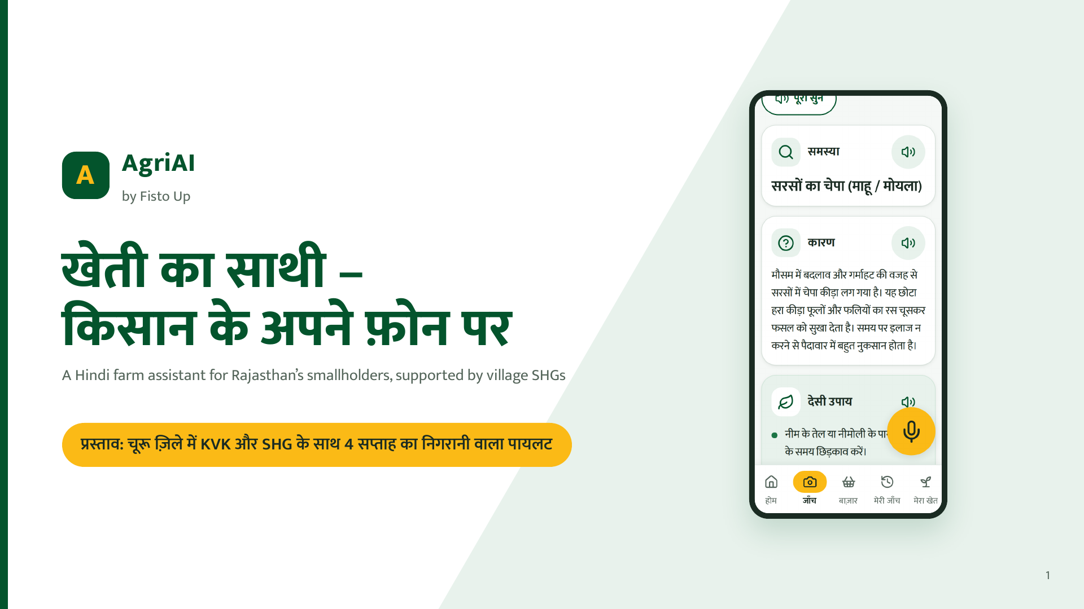
Notes:
Namaste. AgriAI ek Hindi app hai jo kisan ke apne phone par chalta hai. Aaj hum ek cheez maangne aaye hain: Churu mein ek chhota, nigrani wala pilot.

Slide 2
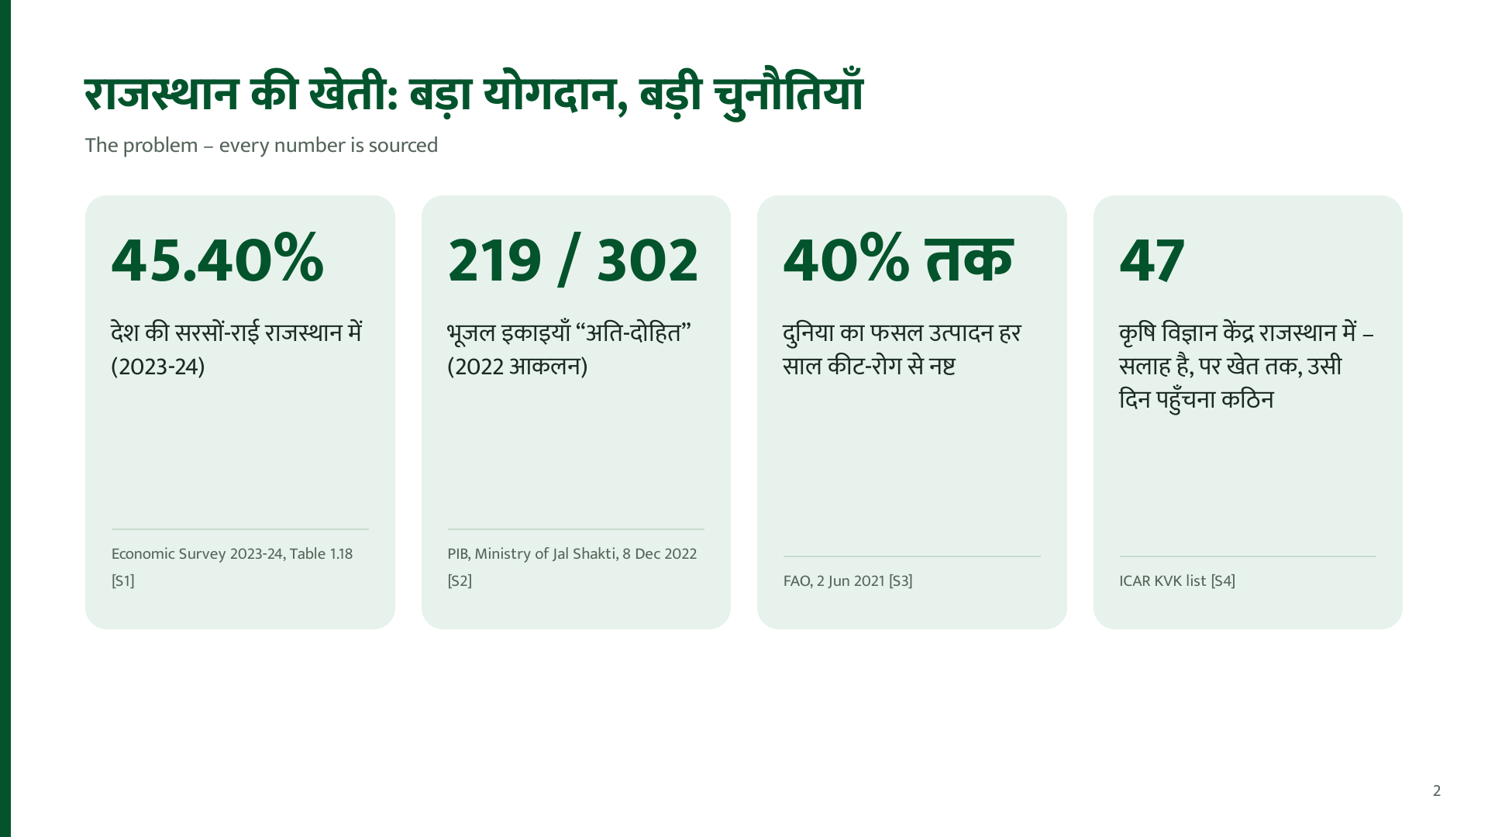
Notes:
Sirf sourced numbers. 40% global hai, Rajasthan ka alag number hum claim nahi karte.

Slide 3
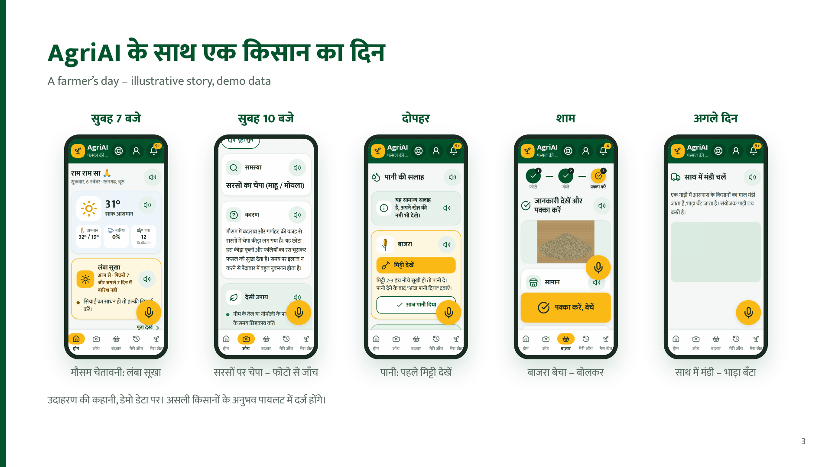
Notes:
Kahani kaalpanik hai, screens asli app ki hain, data demo hai.

Slide 4
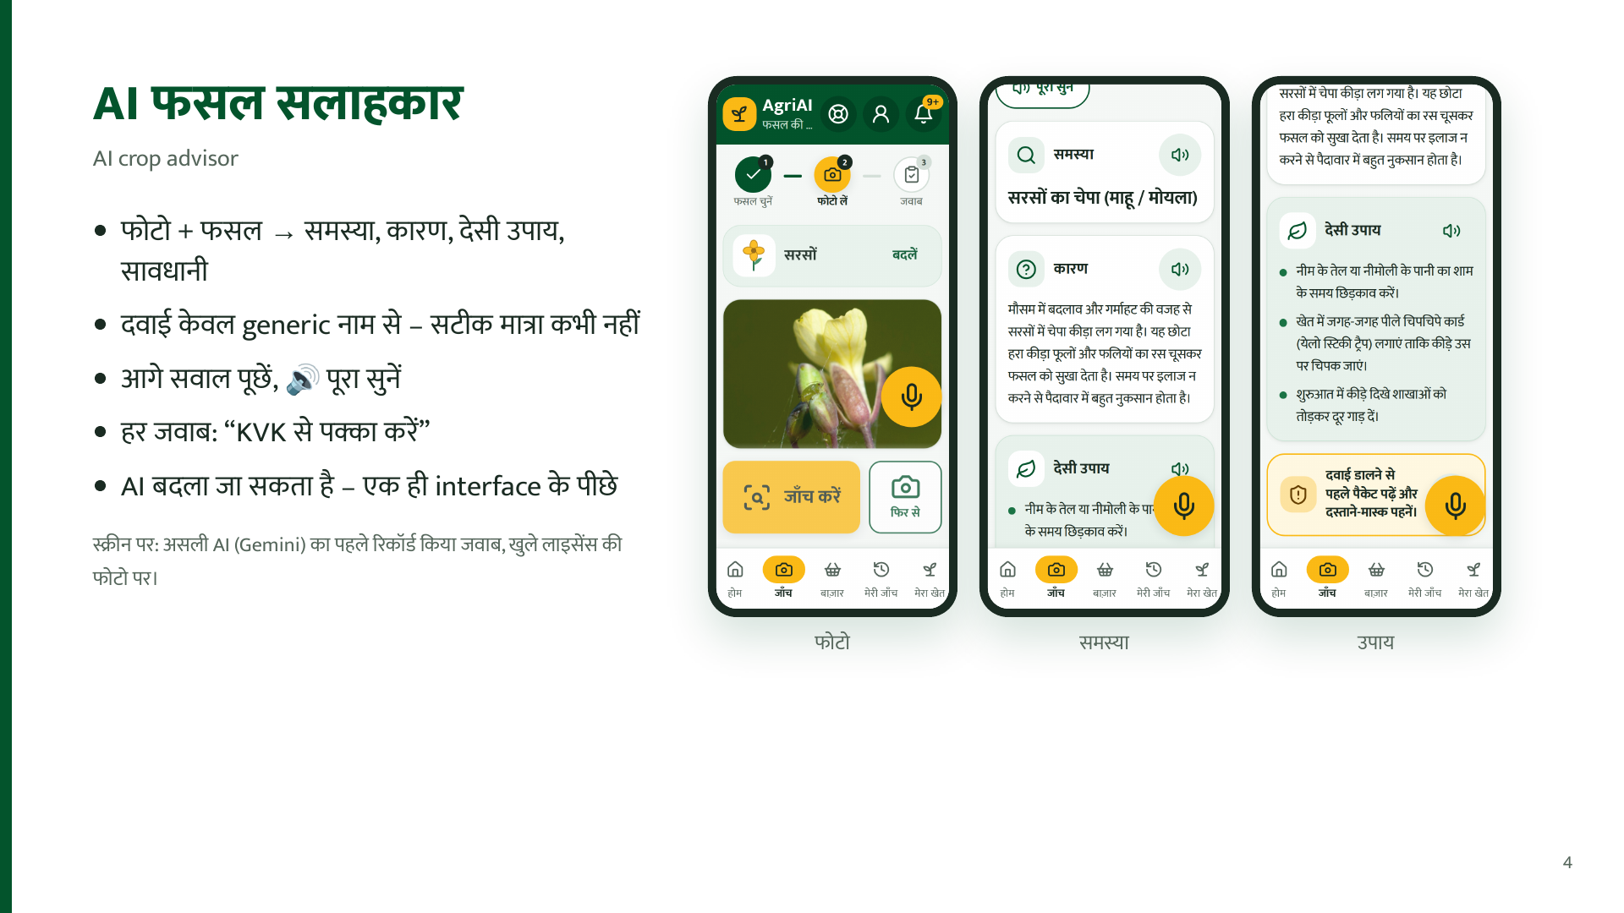
Notes:
Accuracy ka number nahi bata rahe – KVK review pilot se pehle.

Slide 5
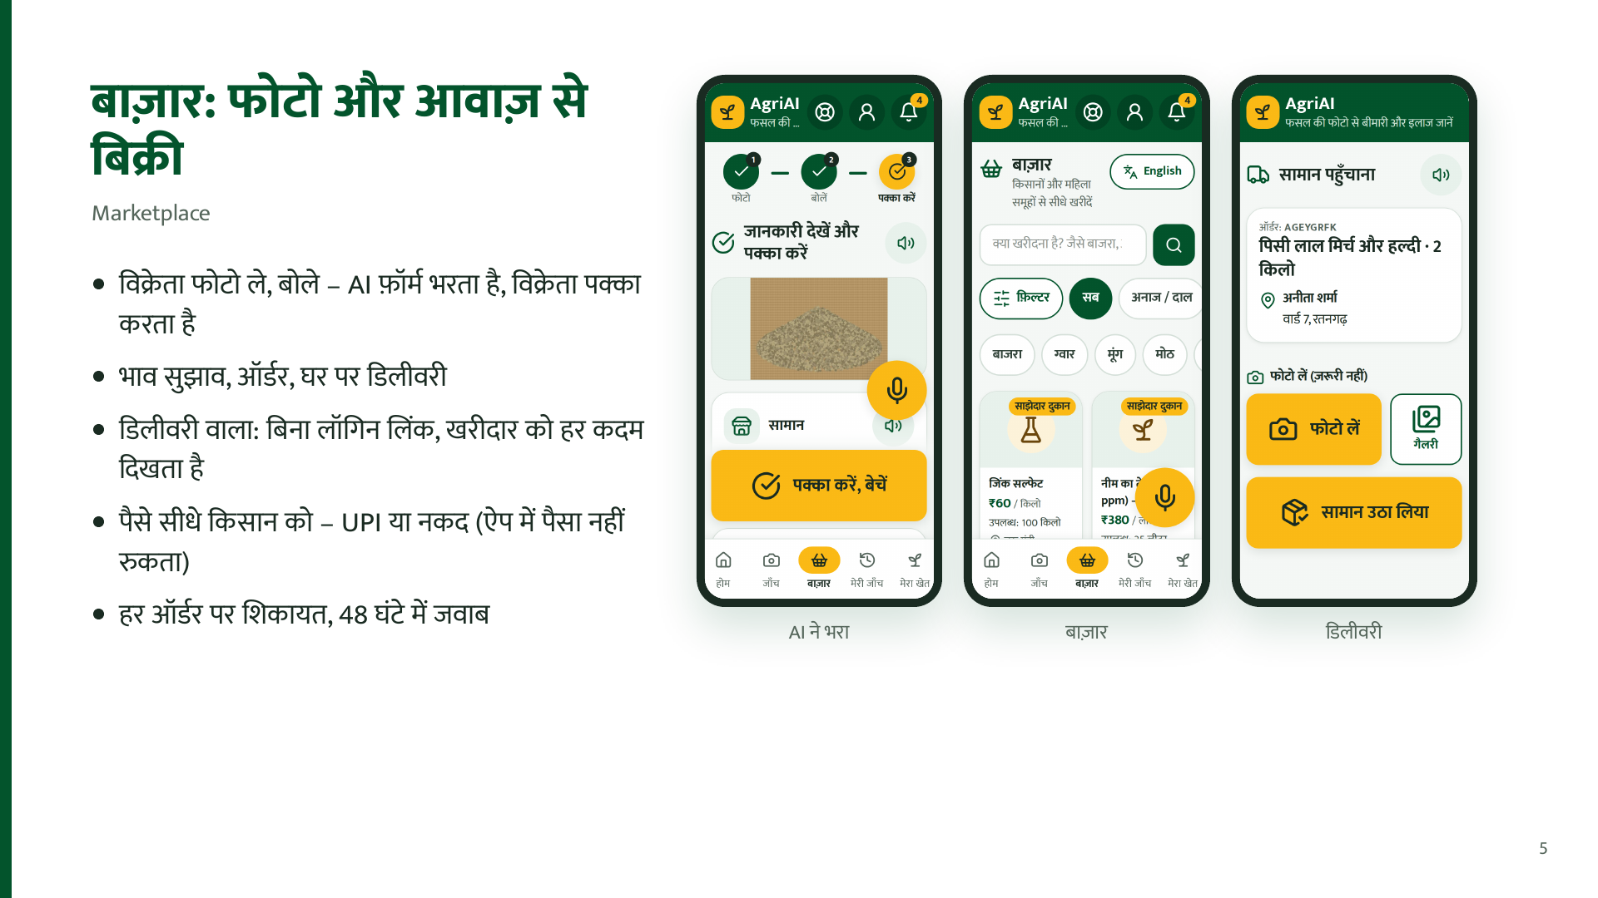
Notes:
Commission sirf poore order par (abhi 3%). Online payment jaan-boojhkar nahi.

Slide 6
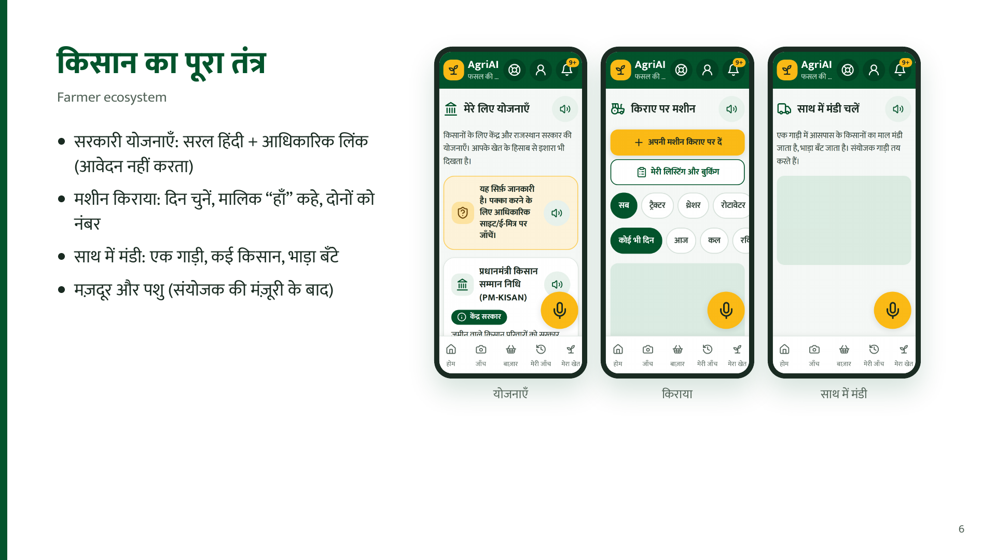
Notes:
Yojana data abhi verify hona baaki hai (PM-KISAN ke alawa). Pashu ka legal review baaki.

Slide 7
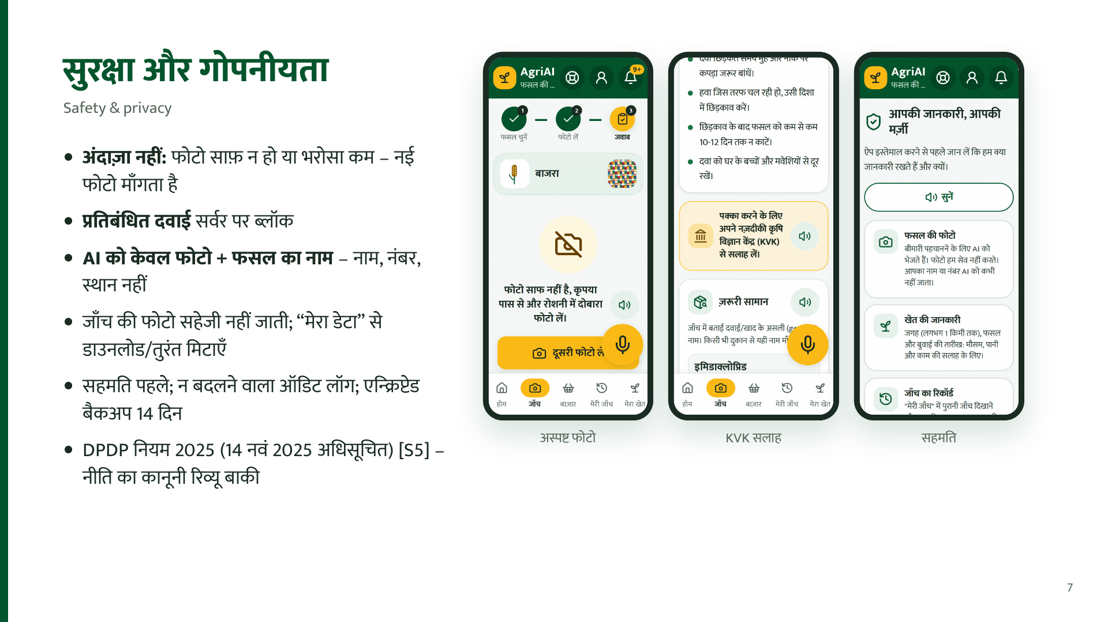
Notes:
Data region: database Mumbai (planned), server Singapore (planned). Photo Google ko jaati hai, store nahi hoti.

Slide 8
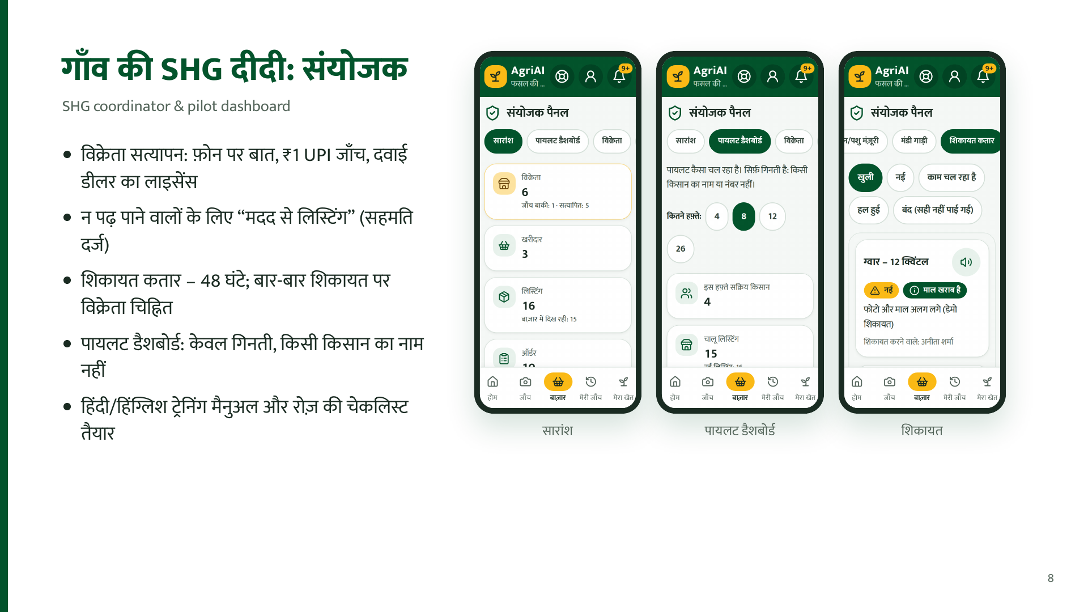
Notes:
Didi ka maandey SHG ke saath tay hoga – abhi koi vaada nahi.

Slide 9
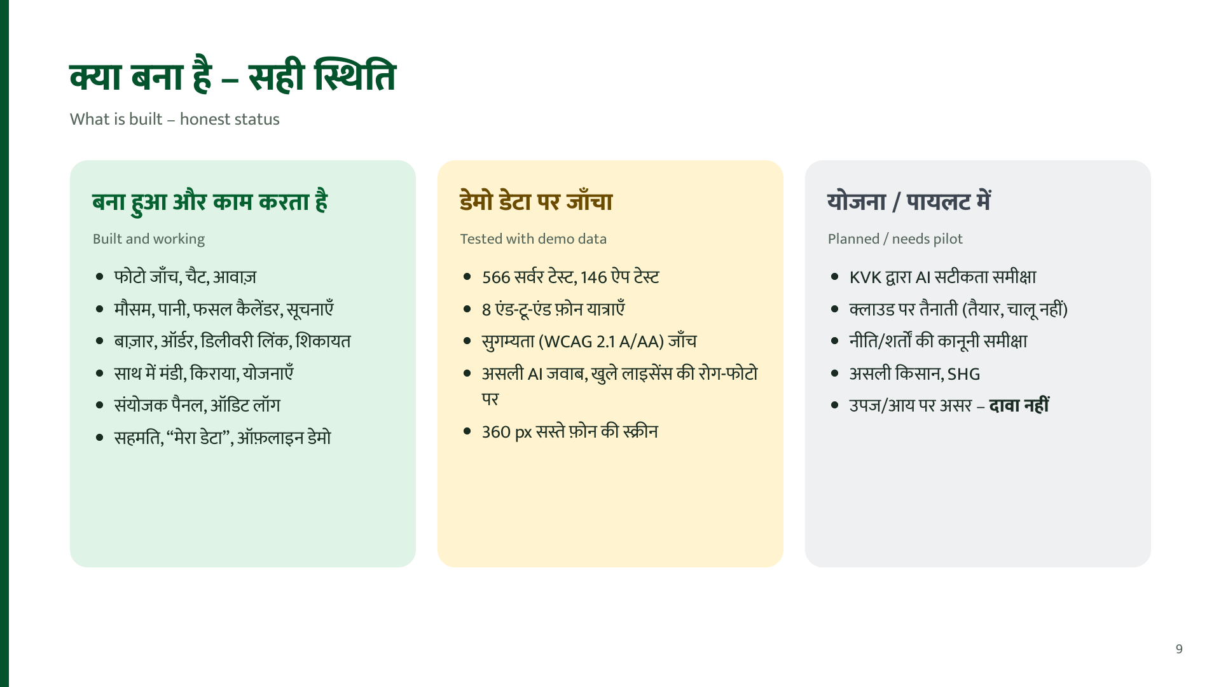
Notes:
Kabhi "proven" nahi bolna. Jo tested hai woh demo data par.

Slide 10
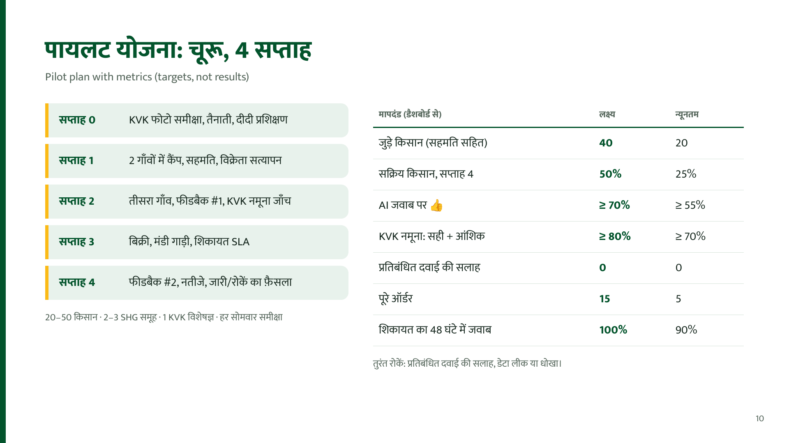
Notes:
Ye lakshya hain, nateeje nahi. Pilot plan: launch-kit/4-pilot.

Slide 11
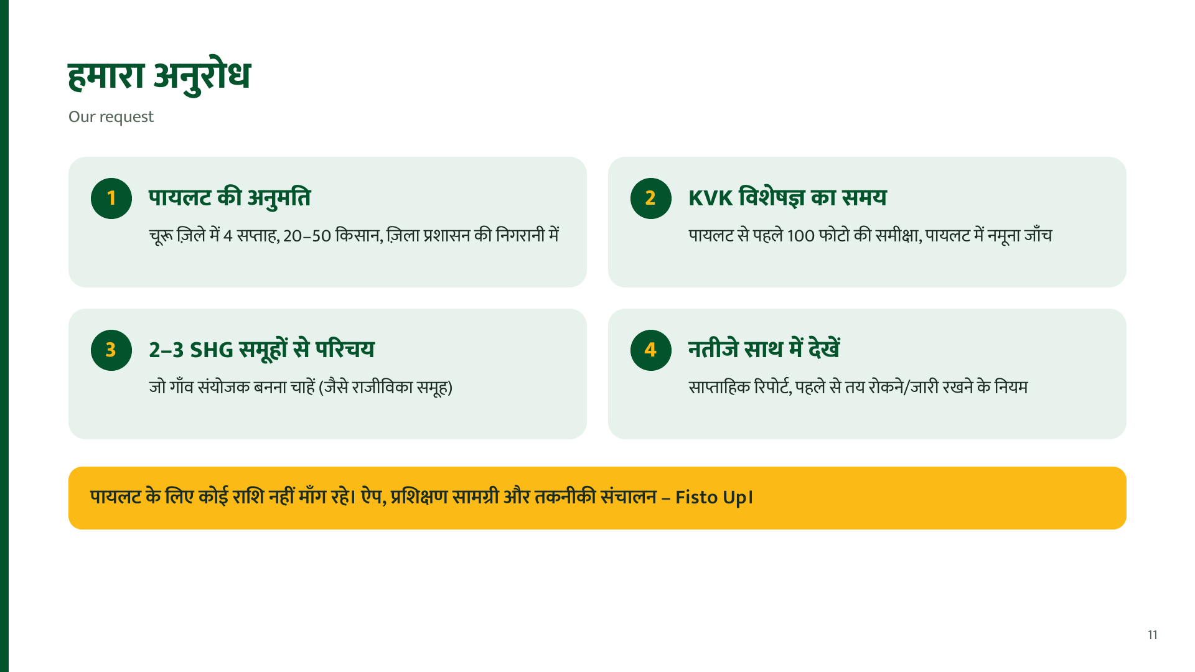
Notes:
Clear ask, phir chup ho jaayein aur sawaal lein.

Slide 12


