Slide 1
12/1/2022
Ana Meeting

Slide 2
https://journals.plos.org/plosone/article?id=10.1371/journal.pone.0230536
Assort using ica, maximizing shared information between spatially near groups

Slide 3
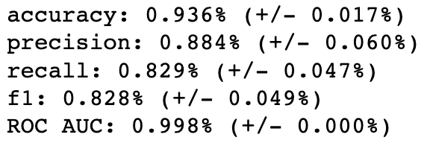
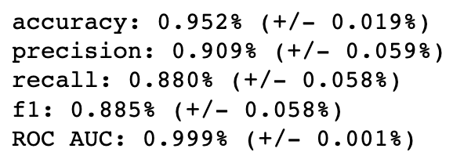
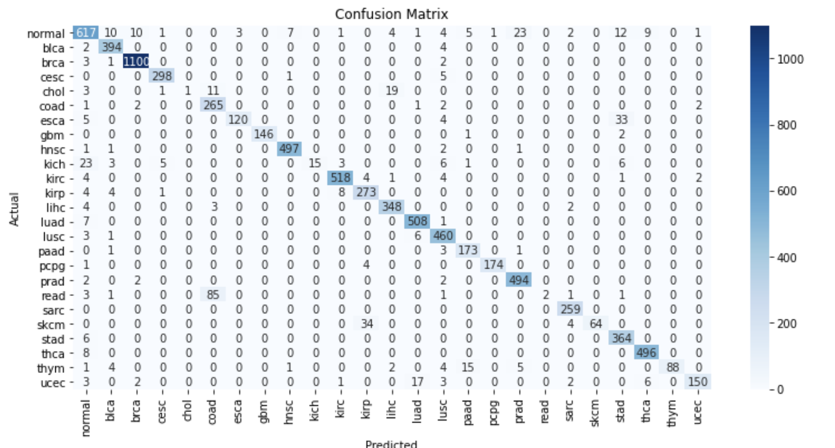
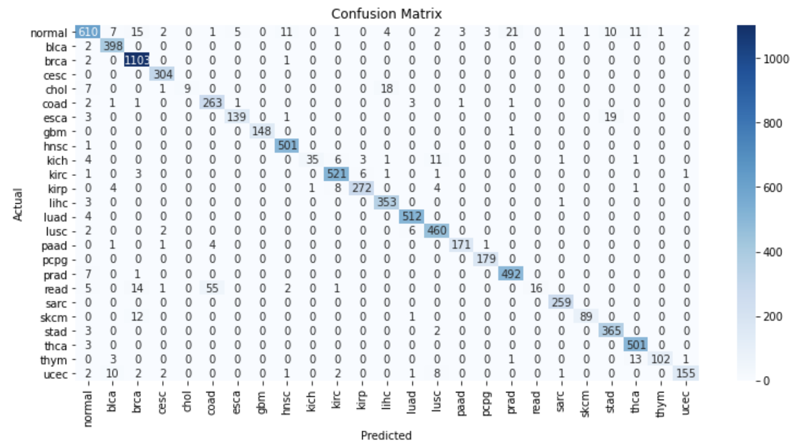
PRELIM run with AFEPSI
Removed any genes with more than 0 expression in 90% of samples in any given subset
3 stratified manifold validation
100 epochs
Batch size = n/7
120 nodes -> Dropout .5 -> 70 nodes -> Dropout .3 -> 25 nodes

