Slide 1
Creating a Crew of Analytical Agents: Leveraging PM and LLMs
This tutorial will introduce participants to the integration of Process Mining (PM) with Large Language Models (LLMs) through an innovative multi-agent framework. Attendees will learn how to design and implement agents that enhance the analytical capabilities of business process management. Hands-on examples and exercises will illustrate how these agents can be effectively utilized, addressing the limitations of LLMs and demonstrating their potential in real-life process mining tasks.

Slide 2
Introduction and Key Concepts
Overview of Process Mining (PM)
Introduction to Large Language Models (LLMs) in Process Mining
Why combine PM and LLMs?

Slide 3
Analytical Agents and Their Roles
What are Analytical Agents?
Multi-agent systems in process analysis

Slide 4
Agentic Workflow Paradigms
Overview of different agentic workflows
Use case: Fully automated Process Analysts

Slide 5
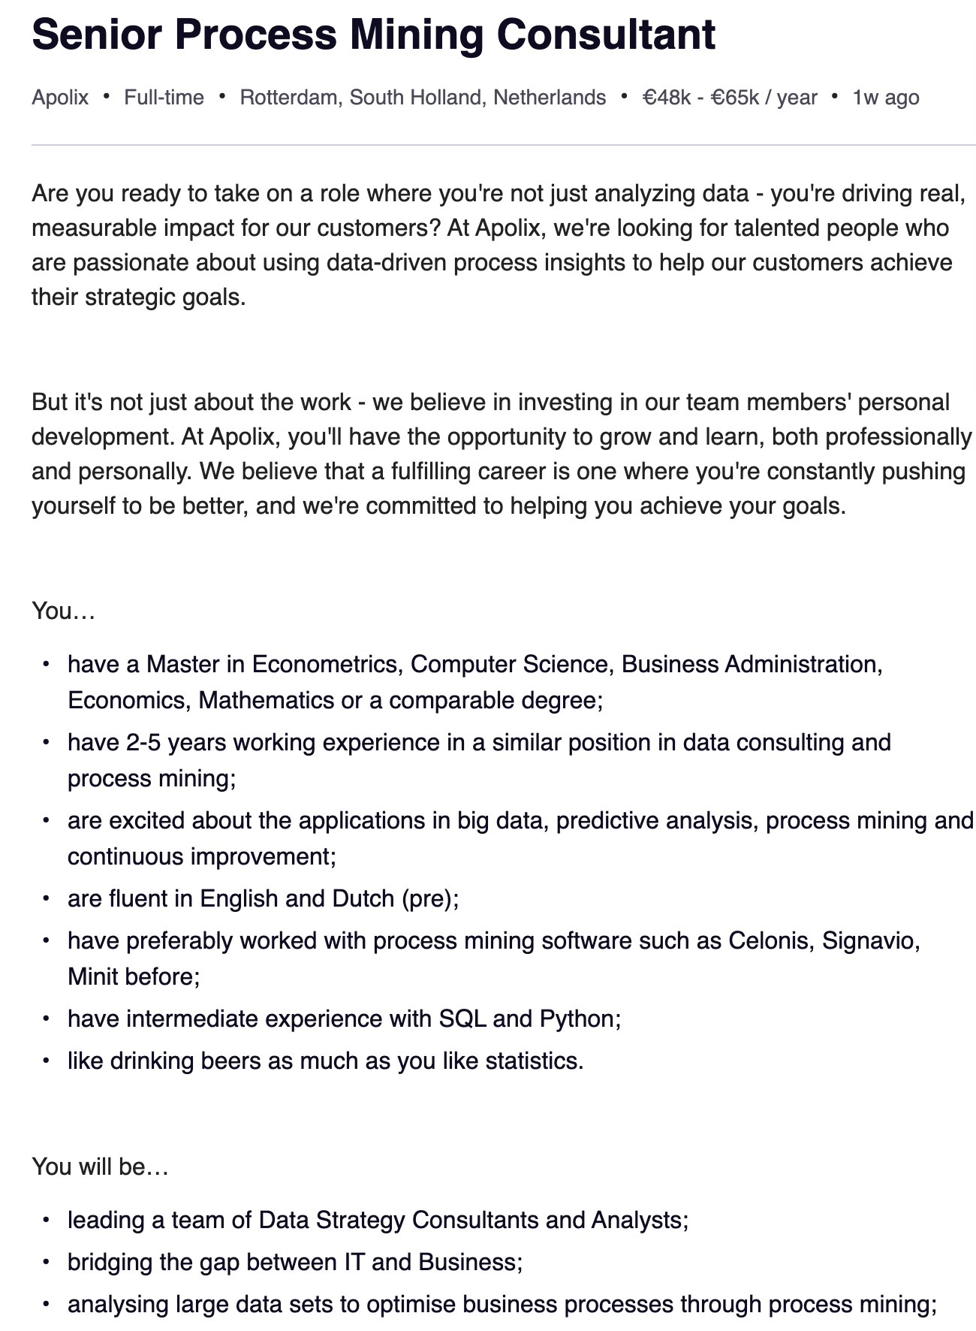
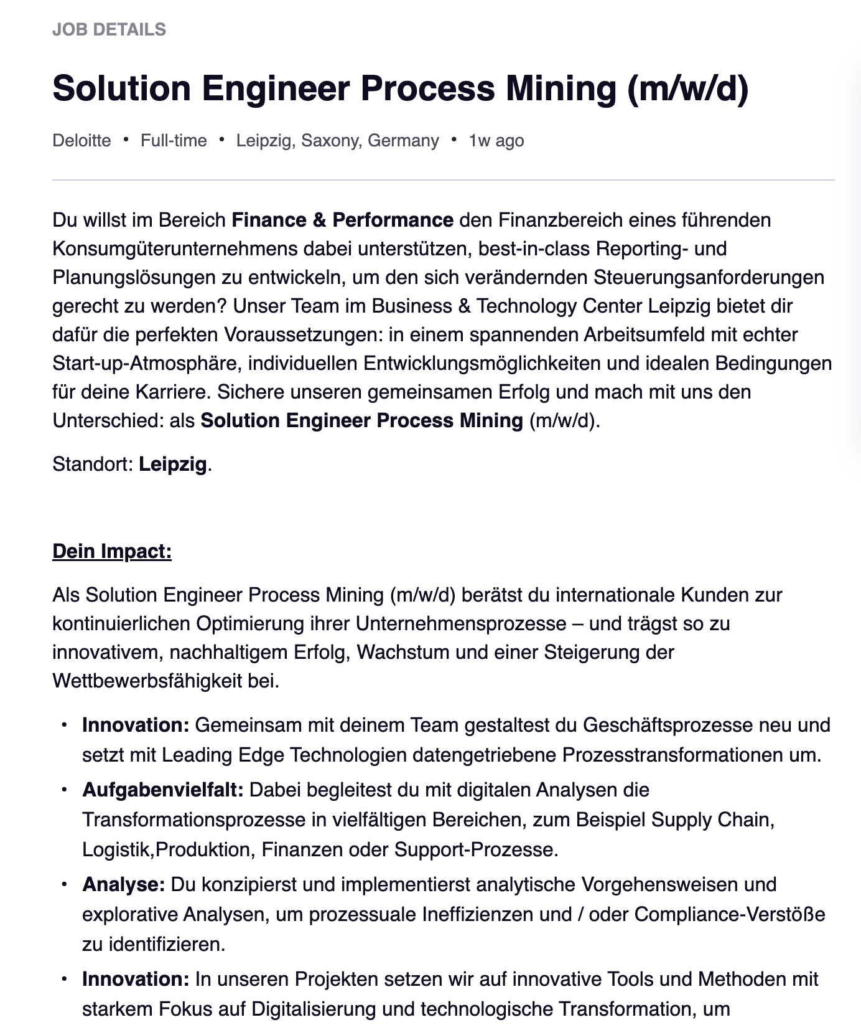
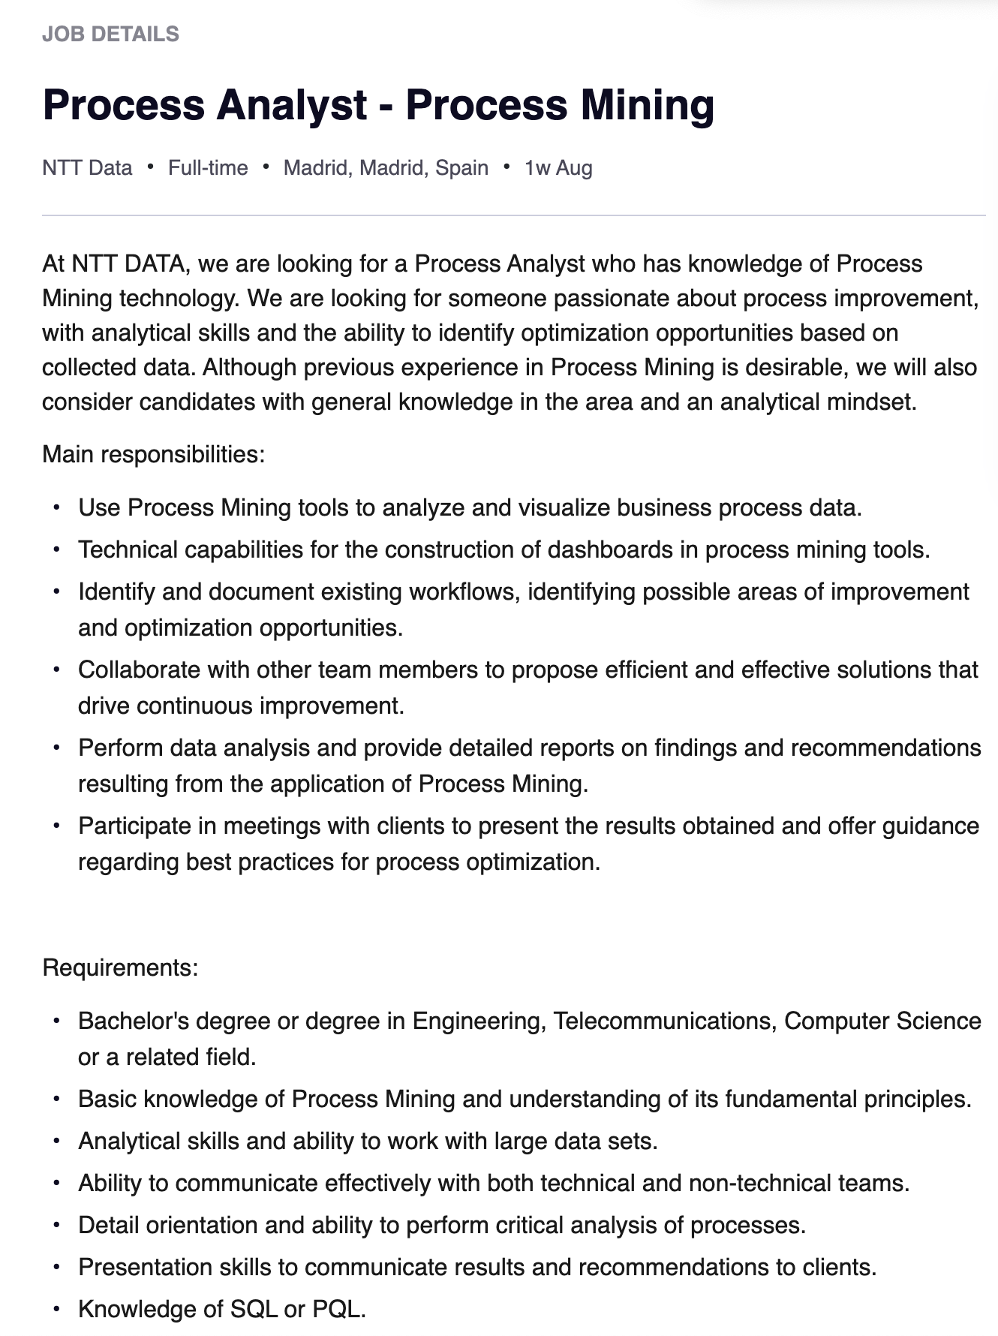

Slide 6
Multi-Prompt Strategies for Effective Process Mining
Decomposing complex queries with least-to-most prompting
Self-reflection strategies to mitigate hallucinations and non-determinism

Slide 7
Hands-On Implementation with CrewAI
Example implementation of CrewAI Python framework
Demonstration: Agents executing tasks in a process mining project

Slide 8
Workshop Exercise: Designing Agentic Workflows
Exercise: Break down a process mining project into roles, tools, and steps
Participants design their own crew of agents

Slide 9
Thank you

Slide 10
Advanced Agentic Concepts: Memory, State, and Guardrails
Enhancing accuracy in agent outputs with memory and state management
Guardrails for ensuring data quality and preventing errors

Slide 11
Evaluation of LLMs in Process Mining
Limitations of current LLMs in process mining
How multi-agent frameworks address these challenges

Slide 12
Future Research and Opportunities
Recent advancements in agentic frameworks
Open challenges in applying LLMs to business process management

Slide 13
Conclusion and Feedback
Participant feedback: Potential impact of LLMs and agentic workflows on process management roles

Slide 14
Interactive Session Components Live demonstrations with Jupyter notebooks Group exercises where participants create their own agent-based workflow Q&A session on practical applications and challenges

