Slide 2
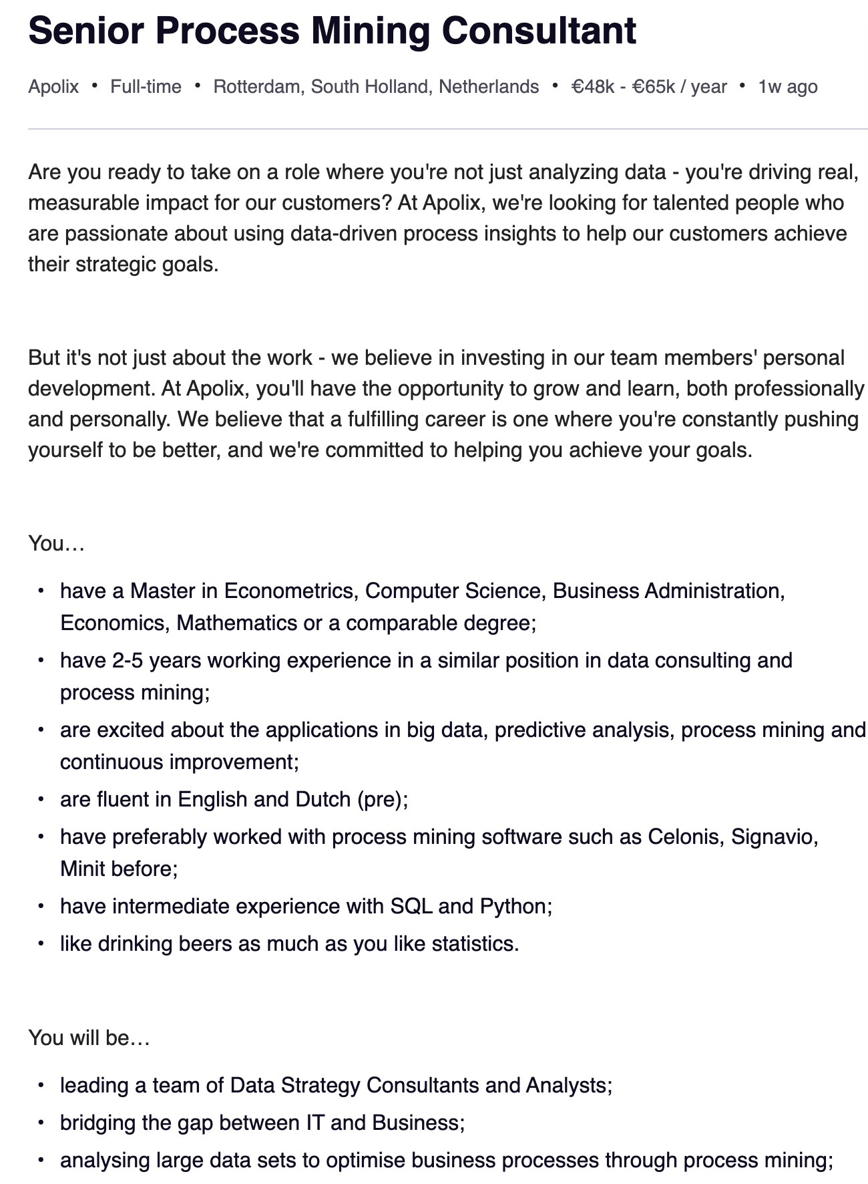
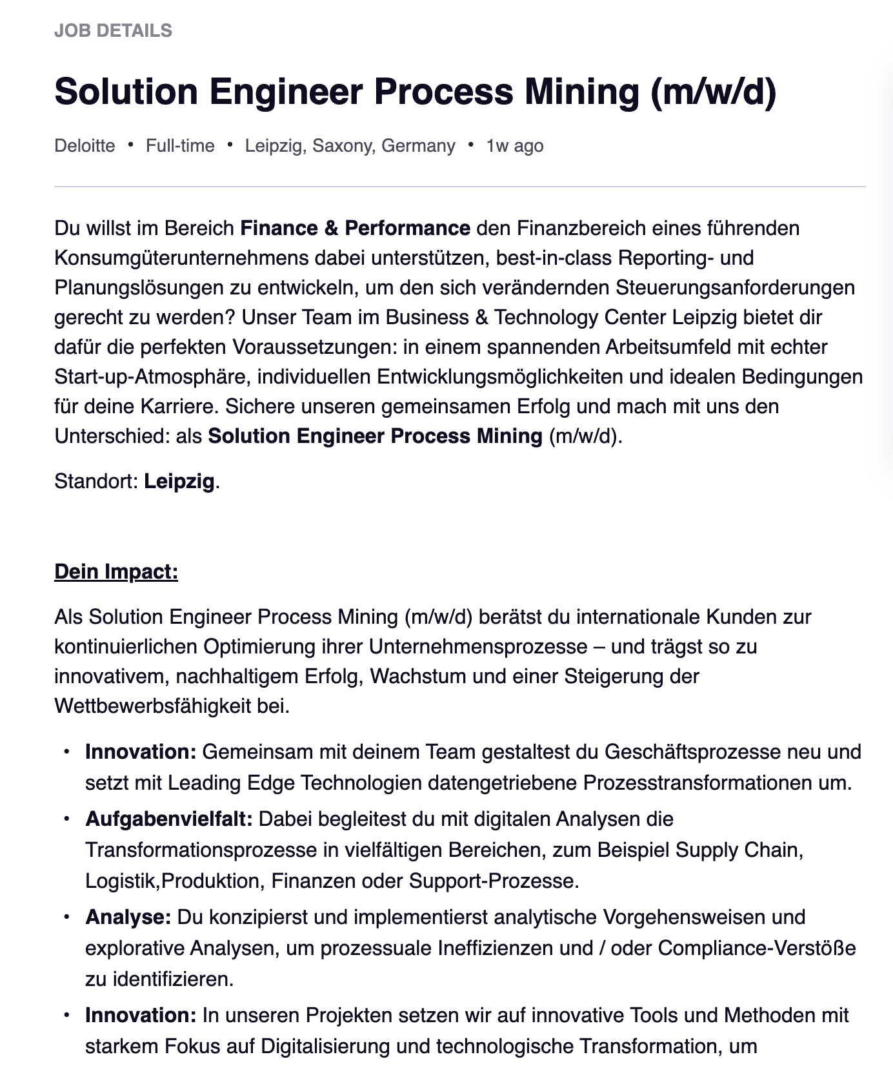
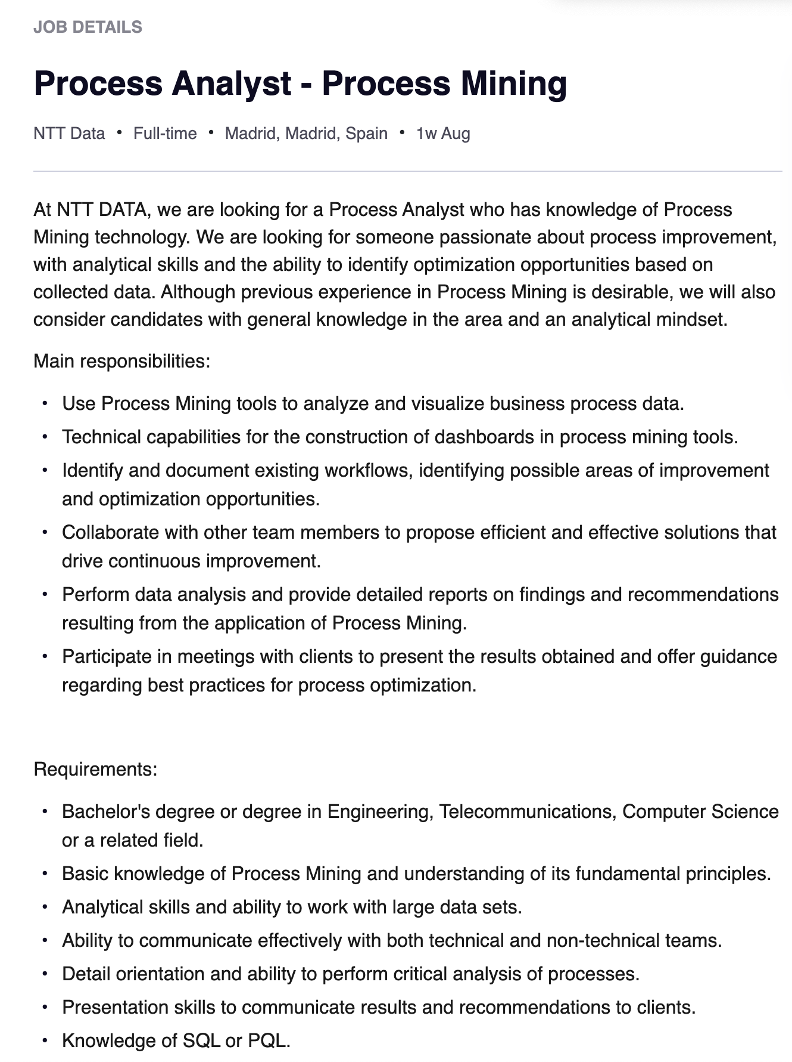

Slide 3
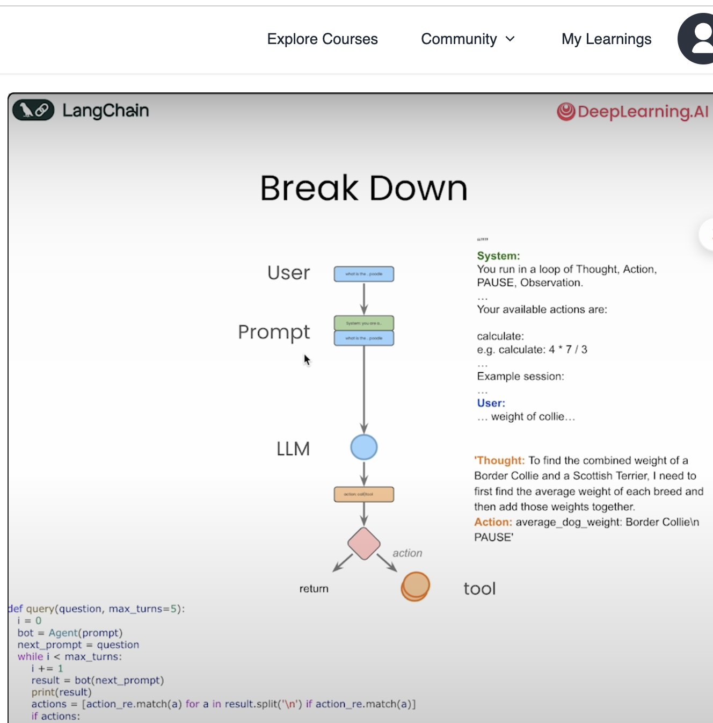
User
What are the root causes
Prompt
You are …
What are the root causes
LLM
Action call tool
action
return
tool

Slide 4
User
What are the root causes
Prompt
You are …
What are the root causes
LLM
Action call tool
action
return
tool

