Slide 1
Fall, 2019
Lecture 04: Application of derivatives

Slide 2
Contents
1
Analysis of functions
2
Relative Extremum
3
Curve sketching
4
Absolute Extremum
5
Optimization problems

Slide 3
Analysis of functions

Slide 4
Increasing and Decreasing functions
A function f is increasing on an interval (a, b) if for any two numbers x₁ and x₂ in (a, b),
f(x₁) < f(x₂) wherever x₁ < x₂.
y
f(x₂)
f(x₁)
x
a
x₁
x₂
b

Slide 5
Increasing and Decreasing functions
A function f is decreasing on an interval (a, b) if for any two numbers x₁ and x₂ in (a, b),
f(x₁) > f(x₂) wherever x₁ < x₂.
y
f(x₁)
f(x₂)
x
a
x₁
x₂
b

Slide 6
Increasing and Decreasing functions
Theorem 1:
If f ′(x) > 0 for each value of x in an interval (a, b), then f is increasing on (a, b).
If f ′(x) < 0 for each value of x in an interval (a, b), then f is decreasing on (a, b).
If f ′(x) = 0 for each value of x in an interval (a, b), then f is constant on (a, b).

Slide 7
Increasing and Decreasing functions: Example
Find the interval where the function f(x) = x² is increasing and the interval where it is decreasing.
Solution:
The derivative of f(x) = x² is f ′(x) = 2x.
f ′(x) = 2x > 0 if x > 0 and f ′(x) = 2x < 0 if x < 0.
Thus, f is increasing on the interval (0, ∞) and decreasing on the interval (– ∞, 0).
f(x) = x²

Slide 8
Increasing and Decreasing functions
Steps for determining the interval where a function is increasing or decreasing
Find all the values of x for which f ′(x) = 0 or f ′ is discontinuous and identify the open intervals determined by these numbers.
Select a test number c in each interval found in step 1 and determine the sign of f ′(c) in that interval.
If f ′(c) > 0, f is increasing on that interval.
If f ′(c) < 0, f is decreasing on that interval.

Slide 9


Increasing and Decreasing functions: Example
Determine the intervals where the function is increasing and where it is decreasing.
Solution:
Firstly, we find the first derivative f’(x) and solve for f’(x)=0:
The numbers divide the real line into the intervals (– ∞, –2), (– 2, 4), and (4, ∞).
We select a convenient test point c in each interval and compute f ′(c).
$$f\left(x\right)=x^{3}−{3x}^{2}−24x+32$$
$$f^{′}\left(x\right)={3x}^{2}−6x−24=3\left(x+2\right)\left(x−4\right)$$
$$f^{′}\left(x\right)=0⇔\left(x=−2\right) or \left(x=4\right)$$

Slide 10


Increasing and Decreasing functions: Example
Determine the intervals where the function is increasing and where it is decreasing.
Solution:
Lets consider the values –3, 0, and 5
Thus, we conclude that f is increasing on the intervals (– ∞, –2), (4, ∞), and is decreasing on the interval (– 2, 4).
$$f\left(x\right)=x^{3}−{3x}^{2}−24x+32$$
$$f^{′}\left(−3\right)={3(−3)}^{2}−6\left(−3\right)−24=21>0$$
$$f^{′}\left(0\right)={3(0)}^{2}−6\left(0\right)−24=−24<0$$
$$f^{′}\left(5\right)={3(5)}^{2}−6\left(5\right)−24=21>0$$

Slide 11
Concavity
A curve is said to be concave upwards when the slope of tangent line to the curve is increasing:
Thus, if f is differentiable on an interval (a, b), then f is concave upwards on (a, b) if f ′ is increasing on (a, b).
y
x

Slide 12
Concavity
A curve is said to be concave downwards when the slope of tangent line to the curve is decreasing:
Thus, if f is differentiable on an interval (a, b), then f is concave downward on (a, b) if f ′ is decreasing on (a, b).
y
x

Slide 13
Concavity
Recall that f ″(x) measures the rate of change of the slope f ′(x) of the tangent line to the graph of f at the point (x, f(x)).
Thus, we can use f ″(x) to determine the concavity of f.
Theorem 2: If f ″(x) > 0 for each value of x in (a, b), then f is concave upward on (a, b).
If f ″(x) < 0 for each value of x in (a, b), then f is concave downward on (a, b).

Slide 14
Concavity
Steps for determining the concavity of a function f.
Determine the values of x for which f ″is zero or where f ″ is not defined, and identify the open intervals determined by these numbers.
Determine the sign of f ″ in each interval found in step 1. To do this compute f ″(c), where c is any conveniently chosen test number in the interval.
If f ″(c) > 0, f is concave upward on that interval.
If f ″(c) < 0, f is concave downward on that interval.

Slide 15


Concavity: Example
Determine the intervals where the function is concave upward and where it is concave downward.
Solution:
Here, and,
Setting which gives x=1.
So we consider the intervals (– ∞, 1) and (1, ∞):
f ″(x) < 0 when x < 1, so f is concave downward on (– ∞, 1).
f ″(x) > 0 when x > 1, so f is concave upward on (1, ∞).
$$f\left(x\right)=x^{3}−{3x}^{2}−24x+32$$
$$f^{′}\left(x\right)=3x^{2}−6x−24$$
$$f^{′′}\left(x\right)=6x−6$$
$$f^{′′}\left(x\right)=0⇔6x−6=0⟹6\left(x−1\right)=0$$

Slide 16
Concavity: Example
Determine the intervals where the function is concave upward and where it is concave downward.
Solution:
The graph confirms that f is concave downward on (– ∞, 1)
and concave upward on (1, ∞):
$$f\left(x\right)=x^{3}−{3x}^{2}−24x+32$$
y
f(x)
x

Slide 17
Inflection Point
A point on the graph of a continuous function where the tangent line exists and where the concavity changes is called an inflection point.
Examples:
y
Inflection Point
x

Slide 18
Inflection Point
A point on the graph of a continuous function where the tangent line exists and where the concavity changes is called an inflection point.
Examples:
y
Inflection Point
x

Slide 19
Inflection Point
Steps for finding the inflection points of a function f.
Compute f ″(x).
Determine the numbers in the domain of f for which f ″(x) = 0 or f ″(x) does not exist.
Determine the sign of f ″(x) to the left and right of each number c found in step 2.
If there is a change in the sign of f ″(x) as we move across x = c, then (c, f(c)) is an inflection point of f.
See textbook for practical examples

Slide 20
Relative Extrema

Slide 21
Relative Extrema
Consider the graph of function f below, there are high points and low points on the graph of f:
High points are called relative maxima
Low points are called relative minima.
Both high and low points are called relative extrema.
y
Relative Maxima
y = f(x)
Relative Minima
x

Slide 22
Relative Maxima
A function f has a relative maximum at x = c if there exists an open interval (a, b) containing c such that f(x) ≤ f(c) for all x in (a, b).
y
Relative Maxima
y = f(x)
x
x₁
x₂

Slide 23
Relative Minima
A function f has a relative minimum at x = c if there exists an open interval (a, b) containing c such that f(x) ≥ f(c) for all x in (a, b).
y
y = f(x)
Relative Minima
x
x₃
x₄

Slide 24
Critical Numbers
We refer to a number in the domain of f that may give rise to a relative extremum as a critical number.
Critical number of f:
A critical number of a function f is any number x in the domain of f such that f ′(x) = 0 or f ′(x) does not exist.

Slide 25
Relative Extrema
The graph below shows us several critical numbers.
At points a, b, and c, f ′(x) = 0.
There is a corner at point d, so f ′(x) does not exist there.
The tangent to the curve at point e is vertical, so f ′(x) does not exist there either.
Note that points a, b, and d are relative extrema, while points c and e are not.
y
Relative Extrema
Not Relative Extrema
x
a
b
c
d
e

Slide 26
The First Derivative Test
Procedure for finding relative extrema of a continuous function f.
Determine the critical numbers of f.
Determine the sign of f ′(x) to the left and right of each critical point.
If f ′(x) changes sign from positive to negative as we move across a critical number c, then f(c) is a relative maximum.
If f ′(x) changes sign from negative to positive as we move across a critical number c, then f(c) is a relative minimum.
If f ′(x) does not change sign as we move across a critical number c, then f(c) is not a relative extrema.

Slide 27

The First Derivative Test: Example
Find the relative maxima and minima of
Solution:.
The derivative of f and equate to zero:
The zeros of f ′(x) are x = –2 and x = 4.
f ′(x) is defined everywhere, so x = –2 and x = 4 are the only critical numbers of f.
Since f ′(x) > 0 if x < –2 and f ′(x) < 0 if -2 < x < 4, we see that f ′(x) changes sign from positive to negative as we move across –2.
Thus, f(–2) = 60 is a relative maximum.
$$f\left(x\right)=x^{3}−{3x}^{2}−24x+32$$
$$f^{′}\left(x\right)=3x^{2}−6x−24=0⟺3\left(x+2\right)\left(x−4\right)=0$$

Slide 28
The First Derivative Test: Example
Find the relative maxima and minima of
Solution:
Since f ′(x) < 0 if -2 < x < 4 and f ′(x) > 0 if, x > 4 we see that f ′(x) changes sign from negative to positive as we move across 4.
Thus, f(4) = – 48 is a relative minimum.
$$f\left(x\right)=x^{3}−{3x}^{2}−24x+32$$
Relative Maximum
y
60
40
20
–20
–40
– 60
f(x)
x
Relative Minimum

Slide 29
The Second Derivative Test
Maxima occur when a curve is concave downwards, while minima occur when a curve is concave upwards.
This is the basis of the second derivative test:
Steps of the second derivative test for finding relative extrema of a continuous function f.
Compute f ′(x) and f ″(x).
Find all the critical numbers of f at which f ′(x) = 0.
Compute f ″(c), if it exists, for each critical number c.
If f ″(c) < 0, then f has a relative maximum at c.
If f ″(c) > 0, then f has a relative minimum at c.
If f ″(c) = 0, then the test fails (it is inconclusive).

Slide 30
Curve sketching

Slide 31
Self Learning
Read textbook Chapter 4, Section 4.3 – (page 254-263).

Slide 32
Absolute extrema

Slide 33
Absolute extrema
The absolute extrema of a function f:
If f(x) ≤ f(c) for all x in the domain of f, then f(c) is called the absolute maximum value of f.
If f(x) ≥ f(c) for all x in the domain of f, then f(c) is called the absolute minimum value of f.

Slide 34

Absolute extrema : Example
f has an absolute minimum at (0, 0):
y
$$f\left(x\right)=x^{2}$$
4
2
x
–2 –1 1 2
Absolute minimum

Slide 35

Absolute extrema : Example
f has an absolute maximum at (0, 4):
y
Absolute maximum
4
2
$$f\left(x\right)={4−x}^{2}$$
x
–2 –1 1 2

Slide 36



Absolute extrema : Example
$$\left(−\frac{1}{\sqrt{2}},−\frac{1}{2}\right)$$
f has an absolute minimum at
and an absolute maximum at
$$\left(\frac{1}{\sqrt{2}},\frac{1}{2}\right)$$
y
1
1/2
–1/2
–1
Absolute maximum
$$f\left(x\right)=x\sqrt{1−x^{2}}$$
x
–1 1
Absolute minimum

Slide 37

Absolute extrema : Example
f has no absolute extrema:
y
7
6
5
4
3
2
1
$$f\left(x\right)={x^{3}−6x}^{2}+9x+2$$
x

Slide 38
Absolute extrema in a closed interval
Theorem: Absolute Extrema in a Closed Interval
If a function f is continuous on a closed interval [a, b], then f has both an absolute maximum value and an absolute minimum value on [a, b].

Slide 39
Absolute extrema in a closed interval: Example
The relative minimum of f at x₃ is also the absolute minimum of f.
The right endpoint b of the interval [a, b] gives rise to the absolute maximum value f(b) of f.
y
Relative maximum
Absolute maximum
Absolute minimum
Relative minimum
Relative minimum
x
a
x₁
x₂
x₃
b

Slide 40
Absolute extrema in a closed interval
Steps to find the absolute extrema of f on a closed interval [a, b]
Find the critical numbers of f that lie on (a, b).
Compute the value of f at each critical number found in step 1 and compute f(a) and f(b).
The absolute maximum value and absolute minimum value of f will correspond to the largest and smallest numbers, respectively, found in step 2.

Slide 41

Absolute extrema in a closed interval: Example
Find the absolute maximum and minimum of defined on the interval [0,3].
Solution:
The derivative of f and equate to zero:
The zeros of f ′(x) are x = –2/3 and x = 2.
f ′(x) is defined everywhere, so x = –2/3 and x = 2 are the only critical numbers of f.
We drop x = – 2/3 since it lies outside the interval [0, 3].
So we calculate, f(0) = 4, f(2) = – 4, and f(3) = 1.
It follows that – 4 is the absolute minimum of f, and 4 is the absolute maximum of f.
$$f\left(x\right)=x^{3}−{2x}^{2}−4x+4$$
$$f^{′}\left(x\right)=3x^{2}−4x−4=0⟺\left(3x+2\right)\left(x−2\right)=0$$

Slide 42

Absolute extrema in a closed interval: Example
Find the absolute maximum and minimum of defined on the interval [0,3].
Solution:
$$f\left(x\right)=x^{3}−{2x}^{2}−4x+4$$
y
4
2
–2
–4
$$f\left(x\right)=x^{3}−{2x}^{2}−4x+4$$
Absolute maximum
x
–2 2 4
Absolute minimum

Slide 43
Applied Example
Tien Dat is a speaker manufacturer in Ho Chi Minh city. The company total profit (in dollars) from manufacturing and selling x units of their model F speakers is given by:
How many units of the speaker must Tien Dat produce to maximize profits?
Solution:
To find the absolute maximum of P on [0, 20,000], first find the critical points of P on the interval (0, 20,000).
Setting P ′ = 0, we get
P ′ is defined everywhere, we have only one critical point at x = 7500.
$$P\left(x\right)=−{0.02x}^{2}+300x−200,000 0≤x≤20,000$$
$$P^{′}\left(x\right)=−0.04x+300=0⟹x=7500$$

Slide 44
Applied Example
Tien Dat is a speaker manufacturer in Ho Chi Minh city. The company total profit (in dollars) from manufacturing and selling x units of their model F speakers is given by:
How many units of the speaker must Tien Dat produce to maximize profits?
Solution:
Evaluating P(x) at x=0; x=7500; and x=20,000 we have: P(0)=-200,000; P(7500)=925,000; P(20,000)=-2,200,000
Thus, Tien Dat will realize the maximum profit of $925,000 by producing 7500 speakers.
$$P\left(x\right)=−{0.02x}^{2}+300x−200,000 0≤x≤20,000$$

Slide 45
OPTIMIZATION PROBLEMS

Slide 46
Optimization problem
Problems involve maximization and minimization of factors.
Maximizing areas, volumes, and profits
Minimizing distances, times, and costs
The applied optimization problems that we will consider in this section fall into the following two categories:
Problems that reduce to maximizing or minimizing a continuous function over a finite closed interval (Tien Dat example).
Problems that reduce to maximizing or minimizing a continuous function over an infinite interval or a finite interval that is not closed.

Slide 47
Optimization problem
Guidelines for Solving Optimization Problems
Assign a letter to each variable mentioned in the problem. If appropriate, draw and label a figure.
Find an expression for the quantity to be optimized.
Use the conditions given in the problem to write the quantity to be optimized as a function f of one variable. Note any restrictions to be placed on the domain of f from physical considerations of the problem.
Finding the maximum / minimum of the function f over its domain.

Slide 48
Optimization problem type 1
By cutting away identical squares from each corner of a rectangular piece of cardboard and folding up the resulting flaps, the cardboard may be turned into an open box.
If the cardboard is 16 inches long and 10 inches wide, find the dimensions of the box that will yield the maximum volume?.
10
16

Slide 49
Optimization problem type 1
Solution:
Let x denote the length in inches of one side of each of the identical squares to be cut out of the cardboard. The dimensions of the box are (16 – 2x) by (10 – 2x) by x in.
x
10
10 – 2x
x
x
16 – 2x
x
16

Slide 50
Optimization problem type 1
Solution:
Let V denote the volume (in cubic inches) of the resulting box. The volume,
is the quantity to be maximized.
$$V\left(x\right)=\left(16−2x\right)\left(10−2x\right)x=4(x^{3}−13x^{2}+40x)$$
x
10 – 2x
16 – 2x

Slide 51

Optimization problem type 1
Solution:
Each side of the box must be nonnegative, so x must satisfy the inequalities x ≥ 0, 16 – 2x ≥ 0, and 10 – 2x ≥ 0.
All these inequalities are satisfied if 0 ≤ x ≤ 5.
Therefore, the problem at hand is equivalent to finding the absolute maximum of
on the closed interval [0, 5].
$$f\left(x\right)=4(x^{3}−13x^{2}+40x)$$

Slide 52
Optimization problem type 1
Solution:
f is continuous on [0, 5]. Setting f ′(x) = 0 we get
which yields the critical numbers x = 20/3 and x = 2. We discard x = 20/3 for being outside the interval [0, 5].
We evaluate f at the critical point and at the endpoints:
f(0) = 0 f(2) = 144 f(5) = 0
Thus, the volume of the box is maximized by taking x = 2.
The resulting dimensions of the box are 12″ ☓ 6″ ☓ 2″.
$$f^{′}\left(x\right)=4\left(3x^{2}−26x+40\right)=4(3x−20)(x−2)$$

Slide 53
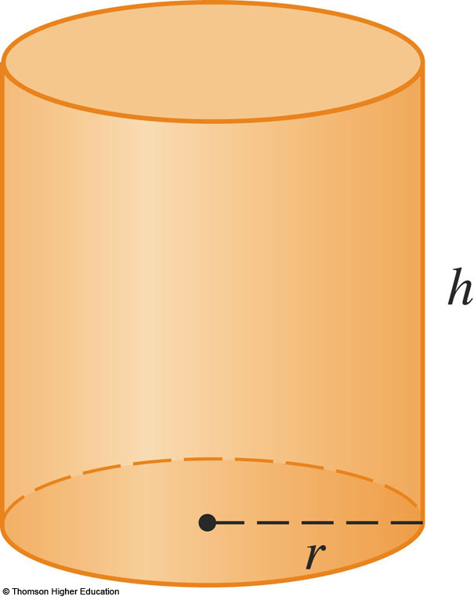
Optimization problem type 2
A cylindrical can is to be made to hold 1L of oil.
in the figure r is the radius and h the height (both in centimeters).
Find the dimensions that will minimize the cost of the metal to manufacture the can.

Slide 54
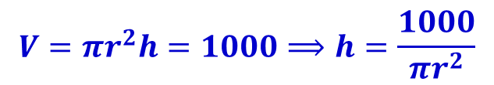
Optimization problem type 2
Solution:
Let r denote the radius, h denote the height of the can (both in centimeters).
The given volume of the can is 1L (equivalent to 1000cm³), so we have:
$$V=πr^{2}h=1000⟹h=\frac{1000}{πr^{2}}$$

Slide 55
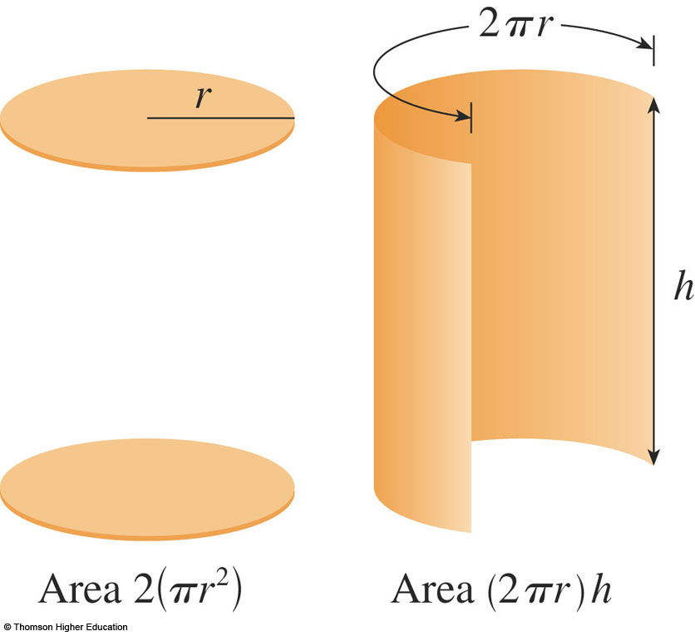

Optimization problem type 2
Solution:
The total surface area of the cylinder includes top, bottom, and sides. Let S denote the total surface area, then The area S(r) is the quantity to be minimized.
$$S=2πr^{2}+2πrh$$ $$=2πr^{2}+2πr\left(\frac{1000}{πr^{2}}\right)$$ $$=2πr^{2}+\frac{2000}{r}$$

Slide 56
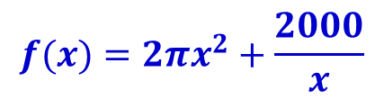

Optimization problem type 2
Solution:
The radius r must be positive, so we have r>0. Therefore, the problem at hand is equivalent to find the absolute minimum of on the infinite interval
$$f(x)=2πx^{2}+\frac{2000}{x}$$
$$\left(0,∞\right)$$

Slide 57



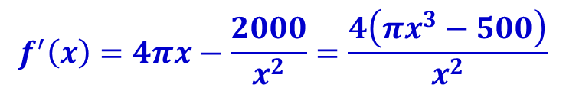
Optimization problem type 2
Solution:
f is continuous on . Setting f ′(x) = 0 we get
which yields the only one critical number We can observe that f’(x)<0 for all x to the left of the critical number, and f’(x)>0 for all x to the right. So f(x) decreasing for all x to the left of the critical number, and increasing for all x to the right. Thus, f(x) must be absolute minimum at
$$\left(0,∞\right)$$
$$f^{′}\left(x\right)=4πx−\frac{2000}{x^{2}}=\frac{4\left(πx^{3}−500\right)}{x^{2}}$$
$$x=\sqrt[3]{\frac{500}{π}}$$
$$x=\sqrt[3]{\frac{500}{π}}$$

Slide 58


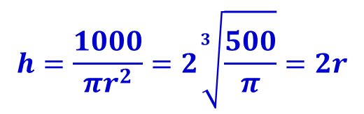
Optimization problem type 2
Solution:
With , the corresponding value of h is We can conclude that the cost of the metal needed to manufacture the can is minimum when:
The radius should be:
The height should be equal to twice the radius—namely, the diameter.
$$r=\sqrt[3]{\frac{500}{π}}$$
$$h=\frac{1000}{πr^{2}}=2\sqrt[3]{\frac{500}{π}}=2r$$
$$r=\sqrt[3]{\frac{500}{π}}$$

Slide 59
Summary
Derivative is introduced as a tool to assist in:
Analyzing function: increasing, decreasing, concavity, critical points, inflection points, relative extrema
Sketching curve of a function
Solving optimization problem: absolute extrema, finding maximizing / minimizing value of a function.

Slide 60
Homework
Problem Set :
Read sections 4.1 - 4.5 in Chapter 4. Test with some exercises at the end of each section (students should do as much as possible)
Read Study guide for topic 5.
All exercises in textbook page 310-314 (chapter 4 review exercise) – except the CAS exercises.
References
[1] H. Anton, I. Bivens, S. Davis, Calculus - Early Transcendentals, 9th Ed., MA, USA: John Wiley & Sons, Inc., 2009.

