Slide 1
Chapter 1 Computer System Overview
Operating Systems: Internals and Design Principles
Ninth Edition
By William Stallings
Notes:
“Operating Systems: Internal and Design Principles”, 9/e, by William Stallings, Chapter 1 “Computer System Overview”.

Slide 2
Operating System
Exploits the hardware resources of one or more processors
Provides a set of services to system users
Manages secondary memory and I/O devices

Slide 3
Basic Elements
Processor
Main Memory
I/O Modules
System Bus

Slide 4
Processor
Controls the operation of the computer
Performs the data processing functions
Referred to as the Central Processing Unit (CPU)

Slide 5
Main Memory
Stores data and programs
Typically volatile
Contents of the memory is lost when the computer is shut down
Referred to as real memory or primary memory

Slide 6
I/O Modules
Move data between the computer and its external environment
Secondary memory devices (e.g. disks)
Communications equipment
Terminals

Slide 7
System Bus
Provides for communication among processors, main memory, and I/O modules

Slide 9
Microprocessor
Invention that brought about desktop and handheld computing
Contains a processor on a single chip
Fastest general purpose processors
Multiprocessors
Each chip (socket) contains multiple processors (cores)

Slide 10
Graphical Processing Units (GPU’s)
Provide efficient computation on arrays of data using Single-Instruction Multiple Data (SIMD) techniques pioneered in supercomputers
No longer used just for rendering advanced graphics
Also used for general numerical processing
Physics simulations for games
Computations on large spreadsheets

Slide 11
Digital Signal Processors (DSPs)
Deal with streaming signals such as audio or video
Used to be embedded in I/O devices like modems
Are now becoming first-class computational devices, especially in handhelds
Encoding/decoding speech and video (codecs)
Provide support for encryption and security

Slide 12
System on a Chip (SoC)
To satisfy the requirements of handheld devices, the classic microprocessor is giving way to the SoC
Other components of the system, such as DSPs, GPUs, I/O devices (such as codecs and radios) and main memory, in addition to the CPUs and caches, are on the same chip

Slide 13
Instruction Execution
A program consists of a set of instructions stored in memory
Processor reads (fetches) instructions from memory
Processor executes each instruction
Two steps

Slide 15
Instruction Fetch and Execute
The processor fetches an instruction from memory
Typically the program counter (PC) holds the address of the next instruction to be fetched
PC is incremented after each fetch

Slide 16
Instruction Register (IR)
Fetched instruction is loaded into Instruction Register (IR)
Processor interprets the instruction and performs required action:
Processor-memory
Processor-I/O
Data processing
Control

Slide 17
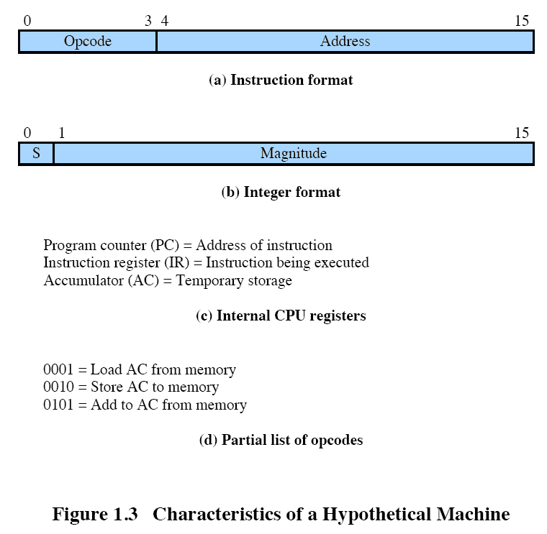

Slide 19
Interrupts
Mechanism by which other modules may interrupt the normal sequencing of the processor
Provided to improve processor utilization
Most I/O devices are slower than the processor
Processor must pause to wait for device
Wasteful use of the processor

Slide 20
Table 1.1 Classes of Interrupts
Program Generated by some condition that occurs as a result of an instruction execution, such as arithmetic overflow, division by zero, attempt to execute an illegal machine instruction, and reference outside a user's allowed memory space.
Timer Generated by a timer within the processor. This allows the operating system to perform certain functions on a regular basis.
I/O Generated by an I/O controller, to signal normal completion of an operation or to signal a variety of error conditions.
Hardware Generated by a failure, such as power failure or memory
failure parity error.

Slide 21
Figure 1.5a Flow of Control Without Interrupts

Slide 22
Figure 1.5b
Short I/O Wait
X = interrupt occurs during course of execution of user program

Slide 23
Figure 1.5c
Long I/O Wait

Slide 30
Multiple Interrupts
An interrupt occurs while another interrupt is being processed
e.g. receiving data from a communications line and printing results at the same time
Two approaches:
Disable interrupts while an interrupt is being processed
Use a priority scheme

Slide 33
Memory Hierarchy
Design constraints on a computer’s memory
How much?
How fast?
How expensive?
If the capacity is there, applications will likely be developed to use it
Memory must be able to keep up with the processor
Cost of memory must be reasonable in relationship to the other components

Slide 34
Memory Relationships
Faster access time = greater cost per bit
Greater capacity = smaller cost per bit
Greater capacity = slower access speed

Slide 35
The Memory Hierarchy
Going down the hierarchy:
Decreasing cost per bit
Increasing capacity
Increasing access time
Decreasing frequency of access to the memory by the processor

Slide 37
Principle of Locality
Memory references by the processor tend to cluster
Data is organized so that the percentage of accesses to each successively lower level is substantially less than that of the level above
Can be applied across more than two levels of memory

Slide 38
Secondary Memory
Also referred to as auxiliary memory
External
Nonvolatile
Used to store program and data files

Slide 39
Cache Memory
Invisible to the OS
Interacts with other memory management hardware
Processor must access memory at least once per instruction cycle
Processor execution is limited by memory cycle time
Exploit the principle of locality with a small, fast memory

Slide 43
Cache Design
Main categories are:
Cache size
Block size
Mapping function
Write policy
Number of cache levels
Replacement algorithm

Slide 44
Cache and Block Size
Cache Size
Small caches have significant impact on performance
Block Size
The unit of data exchanged between cache and main memory

Slide 45
Mapping Function
Determines which cache location the block will occupy
Two constraints affect design:
When one block is read in, another may have to be replaced
The more flexible the mapping function, the more complex is the circuitry required to search the cache

Slide 46
Replacement Algorithm
Least Recently Used (LRU) Algorithm
Effective strategy is to replace a block that has been in the cache the longest with no references to it
Hardware mechanisms are needed to identify the least recently used block
Chooses which block to replace when a new block is to be loaded into the cache

Slide 47
Write Policy
Dictates when the memory write operation takes place
Can occur every time the block is updated
Can occur when the block is replaced
Minimizes write operations
Leaves main memory in an obsolete state

Slide 48
I/O Techniques
When the processor encounters an instruction relating to I/O, it executes that instruction by issuing a command to the appropriate I/O module
Three techniques are possible for I/O operations:
Programmed I/O
Interrupt-Driven I/O
Direct Memory Access (DMA)

Slide 49
Programmed I/O
The I/O module performs the requested action then sets the appropriate bits in the I/O status register
The processor periodically checks the status of the I/O module until it determines the instruction is complete
With programmed I/O the performance level of the entire system is severely degraded

Slide 50
Interrupt-Driven I/O
Processor issues an I/O command to a module and then goes on to do some other useful work
The processor executes the data transfer and then resumes its former processing
The I/O module will then interrupt the processor to request service when it is ready to exchange data with the processor
More efficient than Programmed I/O but still requires active intervention of the processor to transfer data between memory and an I/O module

Slide 51
Interrupt-Driven I/O Drawbacks
Transfer rate is limited by the speed with which the processor can test and service a device
The processor is tied up in managing an I/O transfer
A number of instructions must be executed for each I/O transfer

Slide 52
Direct Memory Access (DMA)
Performed by a separate module on the system bus or incorporated into an I/O module
When the processor wishes to read or write data it issues a command to the DMA module containing:
Whether a read or write is requested
The address of the I/O device involved
The starting location in memory to read/write
The number of words to be read/written

Slide 53
Direct Memory Access
Transfers the entire block of data directly to and from memory without going through the processor
Processor is involved only at the beginning and end of the transfer
Processor executes more slowly during a transfer when processor access to the bus is required
More efficient than interrupt-driven or programmed I/O

Slide 54
Symmetric Multiprocessors (SMP)
A stand-alone computer system with the following characteristics:
Two or more similar processors of comparable capability
Processors share the same main memory and are interconnected by a bus or other internal connection scheme
Processors share access to I/O devices
All processors can perform the same functions
The system is controlled by an integrated operating system that provides interaction between processors and their programs at the job, task, file, and data element levels

Slide 55
SMP Advantages
Performance
A system with multiple processors will yield greater performance if work can be done in parallel
Availability
The failure of a single processor does not halt the machine
Incremental Growth
An additional processor can be added to enhance performance
Scaling
Vendors can offer a range of products with different price and performance characteristics

Slide 57
Multicore Computer
Also known as a chip multiprocessor
Combines two or more processors (cores) on a single piece of silicon (die)
Each core consists of all of the components of an independent processor
In addition, multicore chips also include L2 cache and in some cases L3 cache

Slide 58
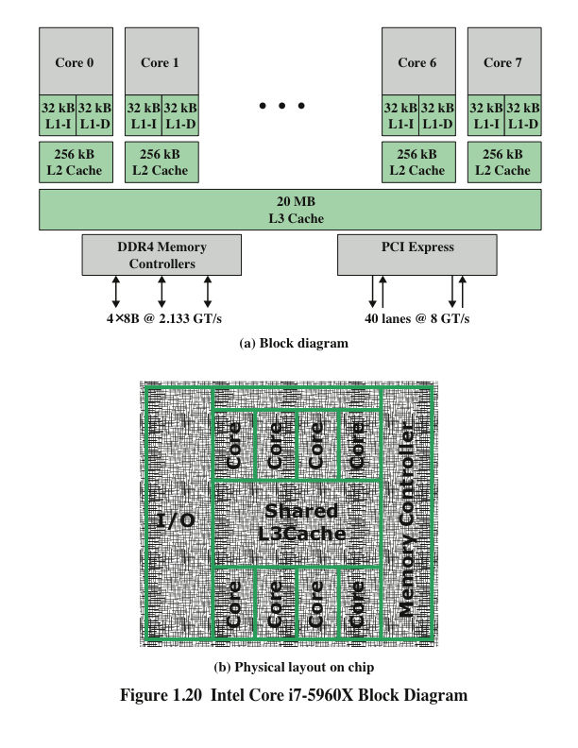

Slide 59
Summary
Basic Elements
Evolution of the microprocessor
Instruction execution
Interrupts
Interrupts and the instruction cycle
Interrupt processing
Multiple interrupts
The memory hierarchy
Cache memory
Motivation
Cache principles
Cache design
Direct memory access
Multiprocessor and multicore organization
Symmetric multiprocessors
Multicore computers
Notes:
Summary of Chapter 1.

