Slide 1

Systems Analysis and Design
Chapter 2: Software development life cycle
Slides in this presentation contain hyperlinks. JAWS users should be able to get a list of links by using INSERT+F7
Notes:
If this PowerPoint presentation contains mathematical equations, you may need to check that your computer has the following installed:
1) MathType Plugin
2) Math Player (free versions available)
3) NVDA Reader (free versions available)

Slide 2
Learning Objectives
1.1 Choose the right SDLC
1.2 Describe the RUP methodologies
1.3 Describe the Agile methodologies
1.4 The great methodologies debate

Slide 3

68% of all Software Projects fail – ZDNET 1.1 Choose the right SDLC
McKinsey – 17% of large IT Projects fail miserably
Geneca - Large IT Projects run 45% over budget, 7% over time, delivering 56% less value
75% Project participants lack confidence in their project

Slide 4

Software Projects fail from around 5 to 47 factors – Alexandria University 1.1 Choose the right SDLC
Organizational Structure
Badly Defined Requirements
Unrealistic or Unarticulated goals
Inability to handle project complexity
Sloppy development practices
Inaccurate estimates

Slide 5

Project failures can be controlled 1.1 Choose the right SDLC
Delivery dates impact project delivery
Projects estimations can be made as close as possible
Risks can be re-assessed, controlled and managed
Staff can be awarded for long work hours

Slide 6
Unified Software Development Process 1.1 Choose the right SDLC
Rational Unified Process
Agile Unified Process
Basic Unified Process
Enterprise Unified Process
Essential Unified Process
Open Unified Process
Oracle Unified Method
RUP-Systems Engineering

Slide 7
Agile methodology 1.1 Choose the right SDLC
Kanban
Scrum
XP
Feature-driven development (FDD)
Dynamic Systems Development Method (DSDM)
Crystal
Lean

Slide 8
What is Rational Unified Process ? 1.2 Describe the RUP methodologies
A software engineering process based on best practices in modern software development
A disciplined approach to assigning and managing tasks and responsibilities in a development organization
Focus on high quality software that meets the needs of its end users within a predictable schedule and budget
A process framework that can be tailored to specific organization or project needs
RUP is a methodology for delivering projects in a maximum performance manner
?
Notes:
The Rational Unified Process™ (RUP) is a Web-enabled software engineering process that enhances team productivity and delivers software best practices to all team members. This e-coach makes process practical by providing prescriptive guidelines, templates and examples for all critical e-development activities. RUP is a customizable framework, which can easily be adapted to work the way you work. It is tightly integrated with Rational tools, allowing development teams to gain the full benefits of the Unified Modeling Language™ (UML), software automation, and other industry best practices. TOOL MENTORS:Oddly enough, they’re all Rational software products...

Slide 9

RUP uses an integration of approaches & initiatives 1.2 Describe the RUP methodologies
Team-Unifying Approach
The RUP unifies a software team by providing a common view of the development process and a shared vision of a common goal
Increased Team Productivity
knowledge base of all processes
view of how to develop software
modeling language
Rational provides many tools
Tool
Specialist
Architect
Release
Engineer
Project
Management
Analyst
Designer /
Developer
Tester
Notes:
The RUP offers:
A Team-Unifying Approach
The Rational Unified Process unifies the entire software development team and enhances team communication by providing each team member with one knowledge base, one modeling language and one view of how to develop software.
Everybody is involved; their roles and activities are well documented and are publishable over an intranet…
Re-iterate the HHGTTG and the Tower of Babel...

Slide 10
Key Aspects of RUP 1.2 Describe the RUP methodologies
Risk-driven process
Risk management integrated into the development process
Iterations are planned based on high priority risks
Use-Case driven development
Use cases express requirements on the system’s functionality and model the business as context for the system
Use cases are defined for the intended system and are used as the basis of the entire development process
Architecture-centric design
Architecture is the primary artefact to conceptualize, construct, manage, and evolve the system
Consists of multiple, coordinated views (or models) of the architecture
Notes:
The RUP offers:
A Team-Unifying Approach
The Rational Unified Process unifies the entire software development team and enhances team communication by providing each team member with one knowledge base, one modeling language and one view of how to develop software.
Everybody is involved; their roles and activities are well documented and are publishable over an intranet…
Re-iterate the HHGTTG and the Tower of Babel...

Slide 11
Rational Unified Process – Snapshot 1.2 Describe the RUP methodologies
time
Phases
Process Workflows
Inception
Elaboration
Construction
Transition
Business Modeling
Requirements
content
Analysis & Design
Implementation
Test
Deployment
Supporting Workflows
Configuration & Change Mgmt
Project Management
Environment
Preliminary Iteration(s)
Iter. #1
Iter. #2
Iter. #n
Iter. #n+1
Iter. #n+2
Iter. #m
Iter. #m+1
Iterations
Notes:
Inception Defines the scope of the project. A business plan is often created to determine whether resources should be committed or not. The model is 20% complete.
Elaboration Plan project, specify features, baseline architecture. Requirements are firmed up, we’re now 80% complete. A detailed cost/resource estimation can be drawn up.
Construction Build the product. Several iterations.
Transition Move the product into and end user environment. Training, installation and support.
An iteration is a distinct sequence of activities based on an established plan and evaluation criteria, resulting in an executable release (internal or external)
A workflow shows all the activities you might go through to produce a particular set of artifacts – more later.

Slide 12
Dynamic Elements Phases and Milestones 1.2 Describe the RUP methodologies
Initial Operational Capability
Major Milestones
Lifecycle Objectives
Lifecycle Architecture
Product Release
time
Inception
Elaboration
Construction
Transition
Define scope of project
Plan project, specify features, baseline architecture
Build product
Transition product to end user community
…
…
…
…

Slide 13
Inception Phase 1.2 Describe the RUP methodologies
Objective:
Understand what to build.
A vision document:
Optional business model
An initial project glossary
Identify key system functionality.
A initial use-case model (10% -20%) complete.
Determine at least one possible solution.
One or several prototypes.
Understand the costs, schedule, and risks associated with the project.
An initial risk assessment.
Business case
Decide what process to follow and what tools to use.
A project plan
Inception is the first of four RUP phase its all about getting familiar with Project goal and Scope .this phase help you determine the project feasibility , what customer want and how will you get into more resource consumable phase.

Slide 14
Elaboration phase 1.2 Describe the RUP methodologies
Objectives:
Elaboration is the second of the four phases in the RUP approach. The goal of the Elaboration phase is to define and baseline the architecture of the system in order to provide a stable basis for the bulk of the design and implementation effort in the Construction phase. The architecture evolves out of a consideration of the most significant requirements (those that have a great impact on the architecture of the system) and an assessment of risks.
Deeper Requirement understanding
At least 80% complete use-case model
Supplementary requirements capturing
non functional requirements
None Use case requirement
Architect consideration.
A Software Architecture Description.
An executable architectural prototype.
Risk mitigation and Accurate Cost/Scapulae
A revised risk list and a revised business case.
Development Case refinement
A development plan for the overall project
coarse-grained project plan
showing iterations
evaluation criteria for each iteration.
Notes:
The purpose of the elaboration phase is to analyze the problem domain, establish a sound architectural foundation,
develop the project plan, and eliminate the highest risk elements of the project. To accomplish these objectives, you must have the “mile wide and inch deep” view of the system. Architectural decisions have to be made with an understanding of the whole system: its scope, major functionality and nonfunctional requirements such as performance requirements.
It is easy to argue that the elaboration phase is the most critical of the four phases. At the end of this phase, the hard “engineering” is considered complete and the project undergoes its most important day of reckoning: the decision on whether or not to commit to the construction and transition phases. For most projects, this also corresponds to the transition from a mobile, light and nimble, low-risk operation to a high-cost, high-risk operation with substantial inertia. While the process must always accommodate changes, the elaboration phase activities ensure that the architecture, requirements and plans are stable enough, and the risks are sufficiently mitigated, so you can predictably determine the cost and schedule for the completion of the development. Conceptually, this level of fidelity would correspond to the level necessary for an organization to commit to a fixed-price construction phase.

Slide 15
Construction Phase 1.2 Describe the RUP methodologies
Construction is really about cost-efficient development of a complete product—an operational version of your system—that can be deployed in the user community
Objectives:
Minimize development costs and achieve some degree of parallelism
Iteratively develop a complete product that is ready to transition to its user community
The software product integrated on the adequate platforms.
The user manuals.
A description of the current release.
Notes:
During the construction phase, all remaining components and application features are developed and integrated into
the product, and all features are thoroughly tested. The construction phase is, in one sense, a manufacturing process
where emphasis is placed on managing resources and controlling operations to optimize costs, schedules, and
quality. In this sense, the management mindset undergoes a transition from the development of intellectual property
during inception and elaboration, to the development of deployable products during construction and transition.
Many projects are large enough that parallel construction increments can be spawned. These parallel activities can
significantly accelerate the availability of deployable releases; they can also increase the complexity of resource
management and workflow synchronization. A robust architecture and an understandable plan are highly correlated.
In other words, one of the critical qualities of the architecture is its ease of construction. This is one reason why the
balanced development of the architecture and the plan is stressed during the elaboration phase. The outcome of the
construction phase is a product ready to put in hands of its end-users.

Slide 16
Transition Phase 1.2 Describe the RUP methodologies
The purpose of the transition phase is to transition the software product to the user community. Once the product has
been given to the end user, issues usually arise that require you to develop new releases, correct some problems, or
finish the features that were postponed.
Objectives:
“beta testing” to validate the new system against user expectations
parallel operation with a legacy system that it is replacing
conversion of operational databases
training of users and maintainers
roll-out the product to the marketing, distribution, and sales teams
Improve future project performance through lessons learned
Notes:
The purpose of the transition phase is to transition the software product to the user community. Once the product has been given to the end user, issues usually arise that require you to develop new releases, correct some problems, or finish the features that were postponed.
The transition phase is entered when a baseline is mature enough to be deployed in the end-user domain.
This typically requires that some usable subset of the system has been completed to an acceptable level of quality
and that user documentation is available so that the transition to the user will provide positive results for all parties.
The transition phase focuses on the activities required to place the software into the hands of the users. Typically,
this phase includes several iterations, including beta releases, general availability releases, as well as bug-fix and
enhancement releases. Considerable effort is expended in developing user-oriented documentation, training users,
supporting users in their initial product use, and reacting to user feedback. At this point in the lifecycle, however,
user feedback should be confined primarily to product tuning, configuring, installation, and usability issues.

Slide 17
RUP Disciplines 1.2 Describe the RUP methodologies
In RUP, the process is described at two levels: the discipline level and the workflow detail level. A Workflow is a grouping of activities that are often performed "together" to produce a specific result. In particular, workflow details describe groups of activities performed together in a discipline.
The workflows for the RUP disciplines and workflow details are described using Unified Modeling Language (UML) activity diagrams. Discipline diagrams contain the workflow details of the discipline.
Notes:
all process elements—roles, activities, artifacts, and the associated concepts, guidelines, and templates—are grouped into logical containers called Disciplines. There are nine disciplines in the standard RUP product
Each discipline may have one or more Workflow detail inside itself . Which are related to the goal and content
which that discipline determine.
Within a workflow detail, activities may be performed in parallel, and each activity may affect more than one artifact , so each discipline may define change on more than one artifact in project domain

Slide 18
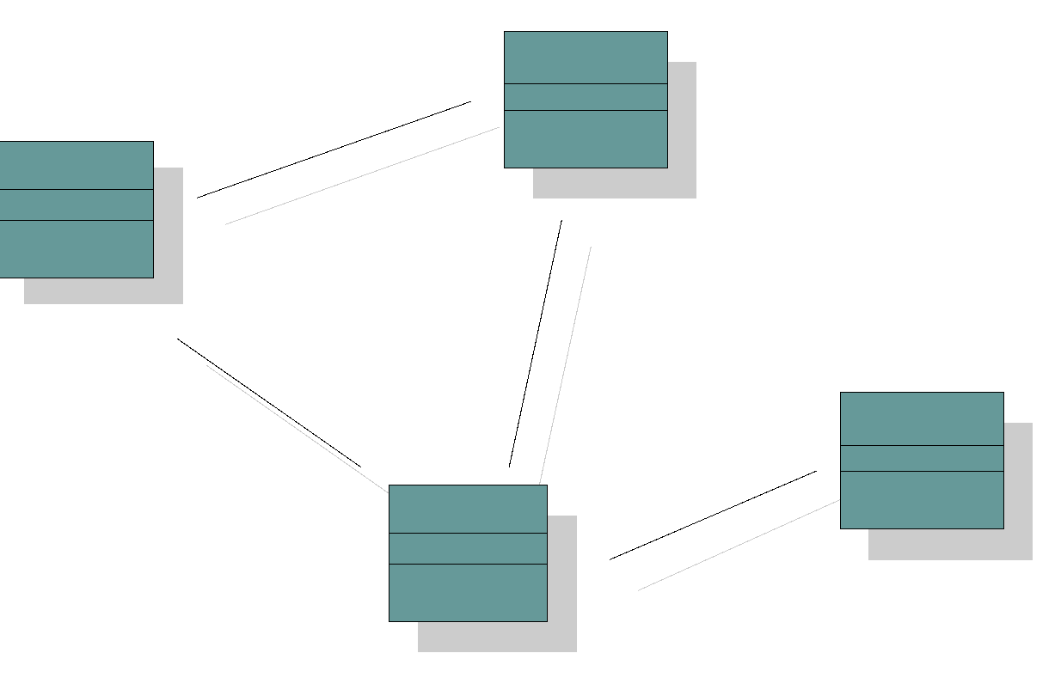
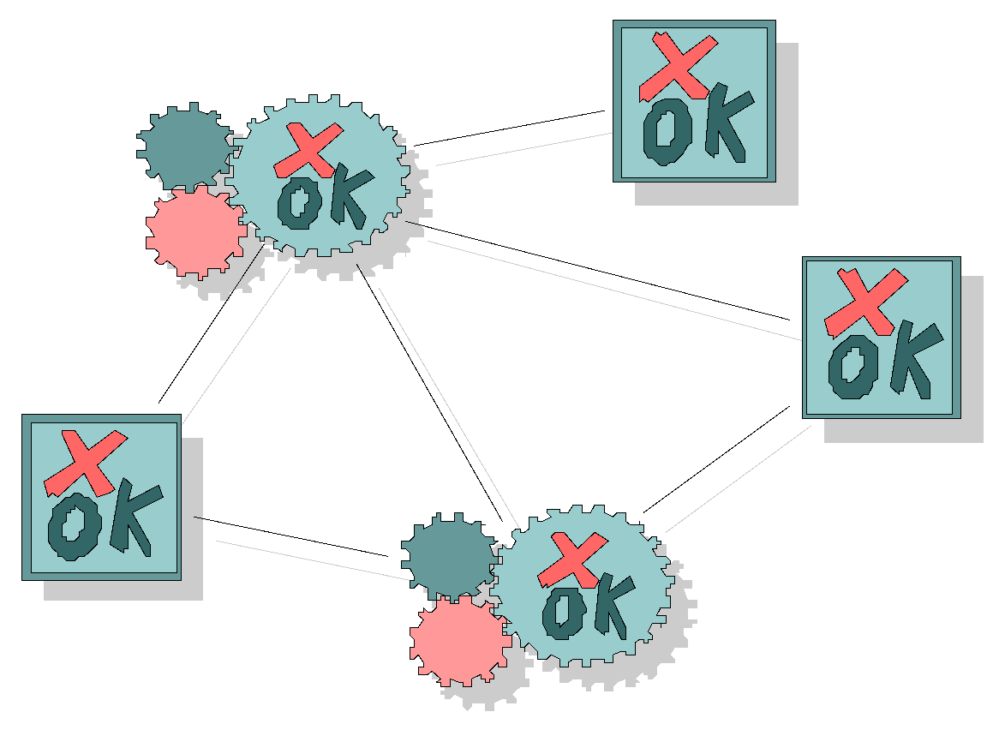
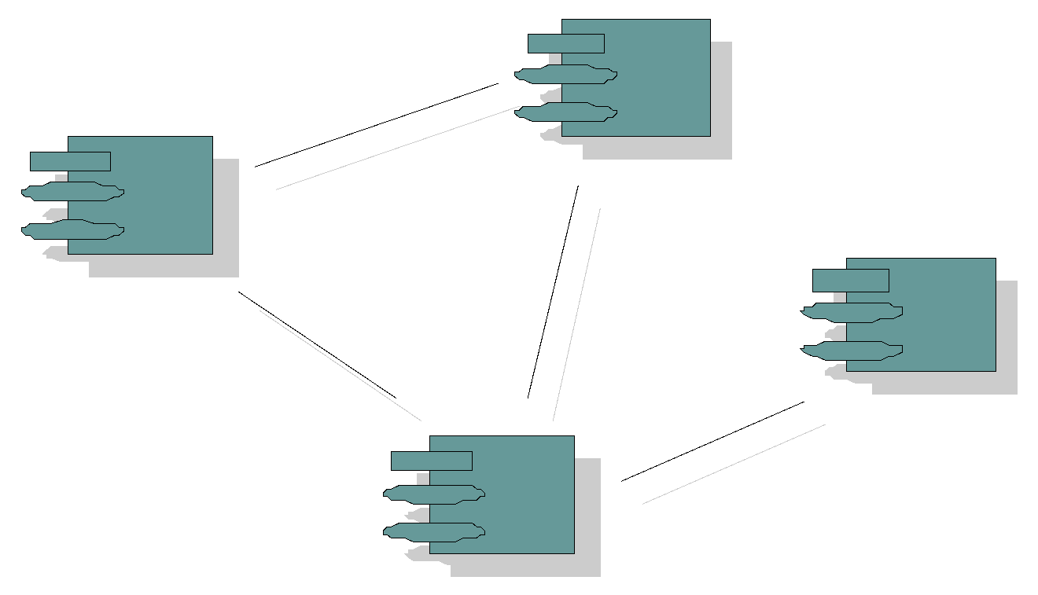
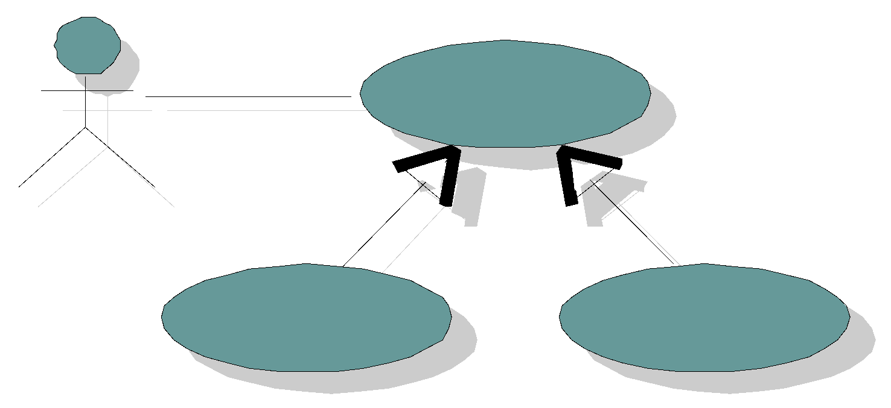


Models and Workflows
Build upon
Each major workflow describes how to create and maintain a particular model.
Business Modeling
Business Model
Requirements Workflow
Use-Case Model
realized by
verified by
Analysis Design Workflow
Design Model
Implementation Workflow
implemented by
Implementation Model
Test Workflow
Used by
Deployment Workflows
Test Model
Deployment model
Notes:
Here this illustration shows the goal and content of each Discipline.
You can see how workflows shape models and artifact during project life cycle. The first involved workflow is Business modeling , which most of it happens in inception ,maximum peak, and elaboration phases.
Usually business modeling start fading in middle of inception phase and end at middle of elaboration.
Usually requirement workflow and business modeling workflows are two parallel workflows at the start of project lifecycle requirement start a bit after business modeling. and both of them lose their peak maximum at the end of elaboration. but consider that requirement workflows have bigger bulb at construction phase than business modeling workflows.
Analyze and design mostly happen in elaboration construction phase , it bulb will fade in middle end of transition phase and start of inception phase.
Implementation workflows bulb are in peak during construction and elaboration it will fade by starting of transition and is almost off during inception phase.
Test workflow is always in twitching , but most of it happens at the end of construction which project will undergo all other major tests like Acceptance and wide QA test.

Slide 19
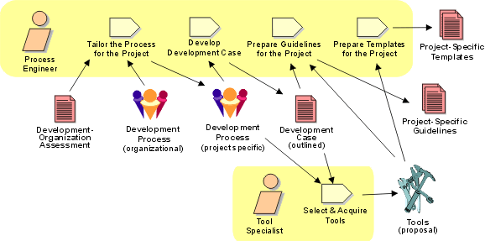
Workflow Detail: Prepare Environment for Project

Slide 20
Bringing It All Together...
In an iteration, you walk through all workflows
Phases
Process Workflows
Inception
Elaboration
Construction
Transition
Business Modeling
Requirements
Analysis & Design
Implementation
Test
Deployment
Supporting Workflows
Configuration & Change Mgmt
Project Management
Environment
Preliminary Iteration(s)
Iter. #1
Iter. #2
Iter. #n
Iter. #n+1
Iter. #n+2
Iter. #m
Iter. #m+1
Iterations

Slide 21
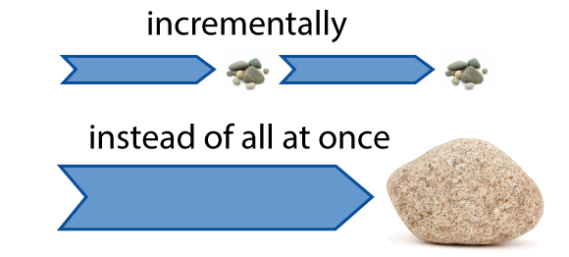
What is Agile? 1.3 Describe the Agile methodologies
Agile is a time boxed, iterative approach to software delivery that builds software incrementally from the start of the project, instead of trying to deliver it all at once near the end.

Slide 22
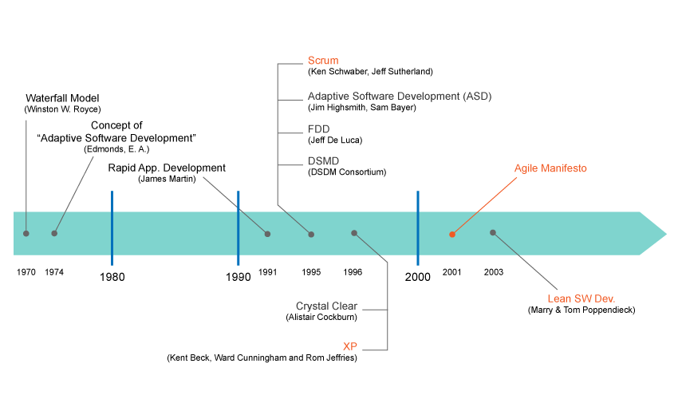
Agile History Timeline 1.3 Describe the Agile methodologies
On February of 2001, seventeen people met to talk about Agile. What emerged was the Agile 'Software Development' Manifesto
Feature Driven Development (Agile Modeling)
Dynamic Systems Development Method (Agile delivery Framework)
Hirotaka Takeuchi 1986
1993 Jeff Sutherland, Jeff McKenna, John Scumniotales

Slide 23
What is Agile? 1.3 Describe the Agile methodologies
Rapid
_{AGILE} Quality-driven
Adaptable
Cooperative _{Iterative}
Not a process, it's a philosophy or set of values

Slide 24
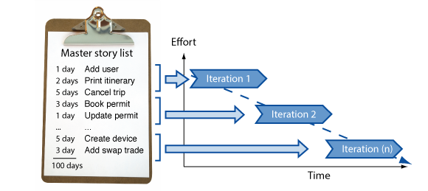
What is Agile? 1.3 Describe the Agile methodologies
It works by breaking projects down into little bits of user functionality called user stories, prioritizing them, and then continuously delivering them in short two week cycles called sprints.

Slide 25
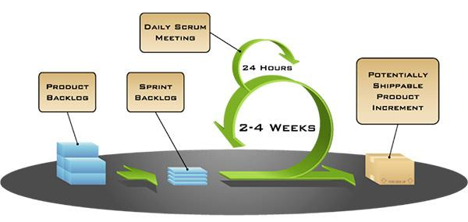
Modern Agile 1.3 Describe the Agile methodologies
The industry has become overloaded with techniques, processes, methodologies and tools that have fallen under the Agile umbrella
Modern Agile aims to move Agile to the next level, not by adding complexity, but by simplifying— stressing only adherence to four principles

Slide 26
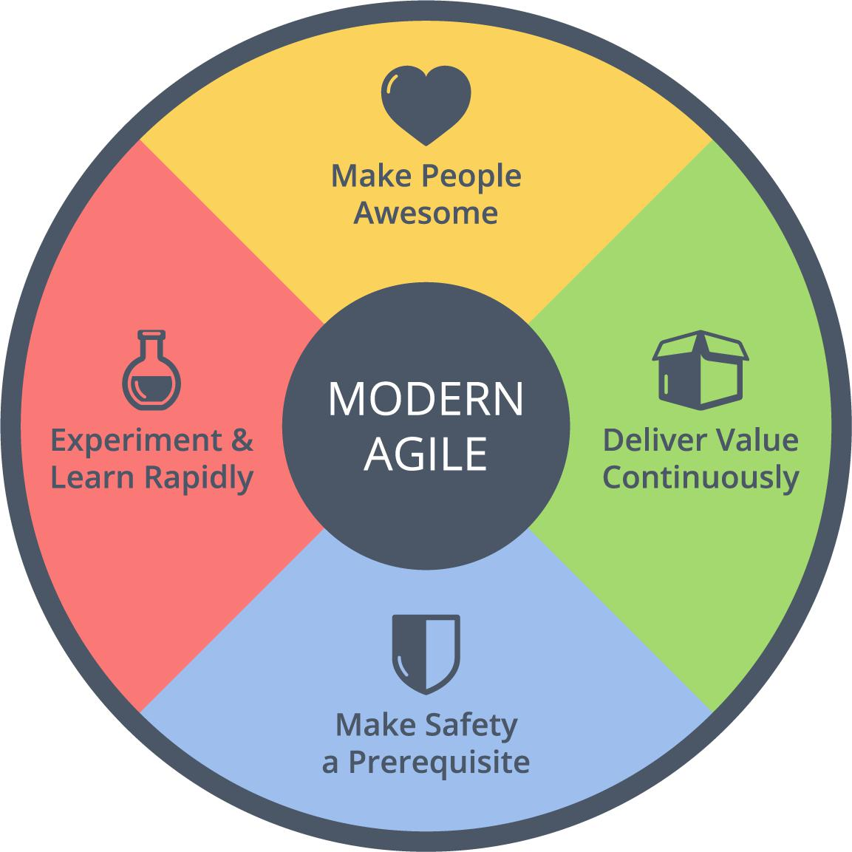
Modern Agile guiding principles 1.3 Describe the Agile methodologies
Experiment & Learn
Rapidly
Is a guiding principle of Modern Agile because it protects us from wasting time and helps us discover success faster
“Make People Awesome”
If you make customers awesome, they tend to be natural promoters of your products or services
Make Safety a Prerequisite
Means establishing safety before engaging in potentially hazardous work
Deliver Value Continuously
Anything valuable that hasn’t been delivered isn’t helping anyone. How might we deliver the right outcomes faster

Slide 27

Agile Umbrella 1.4 The great methodologies debate
More Prescriptive
more rules to follow
RUP (120+)
RUP has over 30 roles, over 20 activities, and over 70 artifacts
Agile
XP (13)
Scrum (9)
Scrum
Crystal
Kanban
XP
DSDM
Kanban (3)
FDD
RUP
And few more…
Do Whatever!! (0)
More Adaptive
fewer rules to follow
* Check wikipedia for list of all Agile methods

Slide 28
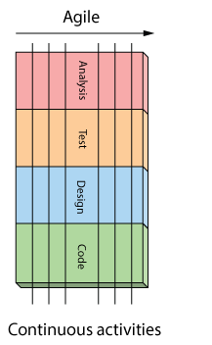
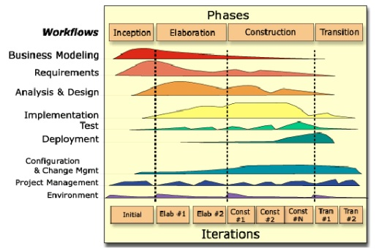
How is Agile different? 1.4 The great methodologies debate
The RUP has determined a project life-cycle consisting of four phases. These phases can break down into small iterations if needed
You are never done A&D, coding and testing on Agile project. So long as there are features to build, these activities continue for the duration of the project

Slide 29
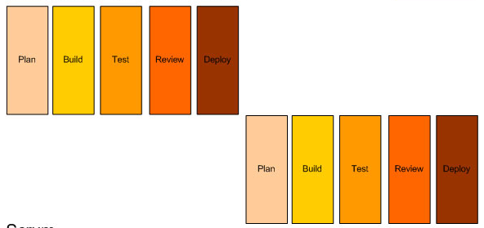
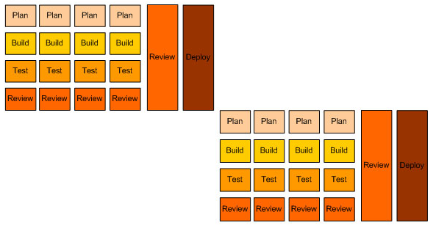
RUP vs Agile: another view
RUP model
Agile model

Slide 30




































Large Companies that use Agile…and lots of local guys, too

Slide 31
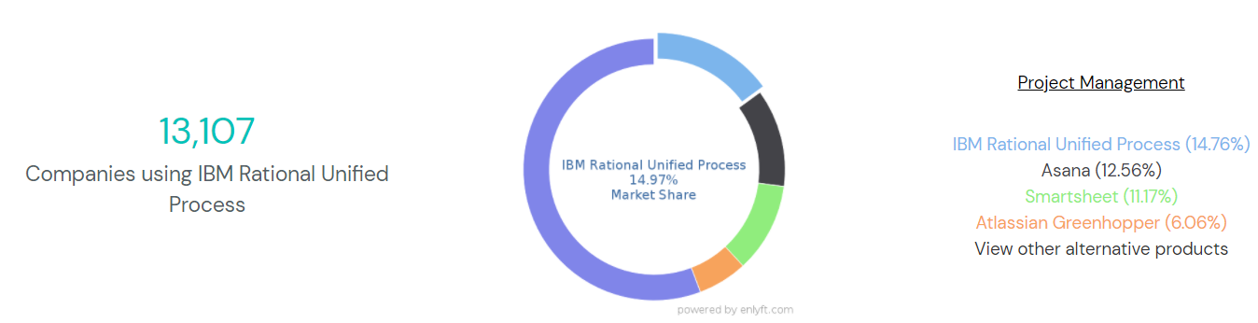
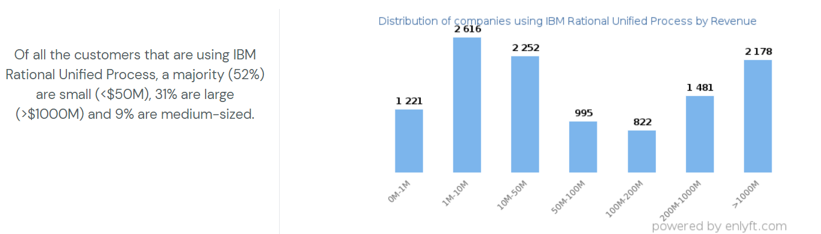

Slide 32
Main characteristics comparison: RUP vs Agile 1.4 The great methodologies debate
RUP:
Heavyweight, Is a Framework
Use-case driven from inception to deployment, small team size
Architecture-centric, model visually, well-documented, lots of artifact
Iterative and incremental, where large projects are divided into smaller projects
Long-term detailed planning
Agile:
Lightweight, Like a Philosophy
Small cross-functional teams are used
Daily status meetings are held, less artifact can be better
Short timeframe increments for each change, short-term planning
A working project is completed at end of each iteration and demonstrated to stakeholders

Slide 33
Main problems comparison: RUP vs Agile 1.4 The great methodologies debate
RUP:
It mostly relies on the ability of experts and professionals to assign the activities to individuals
It is a rather complex method which makes its implementation challenging, particularly for smaller businesses, teams or projects
A long time is spent doing requirements or design work before programming starts
Too many roles, artifacts required
High cost in managing, following RUP project
Tool-set are useful but expensive
Agile:
It can be difficult to keep the interest of customers / users who are involved in the process.
Team members may be unsuited to the intense involvement that characterizes agile methods.
Prioritizing changes can be difficult where there are multiple stakeholders.
Maintaining simplicity requires extra work.
Contracts may be a problem as with other approaches to iterative development.
Because of their focus on small, tightly-integrated teams, there are problems in scaling agile methods to large systems.
Less emphasis on documentation - harder to maintain when you get a new team for maintenance

Slide 34
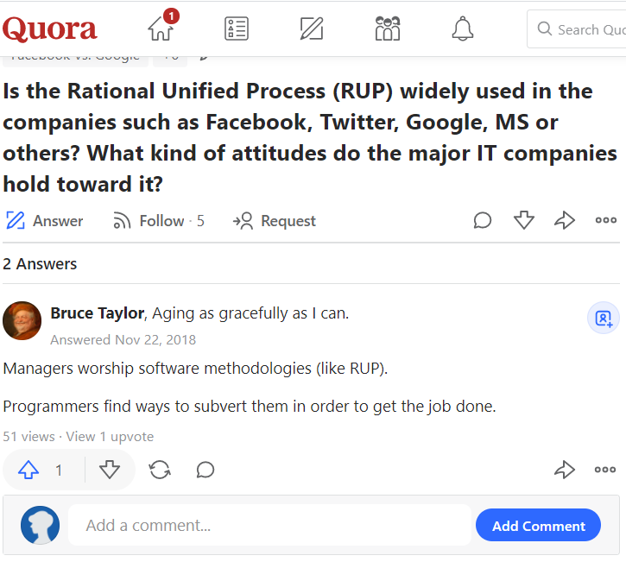
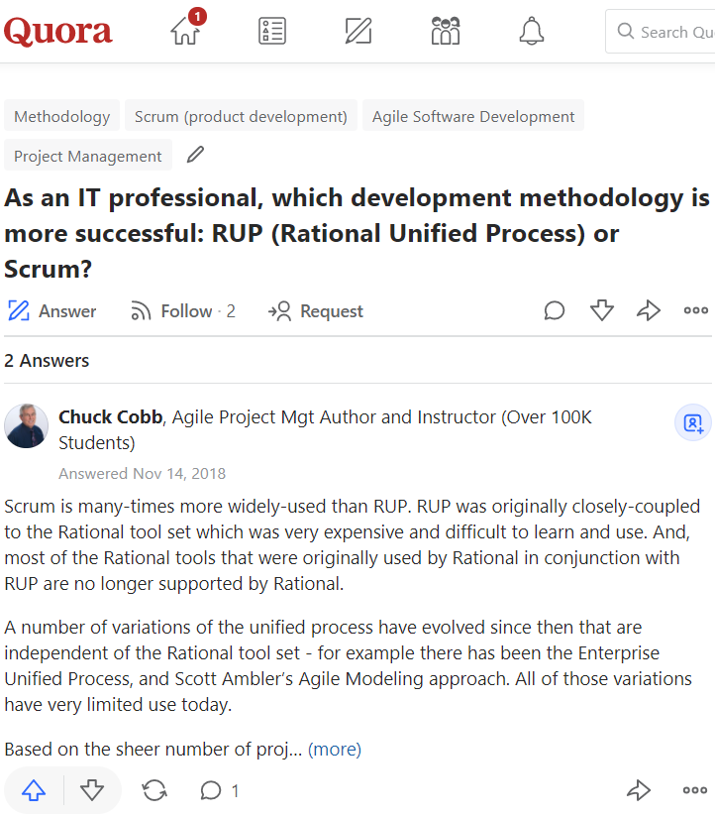
Experts review (1) 1.4 The great methodologies debate

Slide 35
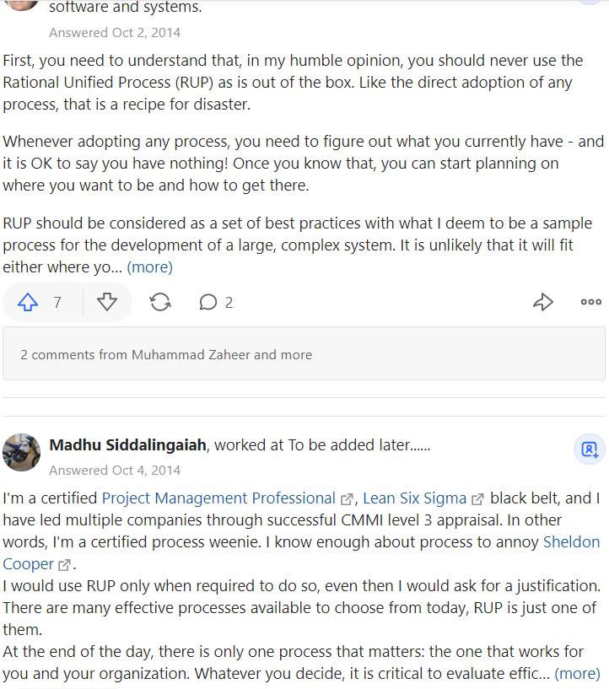
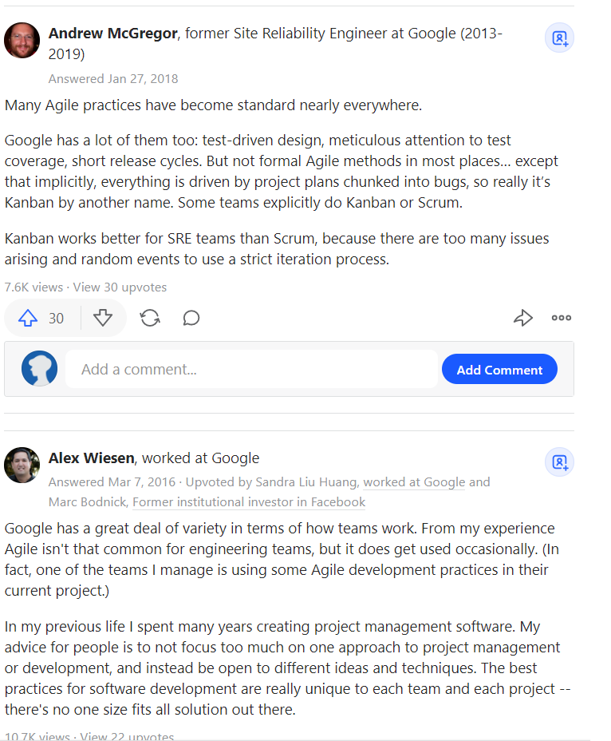
Experts review (2) 1.4 The great methodologies debate

Slide 36
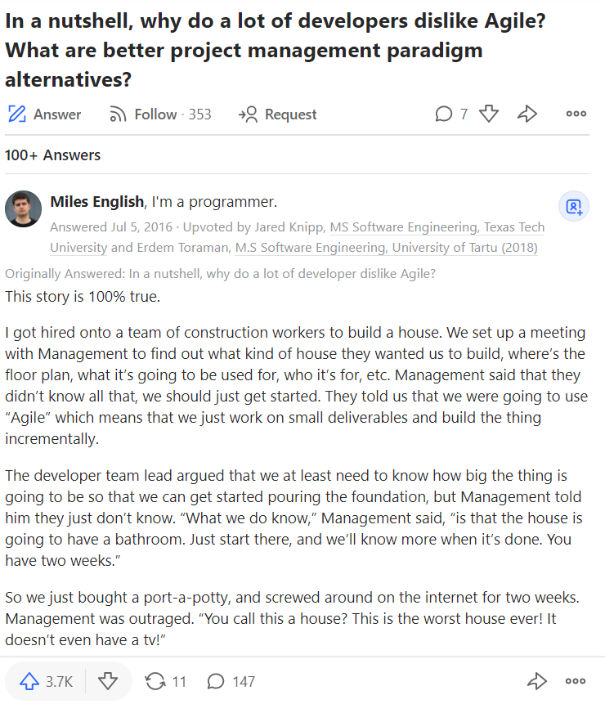
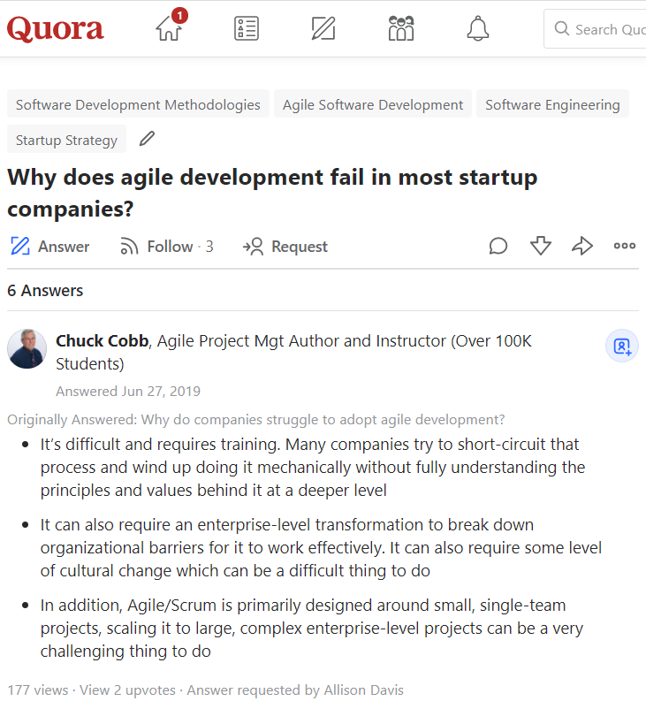
Experts review (3) 1.4 The great methodologies debate

Slide 37
Conclusion
RUP will be main methodology in this course due to the following reasons:
It is a framework
Well documented, having templates, tools, well explanation
Model visually
Easy to learn, do not required much experience as Agile
Good method to learn OOP, OOD
Can be customized into small version with less artifacts

