Slide 1

Systems Analysis and Design
Chapter 3: Determining software requirements
Slides in this presentation contain hyperlinks. JAWS users should be able to get a list of links by using INSERT+F7
Notes:
If this PowerPoint presentation contains mathematical equations, you may need to check that your computer has the following installed:
1) MathType Plugin
2) Math Player (free versions available)
3) NVDA Reader (free versions available)

Slide 2
Learning Objectives
3.1 Describe options for designing and conducting interviews and developing a plan for conducting an interview to determine system requirements
3.2 Explain the advantages and pitfalls of observing workers and analyzing business documents to determine system requirements
3.3 Explain how computing can provide support for requirements determination
3.4 Participate in and help plan a Joint Application Design session
3.5 Use prototyping during requirements determination
3.6 Describe contemporary approaches to requirements determination
3.7 Understand how requirements determination techniques determination techniques apply to the development of electronic commerce applications

Slide 3
Introduction
Analysis has two subphases:
Requirements determination
Requirements structuring

Slide 4
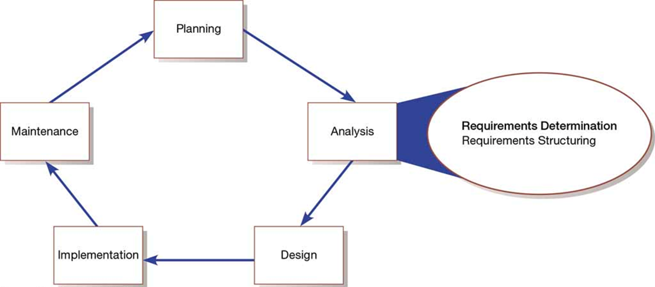
System Development Life Cycle with Analysis Phase Highlighted

Slide 5
The Process of Determining Requirements
Characteristics of a good systems analyst:
Impertinence – question everything
Impartiality – consider all issues to find the best solution
Relax constraints – assume anything is possible and eliminate the infeasible
Attention to detail – every fact must fit with every other fact
Reframing – challenge yourself to look at the organization in new ways

Slide 6
Organizational Components to Understand
Systems analysts need to understand:
Business objectives that drive what and how work is done
Information people need to do their jobs
The data (definition, volume, size) handled in support of jobs
Data transformation and storage (when, how, by whom)
Data handling dependencies and sequences
Data handling and processing rules
Policies and guidelines that describe the nature of the business and market and the environment it operates in
Key events that affect data values and when they occur

Slide 7
Deliverables for Requirements Determination
Deliverables for Requirements Determination
Information collected from conversations with or observations of users: interview transcripts, notes from observation, meeting minutes
Existing written information business mission and strategy statements, sample business forms and reports and computer displays, procedure manuals, job descriptions, training manuals, flowcharts and documentation of existing systems, consultant reports
Computer-based information: results from J A D sessions, reports of existing systems, and displays and reports from system prototypes

Slide 8
Traditional Methods of Collecting System Requirements
Traditional Methods of Collecting System Requirements
Individually interview people informed about the operation and issues of the current system and future systems needs
Interview groups of people with diverse needs to find synergies and contrasts among system requirements
Observe workers at selected times to see how data are handled and what information people need to do their jobs
Study business documents to discover reported issues, policies, rules, and directions as well as concrete examples of the use of data and information in the organization

Slide 9
Guidelines for Effective Interviewing
Guidelines for Effective Interviewing
Plan the Interview Prepare interviewee: appointment, priming questions Prepare checklist, agenda, and questions
Listen carefully and take notes (record if permitted)
Review noes within 48 hours of interview
Seek diverse views

Slide 10
Interviewing and Listening
Open-ended questions – questions in interviews that have no prespecified answers
Closed-ended questions – questions in interviews that ask those responding to choose from among a set of specified responses

Slide 11
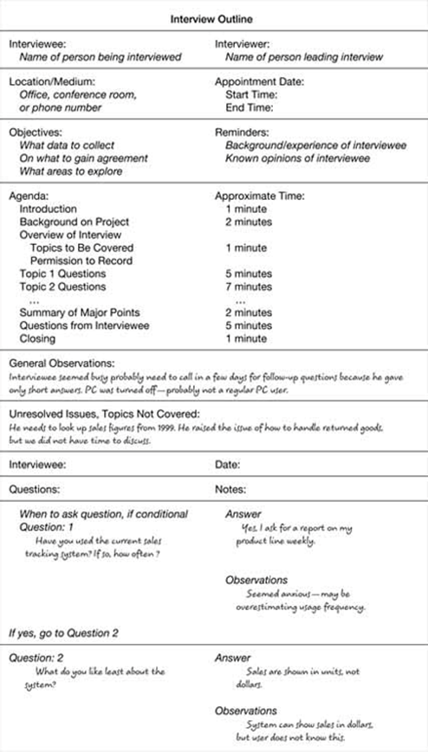
Typical Interview Guide

Slide 12
Interviewing Guidelines
Don’t phrase a question in a way that implies a right or wrong answer
Listen carefully to what is being said
Record notes within 48 hours after an interview
Don’t set expectations about the new system unless you know these will be deliverables
Seek a variety of perspectives from the interviews

Slide 13
Interviewing Groups
Drawbacks to interviewing individuals:
Reconciling contradictions in information collected
New interviews may require new questions
Not an efficient process
Group interview advantages:
More effective use of time
Allows synergy when groups can hear each other
Primary disadvantage is difficulty in scheduling with multiple people involved

Slide 14
Nominal Group Technique (N G T)
Nominal group technique (N G T) – facilitated process that supports idea generation by groups. At the beginning of the process, group members work alone to generate ideas. The ideas are then pooled under the guidance of a trained facilitator.
End result is a listing of either problems or features generated and prioritized by the group
Can be used as part of a J A D effort

Slide 15
Directly Observing Users
Direct observation of workers:
Watching users work at their jobs
Observe actual measure of how employees interact with information systems and how they do their jobs
More accurate than interview
People can change their normal behavior when they know they are being observed
Observation cannot be continuous, thus you are getting only a snapshot of how they work

Slide 16
Learning Objectives
3.1 Describe options for designing and conducting interviews and developing a plan for conducting an interview to determine system requirements
3.2 Explain the advantages and pitfalls of observing workers and analyzing business documents to determine system requirements
3.3 Explain how computing can provide support for requirements determination
3.4 Participate in and help plan a Joint Application Design session
3.5 Use prototyping during requirements determination
3.6 Describe contemporary approaches to requirements determination
3.7 Understand how requirements determination techniques determination techniques apply to the development of electronic commerce applications

Slide 17
Analyzing Procedures and Other Documents (1 of 3)
An analysis of existing documents can give you a wealth of information:
Problems with existing systems
Opportunities to meet new needs with critical information
Identify key people of current system
Values of organization who help determine priorities desired by different users
Special information processing circumstances that might not otherwise be identified
Identify left out features of current software that may lead to needed features in future systems
Identify processing rules that must be enforced

Slide 18
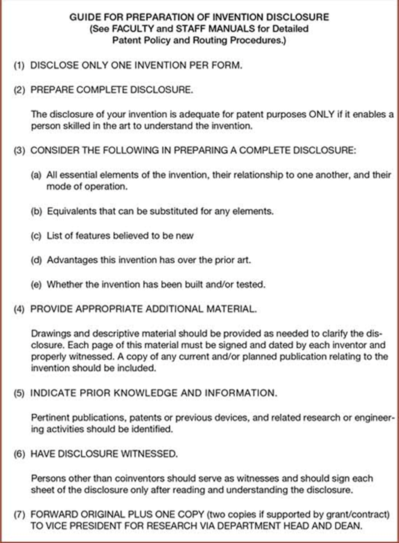
Analyzing Procedures and Other Documents (2 of 3)
A written work procedure describes how a job or task is performed
Formal system – official way a system works as described in organizational documentation.
Informal system – way a system actually works
Example of a Procedure

Slide 19
Analyzing Procedures and Other Documents (3 of 3)
Four major documents analyzed when creating a new system:
Written work procedure
A form such as the invoice form on the previous slide
Gives crucial information about the nature of the organization
A report such as the one on the next slide
Can be used to analyze to determine which data to capture
Documents used to describe the system and how it is used
Examples include flowcharts, data dictionaries, user manuals

Slide 20
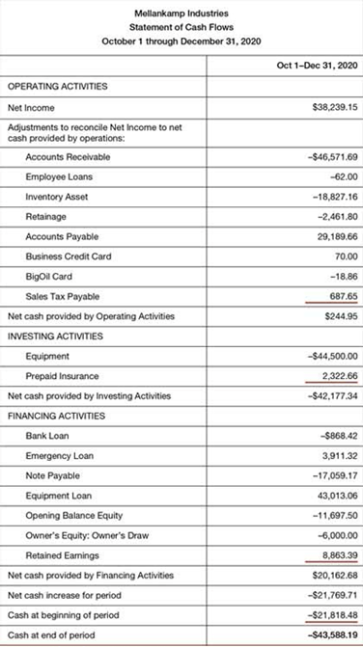
Example of a Report – As Statement of Cash Flows

Slide 21
Comparison of Observation and Document Analysis
Characteristic | Observation | Document Analysis
Information Richness | High (many channels) | Low (passive) and old
Time Required | Can be extensive | Low to moderate
Expense | Can be high | Low to moderate
Chance for Follow-Up and Probing | Good: probing and clarification questions can be asked during or after observation | Limited: probing possible only if original author is available
Confidentiality | Observee is known to interviewer; observee may change behavior when observed | Depends on nature of document; does not change simply by being read
Involvement of Subject | Interviewees may or may not be involved and committed depending on whether they know if they are being observed | None, no clear commitment
Potential Audience | Limited numbers and limited time (snapshot) of each | Potentially biased by which documents were kept or because document was not created for this purpose

Slide 22
Contemporary Methods for Collecting System Requirements
Contemporary Methods for Collecting System Requirements
Bringing session users, sponsors, analysts, and others together in a J A D session to discuss and review system requirements
Iteratively developing system prototypes that refine the understanding of system requirements in concrete terms by showing working versions of system features

Slide 23
Learning Objectives
3.1 Describe options for designing and conducting interviews and developing a plan for conducting an interview to determine system requirements
3.2 Explain the advantages and pitfalls of observing workers and analyzing business documents to determine system requirements
3.3 Explain how computing can provide support for requirements determination
3.4 Participate in and help plan a Joint Application Design session
3.5 Use prototyping during requirements determination
3.6 Describe contemporary approaches to requirements determination
3.7 Understand how requirements determination techniques determination techniques apply to the development of electronic commerce applications

Slide 24
Joint Application Design (1 of 3)
Joint Application Design (J A D) – structured process in which users, managers, and analysts work together for several days in a series of intensive meetings to specify or review system requirements
Started by I B M in the late 1970s
Primary purpose is to collect system requirements simultaneously from key people involved with the system
Enables conflict resolution

Slide 25
Joint Application Design (2 of 3)
Typical J A D participants include:
J A D session leader – organizes and runs session
Users – key users of the system
Managers – managers of the work groups
Sponsor – high level company executive
Systems analysts – member of the systems analysis team
Scribe – records notes from session
I S Staff – I S staff composed of programmers, database analysts, I S planners, and data center personnel

Slide 26
Joint Application Design (3 of 3)
J A D session leader – trained individual who plans and leads Joint Application Design sessions
Scribe – person who makes detailed notes of the happenings at a Joint Application Design session
End results of a J A D:
Documentation detailing existing system
Features of proposed system

Slide 27
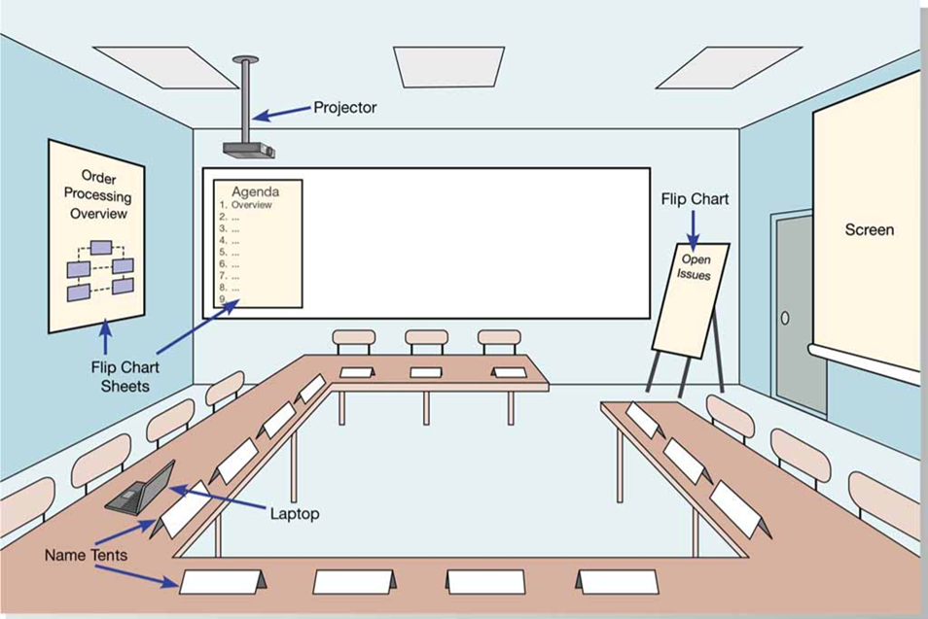
Illustration of the Typical Room Layout for a J A D
(Source: Based on Wood and Silver, 1995)

Slide 28
Learning Objectives
3.1 Describe options for designing and conducting interviews and developing a plan for conducting an interview to determine system requirements
3.2 Explain the advantages and pitfalls of observing workers and analyzing business documents to determine system requirements
3.3 Explain how computing can provide support for requirements determination
3.4 Participate in and help plan a Joint Application Design session
3.5 Use prototyping during requirements determination
3.6 Describe contemporary approaches to requirements determination
3.7 Understand how requirements determination techniques determination techniques apply to the development of electronic commerce applications

Slide 29
Using Prototyping During Requirements Determination (1 of 4)
Prototyping – iterative process of systems development in which requirements are converted to a working system that is continually revised through close collaboration between an analyst and users
Quickly converts basic requirements into working, limited version of final information system
Viewed and tested by the user
Prompts user for modifications for final system

Slide 30
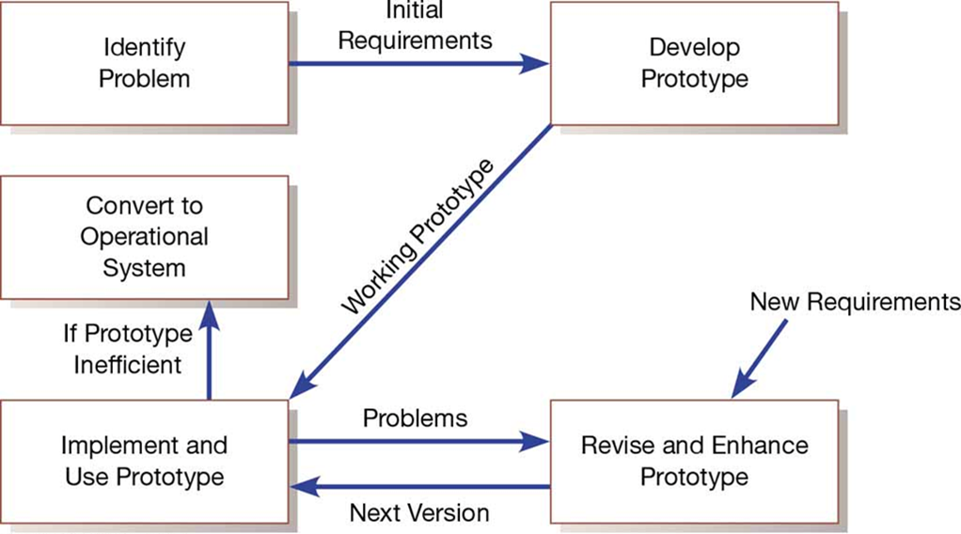
The Prototyping Methodology
(Source: Based on Naumann, J. D. & Jenkins, A. M. (1982). Prototyping: The New Paradigm for Systems Development. M I S Quarterly, 6(3), 29–44)

Slide 31
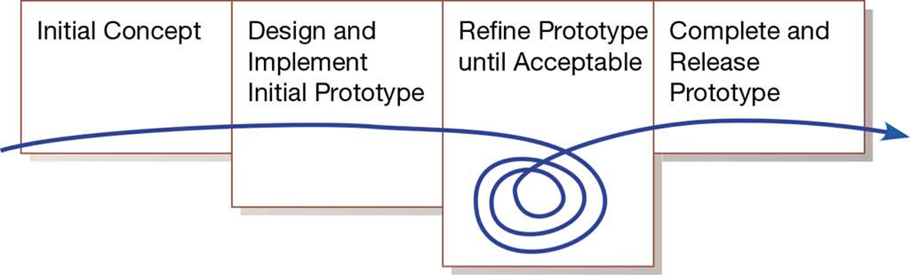
McConnell’s Evolutionary Prototyping Model

Slide 32
Using Prototyping During Requirements Determination (2 of 4)
Evolutionary Prototyping
Begin by modeling part of the target system
If successful, evolve rest of the system from those parts
Prototype becomes the actual production system
Throwaway Prototyping
Prototype is not preserved once system is built
Quickly developed as a mockup

Slide 33
Using Prototyping During Requirements Determination (3 of 4)
Prototyping is most useful when:
User requirements are not clear
Few users are involved in the system
Designs are complex and require concrete form to evaluate
All want specific system requirements as communication problems have existed in the past
Tools and data are readily available to rapidly build a prototype

Slide 34
Using Prototyping During Requirements Determination (4 of 4)
Drawbacks of prototyping as a tool include:
A tendency to avoid creating formal documentation
Difficult to adapt to other potential users
Built as standalones makes it difficult to adapt to other users
S D L C checks are often bypassed

Slide 35
Learning Objectives
3.1 Describe options for designing and conducting interviews and developing a plan for conducting an interview to determine system requirements
3.2 Explain the advantages and pitfalls of observing workers and analyzing business documents to determine system requirements
3.3 Explain how computing can provide support for requirements determination
3.4 Participate in and help plan a Joint Application Design session
3.5 Use prototyping during requirements determination
3.6 Describe contemporary approaches to requirements determination
3.7 Understand how requirements determination techniques determination techniques apply to the development of electronic commerce applications

Slide 36
Business Process Reengineering (B P R)
Business process reengineering (B P R) – search for, and implementation of, radical change in business processes to achieve breakthrough improvements in products and services
Reorganize data flow to eliminate unnecessary steps
Achieve synergy between previously separate steps
Become more responsive to future changes
Can be achieved through creative application of information technologies

Slide 37
Identifying Processes to Reengineer
Key business processes – structured, measured set of activities designed to produce a specific output for a particular customer or market
Focused on organizational outcome (e.g., products)
Same techniques used as requirements determination
Which activities need radical change?
Importance of activity to delivering an outcome
Feasibility of changing the activity
Level of dysfunction of current activity

Slide 38
Disruptive Technologies
Information technologies must be applied to radically improve business processes
Induction – reasoning from the specific to the general
Managers learn power of new technologies and ways to innovate and alter how work is done
Disruptive technologies – technologies that enable breaking long-held business rules that inhibit organizations from making radical business changes

Slide 39
Long-Held Organizational Rules That Are Being Eliminated through Disruptive Technologies
Rule | Disruptive Technology
Information can appear in only one place at one time. | Distributed databases allow the sharing of information.
Businesses must choose between centralization and decentralization. | Advanced telecommunications networks can support dynamic organizational structure.
Managers must make all decisions. | Decision-support tools can aid nonmanagers.
Field personnel need offices where they can receive, store, retrieve, and transmit information. | Wireless data communication and portable computers provide a “virtual” office for workers.
The best contact with a potential buyer is personal contact. | Interactive communication technologies allow complex messaging capabilities.
You have to find out where things are. | Automatic identification and tracking technology knows were things are.
Plans get revised periodically. | High-performing computing can provide real-time updating.

Slide 40
Requirements Determination Using Agile Methodologies
Continual user involvement replaces the S D L C with iterative analyze—design—code—test cycle
Agile usage-centered design focuses on user roles, goals, and tasks to achieve those goals (see table 6-7)
The planning game is a stylized approach to development to maximize interaction between those who use and those who build the system

Slide 41
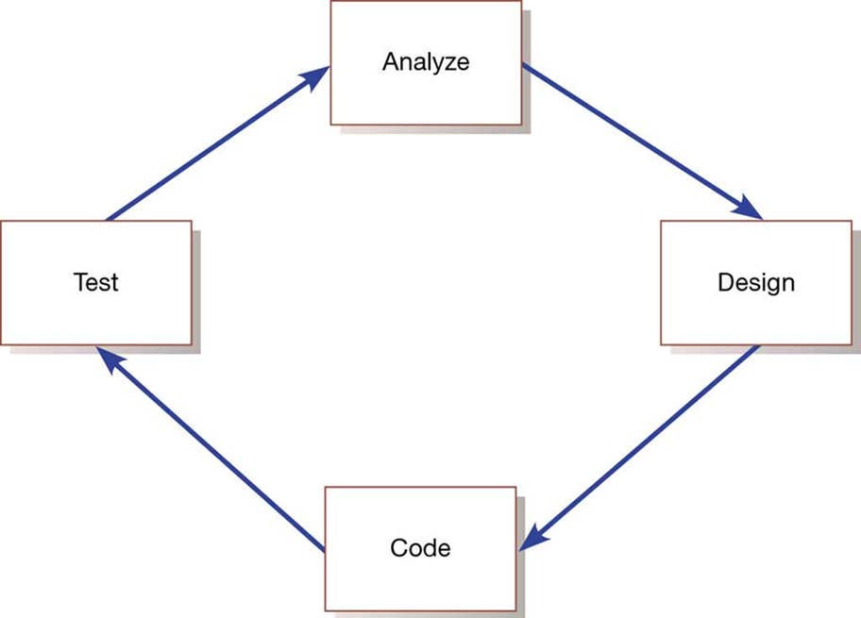
The Iterative Analysis-Design-Code-Test Cycle

Slide 42
Steps in the Agile Usage-Centered Design Method for Requirements Determination
Steps in the Agile Usage-Centered Design Method for Requirements Determination
Gather a group of people, including analysts, users, programmers, and testing staff, and sequester them in a room to collaborate on this design. Include a facilitator who knows this process.
Give everyone a chance to vent about the current system and to talk about the features everyone wants in the new system. Record all of the complaints and suggestions for change on whiteboards or flip charts for everyone to see.
Determine what the most important user roles would be. Determine who will be using the system and what their goals are for using the system. Write the roles on 3 × 5 cards. Sort the cards so that similar roles are close to each other. Patton (2002) calls this a role model.
Determine what tasks user roles will have to complete in order to achieve their goals. Write these down on 3 × 5 cards. Order tasks by importance and then by frequency. Place the cards together based on how similar the tasks are to each other. Patton calls this a task model.
Task cards will be grouped together on the table based on their similarity. Grab a stack of cards. This is called an interaction context.
For each task card in the interaction context, write a description of the task directly on the task card. List the steps that are necessary to complete the task. Keep the descriptions conversational to make them easy to read. Simplify.
Treat each stack as a tentative set of tasks to be supported by a single aspect of the user interface, such as a screen, page, or dialogue, and create a paper-and-pencil prototype for that part of the interface. Show the basic size and placement of the screen components.
Take on a user role and step through each task in the interaction context as modeled in the paper-and-pencil prototype. Make sure the user role can achieve its goals by using the prototype. Refine the prototype accordingly.

Slide 43
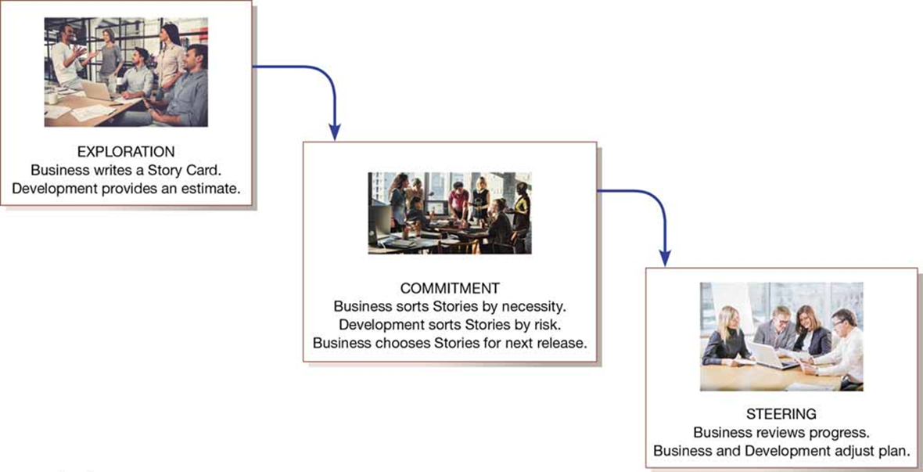
eXtreme Programming’s Planning Game
(Sources: Top to bottom: imtmphoto/ Shutterstock; nenetus/Fotolia; rilueda/Fotolia)

Slide 44
Learning Objectives
3.1 Describe options for designing and conducting interviews and developing a plan for conducting an interview to determine system requirements
3.2 Explain the advantages and pitfalls of observing workers and analyzing business documents to determine system requirements
3.3 Explain how computing can provide support for requirements determination
3.4 Participate in and help plan a Joint Application Design session
3.5 Use prototyping during requirements determination
3.6 Describe contemporary approaches to requirements determination
3.7 Understand how requirements determination techniques determination techniques apply to the development of electronic commerce applications

Slide 45
Electronic Commerce Applications: Determining System Requirements
Determining system requirements for Pine Valley Furniture’s WebStore
System layout and navigation characteristics
WebStore and site management system capabilities
Customer and inventory information
System prototype evolution

Slide 46
Desired Layout and Navigation Feature of WebStore
Desired Layout and Navigation Feature of WebStore | Desired Layout and Navigation Feature of WebStore
Layout and Design | Navigation menu and logo placement should remain consistent throughout the entire site (this allows users to maintain familiarity while using the site and minimizes users who get “lost” in the site) Graphics should be lightweight to allow for quick page display Text should be used over graphics whenever possible
Navigation | Any section of the store should be accessible from any other section via the navigation menu Users should always be aware of what section they are currently in

Slide 47
System Structure of the WebStore and Site Management Systems
WebStore | Site Management System
Main Page Product Line (category) Desks Chairs Tables, File Cabinets Shopping Cart Checkout Account Profile Order Status/History Customer Comments | User Profile Manager
Company Info | Order Maintenance Manager
Feedback | Content (catalog Manager)
Contact Information | Reports Total Hits Most Frequent Page Views Users/Time of Day Users/Day of Week Shoppers Not Purchasing (used shopping cart—did not checkout) Feedback Analysis

Slide 48
Customer and Inventory for WebStore
Corporate Customer | Home Office Customer | Student Customer
Company Name Company Address Company Phone Company Fax Company Preferred Shipping Method Buyer Name Buyer Phone Buyer E-Mail | Name Doing Business as (company name) Address Phone Fax E-Mail | Name School Address Phone E-Mail
Inventory Information | Inventory Information | Inventory Information
S K U Name Description | Finished Product Size Finished Product Weight Available Materials | Available Colors Price Lead Time

Slide 49
Stages of System Implementation of WebStore
Stages of System Implementation of WebStore
Stage 1—Basic Functionality: Simple catalog navigation; two products per section—limited attributes set 25 sample users Simulated credit card transaction Full shopping cart functionality
Stage 2—Look and Feel: Full product attribute set and media (images, video)—commonly referred to as the “product data catalog” Full site layout Simulated integration with Purchasing Fulfillment and Customer Tracking systems
Stage 3—Staging/Preproduction: Full integration with Purchasing Fulfillment and Customer Tracking systems Full credit card processing integration Full product data catalog

Slide 50
Summary (1 of 2)
In this chapter you learned to:
Describe options for designing and conducting interviews and developing a plan for conducting an interview to determine system requirements
Explain the advantages and pitfalls of observing workers and analyzing business documents to determine system requirements
Explain how computing can provide support for requirements determination
Participate in and help plan a Joint Application Design session

Slide 51
Summary (2 of 2)
In this chapter you learned to:
Use prototyping during requirements determination
Describe contemporary approaches to requirements determination
Understand how requirements determination techniques determination techniques apply to the development of electronic commerce applications

