Slide 1

Systems Analysis and Design
Chapter 5: Designing Databases
Slides in this presentation contain hyperlinks. JAWS users should be able to get a list of links by using INSERT+F7
Notes:
If this PowerPoint presentation contains mathematical equations, you may need to check that your computer has the following installed:
1) MathType Plugin
2) Math Player (free versions available)
3) NVDA Reader (free versions available)

Slide 2
Learning Objectives
5.1 Describe the database design process, its outcomes, and the relational database model
5.2 Describe normalization and the rules for second and third normal form
5.3 Transform an entity-relationship (E-R) diagram into an equivalent set of well-structured (normalized) relations
5.4 Merge normalized relations from separate user views into a consolidated set of well-structured relations
5.5 Describe physical database design concepts

Slide 3
Learning Objectives
5.1 Describe the database design process, its outcomes, and the relational database model
5.2 Describe normalization and the rules for second and third normal form
5.3 Transform an entity-relationship (E-R) diagram into an equivalent set of well-structured (normalized) relations
5.4 Merge normalized relations from separate user views into a consolidated set of well-structured relations
5.5 Describe physical database design concepts

Slide 4
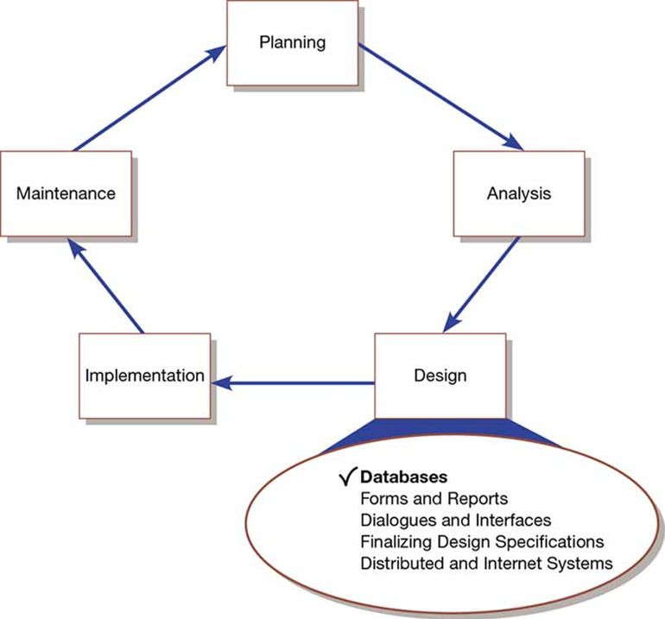
Systems Development Life Cycle with Design Phase Highlighted

Slide 5
Database Design
File and database design occurs in two steps:
Develop a logical database model, which describes data using notation that corresponds to a data organization used by a database management system
Relational database model
Prescribe the technical specifications for computer files and databases in which to store the data
Physical database design provides specifications
Logical and physical database design in parallel with other system design steps

Slide 6
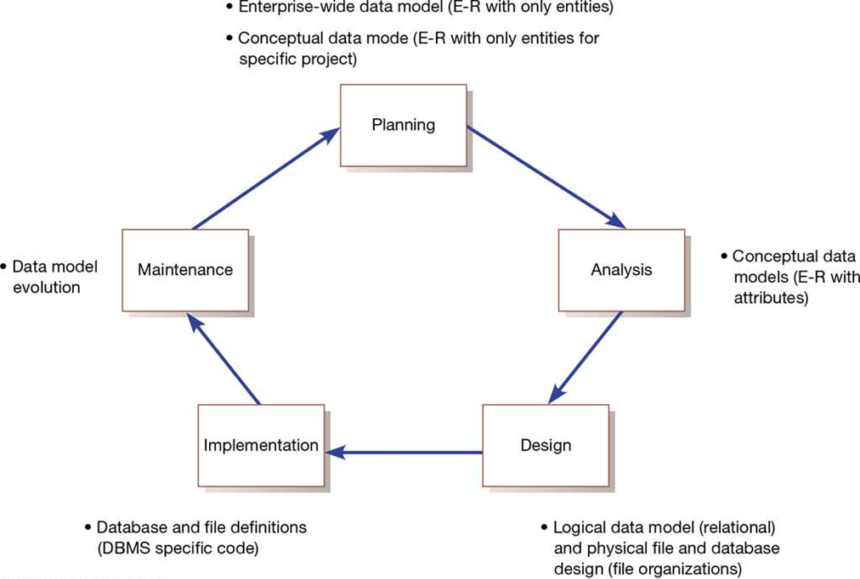
Relationship Between Data Modeling and the S D L C

Slide 7
Database Development Phases
Define data reqs
Conceptual data model
Logical DB design
Distributed DB design
Optional
Internal schema / Populated DB
Physical DB design

Slide 8
Process of Database Design
Four key steps in logical database modeling and design:
Develop a logical data model for each known user interface for the application using normalization principles
Combine normalized data requirements from all user interfaces into one consolidated logical database model (view integration)
Translate the conceptual E-R data model for the application into normalized data requirements
Compare the consolidated logical database design with the translated E-R model and produce one final logical database model for the application

Slide 9
Physical Database Design
Key physical database design decisions:
Choosing a storage format (data type) for each attribute from the logical database model
Grouping attributes from the logical database model into physical records
Arranging related records in secondary memory (hard disks and magnetic tapes) so that records can be stored, retrieved and updated rapidly
Selecting media and structures for storing data to make access more efficient

Slide 10
Deliverables and Outcomes
During logical database design you must account for every data element on a system input or output
Normalized relations are the primary deliverable
Primary key – attribute (or combination of attributes) whose value is unique across all occurrences of a relation
Physical database design converts relations into database tables
Programmers and database analysts code the definitions of the database using Structured Query Language (S Q L)

Slide 11
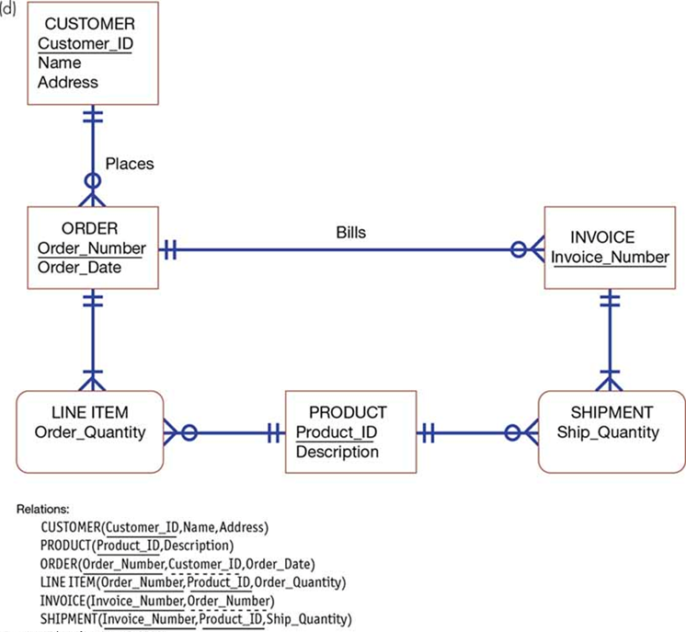
Conceptual Data Model and Transformed Relations

Slide 12
The Relational Database Model (1 of 2)
Relational database model – data represented as a set of related tables or relations
Relation – named, two-dimensional table of data. Each relation consists of a set of named columns and an arbitrary number of unnamed rows.

Slide 13
The Relational Database Model (2 of 2)
Relations have several properties that distinguish them from nonrelational tables:
Entries in cells are simple
Entries in columns are from the same set of values
Each row is unique
The sequence of columns can be interchanged without changing the meaning or use of the relation
The rows may be interchanged or stored in any sequence

Slide 14
Well-Structured Relations
Well-structured relation – relation that contains a minimum amount of redundancy and that allows users to insert, modify, and delete the rows without error or inconsistencies; also known as a table

Slide 15
Introduction
Database design has five purposes as follows:
Structure the data in stable structures (normalize)
Develop a logical database design that reflects the actual data requirements that exist in the forms
Develop a logical database design as a basis for physical database design
Translate a relational database model into a technical file and database design that balances several performance factors
Choose data storage technologies that will efficiently, accurately, and securely process database activities

Slide 16
Normalization (1 of 2)
Normalization – process of converting complex data structures into simple, stable data structures
The result of normalization is that every nonprimary key attribute depends upon the whole primary key and nothing but the primary key
3 normal form

Slide 17
Normalization (2 of 2)
First Normal Form (1N F):
Has no multivalued attributes, unique rows, and all relations are in 1N F
Second Normal Form (2N F):
Each nonprimary key attribute is identified by the whole key (referred to as a full functional dependency)
Third Normal Form (3N F):
Nonprimary key attributes do not depend on each other (referred to as a transitive dependency)

Slide 18
Functional Dependency (1 of 2)
Functional dependency – constraint between two attributes in which the value of one attribute is determined by the value of another attribute
Example of attribute B being functionality dependent on attribute A
Dependency is represented by an arrow ( → )
Attribute B is functionally dependent on attribute A if, for every valid value of A, that value of A uniquely determines the value of B
Represented as: A → B

Slide 19
Functional Dependency (2 of 2)
Functional dependency is not a mathematical dependency
Instances (or sample data) in a relation do not prove the existence of a functional dependency
Knowledge of problem domain is most reliable method for identifying functional dependency

Slide 20
Second Normal Form (2N F)
Second normal form (2N F) – relation is in second normal form if every nonprimary key attribute is functionally dependent on the whole primary key
To convert a relation into 2N F , decompose the relation into new relations using the attributes, called determinants, that determine other attributes
The determinants are the primary keys of the new relations

Slide 21
Third Normal Form (3N F)
Third normal form (3N F) – relation is in second normal form and has no functional (transitive) dependencies between two (or more) nonprimary key attributes
Foreign key – attribute that appears as a nonprimary key attribute in one relation and as a primary key attribute (or part of a primary key) in another relation
Referential integrity – rule that states that either each foreign key value must match a primary key value in another relation or the foreign key value must be null (i.e., have no value)

Slide 22
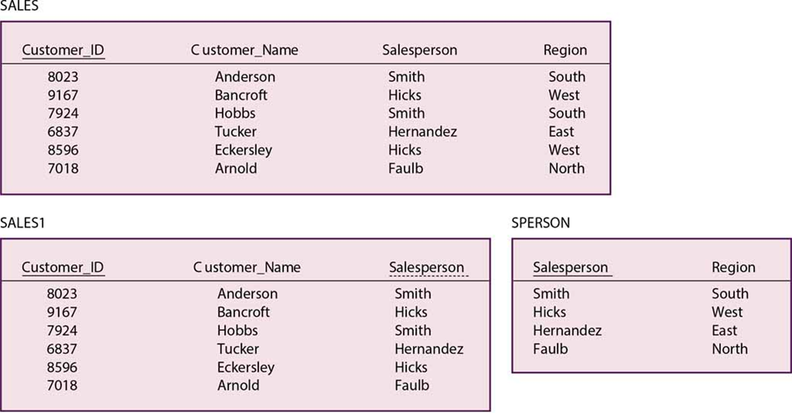
Removing Transitive Dependencies (a) Relation with Transitive Dependency (b) Relation in 3N F

Slide 23
Learning Objectives
5.1 Describe the database design process, its outcomes, and the relational database model
5.2 Describe normalization and the rules for second and third normal form
5.3 Transform an entity-relationship (E-R) diagram into an equivalent set of well-structured (normalized) relations
5.4 Merge normalized relations from separate user views into a consolidated set of well-structured relations
5.5 Describe physical database design concepts

Slide 24
Transforming E-R Diagrams into Relations
Transforming an E-R diagram into normalized relations and merging all of them into one consolidated set of relations takes four steps:
Represent entities (each becomes a relation)
Represent relationships (each must be represented in the relational database design)
Normalize the relations (make them well structured)
Merge the relations (renormalize if necessary to remove redundancy)

Slide 25
Representing Entities
Each regular entity is transformed into a relation
The identifier of the entity type becomes the primary key of the corresponding relation
The primary key must satisfy the following two conditions
The value of the key must uniquely identify every row in the relation
The key should be nonredundant
The entity type label is translated into a relation name

Slide 26
Representing Relationships (1 of 4)
The procedure for representing relationships depends on:
The degree of the relationship (unary, binary, ternary)
The cardinality of the relationship
Binary 1:N Relationship – represented by adding the primary key attribute (or attributes) of the entity on the one side of the relationship as a foreign key in the relation that is on the many side of the relationship

Slide 27
Representing Relationships (2 of 4)
Binary or Unary 1:1 relationship is represented by any of the following:
Add the primary key of A as a foreign key of B
Add the primary key of B as a foreign key of A
Both of the above
Binary and Higher-Degree M:N Relationships – represented by creating another relations, include the primary keys of all relations into the new one as a primary key
Becomes a composite key
Any non-key attributes associated with the M:N relationship are included in the new relation

Slide 28
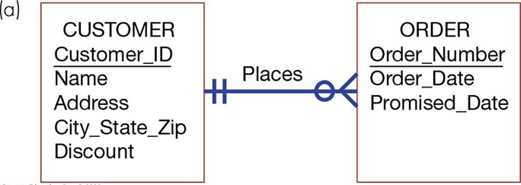
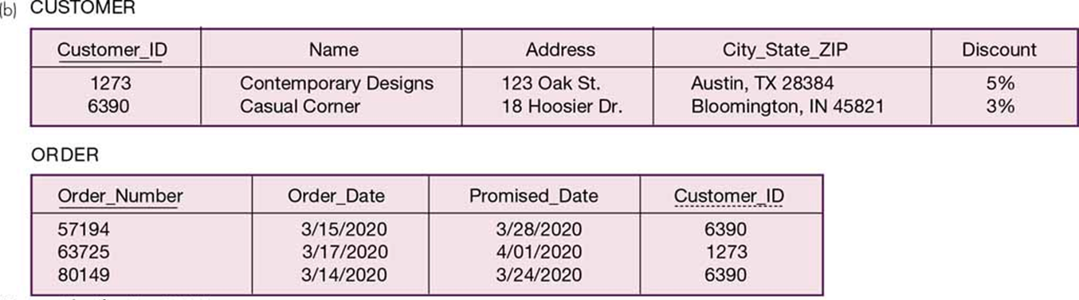
Representing a 1:N Relationship (a) E-R Diagram (b) Relations

Slide 29
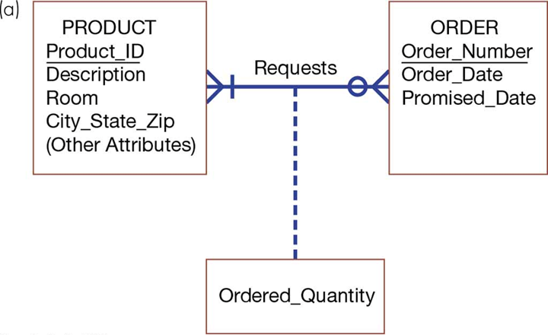
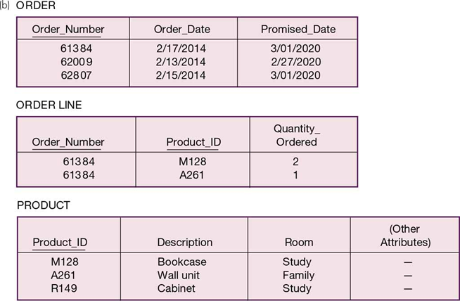
Representing an M:N Relationship (a) E-R Diagram (b) Relations

Slide 30
Representing Relationships (3 of 4)
Unary 1:N Relationship (also called recursive relationships):
Is modeled as a relation
Primary key of that relation is the same as for the entity type
Foreign key is added to the relation that references the primary key values
Recursive foreign key – foreign key in a relation that references the primary key values of that same relation

Slide 31
Representing Relationships (4 of 4)
Unary M:N Relationship is modeled as one relation, then:
Create a separate relation to represent the M:N relationship
The primary key of the new relation is a composite key of two attributes that both take their values from the same primary key
Any attribute associated with the relationship is included as a nonkey attribute in this new relation

Slide 32
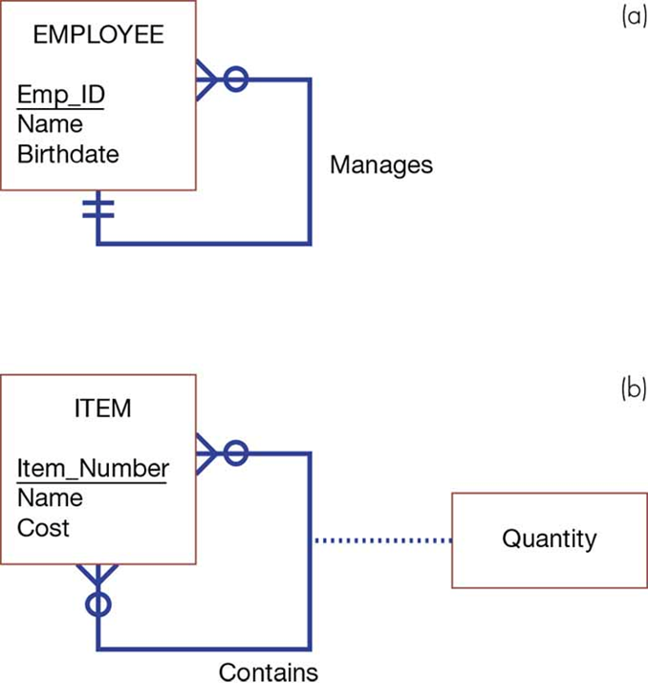
Two Unary Relationships (a) EMPLOYEE with Manages Relationship (1:N) (b) Bill-of-Materials Structure (M:N)

Slide 33
E-R Diagrams to Relational Transformation
E-R Structure | Relational Representation
Regular entity | Create a relation with primary key and nonkey attributes.
Weak entity | Create a relation with a composite primary key (which includes the primary key of the entity on which this weak entity depends) and nonkey attributes.
Binary or unary 1:1 relationship | Place the primary key of either entity in the relation for the other entity or do this for both entities.
Binary 1:N relationship | Place the primary key of the entity on the one side of the relationship as a foreign key in the relation for the entity on the many side.
Binary or unary M:N relationship or associative entity | Create a relation with a composite primary key using the primary keys of the related entities, plus any nonkey attributes associative entity of the relationship or associative entity.
Binary or unary M:N relationship or associative entity with additional key(s) | Create a relation with a composite primary key using the primary keys of the related entities and additional primary key attributes associated with the relationship or associative entity, plus any nonkey attributes of the relationship or associative entity.
Binary or unary M:N relationship or associative entity with its own key | Create a relation with the primary key associated with the relationship or associative entity, plus any nonkey attributes of the relationship or associative entity and the primary keys of the related entities (as foreign key attributes).
Supertype/subtype | Create a relation for the superclass, which contains the primary relationship key and all nonkey attributes in common with all subclasses, plus create a separate relation for each subclass with the same primary key (with the same or local name) but with only the nonkey attributes related to that subclass.

Slide 34
Learning Objectives
5.1 Describe the database design process, its outcomes, and the relational database model
5.2 Describe normalization and the rules for second and third normal form
5.3 Transform an entity-relationship (E-R) diagram into an equivalent set of well-structured (normalized) relations
5.4 Merge normalized relations from separate user views into a consolidated set of well-structured relations
5.5 Describe physical database design concepts

Slide 35
Merging Relations
Merging relations
Is the last step in the logical database design
Purpose is to remove redundant relations
Example when given two relations:
EMPLOYEE1(Emp_ID,Name,Address,Phone)
EMPLOYEE2(Emp_ID,Name,Address,Jobcode,Number_of_Years)
They can be merged together:
EMPLOYEE(Emp_ID,Name,Address,Phone,Jobcode,Number_of_Years)

Slide 36
View Integration Problems (1 of 4)
Must understand the meaning of the data and be prepared to resolve any problems that arise in the process
Synonym – two different names used for the same attribute
When merging, get agreement from users on a single, standard name
Example of two relations with synonym primary keys (representing S S N numbers) of different names:
STUDENT1(Student_ID,Name)
STUDENT2(Matriculation_Number,Name,Address)

Slide 37
View Integration Problems (2 of 4)
Homonym – single attribute name that is used for two or more different attributes
Resolved by creating a new descriptive name
Example: home address versus local address?
STUDENT1(Student_ID,Name,Address)
STUDENT2(Student_ID,Name,Phone_Number,Address)

Slide 38
View Integration Problems (3 of 4)
Dependencies between nonkeys occurs when two 3N F relations are merged to form a single relation such as:
STUDENT1(Student_ID,Major)
STUDENT2(Student_ID,Adviser)
Since both have the same primary key they can be merged as follows:
STUDENT(Student_ID,Major,Adviser)
If a transitive dependency exists such as Major → Advisor
You need to normalize to remove the transitive dependency
STUDENT(Student_ID,Major)
MAJOR ADVISER(Major,Adviser)

Slide 39
View Integration Problems (4 of 4)
Class/Subclass relationships may be hidden in user views or relations. Consider the following:
PATIENT1(Patient_ID,Name,Address,Date_Treated)
PATIENT2(Patient_ID,Room_Number)
What if PATIENT can refer to both inpatient and outpatient? Then what?
The answer? Convert it to a Supertype/Subtype!
PATIENT(Patient_ID,Name,Address)
INPATIENT(Patient_ID,Room_Number)
OUTPATIENT(Patient_ID,Date_Treated)

Slide 40
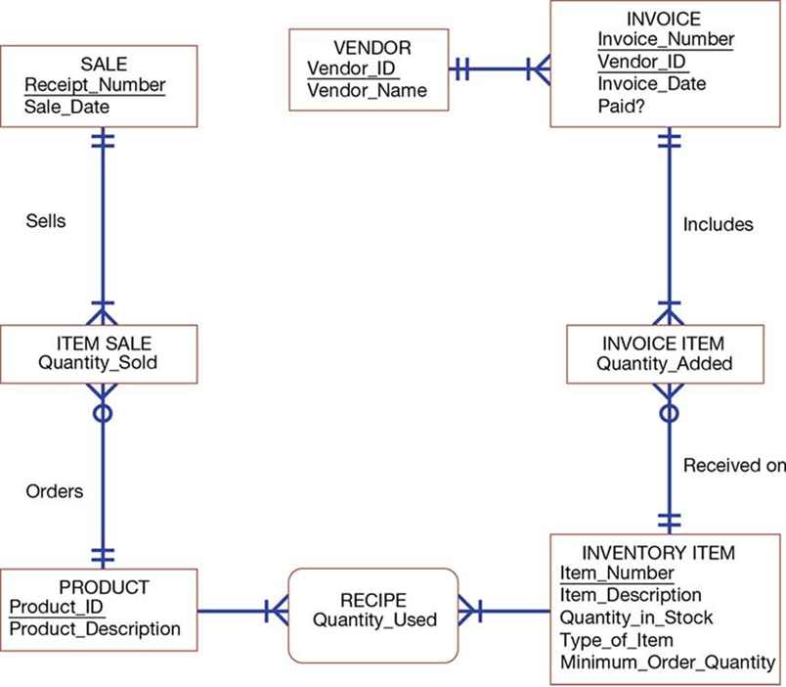
E-R Diagram Corresponding to Normalized Relations of Hoosier Burger’s Inventory Control System

Slide 41
Final Normalized Relations for Hoosier Burger
Final normalized relations for Hoosier Burger:
SALE(Receipt_Number,Sale_Date)
PRODUCT(Product_ID,Product_Description)
INVOICE(Vendor_ID,Invoice_Number,Invoice_Date,Paid?)
INVENTORY ITEM(Item_Number,Item_Description,Quantity_in_ Stock,Minimum_Order_Quantity,Type_of_Item)
ITEM SALE(Receipt_Number,Product_ID,Quantity_Sold)
INVOICE ITEM(Vendor_ID,Invoice_Number,Item_Number,Quantity_Added)
RECIPE(Product_ID,Item_Number,Quantity_Used)
VENDOR(Vendor_ID,Vendor_Name)

Slide 42
Learning Objectives
5.1 Describe the database design process, its outcomes, and the relational database model
5.2 Describe normalization and the rules for second and third normal form
5.3 Transform an entity-relationship (E-R) diagram into an equivalent set of well-structured (normalized) relations
5.4 Merge normalized relations from separate user views into a consolidated set of well-structured relations
5.5 Describe physical database design concepts

Slide 43
Physical File and Database Design
Designing physical files/databases requires the following information:
Normalized relations, including volume estimates
Definitions of each attribute
Descriptions of where and when data are used: entered, retrieved, deleted, and updated (including frequencies)
Expectations or requirements for response time and data integrity
Descriptions of the technologies used for implementing the files and database so that the range of required decisions and choices for each is known

Slide 44
Designing Fields
Field – smallest unit of named application data recognized by system software
An attribute from a relation is now recognized as a field in a database
Data type – coding scheme recognized by system software for representing organizational data

Slide 45
Choosing Data Types
Selecting a data type requires balancing four objectives:
Minimize storage space
Represent all possible values of the field
Improve data integrity of the field
Support all data manipulations desired on the field

Slide 46
Commonly Used Data Types in Oracle 10gram
Data Type | Description
VARCHAR2 | Variable-length character data with a maximum length of 4,000 characters; you must enter a maximum field length (e.g., VARCHAR2(30) for a field with a maximum length of 30 characters). A value less than 30 characters will consume only the required space.
CHAR | Fixed-length character data with a maximum length of 255 characters; default length is 1 character (e.g., CHAR(5) for a field with a fixed length of five characters, capable of holding a value from 0 to 5 characters long).
LONG | Capable of storing up to two gigabytes of one variable-length character data field (e.g., to hold a medical instruction or a customer comment).
NUMBER | Positive and negative numbers in the range 10–130 to 10126; can specify the precision (total number of digits to the left and right of the decimal point) and the scale (the number of digits to the right of the decimal point) (e.g., NUMBER(5) specifies an integer field with a maximum of 5 digits and NUMBER( 5, 2) specifies a field with no more than five digits and exactly two digits to the right of the decimal point).
DATE | Any date from January 1, 4712 B C to December 31, 4712 A D; date stores the century, year, month, day, hour, minute, and second.
BLOB | Binary large object, capable of storing up to four gigabytes of binary data (e.g., a photograph or sound clip).

Slide 47
Calculated Fields
Calculated field – field that can be derived from other database fields. Also known as a computed field or a derived field.
It is common for an attribute to be mathematically related to other data
The database will either stored or compute the calculated field when requested

Slide 48
Controlling Data Integrity
Default value – value a field will assume unless an explicit value is entered for that field
Range control – limits values (numeric or alpha-numeric data) that can be entered into a field
Referential integrity – constraint specifying that the value (or existence) of an attribute in one relation depends on the value (or existence) of the same attribute in another relation
Null value – special field value, distinct from zero, blank, or any other value, that indicates that the value for the field is missing or otherwise unknown

Slide 49
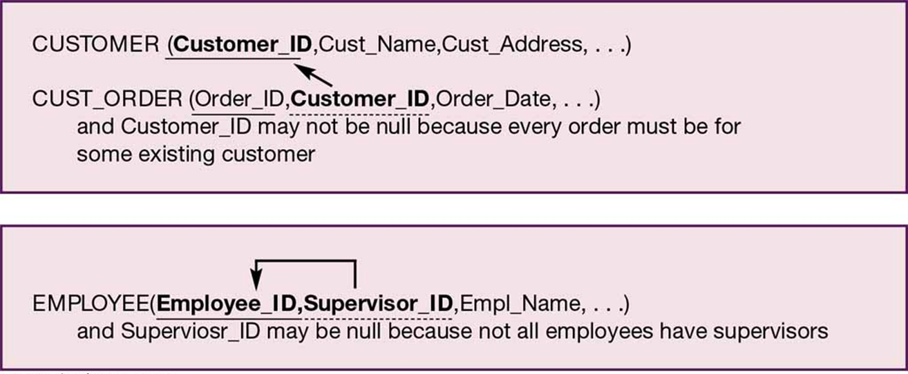
Examples of Referential Integrity Field Controls (a) Referential Integrity Between Relations (b) Referential Integrity Within a Relation

Slide 50
Designing Physical Tables (1 of 3)
A relational table is a set of related tables related by foreign keys referencing primary keys
Physical table – named set of rows and columns that specifies the fields in each row of the table
Denormalization – process of splitting or combining normalized relations into physical tables based on affinity of use of rows and fields

Slide 51
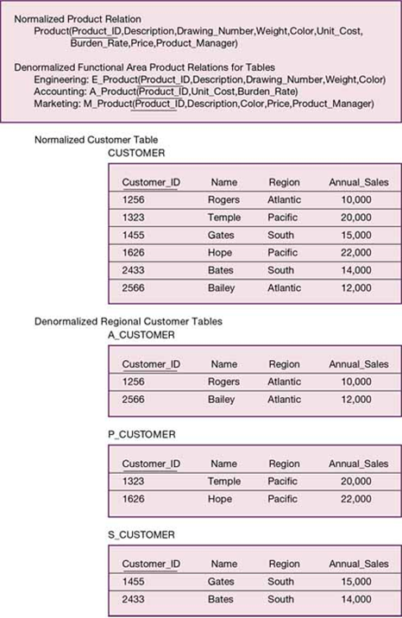
Examples of Denormalization (a) Denormalization by Columns (b) Denormalization by Rows

Slide 52
Designing Physical Tables (2 of 3)
Partitioning is the capability to split a table into separate sections. Partitioning types include:
Range partitioning: partitions are defined by nonoverlapping ranges of values for a specified attribute
Hash partitioning: a table row is assigned to a partition by an algorithm and then maps the specified attribute value to a partition
Composite partitioning: combines range and hash partitioning by first segregating data by ranges on the designated attribute, and then within each of these partitions

Slide 53
Designing Physical Tables (3 of 3)
Partitioning helps speed up system performance
Denormalization can increase change of errors
Three common situations where denormalization is used are:
Two entities with a one-to-one relationship
A many-to-many relationship (associative entity) with nonkey attributes
Reference data

Slide 54
Arranging Table Rows (1 of 5)
The result of denormalization is the definition of one or more physical files
Physical file – named set of table rows stored in a contiguous section of secondary memory
File organization – technique for physically arranging the records of a file

Slide 55
Arranging Table Rows (2 of 5)
Objectives for choosing file organization include:
Fast data retrieval
High throughput for processing transactions
Efficient use of storage space
Protection from failures or data loss
Minimizing need for reorganization
Accommodating growth
Security from unauthorized use

Slide 56
Arranging Table Rows (3 of 5)
Pointer – field of data that can be used to locate a related field or row of data
Three basic families of file organization:
Sequential file organization – file organization in which rows in a file are stored in sequence according to a primary key value
Indexed file organization – file organization in which rows are stored either sequentially or nonsequentially, and an index is created that allows software to locate individual rows
Hashed file organization – file organization in which the address of each row is determined using an algorithm

Slide 57
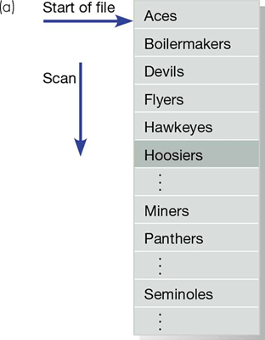
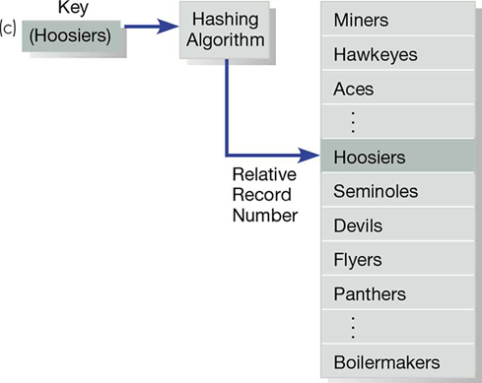
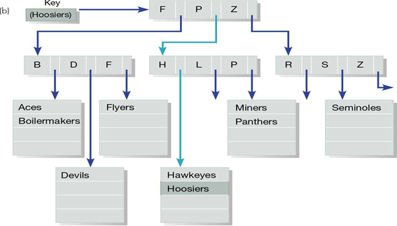
Comparison of File Organizations (a) Sequential (b) Indexed (c) Hashed

Slide 58
Arranging Table Rows (4 of 5)
Index – table used to determine the location of rows in a file that satisfy some condition
Secondary key – represents one or a combination of fields for which more than one row may have the same combination of values
Allows an index to point to more than one record

Slide 59
Arranging Table Rows (5 of 5)
Indexed file organization
Advantage is allowing for both random and sequential processing
Disadvantages include:
Extra space required to store indexes
Extra time necessary to access and maintain indexes
Guidelines for choosing indexes include:
Specify a unique index for the primary key of each table
Specify an index for foreign keys
Specify an index for nonkey fields that are referenced in qualification, sorting and grouping commands for the purpose of retrieving data

Slide 60
Comparative Features of Sequential, Indexed, and Hashed File Organizations
Factor | File Sequential | Organization Indexed | Hashed
Storage space | No wasted space | No wasted space for data, but extra space for index | Extra space may be needed to allow for addition and deletion of records
Sequential retrieval on primary key | Very fast | Moderately fast | Impractical
Random retrieval on primary key | Impractical | Moderately fast | Very fast
Multiple key retrieval | Possible, but requires scanning whole file | Very fast with multiple indexes | Not possible
Deleting rows | Can create wasted space or require reorganizing | If space can be dynamically allocated, this is easy, but requires maintenance of indexes | Very easy
Adding rows | Requires rewriting file | If space can be dynamically allocated, this is easy, but requires maintenance of indexes | Very easy, except multiple keys with same address require extra work
Updating rows | Usually requires rewriting file | Easy, but requires maintenance of indexes | Very easy

Slide 61
Designing Controls for Files (1 of 2)
Two goals of physical table design:
Protection from failure or data loss
Security from unauthorized use
These goals are achieved primarily by implementing controls on each file
Two additional types of controls address
Backup
Security

Slide 62
Designing Controls for Files (2 of 2)
Techniques for file restoration:
Periodically making a backup copy of a file
Storing a copy of each change to a file in a transaction log or audit trail
Storing a copy of each row before or after it is changed
Means of building data security into a file:
Coding, or encrypting, the data in the file
Requiring data file users to identify themselves by entering user names and passwords
Prohibiting users from directly manipulating any data in the file by forcing users to work with a copy (real or virtual)

Slide 63
Summary
In this chapter you learned how to:
5.1 Describe the database design process, its outcomes, and the relational database model
5.2 Describe normalization and the rules for second and third normal form
5.3 Transform an entity-relationship (E-R) diagram into an equivalent set of well-structured (normalized) relations
5.4 Merge normalized relations from separate user views into a consolidated set of well-structured relations
5.5 Describe physical database design concepts including choosing storage formats for fields in database tables, translating well-structured relations into efficient database tables, explaining when to use different types of file organizations to store computer files, and describing the purpose of indexes and the important considerations in selecting attributes to be indexed

