Slide 1

Systems Analysis and Design
Chapter 7: Introduction to UML
    Slides in this presentation contain hyperlinks. JAWS users should be able to get a list of links by using INSERT+F7
Notes:
If this PowerPoint presentation contains mathematical equations, you may need to check that your computer has the following installed:
1) MathType Plugin
2) Math Player (free versions available)
3) NVDA Reader (free versions available)

Slide 2
How can you explain the effect of
polluted water or global warming issue?

Slide 3
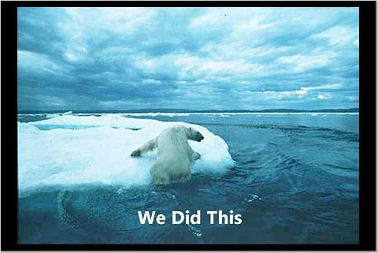
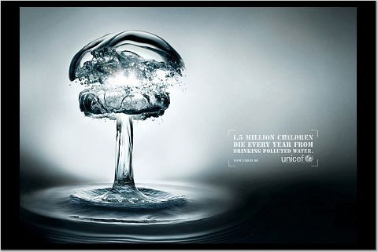

Slide 4

1 picture’s worth 1000 words

Slide 5
Learning Objectives
7.1 History of UML
7.2 Systems, Models and Views
7.3 Design Use cases
7.4 Design Class diagrams
7.5 Design Interaction diagrams
7.6 Design another types of diagrams

Slide 6
What is UML?
Unified Modeling Language
  OMG Standard, Object Management Group
  Based on work from Booch, Rumbaugh, Jacobson
UML is a modeling language to express and design documents, software
  Particularly useful for OO design
  Not a process, but some have been proposed using UML
  Independent of implementation language

Slide 7
Why use UML?
Standard language for specifying, visualizing, constructing, and documenting the artifacts of software systems, business modeling and other non-software systems.
The UML represents a collection of best engineering practices that have proven successful in the modeling of large and complex systems.
The UML is a very important part of developing object oriented software and the software development process.
The UML uses mostly graphical notations to express the design of software projects.
Using the UML helps project teams communicate, explore potential designs, and validate the architectural design of the software.

Slide 8
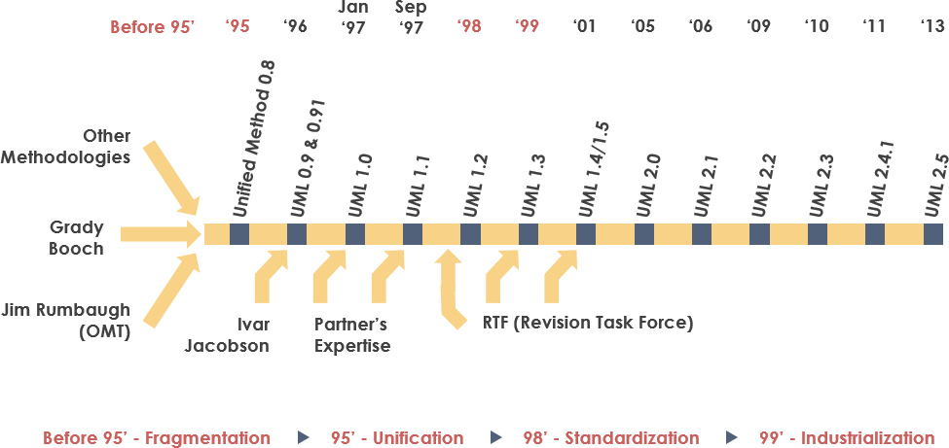
History of UML

Slide 9
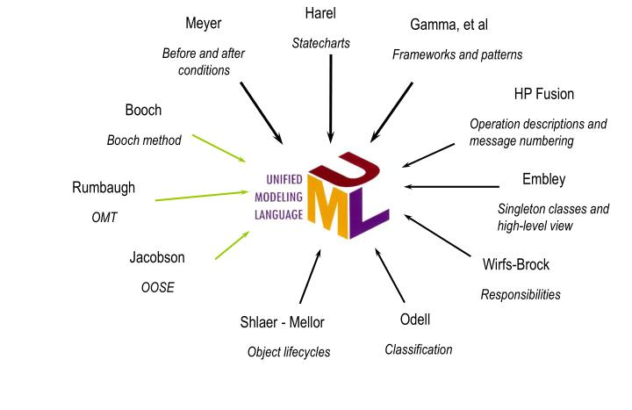
Contributions to UML

Slide 10
UML Diagrams
Structure diagram
  Object diagram
  Class diagram
  Component diagram
  Deployment diagram
  Package diagram
  Composite structure diagram (UML 2.2)
  Profile diagram (UML 2.2)
Behavior diagram
  Interaction diagrams:
    Sequence diagram
    Collaboration diagram (communication diagram in UML 2.2)
    Interaction overview diagram (UML 2.2)
    Timing diagram (UML 2.2)
  Use case diagram
  Activity diagram
  State diagram

Slide 11
Learning Objectives
7.1 History of UML
7.2 Systems, Models and Views
7.3 Design Use cases
7.4 Design Class diagrams
7.5 Design Interaction diagrams
7.6 Design another types of diagrams

Slide 12
Systems, Models and Views
A model is an abstraction describing a subset of a system
A view depicts selected aspects of a model
A notation is a set of graphical or textual rules for depicting views
Views and models of a single system may overlap each other
Examples:
System: Aircraft
Models: Flight simulator, machine model
Views: Radar, electrical wiring, fuel system

Slide 13
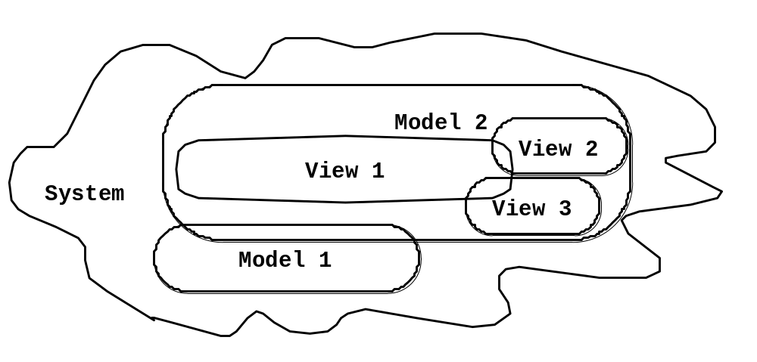
Systems, Models and Views
Flightsimulator
Weather
Radar
Aircraft
Electrical
Wiring
Machine Model

Slide 14
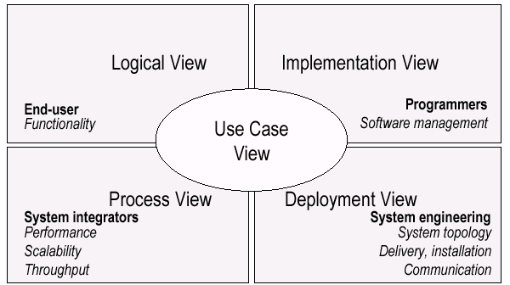
UML Models, Views, Diagrams
UML is a multi-diagrammatic language, each diagram is a view into a model
  Diagram presented from the aspect of a particular stakeholder
  Provides a partial representation of the system
  Is semantically consistent with other views
Example views:

Slide 15
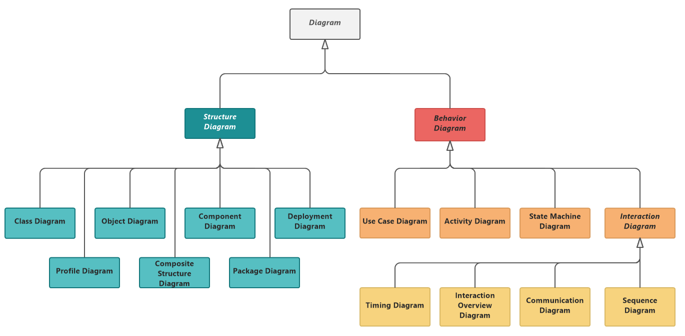
Type of Diagrams

Slide 16
How Many Views?
Views should to fit the context
  Not all systems require all views
  Single processor: drop deployment view
  Single process: drop process view
  Very small program: drop implementation view
A system might need additional views
  Data view, security view, …
You can model 80% of most problems by using about 20% UML diagrams
We only cover the 20% here

Slide 17
Basic Modeling Steps
Use Cases Model
  Capture requirements
Domain Model
  Capture process, key classes
Design Model
  Capture details and behaviors of use cases and domain objects
  Add classes that do the work and define the architecture

Slide 18
Learning Objectives
7.1 History of UML
7.2 Systems, Models and Views
7.3 Design Use cases
7.4 Design Class diagrams
7.5 Design Interaction diagrams
7.6 Design another types of diagrams

Slide 19
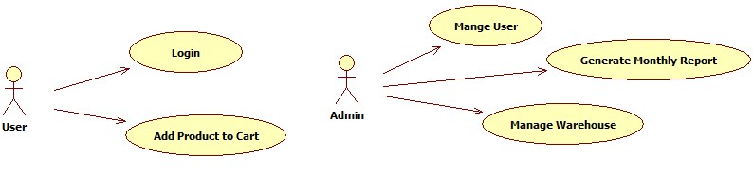
Use Case Diagrams
Used during requirements elicitation to represent external behavior
  Actors represent roles, that is, a type of user of the system
  Use cases represent a sequence of interaction for a type of functionality; summary of scenarios
The use case model is the set of all use cases. It is a complete description of the functionality of the system and its environment

Slide 20
Actors
An actor models an external entity which communicates with the system:
  User
  External system
  Physical environment
An actor has a unique name and an optional description.
Examples:
  Passenger: A person in the train
  GPS satellite: Provides the system with GPS coordinates
User
Admin

Slide 21
Use Case
A use case represents a class functionality provided by the system as an event flow.
A use case consists of:
  Unique name
  Participating actors
  Entry conditions
  Flow of events
  Exit conditions
  Special requirements
Add Product to Cart
Manage User

Slide 22
Use Case Specification: Example
UC Name: Purchase ticket
Participating actor: Passenger
Preconditions:
Passenger standing in front of ticket distributor.
Passenger has sufficient money to purchase ticket.
Postconditions:
Passenger has ticket.
Flow of Events:
1. Passenger selects the number of zones to be traveled.
2. Distributor displays the amount due.
3. Passenger inserts money, of at least the amount due.
4. Distributor returns change.
5. Distributor issues ticket.

Slide 23
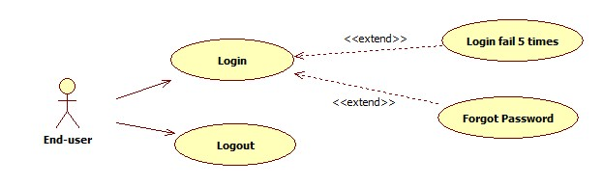
UC Association: extend
<<extend>> relationships represent exceptional invoked cases
The exceptional flows are factored out of the main event flow for clarity
UCs representing exceptional flows can extend more than one UC

Slide 24
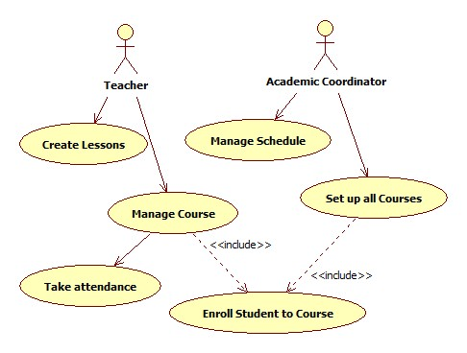
UC Association: include
<<include>> relationship represents behavior that is factored out of the use case.
<<include>> behavior is factored out for reuse, not because it is an exception.
The direction of a <<include>> relationship is to the using use case (unlike <<extend>> relationships).

Slide 25
Use Cases are useful to…
Determining requirements
  New use cases often generate new requirements as the system is analyzed and the design takes shape.
Communicating with clients
  Their notational simplicity makes use case diagrams a good way for developers to communicate with clients.
Generating test cases
  The collection of scenarios for a use case may suggest a suite of test cases for those scenarios.

Slide 26
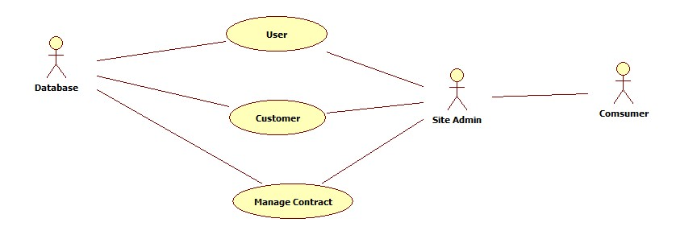
Where are mistakes?

Slide 27
Learning Objectives
7.1 History of UML
7.2 Systems, Models and Views
7.3 Design Use cases
7.4 Design Class diagrams
7.5 Design Interaction diagrams
7.6 Design another types of diagrams

Slide 28
Class Diagrams
Gives an overview of a system by showing its classes and the relationships among them.
  Class diagrams are static
  Display what interacts but not what happens when they do interact
Also shows attributes and operations of each class
Good way to describe the overall architecture of system components

Slide 29
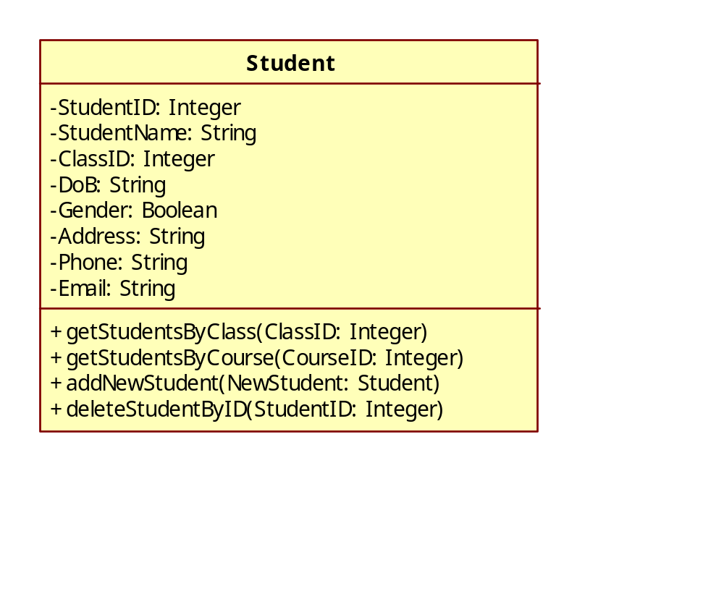
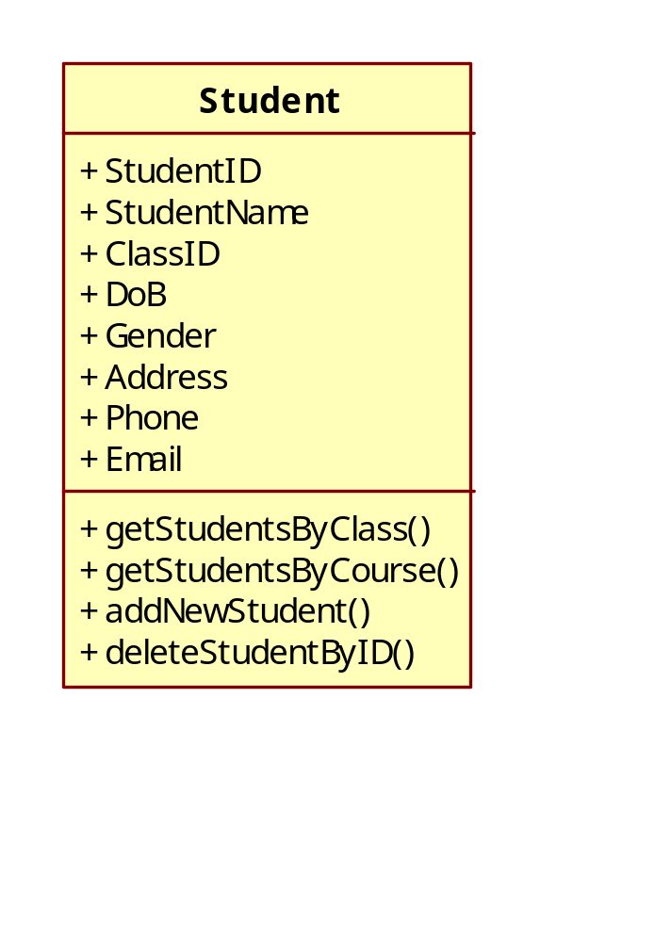
Classes – Not Just for Code
Name
Attributes
Operations
A class represent a concept
A class encapsulates state (attributes) and behavior (operations).
Each attribute has a type.
Each operation has a signature.
The class name is the only mandatory information.

Slide 30
Class Notation
A class is a rectangle divided into three parts
  Class name
  Class attributes (i.e. data members, variables)
  Class operations (i.e. methods)
Modifiers
  Private: -
  Public: +
  Protected: #
  Static: Underlined (i.e. shared among all members of the class)
Abstract class: Name in italics

Slide 31
Class Diagram: Association Types
Lines or arrows between classes indicate relationships
  Association
    A relationship between instances of two classes, where one class must know about the other to do its work, e.g. client communicates to server
    indicated by a straight line or arrow
  Aggregation
    An association where one class belongs to a collection, e.g. instructor part of Faculty
    Indicated by an empty diamond on the side of the collection
  Composition
    Strong form of Aggregation
    Lifetime control; components cannot exist without the aggregate
    Indicated by a solid diamond on the side of the collection
  Inheritance
    An inheritance link indicating one class a superclass relationship, e.g. bird is part of mammal
    Indicated by triangle pointing to superclass

Slide 32

Binary Association
Binary Association: Both entities “Know About” each other
myB.service();
myA.doSomething();
Optionally, may create an Associate Class

Slide 33

Unary Association
A knows about B, but B knows nothing about A
myB.service();
Arrow points in direction
of the dependency

Slide 34

Aggregation
Aggregation is an association with a “collection-member” relationship
void doSomething()
aModule.service();
Hollow diamond on
the Collection side
No sole ownership implied

Slide 35
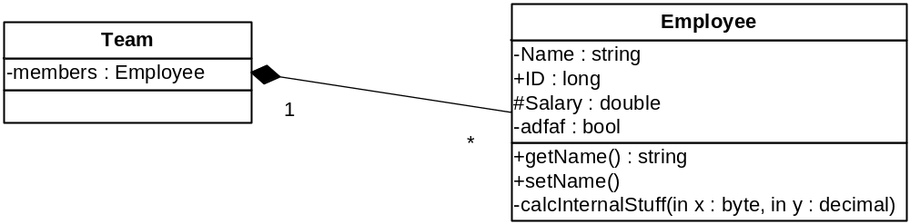
Composition
Composition is Aggregation with:
Lifetime Control (owner controls construction, destruction)
Part object may belong to only one whole object
members[0] =
new Employee();
…
delete members[0];
Filled diamond on side of the Collection

Slide 36
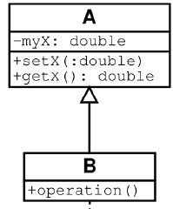
Inheritance
Standard concept of inheritance
Base Class
Derived Class
class B() extends A
…

Slide 37
UML Multiplicities
Multiplicities | Meaning
0..1 | zero or one instance. The notation n . . m indicates n to m instances.
0..* or * | no limit on the number of instances (including none).
1 | exactly one instance
1..* | at least one instance

Slide 38
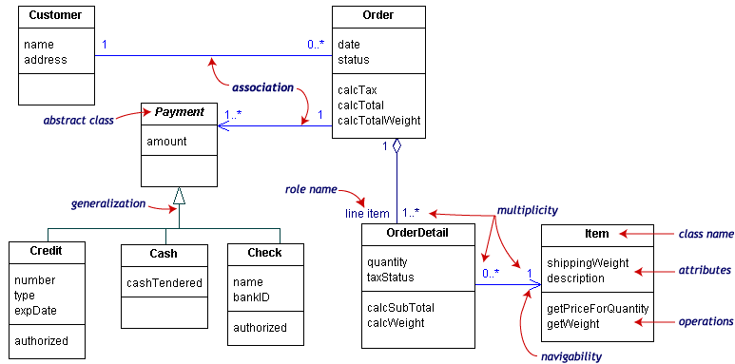
UML Class Example

Slide 39
Learning Objectives
7.1 History of UML
7.2 Systems, Models and Views
7.3 Design Use cases
7.4 Design Class diagrams
7.5 Design Interaction diagrams
7.6 Design another types of diagrams

Slide 40
Interaction Diagrams
Interaction diagrams are dynamic, they describe how objects collaborate
Communication diagram:
  Shows the objects along with the messages that travel from one to another
  Shows the messages the objects send each other
Sequence diagram:
  Indicates what messages are sent and when
  Time progresses from top to bottom
  Objects involved are listed left to right

Slide 41
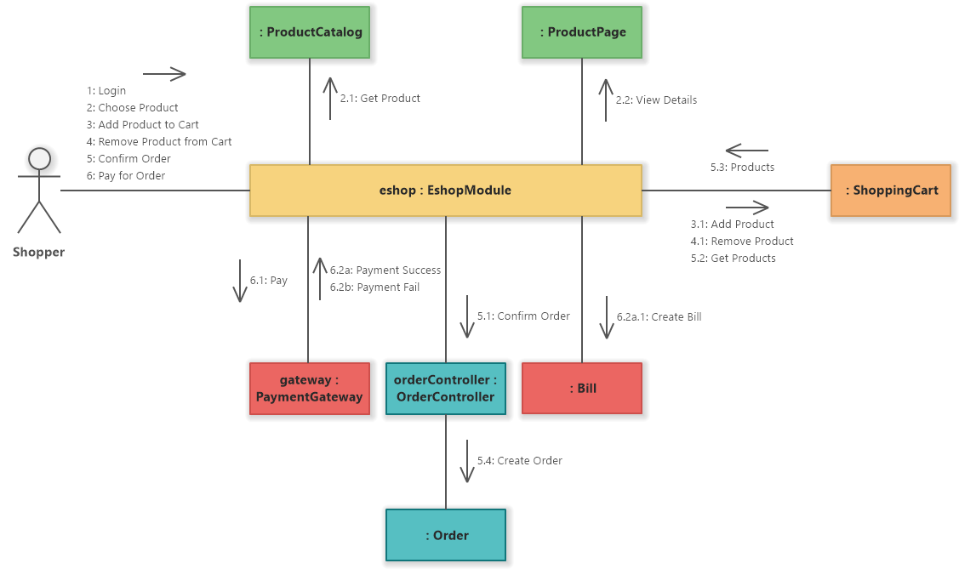
Communication Diagram: Example

Slide 42
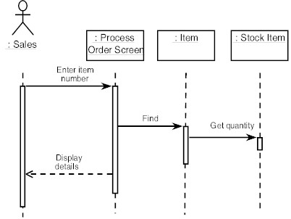
Sequence Diagram: Format
Actor from
Use Case
Objects
1
Activation
2
3
4
Lifeline
Calls = Solid Lines
Returns = Dashed Lines

Slide 43
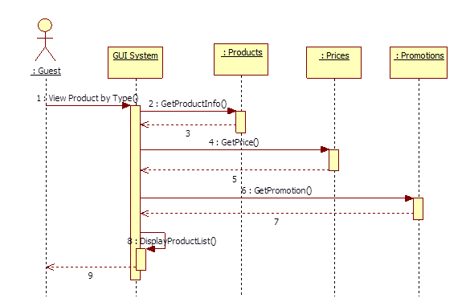
Sequence Diagram: Common Mistakes
Meaningless object name such as: Server, Database
Return message in solid line format
Too much useless return messages
Messages from Actor are not exist in target objects

Slide 44
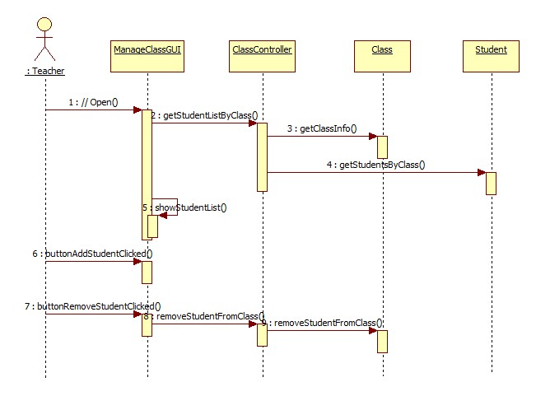
Sequence Diagram: Example

Slide 45
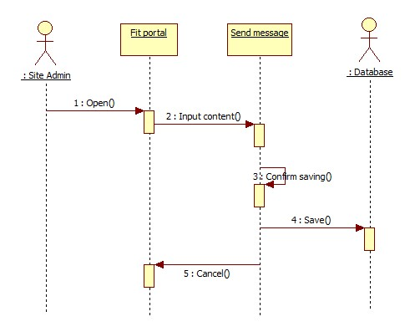
Where are mistakes?

Slide 46
Learning Objectives
7.1 History of UML
7.2 Systems, Models and Views
7.3 Design Use cases
7.4 Design Class diagrams
7.5 Design Interaction diagrams
7.6 Design another types of diagrams

Slide 47


Activity Diagrams
Fancy flowchart
  Displays the flow of activities involved in a single process
  States
    Describe what is being processed
    Indicated by boxes with rounded corners
  Swim lanes
    Indicates which object is responsible for what activity
  Branch
    Transition that branch
    Indicated by a diamond
  Fork
    Transition forking into parallel activities
    Indicated by solid bars
  Start and End

Slide 48

Activity Diagram Example

Slide 49
State Transition Diagrams
Fancy version of a DFA
Shows the possible states of the object and the transitions that cause a change in state
Notation
  States are rounded rectangles
  Transitions are arrows from one state to another. Events or conditions that trigger transitions are written beside the arrows.
  Initial and Final States indicated by circles as in the Activity Diagram
  Final state terminates the action; may have multiple final states

Slide 50
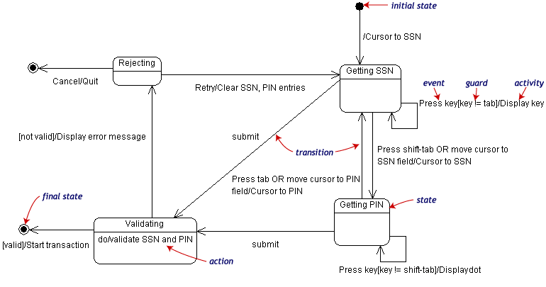
State Transition Example
Validating PIN/SSN

Slide 51
Component Diagrams
Shows various components in a system and their dependencies, interfaces
Explains the structure of a system
Usually a physical collection of classes
  Similar to a Package Diagram in that both are used to group elements into logical structures
  With Component Diagrams all of the model elements are private with a public interface whereas Package diagrams only display public items.

Slide 52


Component Diagram Notation
Components are shown as rectangles with two tabs at the upper left
Dashed arrows indicate dependencies
Circle and solid line indicates an interface to the component

Slide 53
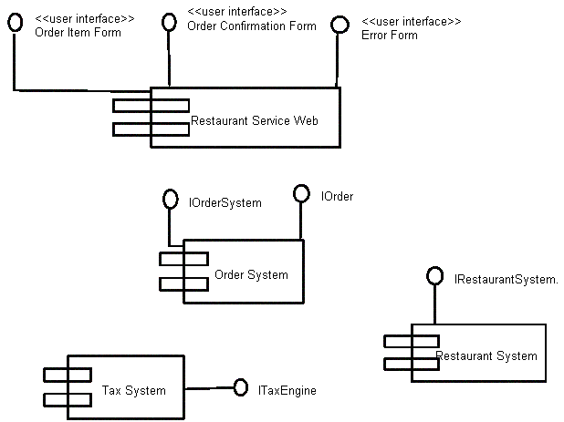
Component Diagram: Example
Graphical depiction of components

Slide 54
Package Diagrams
To organize complex class diagrams, you can group classes into packages. A package is a collection of logically related UML elements
Notation
  Packages appear as rectangles with small tabs at the top.
  The package name is on the tab or inside the rectangle.
  The dotted arrows are dependencies. One package depends on another if changes in the other could possibly force changes in the first.
  Packages are the basic grouping construct with which you may organize UML models to increase their readability

Slide 55
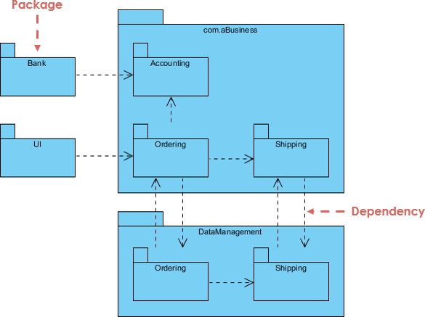
Package Diagrams: Example

Slide 56
Deployment Diagrams
Shows the physical architecture of the hardware and software of the deployed system
Nodes
  Typically contain components or packages
  Usually some kind of computational unit; e.g. machine or device (physical or logical)
Physical relationships among software and hardware in a delivered systems
  Explains how a system interacts with the external environment

Slide 57
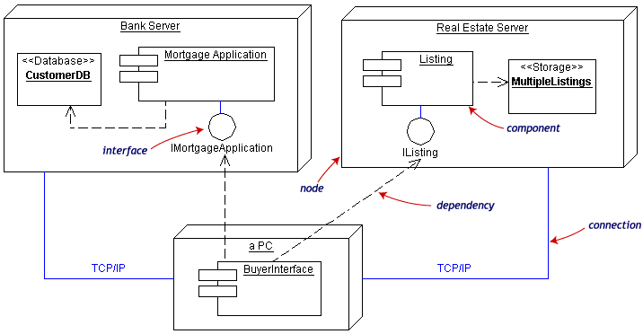
Deployment Diagram: Example
Often the Component Diagram is combined with the Deployment

Slide 58
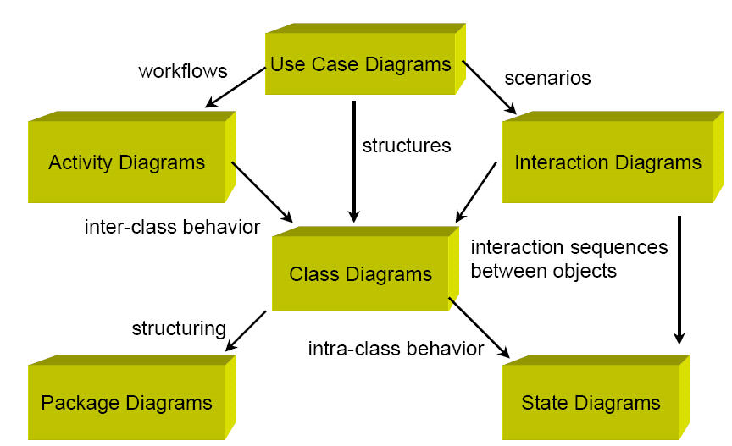
Summary

Slide 59
Activity
Draw Fit portal use case diagram
Describe the function “Send message” on Fit portal by an Activity diagram
Design the function “Send message” by a Sequence diagram

Slide 60
Thanks for your attention

