Slide 1

Systems Analysis and Design
Chapter 8: Requirement Definition in RUP
Slides in this presentation contain hyperlinks. JAWS users should be able to get a list of links by using INSERT+F7
Notes:
If this PowerPoint presentation contains mathematical equations, you may need to check that your computer has the following installed:
1) MathType Plugin
2) Math Player (free versions available)
3) NVDA Reader (free versions available)

Slide 2
Learning Objectives
8.1 Definition, Deliverables, Types of Requirement
8.2 Problems & Risks
8.3 Process of Requirement Definition in RUP
8.4 Requirement Specification
8.5 Requirement Analysis Techniques
8.6 Requirement Analyst, Business Analyst

Slide 3
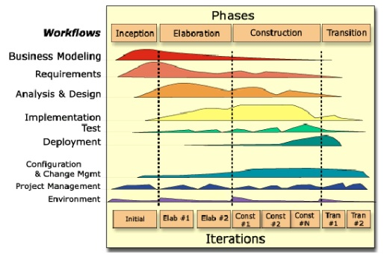
Definition
Requirement Definition (RD): is a process of collecting the user needs to solve a problem or issues and achieve an objective

Slide 4
Why?
Only 16.2% of projects will be completed on time & on budget
About 40-56% of project conflicts can be traced to requirement errors
Finding and fixing requirement errors consumes 70-85% of project rework costs
The average project exceeds its planned time schedule by 120%
About 52.7% of projects will cost 189% of their original estimate
About 30% of projects are cancelled before completion

Slide 5
Organizational Components to Understand (Chapter 3)
Business objectives that drive what and how work is done
Information people need to do their jobs
The data (definition, volume, size) handled in support of jobs
Data transformation and storage (when, how, by whom)
Data handling dependencies and sequences
Data handling and processing rules
Policies and guidelines that describe the nature of the business and market and the environment it operates in
Key events that affect data values and when they occur

Slide 6
Deliverables for Requirements Determination (Chapter 3)
Deliverables for Requirements Determination
Information collected from conversations with or observations of users: interview transcripts, notes from observation, meeting minutes
Existing written information business mission and strategy statements, sample business forms and reports and computer displays, procedure manuals, job descriptions, training manuals, flowcharts and documentation of existing systems, consultant reports
Computer-based information: results from J A D sessions, reports of existing systems, and displays and reports from system prototypes

Slide 7
Types of requirement
Conscious Requirements
Unconscious Requirements
Undreamed Requirements
Non Functional Requirements
Are those that the stakeholders are particularly aware of
What else?
Are those that the stakeholder knows the requirement so well that he thinks that it’s not worth mentioning
Are those that the stakeholders do not ask for, either because he thinks they are not possible or because they are new ideas that have occurred to them
Talks about hardware and software requirement of an application. It also talks about application performance, number of normal and concurrent users, page response time

Slide 8
Non-functional requirement types
NFRs
Performance
Quality
Environment
Reliability
Maintainability
Recoverability
Usability
Integrity
Interoperability
Privacy, Certification
Open source, Licensing
Compatibility
Portability
Learnability
Flexibility
Robustness
Stability
Response time
Documentation
Fault tolerance
Data Integrity
Ethical
Backup, Capacity
Localization

Slide 9
Learning Objectives
8.1 Definition, Deliverables, Types of Requirement
8.2 Problems & Risks
8.3 Process of Requirement Definition in RUP
8.4 Requirement Specification
8.5 Requirement Analysis Techniques
8.6 Requirement Analyst, Business Analyst

Slide 10
Problems & Risks (1 of 2)
Users have trouble in explaining what they want.
Developers have trouble in translating user requirements into working programs and databases
Both the business worlds and technology worlds are constantly changing

Slide 11
Problems & Risks (2 of 2)
Scope and Vision not clearly defined
All requirements are critical, no priority is defined
Signed-off requirements keep changing
New requirements get added in the middle of the project
Users/ Customers are busy and not available to specify requirements
Functionality built, rarely or never used

Slide 12
Requirement Volatility
Internal Factors
Not capturing requirements from all relevant stake holders
Not using right requirement capturing technique depending on the context
Not capturing all relevant details
Not having measures such as check-list to ensure completeness of requirements captured
Not having measures to ensure clarity
External Factors
Market driven
Need to be handled and managed

Slide 13
Learning Objectives
8.1 Definition, Deliverables, Types of Requirement
8.2 Problems & Risks
8.3 Process of Requirement Definition in RUP
8.4 Requirement Specification
8.5 Requirement Analysis Techniques
8.6 Requirement Analyst, Business Analyst

Slide 14
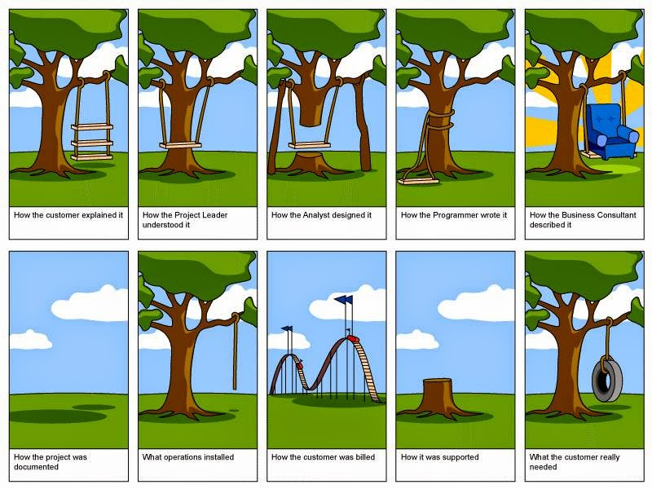

Slide 15
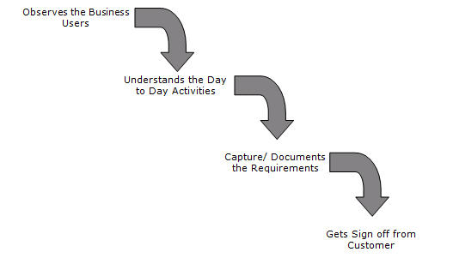
Process of Requirement Definition

Slide 16
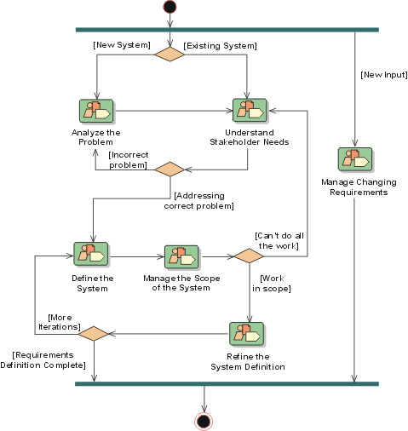
Process of Requirement Definition in RUP

Slide 17
Managing the Scope of Project
Carefully prioritize the requirements, based on input from all stakeholders, and manage its scope
Carefully choosing requirements to for each increment that mitigates known risks in the project
To do so, you need to negotiate the scope (of each iteration) with the stakeholders of the project. This typically requires good skills in managing expectations of the output
Need to have control of the sources of requirements, of how the work products of the project look

Slide 18
Refining the System Definition
The detailed definition of the system needs to be presented in such a way that your stakeholders can understand, agree to, and sign off on it
Needs to cover not only functionality, but also NFRs
Needs to produce different kinds of descriptions for different audiences
Often in combination with simple visual prototypes
Another component of the detailed definition of the system is to state how the system should be tested

Slide 19
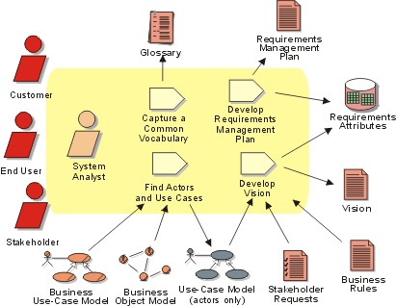
Roles & Deliverables

Slide 20
The requirements document
The requirements document is the official statement of what is required of the system developers
Should include both a definition and a specification of requirements
It is NOT a design document. As far as possible, it should set of WHAT the system should do rather than HOW it should do it

Slide 21
Learning Objectives
8.1 Definition, Deliverables, Types of Requirement
8.2 Problems & Risks
8.3 Process of Requirement Definition in RUP
8.4 Requirement Specification
8.5 Requirement Analysis Techniques
8.6 Requirement Analyst, Business Analyst

Slide 22
Requirement Specification
Glossary
Requirements Management Plan
Software Requirements Specification
Supplementary Specification
Stakeholder Requests
Use-Case Specification
Vision

Slide 23
Requirement Specification: Glossary
The Glossary defines important terms used by the project
Provides a consistent set of definitions to help avoid misunderstandings
Project members initially use the Glossary to understand the terms that are specific to the project. This document is also important to people performing these roles:
Developers when designing and implementing classes, database tables, user-interfaces, and so forth
Analysts, can clearly define business rules, make correct and consistent use of those terms
Developers and technical writers construct training material and documentation using recognized terminology

Slide 24
Requirement Specification: Requirements Management Plan
Describes how the project will set up:
requirements documentations
requirement types
and their respective requirements attributes and traceability
Specifying the information and control mechanisms to be collected and used for measuring, reporting, and controlling changes to the product requirements
The Requirements Management Plan is developed during the Inception phase and is updated at each major milestone

Slide 25
Requirement Specification: Software Requirements Specification
Focuses on the collection and organization of all requirements surrounding your project
Determines the correct location and organization of the requirements
When using use-case modeling, this artifact consists of a package containing use cases of the use-case model
The SRS package controls the evolution of the system throughout the development phase of the project

Slide 26
Requirement Specification: Supplementary Specification
The Supplementary Specifications capture the system requirements that are not readily captured in the use cases of the use-case model. Such requirements include:
Legal and regulatory requirements, and application standards
Quality attributes of the system to be built, including usability, reliability, performance, and supportability requirements
Other requirements such as operating systems and environments, compatibility requirements, and design constraints
The following roles and role sets use the Supplementary Specifications:
Developers: when define class responsibilities, operations, attributes
Managers refer for input when planning iterations
Testers use it to verify system compliance.

Slide 27
Requirement Specification: Stakeholder Requests
Contains any type of requests a stakeholder (customer, end user, marketing person, and so on) might have on the system
May also contain references to any type of external sources to which the system must comply
Although the system analyst is responsible for this artifact, many people will contribute to it: marketing people, end users, customers
This information may be collected in a document or automated tool and appropriate requests should be tracked and reported on following an approved Change Request Management (CRM) process.

Slide 28
Requirement Specification: Use-Case Specification
Describes what happens inside the system, if information is exchanged, be specific about what is passed back and forth
Improves clarity by pasting graphical depictions of user interfaces, process flows or other figures into the use case
Use case diagram, Activity diagram or even Sequence diagram often clarifies the behavior of a system better than pages upon pages of text
Use the right presentation medium for your problem, but be wary of using terminology, notations or figures that your audience may not understand, remember that your purpose is to clarify, not obscure

Slide 29
Requirement Specification: Vision
The Vision document provides a high-level–sometimes contractual–basis for the more detailed technical requirements
The Vision captures very high-level requirements and design constraints to give the reader an understanding of the system to be developed
It provides input to the project-approval process
The Vision document will be read by managers, funding authorities roles in use-case modeling, and developers in general

Slide 30
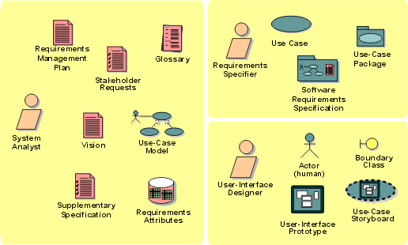
Requirement Artifact Set

Slide 31
Learning Objectives
8.1 Definition, Deliverables, Types of Requirement
8.2 Problems & Risks
8.3 Process of Requirement Definition in RUP
8.4 Requirement Specification
8.5 Requirement Analysis Techniques
8.6 Requirement Analyst, Business Analyst

Slide 32
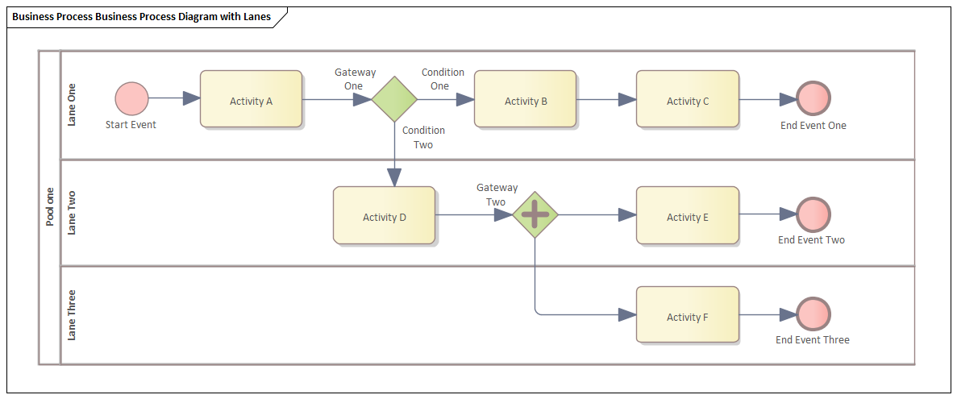
Requirement Analysis Techniques
Business process modeling notation (BPMN)
UML (Unified Modeling Language)
Flowchart technique
Data flow diagram
Role Activity Diagrams (RAD)
Gantt Charts
IDEF (Integrated Definition for Function Modeling)
Gap Analysis

Slide 33
Requirements Validation
Concerned with demonstrating that the requirements define the system that the customer really wants
Requirements error costs are high so validation is very important
Fixing a requirements error after delivery may cost up to 100 times the cost of fixing an implementation error
Requirements checking
Validity
Consistency
Completeness
Realism
Verifiability

Slide 34
Requirements Validation Techniques
Reviews
Systematic manual analysis of the requirements
Prototyping
Using an executable model of the system to check requirements.
Test-case generation
Developing tests for requirements to check testability
Automated consistency analysis
Checking the consistency of a structured requirements description

Slide 35
Learning Objectives
8.1 Definition, Deliverables, Types of Requirement
8.2 Problems & Risks
8.3 Process of Requirement Definition in RUP
8.4 Requirement Specification
8.5 Requirement Analysis Techniques
8.6 Requirement Analyst, Business Analyst

Slide 36

Requirement Analyst
Requirement Analyst (or more well-known name: Business Analyst - BA) describes business needs in the language understandable both for Business and for Development
Building trust relationship with stakeholders
Using various
techniques
and tools

Slide 37
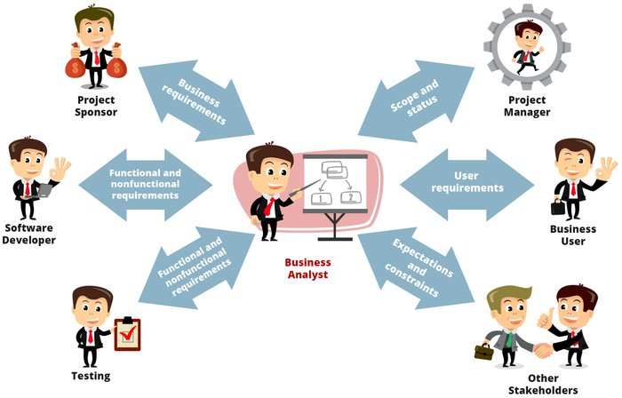
Requirement Analyst: Communication

Slide 38
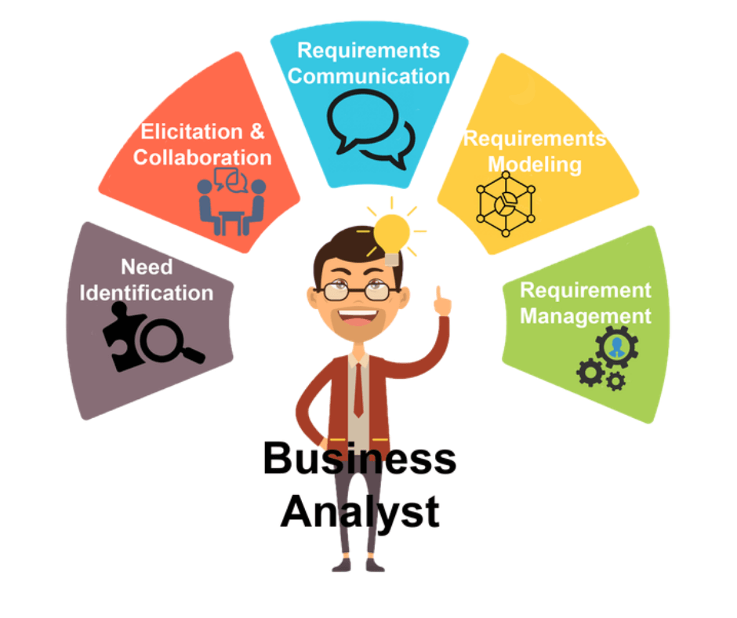
Requirement Analyst: Job Description

Slide 39
Summary
Definition, Deliverables, Types of Requirement
Problems & Risks
Process of Requirement Definition in RUP
Requirement Specification
Requirement Analysis Techniques
Requirement Analyst, Business Analyst

Slide 40
Question?

