Slide 1

Systems Analysis and Design
Chapter 9: A&D in RUP
Slides in this presentation contain hyperlinks. JAWS users should be able to get a list of links by using INSERT+F7
Notes:
If this PowerPoint presentation contains mathematical equations, you may need to check that your computer has the following installed:
1) MathType Plugin
2) Math Player (free versions available)
3) NVDA Reader (free versions available)

Slide 2

Questions
Basic questions:
What is purpose of BMP?
What is purpose of RD?
What is purpose of A&D?
How RD helps to facilitate A&D?
Advanced questions:
Clarify difference between Analysis and Design
What is capsule design?
Give an example of design mechanism?

Slide 3
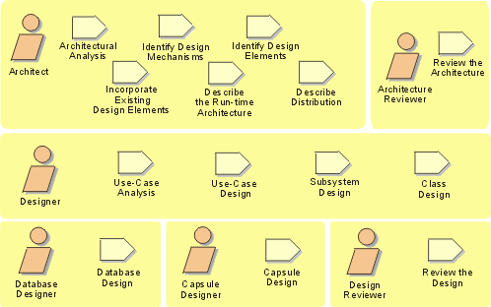
Analysis and Design Activity Overview
Notes:
Remember, for analysis and design, we start out with the use-case model and the supplementary specifications from the Requirements workflow and end up with the design model that serves as an abstraction of the source code.
The design activities are centered around the notion of architecture. The production and validation of this architecture is the main focus of early design iterations. The architecture is an important vehicle not only for developing a good design model, but also for increasing the quality of any model built during system development.
The focus of this course is on the activities of the Designer. The Architect’s activities will be discussed, but many of the architectural decisions will be “given”. Each of the Architect and Designer activities will be addressed in individual course modules.
Walk the students through the activities reviewing the meaning of the representational icons (e.g., workers, activities). Activities can be considered operations on the workers.
The order shown is not the order in which the activities can be executed. The analysis and design workflow helps to dictate order.
The process as described in this course develops a design model, not a separate analysis model. To maintain a separate analysis model, some modifications to the process would be necessary, the discussion of which is out of the scope of this course.
Emphasize the Use-Case Analysis activity and how it describes a process for finding classes and objects from use cases. Some people have called it: 'closing the traceability gap’ -- use cases and scenario's help you get from requirements to objects.

Slide 4
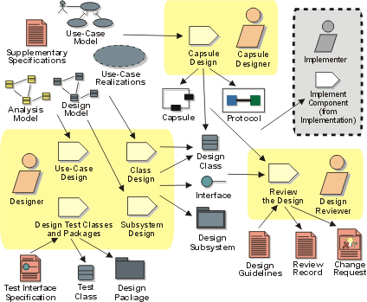

Slide 5
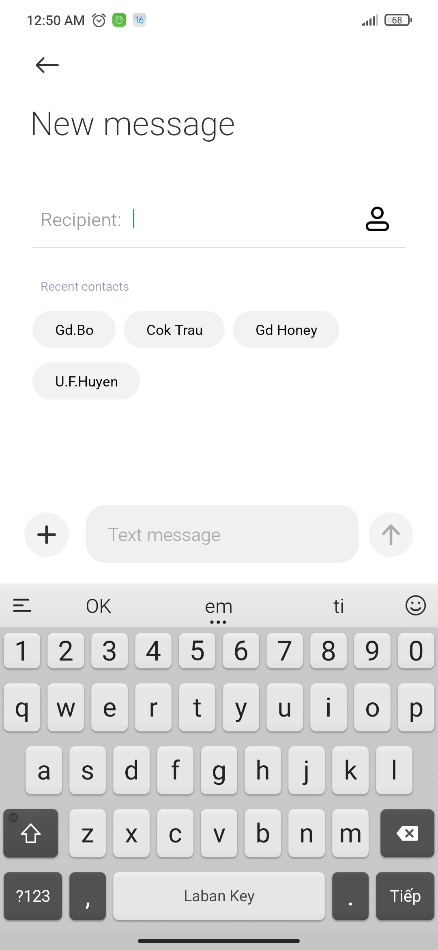
Case study 1
Application: Message, use case: New Message
Flow of events:
User can type phone number in Recipient text box
Or User can click on the icon on the right hand side of Recipient text box to get phone number from Contact application
Or User can choose contact directly from Recent contact
System display default value of Text area for inputting text content: Text message
User can attach a file/photo/icon by click (+) button on left hand side of Text message area
User click to the button on right side of Text message area to send the message if mobile network is available

Slide 6
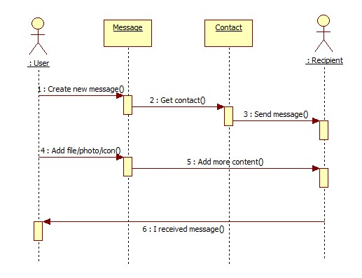

Slide 7
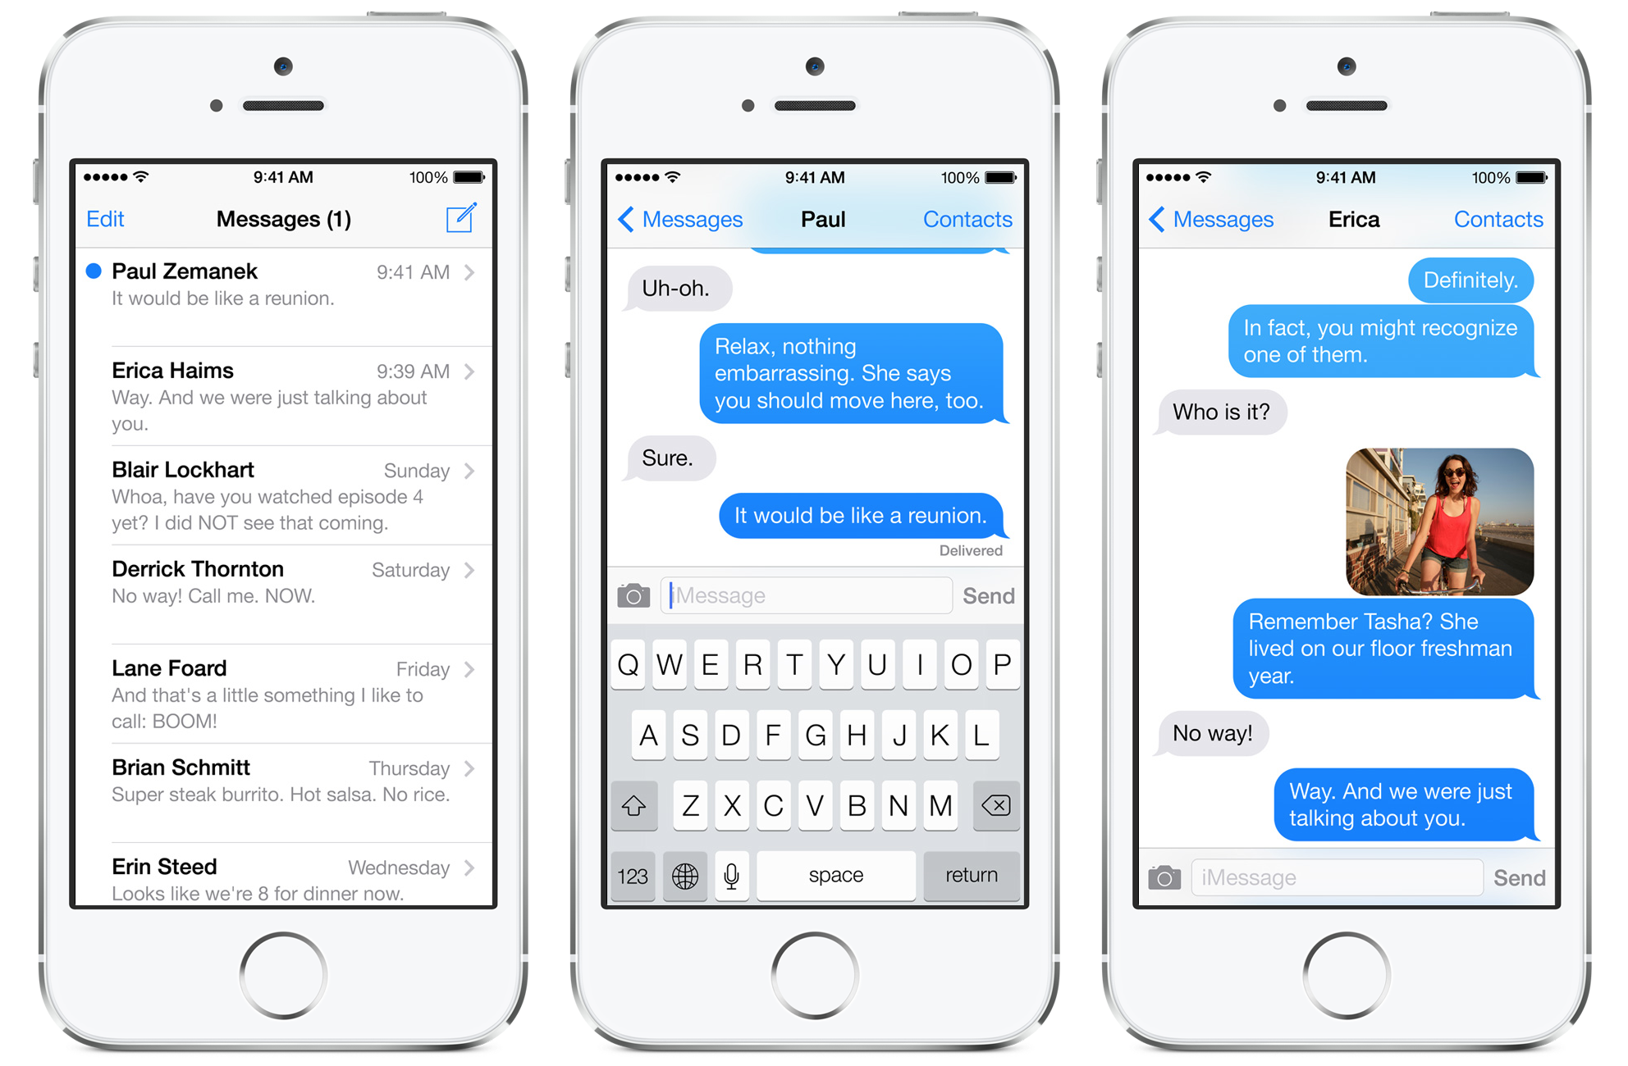
Case study 2
Application: Message (iOS)
Use case: Display Message
Problem:
Do we need to access recipient message app database?
Messages are stored online or in local storage?
What is sorting strategy for displaying message? How to design it in diagram?
Design sequence diagram?

Slide 8
Objectives
To explain how a software design may be represented as a set of interacting objects that manage their own state and operations
To describe the activities in the object-oriented design process
To introduce various models that can be used to describe an object-oriented design
To show how the UML may be used to represent these models

Slide 9
Topics covered
Analysis and design
Objects and object classes
An object-oriented design process
Design evolution

Slide 10
Q&a
What is characteristics of OOAD?
What is difference between an Analysis and a Requirement Definition?
What is difference between an Analysis and a Design step?
What are 3 main activities of A&D?
Explain key activities of A&D in RUP?
Why we need to hide information inside objects?

Slide 11
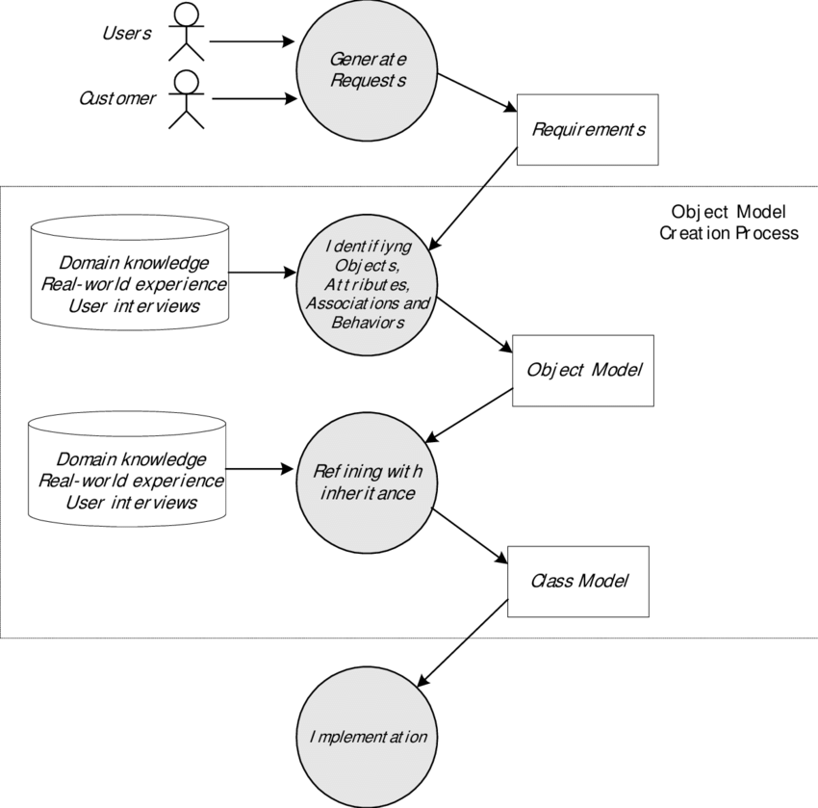

Slide 12
The Object-Oriented Analysis
In Analysis we model the users’ requirements
For what the eventual system must DO
Output of this process is a conceptual model
Consisting of 2 deliverables:
Requirements Model
Object Model

Slide 13
The Requirements model
Project Scope
Context Diagram
Use Case Model
Use case diagram
Activity diagram
Interface Descriptions
Feasibility study

Slide 14
Object model
Class diagram
State transition diagram
Sequence diagram
Collaboration diagram

Slide 15
The Object-Oriented Design
Modify Analysis model to reflect design decisions,
Mostly by adding information to the existing model.
Add some new classes that do not directly model things in the real world.
Result is a plan of how the system will do what the Requirements Analysis asks for

Slide 16
Analysis and Design Overview
Analysis and Design
Design Model
Use-Case Model
Architecture
Document
Glossary
Supplementary
Specification
Data Model
Notes:
The input artifacts are the Use-Case Model, Glossary, and Supplementary Specification from the Requirements workflow. The result of analysis and design is a Design Model that serves as an abstraction of the source code; that is, the design model acts as a "blueprint" of how the source code is structured and written. The Design Model consists of design classes structured into design packages; it also contains descriptions of how objects of these design classes collaborate to perform use cases (use-case realizations).
The design activities are centered around the notion of architecture. The production and validation of this architecture is the main focus of early design iterations. Architecture is represented by a number of architectural views. These views capture the major structural design decisions. In essence architectural views are abstractions or simplifications of the entire design, in which important characteristics are made more visible by leaving details aside. The architecture is an important vehicle not only for developing a good design model, but also for increasing the quality of any model built during system development. The architecture is documented in the Architecture Document.
The development of the Architecture Document is out of the scope of this course, but we will discuss it’s contents and how to interpret them.
If a separate analysis model is desired, then an Analysis Model would be listed as a separate artifact (in addition to the Design Model).

Slide 17
Analysis Versus Design
Analysis
Focus on understanding the problem
Idealized design
Behavior
System structure
Functional requirements
A small model
Design
Focus on understanding the solution
Operations and Attributes
Performance
Close to real code
Object lifecycles
Non-functional requirements
A large model
Notes:
An instructor once said: “Analysis Vs. Design is important because of the mind-set. If you tried to manage all of the analysis and design issues in one go, your brain would explode on all but the most trivial developments. It’s just too much to take in, comprehend, and model in one go. So I mentally switch “OK, analysis - problem domain - don’t care about memory, persistence, databases, language, etc”. “Right now it’s design and I do care about all those things - but now I can stop thinking (too a degree) about trying to understand the business domain.” It’s about managing the 7+/-2 things I can think about in one go. It also separates out the skills (a bit).”
Another instructor once said: “analysis is the study of and eventual comprehension of “some thing” [the problem space]. But to understand it, we must invent some entities to hold onto the thing that we have just grasped - this inventive process is design. That is, human cognitive thinking is actually interwoven analysis/design and any attempt to separate them is really only an idealization. Therefore, if I try to apply two separate “steps” in the production of, say, a class diagram [and call those steps A and then D], I will introduce ambiguity into my process because cognitive process forces one to “produce a solution” in order to “understand a problem” - that D is necessary to have any results from A.”
Think of analysis as an idealized design step - where we ignore several complicating issues. This can turn into a religious debate.
The differences between analysis and design are ones of focus and emphasis. The above slide lists the things that you focus on in analysis versus design.
The goal in Analysis is to understand the problem and to begin to develop a visual model of what you are trying to build, independent of implementation and technology concerns. Analysis focuses on translating the functional requirements into software concepts. The idea is to get a rough cut at the objects that comprise our system, but focusing on behavior (and therefore encapsulation). We then move very quickly, nearly seamlessly into “design” and the other concerns.
A goal of design is to refine the model with the intention of developing a design model that will allow a seamless transition to the coding phase. In design, we adapt to the implementation and the deployment environment. The implementation environment is the 'developer' environment, which is a software superset and a hardware subset of the deployment environment
In modeling, we start with an object model that closely resembles the real world (analysis), and then find more abstract (but more fundamental) solutions to a more generalized problem (design). The real power of software design is that it can create more powerful metaphors for the real world which change the nature of the problem, making it easier to solve.

Slide 18
Analysis and Design is not Top-Down or Bottom-Up
Subsystems
Top
Down
Bottom
Up
Use Cases
Design Classes
Notes:
Analysis and design is not top-down or bottom-up.
The use case comes in from the left and defines a middle level.
The analysis classes are not defined in a top-down pattern or a bottom-up pattern, they are in the middle. From this middle level one may move up or down.
Defining subsystems is moving up and defining design classes is moving down.
Analysis is both top-to-middle, middle-up, middle-down and bottom-to-middle. There is no way of saying that one path is more important than another - you have to travel on all paths to get the system right.
All of these four paths are equally important. That is why the bottom-up and top-down question can´t be solved.

Slide 19
Topics covered
Analysis and design
Objects and object classes
An object-oriented design process
Design evolution

Slide 20
Object-oriented development
Object-oriented analysis, design and programming are related but distinct.
OOA is concerned with developing an object model of the application domain.
OOD is concerned with developing an object-oriented system model to implement requirements.
OOP is concerned with realising an OOD using an OO programming language such as Java or C++.

Slide 21
Characteristics of OOD
Objects are abstractions of real-world or system entities and manage themselves.
Objects are independent and encapsulate state and representation information.
System functionality is expressed in terms of object services.
Shared data areas are eliminated. Objects communicate by message passing.
Objects may be distributed and may execute sequentially or in parallel.

Slide 22
Advantages of OOD
Easier maintenance. Objects may be understood as stand-alone entities.
Objects are potentially reusable components.
For some systems, there may be an obvious mapping from real world entities to system objects.

Slide 23
Objects and classes
Objects are entities in a software system which represent instances of real-world and system entities.
Classes are templates for objects. They may be used to create objects.
Classes may inherit attributes and services from other object classes.

Slide 24
Objects and classes
An object is an entity that has a state and a defined set of operations which operate on that state. The state is represented as a set of object attributes. The operations associated with the object provide services to other objects (clients) which request these services when some computation is required.
Objects are created according to some object class definition. An object class definition serves as a template for objects. It includes declarations of all the attributes and services which should be associated with an object of that class.

Slide 25
Employee object class (UML)

Slide 26
Object communication
Conceptually, objects communicate by message passing.
Messages
The name of the service requested by the calling object;
Copies of the information required to execute the service and the name of a holder for the result of the service.
In practice, messages are often implemented by procedure calls
Name = procedure name;
Information = parameter list.

Slide 27
Message examples
// Call a method associated with a buffer // object that returns the next value // in the buffer
v = circularBuffer.Get () ;
// Call the method associated with a // thermostat object that sets the // temperature to be maintained
thermostat.setTemp (20) ;

Slide 28
Interacting objects

Slide 29
Generalisation and inheritance
Objects are members of classes that define attribute types and operations.
Classes may be arranged in a class hierarchy where one class (a super-class) is a generalisation of one or more other classes (sub-classes).
A sub-class inherits the attributes and operations from its super class and may add new methods or attributes of its own.
Generalisation in the UML is implemented as inheritance in OO programming languages.

Slide 30
A generalisation hierarchy

Slide 31
Advantages of inheritance
It is an abstraction mechanism which may be used to classify entities.
It is a reuse mechanism at both the design and the programming level.
The inheritance graph is a source of organisational knowledge about domains and systems.

Slide 32
Problems with inheritance
Object classes are not self-contained. they cannot be understood without reference to their super-classes.
Designers have a tendency to reuse the inheritance graph created during analysis. Can lead to significant inefficiency.
The inheritance graphs of analysis, design and implementation have different functions and should be separately maintained.

Slide 33
The Unified Modeling Language
Several different notations for describing object-oriented designs were proposed in the 1980s and 1990s.
The Unified Modeling Language is an integration of these notations.
It describes notations for a number of different models that may be produced during OO analysis and design.
It is now a de facto standard for OO modelling.

Slide 34
Concurrent objects
The nature of objects as self-contained entities make them suitable for concurrent implementation.
The message-passing model of object communication can be implemented directly if objects are running on separate processors in a distributed system.

Slide 35
Servers and active objects
Servers.
The object is implemented as a parallel process (server) with entry points corresponding to object operations. If no calls are made to it, the object suspends itself and waits for further requests for service.
Active objects
Objects are implemented as parallel processes and the internal object state may be changed by the object itself and not simply by external calls.

Slide 36
Active transponder object
Active objects may have their attributes modified by operations but may also update them autonomously using internal operations.
A Transponder object broadcasts an aircraft’s position. The position may be updated using a satellite positioning system. The object periodically update the position by triangulation from satellites.

Slide 37
An active transponder object
class Transponder extends Thread {
Position currentPosition ;
Coords c1, c2 ;
Satellite sat1, sat2 ;
Navigator theNavigator ;
public Position givePosition ()
{
return currentPosition ;
}
public void run ()
{
while (true)
{
c1 = sat1.position () ;
c2 = sat2.position () ;
currentPosition = theNavigator.compute (c1, c2) ;
}
}
} //Transponder

Slide 38
Java threads
Threads in Java are a simple construct for implementing concurrent objects.
Threads must include a method called run() and this is started up by the Java run-time system.
Active objects typically include an infinite loop so that they are always carrying out the computation.

Slide 39
Topics covered
Analysis and design
Objects and object classes
An object-oriented design process
Design evolution

Slide 40
Some UML modeling notations
Use case diagram
Class diagram
Sequence diagram
Statechart diagram
Activity diagram
Deployment diagram
Component diagram
Collaboration diagram

Slide 41
An object-oriented design process
Structured design processes involve developing a number of different system models
They require a lot of effort for development and maintenance of these models and, for small systems, this may not be cost-effective
However, for large systems developed by different groups design models are an essential communication mechanism.

Slide 42
Process stages
Highlights key activities without being tied to any proprietary process such as the RUP.
Define the context and modes of use of the system;
Design the system architecture;
Identify the principal system objects;
Develop design models;
Specify object interfaces.

Slide 43
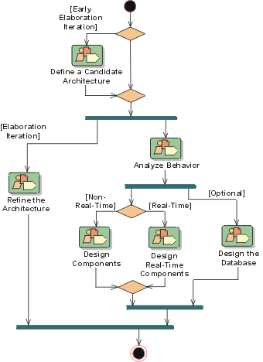
Notes:
A mere enumeration of all workers, activities and artifacts does not constitute a process. We need a way to describe the activities, some valuable result, and interactions between workers. A workflow is a sequence of activities that produces a result of observable value.
In UML terms, a workflow can be expressed as a sequence diagram, a collaboration diagram, or an activity diagram. We use a form of activity diagram in the Rational Unified Process. For each core workflow, an activity diagram is presented. This diagram shows the workflow, expressed in terms of workflow details.
This slide shows the Analysis and Design workflow. The early Elaboration Phase focuses on creating an initial architecture for the system (Define a Candidate Architecture) to provide a starting point for the main analysis work. If the architecture already exists (either because it was produced in previous iterations, in previous projects, or is obtained from an application framework), the focus of the work changes to refining the architecture (Refine the Architecture) and analyzing behavior and creating an initial set of elements which provide the appropriate behavior (Analyze Behavior).
After the initial elements are identified, they are further refined. Design Components and Design Real-Time Components produce a set of components which provide the appropriate behavior to satisfy the requirements on the system. In parallel with these activities, persistence issues are handled in Design the Database. The result is an initial set of components which are further refined in the Implementation Workflow.
Each workflow contains RUP activities that can take place. RUP activities can exist in many different workflow activities. For example, Use-Case Analysis can be found in both Define a Candidate Architecture and Analyze Behavior.

Slide 44
Analysis and Design Activity Overview
Notes:
Remember, for analysis and design, we start out with the use-case model and the supplementary specifications from the Requirements workflow and end up with the design model that serves as an abstraction of the source code.
The design activities are centered around the notion of architecture. The production and validation of this architecture is the main focus of early design iterations. The architecture is an important vehicle not only for developing a good design model, but also for increasing the quality of any model built during system development.
The focus of this course is on the activities of the Designer. The Architect’s activities will be discussed, but many of the architectural decisions will be “given”. Each of the Architect and Designer activities will be addressed in individual course modules.
Walk the students through the activities reviewing the meaning of the representational icons (e.g., workers, activities). Activities can be considered operations on the workers.
The order shown is not the order in which the activities can be executed. The analysis and design workflow helps to dictate order.
The process as described in this course develops a design model, not a separate analysis model. To maintain a separate analysis model, some modifications to the process would be necessary, the discussion of which is out of the scope of this course.
Emphasize the Use-Case Analysis activity and how it describes a process for finding classes and objects from use cases. Some people have called it: 'closing the traceability gap’ -- use cases and scenario's help you get from requirements to objects.

Slide 45
Use-Case
Realization
Architect
Designer
Package/ Subsystem
Design Model
Class
Software Architecture
Document
Design
Reviewer
Data Model
Database Designer
Architecture
Reviewer
Notes:
Again, the focus of this course is on the activities and artifacts of the Designer.
The Architect leads and coordinates technical activities and artifacts throughout the project. The Architect establishes the overall structure for each architectural view: the decomposition of the view, the grouping of elements, and the interfaces between these major groupings. Thus, in contrast with the other workers, the Architect's view is one of breadth, as opposed to depth.
A Designer defines the responsibilities, operations, attributes, and relationships of one or several classes and determines how they should be adjusted to the implementation environment. A Designer may have responsibility for one or more Design Packages or Design Subsystems, including any classes owned by the packages or subsystems. A Designer may be responsible for a Use-Case Realization, in order to ensure the overall consistency of how a particular use case is realized using the design elements.
The Database Designer defines the tables, indexes, views, constraints, triggers, stored procedures, table spaces or storage parameters, and other database-specific constructs needed to store, retrieve, and delete persistent objects. This information is maintained in the Data Model.
The Architecture Reviewer plans and conducts the formal reviews of the software architecture in general.
The Design Reviewer plans and conducts the formal reviews of the design model.

Slide 46
Running example: Simple personnel information system
Design a simple information system to support a personnel manager.
Features include the ability to add, query and delete personnel in a database.

Slide 47
System context and models of use
Develop an understanding of the relationships between the software being designed and its external environment
System context
A static model that describes other systems in the environment. Use a subsystem model to show other systems.
Model of system use
A dynamic model that describes how the system interacts with its environment. Use use-cases to show interactions

Slide 48
Use-case models
Use-case models are used to represent each interaction with the system.
A use-case model shows the system features as ellipses and the interacting entity as a stick figure.
Flow of events within a use case can be depicted using sequence diagrams.

Slide 49
Use cases for the personnel information system
The diagram is only part of the story.
Need to also develop use case descriptions (not shown here).

Slide 50
Sequence models
Uses
OOA – depict flow of events within a use case; helps identify initial objects
OOD – depict interactions of objects; helps identify methods and other attributes and classes
Review
Objects are arranged horizontally across the top;
Time is represented vertically so models are read top to bottom;
Interactions are represented by labelled arrows, Different styles of arrow represent different types of interaction;
A thin rectangle in an object lifeline represents the time when the object is the controlling object in the system.

Slide 51
Add personnel sequence

Slide 52
Search personnel sequence

Slide 53
Delete personnel sequence

Slide 54
Object identification
Identifying objects (or object classes) is the most difficult part of object oriented analysis and design.
There is no 'magic formula' for object identification. It relies on the skill, experience and domain knowledge of system designers.
Object identification is an iterative process. You are unlikely to get it right first time.

Slide 55
Approaches to identification
Use a grammatical approach based on a natural language description of the system.
Base the identification on tangible things in the application domain.
Use a behavioural approach and identify objects based on what participates in what behaviour.
Use a scenario-based analysis. The objects, attributes and methods in each scenario are identified.

Slide 56
Application domain objects
Initial class diagram derived from the behavioral models (sequence diagrams).

Slide 57
Architectural design
Once interactions between the system and its environment have been understood and initial objects have been identified, you use this information for designing the system architecture.
A layered architecture as discussed in Chapter 11 is appropriate for the information system
User interface layer for handling interactions;
Application logic layer for controlling data access and updates;
Data management layer for storing data.
There should normally be no more than 7 subsystems in an architectural model.

Slide 58
Design models
Design models show the objects and object classes and relationships between these entities.
Static models describe the static structure of the system in terms of object classes and relationships.
Dynamic models describe the dynamic interactions between objects.

Slide 59
Examples of design models
Sub-system models that show logical groupings of objects into coherent subsystems.
Sequence models that show the sequence of object interactions.
State machine models that show how individual objects change their state in response to events.
Other models include use-case models, aggregation models, generalisation models, etc.

Slide 60
Subsystem models
Shows how the design is organised into logically related groups of objects.
In the UML, these are shown using packages - an encapsulation construct. This is a logical model. The actual organisation of objects in the system may be different.

Slide 61
Application domain objects
(Initial class diagram)

Slide 62
Subsystem decomposition
In this case, each layer is one subsystem.
In general, a layer can have more than one subsystem.

Slide 63
Distribution strategy
(Deployment diagram)

Slide 64
Platforms and implementation technologies
(Deployment diagram)

Slide 65
Further objects and object refinement
Use domain knowledge to identify more objects and operations
What attributes should be included in a personnel database?
What other checking should be done before allowing a deletion?
Use software development knowledge to identify solution objects
Design patterns often add more abstract classes.
Performance issues may require the use of proxy objects to cache some of the database in memory
What other widgets need to be defined on the personnel form?

Slide 66
Static model – class diagram
Includes objects from solution domain.

Slide 67
Static model – more details
Expand class attributes and operations.

Slide 68
Dynamic models
Sequence models
Show interaction between objects
Statechart models
Show transitions within an object

Slide 69
Add personnel (with proxy object)

Slide 70
PersonnelControl state machine

Slide 71
Object interface specification
Object interfaces have to be specified so that the objects and other components can be designed in parallel.
Designers should avoid designing the interface representation but should hide this in the object itself.
Objects may have several interfaces which are viewpoints on the methods provided.
The UML uses class diagrams for interface specification but Java may also be used.
Heuristic: figure out how you plan to divide the work, and specify the interfaces between the divisions.

Slide 72
Database interface
An interface can be defined to hide the details of how the underlying database tables are organized.
interface class DatabaseInterface {
public void AddPersonnel();
public void DeletePersonnel();
public void queryPersonnel()
}
public class ProxyDatabaseInterface implements DatabaseInterface {
…
}
public class RealDatabaseInterface implements DatabaseInterface {
…
}

Slide 73
Topics covered
Analysis and design
Objects and object classes
An object-oriented design process
Design evolution

Slide 74
Design evolution
Hiding information inside objects means that changes made to an object do not affect other objects in an unpredictable way.
Example: the system must now support different types of personnel with different attributes.
To support this, we can create subclasses of Personnel class as well as PersonnelForm class to accommodate different types of Personnel. The application logic does not have to change (ideally).

Slide 75
Key points
OOD is an approach to design so that design components have their own private state and operations.
Objects should have constructor and inspection operations. They provide services to other objects.
Objects may be implemented sequentially or concurrently.
The Unified Modeling Language provides different notations for defining different object models.

Slide 76
Key points
A range of different models may be produced during an object-oriented design process. These include static and dynamic system models.
Object interfaces should be defined precisely using e.g. a programming language like Java.
Object-oriented design potentially simplifies system evolution.

Slide 77
EXAMPLE

Slide 78
Weather system description
A weather mapping system is required to generate weather maps on a regular basis using data collected from remote, unattended weather stations and other data sources such as weather observers, balloons and satellites. Weather stations transmit their data to the area computer in response to a request from that machine.
The area computer system validates the collected data and integrates it with the data from different sources. The integrated data is archived and, using data from this archive and a digitised map database a set of local weather maps is created. Maps may be printed for distribution on a special-purpose map printer or may be displayed in a number of different formats.

Slide 79
Layered architecture
Data display layer where objects are
«subsystem»
concerned with preparing and
Data display
presenting the data in a human-
readable form
«subsystem»
Data archiving layer where objects
Data archiving
are concerned with storing the data
for future processing
Data processing layer where objects
«subsystem»
are concerned with checking and
Data processing
integ
rating the collected data
Data collection layer where objects
«subsystem»
are concerned with acquiring data
Data collection
from remote sources

Slide 80
Subsystems in the weather mapping system

Slide 81
Use-cases for the weather station

Slide 82
Use-case description

Slide 83
Weather station architecture

Slide 84
Weather station description
A weather station is a package of software controlled instruments which collects data, performs some data processing and transmits this data for further processing. The instruments include air and ground thermometers, an anemometer, a wind vane, a barometer and a rain gauge. Data is collected periodically.
When a command is issued to transmit the weather data, the weather station processes and summarises the collected data. The summarised data is transmitted to the mapping computer when a request is received.

Slide 85
Weather station object classes
Ground thermometer, Anemometer, Barometer
Application domain objects that are ‘hardware’ objects related to the instruments in the system.
Weather station
The basic interface of the weather station to its environment. It therefore reflects the interactions identified in the use-case model.
Weather data
Encapsulates the summarised data from the instruments.

Slide 86
Weather station object classes

Slide 87
Further objects and object refinement
Use domain knowledge to identify more objects and operations
Weather stations should have a unique identifier;
Weather stations are remotely situated so instrument failures have to be reported automatically. Therefore attributes and operations for self-checking are required.
Active or passive objects
In this case, objects are passive and collect data on request rather than autonomously. This introduces flexibility at the expense of controller processing time.

Slide 88
Weather station subsystems

Slide 89
Data collection sequence

Slide 90
Statecharts
Show how objects respond to different service requests and the state transitions triggered by these requests
If object state is Shutdown then it responds to a Startup() message;
In the waiting state the object is waiting for further messages;
If reportWeather () then system moves to summarising state;
If calibrate () the system moves to a calibrating state;
A collecting state is entered when a clock signal is received.

Slide 91
Weather station state diagram

Slide 92
Weather station interface

Slide 93
Design evolution
Hiding information inside objects means that changes made to an object do not affect other objects in an unpredictable way.
Assume pollution monitoring facilities are to be added to weather stations. These sample the air and compute the amount of different pollutants in the atmosphere.
Pollution readings are transmitted with weather data.

Slide 94
Changes required
Add an object class called Air quality as part of WeatherStation.
Add an operation reportAirQuality to WeatherStation. Modify the control software to collect pollution readings.
Add objects representing pollution monitoring instruments.

Slide 95
Pollution monitoring

